Slide 1
Constrained voucher
draft-ietf-anima-constrained-voucher-14
Michael Richardson, Peter van der Stok,
Panos Kampanakis, Esko Dijk
IETF 112
ANIMA Working Group

Slide 2
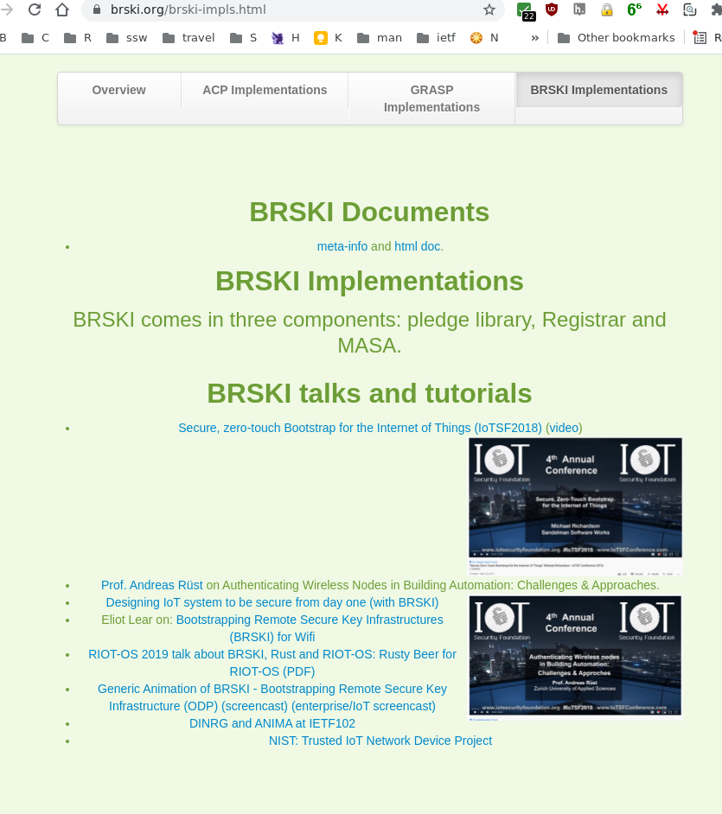

Constrained Voucher
BRSKI uses EST, HTTP and TLS
This draft proposes
      constrained voucher additions to voucher and use of SIDs
      Extends coap-est draft with BRSKI extensions to EST
            CoAP, CBOR, CMS, and COSE
to support voucher transport for constrained devices
EST: Enrollment over Secure Transport
BRSKI: Bootstrapping of Remote Secure Key Infrastructures
SID: YANG Schema Item iDentifier
COSE: CBOR Signing and Encryption (RFC 8152)
CMS: Cryptographic message Syntax (RFC 5652)
CBOR: Concise Binary Object Representation (RFC 7049)

Slide 3
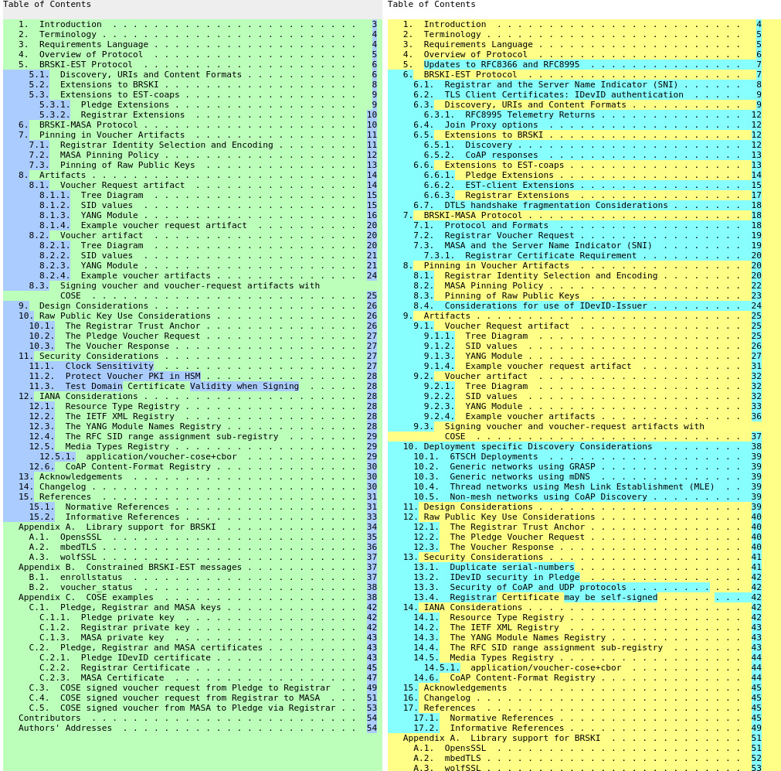
Changes since IETF111
Changes since version 13
Clarify what the Updates are
Much expanded BRSKI-EST section
Some errors in SID allocation
17 issues open
  (83 closed)
  All review comments closed
Security Considerations completed
Added section on what to implement in specific Deployments
Considered what to do if yang-cbor documents do not progress

Slide 4
Dependent upon CORE WG drafts
- still in IESG review
yang-cbor/yang-sid design team formed to deal with review comments has had four meetings
18 issues still open (including a bunch of wontfix)
34 issues closed
Design team includes Andy Bierman
My recommendation to ANIMA constrained-voucher team is that the SID documents will get through IESG review before Xmas break

Slide 5



Hackathon Results
IETF112 Hackathon Nov 1-5. Meet up in gather.town @ 14:00 UTC, at table A(NIMA).
Not really any participants. I think people (me included!) are exhausted.
  BUT: L2 VPN now working, and we will test asynchronously.
NIST NCCoE IoT-onboarding
  https://www.federalregister.gov/documents/2021/10/26/2021-23293/national-cybersecurity-center-of-excellence-nccoe-trusted-internet-of-things-iot-device

Slide 6
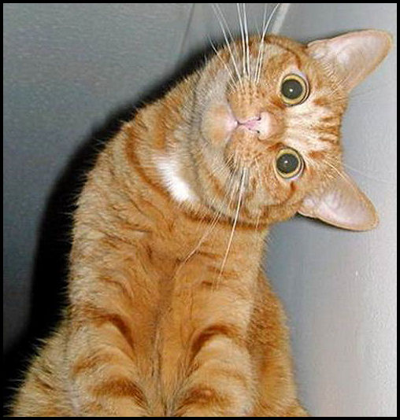
Discussion
Thanks to weekly discussions in BRSKI design team on Thursday
Next meeting Nov. 25

Slide 7
Conclusions
Three directorate reviews occurred and were reacted to.
Security Considerations is done.
Applicability Statement is done.
Ready for WGLC!
no major issues
Only minor issues remain, many of which are wishes

