Slide 1
Constrained voucher
draft-ietf-anima-constrained-voucher-15
Michael Richardson, Peter van der Stok,
Panos Kampanakis, Esko Dijk
IETF 113
ANIMA Working Group

Slide 2
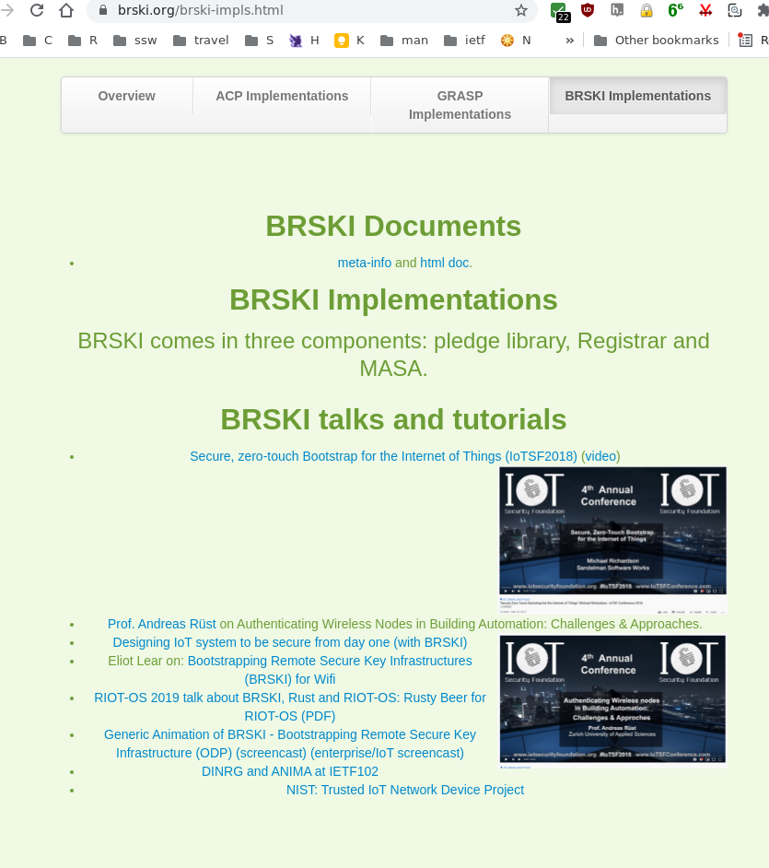

Constrained Voucher
BRSKI uses EST, HTTP and TLS
This draft proposes
      constrained voucher additions to voucher and use of SIDs
      Extends coap-est draft with BRSKI extensions to EST
            CoAP, CBOR, CMS, and COSE
to support voucher transport for constrained devices
EST: Enrollment over Secure Transport
BRSKI: Bootstrapping of Remote Secure Key Infrastructures
SID: YANG Schema Item iDentifier
COSE: CBOR Signing and Encryption (RFC 8152)
CMS: Cryptographic message Syntax (RFC 5652)
CBOR: Concise Binary Object Representation (RFC 7049)

Slide 3
Changes since IETF112
https://www.ietf.org/rfcdiff?url1=draft-ietf-anima-constrained-voucher-14&url2=draft-ietf-anima-constrained-voucher-16
Many small edits
  IANA fixes
Fixes to examples.
Added table for mapping of assertion values to integers (not strings)
Interop efforts

Slide 4
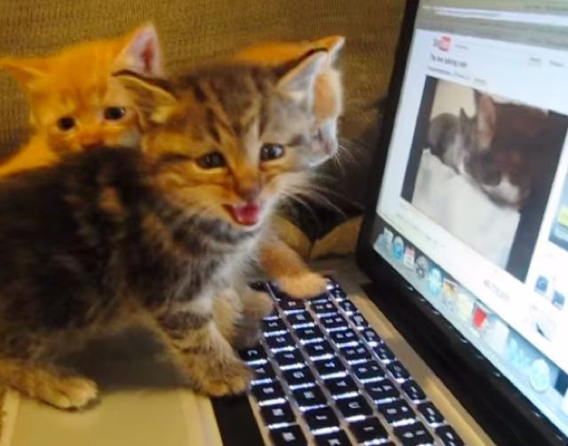




Hackathon Results
IETF113 interop testing, online and via IETF VPN. In the weeks up to meeting.
Participants: Esko (IOT-Consultancy), Peter, Michael (Sandelman), Thomas (Siemens),
  Will repeat at next Hackathon, but also participants want to continue between events.
  IETF L2 VPN (used)
Same cats as last time, different bugs

Slide 5
List of Hackathon Issues (1)
Still need Early Allocation of TBD3 - previous efforts used 65502 (private use value) for Content-Format
SNI must be used for Registrar/MASA connection
still have to get AuthorityKeyIdentifier correct for IDevID
Much external distraction to participants
in-room, right-now, right-here work is superior to vague on-line efforts

Slide 6

Discussion
Ready for WGLC!
Thanks to weekly discussions in BRSKI design team on Thursday
Will resume in April

