Slide 1
Constrained voucher
draft-ietf-anima-constrained-voucher-12
Michael Richardson, Peter van der Stok,
Panos Kampanakis, Esko Dijk
IETF 111
ANIMA Working Group

Slide 2
Constrained Voucher
BRSKI uses EST, HTTP and TLS
This draft proposes
      constrained voucher additions to voucher and use of SIDs
      Extends coap-est draft with BRSKI extensions to EST
            CoAP, CBOR, CMS, and COSE
to support voucher transport for constrained devices
EST: Enrollment over Secure Transport
BRSKI: Bootstrapping of Remote Secure Key Infrastructures
SID: YANG Schema Item iDentifier
COSE: CBOR Signing and Encryption (RFC 8152)
CMS: Cryptographic message Syntax (RFC 5652)
CBOR: Concise Binary Object Representation (RFC 7049)

Slide 3
Changes since IETF110

Slide 4

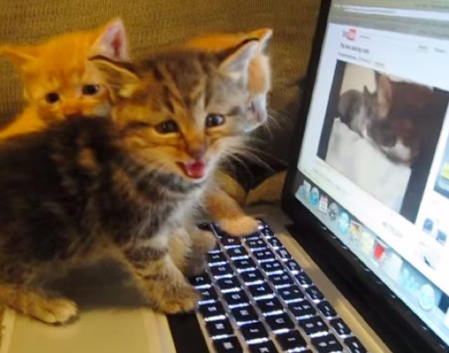
Hackathon Results
To be updated after meeting
Here are some cats

Slide 5
List of Hackathon Issues
Early Allocation of TBD3 - previous efforts used 65502 (private use value) for Content-Format
Problems getting CCM_8 mode enabled
What should Registrar/MASA have as mandatory to implement ciphers?
SNI must be used for Registrar/MASA connection
  SNI must be ignored to Pledge/Registrar
is it allowed to omit x5bag on Voucher reply?
is x5bag mandatory on Registar/MASA voucher-request?

Slide 6
X5BAG, and auditing of MASA reply by Registrar

Slide 7
Discussion
Thanks to weekly discussions in BRSKI design team on Thursday

Slide 8
Conclusion
Two directorate reviews occured
Security Considerations still needed
Applicability Statement needed

