Slide 1
Operational Considerations for MASA, Registrar and IDevID https://datatracker.ietf.org/doc/draft-richardson-anima-masa-considerations/ https://datatracker.ietf.org/doc/draft-richardson-anima-registrar-considerations/ https://datatracker.ietf.org/doc/draft-richardson-secdispatch-idevid-considerations
Michael Richardson
IETF 124: 2024-11-05
ANIMA Working Group

Slide 2
History of Documents
draft-ietf-anima-
registrar-considerations
(enterprise private CA)
RFC8994 (ACP)
RFC8995 (BRSKI)
draft-ietf-anima-
masa-considerations
(vendor private CA + voucher)
Document
Split up
draft-irtf-t2trg-
taxonomy-manufacturer-anchors-11
draft-ietf-anima-
brski-considerations ?merged?

Slide 3
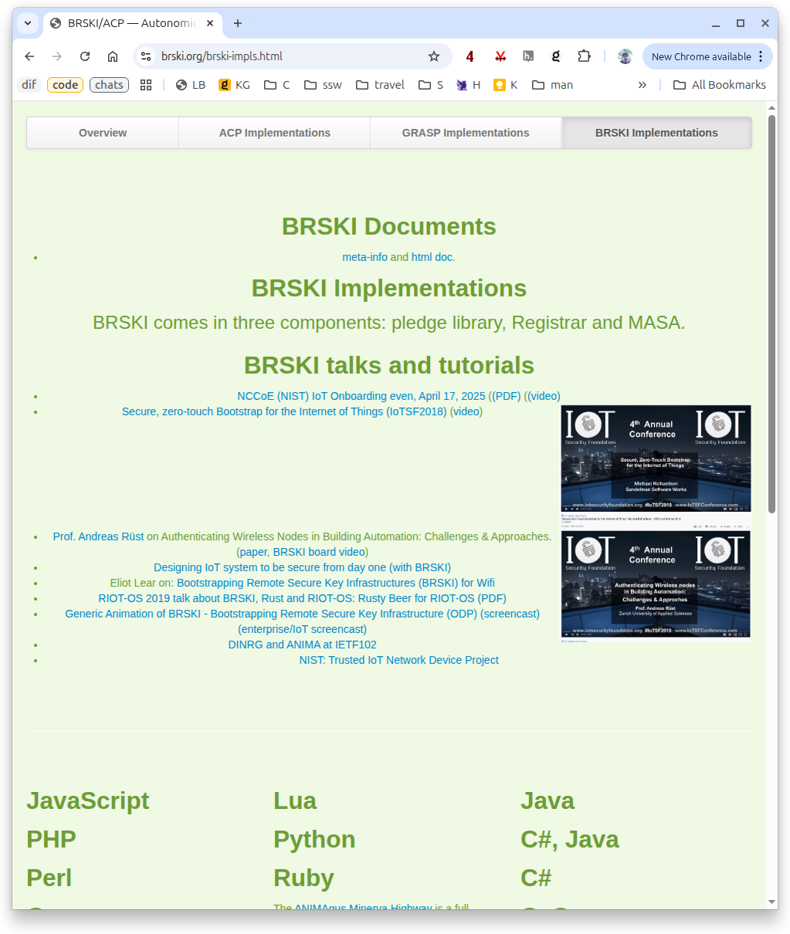
ANIMA ACP:
BRSKI.org / RFC8994.org / RFC8995.org
any resemblance to cbor.io is intentional.
static jekyll site, https://github.com/AnimaGUS-minerva/brski.org fork and contribute
not hosted at github, because no IPv6 at the time

Slide 4



Operational Considerations for MASA draft-ietf-anima-masa-considerations
manufacturer has to maintain a PKI.
  this document provides prescriptive advice on how the private parts are kept, by the manufacturer, in the “factory”
IDevID
PKI

Slide 5

BRSKI: where the Private PKIs go
manufacturer
icons at:
https://github.com/iot-dir/slides/tree/master/anima/brski
(CC-4.0)
PKI advice for manufacturer
mTLS advice
pinning advice
Manufacturer
Validates
Device
IDevID
Network
Operator
(owner/
resident)
IDevID
Pledge
PKI advice for operator
home, small, large

Slide 6



BRSKI diagram: creating vouchers
PKI advice for MASA
MASA
(manufacturer
Authorized
Signing
authority)
Voucher
Trust
anchor
Network
Operator
(owner/
resident)
Registrar
(or JRC)
Pledge
signed
voucher
request

Slide 7
Operational Considerations for Registrar draft-ietf-anima-registrar-considerations
.------------.
| MASA |
| client |
| BRSKI-MASA |
'------------'
^
|
.------------. | .---------------.
| management | .----------. | certification |
| interface |<---| database |----->| authority |
'------------' '----------' '---------------'
|
|
v
.------------. .-----------. .------------.
| Join Proxy | | Pledge |--. | EST/BRSKI |
|------------| | Interface | | |------------|
| GRASP | | BRSKI-EST |e | | GRASP |
| (DULL) | '-----------'T | '------------'
'------------' '-----------'
This document is about many design issues, including:
prescriptive statements about appropriate security for the private certification authority
scaling issues relating to TLS/HTTPS operations
synchronous vs asynchronous issues on how BRSKI-MASA client interacts with BRSKI-EST server
Incremental deployment of ACP into an existing NOC, including additional ACP-connect considerations
all
non-normative
advice

Slide 8
Merge Documents?
1. Introduction (REGISTRAR)
1.1. Terminology
1.2. Reference Network and Diagrams
1.3. Internal architectural view
2. Connecting the Autonomic Control Plane to NOC
3. Public Key Infrastructure Recommendations for the
Registrar
3.1. PKI recommendations for Tier-1/ISP Networks
3.2. Enterprise Network
3.3. Home Network
4. Architecture Considerations for the Registrar
4.1. Completely Synchronous Registrar
4.2. Partially Synchronous Registrar
4.3. Asynchronous Registrar
5. Certificates needed for the Registrar
5.1. TLS Server Certificate for BRSKI-EST
5.2. TLS Client Certificate for BRSKI-MASA
5.3. Certificate for signing of Voucher-Requests
6. Autonomic Control Plane Addressing
7. Privacy Considerations
8. Security Considerations
1. Introduction (MASA)
2. Operational Considerations for Manufacturer Authorized Signing
Authority (MASA)
2.1. Deflecting unwanted TLS traffic with Client
Certificates
2.2. Web framework architecture
2.3. Self-contained multi-product MASA, no PKI
2.4. Self-contained multi-product MASA, with one-level PKI
2.5. Self-contained per-product MASA
2.6. Per-product MASA keys intertwined with IDevID PKI
2.7. Rotating MASA authorization keys
3. Operational Considerations for Constrained MASA
4. Operational Considerations for creating Nonceless vouchers
5. Business Continuity and Escow Considerations
6. Privacy Considerations
7. Security Considerations

Slide 9
Discussion

