Slide 1
RFC8366bis voucher
draft-ietf-anima-rfc8366bis
was ADOPTED: January 2022
Michael Richardson,
(+Kent Watsen, Qiufang Ma, Max Pritiken, Toerless Eckert)
IETF 122
ANIMA Working Group

Slide 2
RFC8366bis:
The storey so far
Tried to do extensions (see auxiliary slide for history). Failed.
  Moved all YANG extensions from: brski-cloud, cBRSKI, brski-prm into RFC8633bis into this document.
  Moved all YANG-CBOR (SID) work from cBRSKI into this document, verified that we things worked, tooling (pyang) was okay.
  waited for other documents to all become stable (equilibrium)
Noticed how RFC8520 (MUD) did extensions via draft-ietf-opsawg-mud-ol document, using “extensions”
Wrote draft-richardson-netmod-atrest-extensions, have not yet presented it or socialized it with netconf group. Implemented this. See next slides.

Slide 3
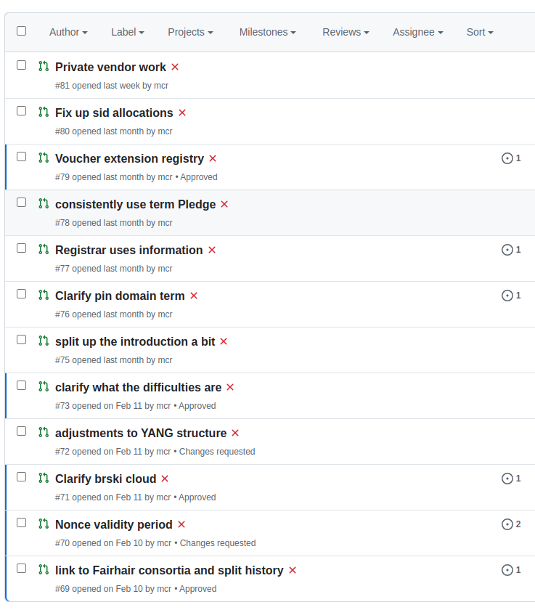
RFC8366bis:
Reviews and changes
Processed Document review from Alexander Clemm.
Other comments accumulated.
These pull requests are not yet merged, but new document is based upon accumulation of patches.
Please go comment/read the pull requests.
Merge them all April 4, 2025.

Slide 4

Extension
Process (PR #79)
Avoid having to wrap up documents again for simple extensions in the future.
Support vendor (MASA) <-> Pledge extensions.
Possible to just abuse JSON dictionaries to add anything you like
  (not the YANG way!)
not possible/easy when using CBOR (cBRSKI) due to need to allocate SIDs
leaf-list extensions {
type string {
length "1..40";
}
description "A list of extension names that are used in this Voucher file. Each name is registered with the IANA and described in an RFC.";
}

Slide 5
Extension
JSON view
In JSON, new YANG extension creates a new module name, e.g., “ietf-voucher-delegated”
{
"ietf-voucher:voucher": {
"created-on": "2016-10-07T19:31:42Z",
"assertion": "logged",
“extensions” : [ “ietf-voucher-delegated” ],
"serial-number": "JADA123456789",
"idevid-issuer": "base64encodedvalue==",
"pinned-domain-cert": "base64encodedvalue==",
"nonce": "base64encodedvalue=="
“ietf-voucher-delegated”: {
“delegation-enabled-flag”: “true”,
“delegation-countdown” : 12,
}
}
}

Slide 6
Extension
CBOR view
In CBOR, new YANG extension creates requires a new SID allocation.
  standard extensions get this from IANA
  or from alternate Mega-Range (see RFC9595 section 6.3)
  Vendor proprietary extensions could use draft-bormann-core-yang-sid-pen (still WIP)
{
2451: { / SID = 2451, ietf-voucher:voucher|voucher /
1: 2, / SID = 2452, assertion "proximity" /
2: "2022-12-05T19:19:23Z", / SID = 2453, created-on /
3: false, / SID = 2454, domain-cert-revocation-checks /
17: [ 61000 ], / SID = 2468, extensions /
7: h'831D5198A6CA2C7F', / SID = 2508, nonce /
8: h'308201' ... '8CFF', / SID = 2459, pinned-domain-cert /
11: "JADA123456789" / SID = 2462, serial-number /
Tag<47>61000: {
1: true, / SID=61001, delegation-enabled-flag /
2: 12, / SID=61002, delegation-countdown /
}
}
}
CBOR diagnostic Format

Slide 7

Simple Extension
Previous system might be too much for simple vendor/pledge extension
manufacturer-private
Is a one-time, non-interoperable way to insert stuff.
Must be bstr encoded because otherwise it would be delta encoded.
{
2451: { / SID = 2451, ietf-voucher:voucher|voucher /
1: 2, / SID = 2452, assertion "proximity" /
2: "2022-12-05T19:19:23Z", / SID = 2453, created-on /
3: false, / SID = 2454, domain-cert-revocation-checks /
18: <<[ / SID = 2469, manufacturer-private /
87: “potato” / bstr encoded! /
]>>,
7: h'831D5198A6CA2C7F', / SID = 2508, nonce /
8: h'308201' ... '8CFF', / SID = 2459, pinned-domain-cert /
11: "JADA123456789" / SID = 2462, serial-number /
}
}
CBOR diagnostic Format

Slide 9
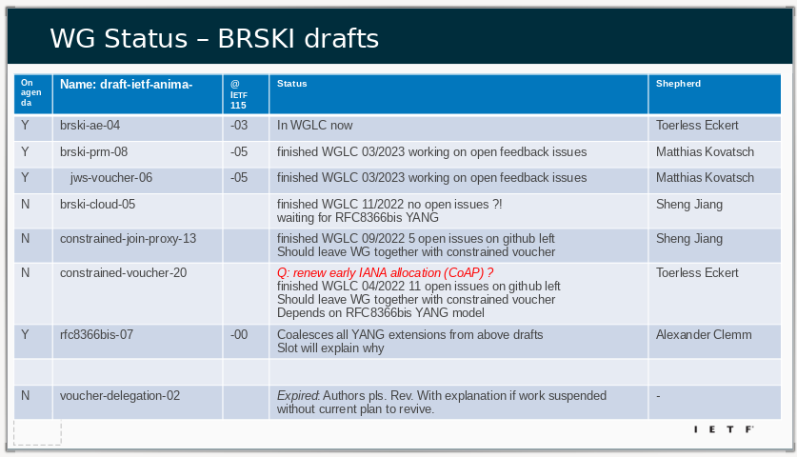
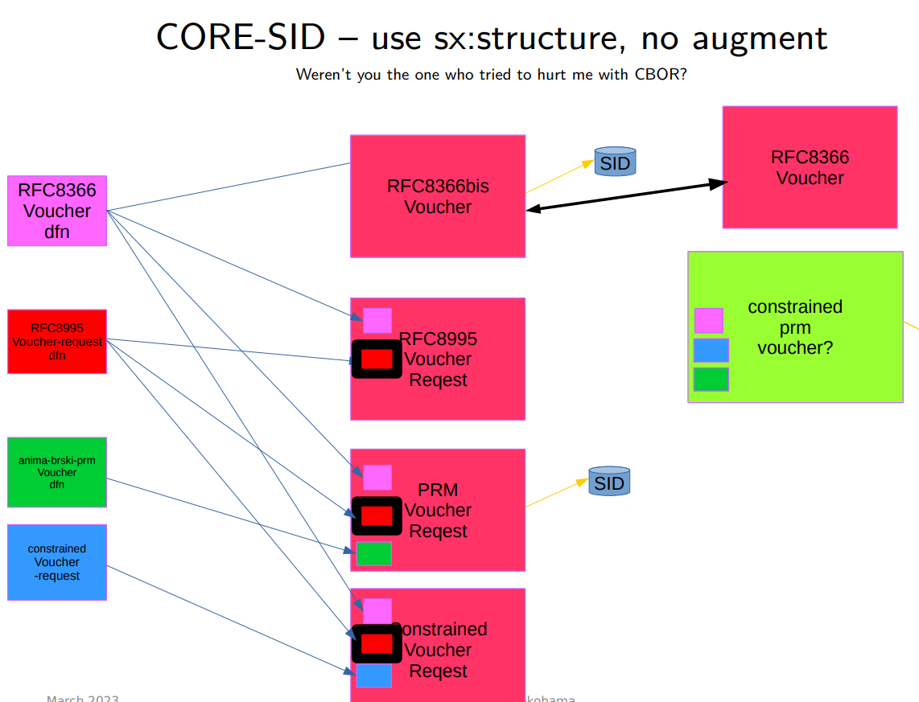
Aux Slide: Discussions at IETF116 and before
If you didn’t see the discussion and situation, then please visit: https://play.conf.meetecho.com/Playout/?session=IETF116-NETMOD-20230331-0030 Start at 1:53:00.
Working through WGLC on documents that now depend upon RFC8366bis.
draft-ietf-anima-brski-cloud draft-ietf-anima-constrained-join-proxy draft-ietf-anima-jws-voucher are still not in WGLC.

Slide 10
Next Step?
Get the other documents out of the WG, as if they need changes to YANG, then 8366bis can be revised

