Slide 1
RFC8366bis voucher
AD review comments
draft-ietf-anima-rfc8366bis
was ADOPTED: January 2022
Michael Richardson,
(+Esko Dijk, Kent Watsen, Qiufang Ma, Max Pritiken, Toerless Eckert)
IETF 125
ANIMA Working Group

Slide 2
RFC8366bis:
Status.
WGLC ended, 2026-01-31.
Added Esko Dijk as co-author
  Removed Max Pritikin (with his blessing)
AD (Mahesh) review 2026-02-26
Version 28 posted 2026-03-14, email with details posted Monday.
Fixed Updates (8995)/ Obsoletes (8633)
All [BRSKI] changed to [RFC8995], avoiding some confusion about references.
YANG authors synchronized, many references updated/fixed.
RFC8792 wrapping removed from YANG.
Moved ECDSA/EDDSA BCP14 statements from YANG “-pubk” description to cBRSKI document.
Removed “-grouping” from name of groupings, as redundant.

Slide 3
Next Step: IESG evaluation
Documents waiting on this document include:
Constrained-voucher
Constrained-join-proxy
Brski-cloud
Brski-prm
Jws-voucher
ietf-acme-integrations

Slide 4
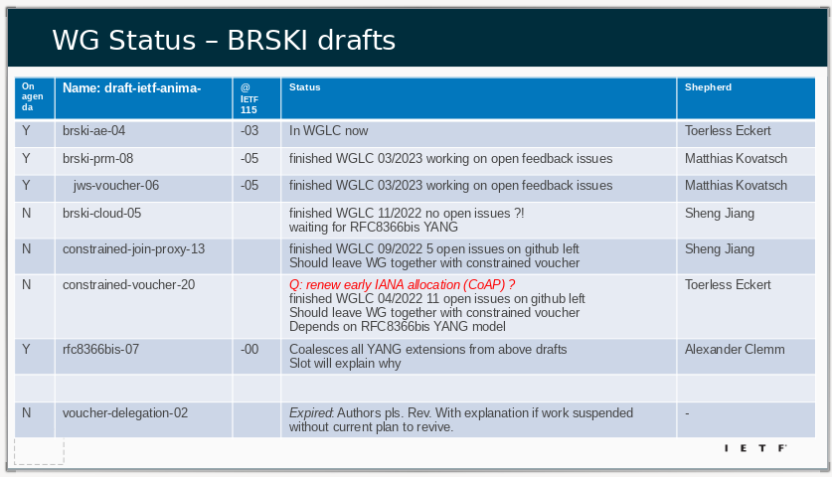
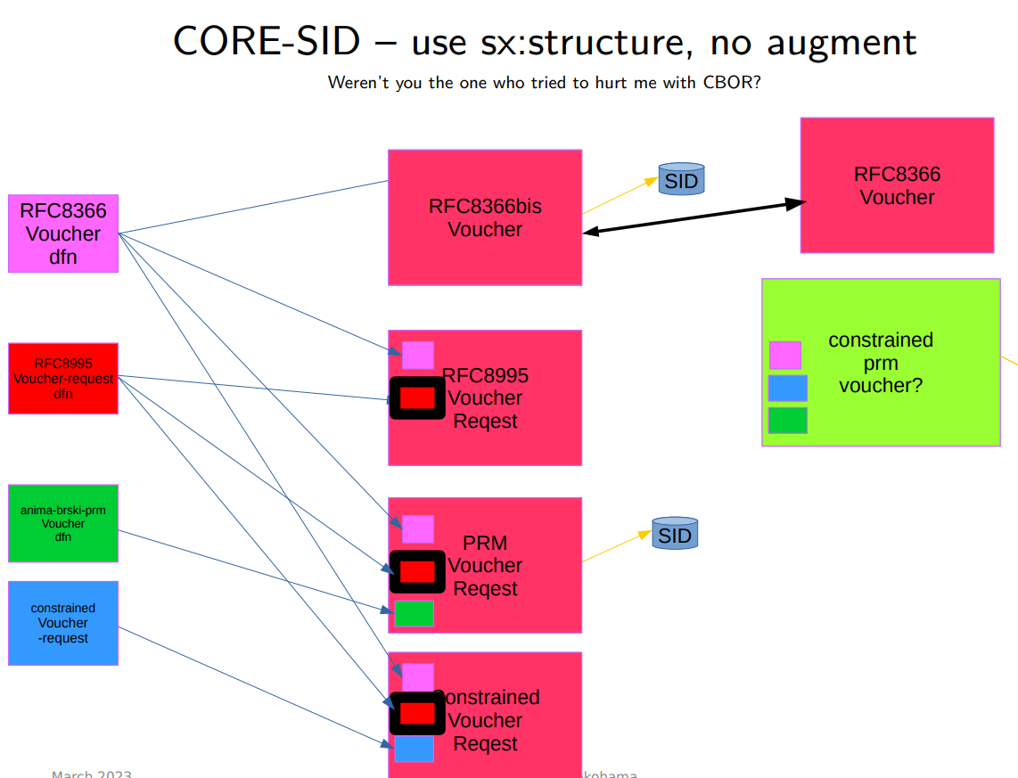
Aux Slide: Discussions at IETF116 and before
If you didn’t see the discussion and situation, then please visit: https://play.conf.meetecho.com/Playout/?session=IETF116-NETMOD-20230331-0030 Start at 1:53:00.
Working through WGLC on documents that now depend upon RFC8366bis.
draft-ietf-anima-brski-cloud draft-ietf-anima-constrained-join-proxy draft-ietf-anima-jws-voucher are still not in WGLC.

