Slide 1
RFC8366bis voucher
draft-ietf-anima-rfc8366bis
was ADOPTED: January 2022
Michael Richardson,
(+Kent Watsen, Qiufang Ma, Max Pritiken, Toerless Eckert)
IETF 117
ANIMA Working Group

Slide 2
RFC8366bis:
The Plan from Before
get draft adopted (occured Jan. 2022)
get agreement on whether are trying to get to Internet Standard now (or not)
  NOT!
revised document to include IANA maintained YANG module for enumerated registry
collect other voucher extensions into document
  DONE.

Slide 3
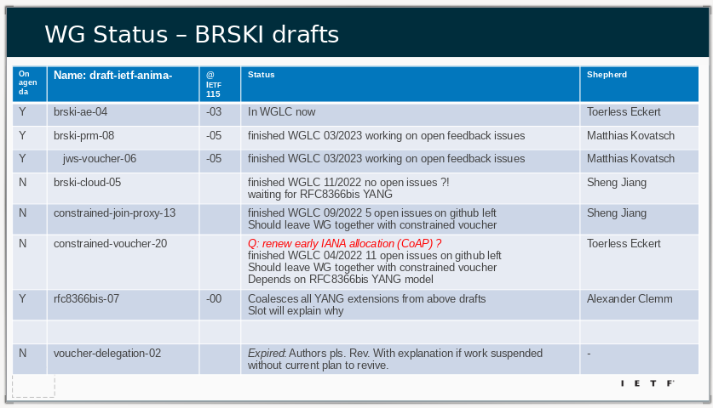
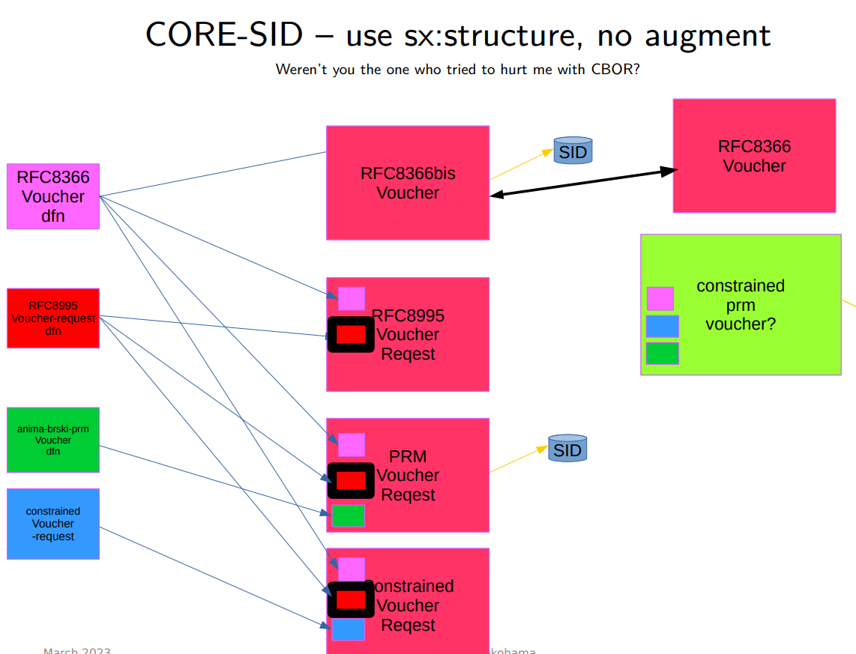
Discussions at IETF116 and before
If you didn’t see the discussion and situation, then please visit: https://play.conf.meetecho.com/Playout/?session=IETF116-NETMOD-20230331-0030 Start at 1:53:00.
Working through WGLC on documents that now depend upon RFC8366bis.
draft-ietf-anima-brski-cloud draft-ietf-anima-constrained-join-proxy draft-ietf-anima-jws-voucher are still not in WGLC.

Slide 4
Next Step?
Get the other documents out of the WG, as if they need changes to YANG, then 8366bis can be revised

