Slide 1
RFC8366bis voucher
draft-ietf-anima-rfc8366bis
was ADOPTED: January 2022
Michael Richardson,
(+Kent Watsen, Qiufang Ma, Max Pritiken, Toerless Eckert)
IETF 124
ANIMA Working Group

Slide 2
RFC8366bis:
The storey so far
Tried to do extensions (see IETF122 slides for history). Failed.
  Moved all YANG extensions from: brski-cloud, cBRSKI, brski-prm into RFC8633bis into this document.
  Moved all YANG-CBOR (SID) work from cBRSKI into this document, verified that we things worked, tooling (pyang) was okay.
  waited for other documents to all become stable (equilibrium)
Noticed how RFC8520 (MUD) did extensions via draft-ietf-opsawg-mud-ol document, using “extensions”
Had problems in 2024 and 2025 with pyang and SID allocators. Found and fixed finally.

Slide 3
WGLC Comments
Review from Esko, many comments about the YANG addressed in -16
Final comments addressed in -17 (just posted)
Found issues with SID allocation in pyang sid.py, fixed them, working on upstreaming those changes.
WGLC seems done?

Slide 4
Next Step: pass up to AD, IESG
Questions.
Discussion.

Slide 5
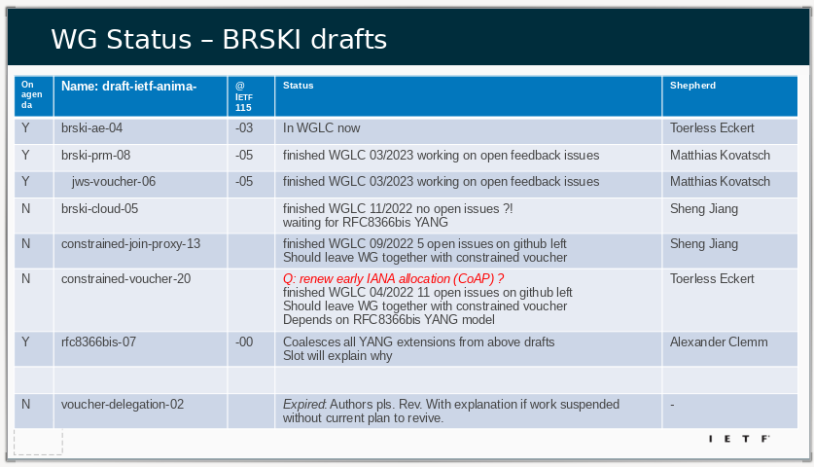
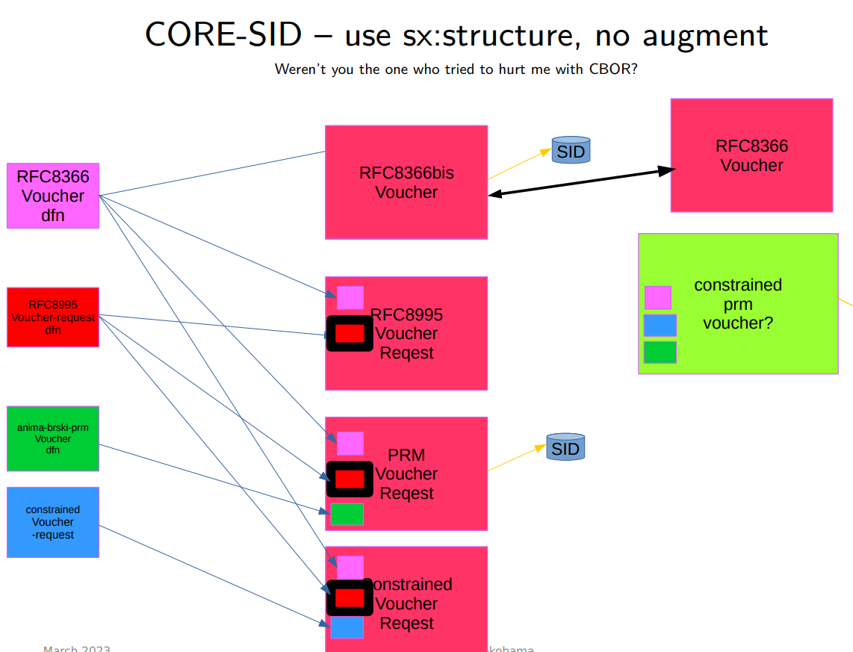
Aux Slide: Discussions at IETF116 and before
If you didn’t see the discussion and situation, then please visit: https://play.conf.meetecho.com/Playout/?session=IETF116-NETMOD-20230331-0030 Start at 1:53:00.
Working through WGLC on documents that now depend upon RFC8366bis.
draft-ietf-anima-brski-cloud draft-ietf-anima-constrained-join-proxy draft-ietf-anima-jws-voucher are still not in WGLC.

