Slide 1
Fernow microbiome

Slide 2
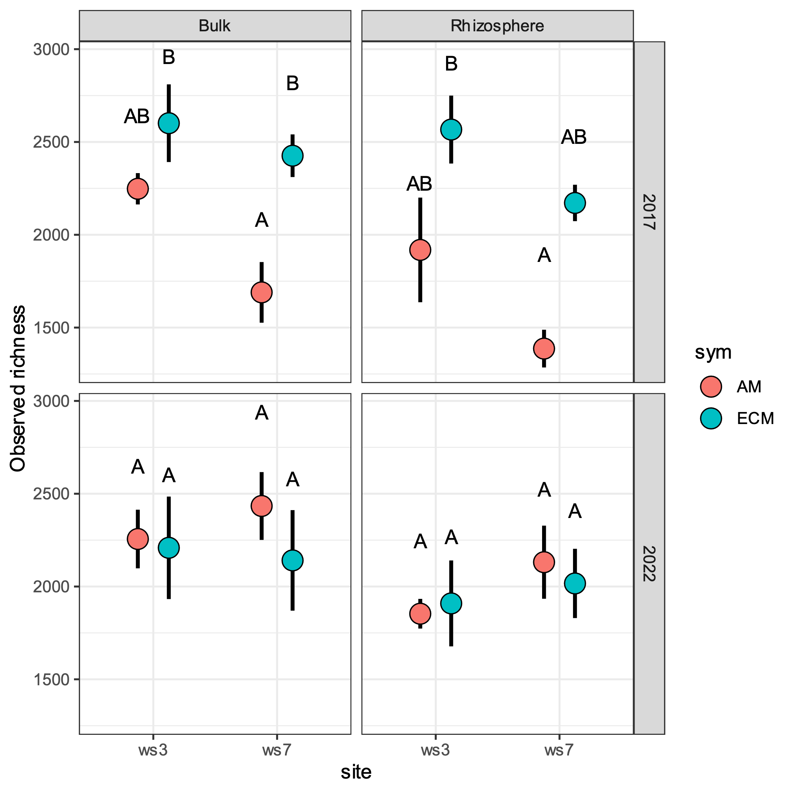
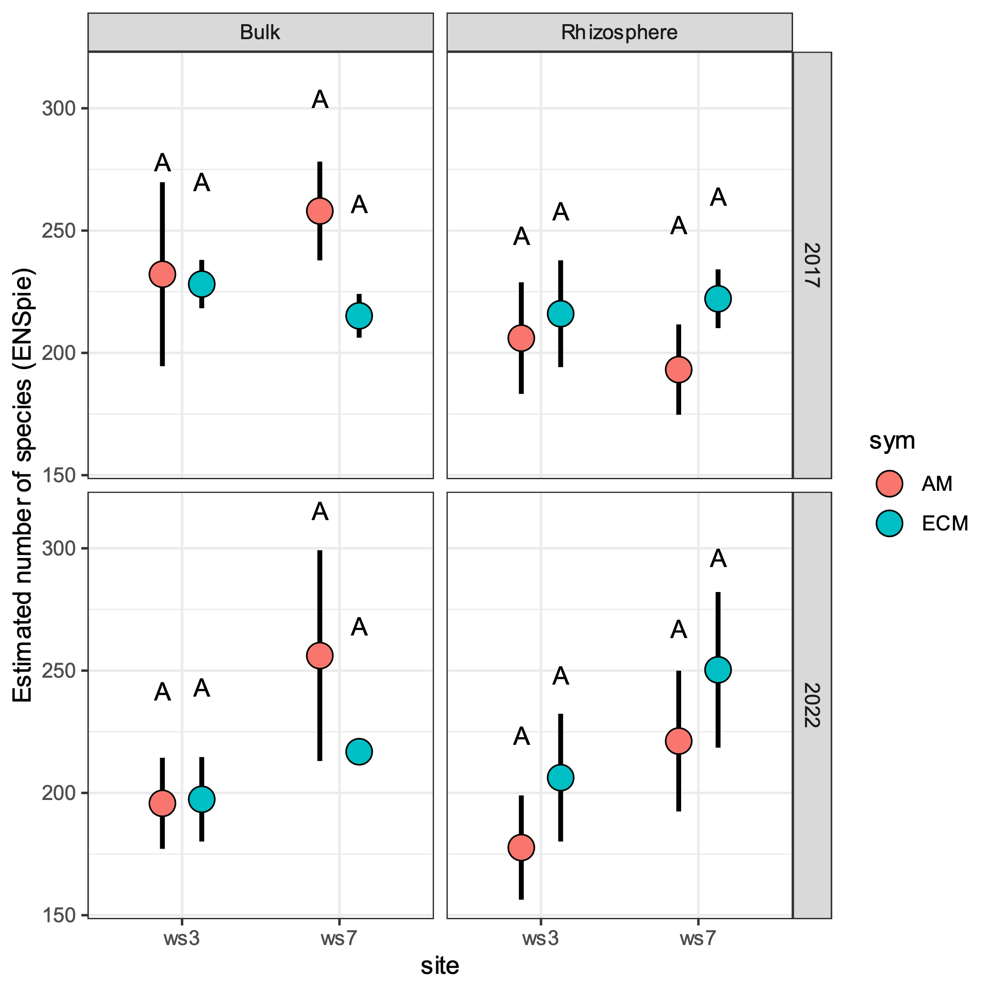
Bacterial Alpha Diversity
***Note: statistical comparisons are only between symbiotroph and sampling sites at each soil type and sampling date. Meaning letters are only comparable within each subpanel.

Slide 3
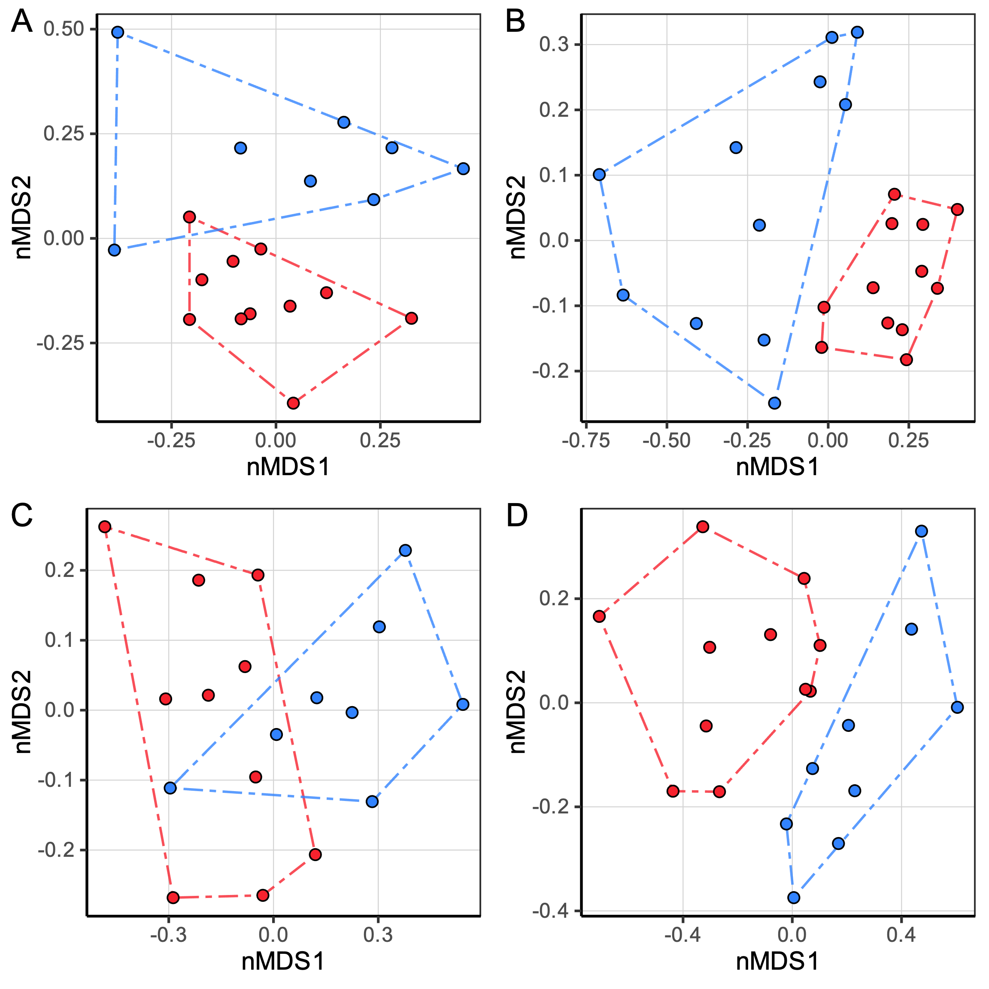
Bacterial Beta Diversity
Comparison between watershed sampling sites.
WS3
WS7
A – Sampling date 2017; AMF dominated locations ; ** significant
B – Sampling date 2017; ECM dominated locations ; ** significant
C – Sampling date 2022; AMF dominated locations ; ** significant
D – Sampling date 2022; ECM dominated locations ; ** significant
***NOTE: Community composition is a combination of rhizosphere and bulk soil samples. Since site differences hold up when separated, combing data gives more statistical power

Slide 4
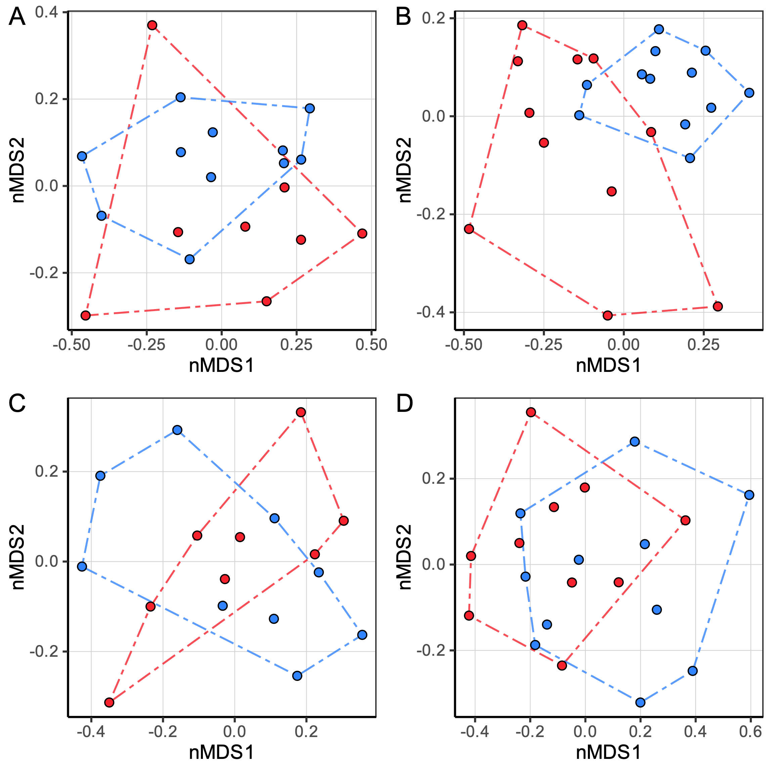
Bacterial Beta Diversity
Comparison between mycorrhizal dominated sites.
AMF
ECM
A – Sampling date 2017; watershed 7; ** significant
B – Sampling date 2017; watershed 3 ; ** significant
C – Sampling date 2022; watershed 7 ; non-significant
D – Sampling date 2022; watershed 3; non-significant
***NOTE: Community composition is a combination of rhizosphere and bulk soil samples. Since site differences hold up when separated, combing data gives more statistical power

Slide 5
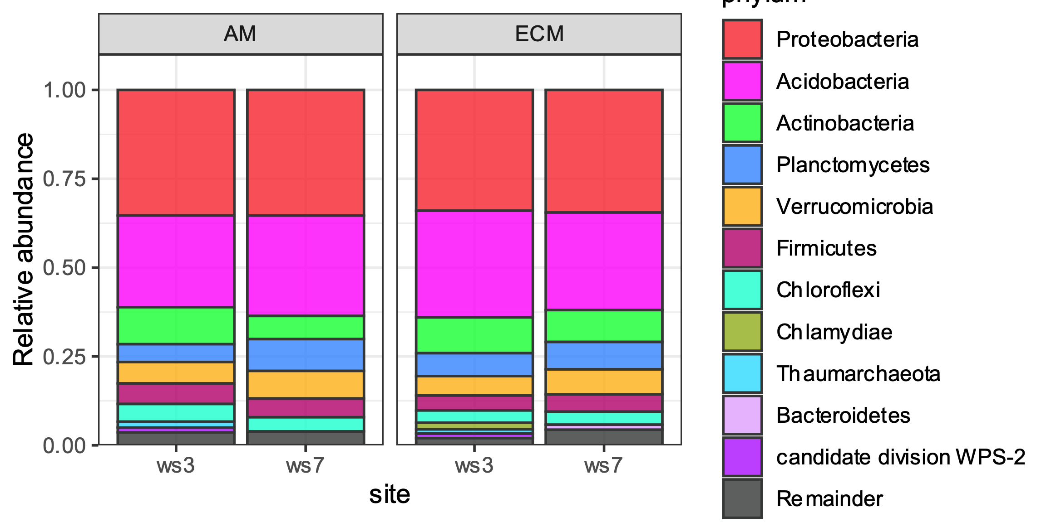
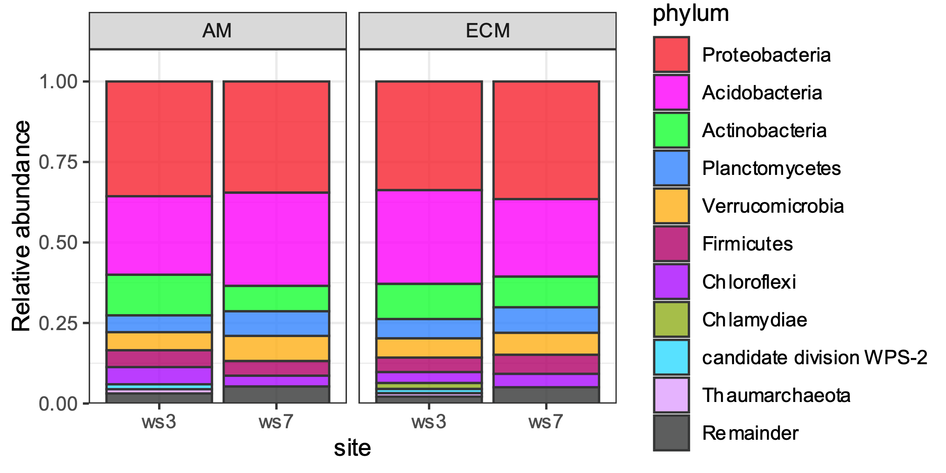
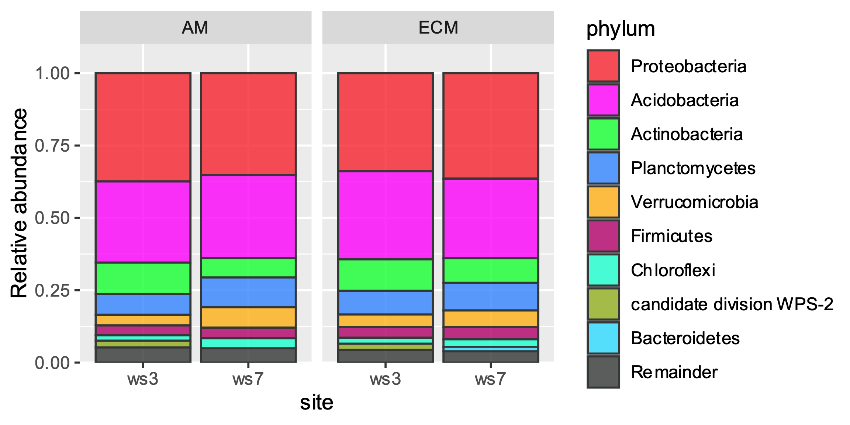
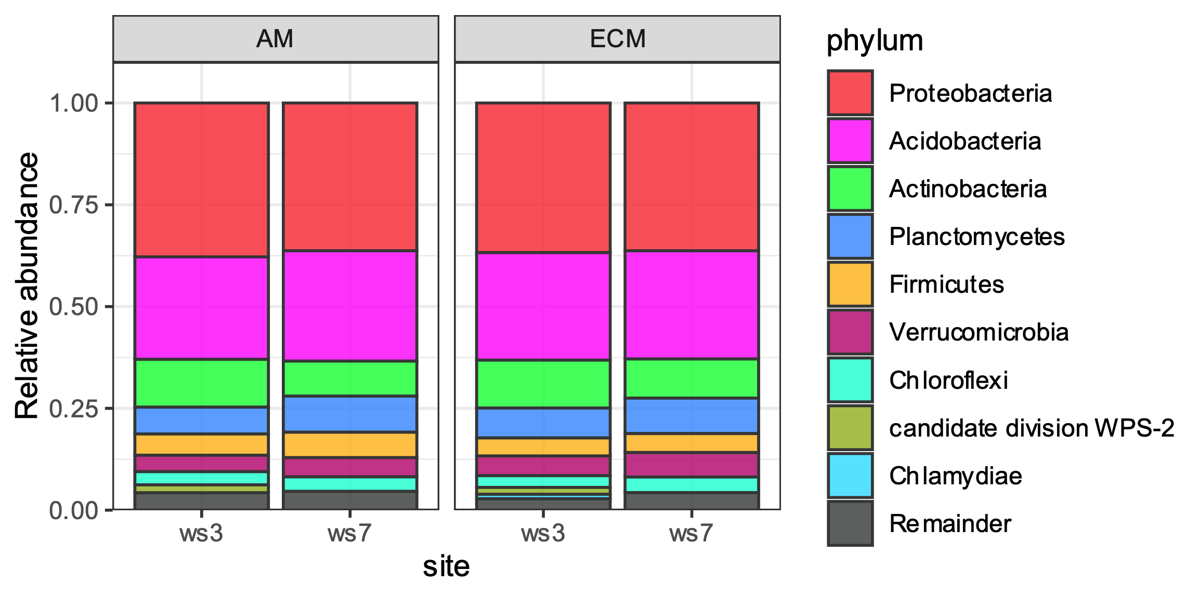
Taxonomic composition of bacterial community
Rhizosphere soil for 2017 sampling date
Bulk soil for 2017 sampling date
Rhizosphere soil for 2022 sampling date
Bulk soil for 2022 sampling date

Slide 6
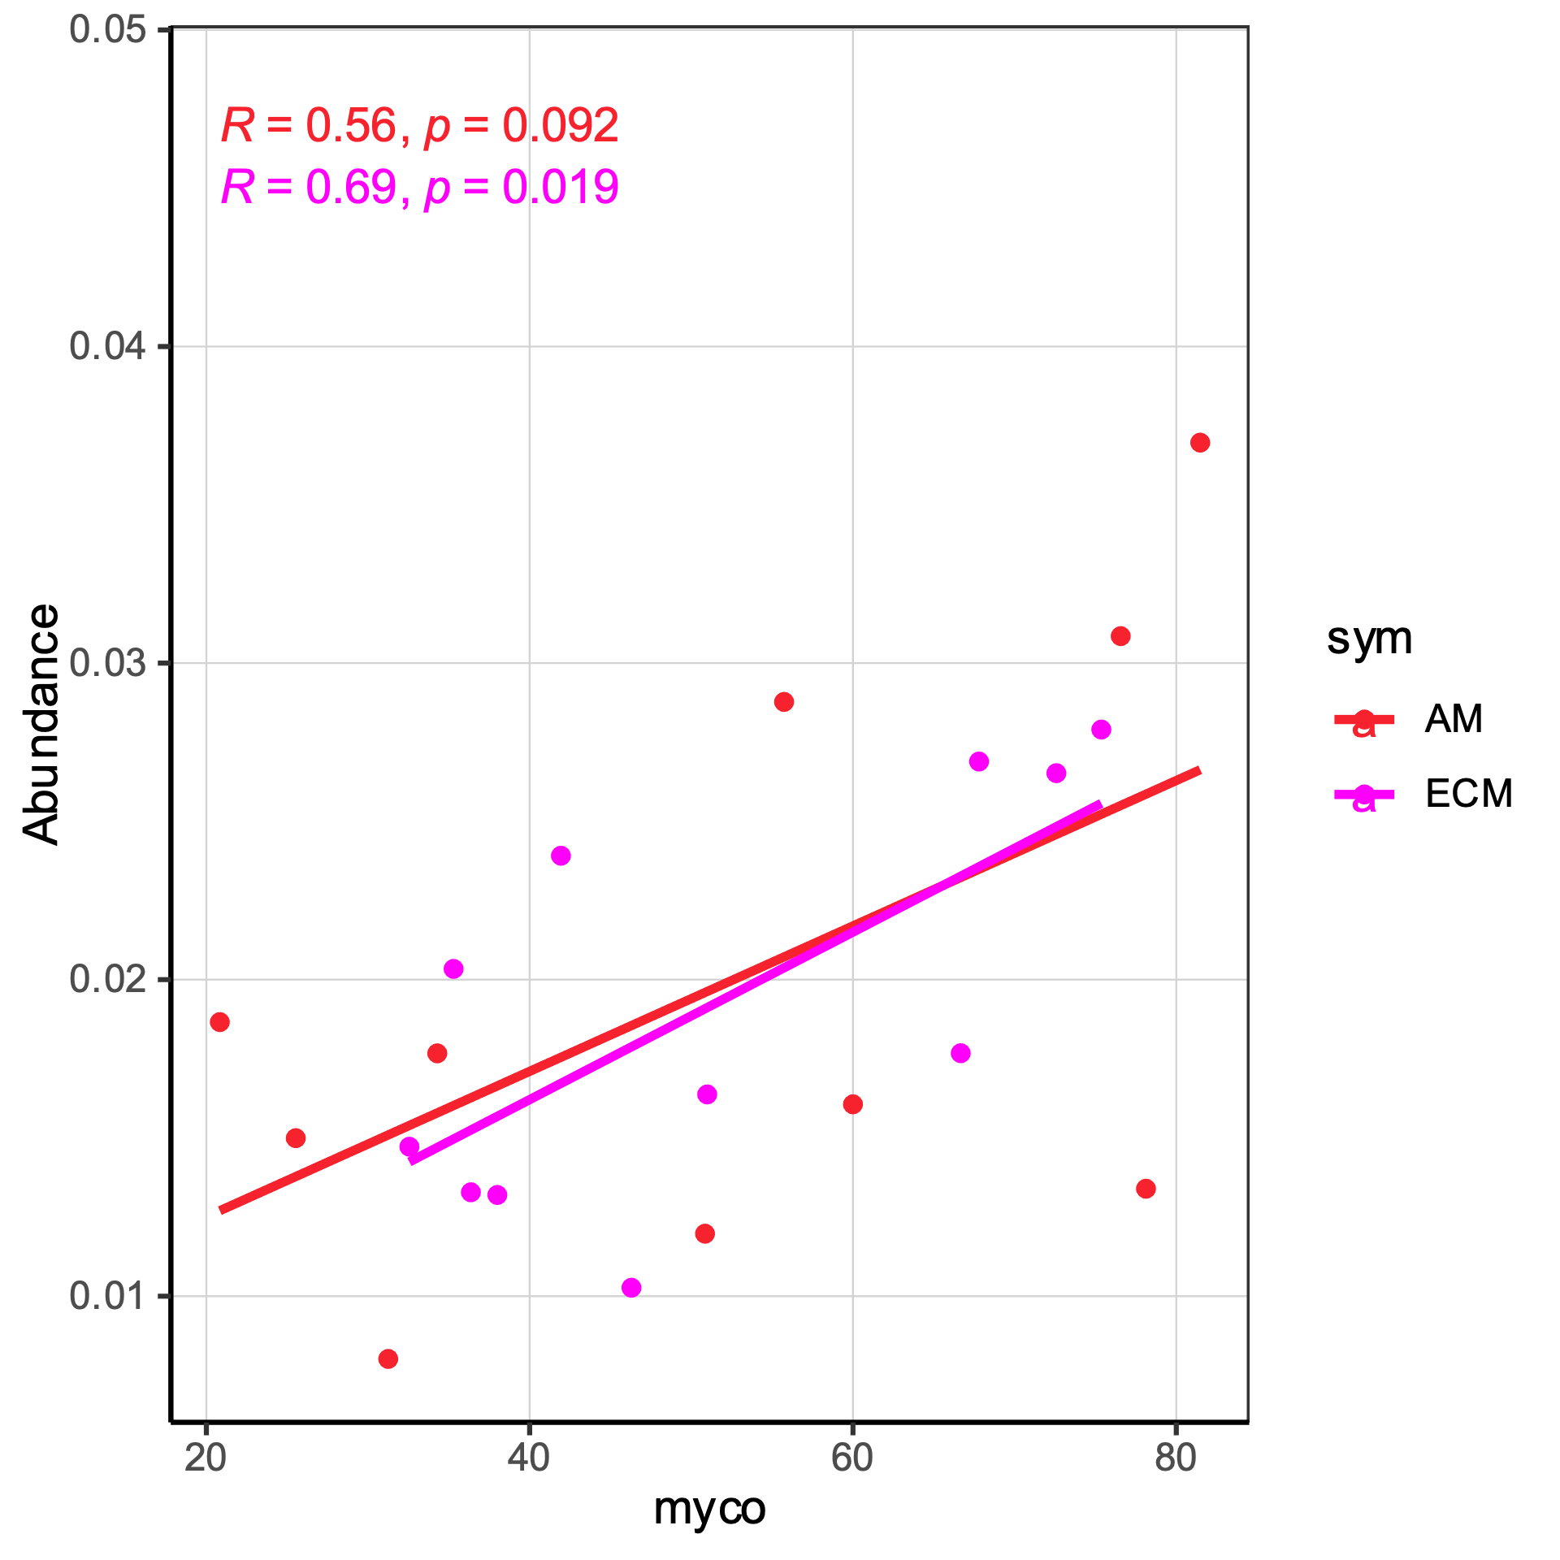
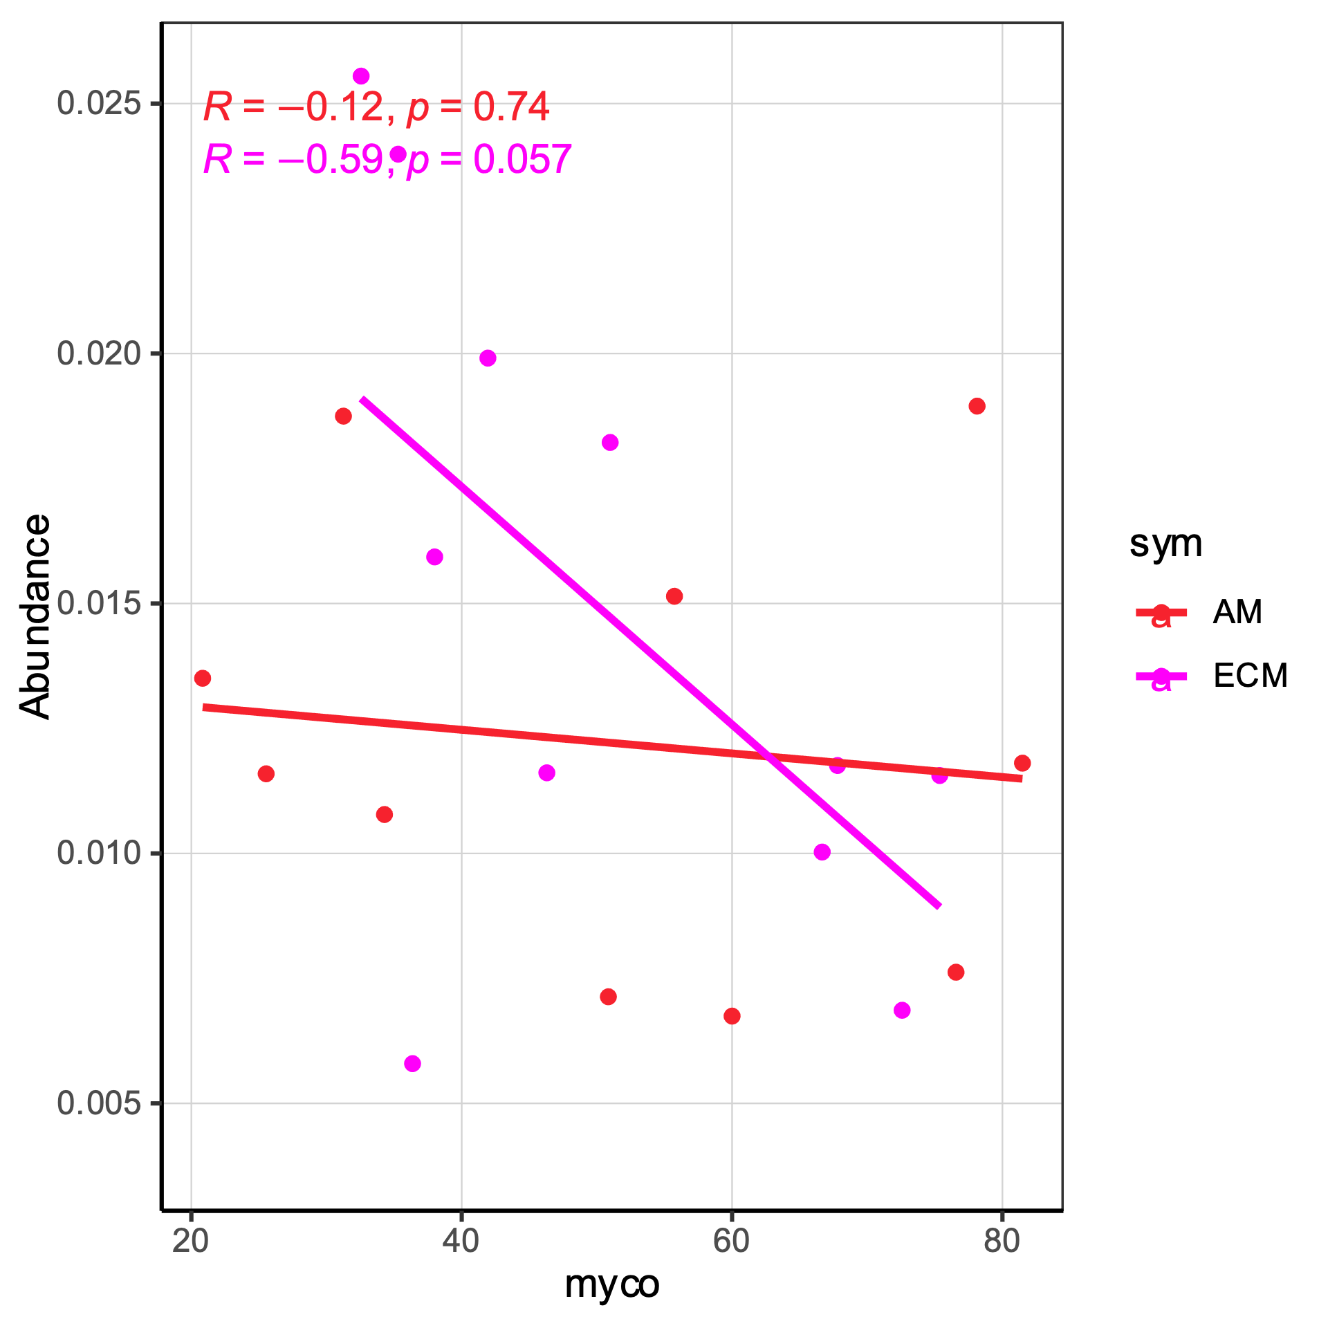
Correlations between bacterial genera abundance and mycorrhizal colonization
Gemmata
Methylocapsa

