Slide 1


CAPSTONE PROJECT
PROJECT TITLE
Presented By
Student Name : Animalla Vimal Kumar
College Name : Guru nanak institute of technology
Department : computer science and engineering
Email ID:avimal94924@gmail.com

Slide 2
OUTLINE:
Problem Statement
Proposed System/Solution
System Development Approach (Technology Used)
Algorithm & Deployment
Result (Output Image)
Conclusion
Future Scope
References

Slide 3
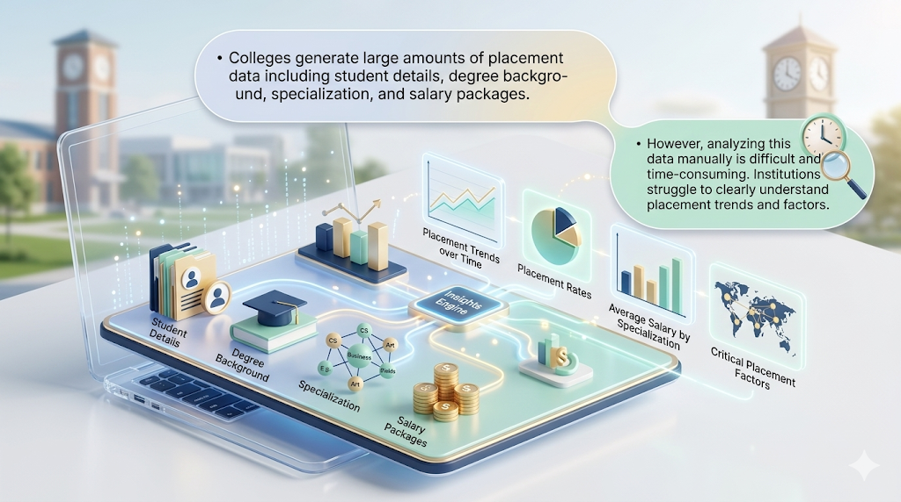
Problem Statement:
Colleges and universities generate a large volume of placement-related data every year, including information about student demographics, academic performance, degree background, specialization, work experience, and salary packages offered by recruiting companies. This data holds valuable insights that can help institutions evaluate the effectiveness of their training programs and understand the factors that influence student placement success. However, in many institutions, this data is stored in spreadsheets or databases without proper analytical tools to interpret it effectively. As a result, analyzing placement data manually becomes a difficult and time-consuming process.
Manual analysis often leads to incomplete insights, errors, and difficulty in identifying important trends. For example, placement cells may find it challenging to determine which specialization leads to higher placement rates or which academic factors significantly influence salary packages. Without proper visualization and analysis, institutions cannot clearly identify patterns such as the relationship between work experience and placement success or how different degree backgrounds impact employability.

Slide 4
Proposed Solution:
The proposed system is a Campus Placement Analysis Dashboard developed using Power BI to analyze and visualize student placement data in an interactive and easy-to-understand format. The dashboard integrates multiple placement parameters such as student count, placement status, degree type, specialization, gender,andsalarypackagestoprovidemeaningfulinsights. Interactive visualizations are used to analyze placement trends:
Pie/Donut Chart: Shows the distribution of placed vs not placed students.
Bar Chart: Displays placement distribution based on degree type (Comm & Mgmt, Sci & Tech, Others).
Column Chart: Analyzes specialization and salary distribution.
Scatter Plot: Shows the relationship between degree percentage and salary package
Filters such as gender, degree type, specialization, and work experience allow users to dynamically explore the data and identify placement patterns. This enables institutions to easily evaluate placement performance and understand which academic backgrounds or specializations have higher placement success.
Overall, the dashboard provides real-time visual insights, helping placement officers and institutions make informed decisions to improve placement strategies and student outcomes

Slide 5
System Approach:
The system is developed using Power BI to analyze and visualize campus placement data through an interactive dashboard. The development approach follows a structured process starting from data collection to visualization and analysis.
First, the placement dataset containing student information such as gender, degree type, specialization, work experience, salary, and placement status is imported into Power BI. The data is then cleaned and transformed using Power Query to remove inconsistencies and prepare it for analysis.
Next, data modeling and calculations are performed to generate key metrics such as Total Students, Placed Students, and Placement Rate. These values are displayed using KPI cards to provide a quick overview of placement performance.
The system then uses multiple visualization techniques to represent placement insights:
Donut Chart: Displays the proportion of placed and not placed students.
Bar Chart: Shows placement distribution across different degree types.
Column Chart: Represents specialization-wise salary analysis.
Scatter Plot: Illustrates the relationship between degree percentage and salary.

Slide 6
Algorithm & Deployment:
Load Placement Dataset into Power BI The campus placement dataset containing student details such as gender, degree type, specialization, work experience, salary, and placement status is imported into Power BI.
Data Cleaning and Transformation Using Power Query Editor, the dataset is cleaned by organizing columns, correcting data types, and preparing fields required for analysis.
Create Calculated Measures Key metrics are calculated to evaluate placement performance.
Example 1: Placement Rate = (Placed Students / Total Students) × 100
Example 2: Total Students and Placed Students counts used for KPI cards.
4. Build Interactive Dashboard Visualizations Multiple visual components are created to analyze placement data:
KPI Cards: Total Students, Placed Students, Placement Rate
Donut Chart: Placement status distribution (Placed vs Not Placed)
Bar Chart: Placement count by degree type
Column Chart: Specialization vs Salary analysis
Scatter Plot: Degree percentage vs Salary relationship

Slide 7
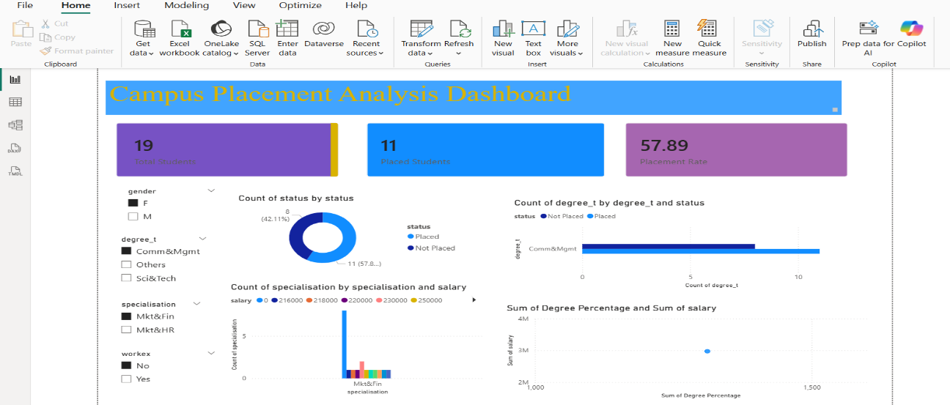
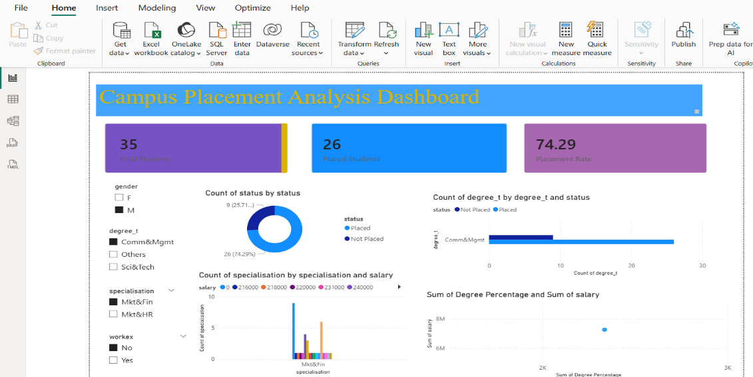
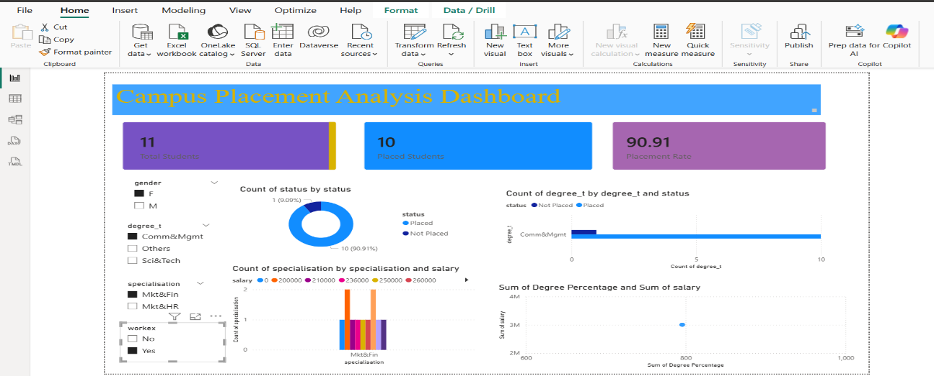

Result:
Fig 1: Campus Placement Analysis Dashboard in Power BI
Fig 2:Gender-Filtered Campus Placement Dashboard
Fig 3: Placement Dashboard for Female Students with Work Experience
Fig 4:Placement Dashboard for Male Students with Work Experience

Slide 8
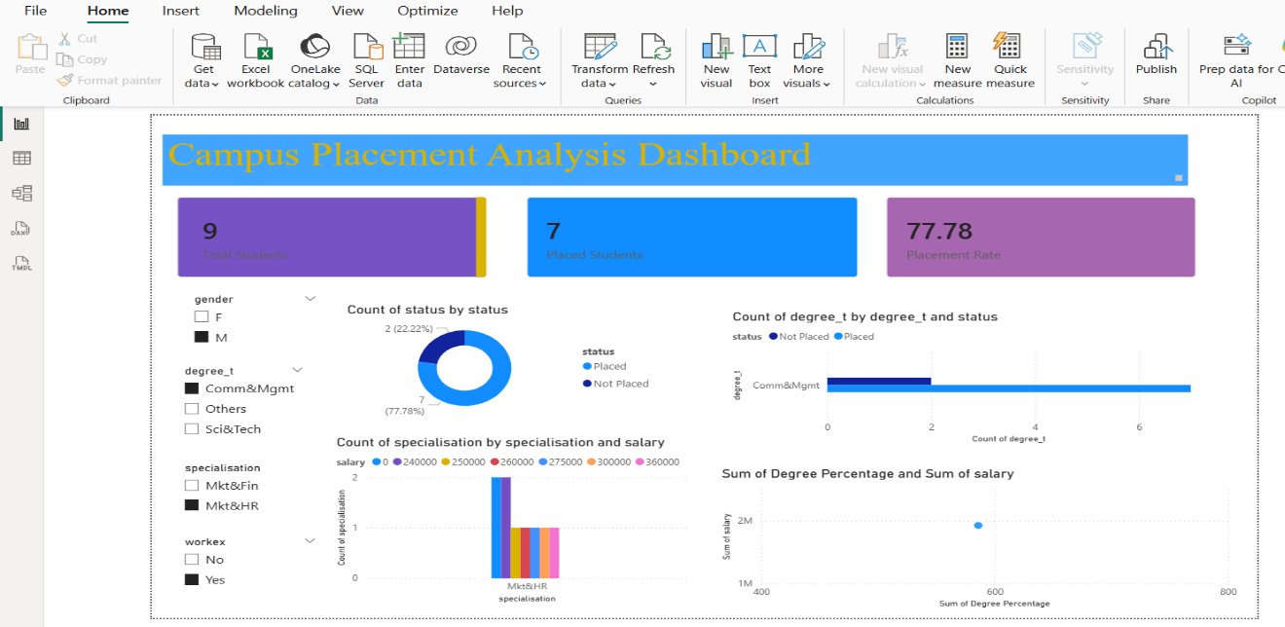



Result:
Fig 5: Placement Analysis for Male Students in Mkt&HR Specialization with Work Experience
Fig 6: Placement Analysis for Female Students in Mkt&HR Specialization with Work Experience
Fig 7: Placement Analysis for Female Students from “Others” Degree with Work Experience
Fig 8: Placement Analysis for Male Students from “Others” Degree with Work Experience

Slide 9
Conclusion:
The Campus Placement Analysis Dashboard provides a clear and interactive way to analyze student placement data using Power BI. The dashboard visually represents key metrics such as total students, placed students, placement rate, degree type, specialization, and salary distribution, making it easier to understand placement trends.
By using different visualizations like KPI cards, charts, and filters, users can quickly identify patterns in placement performance and compare placement outcomes across different student categories. This helps institutions evaluate placement effectiveness and understand factors influencing student placements.
Overall, the dashboard simplifies complex placement data into meaningful insights, enabling better decision-making for improving campus placement strategies and student career opportunities.

Slide 10
Future scope:
The Campus Placement Analysis Dashboard can be further enhanced by integrating advanced analytical and technological features to improve placement insights and decision-making.
One important improvement is the integration of real-time data sources. Currently, the dashboard analyzes static placement datasets, but in the future it can be connected to live databases or institutional management systems so that placement information is automatically updated.
Another future enhancement is the use of predictive analytics and machine learning models to forecast student placement probability. By analyzing factors such as academic performance, specialization, work experience, and skill sets, the system could predict which students are more likely to get placed and help institutions take proactive steps to improve outcomes.
The dashboard can also be extended to include company-wise and department-wise placement analysis, allowing institutions to evaluate which companies recruit the most students and which departments achieve higher placement rates.
Additionally, the system can be developed into a web-based or cloud-based application where placement officers, faculty members, and students can access placement analytics from anywhere. This would improve accessibility and collaboration.

Slide 11
References:
Factors Affecting Campus Placement Dataset (Kaggle) Benroshan. Academic and Employability Factors Influencing Placement Dataset. Kaggle.
Campus Recruitment Dataset Analysis. Kaggle Notebook.
Gupta, T. (2025). Applying ML Classification Algorithm & Data Analysis on Placement Dataset. Medium Article.
Muhajir, D. (2022). Improving Classification Algorithm on Education Dataset Using Hyperparameter Tuning. Procedia Computer Science.
GitHub Link: https://github.com/animallavimalkumar/Campus_Placement_Analysis

Slide 12
Thank You

