Slide 1
AnimalTrack Systems
James

Slide 2

Welcome Page Login & Sign Up
3 Scenarios:
When a user first download the app and opens it for the first time, the page that they will get is a page that says information about AnimalTrack and then they will choose sign up
When a user already downloaded the app before and has an account already, when they will be redirected to the home page automatically
When a user made an account on another device and first downloads the app on this device, then they will still get the welcome page, and they will likely choose the login choice

Slide 3
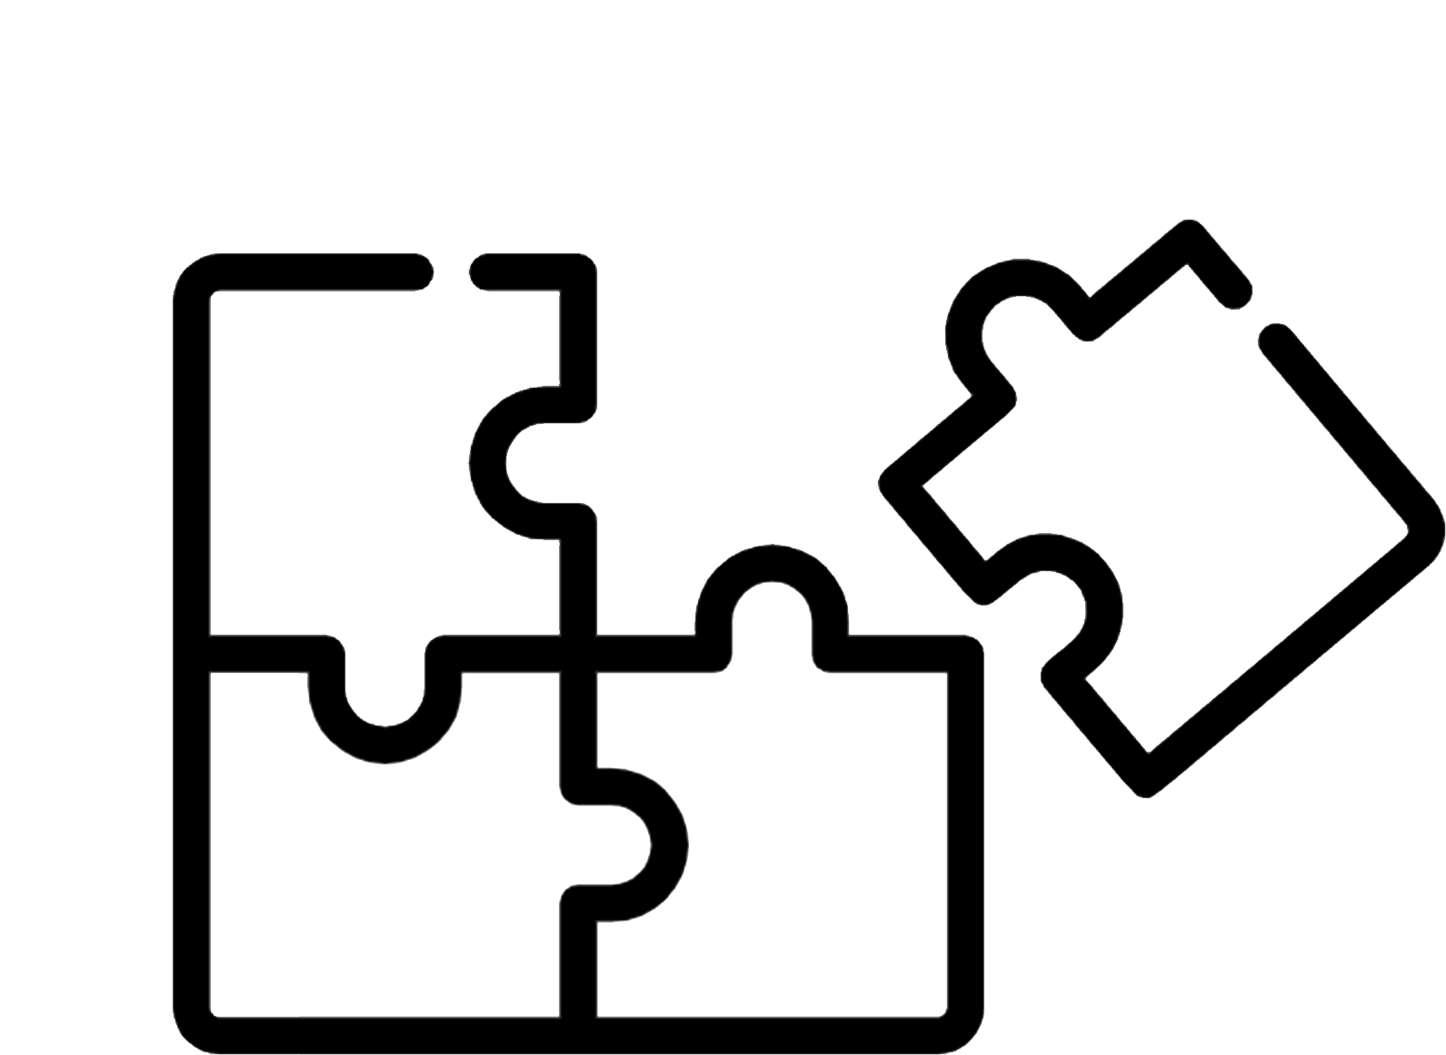
Contribution Points A way to calculate users’ contribution
Factors that affects someone’s contribution (Not including spam):
# of observations: 2 points per photo
# of species: 4 points per different species that you upload
# of people invited: 20 points per invited guest
# of posts or other elements that you shared through other social media platforms: 8 points per share
# of likes obtained: 1 point per like
# of likes sent: 1 point per like
# of comments obtained: 1 point per comment
# of comments sent: 1 point per comment

Slide 4

Points Community & Sections
The point system for communities and sections is on a
5-base scale
The formula to calculate the points of each community and sections are:
Community:
Section:

Slide 5

AI Identification With Amazon Rekognition; Like DeepMask, SharpMask, and MultiPathNet.
When a user takes a photo, the AI identifier will automatically identify what that image was and what species it was. The user can then change the species name if the AI was incorrect.

Slide 6
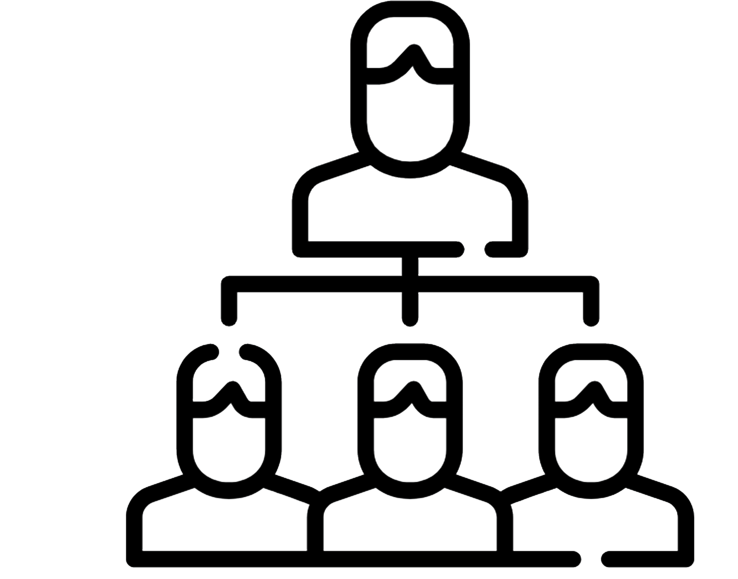
Community Leader System To hide other’s posts & to create forums
Registering()
The community leaders can hide other’s posts because the administrators don’t have time to check every time for inappropriate content, and the community leaders can hide the posts. Then the administrators behind the database can restore or deleted that image.
3 Steps to become a community leader:
- Be in the top 10% of your community
- Have more than 500 contribution points
- They must upload at least 3 photos per week to remain as community leader

Slide 7

Default Positioning Location & Points
When a user takes in a picture in Oakville the first time for example, Oakville will be their default location. If they travel to another city, and they take a photo there, then the locations of their accounts are in Oakville and the other city.

Slide 8

Forums Discussion & Topics
Forums are a way for users to connect with each other and share actions that they did which they would like to share
Forums can only be created by community leaders
People in that community can join the forum if they are in the location
If you are not in the area where the forum is dedicated, then you can only see other’s conversation and you will not be able to comment.

Slide 9

Safety Security & Privacy
Forget password?

Slide 10

Graphing Plotting & Analyzing
Overtime, the database will generate a graph out of the collection of data and will be sent to administrators over a year or more
The data will be sent to environment and animal organizations, and they will analyze the trends of the graph
The graph is easily access through the app itself too
There is a graph of every animal species, and there will be amore generic graph displaying the total # of uploads

Slide 11
End of Presentation

