Slide 1
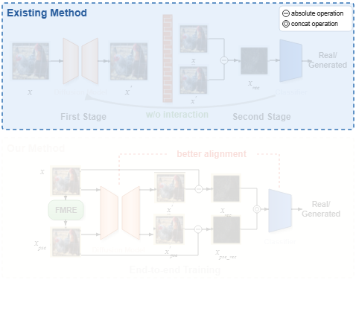
Notes:
Existing reconstruction-based detection methods split the pipeline into two disconnected stages.
[Alpha Masking · CVPR_2025_arch01051 · frame_00.png · 2.00s]

Slide 2
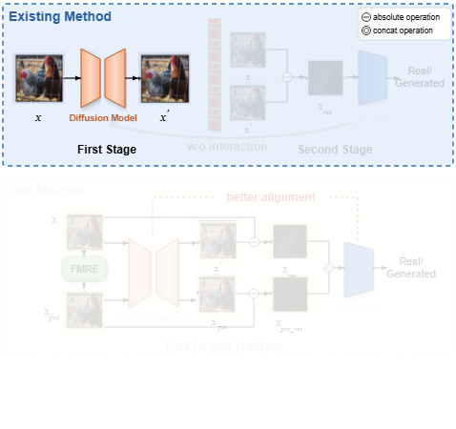
Notes:
In the first stage, an input image is passed through a pre-trained diffusion model to produce a reconstructed image.
[Alpha Masking · CVPR_2025_arch01051 · frame_01.png · 6.00s]

Slide 3
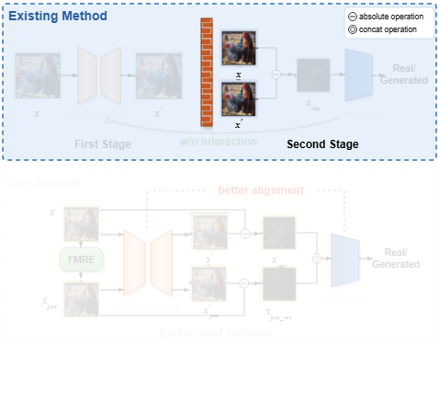
Notes:
A conceptual barrier isolates the two stages, passing frozen representations forward without joint optimization.
[Alpha Masking · CVPR_2025_arch01051 · frame_02.png · 10.00s]

Slide 4
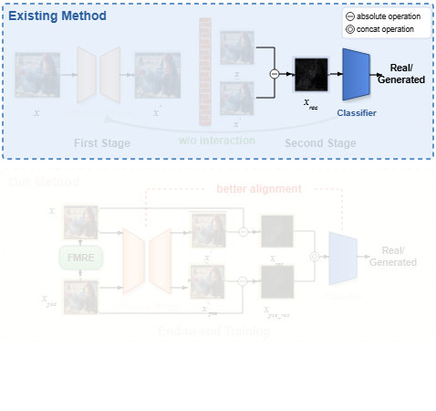
Notes:
The second stage computes the absolute reconstruction error and trains a backend classifier to predict whether the image is real or generated.
[Alpha Masking · CVPR_2025_arch01051 · frame_03.png · 14.00s]

Slide 5
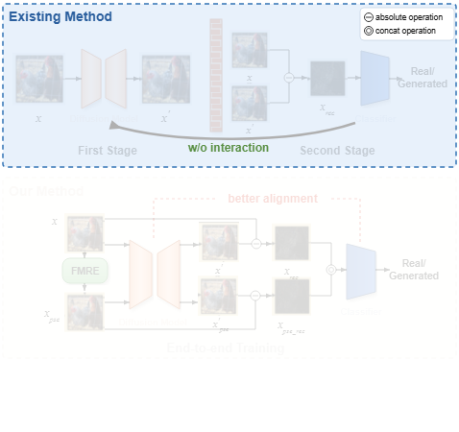
Notes:
Crucially, this existing architecture lacks direct interaction between the diffusion model and the downstream classifier.
[Alpha Masking · CVPR_2025_arch01051 · frame_04.png · 18.00s]

Slide 6
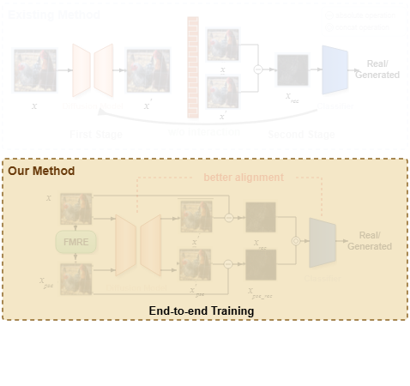
Notes:
In contrast, the proposed framework unifies reconstruction and classification into an end-to-end training pipeline.
[Alpha Masking · CVPR_2025_arch01051 · frame_05.png · 22.00s]

Slide 7
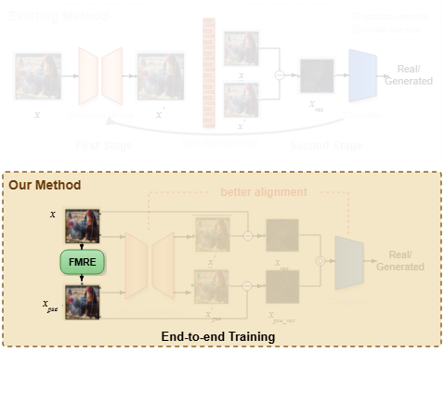
Notes:
The Frequency Mask Refinement module filters out difficult-to-reconstruct mid-band frequencies to produce a pseudo-generated image.
[Alpha Masking · CVPR_2025_arch01051 · frame_06.png · 26.00s]

Slide 8
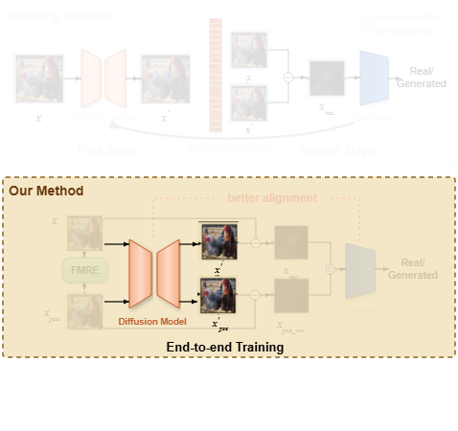
Notes:
Both the original and pseudo-generated images are passed to the diffusion autoencoder for parallel reconstruction.
[Alpha Masking · CVPR_2025_arch01051 · frame_07.png · 30.00s]

Slide 9
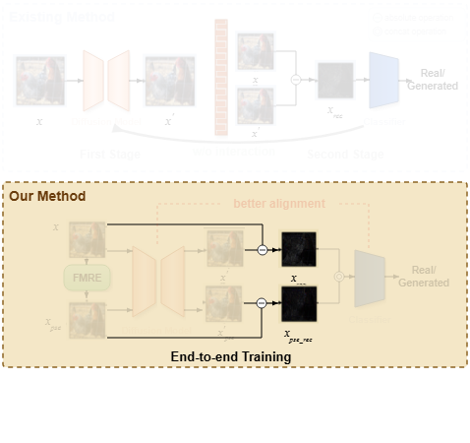
Notes:
Absolute difference operations calculate distinct reconstruction error maps for both the original and pseudo-generated inputs.
[Alpha Masking · CVPR_2025_arch01051 · frame_09.png · 32.00s]

Slide 10
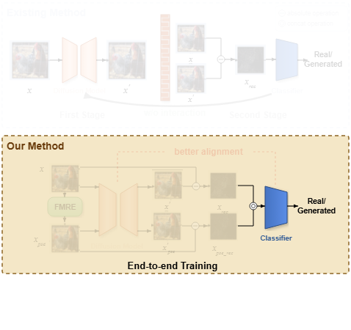
Notes:
These dual reconstruction error maps are concatenated and fed into the classifier to make the final real or generated prediction.
[Alpha Masking · CVPR_2025_arch01051 · frame_10.png · 38.00s]

Slide 11
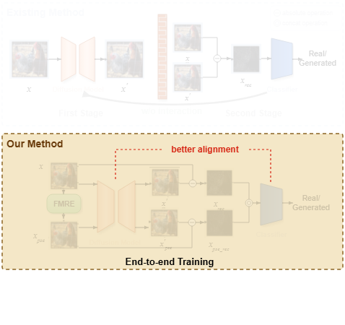
Notes:
This integrated design ensures better alignment between artifact generation and artifact detection across the latent space.
[Alpha Masking · CVPR_2025_arch01051 · frame_11.png · 42.00s]

