Slide 1
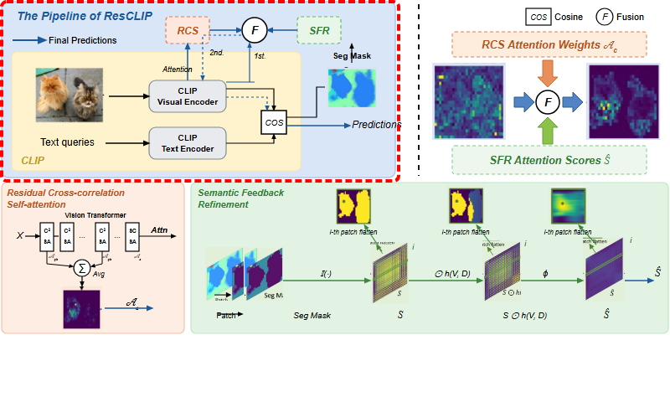
Notes:
The ResCLIP pipeline integrates two core modules to achieve training-free dense vision-language inference.
[Hopping Bbox · CVPR_2025_arch02361 · frame_00.png · 0.50s]

Slide 2
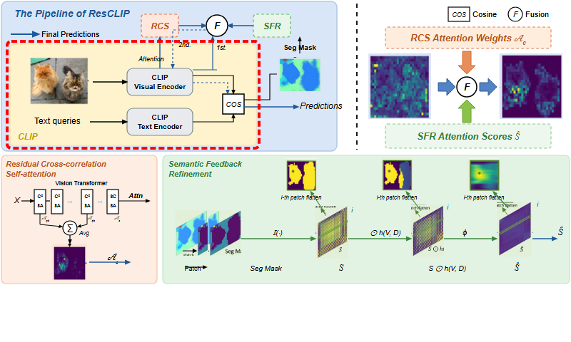
Notes:
It builds upon the foundational vision-language architecture of CLIP.
[Hopping Bbox · CVPR_2025_arch02361 · frame_01.png · 1.50s]

Slide 3
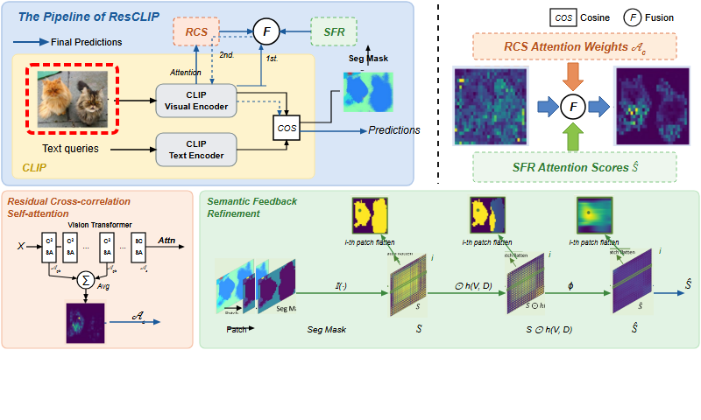
Notes:
An input image is partitioned into patches and fed to the visual pipeline.
[Hopping Bbox · CVPR_2025_arch02361 · frame_02.png · 2.50s]

Slide 4
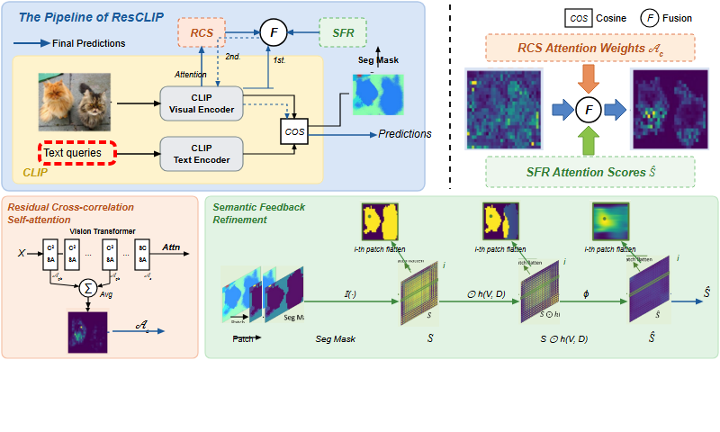
Notes:
Concurrently, text queries corresponding to target semantic categories are supplied.
[Hopping Bbox · CVPR_2025_arch02361 · frame_03.png · 3.50s]

Slide 5
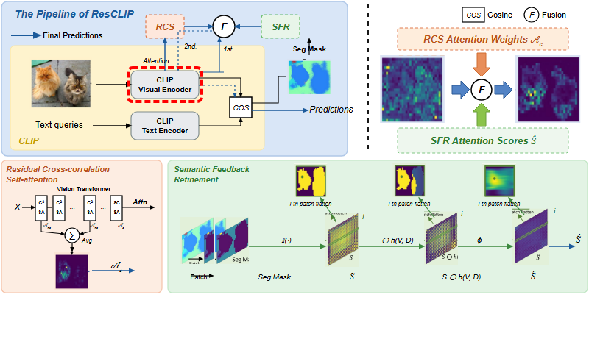
Notes:
The CLIP Visual Encoder extracts visual feature representations across multi-head self-attention layers.
[Hopping Bbox · CVPR_2025_arch02361 · frame_04.png · 4.50s]

Slide 6
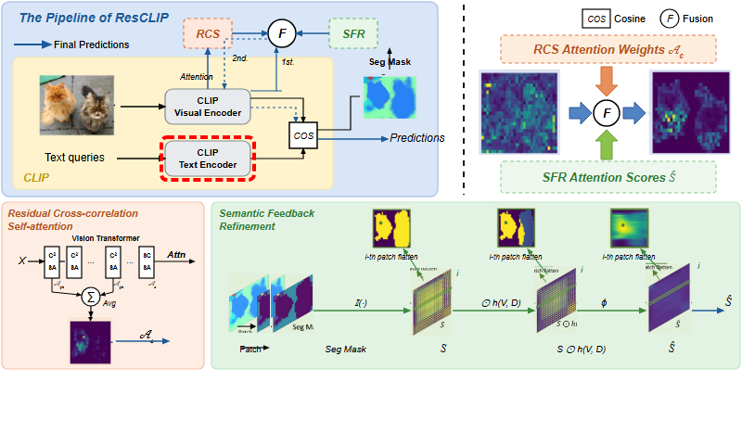
Notes:
The CLIP Text Encoder computes text embeddings to align with visual tokens.
[Hopping Bbox · CVPR_2025_arch02361 · frame_05.png · 5.50s]

Slide 7
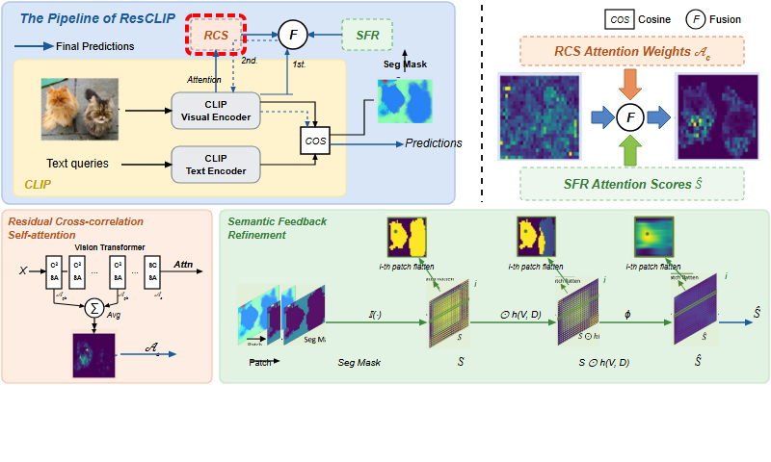
Notes:
The Residual Cross-correlation Self-attention module extracts attention across intermediate encoder layers.
[Hopping Bbox · CVPR_2025_arch02361 · frame_06.png · 6.50s]

Slide 8

Notes:
In parallel, the Semantic Feedback Refinement module refines attention based on category regions.
[Hopping Bbox · CVPR_2025_arch02361 · frame_07.png · 7.50s]

Slide 9
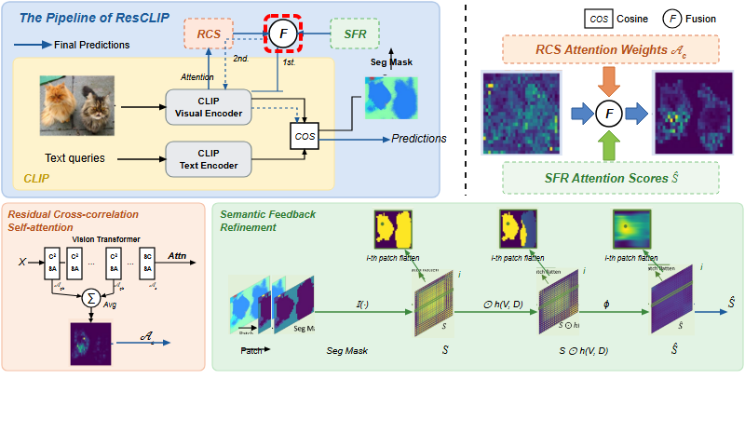
Notes:
Both attention components are fused to remodel the attention in the final layer.
[Hopping Bbox · CVPR_2025_arch02361 · frame_08.png · 8.50s]

Slide 10
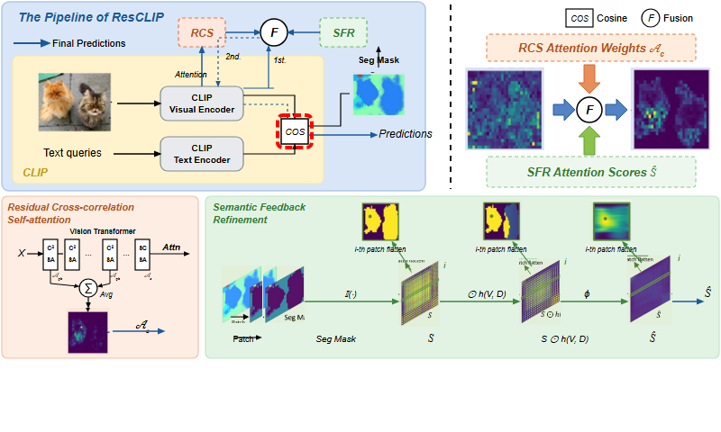
Notes:
Cosine similarity measures the alignment between dense visual tokens and text representations.
[Hopping Bbox · CVPR_2025_arch02361 · frame_09.png · 9.50s]

Slide 11
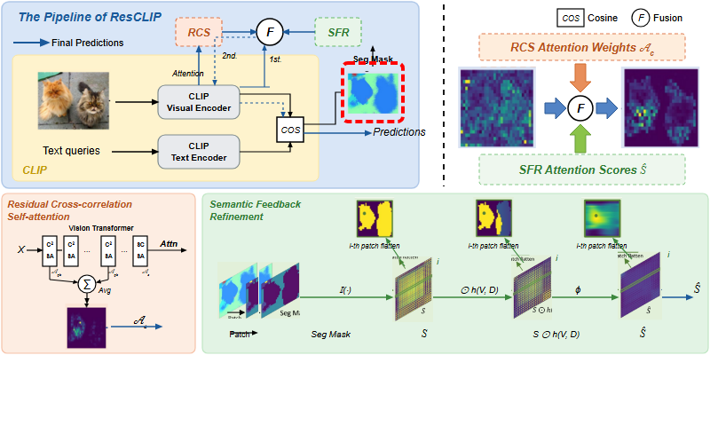
Notes:
An initial segmentation mask is derived and fed back to guide the semantic refinement module.
[Hopping Bbox · CVPR_2025_arch02361 · frame_10.png · 10.50s]

Slide 12

Notes:
After iterative refinement, the system generates the final dense semantic segmentation predictions.
[Hopping Bbox · CVPR_2025_arch02361 · frame_11.png · 11.50s]

Slide 13
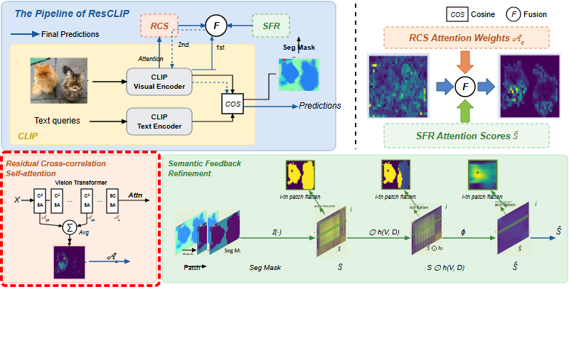
Notes:
Looking into the Residual Cross-correlation Self-attention module in detail,
[Hopping Bbox · CVPR_2025_arch02361 · frame_12.png · 12.50s]

Slide 14
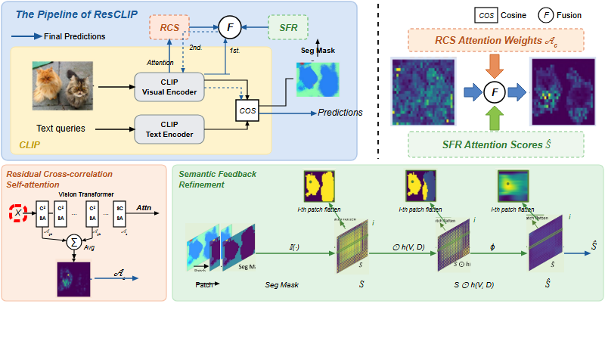
Notes:
visual tokens pass through successive transformer layers.
[Hopping Bbox · CVPR_2025_arch02361 · frame_13.png · 13.50s]

Slide 15

Notes:
Cross-correlation self-attention is computed at early intermediate layers,
[Hopping Bbox · CVPR_2025_arch02361 · frame_14.png · 14.50s]

Slide 16

Notes:
as well as mid-level layers,
[Hopping Bbox · CVPR_2025_arch02361 · frame_15.png · 15.50s]

Slide 17
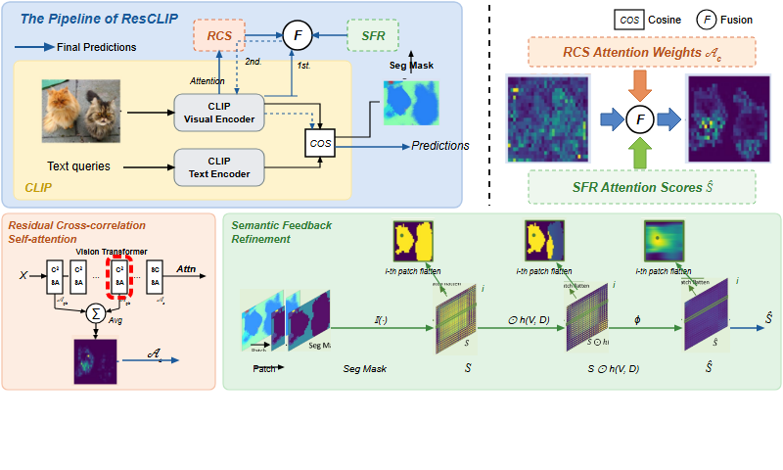
Notes:
and deeper non-final layers, capturing rich spatial and cross-feature correspondence.
[Hopping Bbox · CVPR_2025_arch02361 · frame_16.png · 16.50s]

Slide 18

Notes:
The final block utilizes self-correlation self-attention to preserve spatial covariance.
[Hopping Bbox · CVPR_2025_arch02361 · frame_18.png · 17.50s]

Slide 19

Notes:
The cross-correlation attention maps from these non-last layers are averaged,
[Hopping Bbox · CVPR_2025_arch02361 · frame_19.png · 19.50s]

Slide 20
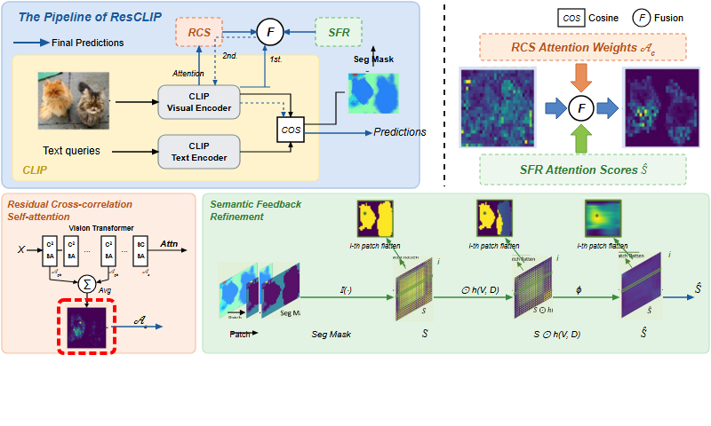
Notes:
forming a clear, localized spatial activation map.
[Hopping Bbox · CVPR_2025_arch02361 · frame_20.png · 20.50s]

Slide 21

Notes:
This aggregated attention matrix is output as the RCS attention representation.
[Hopping Bbox · CVPR_2025_arch02361 · frame_21.png · 21.50s]

Slide 22
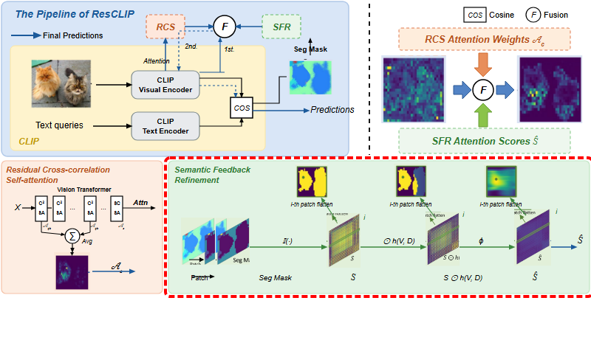
Notes:
Next, the Semantic Feedback Refinement module optimizes the attention using category masks.
[Hopping Bbox · CVPR_2025_arch02361 · frame_22.png · 22.50s]

Slide 23

Notes:
It takes the initial continuous segmentation map,
[Hopping Bbox · CVPR_2025_arch02361 · frame_23.png · 23.50s]

Slide 24

Notes:
and converts it into patch-level category assignments.
[Hopping Bbox · CVPR_2025_arch02361 · frame_24.png · 24.50s]

Slide 25
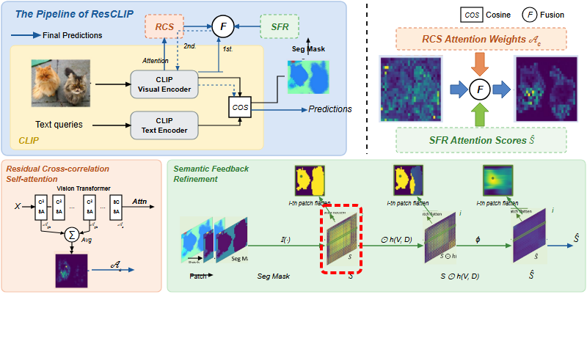
Notes:
An indicator function constructs a binary semantic co-occurrence matrix.
[Hopping Bbox · CVPR_2025_arch02361 · frame_25.png · 25.50s]

Slide 26
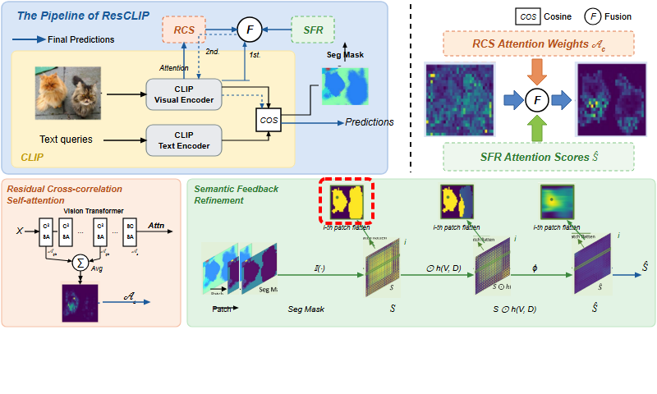
Notes:
For any given patch, matching categories across the image are highlighted.
[Hopping Bbox · CVPR_2025_arch02361 · frame_26.png · 26.50s]

Slide 27
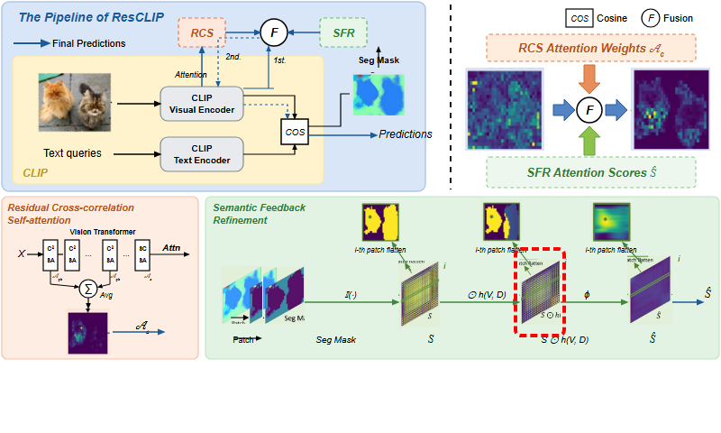
Notes:
A spatial distance-based decay function is applied to prioritize connected local regions,
[Hopping Bbox · CVPR_2025_arch02361 · frame_27.png · 27.50s]

Slide 28

Notes:
reducing the influence of disjoint regions of the same class.
[Hopping Bbox · CVPR_2025_arch02361 · frame_28.png · 28.50s]

Slide 29

Notes:
A Gaussian smoothing kernel is then applied across the rows,
[Hopping Bbox · CVPR_2025_arch02361 · frame_29.png · 29.50s]

Slide 30
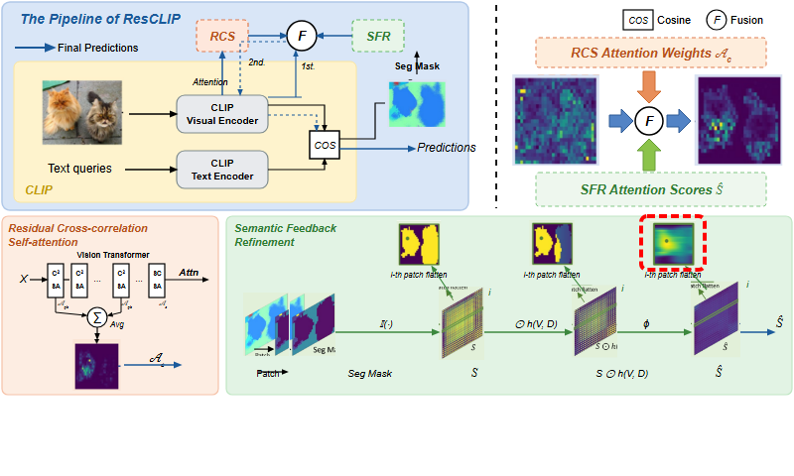
Notes:
yielding a smoothly distributed attention map for each patch.
[Hopping Bbox · CVPR_2025_arch02361 · frame_30.png · 30.50s]

Slide 31

Notes:
This yields the final refined SFR attention scores.
[Hopping Bbox · CVPR_2025_arch02361 · frame_31.png · 31.50s]

Slide 32

Notes:
Finally, the fusion stage combines the attention components.
[Hopping Bbox · CVPR_2025_arch02361 · frame_32.png · 32.50s]

Slide 33

Notes:
The RCS attention weights provide cross-feature spatial context.
[Hopping Bbox · CVPR_2025_arch02361 · frame_33.png · 33.50s]

Slide 34
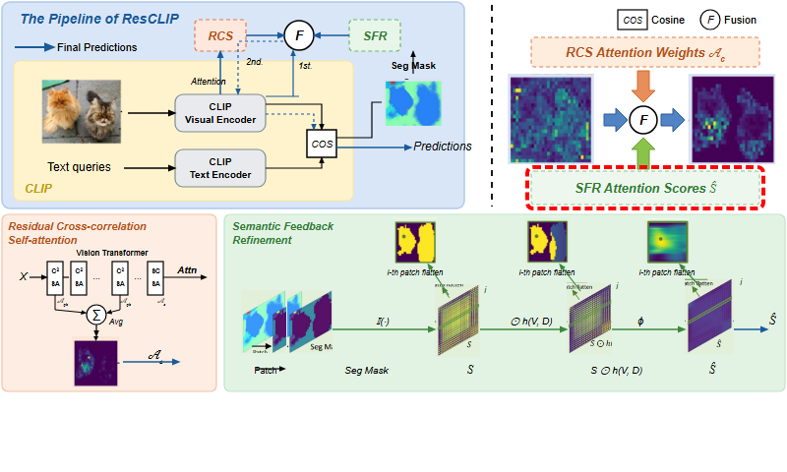
Notes:
The SFR attention scores reinforce local semantic consistency.
[Hopping Bbox · CVPR_2025_arch02361 · frame_34.png · 34.50s]

Slide 35

Notes:
The noisy, diffuse attention of standard CLIP,
[Hopping Bbox · CVPR_2025_arch02361 · frame_35.png · 35.50s]

Slide 36

Notes:
is transformed through weighted attention fusion,
[Hopping Bbox · CVPR_2025_arch02361 · frame_36.png · 36.50s]

Slide 37
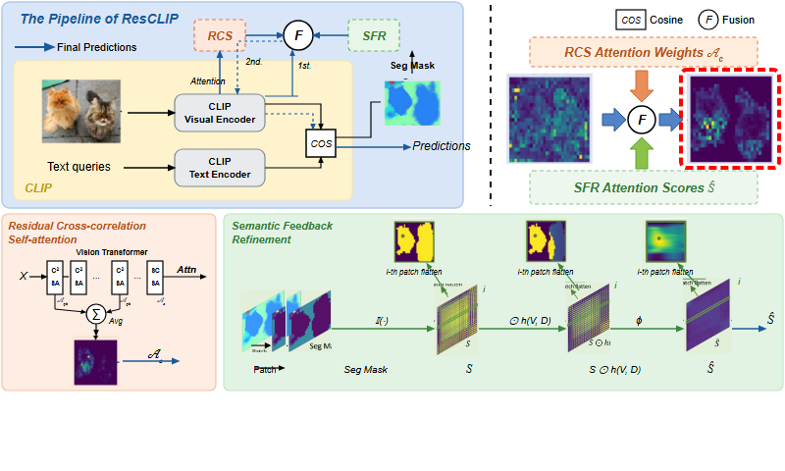
Notes:
producing a sharp, object-centric attention map for accurate training-free dense inference.
[Hopping Bbox · CVPR_2025_arch02361 · frame_37.png · 37.50s]

