Slide 1
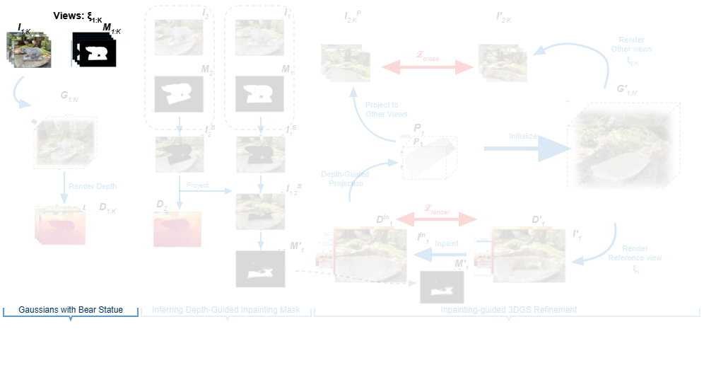
Notes:
The pipeline begins in the first section with multiple camera views and their corresponding foreground object masks.
[Alpha Masking · CVPR_2025_pipe00004 · frame_00.png · 1.00s]

Slide 2
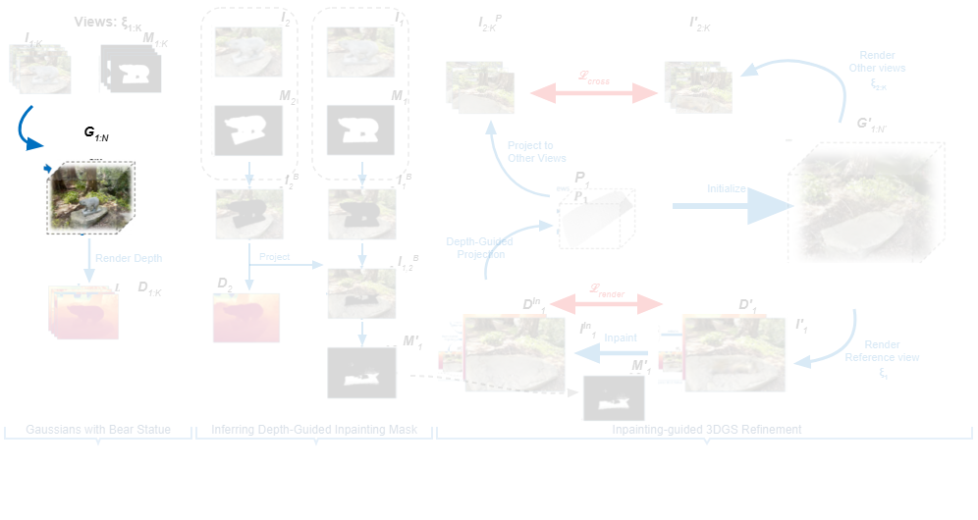
Notes:
These inputs are used to construct an initial set of three-dimensional Gaussians containing the statue.
[Alpha Masking · CVPR_2025_pipe00004 · frame_01.png · 3.00s]

Slide 3
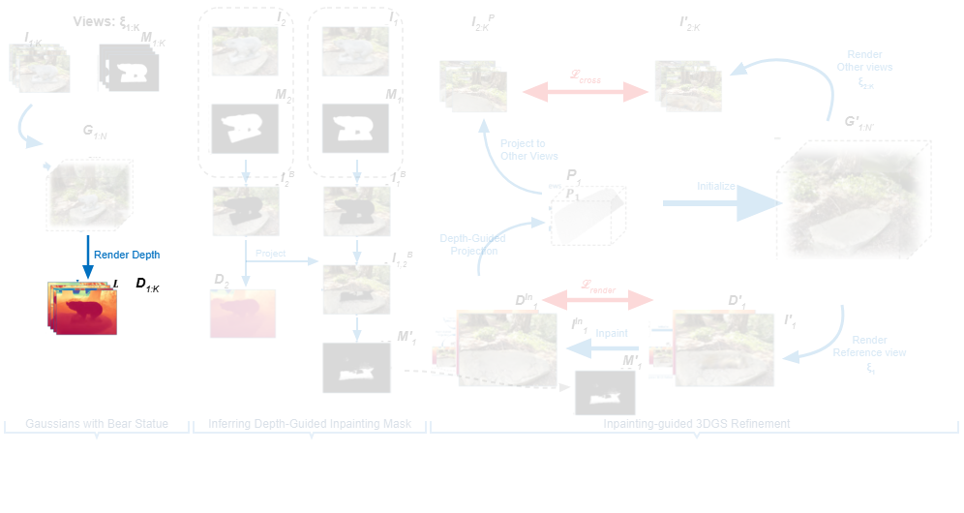
Notes:
Depth maps are then rendered across the set of camera viewpoints.
[Alpha Masking · CVPR_2025_pipe00004 · frame_02.png · 5.00s]

Slide 4
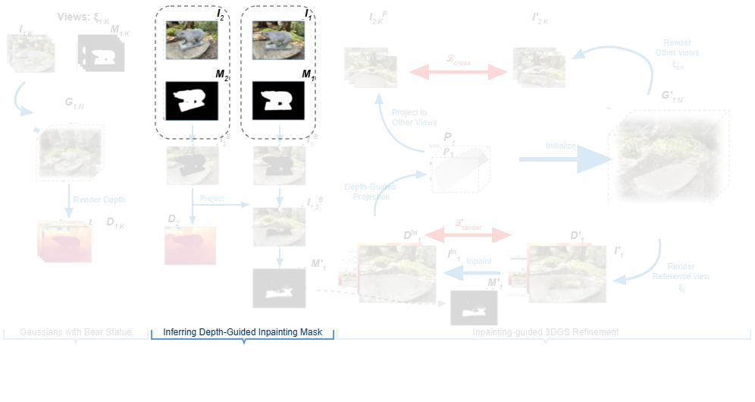
Notes:
Entering the depth-guided mask inference stage, reference and secondary views are paired with their respective masks.
[Alpha Masking · CVPR_2025_pipe00004 · frame_03.png · 7.00s]

Slide 5
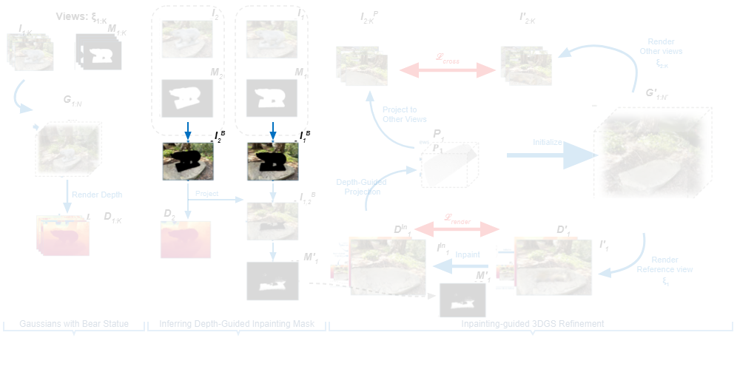
Notes:
Applying these masks isolates the visible background regions for both viewpoints.
[Alpha Masking · CVPR_2025_pipe00004 · frame_04.png · 9.00s]

Slide 6
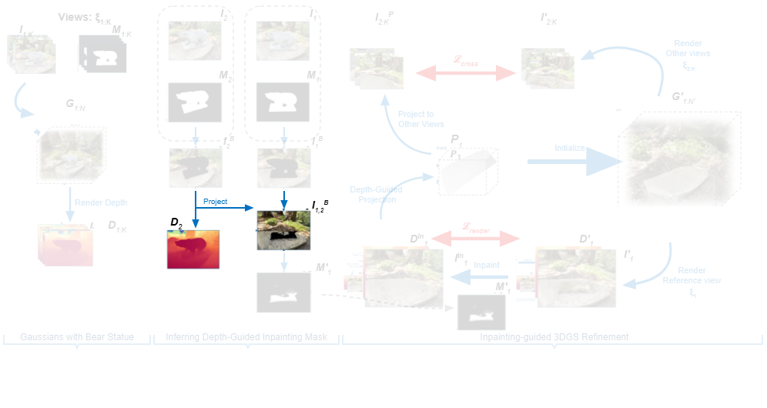
Notes:
Using depth from the second view, background content is projected onto the reference view.
[Alpha Masking · CVPR_2025_pipe00004 · frame_05.png · 11.00s]

Slide 7
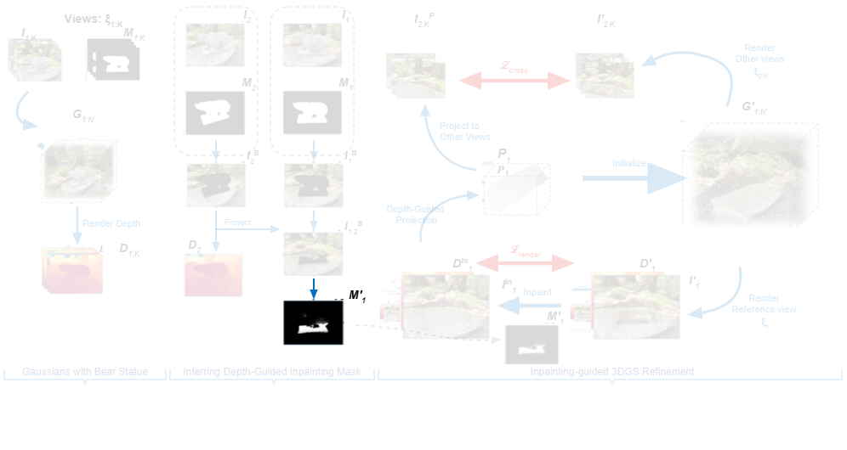
Notes:
This determines the final depth-guided inpainting mask for the reference view.
[Alpha Masking · CVPR_2025_pipe00004 · frame_06.png · 13.00s]

Slide 8
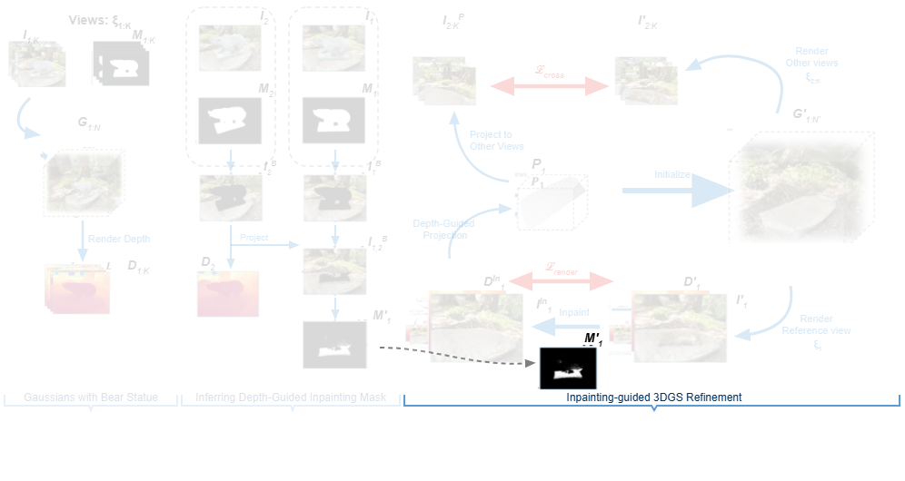
Notes:
The mask is transferred into the final inpainting-guided refinement stage.
[Alpha Masking · CVPR_2025_pipe00004 · frame_07.png · 15.00s]

Slide 9
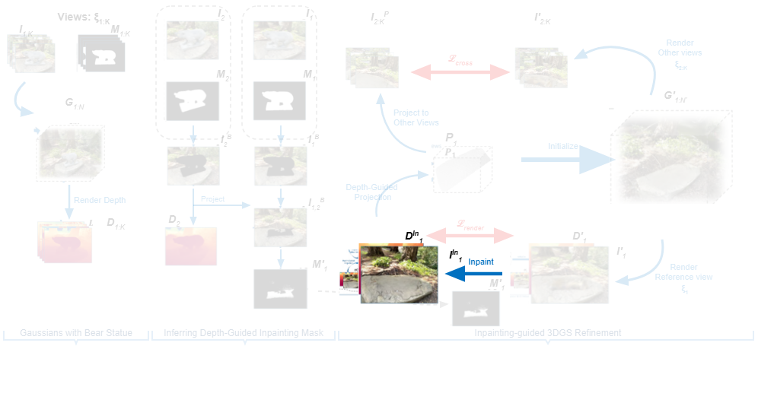
Notes:
Inpainting is performed on the reference view to synthesize missing background color and depth.
[Alpha Masking · CVPR_2025_pipe00004 · frame_08.png · 17.00s]

Slide 10
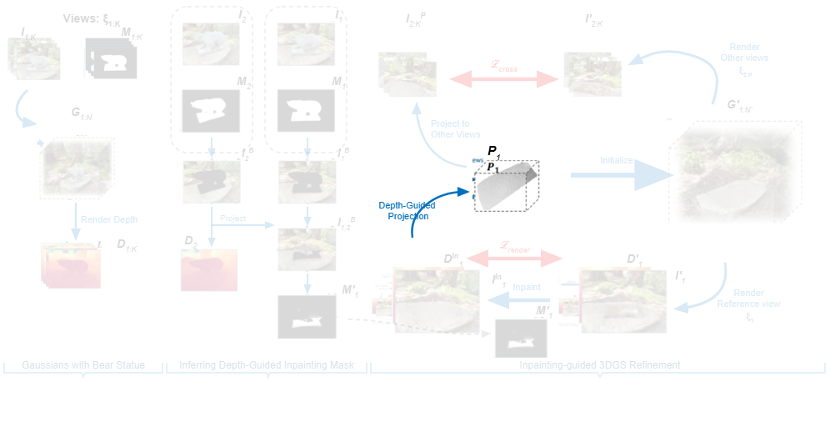
Notes:
Depth-guided projection then lifts the inpainted reference view into a three-dimensional surface structure.
[Alpha Masking · CVPR_2025_pipe00004 · frame_09.png · 19.00s]

Slide 11
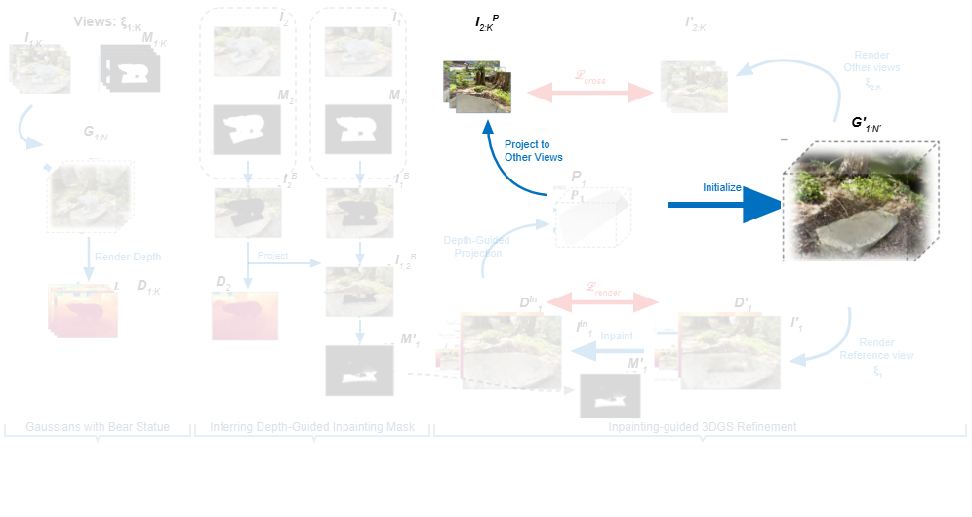
Notes:
This structure initializes the refined Gaussians while projecting background information onto the remaining viewpoints.
[Alpha Masking · CVPR_2025_pipe00004 · frame_10.png · 21.00s]

Slide 12
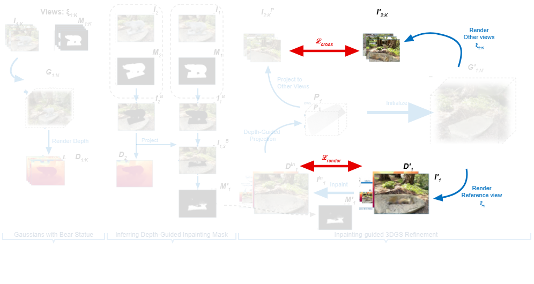
Notes:
Finally, render loss on the reference view and cross-view loss on other rendered views supervise the refined scene.
[Alpha Masking · CVPR_2025_pipe00004 · frame_11.png · 23.00s]

