Slide 1
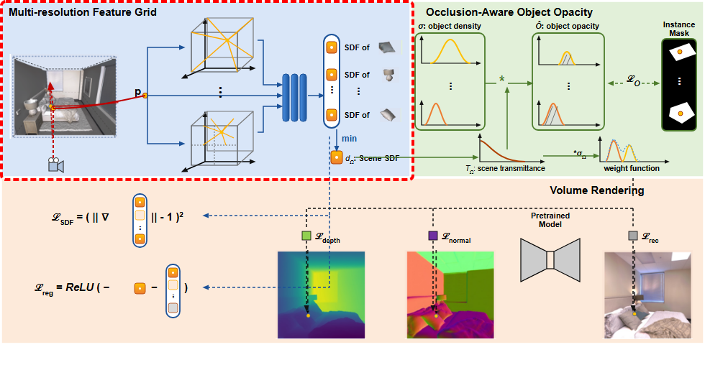
Notes:
The pipeline begins with the multi-resolution feature grid module.
[Hopping Bbox · ICCV_2023_set5_000059 · frame_00.png · 0.75s]

Slide 2
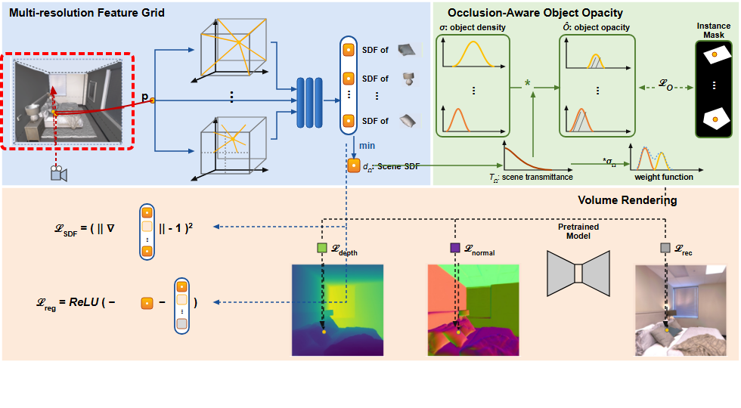
Notes:
A 3D indoor scene is modeled compositionally from multi-view inputs.
[Hopping Bbox · ICCV_2023_set5_000059 · frame_01.png · 2.25s]

Slide 3
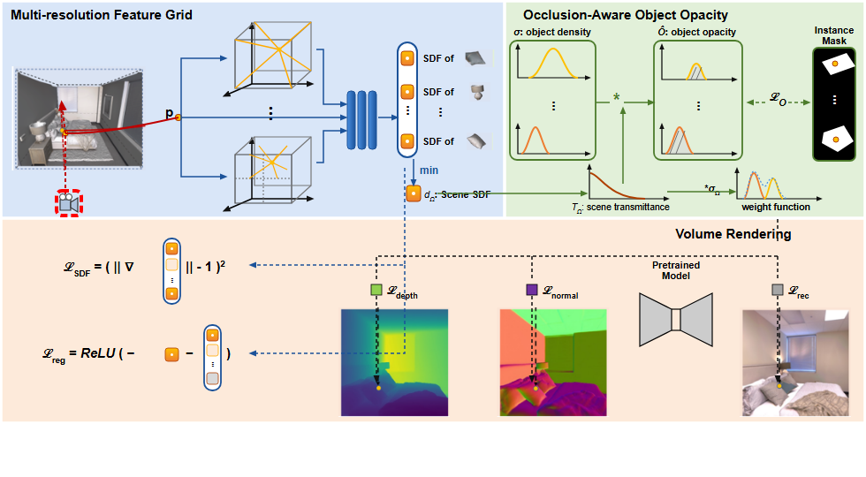
Notes:
A camera casts viewing rays into the 3D space.
[Hopping Bbox · ICCV_2023_set5_000059 · frame_02.png · 3.75s]

Slide 4

Notes:
Along each ray, multiple 3D spatial points are sampled.
[Hopping Bbox · ICCV_2023_set5_000059 · frame_03.png · 5.25s]

Slide 5

Notes:
For each queried point coordinate,
[Hopping Bbox · ICCV_2023_set5_000059 · frame_04.png · 6.75s]

Slide 6
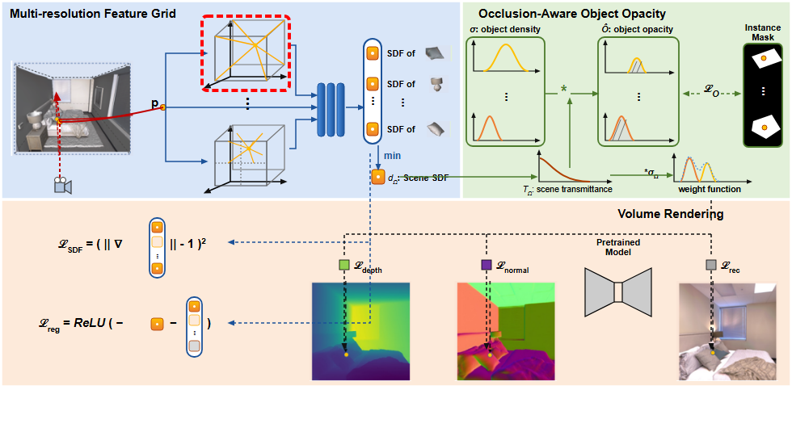
Notes:
features are queried across multiple grid resolutions, from coarse levels,
[Hopping Bbox · ICCV_2023_set5_000059 · frame_05.png · 8.25s]

Slide 7
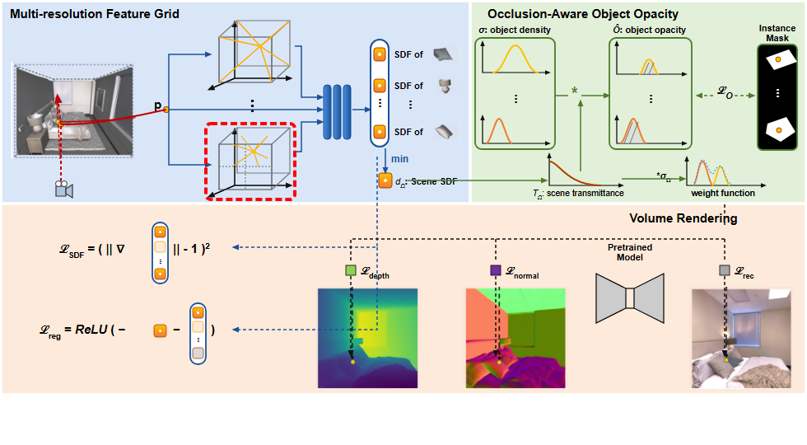
Notes:
down to finer levels using spatial hash tables.
[Hopping Bbox · ICCV_2023_set5_000059 · frame_06.png · 9.75s]

Slide 8
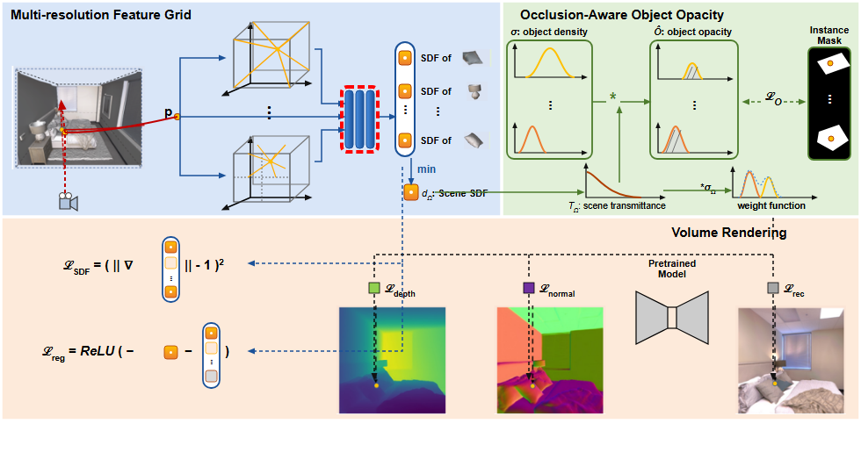
Notes:
These interpolated features are concatenated and fed into a lightweight neural network.
[Hopping Bbox · ICCV_2023_set5_000059 · frame_07.png · 11.25s]

Slide 9
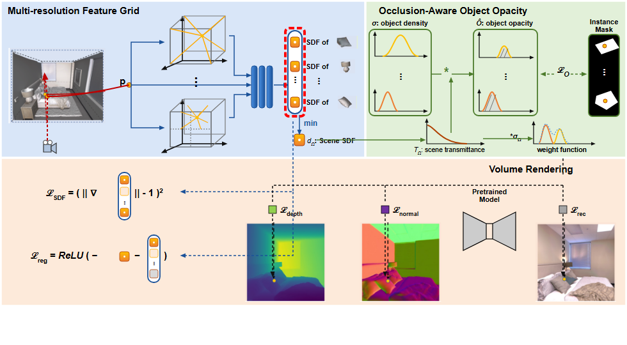
Notes:
The network outputs a vector containing signed distance function values for each individual object.
[Hopping Bbox · ICCV_2023_set5_000059 · frame_08.png · 12.75s]

Slide 10
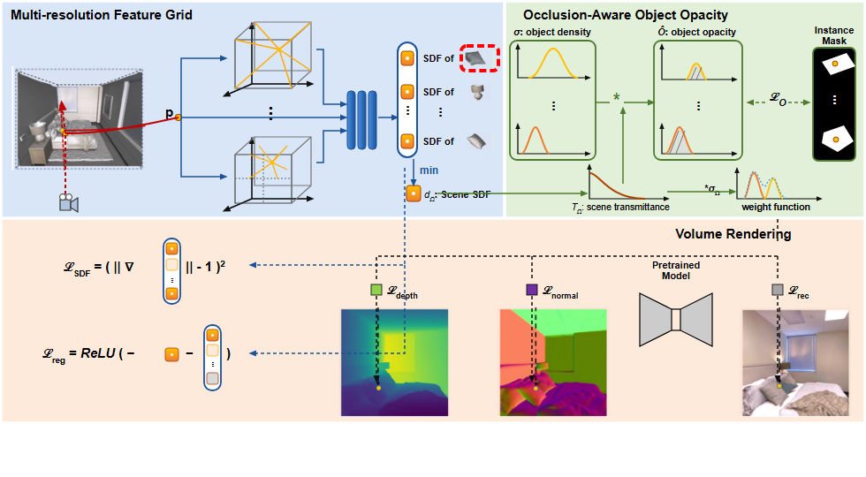
Notes:
These encompass specific instance geometries, such as pillows,
[Hopping Bbox · ICCV_2023_set5_000059 · frame_09.png · 14.25s]

Slide 11
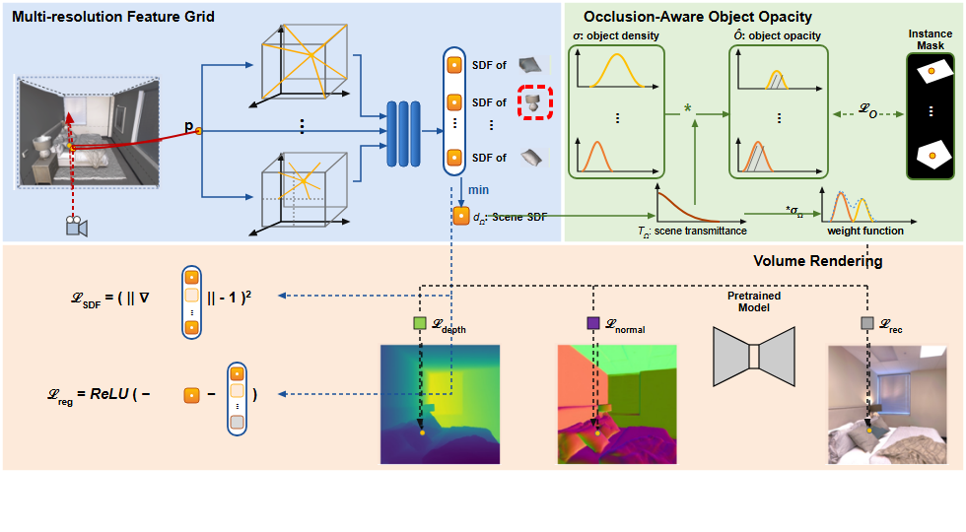
Notes:
lamps,
[Hopping Bbox · ICCV_2023_set5_000059 · frame_10.png · 15.75s]

Slide 12
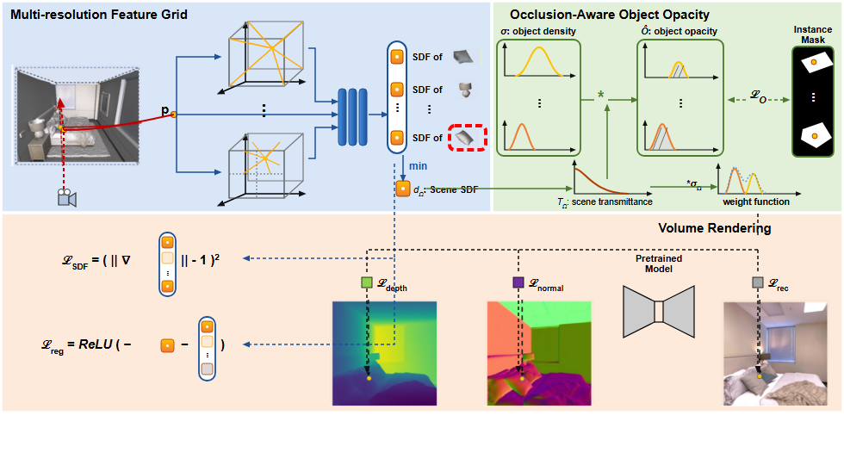
Notes:
and other segmented items in the scene.
[Hopping Bbox · ICCV_2023_set5_000059 · frame_11.png · 17.25s]

Slide 13

Notes:
A minimum operation is applied across all object distance predictions,
[Hopping Bbox · ICCV_2023_set5_000059 · frame_12.png · 18.75s]

Slide 14
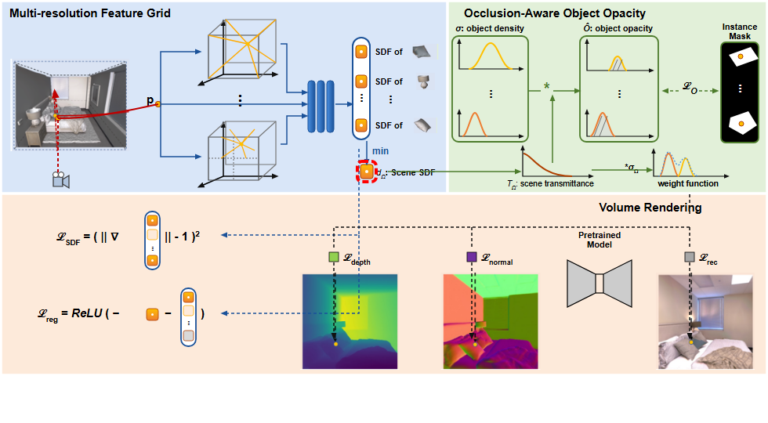
Notes:
extracting the global scene signed distance value,
[Hopping Bbox · ICCV_2023_set5_000059 · frame_13.png · 20.25s]

Slide 15

Notes:
denoted as the overall scene SDF.
[Hopping Bbox · ICCV_2023_set5_000059 · frame_14.png · 21.75s]

Slide 16
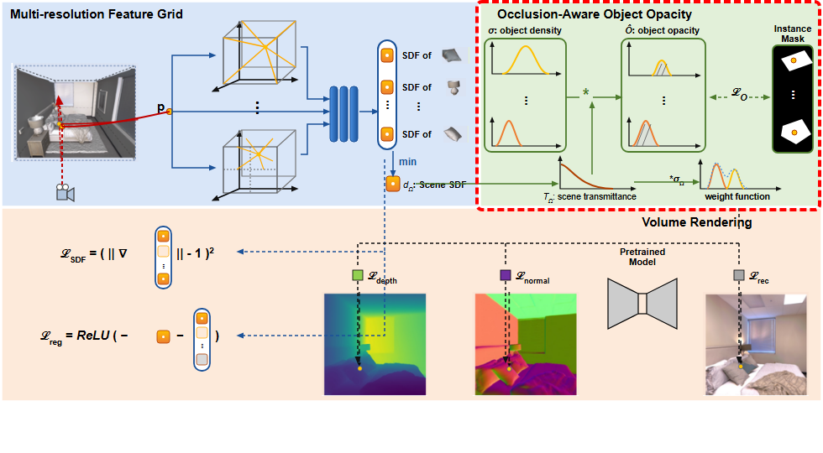
Notes:
Next, the occlusion-aware object opacity module calculates individual object opacities.
[Hopping Bbox · ICCV_2023_set5_000059 · frame_15.png · 23.25s]

Slide 17
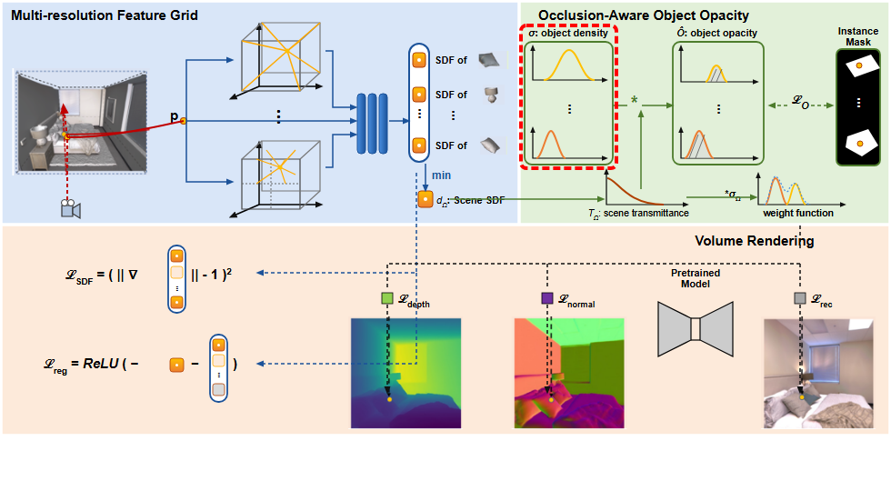
Notes:
Object SDFs are first converted into individual object density distributions.
[Hopping Bbox · ICCV_2023_set5_000059 · frame_16.png · 24.75s]

Slide 18

Notes:
Concurrently, the global scene transmittance is computed along the ray,
[Hopping Bbox · ICCV_2023_set5_000059 · frame_17.png · 26.25s]

Slide 19
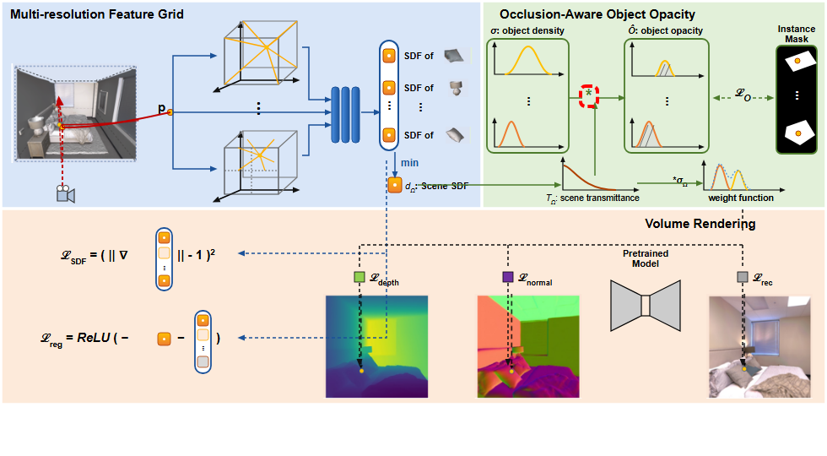
Notes:
and multiplied by each object's density.
[Hopping Bbox · ICCV_2023_set5_000059 · frame_18.png · 27.75s]

Slide 20
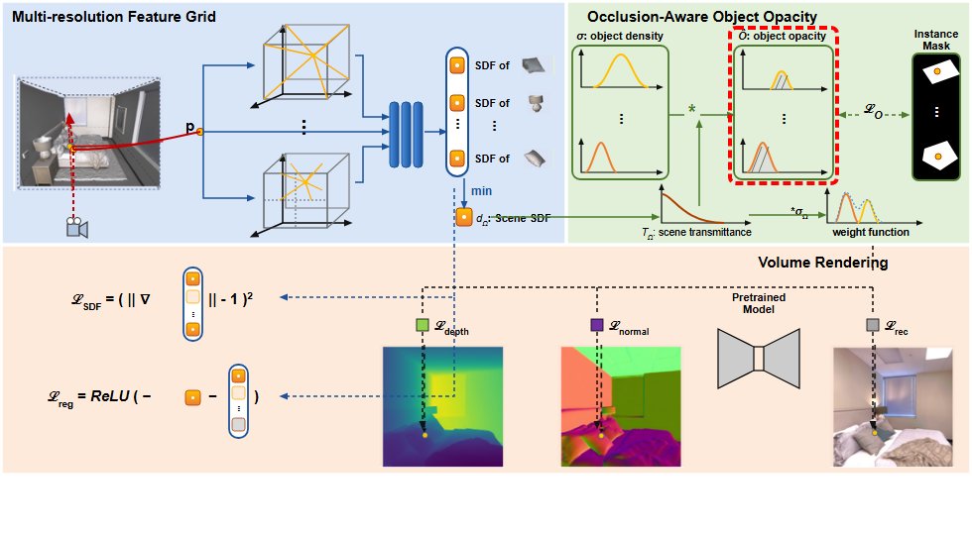
Notes:
This produces occlusion-aware object opacities that account for frontal blocking.
[Hopping Bbox · ICCV_2023_set5_000059 · frame_19.png · 29.25s]

Slide 21

Notes:
The composite weight function governs the overall volume rendering contribution.
[Hopping Bbox · ICCV_2023_set5_000059 · frame_20.png · 30.75s]

Slide 22

Notes:
An object opacity loss is evaluated,
[Hopping Bbox · ICCV_2023_set5_000059 · frame_21.png · 32.25s]

Slide 23
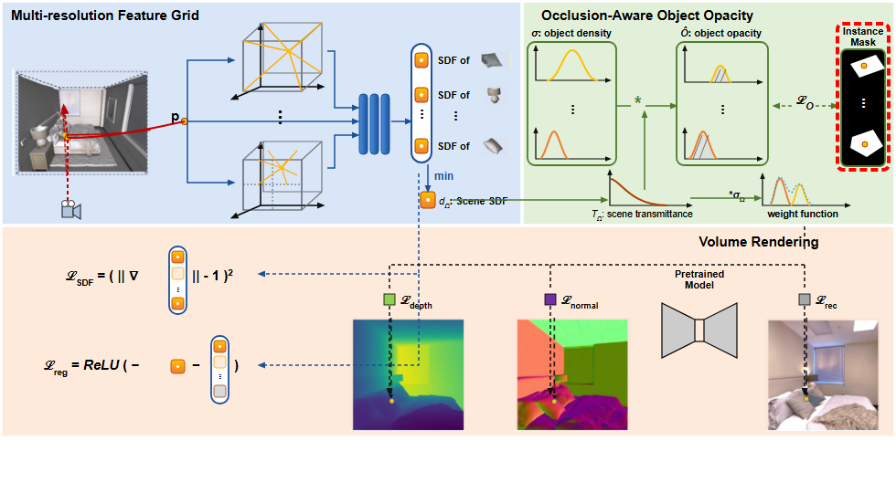
Notes:
supervising the rendered object opacities directly against 2D instance segmentation masks.
[Hopping Bbox · ICCV_2023_set5_000059 · frame_22.png · 33.75s]

Slide 24

Notes:
Finally, several regularization and multi-modal rendering losses are optimized.
[Hopping Bbox · ICCV_2023_set5_000059 · frame_23.png · 35.25s]

Slide 25
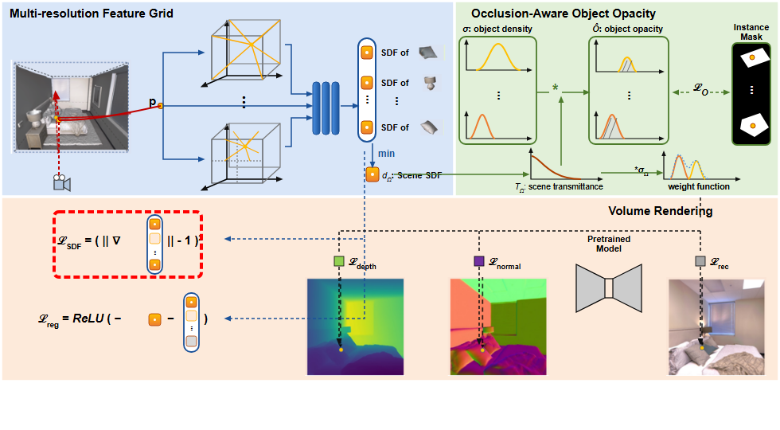
Notes:
An Eikonal loss enforces valid distance field gradients across the scene.
[Hopping Bbox · ICCV_2023_set5_000059 · frame_24.png · 36.75s]

Slide 26
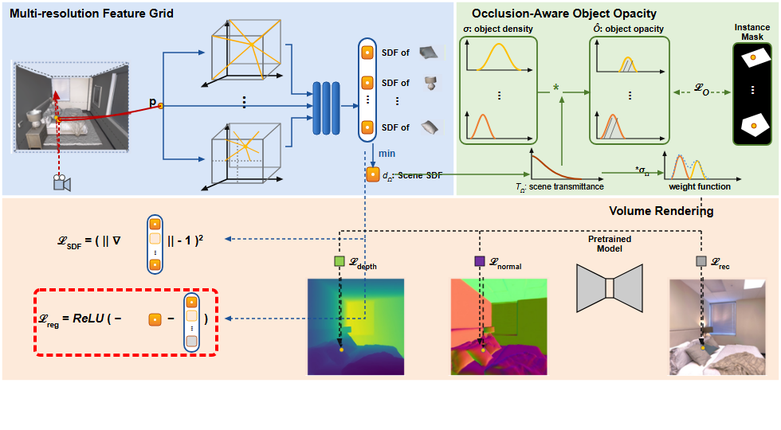
Notes:
An object distinction regularization loss prevents internal collision and overlap between separate instances.
[Hopping Bbox · ICCV_2023_set5_000059 · frame_25.png · 38.25s]

Slide 27
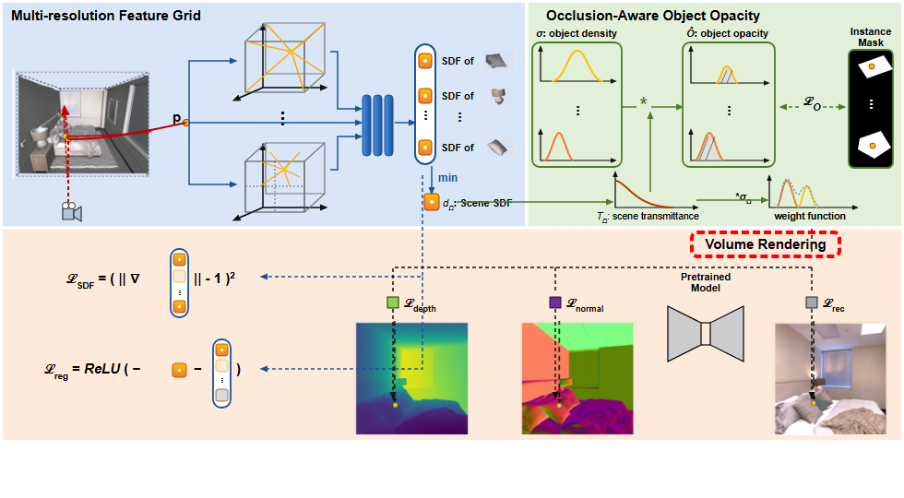
Notes:
Volume rendering synthesizes geometric cues and appearance.
[Hopping Bbox · ICCV_2023_set5_000059 · frame_26.png · 39.75s]

Slide 28
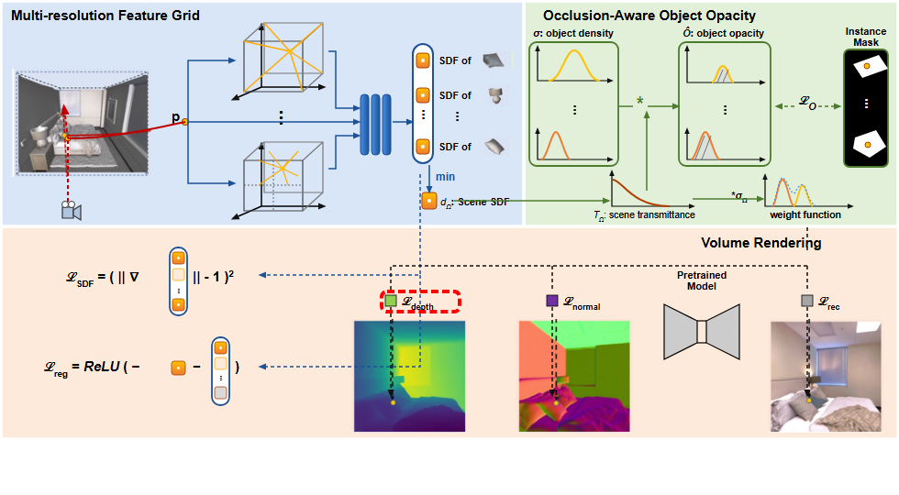
Notes:
A scale-invariant depth loss,
[Hopping Bbox · ICCV_2023_set5_000059 · frame_27.png · 41.25s]

Slide 29

Notes:
supervises rendered depth maps.
[Hopping Bbox · ICCV_2023_set5_000059 · frame_28.png · 42.75s]

Slide 30
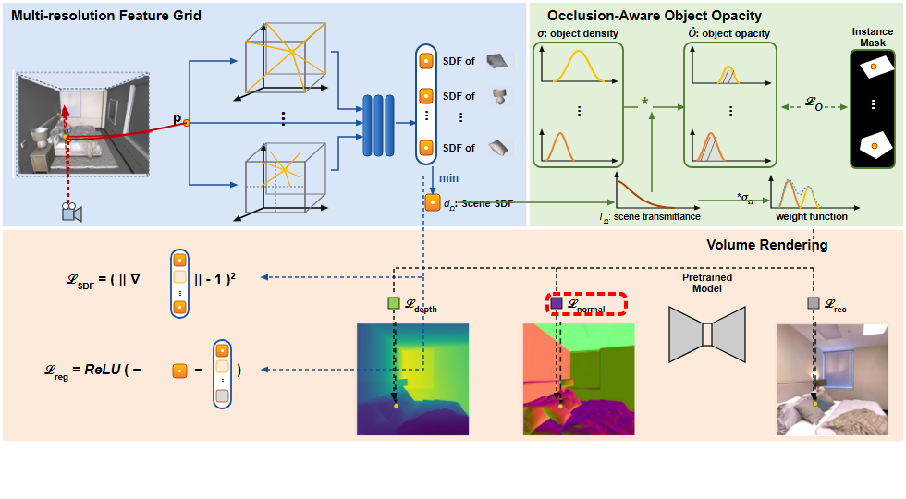
Notes:
A surface normal loss,
[Hopping Bbox · ICCV_2023_set5_000059 · frame_29.png · 44.25s]

Slide 31
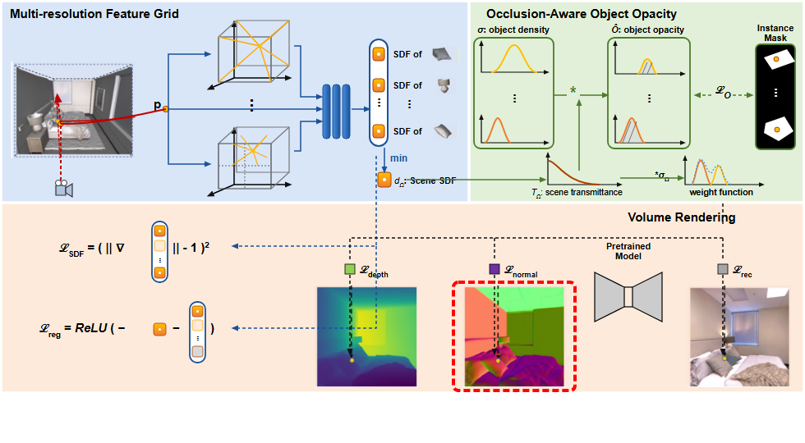
Notes:
aligns predicted surface normals with pseudo-ground-truth,
[Hopping Bbox · ICCV_2023_set5_000059 · frame_30.png · 45.75s]

Slide 32
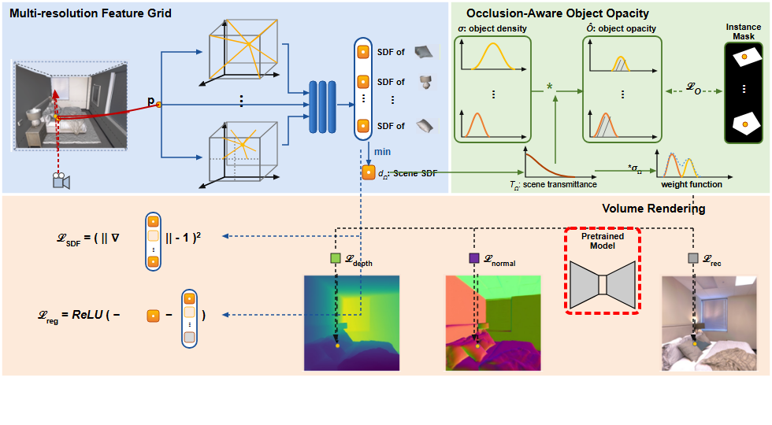
Notes:
derived from a pre-trained monocular estimation network.
[Hopping Bbox · ICCV_2023_set5_000059 · frame_31.png · 47.25s]

Slide 33
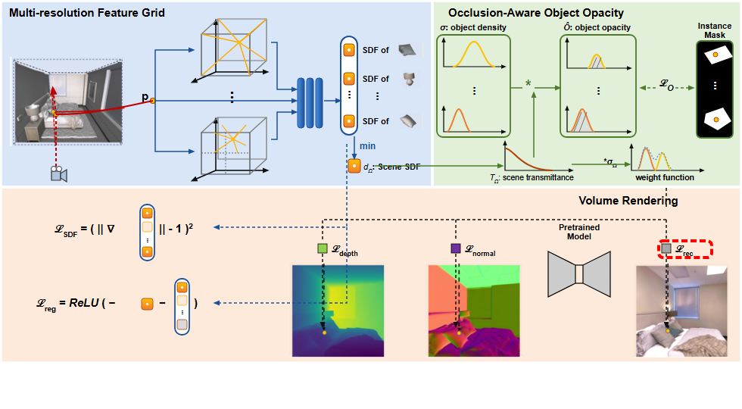
Notes:
Lastly, an RGB reconstruction loss,
[Hopping Bbox · ICCV_2023_set5_000059 · frame_32.png · 48.75s]

Slide 34
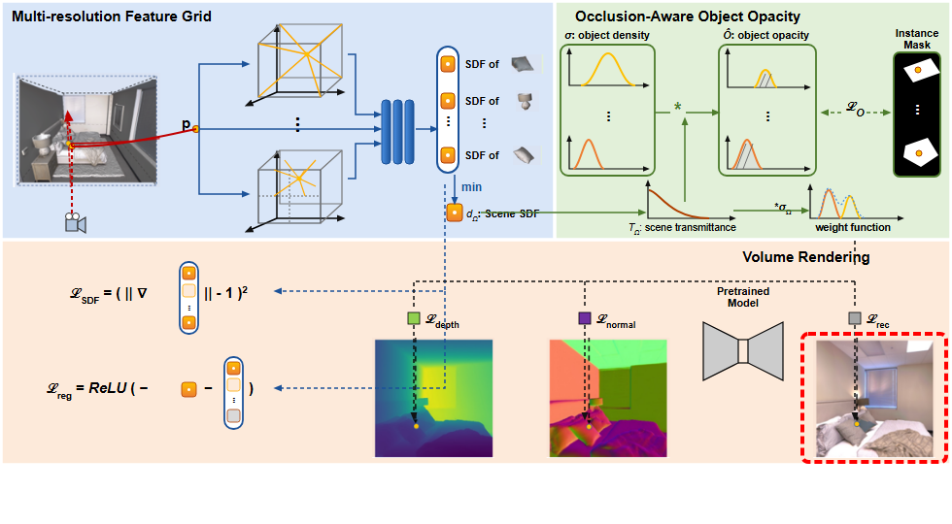
Notes:
ensures photorealistic rendering against ground truth captured images.
[Hopping Bbox · ICCV_2023_set5_000059 · frame_33.png · 50.25s]

