Slide 1
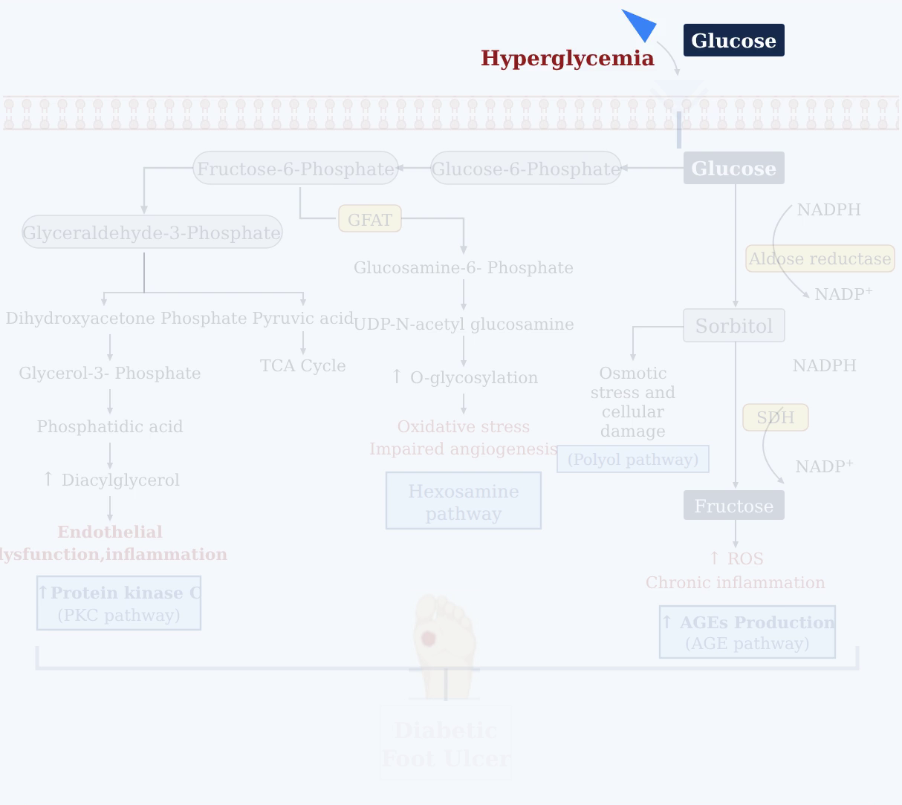
Notes:
Under chronic hyperglycemic conditions, elevated levels of extracellular glucose accumulate outside the cell membrane.
[Alpha Masking · Pubmed_bio_00001 · frame_00.png · 0.000s]

Slide 2
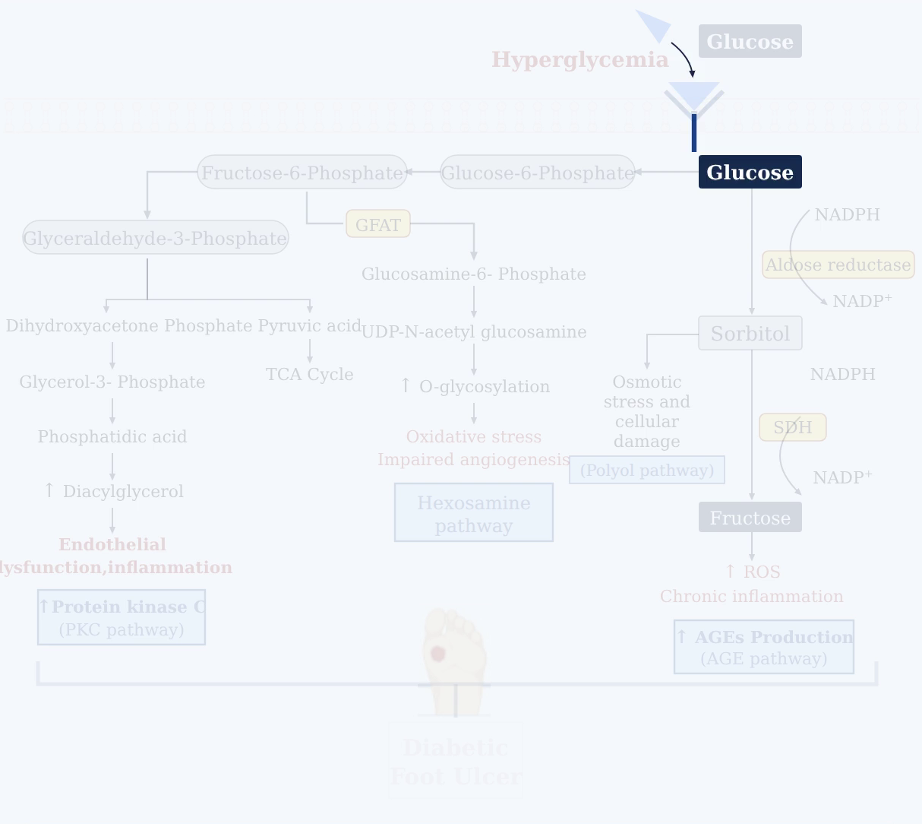
Notes:
This excess glucose is transported across the membrane into the cytoplasm, significantly increasing intracellular glucose availability.
[Alpha Masking · Pubmed_bio_00001 · frame_01.png · 0.500s]

Slide 3
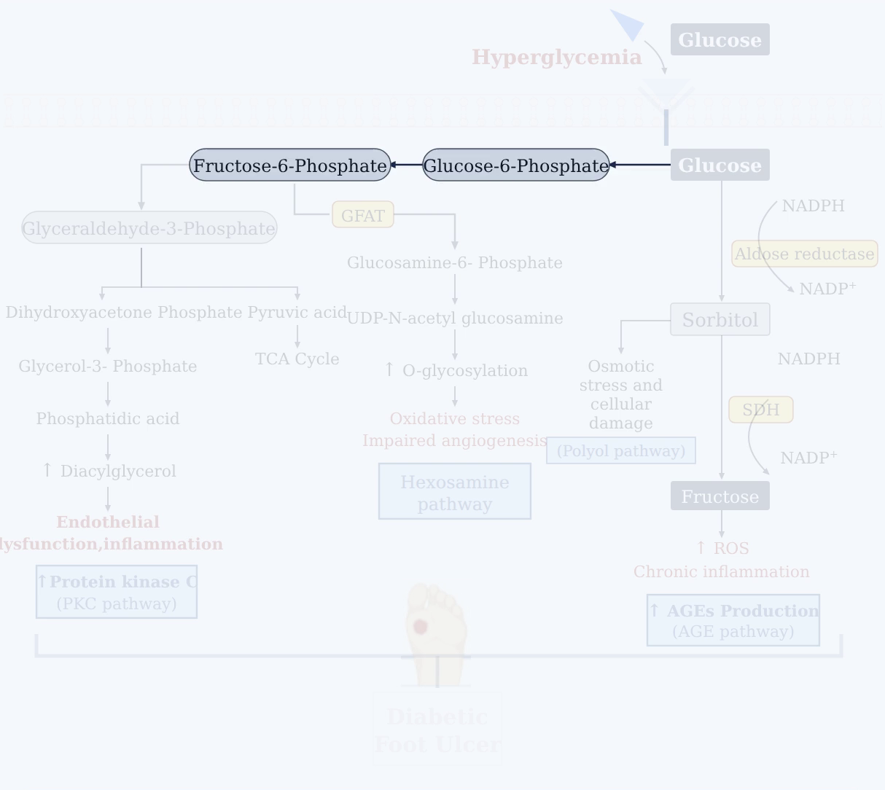
Notes:
Intracellular glucose enters the glycolytic pathway, where it is sequentially metabolized into glucose-6-phosphate and fructose-6-phosphate.
[Alpha Masking · Pubmed_bio_00001 · frame_02.png · 1.000s]

Slide 4
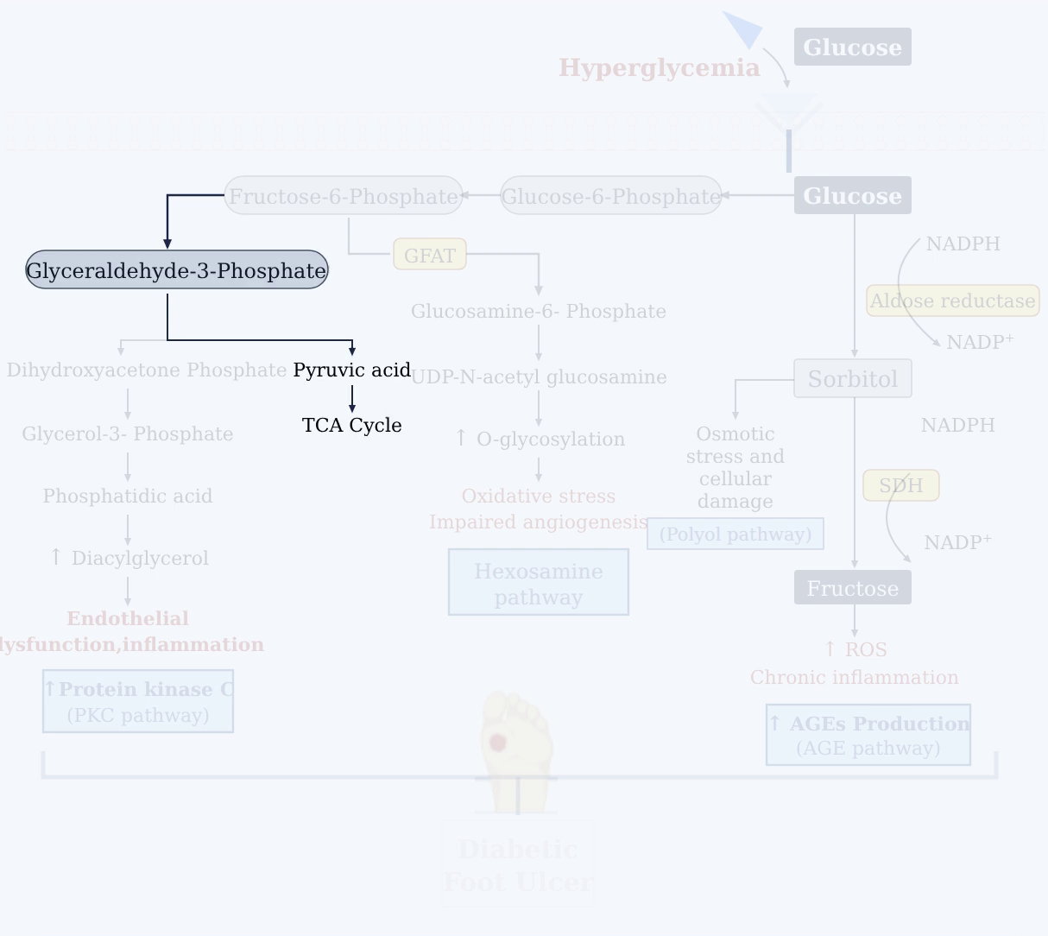
Notes:
Glycolysis progresses from fructose-6-phosphate to glyceraldehyde-3-phosphate, eventually yielding pyruvic acid to feed the citric acid cycle.
[Alpha Masking · Pubmed_bio_00001 · frame_03.png · 1.500s]

Slide 5
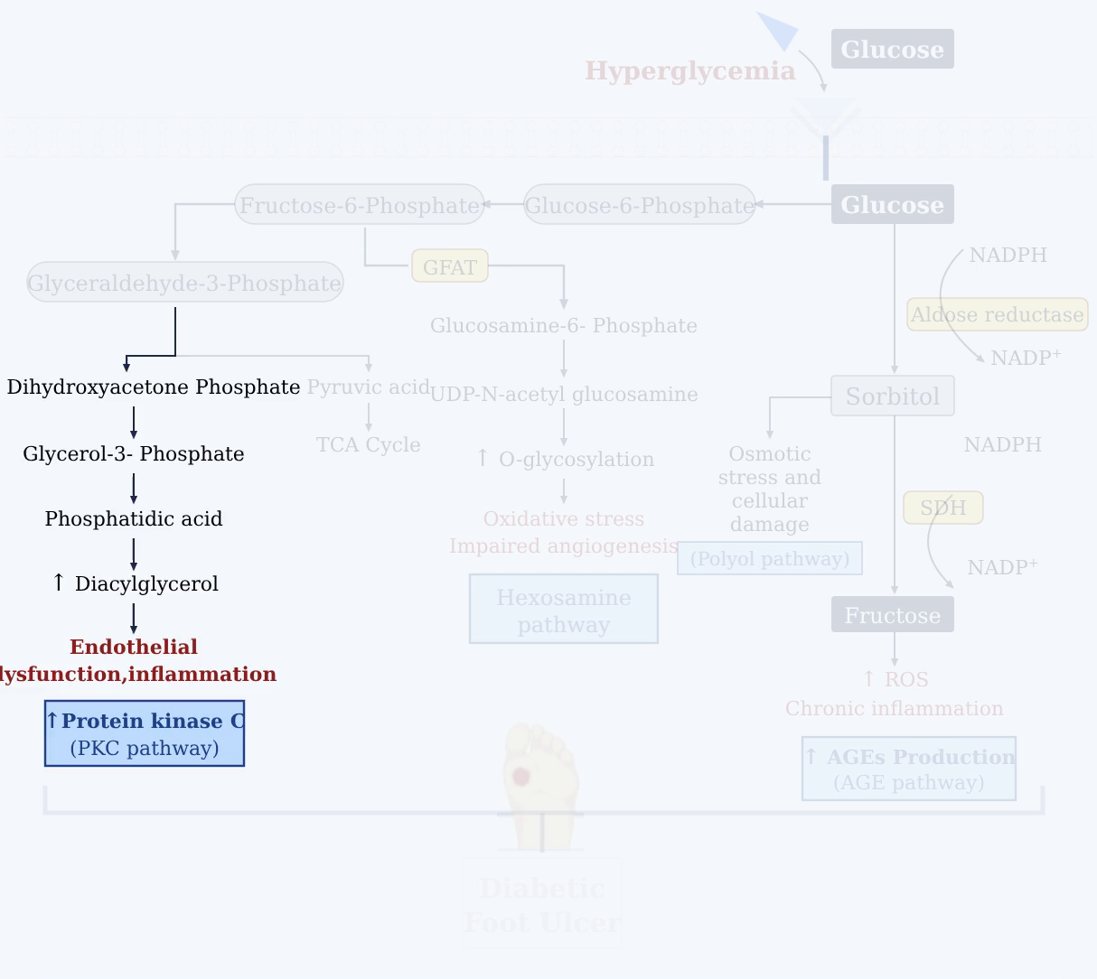
Notes:
Excess glyceraldehyde-3-phosphate diverts into synthesizing diacylglycerol via DHAP and phosphatidic acid, activating protein kinase C to drive endothelial dysfunction and inflammation.
[Alpha Masking · Pubmed_bio_00001 · frame_04.png · 2.000s]

Slide 6
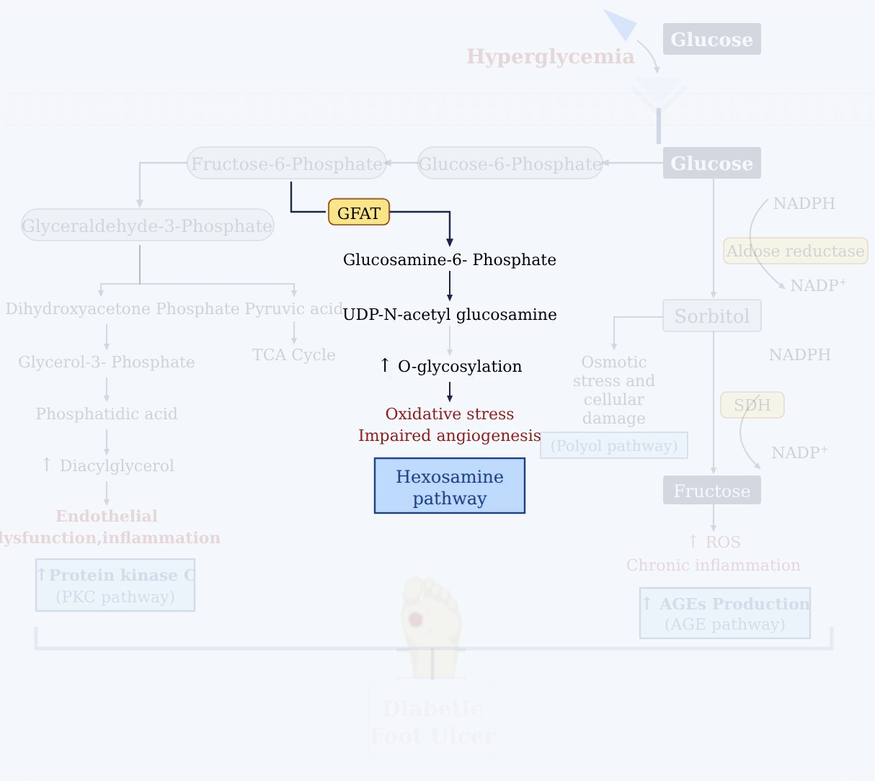
Notes:
Concurrently, fructose-6-phosphate enters the hexosamine pathway via GFAT, producing UDP-GlcNAc to increase protein O-glycosylation, which induces oxidative stress and impairs angiogenesis.
[Alpha Masking · Pubmed_bio_00001 · frame_05.png · 2.500s]

Slide 7
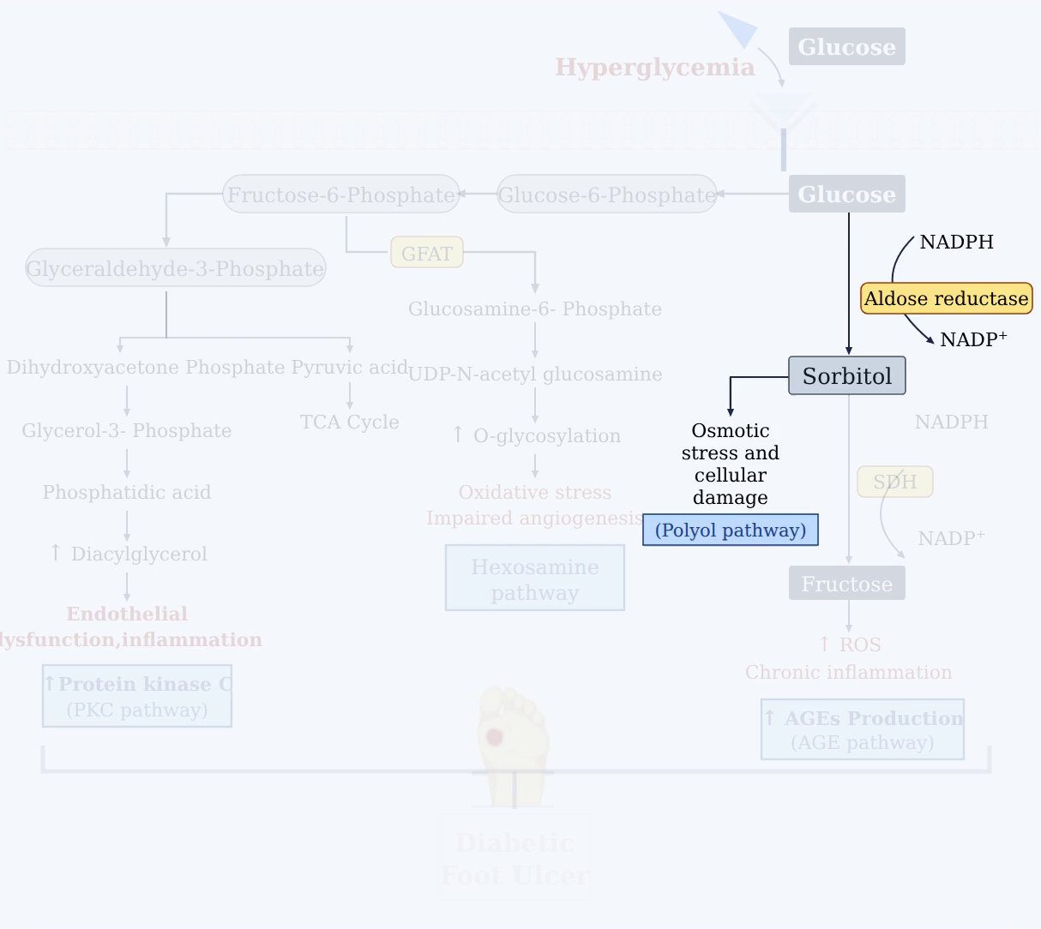
Notes:
Excess intracellular glucose is also shunted into the polyol pathway, where aldose reductase converts it to sorbitol while consuming NADPH, triggering osmotic stress and cellular damage.
[Alpha Masking · Pubmed_bio_00001 · frame_06.png · 3.000s]

Slide 8
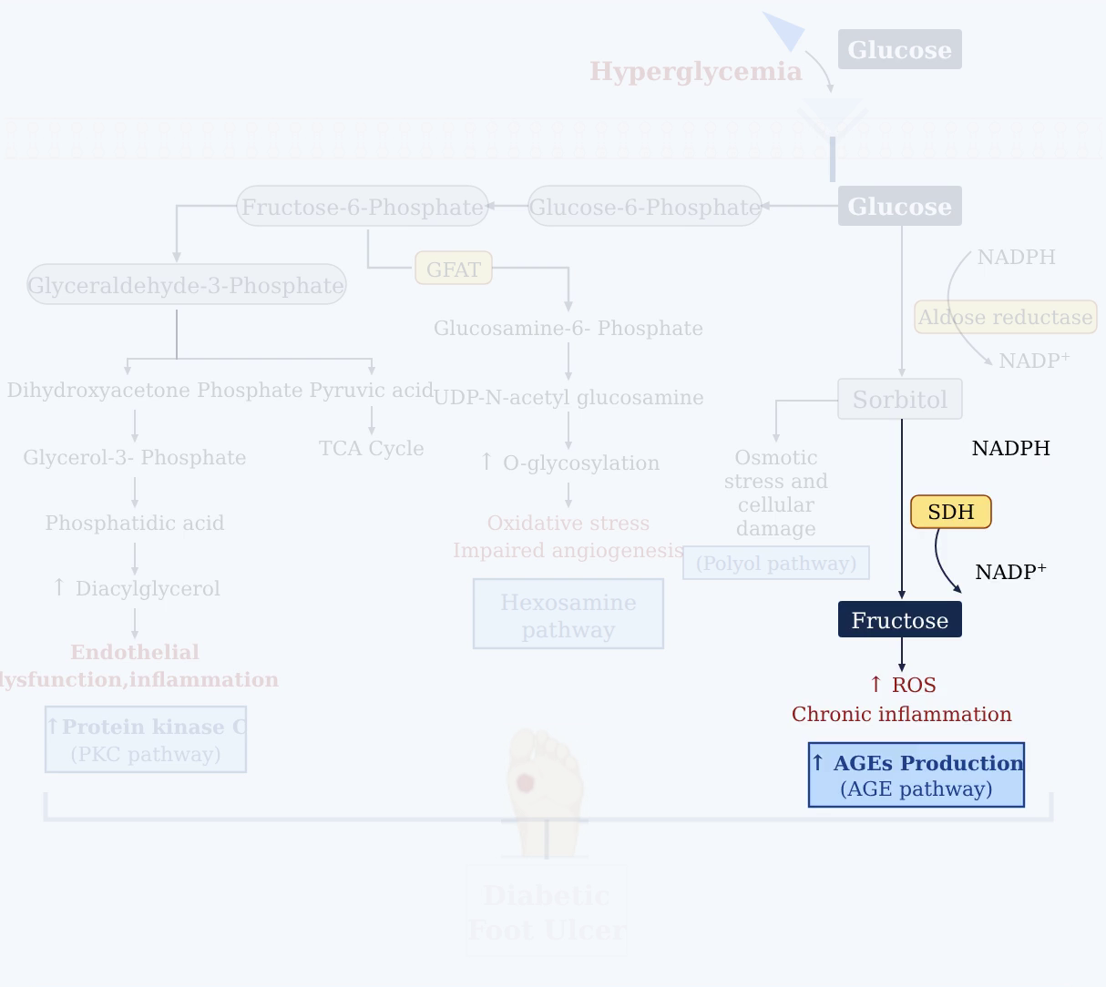
Notes:
Sorbitol dehydrogenase then metabolizes sorbitol into fructose, further fueling reactive oxygen species generation, advanced glycation end-product (AGE) formation, and chronic inflammation.
[Alpha Masking · Pubmed_bio_00001 · frame_07.png · 3.500s]

Slide 9
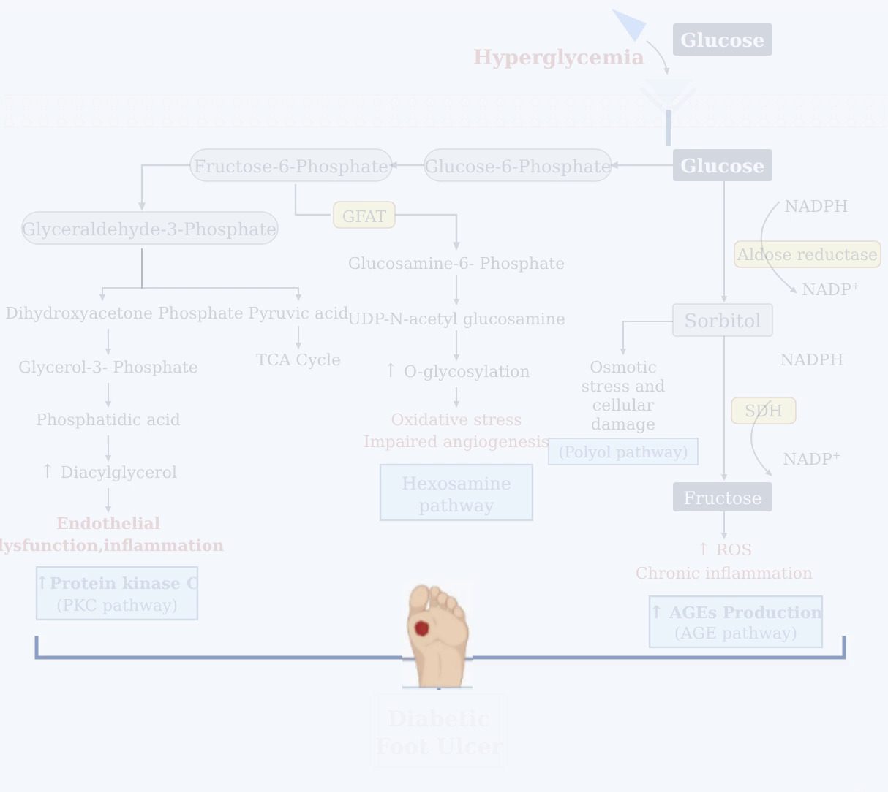
Notes:
These four interconnected pathological pathways collectively disrupt normal cellular defense and repair mechanisms in peripheral tissues.
[Alpha Masking · Pubmed_bio_00001 · frame_08.png · 4.000s]

Slide 10
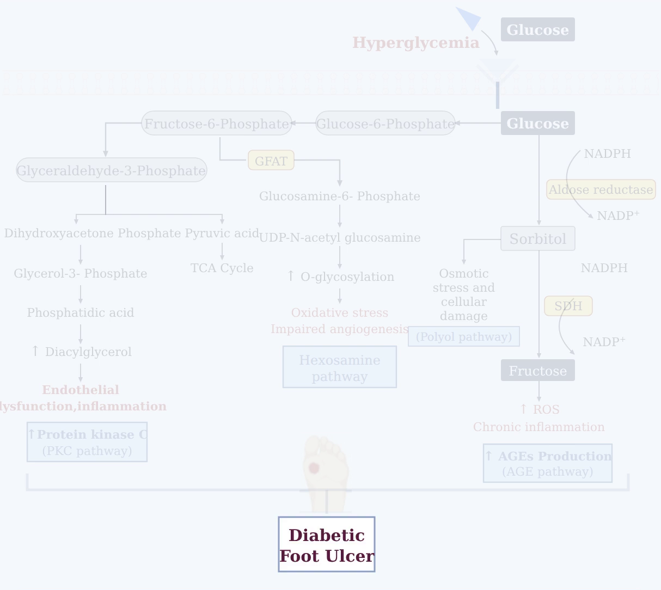
Notes:
The cumulative burden of oxidative stress, inflammation, and vascular dysfunction ultimately compromises wound healing, resulting in diabetic foot ulcers.
[Alpha Masking · Pubmed_bio_00001 · frame_09.png · 4.500s]

