Slide 1
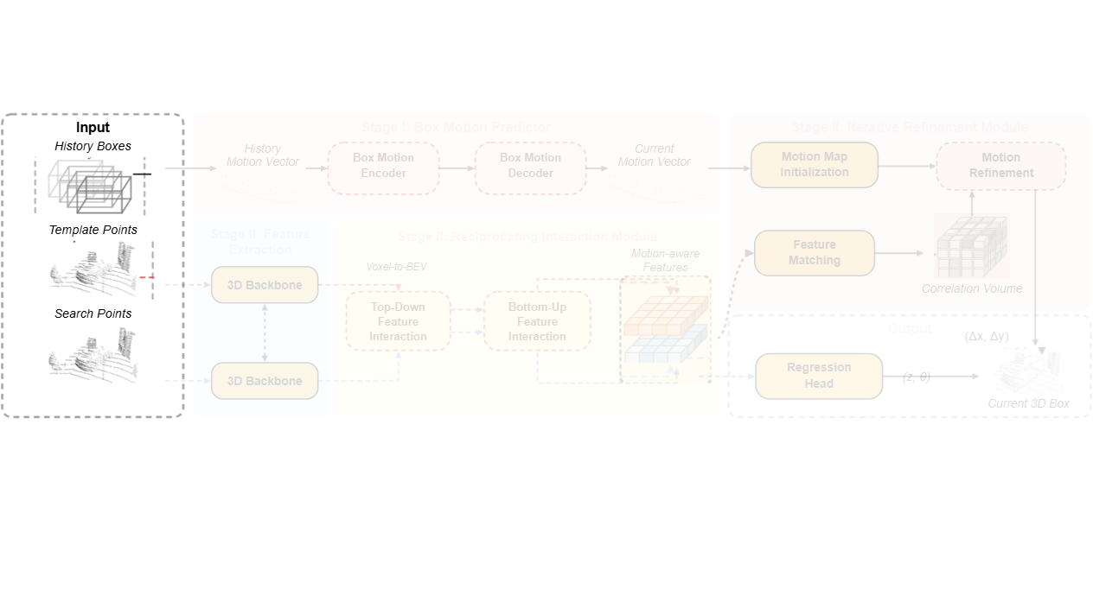
Notes:
The tracking framework begins by receiving historical bounding boxes along with consecutive template and search point clouds.
[Alpha Masking · SciMMIR_arch_diff_000000256 · frame_00.png · 1.50s]

Slide 2
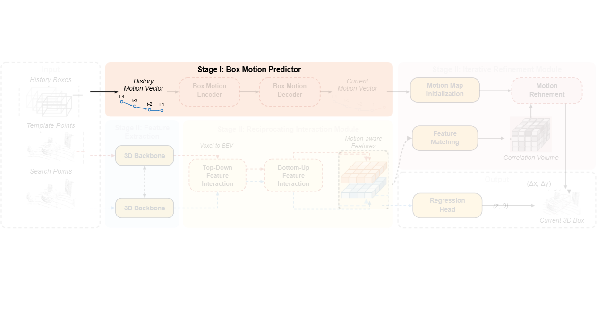
Notes:
In Stage One, the sequence of past bounding boxes is converted into a history motion vector representing prior trajectories.
[Alpha Masking · SciMMIR_arch_diff_000000256 · frame_01.png · 4.50s]

Slide 3
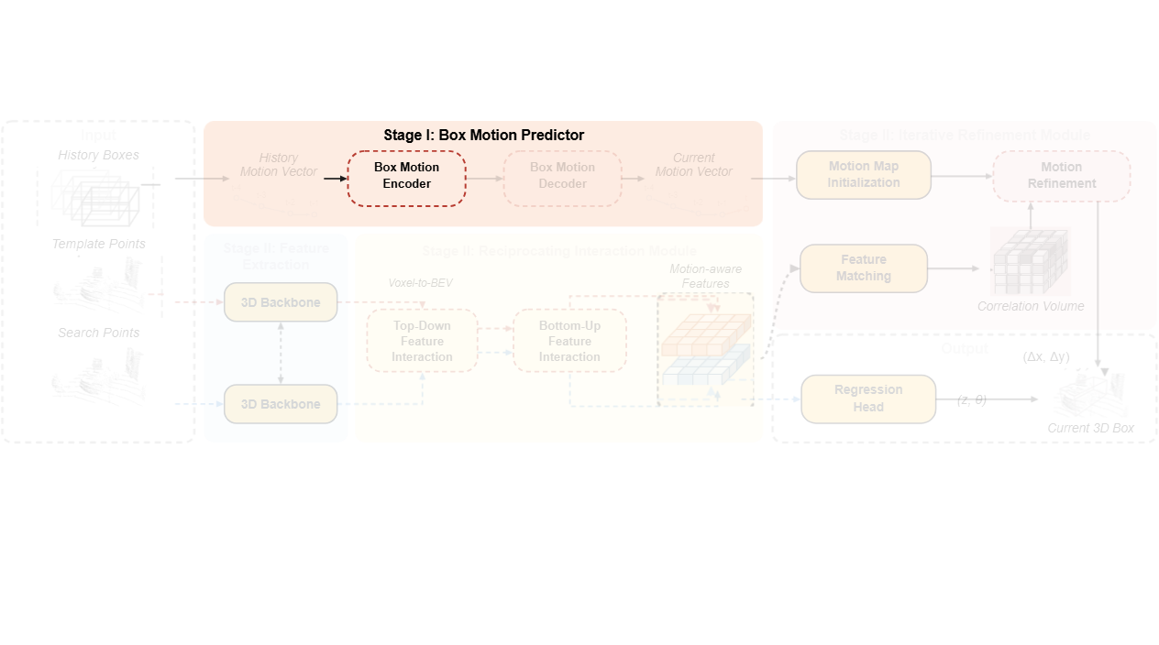
Notes:
This history vector is processed by a box motion encoder to capture global temporal patterns and suppress noise.
[Alpha Masking · SciMMIR_arch_diff_000000256 · frame_02.png · 7.50s]

Slide 4
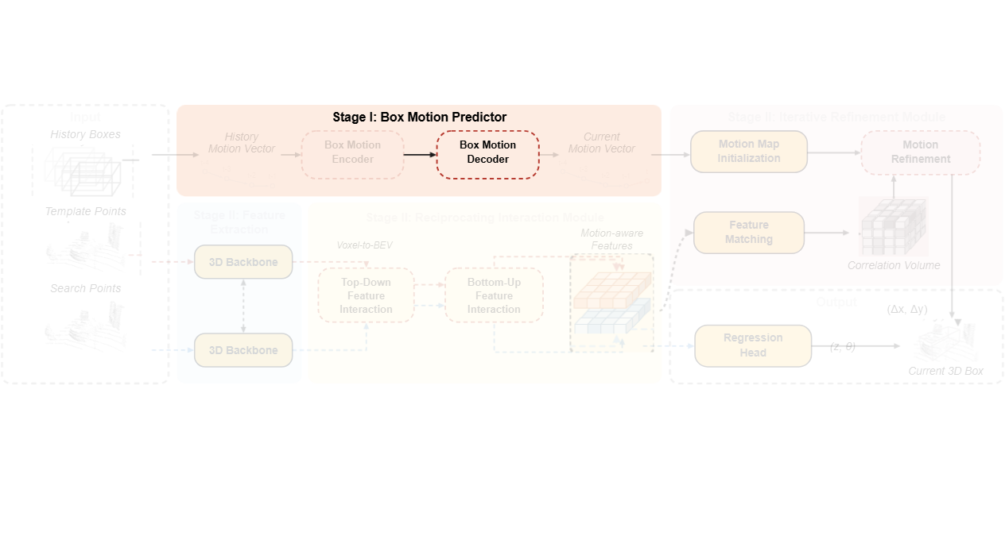
Notes:
The box motion decoder then predicts the subsequent movement using learned temporal tokens.
[Alpha Masking · SciMMIR_arch_diff_000000256 · frame_04.png · 9.00s]

Slide 5
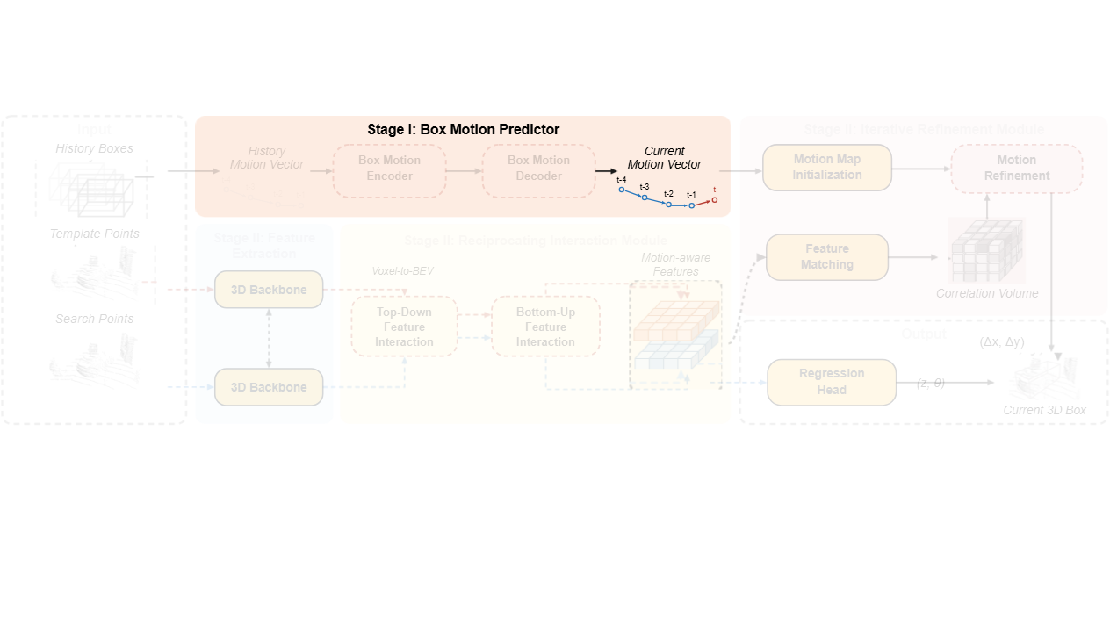
Notes:
This yields a coarse estimate of the current motion vector for the target center.
[Alpha Masking · SciMMIR_arch_diff_000000256 · frame_05.png · 13.50s]

Slide 6
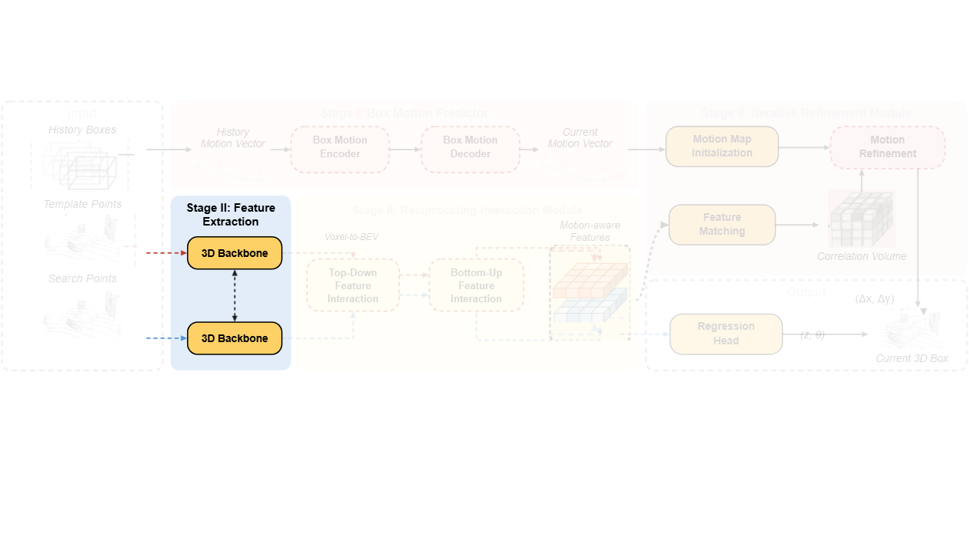
Notes:
In Stage Two, weight-shared three-dimensional sparse convolution backbones extract geometric features from the template and search point clouds.
[Alpha Masking · SciMMIR_arch_diff_000000256 · frame_06.png · 16.50s]

Slide 7
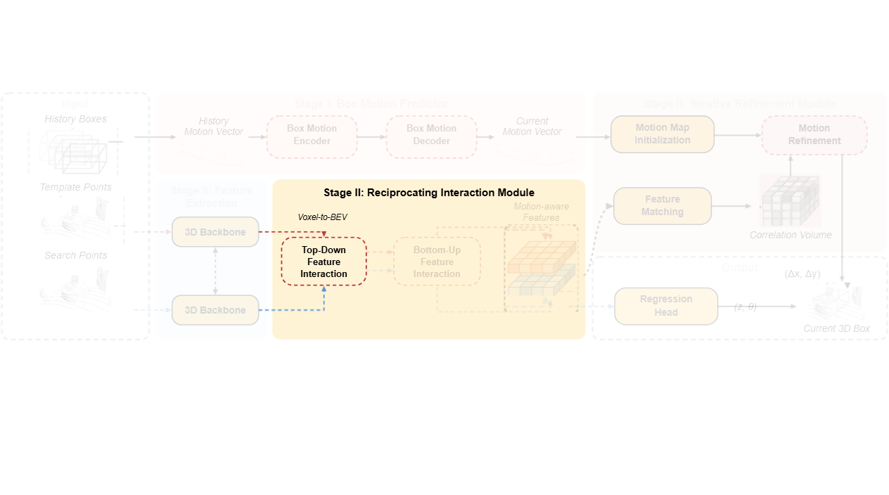
Notes:
Voxel features are transformed into bird's-eye-view representations and processed through top-down feature interaction to learn multi-scale spatial relations.
[Alpha Masking · SciMMIR_arch_diff_000000256 · frame_07.png · 19.50s]

Slide 8
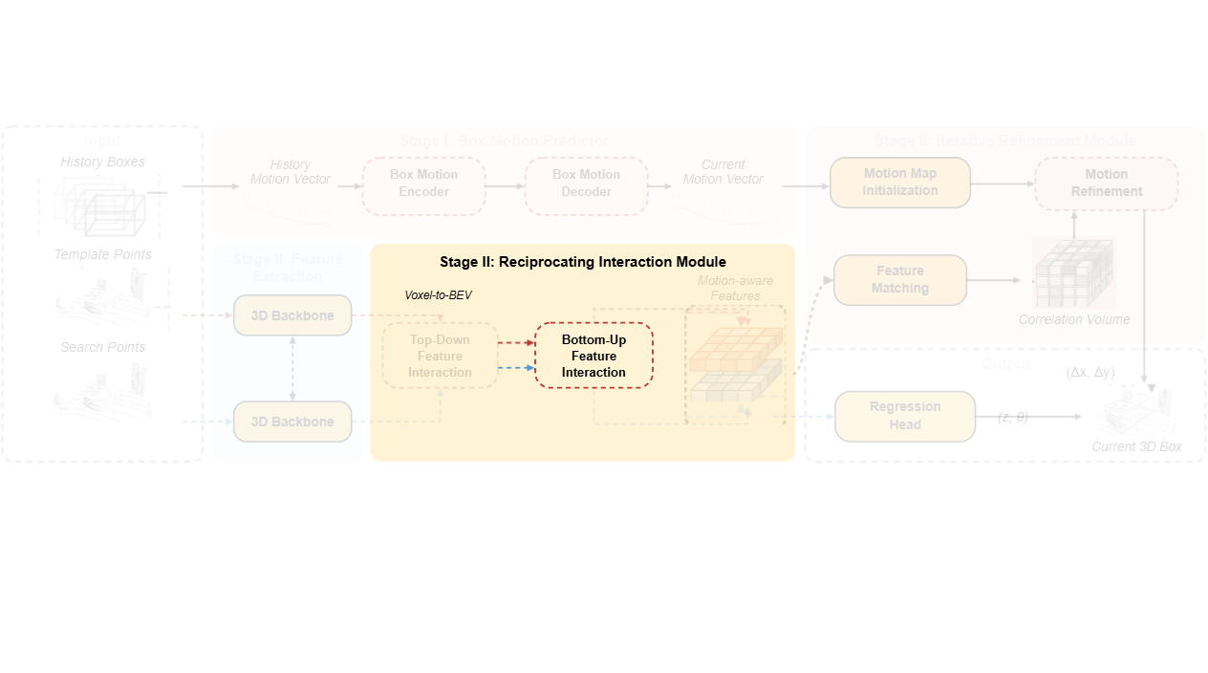
Notes:
A bottom-up interaction stream then aggregates and re-weights these multi-scale features using deformable attention.
[Alpha Masking · SciMMIR_arch_diff_000000256 · frame_08.png · 22.50s]

Slide 9
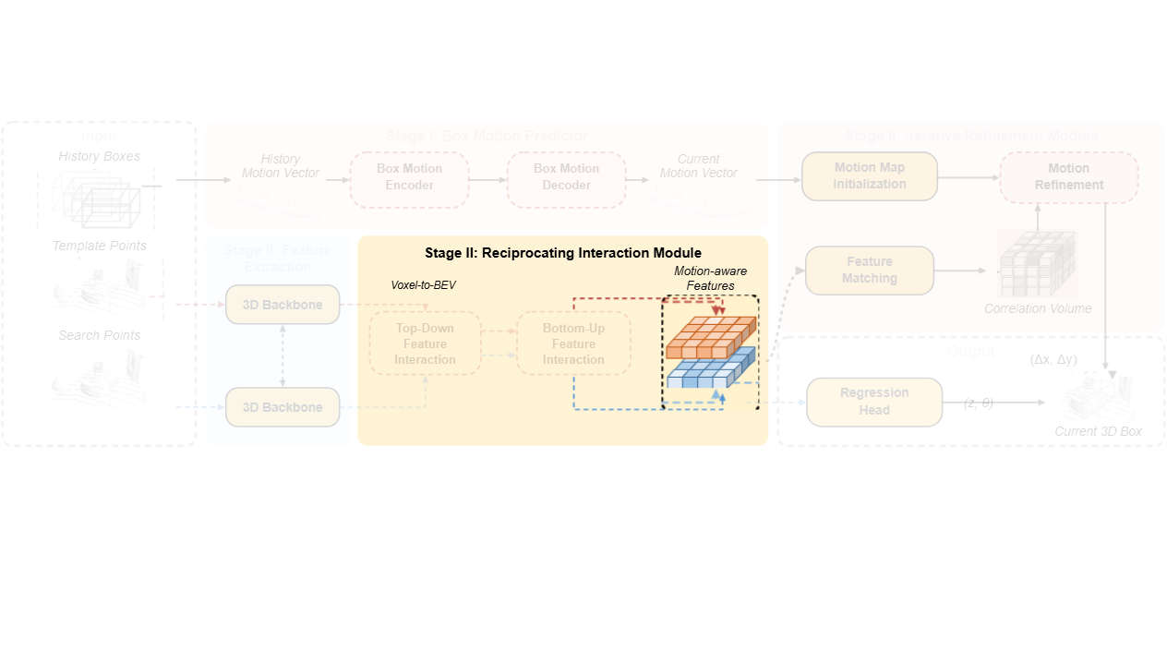
Notes:
This produces refined motion-aware feature maps for both the search and template regions.
[Alpha Masking · SciMMIR_arch_diff_000000256 · frame_09.png · 25.50s]

Slide 10
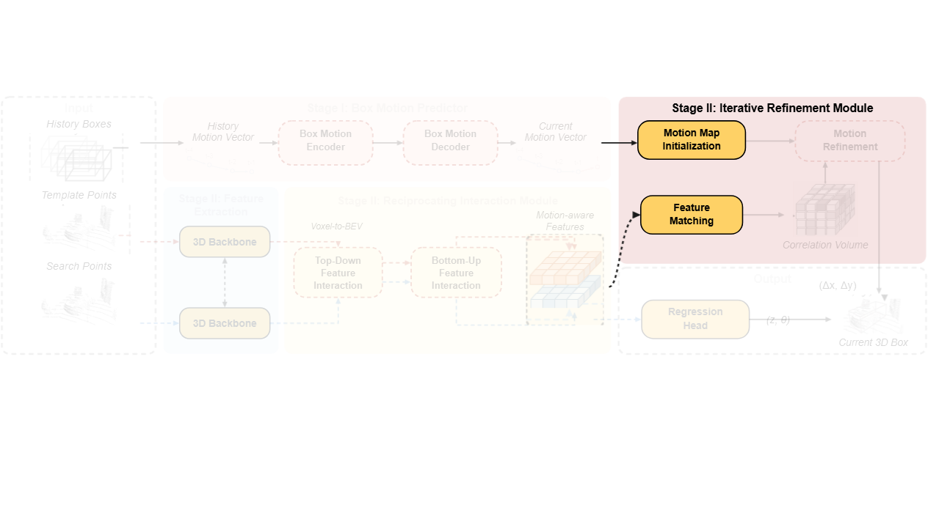
Notes:
In the iterative refinement module, the coarse motion vector initializes a motion map while motion-aware features undergo feature matching.
[Alpha Masking · SciMMIR_arch_diff_000000256 · frame_10.png · 28.50s]

Slide 11
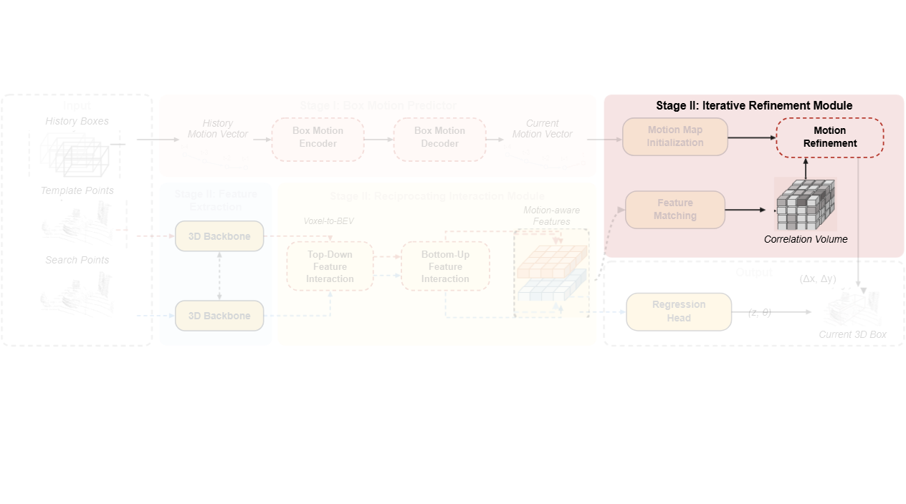
Notes:
A correlation volume is generated to iteratively sample geometric correspondences and refine the planar motion map.
[Alpha Masking · SciMMIR_arch_diff_000000256 · frame_12.png · 30.00s]

Slide 12
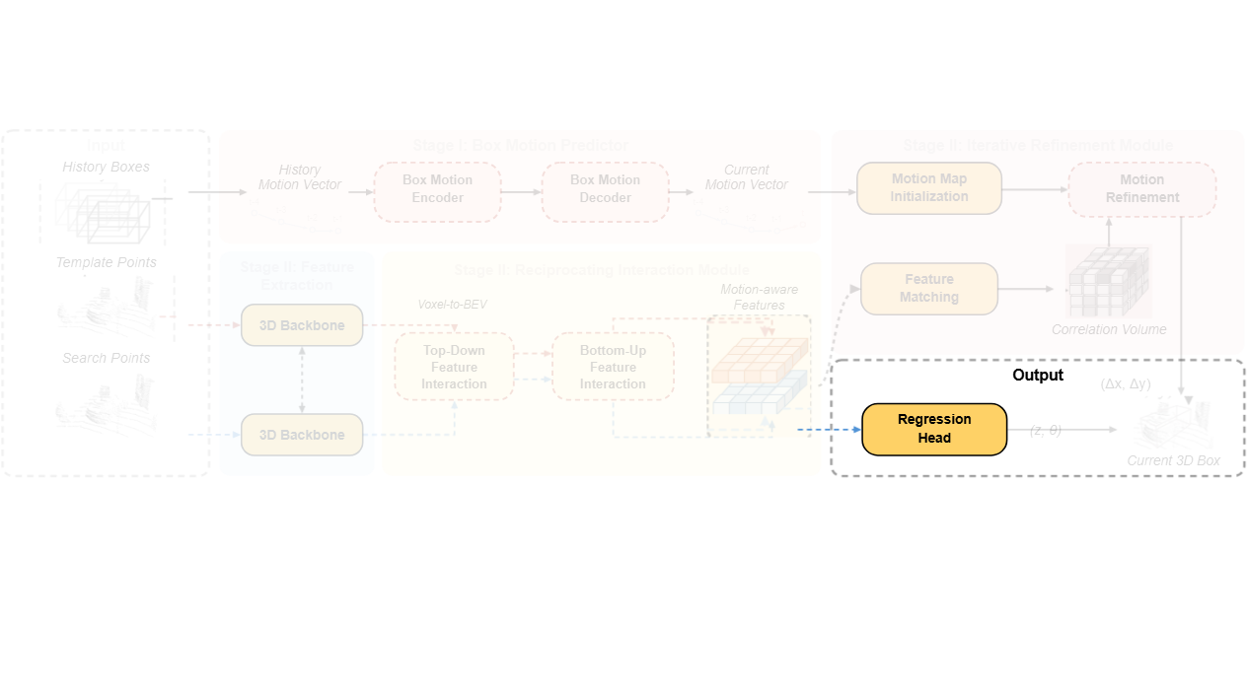
Notes:
Concurrently, the regression head predicts the vertical position and heading angle from the search features.
[Alpha Masking · SciMMIR_arch_diff_000000256 · frame_13.png · 34.50s]

Slide 13
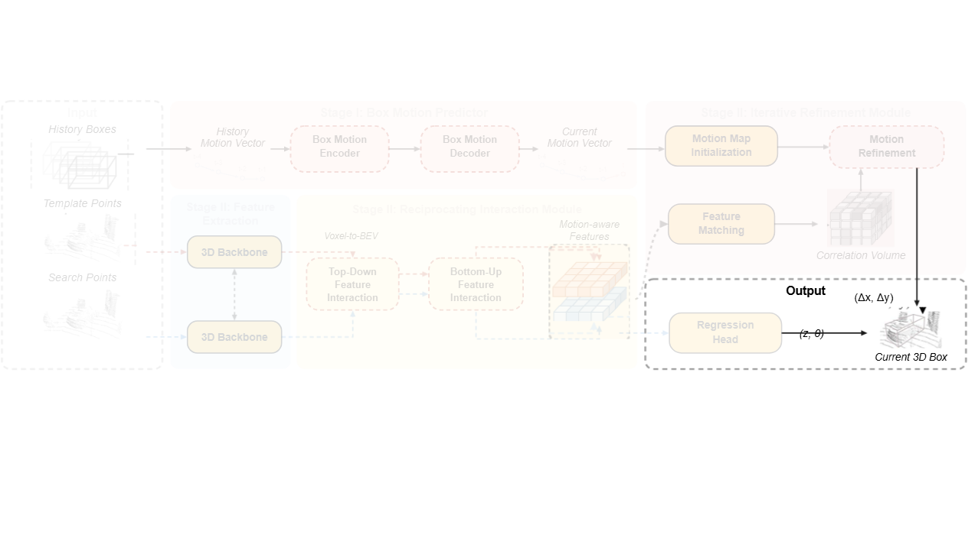
Notes:
Finally, combining the refined horizontal offsets with the vertical coordinate and orientation outputs the predicted current three-dimensional bounding box.
[Alpha Masking · SciMMIR_arch_diff_000000256 · frame_15.png · 36.00s]

