Slide 1
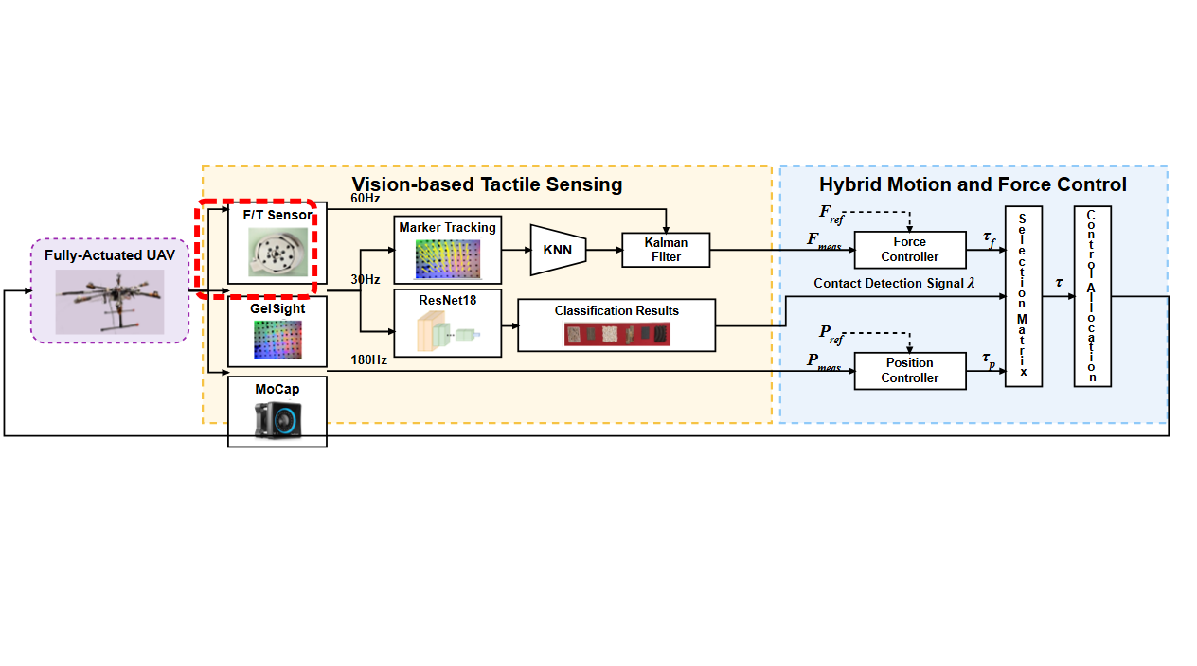
Notes:
A fully-actuated unmanned aerial vehicle serves as the experimental platform to execute physical interaction tasks.
[Sliding Bbox · SciMMIR_arch_diff_000000348 · frame_0003.png · 1.476s]

Slide 2
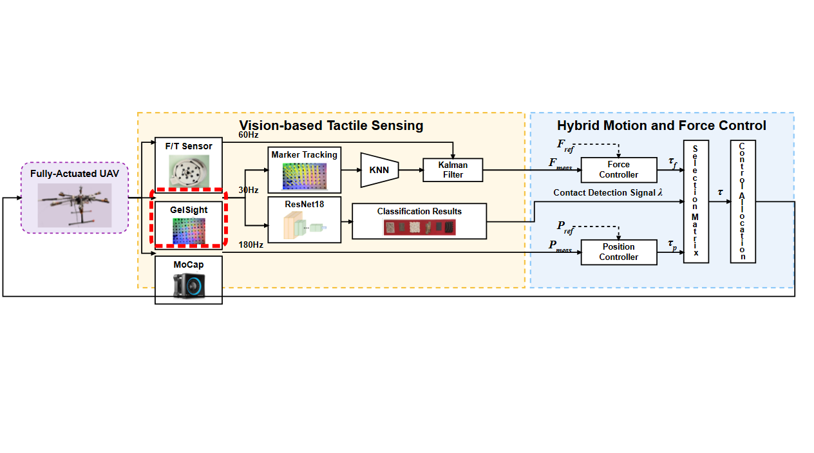
Notes:
The onboard force-torque sensor at the manipulator base provides direct force measurements at sixty hertz.
[Sliding Bbox · SciMMIR_arch_diff_000000348 · frame_0007.png · 5.167s]

Slide 3
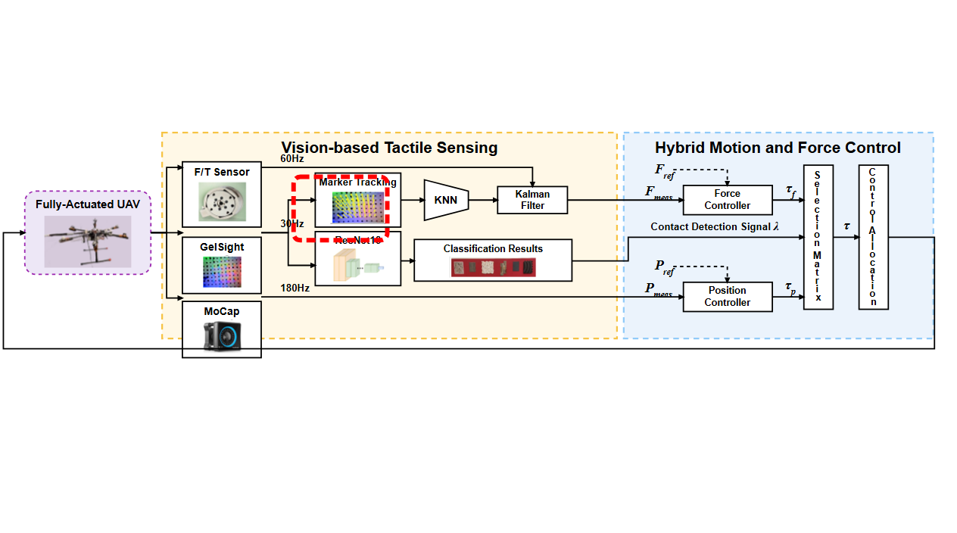
Notes:
At the end-effector tip, a GelSight vision-based tactile sensor captures optical tactile images at thirty hertz.
[Sliding Bbox · SciMMIR_arch_diff_000000348 · frame_0011.png · 8.858s]

Slide 4
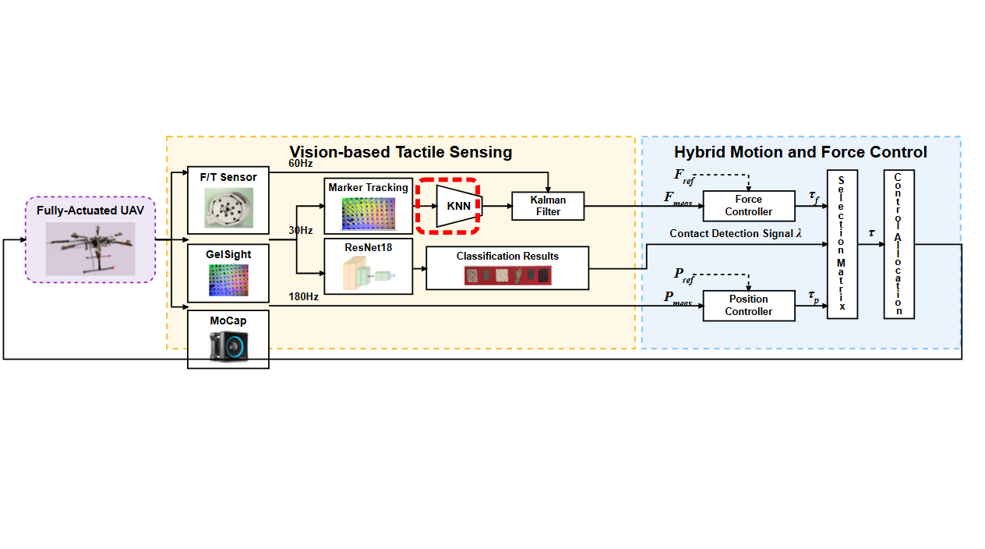
Notes:
Optical flow tracks the motion of printed markers to capture the deformation of the elastomer gel pad.
[Sliding Bbox · SciMMIR_arch_diff_000000348 · frame_0015.png · 12.554s]

Slide 5
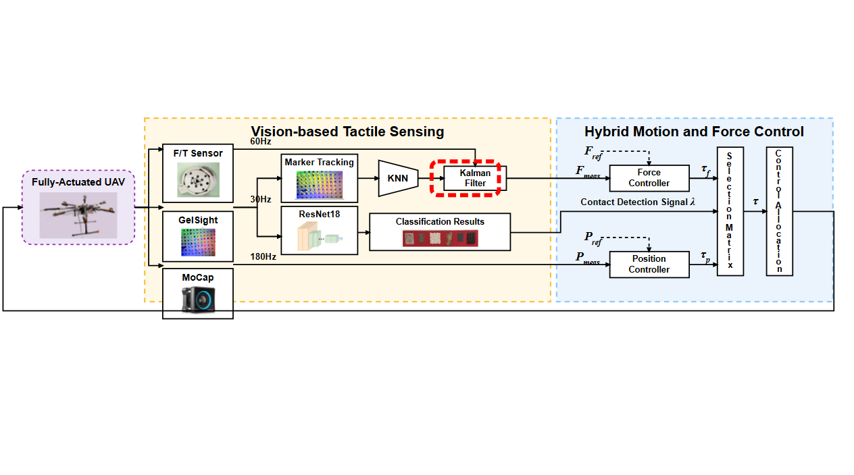
Notes:
A k-nearest neighbors model then estimates the contact force directly from these marker displacement features.
[Sliding Bbox · SciMMIR_arch_diff_000000348 · frame_0019.png · 16.246s]

Slide 6
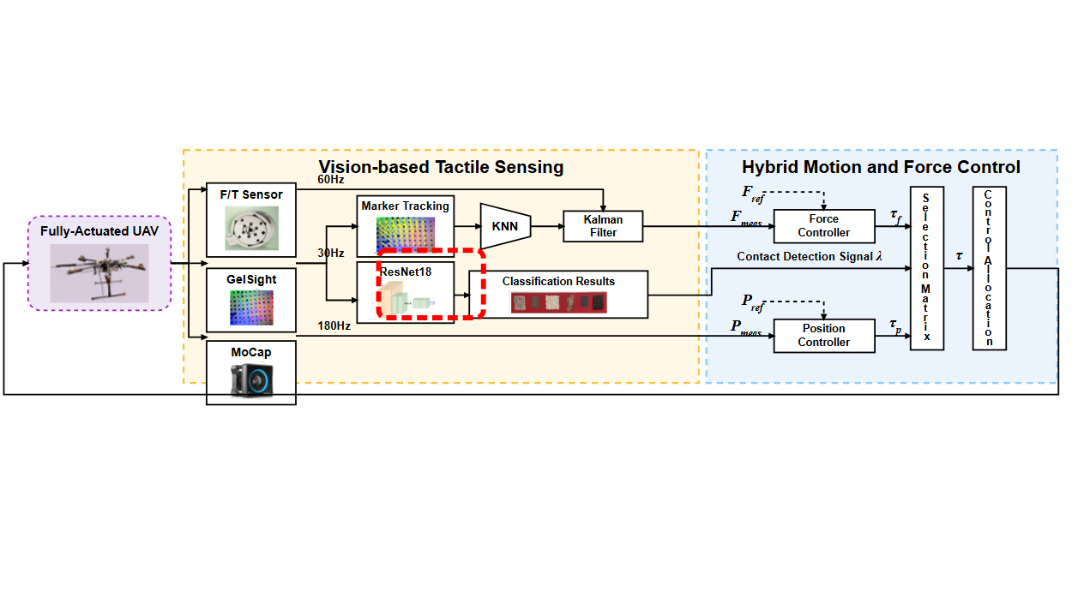
Notes:
A Kalman filter fuses the force-torque sensor measurements and tactile estimates to obtain the measured contact force.
[Sliding Bbox · SciMMIR_arch_diff_000000348 · frame_0023.png · 19.937s]

Slide 7
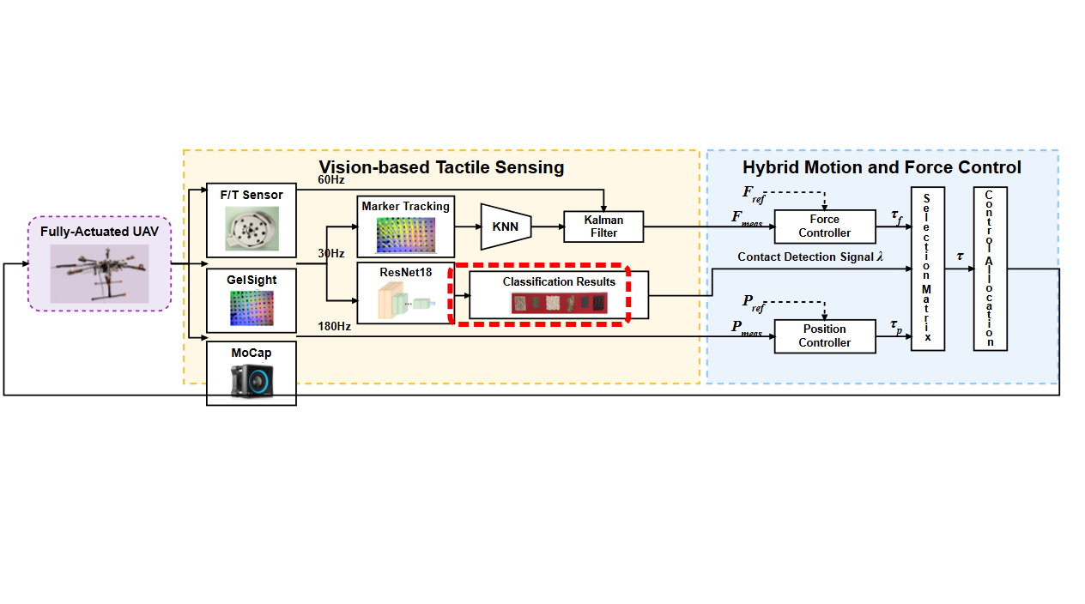
Notes:
In parallel, a ResNet-18 neural network processes the full tactile image to determine contact and recognize surface textures.
[Sliding Bbox · SciMMIR_arch_diff_000000348 · frame_0027.png · 23.628s]

Slide 8
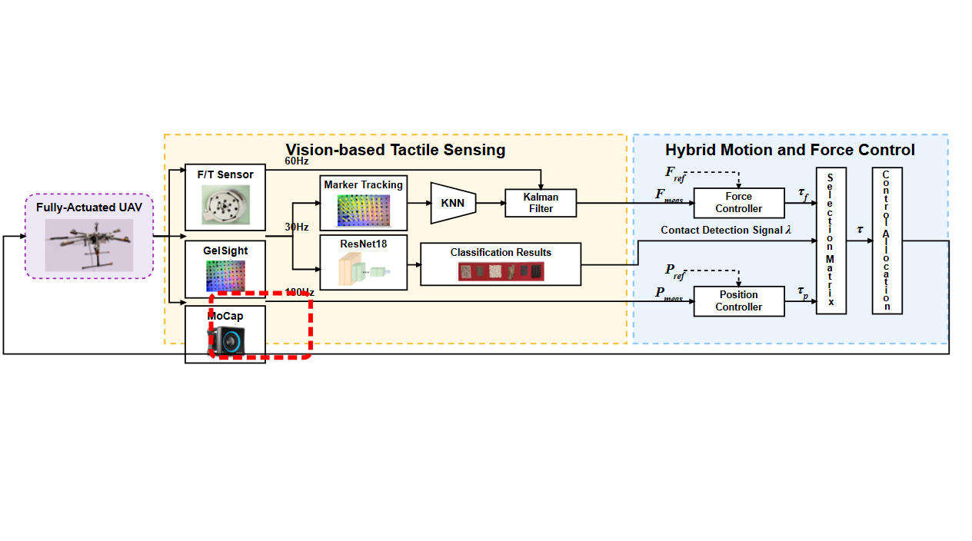
Notes:
The classification output identifies the contact texture and generates a discrete contact detection switching signal.
[Sliding Bbox · SciMMIR_arch_diff_000000348 · frame_0031.png · 27.324s]

Slide 9
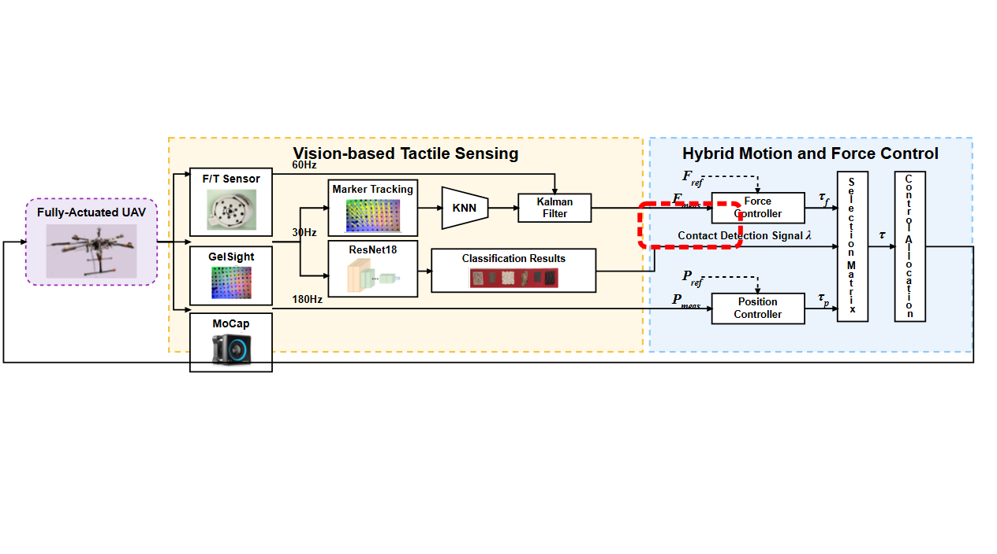
Notes:
A motion capture system provides high-rate position measurements at one hundred eighty hertz.
[Sliding Bbox · SciMMIR_arch_diff_000000348 · frame_0035.png · 31.015s]

Slide 10
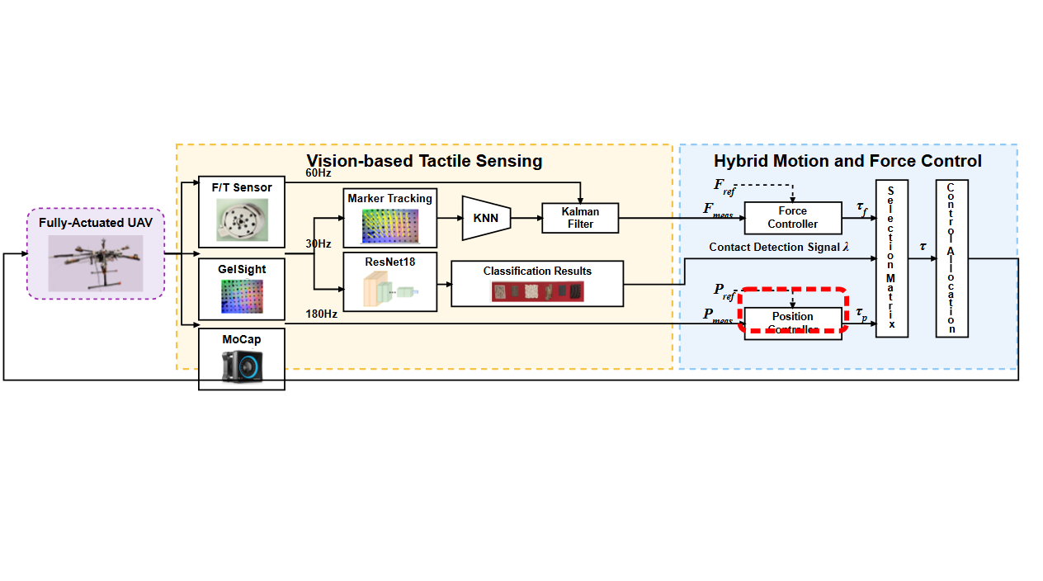
Notes:
The force controller computes the force tracking control effort using the fused contact force and reference force.
[Sliding Bbox · SciMMIR_arch_diff_000000348 · frame_0039.png · 34.706s]

Slide 11
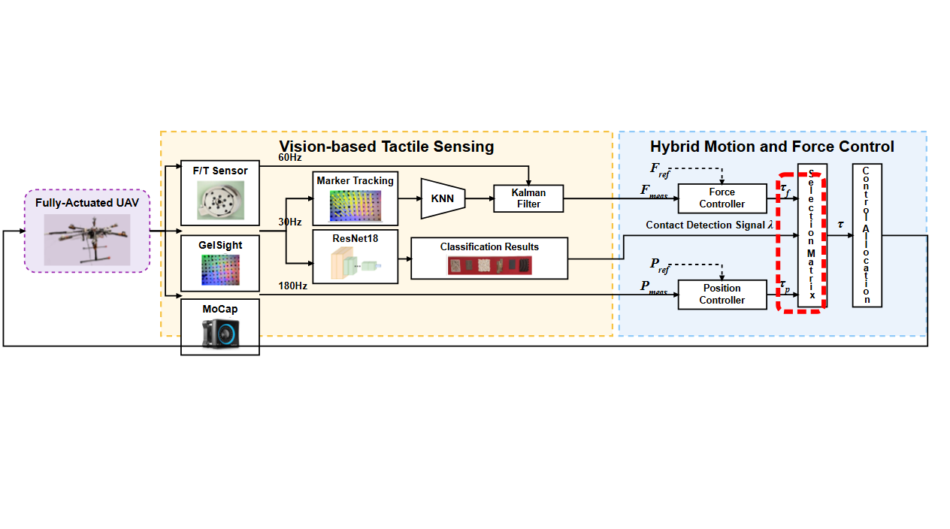
Notes:
Simultaneously, a position controller calculates the motion control command based on reference and measured positions.
[Sliding Bbox · SciMMIR_arch_diff_000000348 · frame_0043.png · 38.398s]

Slide 12
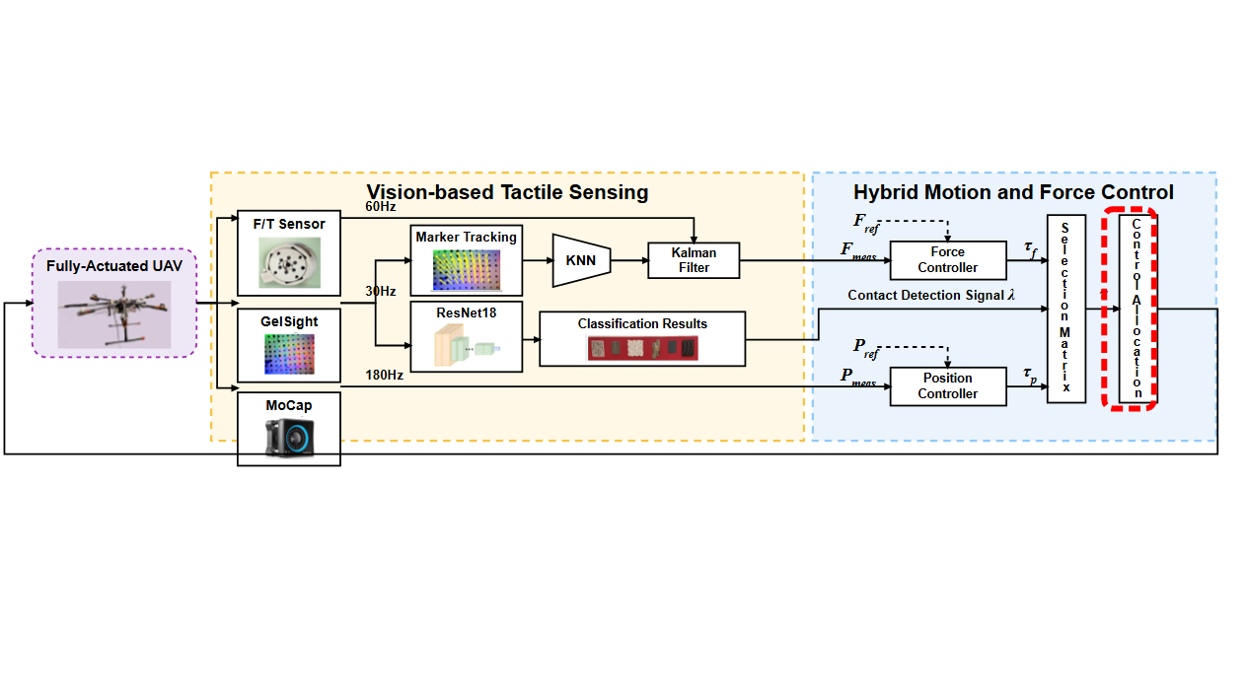
Notes:
A selection matrix dynamically blends the motion and force control commands based on the contact detection state.
[Sliding Bbox · SciMMIR_arch_diff_000000348 · frame_0047.png · 42.091s]

Slide 13

Notes:
Finally, the control allocation module maps the combined wrench command into individual rotor speeds for the fully-actuated vehicle.
[Sliding Bbox · SciMMIR_arch_diff_000000348 · frame_0051.png · 45.785s]

