Slide 1
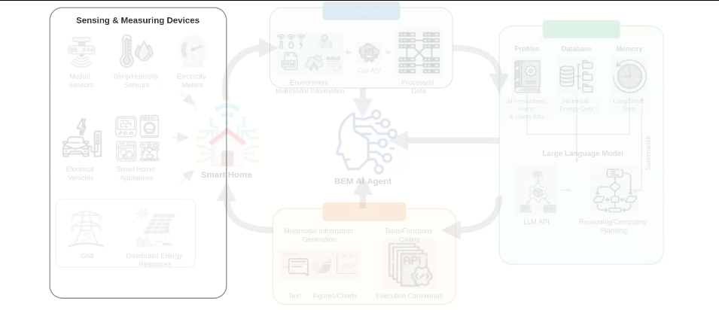
Notes:
The framework begins with the Sensing and Measuring Devices, which capture physical data from the building environment.
[Alpha Masking · arch_arxiv_ai_2025_000000112 · frame_00.png · 1]

Slide 2
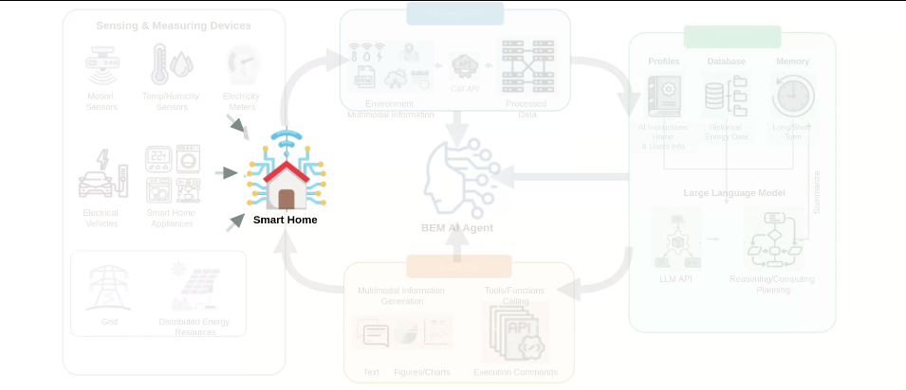
Notes:
These devices continuously feed real-time data into the central Smart Home hub, establishing the baseline environmental and energy states.
[Alpha Masking · arch_arxiv_ai_2025_000000112 · frame_01.png · 2]

Slide 3
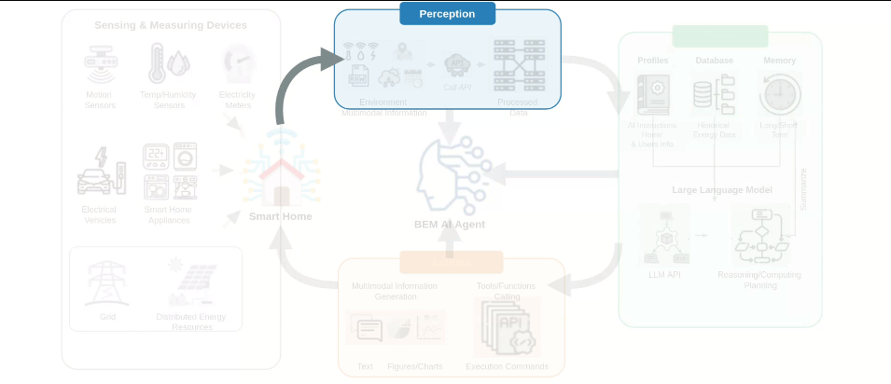
Notes:
The Perception module acts as the sensory interface, receiving raw multimodal information from the Smart Home.
[Alpha Masking · arch_arxiv_ai_2025_000000112 · frame_02.png · 3]

Slide 4
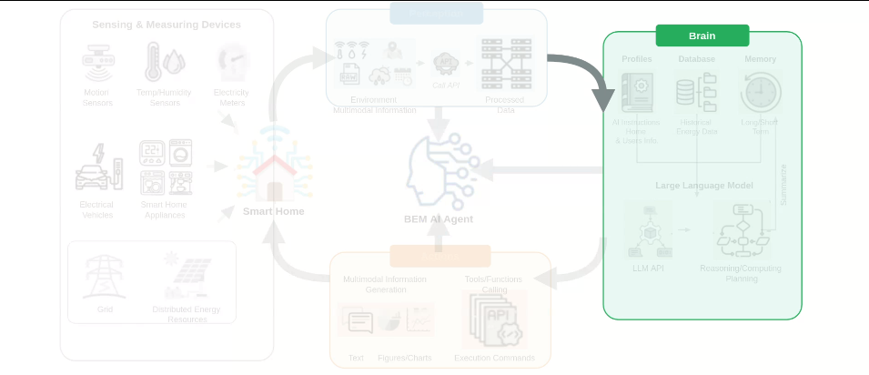
Notes:
This information is processed and routed to the Brain module, which serves as the central computational and decision-making layer.
[Alpha Masking · arch_arxiv_ai_2025_000000112 · frame_03.png · 4]

Slide 5
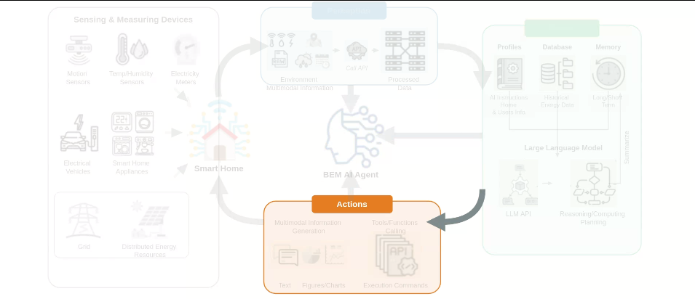
Notes:
Based on the Brain's decisions, the Actions module translates plans into physical device controls and user interactions.
[Alpha Masking · arch_arxiv_ai_2025_000000112 · frame_04.png · 5]

Slide 6
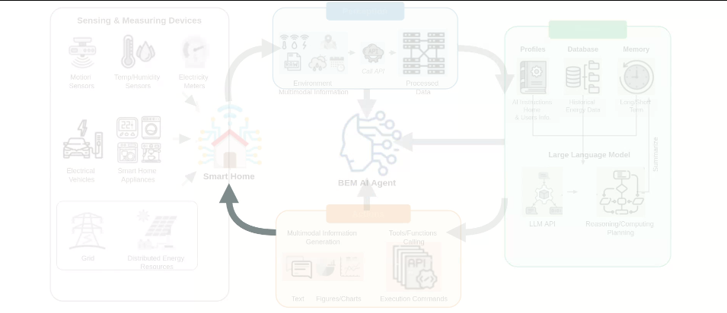
Notes:
These actions are executed back in the Smart Home, completing the closed feedback loop.
[Alpha Masking · arch_arxiv_ai_2025_000000112 · frame_05.png · 6]

Slide 7
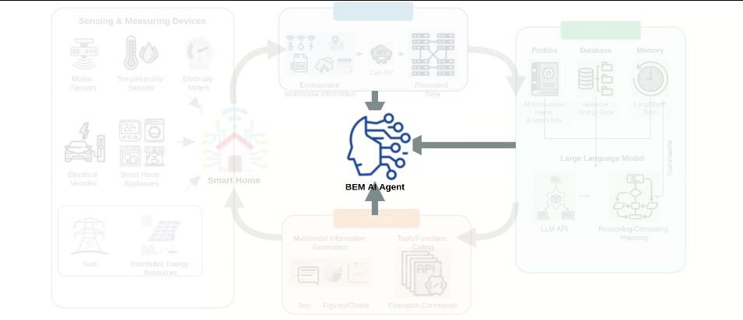
Notes:
At the center of this loop is the BEM AI Agent, coordinating perception, reasoning, and action to optimize energy management.
[Alpha Masking · arch_arxiv_ai_2025_000000112 · frame_06.png · 7]

Slide 8
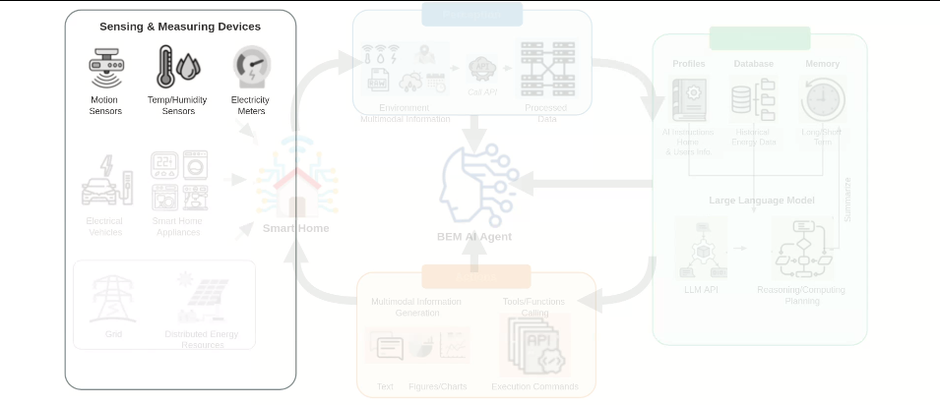
Notes:
Looking closer at the sensing layer, it includes motion sensors, temperature and humidity sensors, and smart electricity meters.
[Alpha Masking · arch_arxiv_ai_2025_000000112 · frame_07.png · 8]

Slide 9
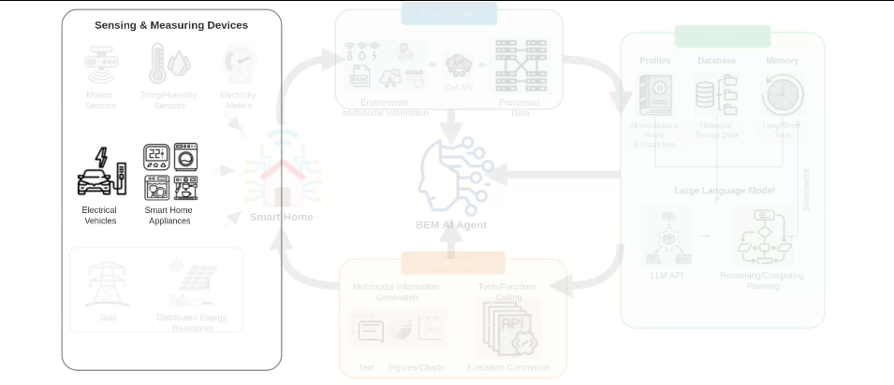
Notes:
It also monitors high-load assets like electric vehicles and various smart home appliances.
[Alpha Masking · arch_arxiv_ai_2025_000000112 · frame_08.png · 9]

Slide 10
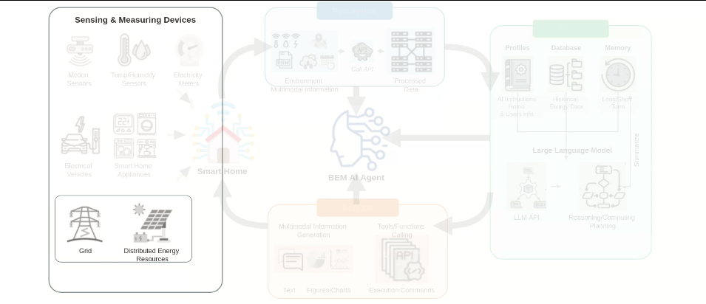
Notes:
Additionally, the system tracks grid interactions and distributed energy resources, such as solar photovoltaic arrays.
[Alpha Masking · arch_arxiv_ai_2025_000000112 · frame_09.png · 10]

Slide 11
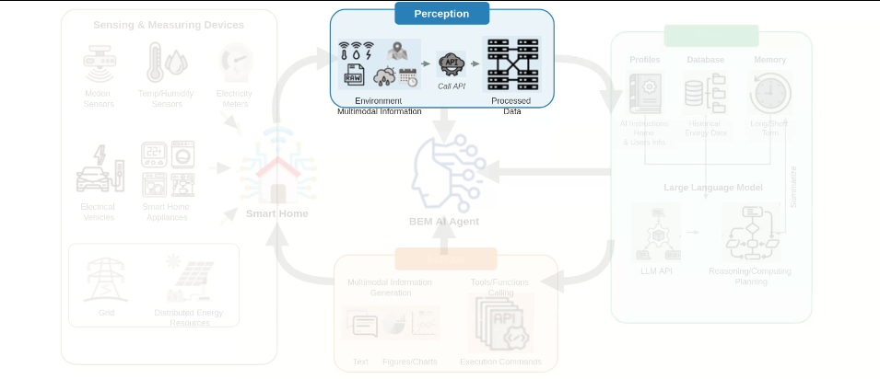
Notes:
Within the perception module, raw environmental information is structured and refined through API calls to generate clean, processed data.
[Alpha Masking · arch_arxiv_ai_2025_000000112 · frame_10.png · 11]

Slide 12
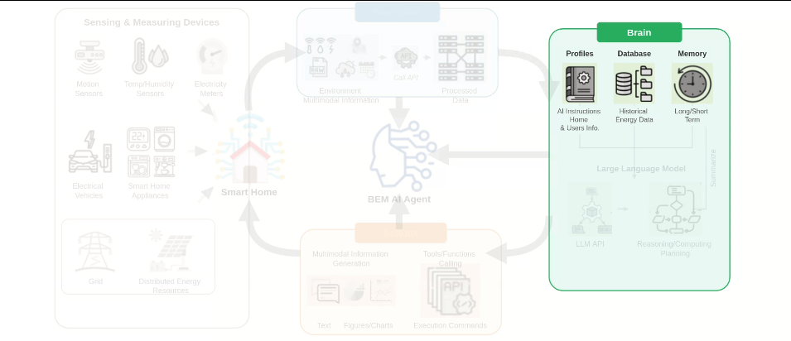
Notes:
The brain module stores this data across three key layers: system profiles, historical energy databases, and long- or short-term memory.
[Alpha Masking · arch_arxiv_ai_2025_000000112 · frame_11.png · 12]

Slide 13
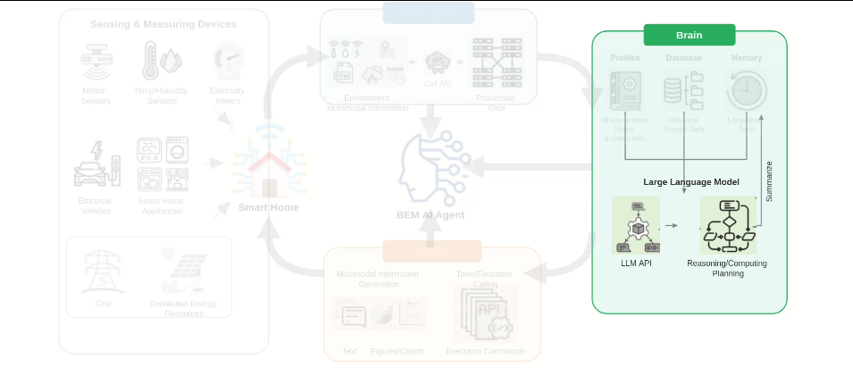
Notes:
A Large Language Model processes these inputs via an API, executing reasoning and planning before summarizing key insights back into long-term memory.
[Alpha Masking · arch_arxiv_ai_2025_000000112 · frame_12.png · 13]

Slide 14
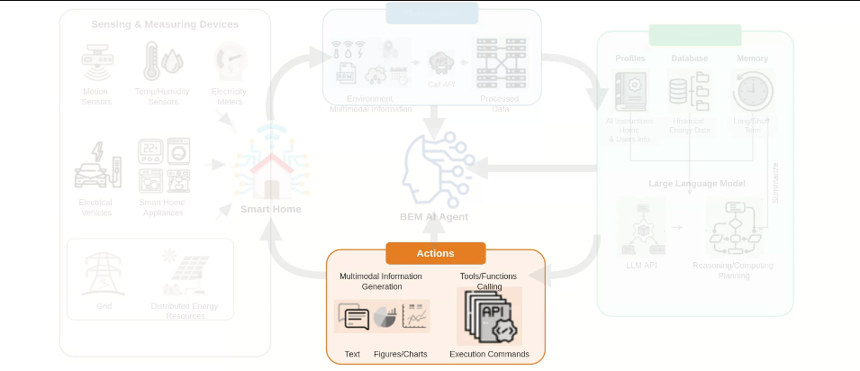
Notes:
Finally, the action module executes these plans by generating text and charts for the user, or calling APIs to issue direct device execution commands.
[Alpha Masking · arch_arxiv_ai_2025_000000112 · frame_13.png · 14]

