Slide 1

Notes:
This is the high-level overview of the Animate Banana pipeline, which automatically transforms static process-oriented diagrams into animated narratives.
[Progressive Reveal · pipeline_animated · frame_00.png · ]

Slide 2

Notes:
Stage one is the Diagram Transmuter, which converts the input diagram into animation-aware diagram code.
[Progressive Reveal · pipeline_animated · frame_01.png · ]

Slide 3

Notes:
The process begins with a static input diagram.
[Progressive Reveal · pipeline_animated · frame_02.png · ]

Slide 4
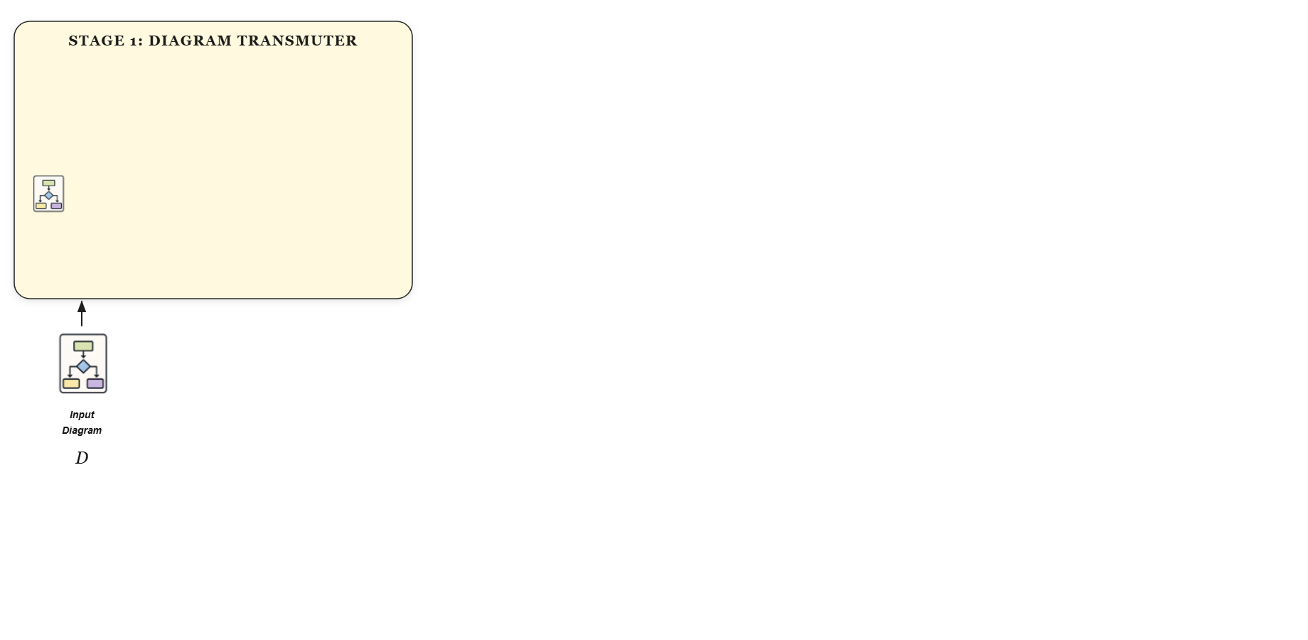
Notes:
This input diagram is fed directly into the Diagram Transmuter.
[Progressive Reveal · pipeline_animated · frame_03.png · ]

Slide 5
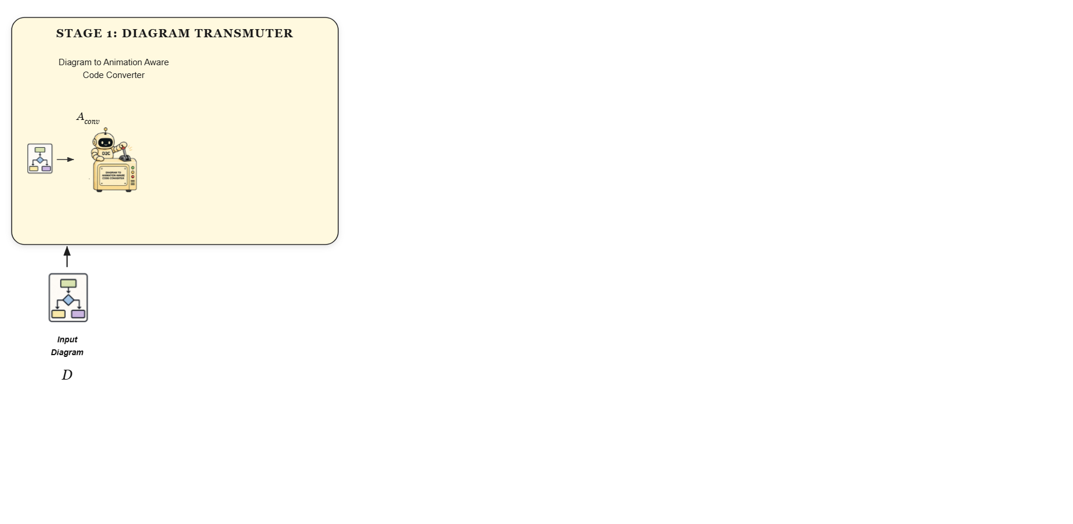
Notes:
Inside, a specialized converter agent generates an initial code representation, assigning persistent semantic identifiers to all animatable elements.
[Progressive Reveal · pipeline_animated · frame_04.png · ]

Slide 6
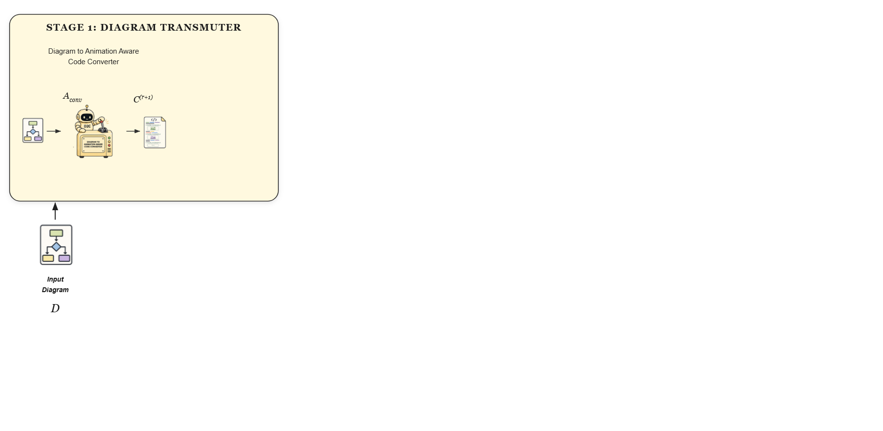
Notes:
This produces an initial draft of the animation-aware diagram code.
[Progressive Reveal · pipeline_animated · frame_05.png · ]

Slide 7
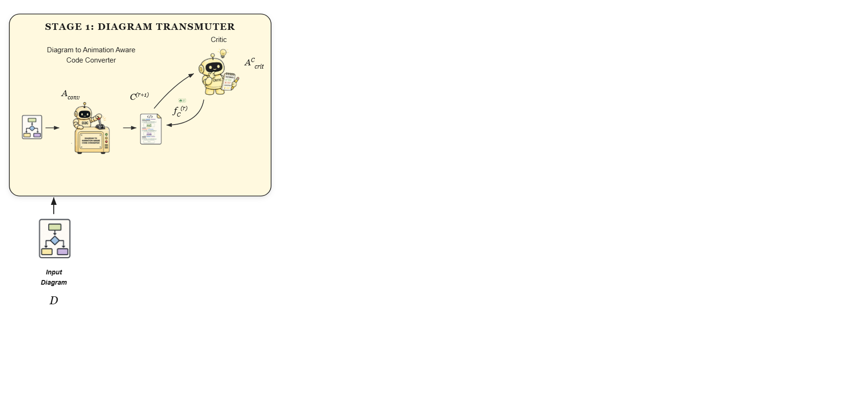
Notes:
A critic agent then evaluates the rendered code against the original diagram, providing iterative feedback to the converter to refine the code's visual and structural fidelity.
[Progressive Reveal · pipeline_animated · frame_06.png · ]

Slide 8
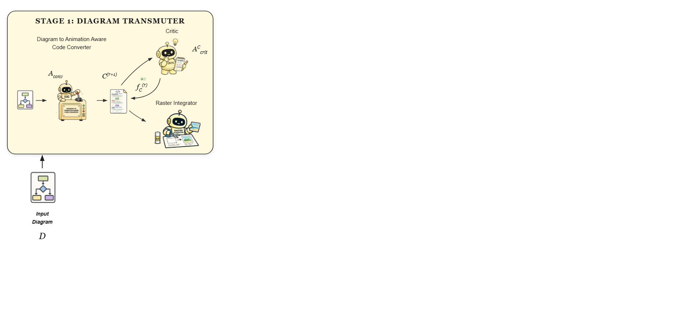
Notes:
Simultaneously, a raster integrator extracts complex visual regions, such as photographs or plots, and inserts them directly into the code to preserve them without reconstruction.
[Progressive Reveal · pipeline_animated · frame_07.png · ]

Slide 9
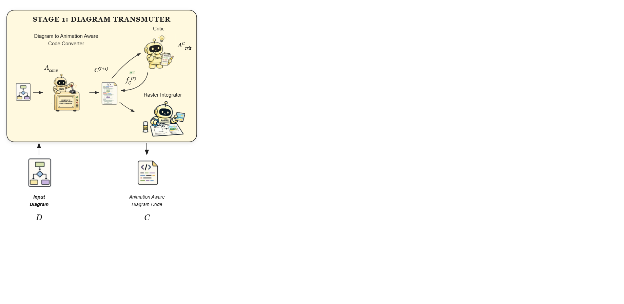
Notes:
The final output of this stage is the refined animation-aware diagram code.
[Progressive Reveal · pipeline_animated · frame_08.png · ]

Slide 10
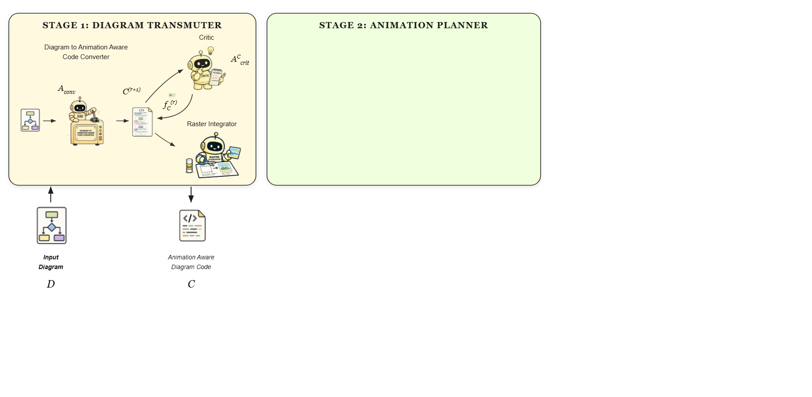
Notes:
Stage two is the Animation Planner, which designs a structured presentation and narration plan.
[Progressive Reveal · pipeline_animated · frame_09.png · ]

Slide 11
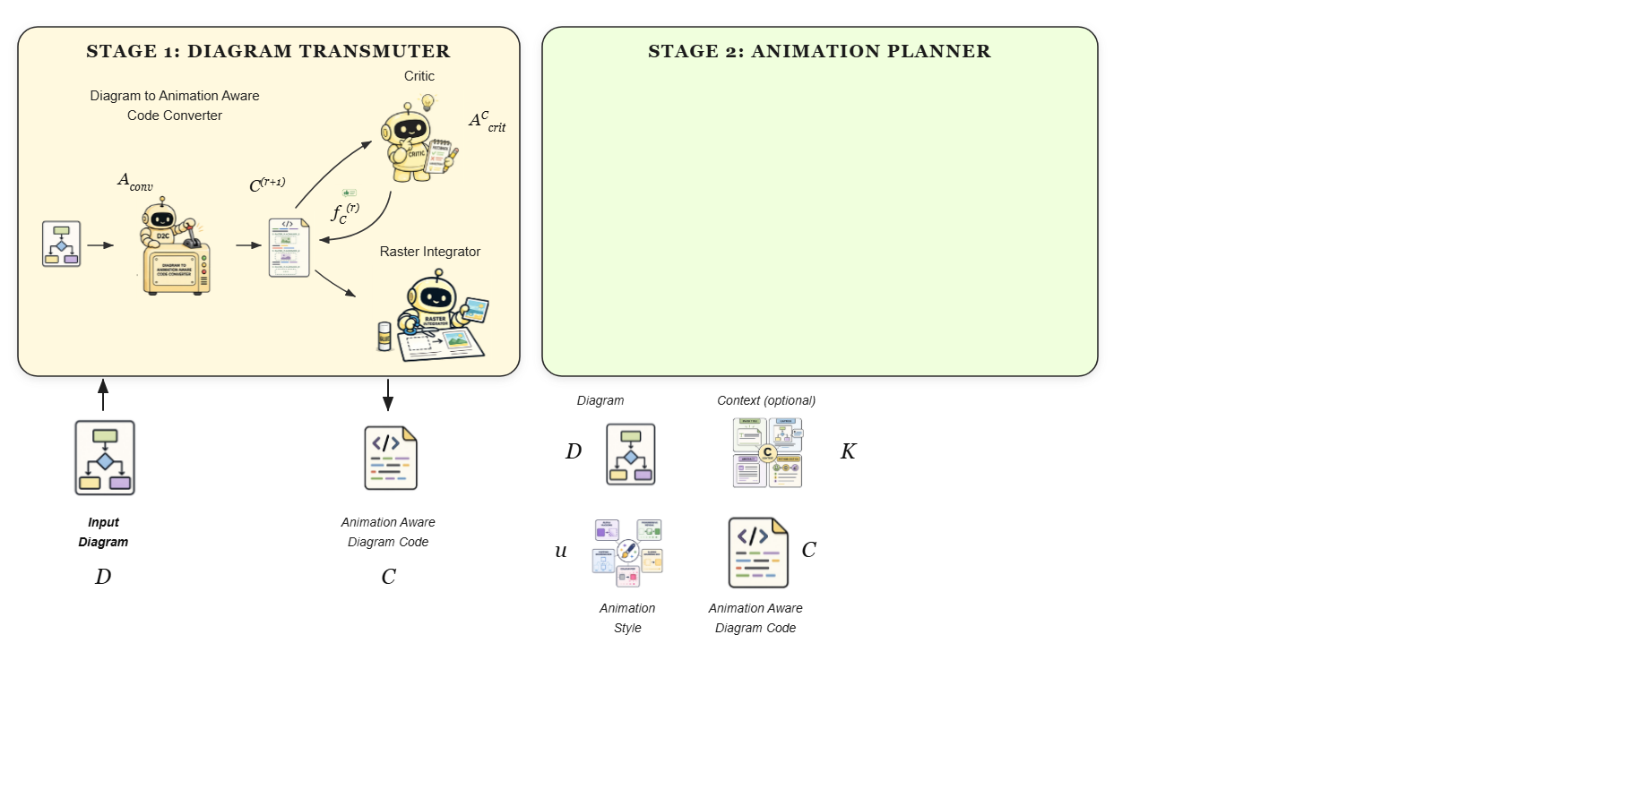
Notes:
This stage takes the diagram, optional auxiliary context, the user-specified animation style, and the generated diagram code as inputs.
[Progressive Reveal · pipeline_animated · frame_10.png · ]

Slide 12
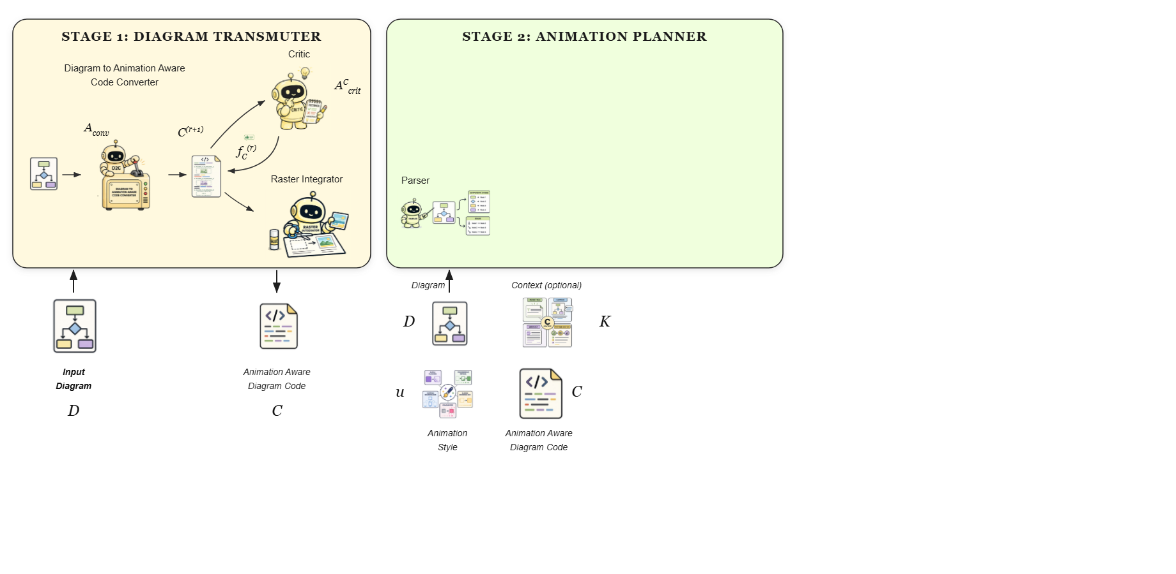
Notes:
First, a parser processes the diagram code.
[Progressive Reveal · pipeline_animated · frame_11.png · ]

Slide 13
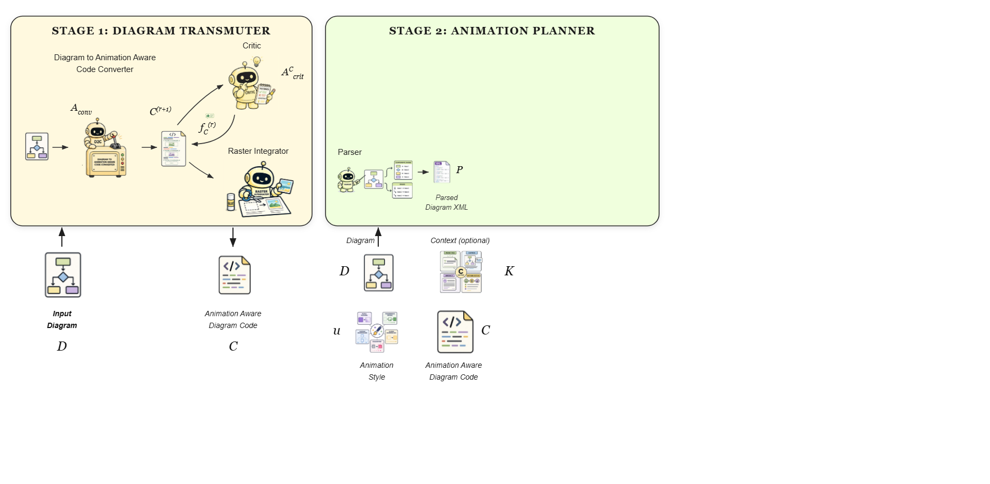
Notes:
It abstracts away rendering details to produce a structured XML representation of the diagram's entities and relationships.
[Progressive Reveal · pipeline_animated · frame_12.png · ]

Slide 14
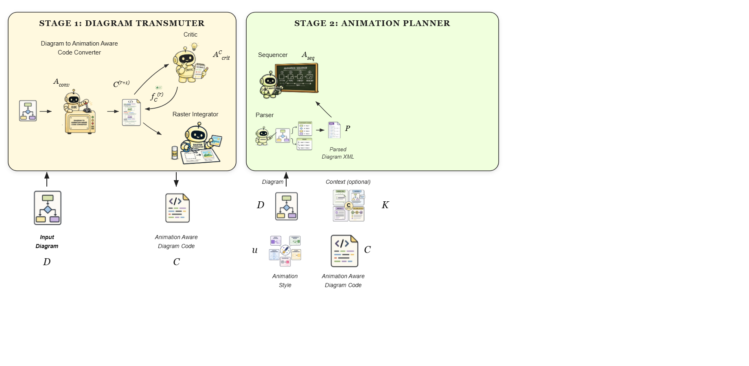
Notes:
A sequencer agent then reasons over this XML to construct an initial presentation sequence, determining the grouping and traversal order of elements.
[Progressive Reveal · pipeline_animated · frame_13.png · ]

Slide 15
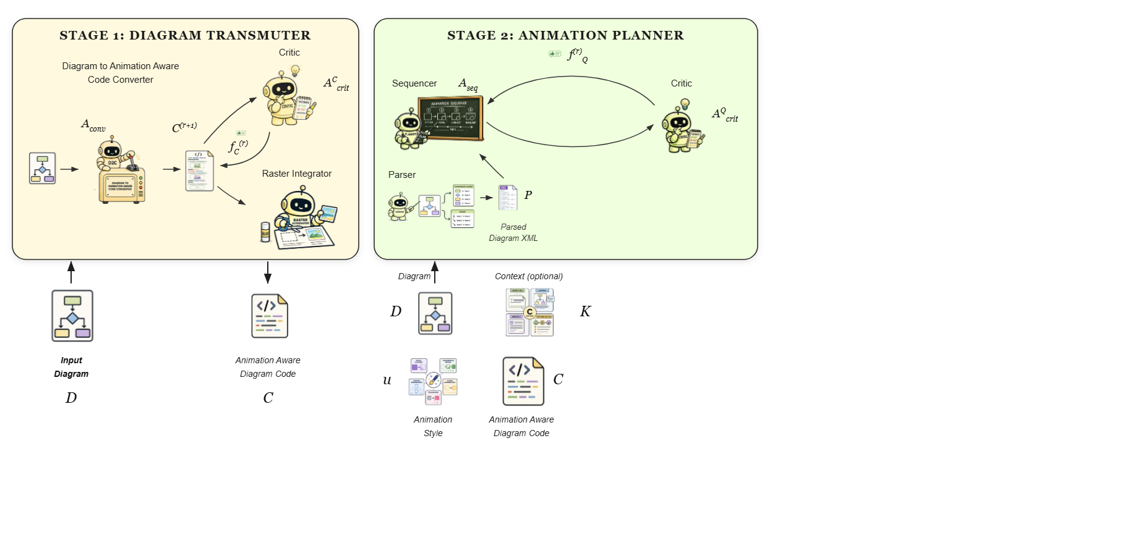
Notes:
A sequence critic evaluates this plan for coverage and coherence, guiding the sequencer through iterative refinement.
[Progressive Reveal · pipeline_animated · frame_14.png · ]

Slide 16
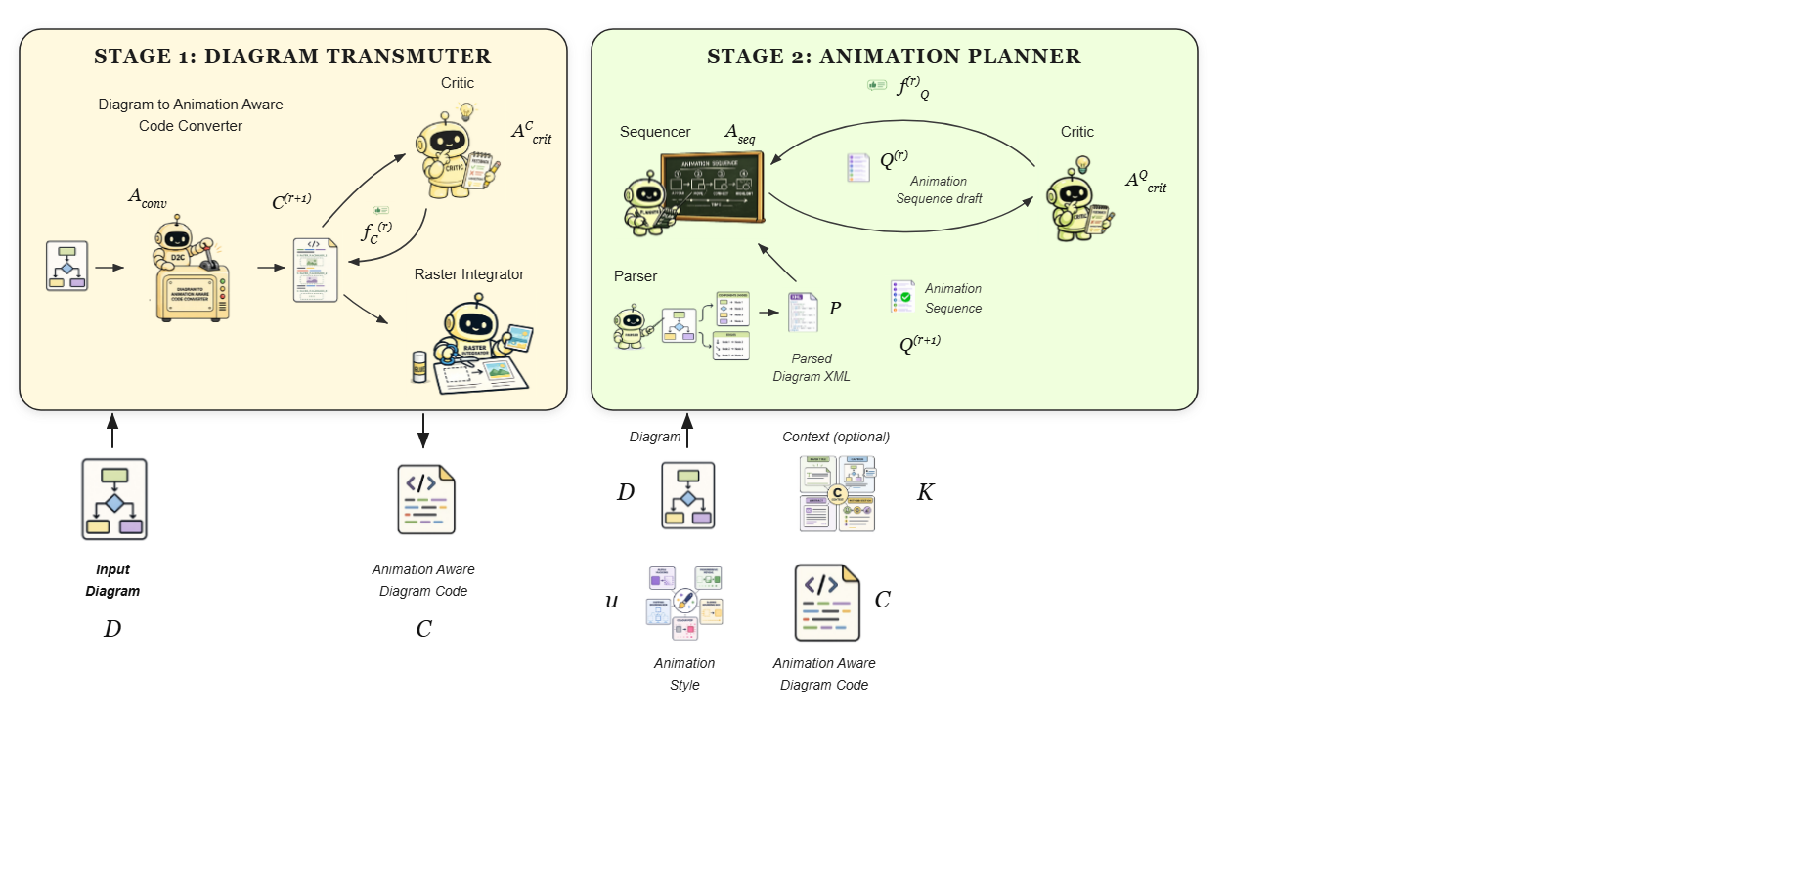
Notes:
This results in a validated animation sequence draft, tailored to the chosen animation style.
[Progressive Reveal · pipeline_animated · frame_15.png · ]

Slide 17
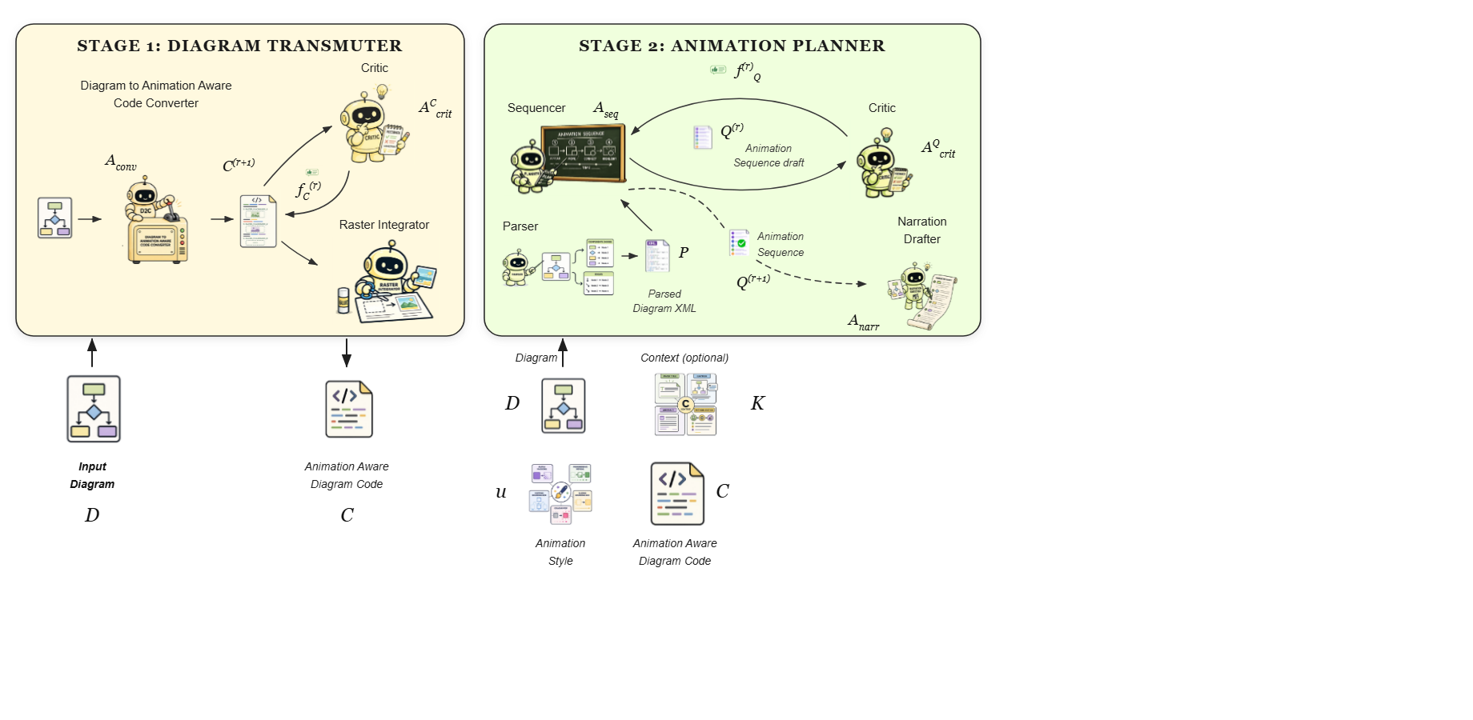
Notes:
Next, a narration drafter generates synchronized explanatory text for each step, utilizing any available auxiliary context to enrich the descriptions.
[Progressive Reveal · pipeline_animated · frame_16.png · ]

Slide 18
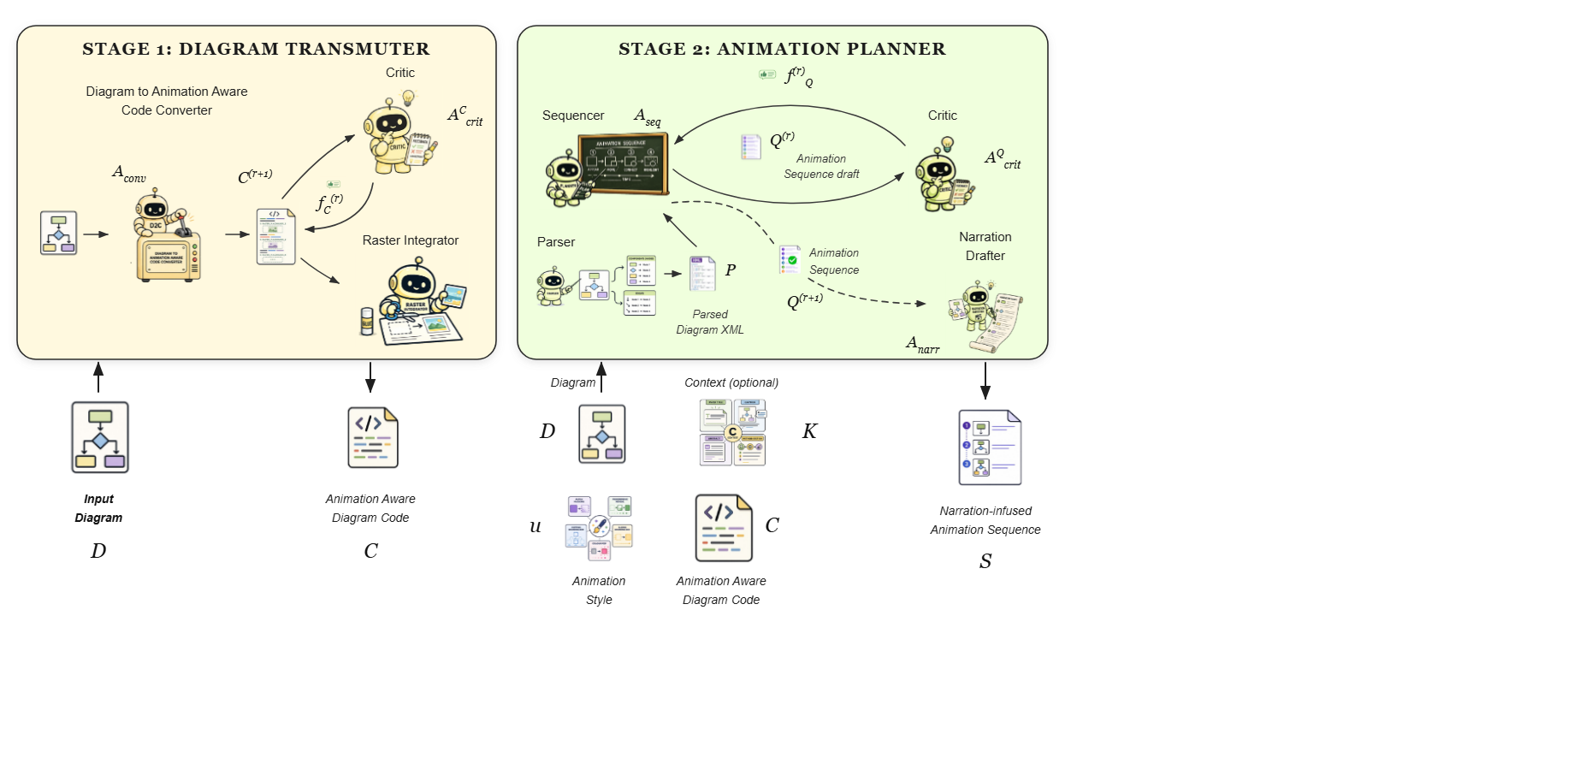
Notes:
This produces the narration-infused animation sequence, coupling visual steps with spoken explanations.
[Progressive Reveal · pipeline_animated · frame_17.png · ]

Slide 19
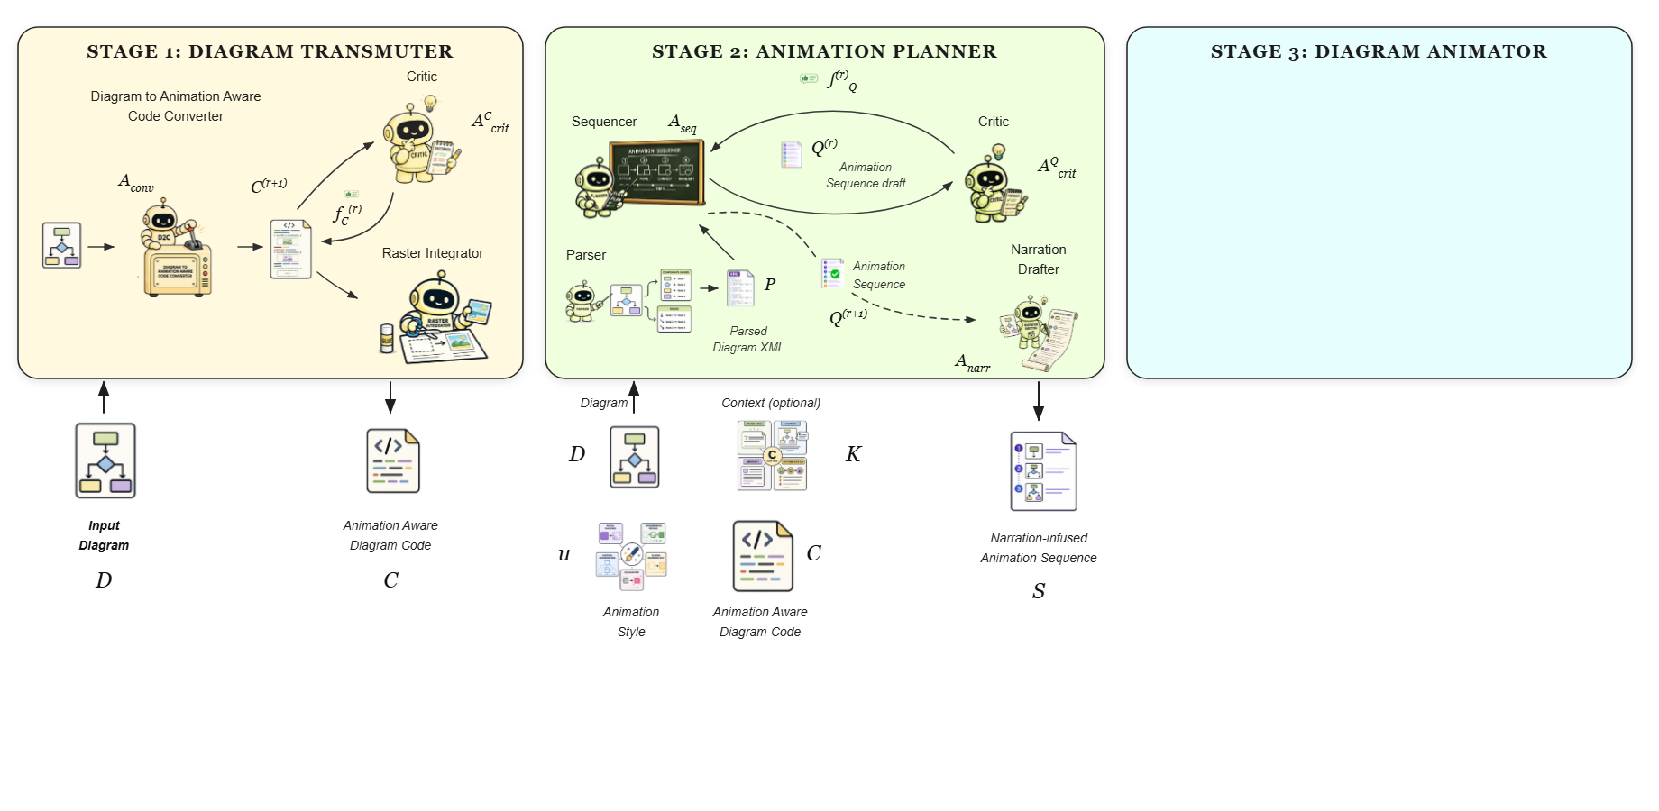
Notes:
Stage three is the Diagram Animator, which synthesizes the final animated narrative.
[Progressive Reveal · pipeline_animated · frame_18.png · ]

Slide 20
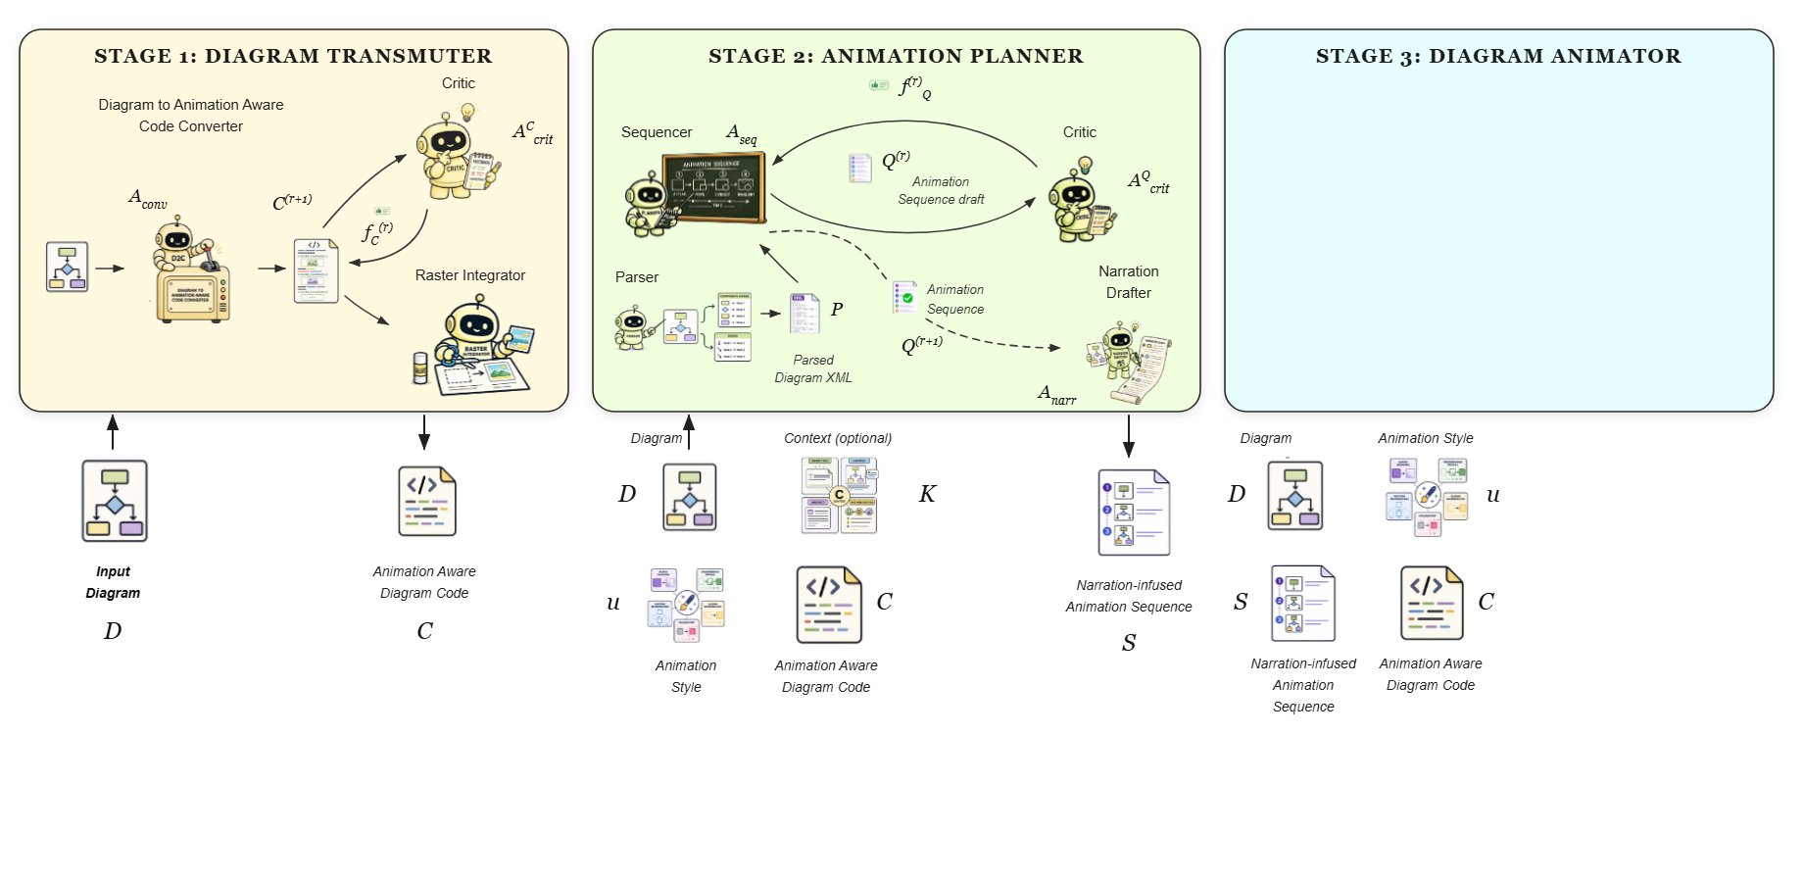
Notes:
It ingests the original diagram, the chosen animation style, the narration-infused sequence, and the diagram code.
[Progressive Reveal · pipeline_animated · frame_19.png · ]

Slide 21
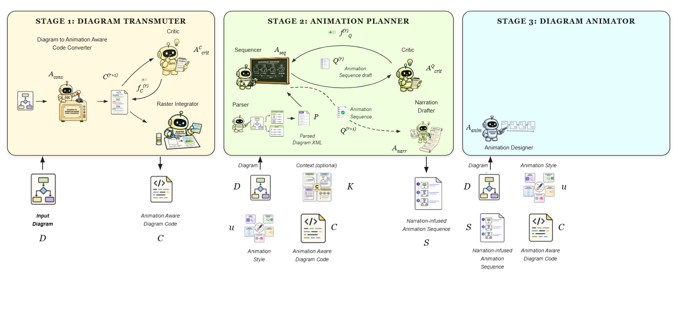
Notes:
An animation designer agent generates an initial executable animation program based on these inputs.
[Progressive Reveal · pipeline_animated · frame_20.png · ]

Slide 22
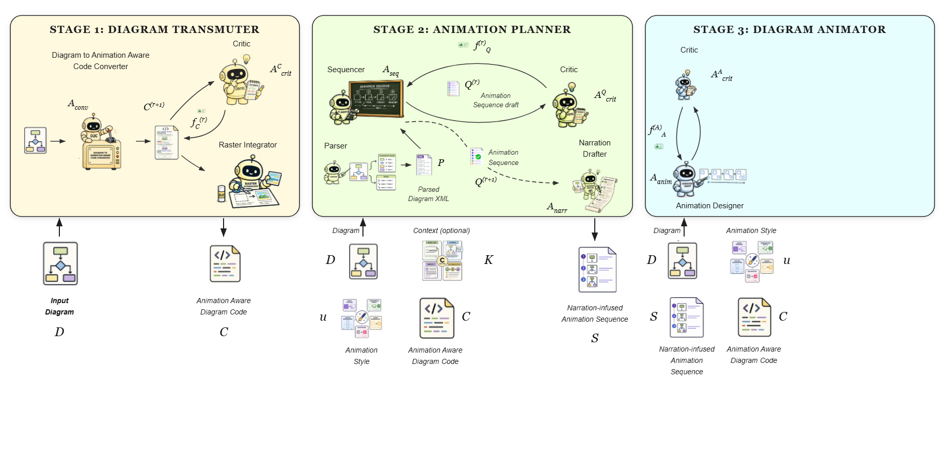
Notes:
An animation critic evaluates the rendered frames against the source diagram, using a critic memory of past feedback to correct visual and temporal errors.
[Progressive Reveal · pipeline_animated · frame_21.png · ]

Slide 23
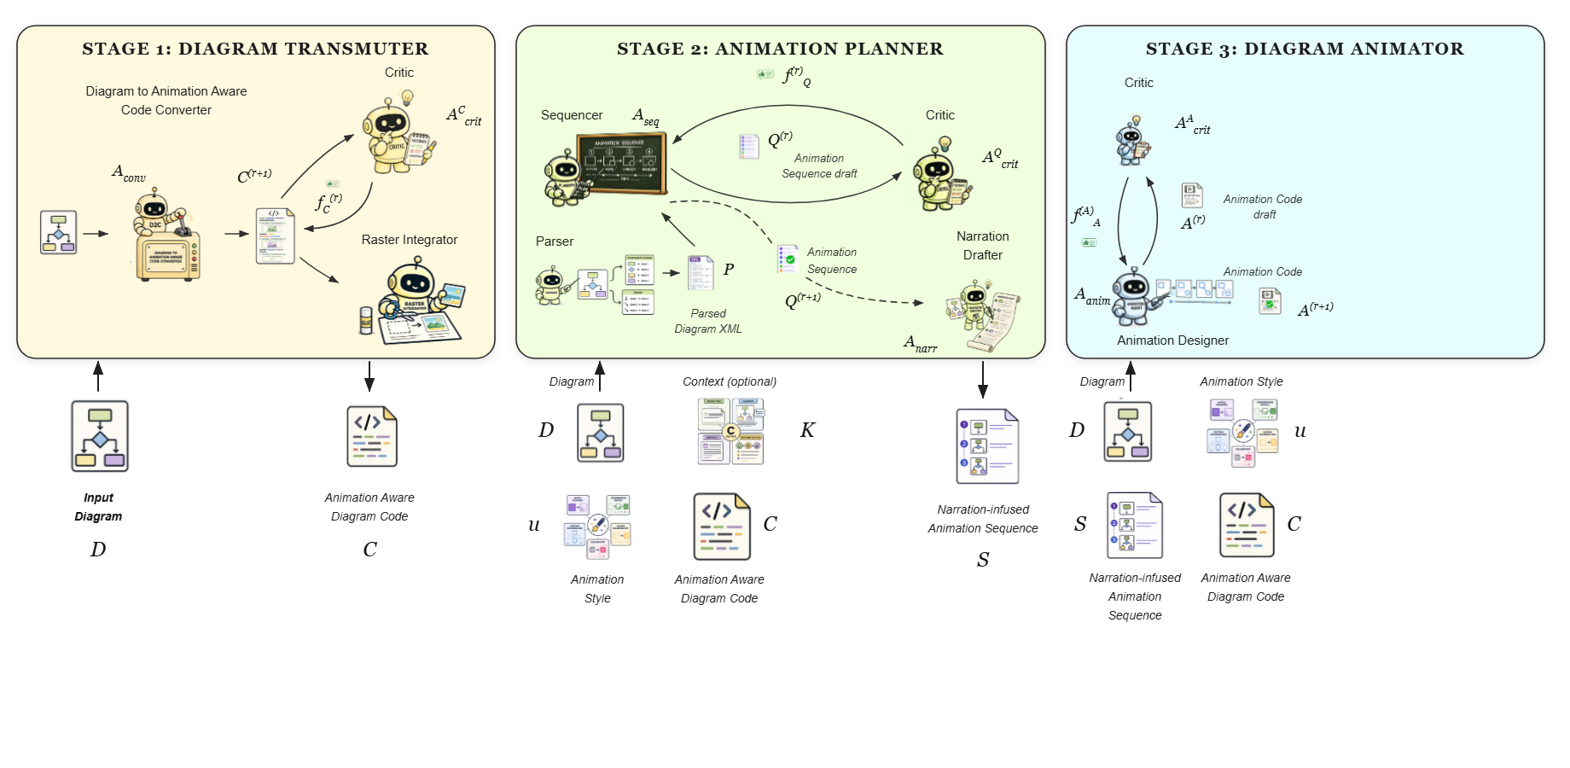
Notes:
This iterative process refines the executable animation code.
[Progressive Reveal · pipeline_animated · frame_22.png · ]

Slide 24
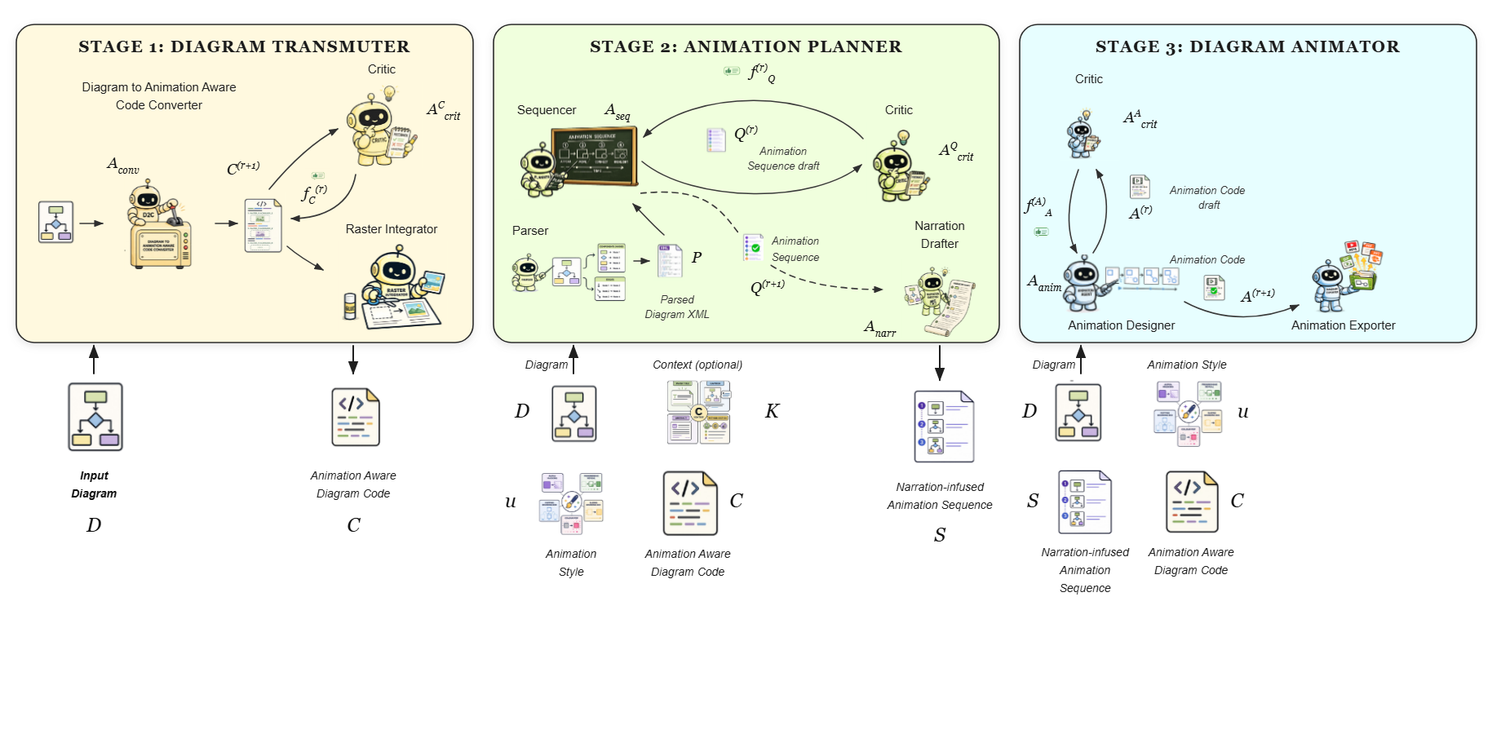
Notes:
Once validated, an animation exporter renders the frames into the target presentation format.
[Progressive Reveal · pipeline_animated · frame_23.png · ]

Slide 25
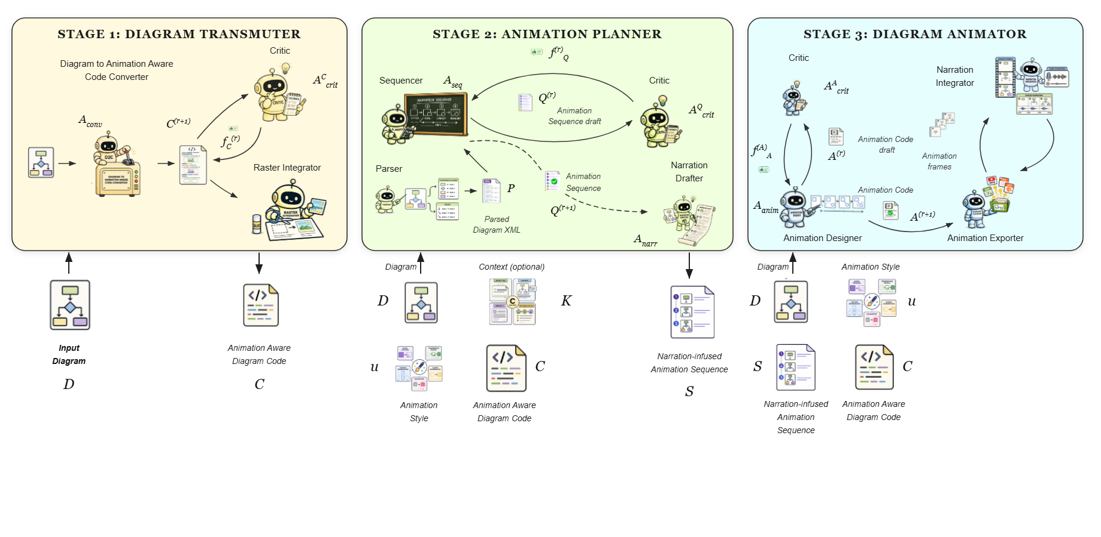
Notes:
In parallel, a narration integrator uses speech synthesis to align the step-level narration with the corresponding visual states.
[Progressive Reveal · pipeline_animated · frame_24.png · ]

Slide 26
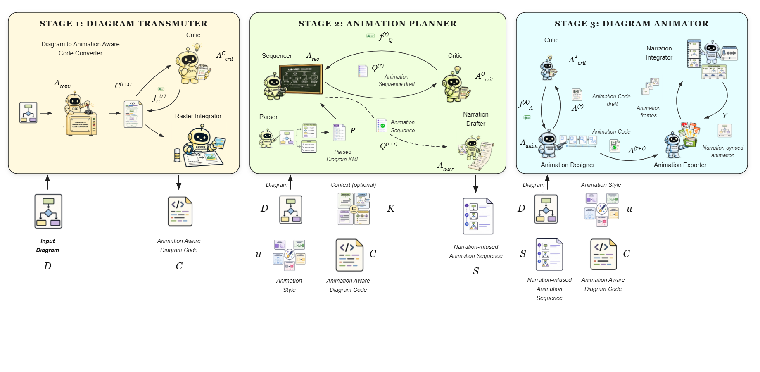
Notes:
This ensures that the visual transitions and audio explanations are perfectly synchronized.
[Progressive Reveal · pipeline_animated · frame_25.png · ]

Slide 27
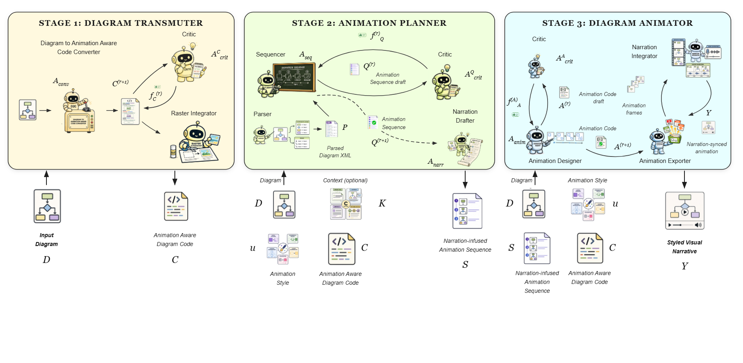
Notes:
The final output is a styled visual narrative, ready to be deployed across multiple formats such as MP4, PDF, or PowerPoint.
[Progressive Reveal · pipeline_animated · frame_26.png · ]

