Slide 1
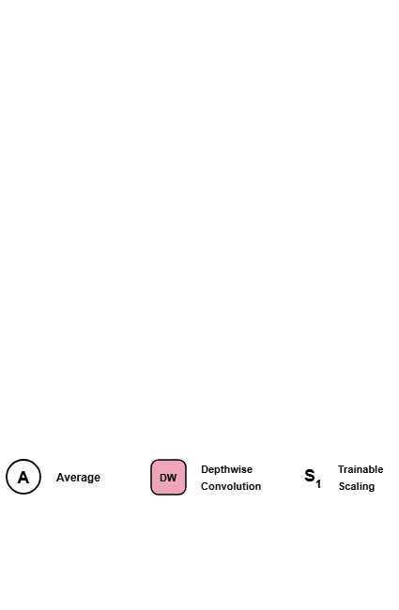
Notes:
The diagram introduces key architectural conventions, including average aggregation, depthwise convolutions, and trainable scaling parameters.
[Progressive Reveal · CVPR_2025_arch00012 · frame_00.png · 0.50s]

Slide 2
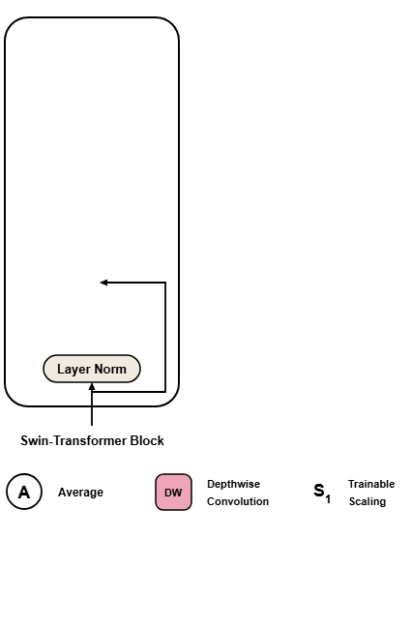
Notes:
In the Swin-Transformer block, input features pass through layer normalization alongside an initial residual shortcut.
[Progressive Reveal · CVPR_2025_arch00012 · frame_01.png · 1.00s]

Slide 3
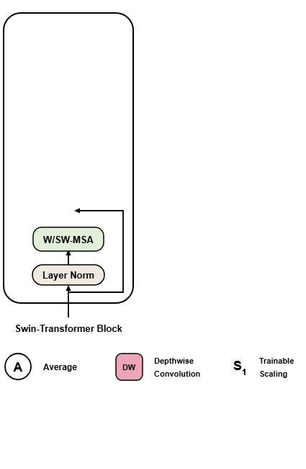
Notes:
Normalized features enter the window and shifted-window multi-head self-attention module to capture spatial context.
[Progressive Reveal · CVPR_2025_arch00012 · frame_02.png · 1.50s]

Slide 4
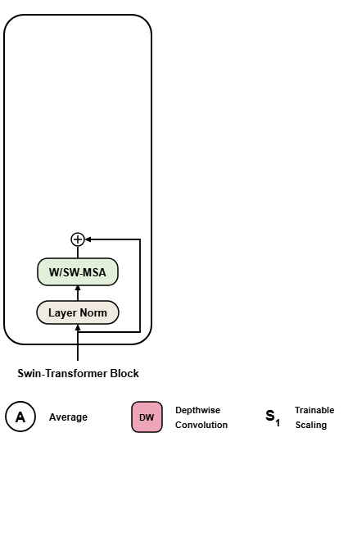
Notes:
The attention outputs are then merged with the initial residual connection.
[Progressive Reveal · CVPR_2025_arch00012 · frame_03.png · 2.00s]

Slide 5
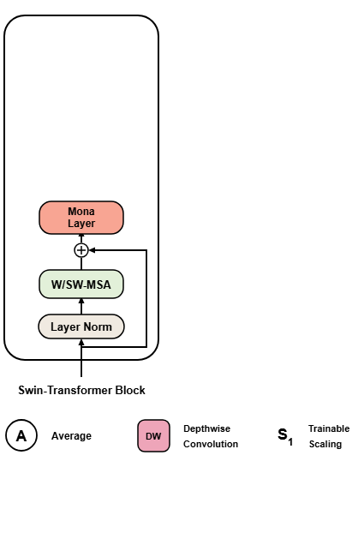
Notes:
The first Mona adapter layer processes the aggregated representation to enhance visual feature adaptation.
[Progressive Reveal · CVPR_2025_arch00012 · frame_04.png · 2.50s]

Slide 6
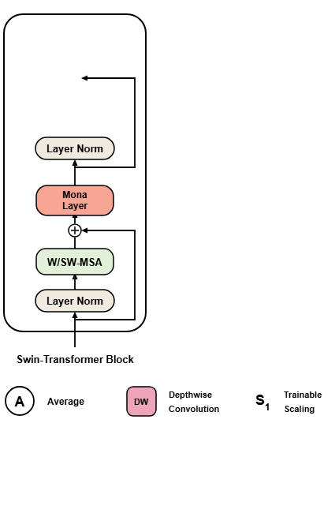
Notes:
Features undergo a second layer normalization step before the feed-forward network, accompanied by another skip connection.
[Progressive Reveal · CVPR_2025_arch00012 · frame_05.png · 3.00s]

Slide 7
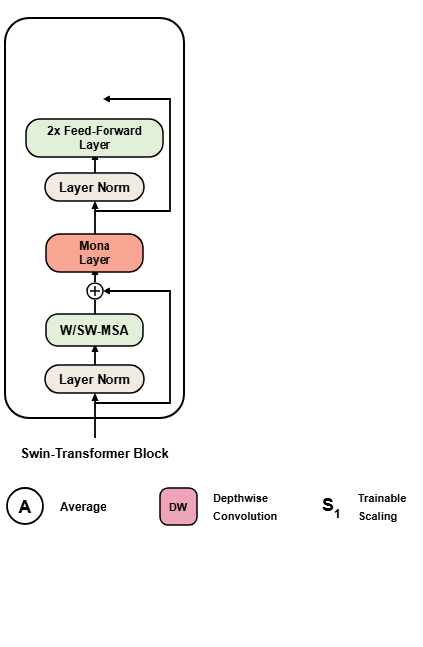
Notes:
A feed-forward layer then transforms the intermediate token representations.
[Progressive Reveal · CVPR_2025_arch00012 · frame_06.png · 3.50s]

Slide 8
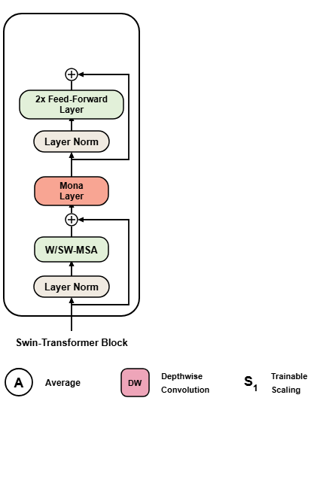
Notes:
The feed-forward output is summed with its corresponding shortcut.
[Progressive Reveal · CVPR_2025_arch00012 · frame_07.png · 4.00s]

Slide 9
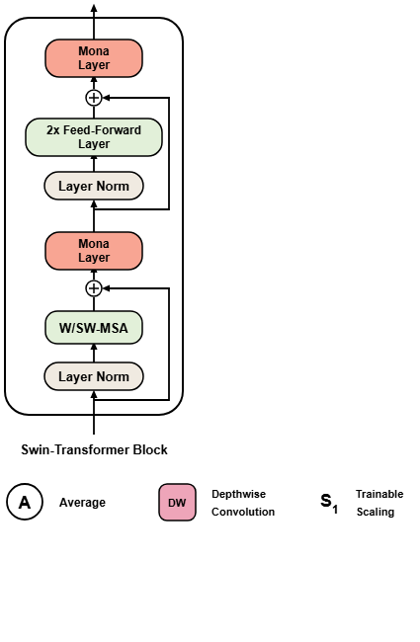
Notes:
A second Mona layer further refines the features before outputting the final representation of the Swin-Transformer block.
[Progressive Reveal · CVPR_2025_arch00012 · frame_08.png · 4.50s]

Slide 10
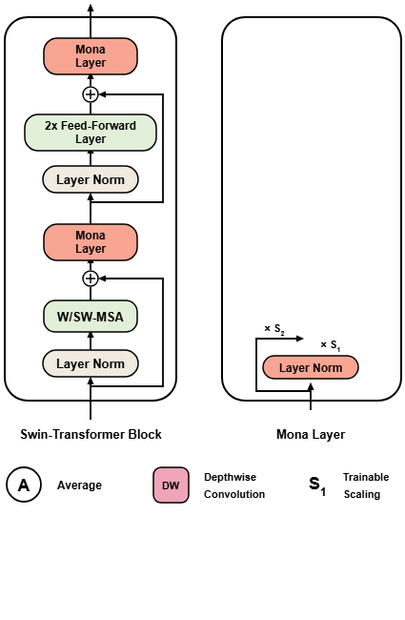
Notes:
Inside the Mona layer, input features undergo layer normalization scaled by a trainable factor, while a parallel skip branch is scaled by a second factor.
[Progressive Reveal · CVPR_2025_arch00012 · frame_09.png · 5.00s]

Slide 11
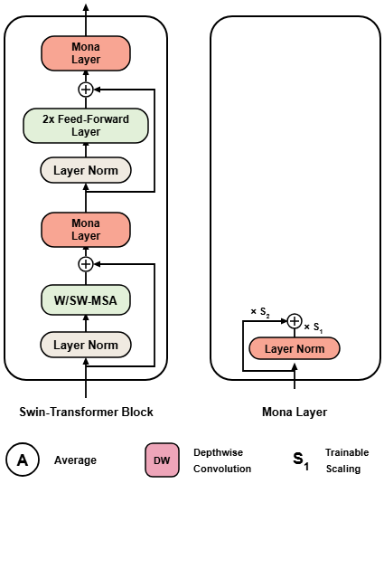
Notes:
The scaled feature streams are combined at an addition node to regulate input distribution.
[Progressive Reveal · CVPR_2025_arch00012 · frame_10.png · 5.50s]

Slide 12
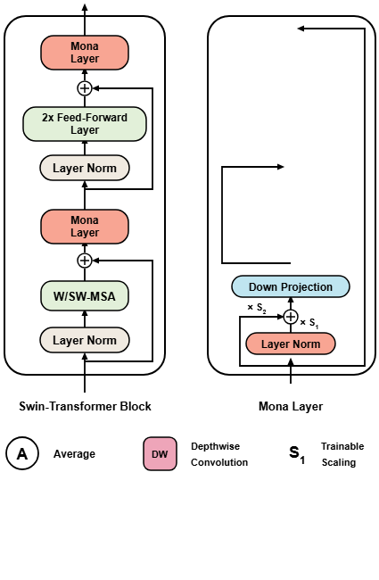
Notes:
A down projection layer reduces channel dimensionality before branching into multi-scale convolutional paths and residual shortcuts.
[Progressive Reveal · CVPR_2025_arch00012 · frame_11.png · 6.00s]

Slide 13
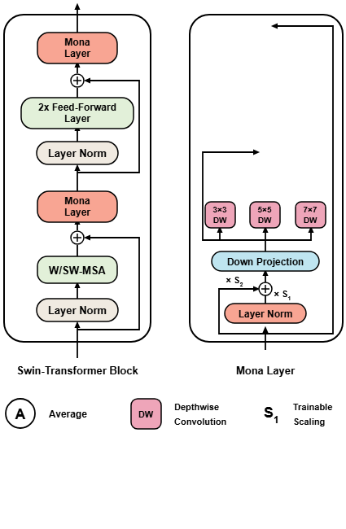
Notes:
Three parallel depthwise convolutions with 3x3, 5x5, and 7x7 kernels extract multi-scale visual patterns.
[Progressive Reveal · CVPR_2025_arch00012 · frame_12.png · 6.50s]

Slide 14
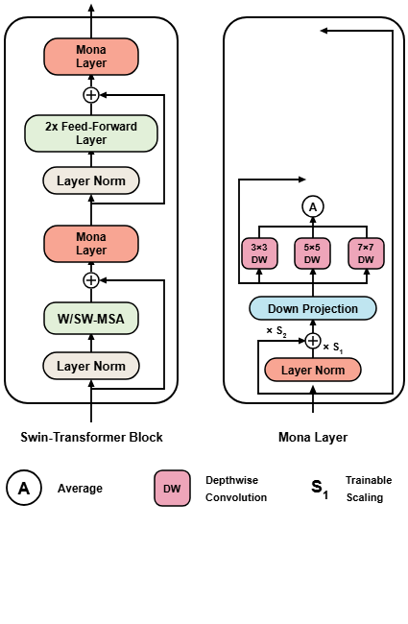
Notes:
Outputs from all three kernel branches are combined using an averaging operation.
[Progressive Reveal · CVPR_2025_arch00012 · frame_13.png · 7.00s]

Slide 15

Notes:
The averaged depthwise feature is added to the pre-convolution residual branch.
[Progressive Reveal · CVPR_2025_arch00012 · frame_14.png · 7.50s]

Slide 16
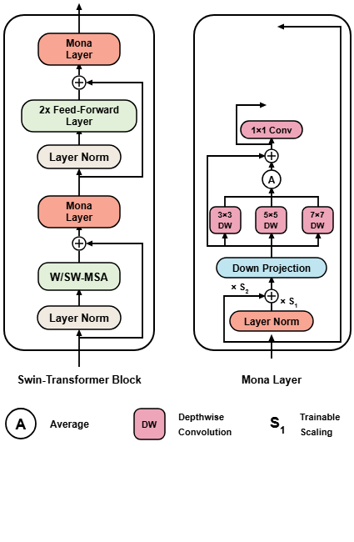
Notes:
A 1x1 convolution aggregates point-wise channel features alongside an adjacent residual shortcut.
[Progressive Reveal · CVPR_2025_arch00012 · frame_15.png · 8.00s]

Slide 17

Notes:
The 1x1 convolution output is summed with its shortcut connection.
[Progressive Reveal · CVPR_2025_arch00012 · frame_16.png · 8.50s]

Slide 18
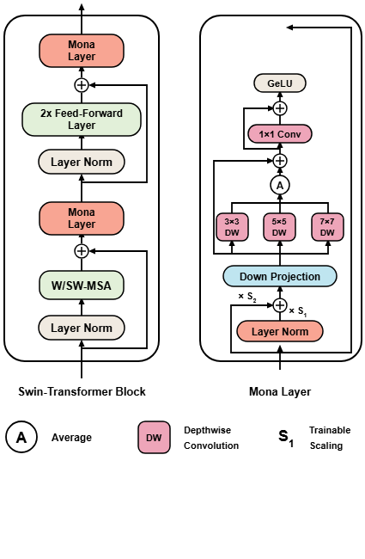
Notes:
A GeLU activation function introduces non-linearity.
[Progressive Reveal · CVPR_2025_arch00012 · frame_17.png · 9.00s]

Slide 19
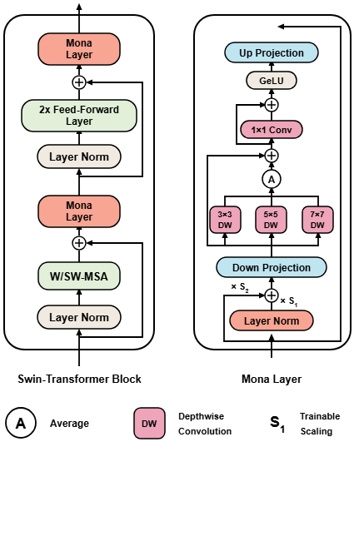
Notes:
An up projection layer restores the original feature channel dimensions.
[Progressive Reveal · CVPR_2025_arch00012 · frame_18.png · 9.50s]

Slide 20
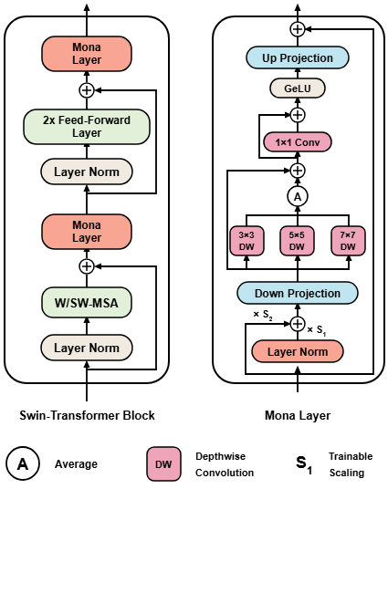
Notes:
Finally, the outer residual is added to yield the complete output of the Mona layer.
[Progressive Reveal · CVPR_2025_arch00012 · frame_19.png · 10.00s]

