Slide 1
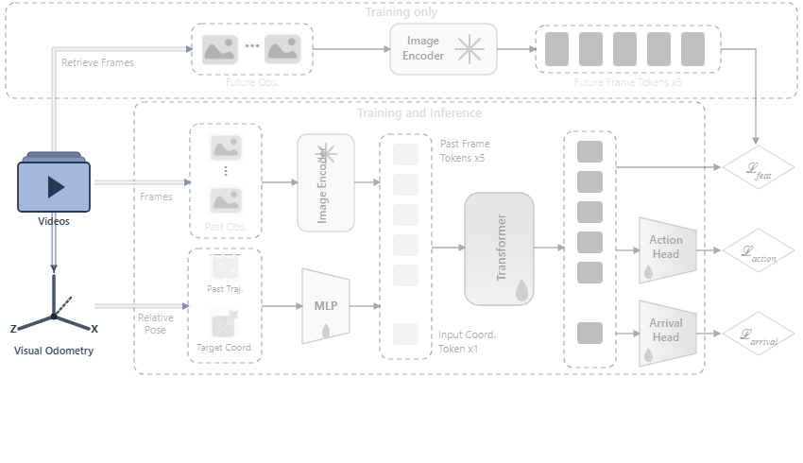
Notes:
The framework takes egocentric video inputs and derives local relative camera poses using visual odometry.
[Colour Pop · CVPR_2025_arch00389 · frame_00.png · ]

Slide 2
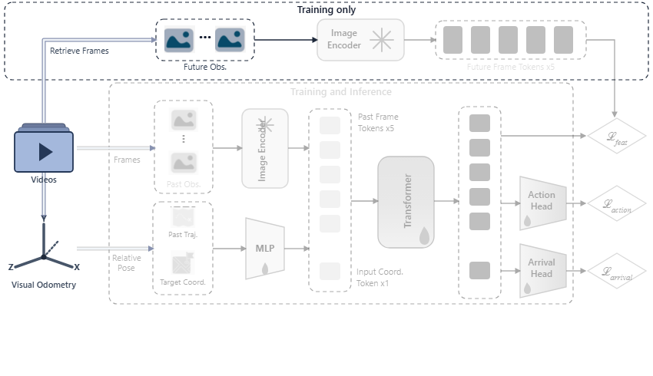
Notes:
Exclusively during training, future observation frames are retrieved from the video stream.
[Colour Pop · CVPR_2025_arch00389 · frame_01.png · ]

Slide 3
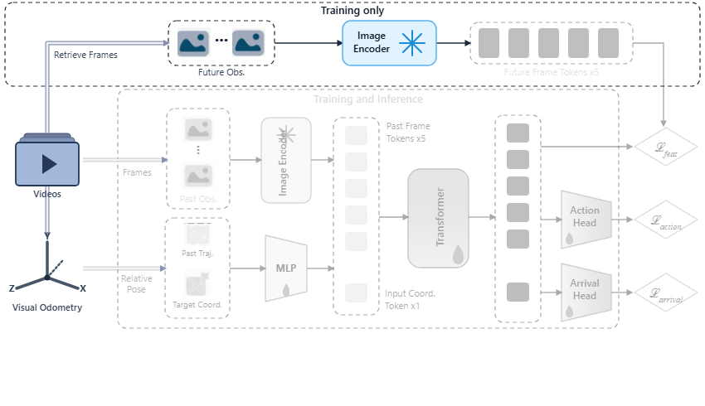
Notes:
A frozen image encoder processes these future frames.
[Colour Pop · CVPR_2025_arch00389 · frame_02.png · ]

Slide 4
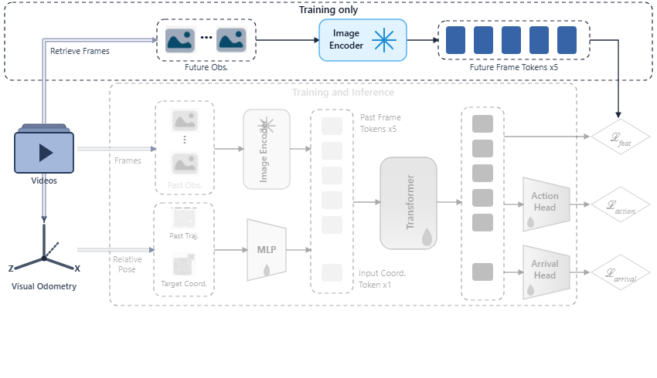
Notes:
This extracts future frame tokens to serve as reference targets for feature hallucination supervision.
[Colour Pop · CVPR_2025_arch00389 · frame_03.png · ]

Slide 5
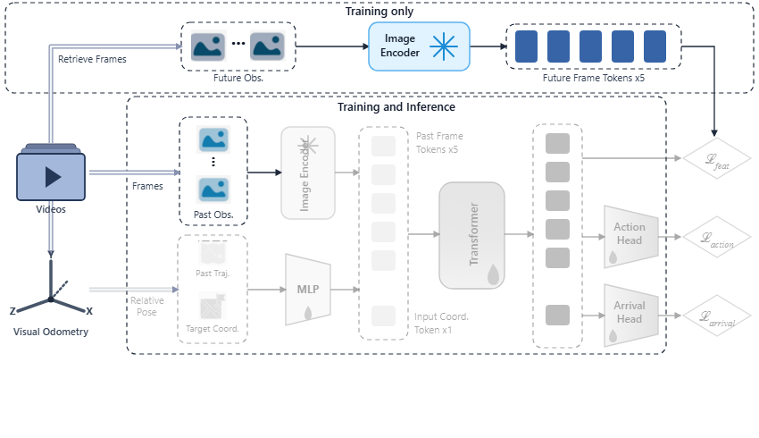
Notes:
In both training and inference, past visual observation frames are sampled from the video input.
[Colour Pop · CVPR_2025_arch00389 · frame_04.png · ]

Slide 6
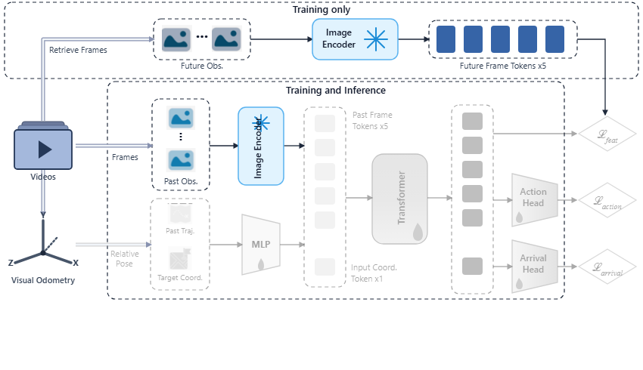
Notes:
The frozen image encoder extracts past frame tokens from these observations.
[Colour Pop · CVPR_2025_arch00389 · frame_05.png · ]

Slide 7
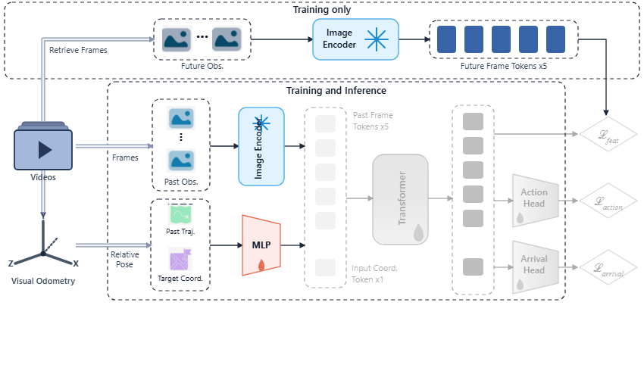
Notes:
Simultaneously, relative poses from visual odometry supply past trajectories and target coordinates, which a multi-layer perceptron embeds into a coordinate token.
[Colour Pop · CVPR_2025_arch00389 · frame_06.png · ]

Slide 8

Notes:
The past frame tokens and the coordinate token combine to form the full input sequence.
[Colour Pop · CVPR_2025_arch00389 · frame_07.png · ]

Slide 9
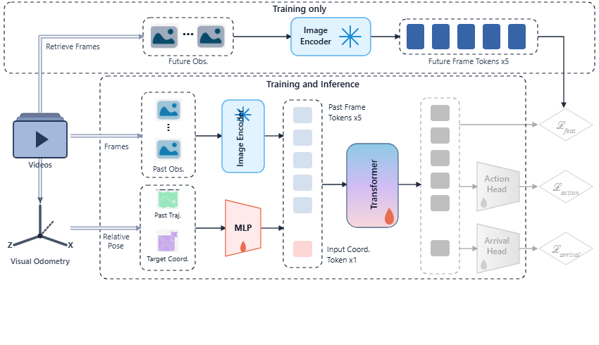
Notes:
A transformer processes the combined sequence to model spatial and temporal dynamics.
[Colour Pop · CVPR_2025_arch00389 · frame_08.png · ]

Slide 10
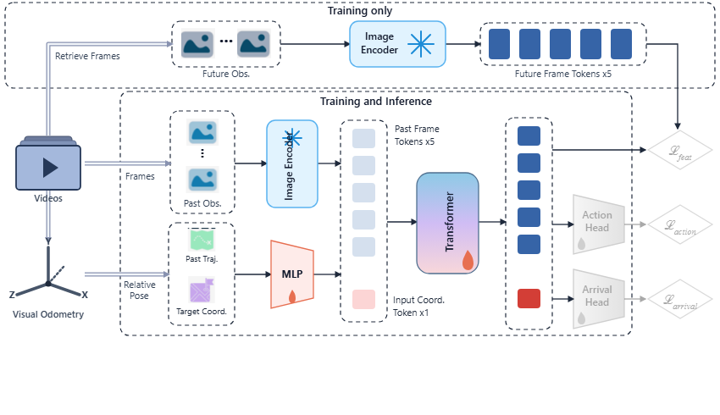
Notes:
The transformer outputs contextual tokens directed to prediction heads and feature alignment.
[Colour Pop · CVPR_2025_arch00389 · frame_09.png · ]

Slide 11

Notes:
An auxiliary feature loss guides the transformer by aligning output tokens with the future frame representations.
[Colour Pop · CVPR_2025_arch00389 · frame_10.png · ]

Slide 12
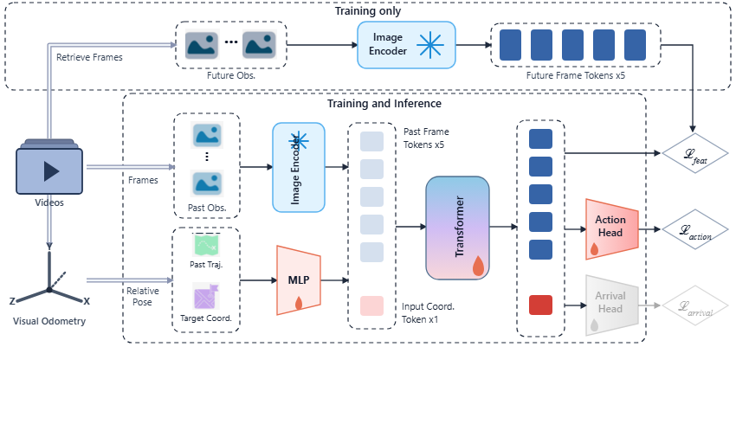
Notes:
The action head decodes future action waypoints, optimized under the action loss function.
[Colour Pop · CVPR_2025_arch00389 · frame_11.png · ]

Slide 13
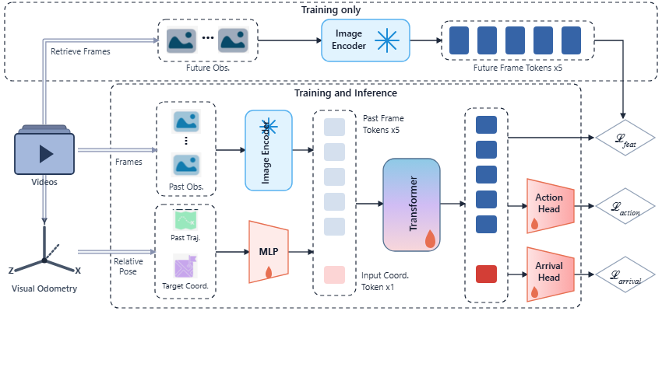
Notes:
Concurrently, the arrival head estimates sub-goal arrival status, supervised by the arrival loss.
[Colour Pop · CVPR_2025_arch00389 · frame_12.png · ]

