Slide 1
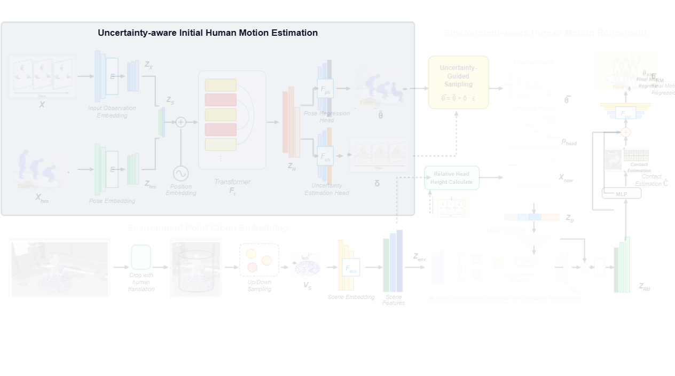
Notes:
First, the framework initiates the uncertainty-aware initial human motion estimation module to predict preliminary full-body motion along with joint uncertainty.
[Alpha Masking · CVPR_2025_arch00932 · frame_00.png · 1.00s]

Slide 2
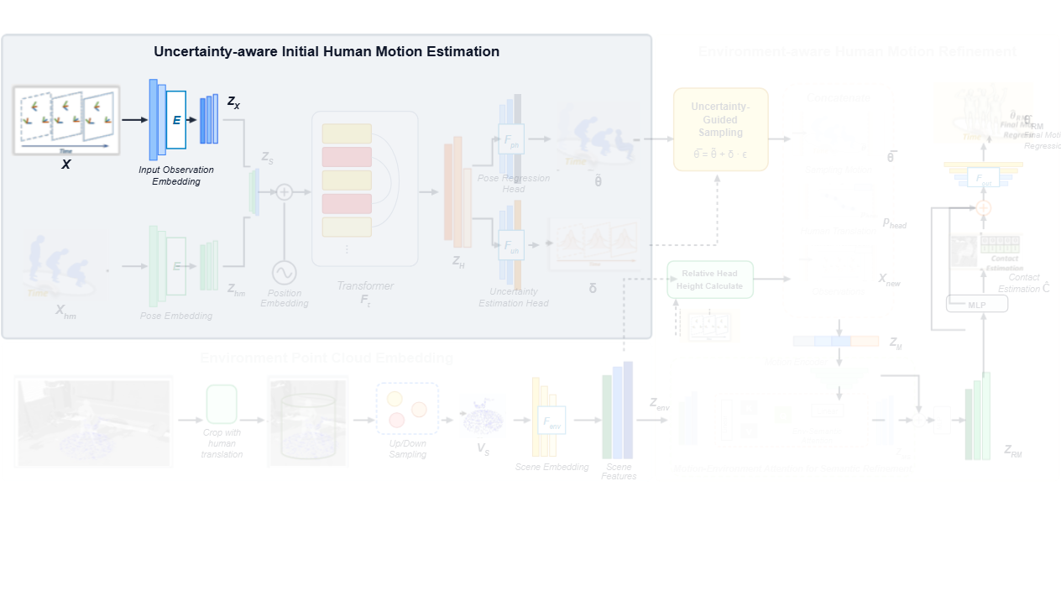
Notes:
Sparse tracking signals from the head and hand controllers are embedded into observation feature representations.
[Alpha Masking · CVPR_2025_arch00932 · frame_01.png · 3.00s]

Slide 3
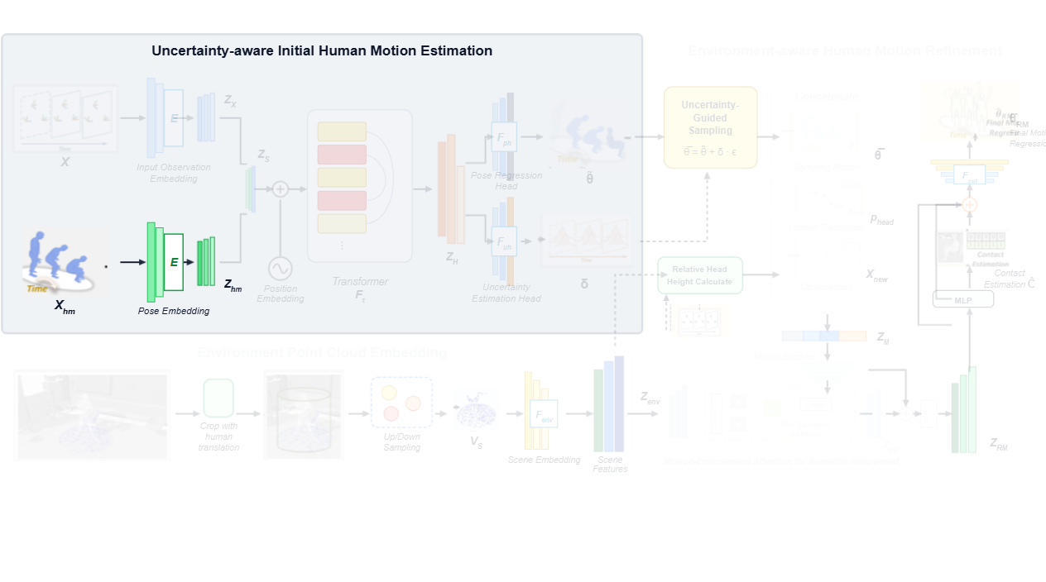
Notes:
Concurrently, historical human motion sequences are processed through a pose encoder to extract motion history embeddings.
[Alpha Masking · CVPR_2025_arch00932 · frame_02.png · 5.00s]

Slide 4
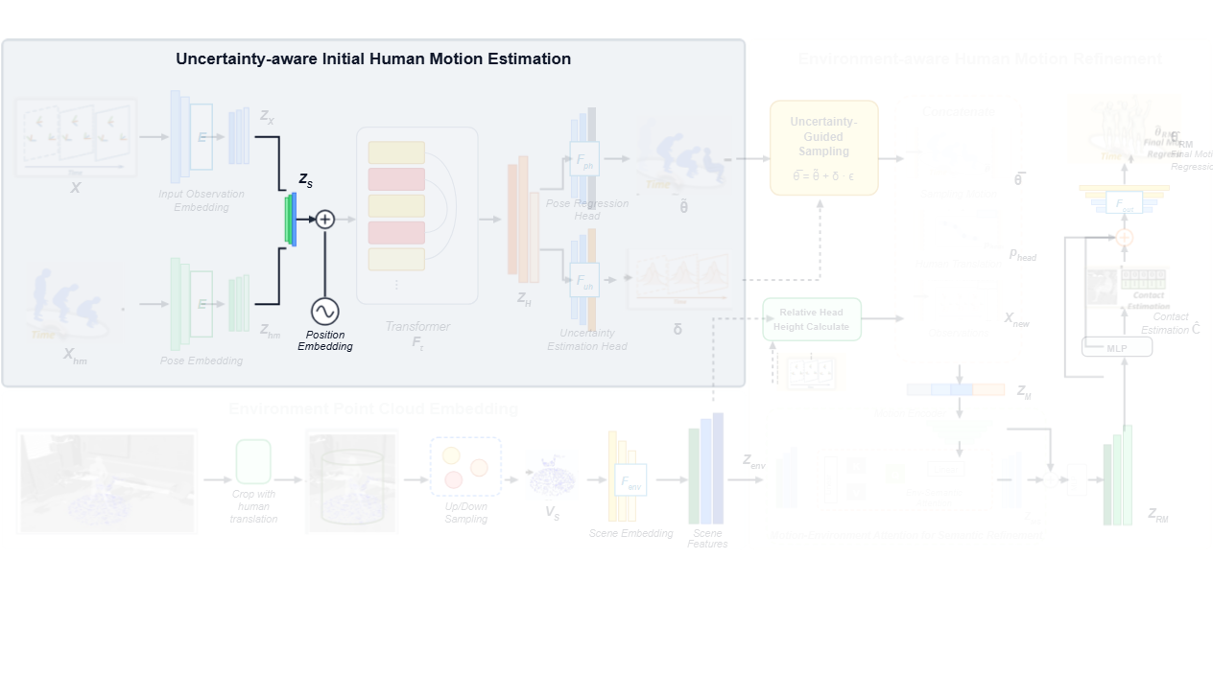
Notes:
The observation and historical motion representations are concatenated into a shallow motion representation and combined with temporal position embeddings.
[Alpha Masking · CVPR_2025_arch00932 · frame_04.png · 6.00s]

Slide 5
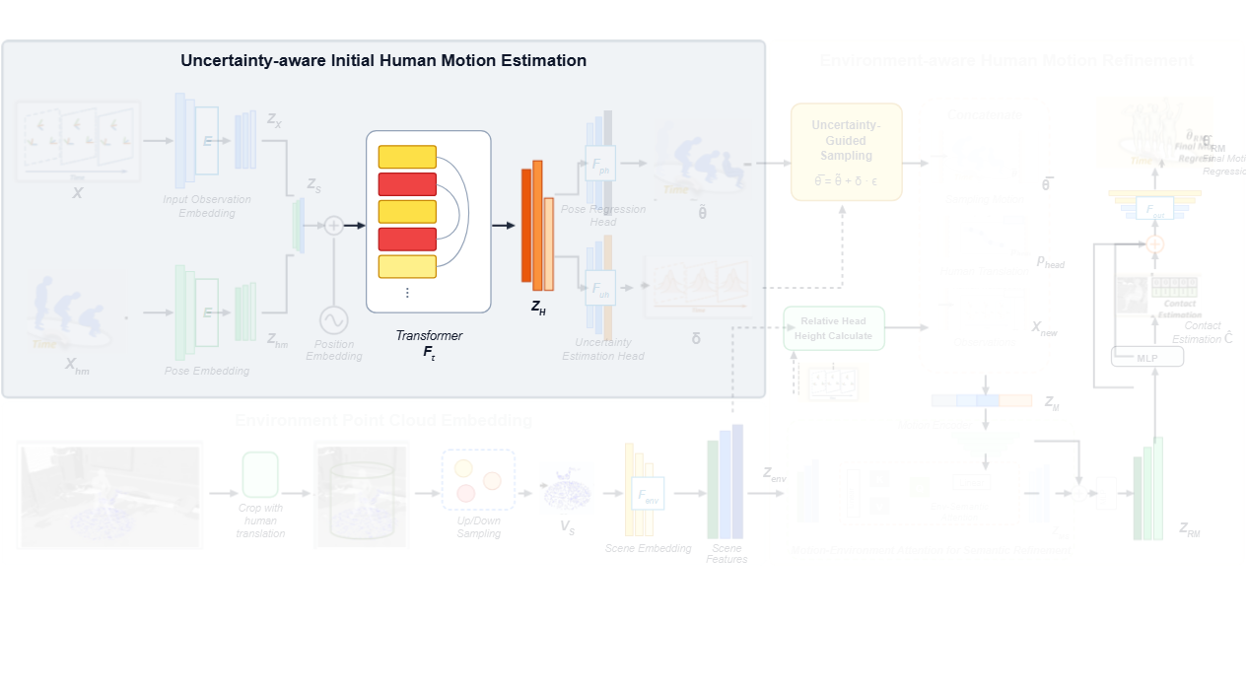
Notes:
A transformer encoder then models temporal dependencies across frames, extracting high-dimensional motion features.
[Alpha Masking · CVPR_2025_arch00932 · frame_05.png · 9.00s]

Slide 6
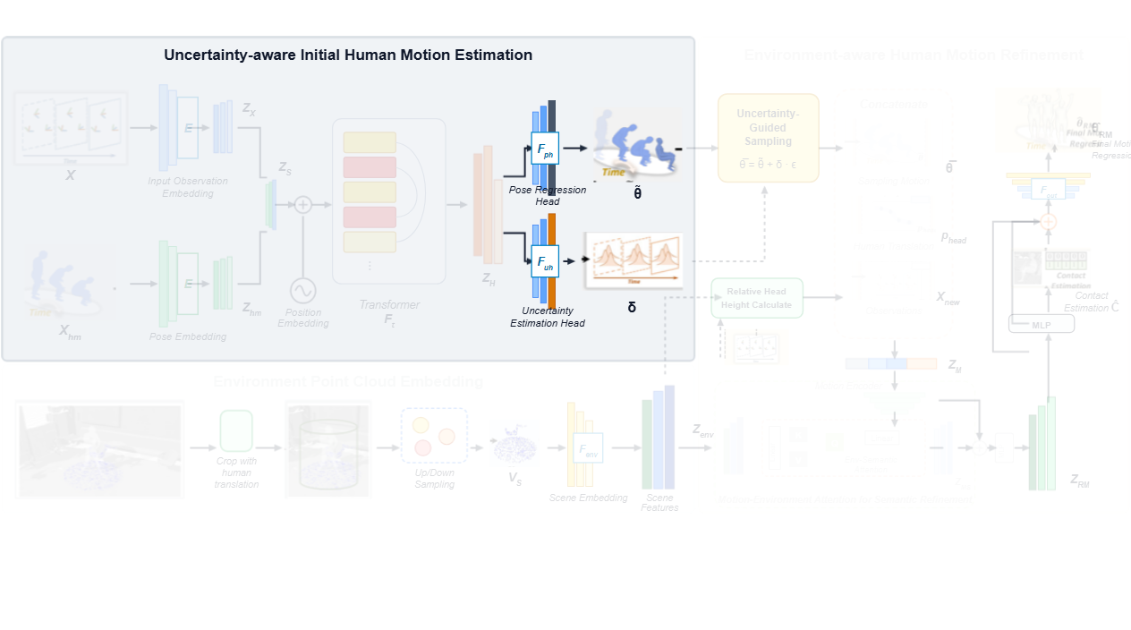
Notes:
These features feed into a pose regression head to estimate initial poses, while an uncertainty estimation head quantifies joint-level uncertainty.
[Alpha Masking · CVPR_2025_arch00932 · frame_06.png · 11.00s]

Slide 7
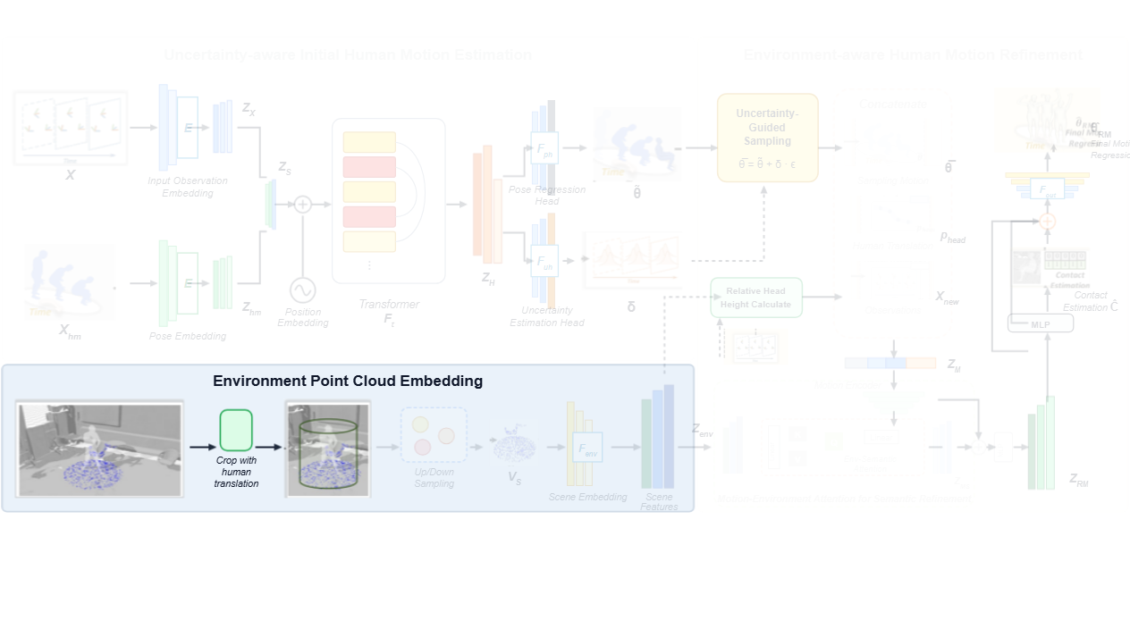
Notes:
In the environment point cloud embedding module, the 3D scene point cloud is cropped locally around the estimated human trajectory.
[Alpha Masking · CVPR_2025_arch00932 · frame_07.png · 13.00s]

Slide 8
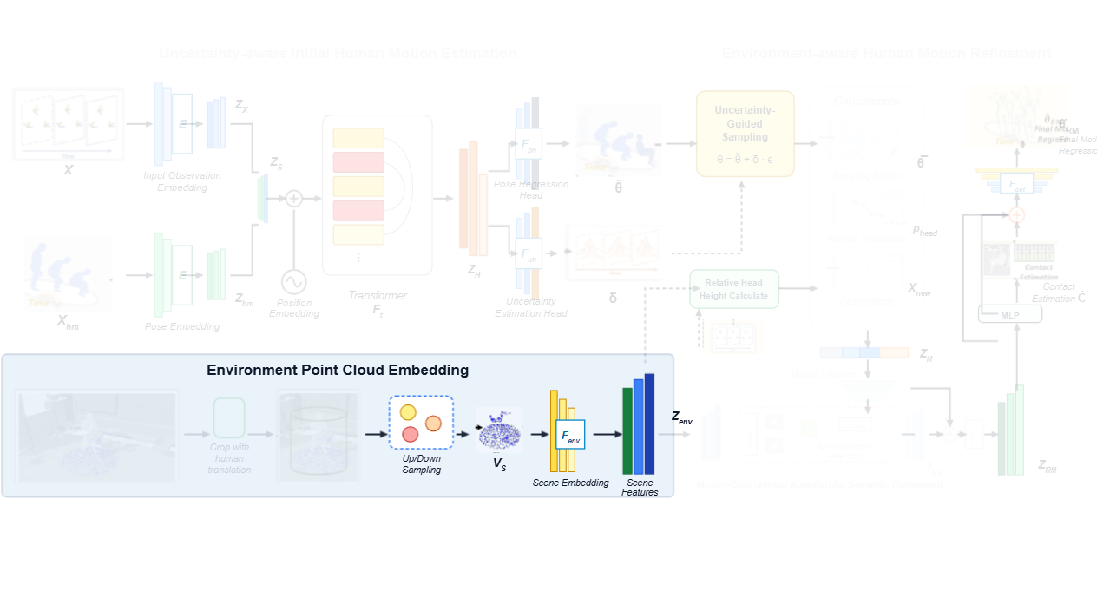
Notes:
The cropped points are sampled and encoded by a scene encoder to yield environment scene features.
[Alpha Masking · CVPR_2025_arch00932 · frame_09.png · 14.00s]

Slide 9
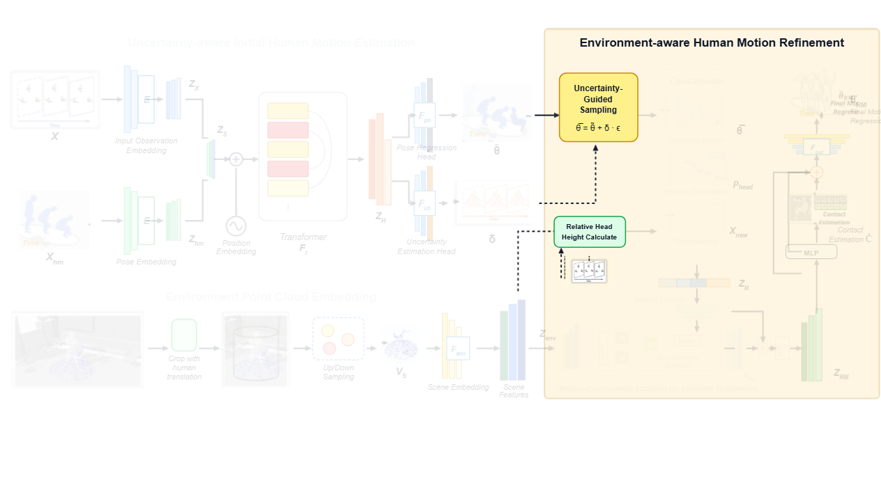
Notes:
In the refinement stage, uncertainty-guided sampling generates motion hypotheses, while relative head height is computed against the local terrain.
[Alpha Masking · CVPR_2025_arch00932 · frame_10.png · 17.00s]

Slide 10
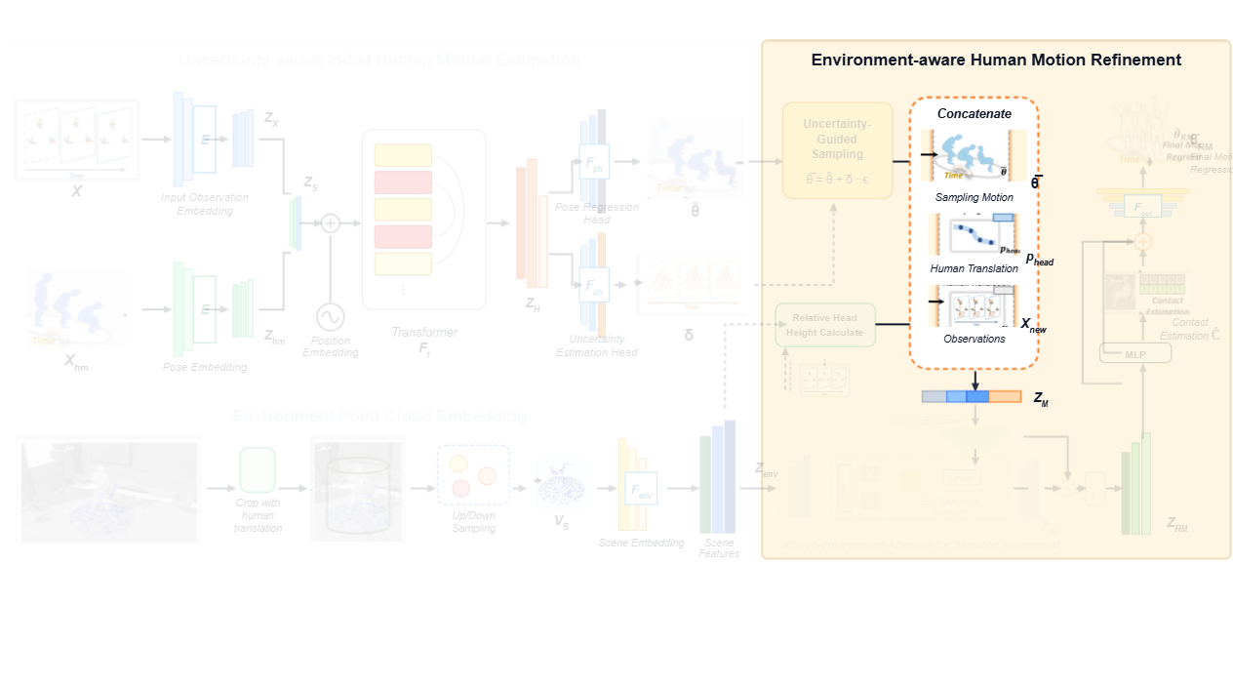
Notes:
The sampled poses, head translation, and extended observations are concatenated to form unified motion embeddings.
[Alpha Masking · CVPR_2025_arch00932 · frame_11.png · 19.00s]

Slide 11
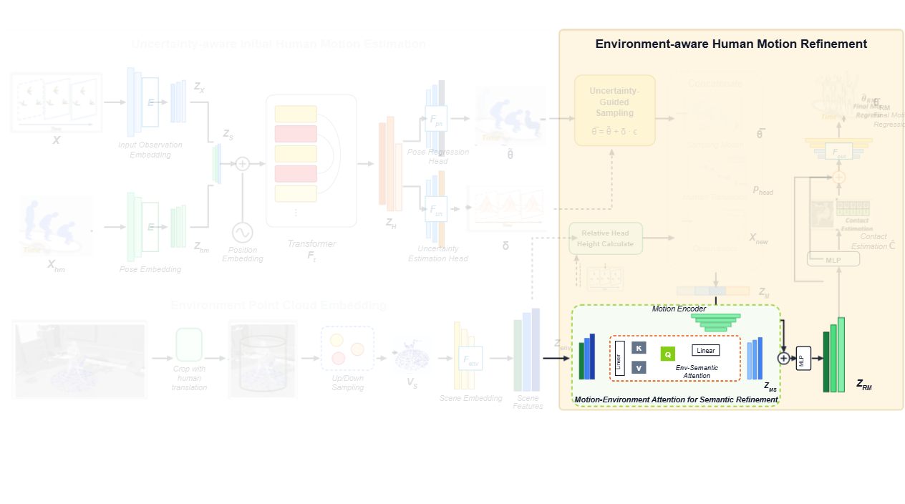
Notes:
A motion-environment cross-attention module integrates environmental semantics with the motion tokens to produce refined motion representations.
[Alpha Masking · CVPR_2025_arch00932 · frame_13.png · 20.00s]

Slide 12
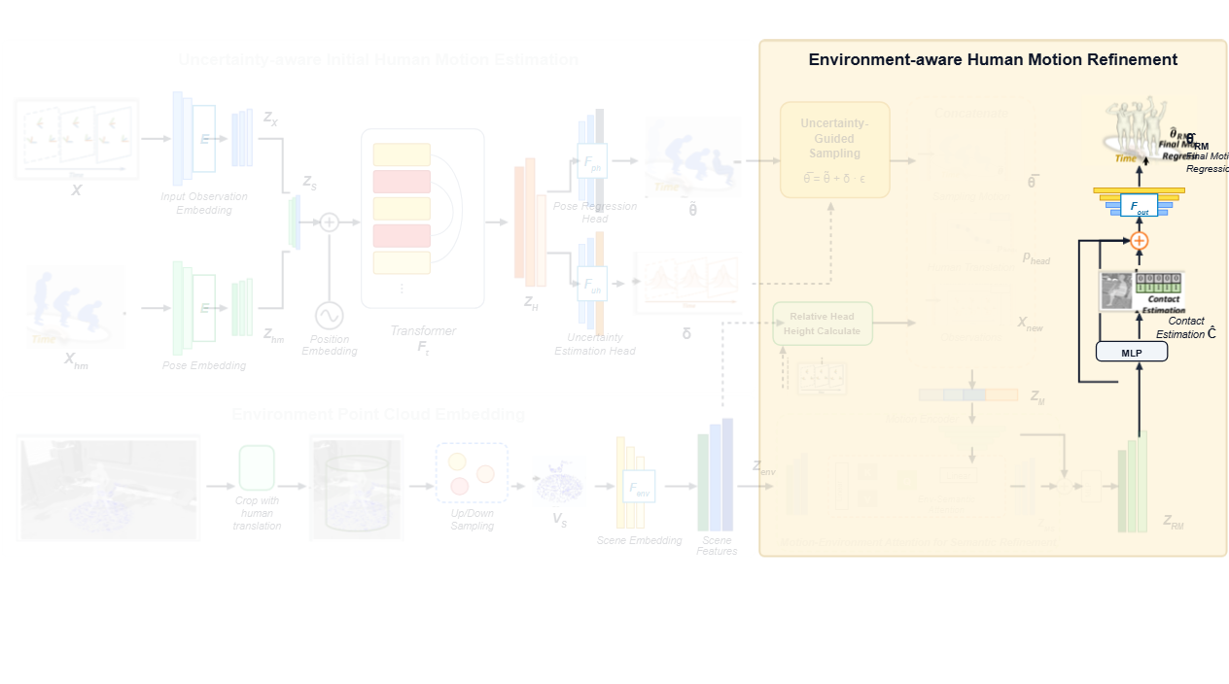
Notes:
Finally, contact probabilities are estimated and combined with the refined representation to regress the physically plausible final full-body motion.
[Alpha Masking · CVPR_2025_arch00932 · frame_14.png · 23.00s]

