Slide 1
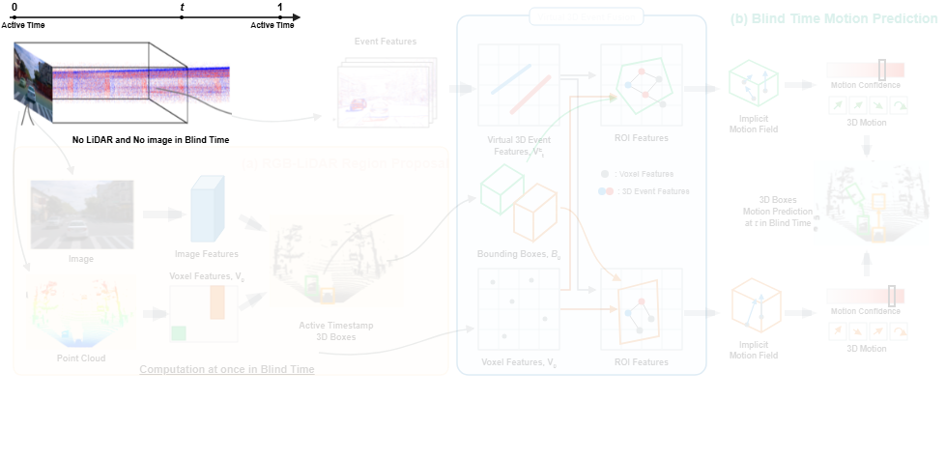
Notes:
During the blind time between active sensor frames where LiDAR and image data are unavailable, an asynchronous event camera captures continuous spatiotemporal measurements.
[Alpha Masking · CVPR_2025_arch00938 · frame_00.png · 1.60s]

Slide 2
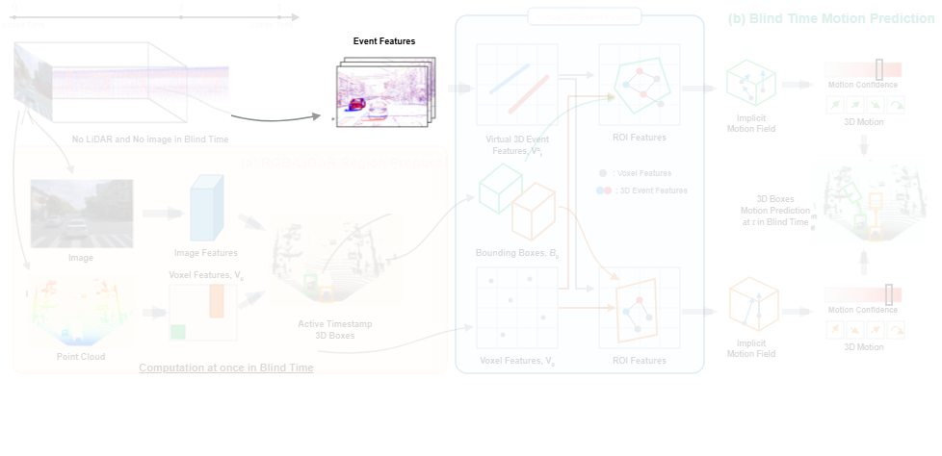
Notes:
These continuous event streams are converted into voxel grids and encoded into two-dimensional event feature representations.
[Alpha Masking · CVPR_2025_arch00938 · frame_01.png · 4.80s]

Slide 3
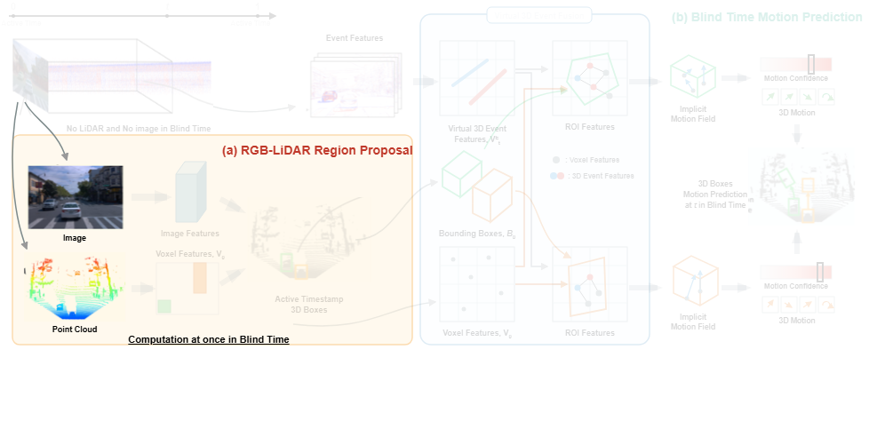
Notes:
At the initial active timestamp, synchronized camera images and LiDAR point clouds are collected by the region proposal network.
[Alpha Masking · CVPR_2025_arch00938 · frame_02.png · 8.00s]

Slide 4
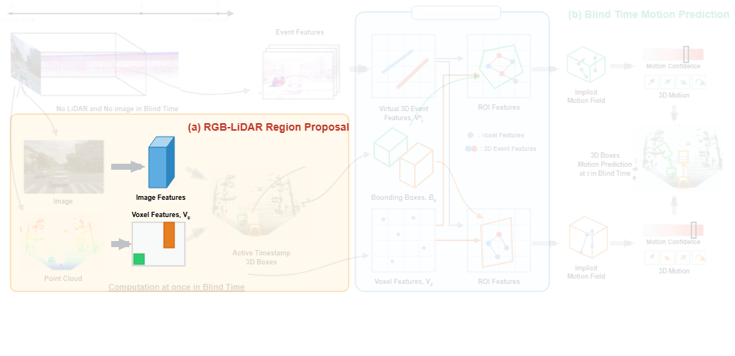
Notes:
The network extracts two-dimensional image features and constructs three-dimensional voxel feature grids.
[Alpha Masking · CVPR_2025_arch00938 · frame_03.png · 11.20s]

Slide 5
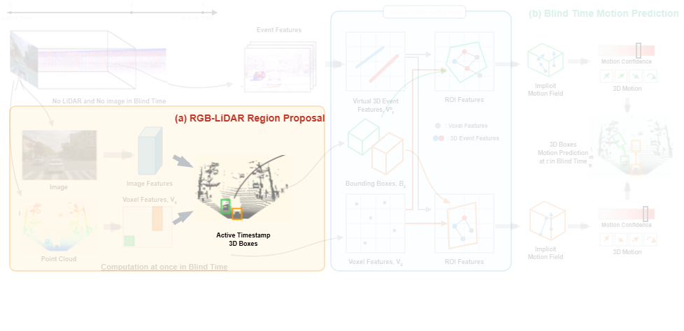
Notes:
Combining these multi-modal features generates initial three-dimensional bounding box proposals for the active timestamp.
[Alpha Masking · CVPR_2025_arch00938 · frame_04.png · 14.40s]

Slide 6
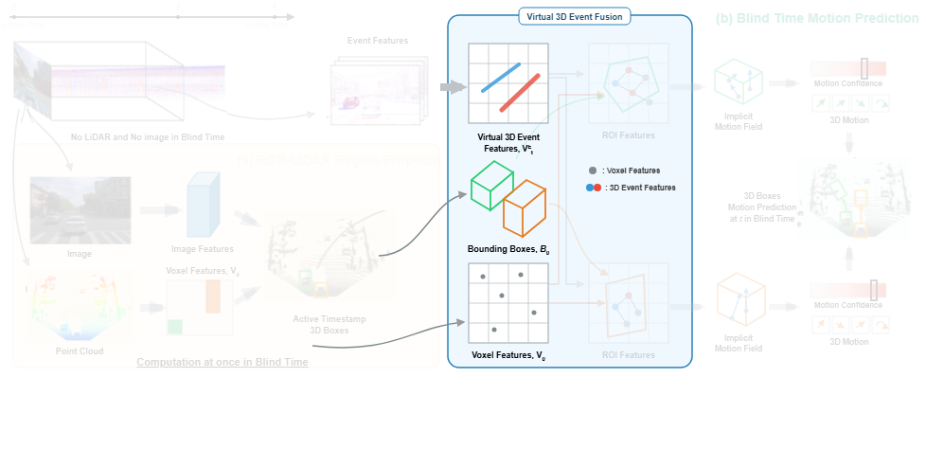
Notes:
In the Virtual 3D Event Fusion module, event features are projected into virtual 3D space and aligned with the initial bounding boxes and shared voxel features.
[Alpha Masking · CVPR_2025_arch00938 · frame_05.png · 17.60s]

Slide 7
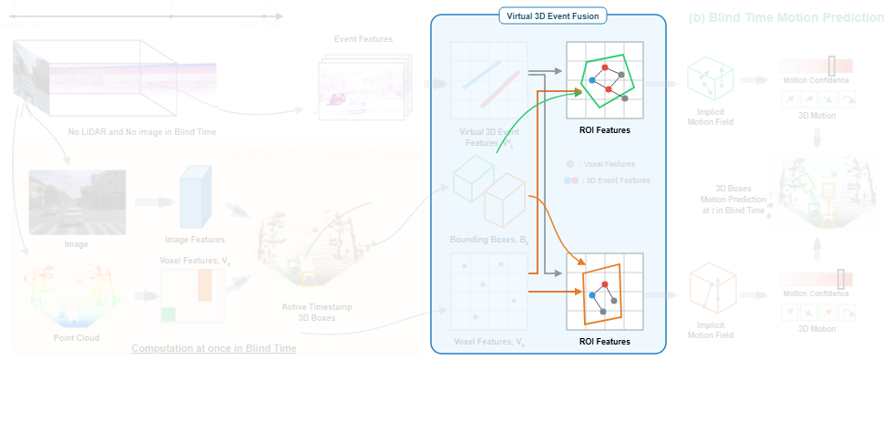
Notes:
Region of interest pooling is applied separately to virtual event and voxel features within each proposal to form fused region features.
[Alpha Masking · CVPR_2025_arch00938 · frame_07.png · 19.20s]

Slide 8
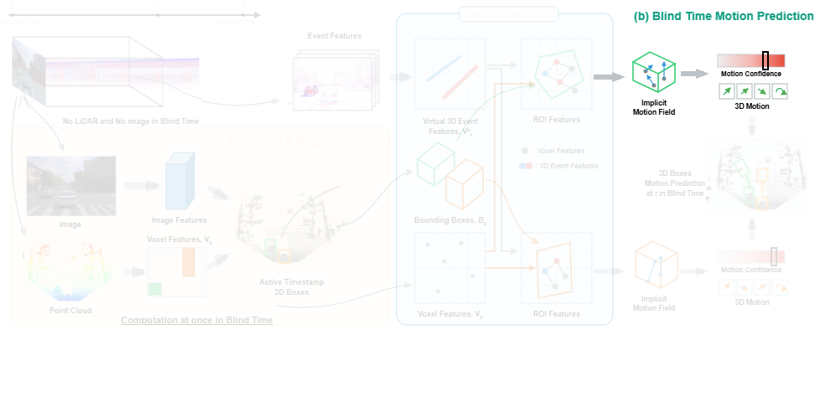
Notes:
During blind time motion prediction, an implicit motion field is generated to estimate explicit motion vectors and a motion confidence score for each object.
[Alpha Masking · CVPR_2025_arch00938 · frame_08.png · 24.00s]

Slide 9
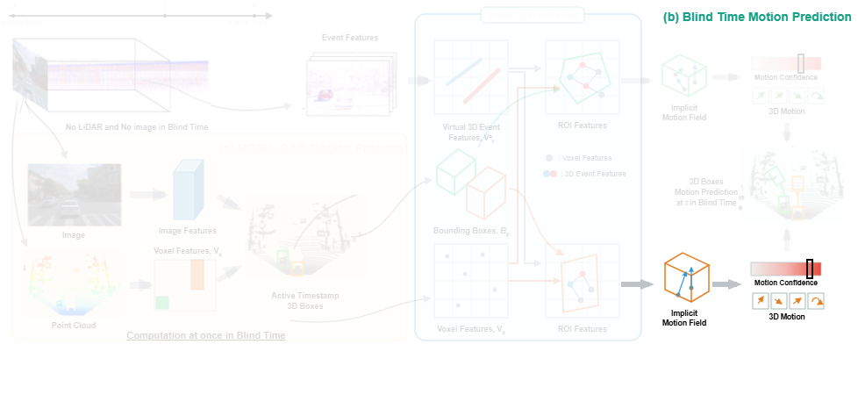
Notes:
Simultaneously, parallel proposal tracks derive their respective implicit motion fields and confidence metrics.
[Alpha Masking · CVPR_2025_arch00938 · frame_09.png · 27.20s]

Slide 10
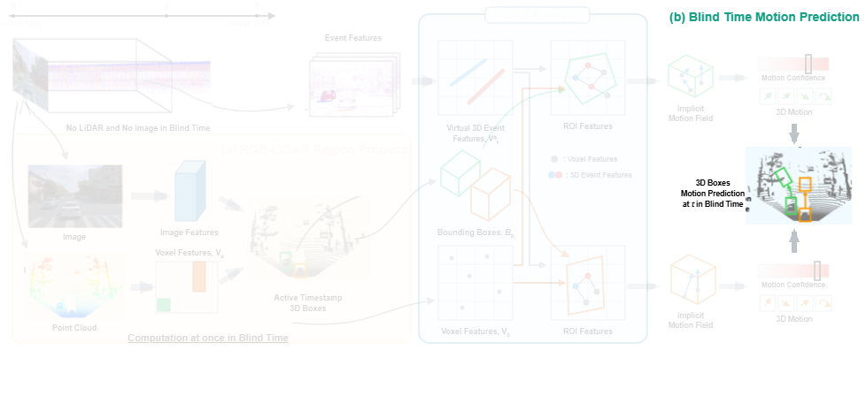
Notes:
Finally, the predicted spatial shifts and rotations update the bounding boxes, producing accurate 3D object detections at arbitrary inter-frame timestamps.
[Alpha Masking · CVPR_2025_arch00938 · frame_10.png · 30.40s]

