Slide 1
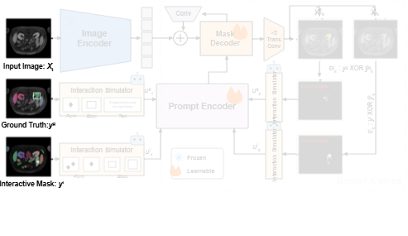
Notes:
The training pipeline begins with three inputs: the input medical image, its corresponding ground truth mask, and generated interactive masks.
[Alpha Masking · CVPR_2025_arch01488 · frame_00.png · 1.00s]

Slide 2
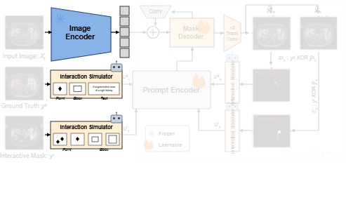
Notes:
A frozen image encoder extracts visual tokens from the input image, while initial interaction simulators derive point, bounding box, and text prompts from the masks.
[Alpha Masking · CVPR_2025_arch01488 · frame_01.png · 3.00s]

Slide 3
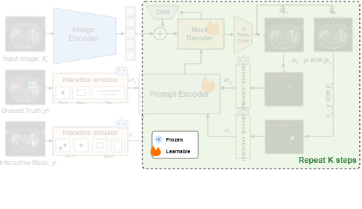
Notes:
The system then enters an iterative interaction loop that simulates multiple consecutive refinement steps.
[Alpha Masking · CVPR_2025_arch01488 · frame_02.png · 5.00s]

Slide 4
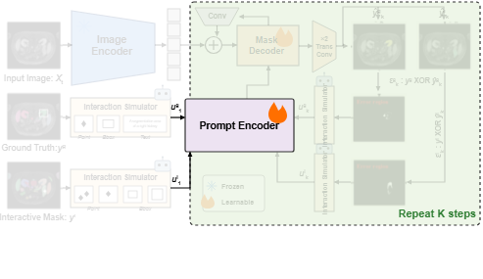
Notes:
The initial simulated interaction prompts are processed by a learnable prompt encoder.
[Alpha Masking · CVPR_2025_arch01488 · frame_03.png · 7.00s]

Slide 5
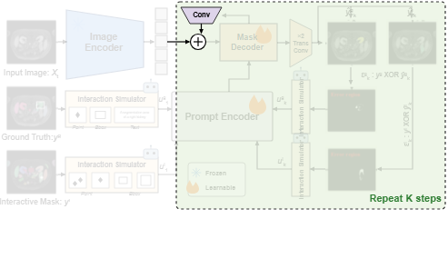
Notes:
The extracted image tokens are combined with convolutional feedback features via element-wise addition.
[Alpha Masking · CVPR_2025_arch01488 · frame_04.png · 9.00s]

Slide 6
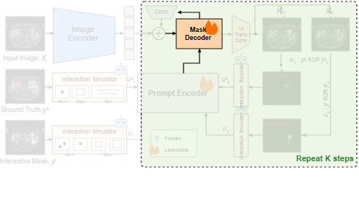
Notes:
A learnable mask decoder integrates these fused image features with the encoded prompts and circulates intermediate features back through a convolution layer.
[Alpha Masking · CVPR_2025_arch01488 · frame_05.png · 11.00s]

Slide 7
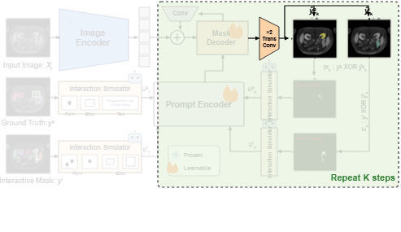
Notes:
Transposed convolution layers then upsample the decoded representations into predicted segmentation masks for both the ground truth and interactive targets.
[Alpha Masking · CVPR_2025_arch01488 · frame_06.png · 13.00s]

Slide 8
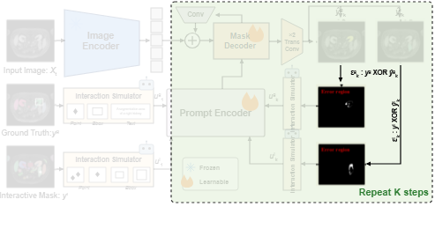
Notes:
The framework computes error regions by identifying discrepancies between each predicted mask and its target.
[Alpha Masking · CVPR_2025_arch01488 · frame_07.png · 15.00s]

Slide 9
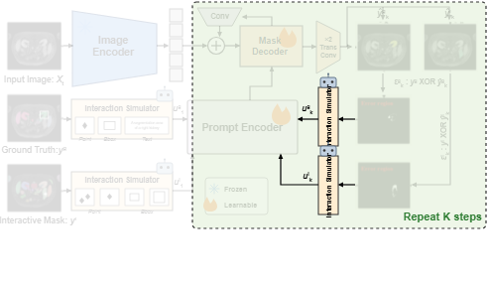
Notes:
Interaction simulators place corrective prompts on these error regions and feed them back to the prompt encoder, completing the feedback loop across iterations.
[Alpha Masking · CVPR_2025_arch01488 · frame_08.png · 17.00s]

