Slide 1
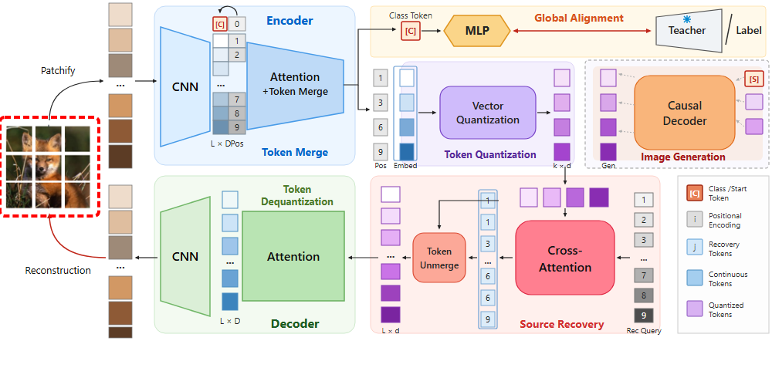
Notes:
The pipeline begins with an input image.
[Hopping Bbox · CVPR_2025_arch01761 · frame_00.png · 0.50s]

Slide 2

Notes:
The image is first partitioned into a sequence of regular visual patches.
[Hopping Bbox · CVPR_2025_arch01761 · frame_01.png · 1.50s]

Slide 3

Notes:
These patches are passed into the hybrid encoder network.
[Hopping Bbox · CVPR_2025_arch01761 · frame_02.png · 2.50s]

Slide 4

Notes:
A convolutional encoder extracts low-level local features.
[Hopping Bbox · CVPR_2025_arch01761 · frame_03.png · 3.50s]

Slide 5

Notes:
A dedicated class token is prepended alongside spatial position encodings.
[Hopping Bbox · CVPR_2025_arch01761 · frame_04.png · 4.50s]

Slide 6

Notes:
This forms the initial full-length sequence of continuous tokens.
[Hopping Bbox · CVPR_2025_arch01761 · frame_05.png · 5.50s]

Slide 7

Notes:
Self-attention layers with token merging progressively compress similar tokens.
[Hopping Bbox · CVPR_2025_arch01761 · frame_06.png · 6.50s]

Slide 8
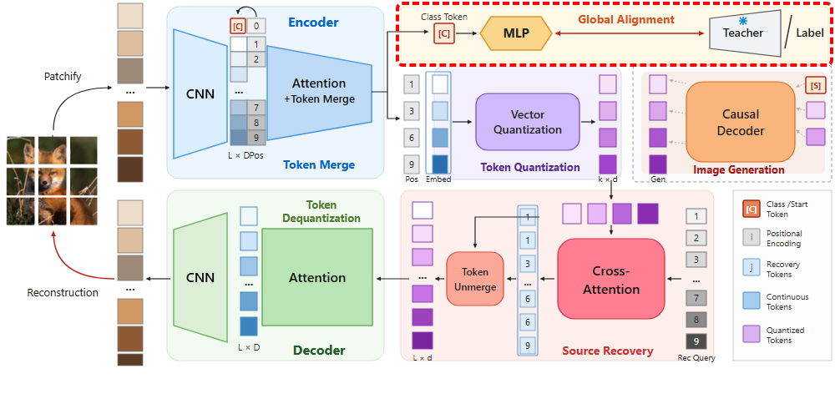
Notes:
The global alignment module enriches the learned representations.
[Hopping Bbox · CVPR_2025_arch01761 · frame_07.png · 7.50s]

Slide 9
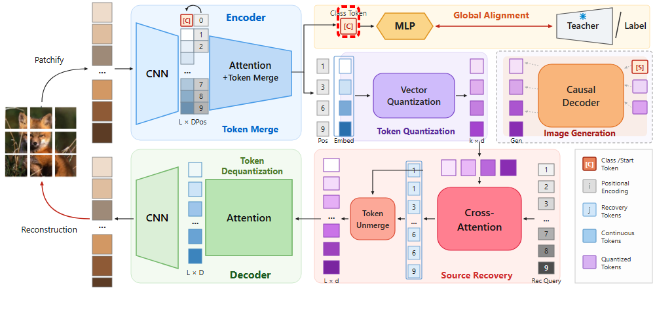
Notes:
The class token is extracted from the encoder output.
[Hopping Bbox · CVPR_2025_arch01761 · frame_08.png · 8.50s]

Slide 10

Notes:
It is projected through a multi-layer perceptron head.
[Hopping Bbox · CVPR_2025_arch01761 · frame_09.png · 9.50s]

Slide 11

Notes:
And aligned with target representations from a teacher model or ground truth labels.
[Hopping Bbox · CVPR_2025_arch01761 · frame_10.png · 10.50s]

Slide 12
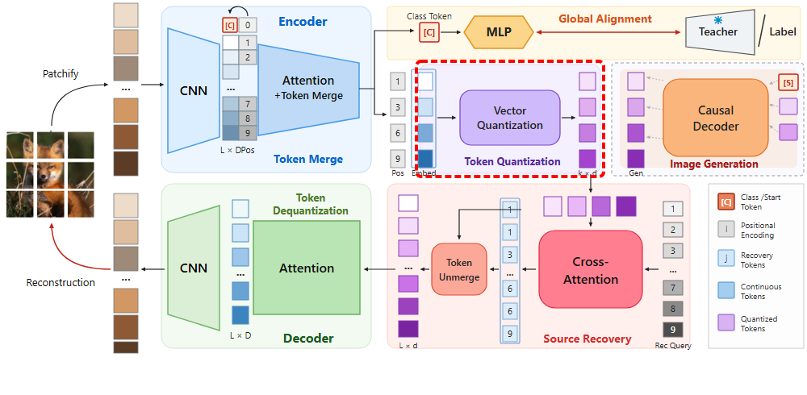
Notes:
In parallel, the compressed visual tokens enter the token quantization module.
[Hopping Bbox · CVPR_2025_arch01761 · frame_11.png · 11.50s]

Slide 13

Notes:
Positional indices of the merged tokens are retained.
[Hopping Bbox · CVPR_2025_arch01761 · frame_12.png · 12.50s]

Slide 14

Notes:
The continuous embedding representations are extracted.
[Hopping Bbox · CVPR_2025_arch01761 · frame_13.png · 13.50s]

Slide 15

Notes:
Vector quantization discretizes each token into discrete codes.
[Hopping Bbox · CVPR_2025_arch01761 · frame_14.png · 14.50s]

Slide 16
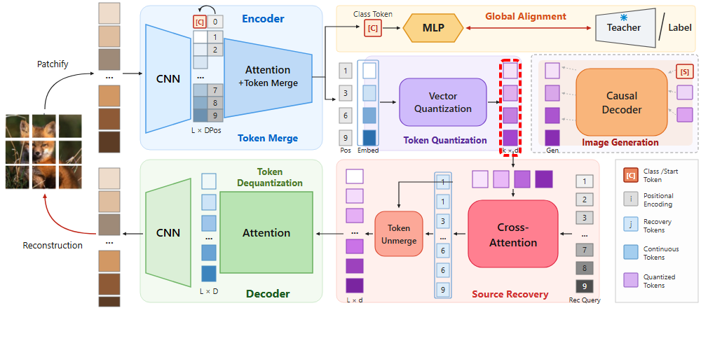
Notes:
This yields a compact set of quantized semantic tokens.
[Hopping Bbox · CVPR_2025_arch01761 · frame_15.png · 15.50s]

Slide 17
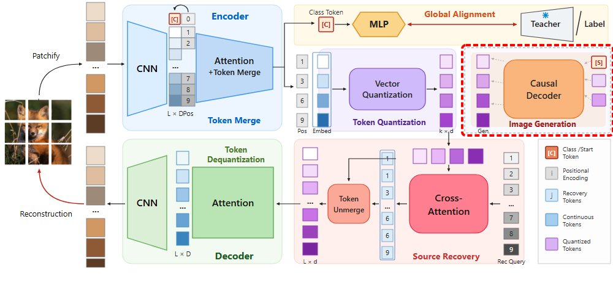
Notes:
During the generative stage, these discrete tokens drive image generation.
[Hopping Bbox · CVPR_2025_arch01761 · frame_16.png · 16.50s]

Slide 18
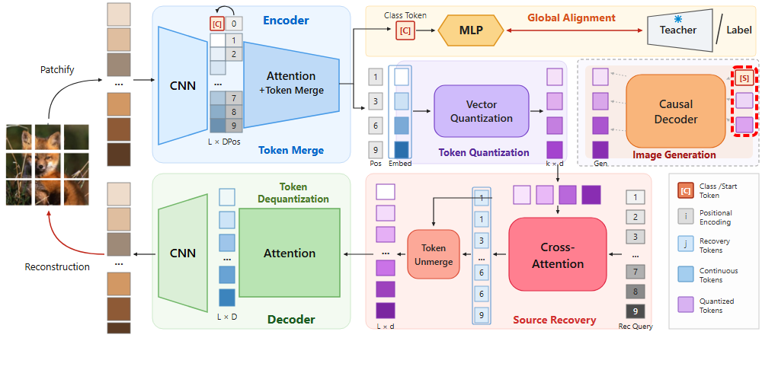
Notes:
An autoregressive generation process starts with a start token.
[Hopping Bbox · CVPR_2025_arch01761 · frame_17.png · 17.50s]

Slide 19
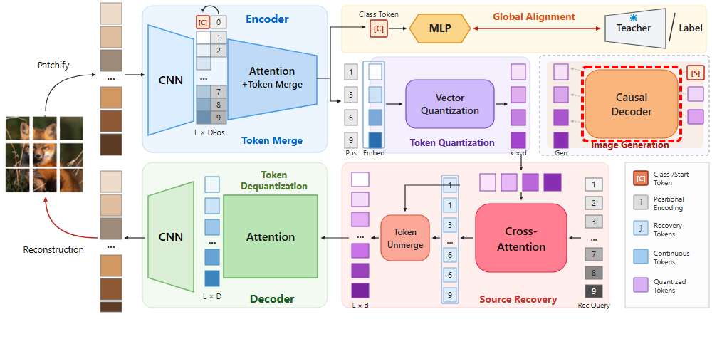
Notes:
The causal decoder synthesizes tokens sequentially with key-value cache compression.
[Hopping Bbox · CVPR_2025_arch01761 · frame_18.png · 18.50s]

Slide 20

Notes:
Predicting the compact sequence of quantized tokens.
[Hopping Bbox · CVPR_2025_arch01761 · frame_19.png · 19.50s]

Slide 21
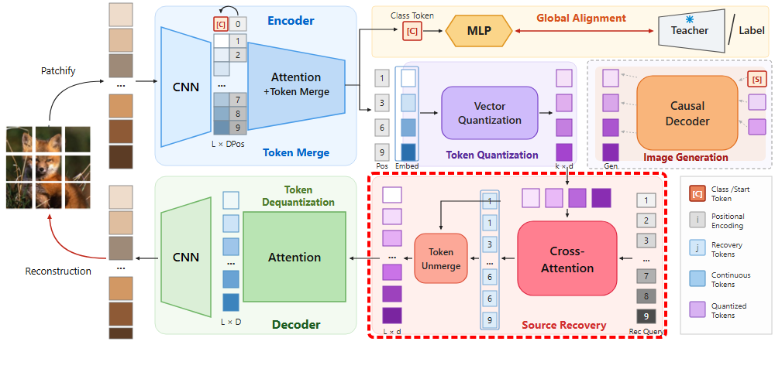
Notes:
Next, the source recovery module reconstructs full spatial context.
[Hopping Bbox · CVPR_2025_arch01761 · frame_20.png · 20.50s]

Slide 22

Notes:
The quantized tokens are supplied to the recovery cross-attention mechanism.
[Hopping Bbox · CVPR_2025_arch01761 · frame_21.png · 21.50s]

Slide 23
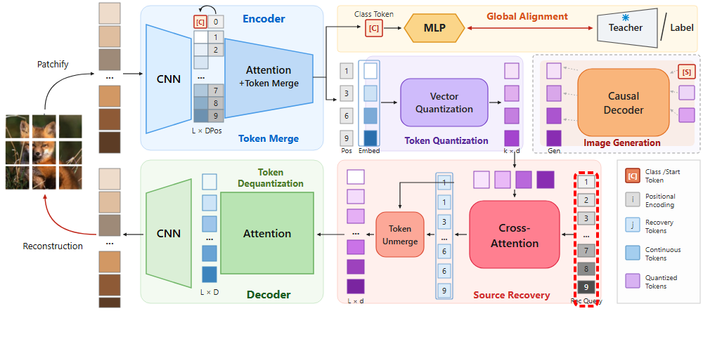
Notes:
A set of learnable recovery queries corresponds to all original spatial positions.
[Hopping Bbox · CVPR_2025_arch01761 · frame_22.png · 22.50s]

Slide 24

Notes:
Cross-attention models the relationships between original positions and merged tokens.
[Hopping Bbox · CVPR_2025_arch01761 · frame_23.png · 23.50s]

Slide 25
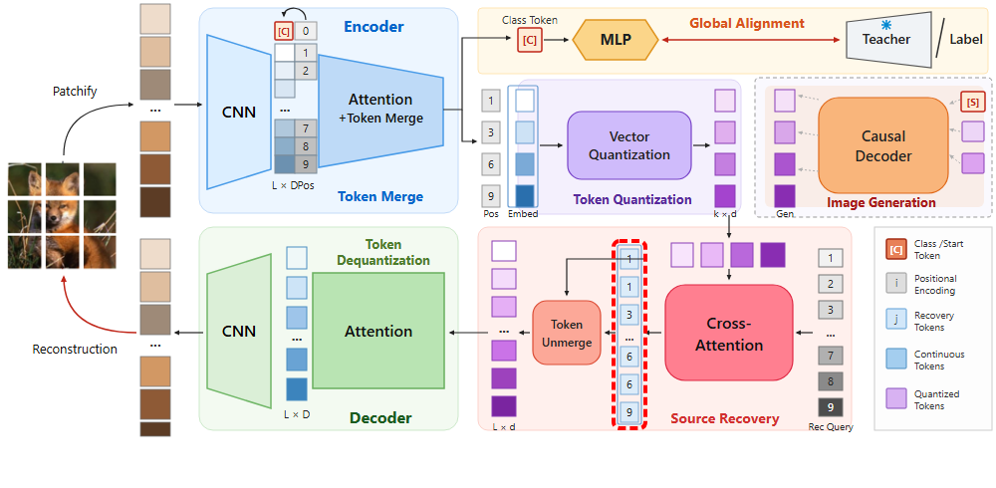
Notes:
This predicts the source matrix to establish token assignments.
[Hopping Bbox · CVPR_2025_arch01761 · frame_24.png · 24.50s]

Slide 26

Notes:
The token unmerge operation uses these assignments to uncompress the tokens.
[Hopping Bbox · CVPR_2025_arch01761 · frame_25.png · 25.50s]

Slide 27
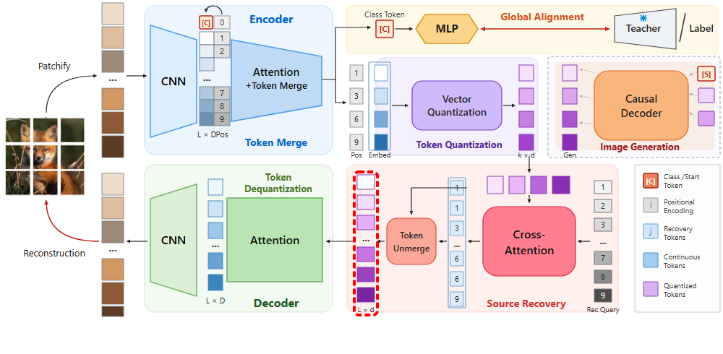
Notes:
Restoring the full sequence length while preserving spatial fidelity.
[Hopping Bbox · CVPR_2025_arch01761 · frame_26.png · 26.50s]

Slide 28
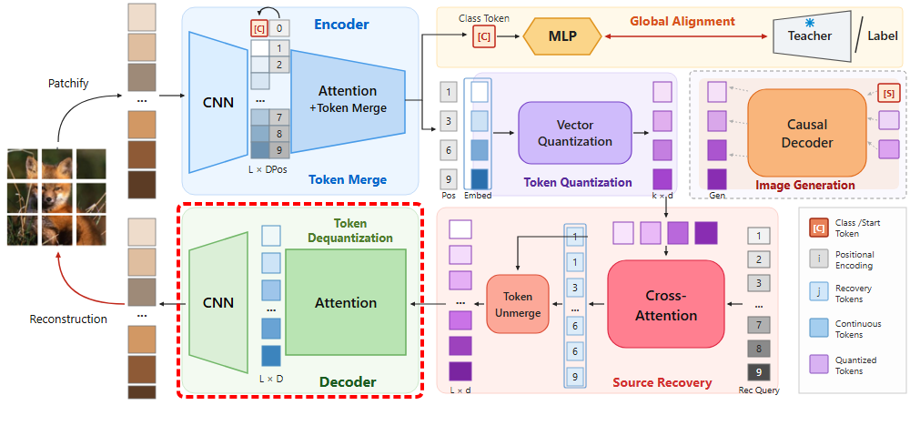
Notes:
The restored sequence is then processed by the decoder.
[Hopping Bbox · CVPR_2025_arch01761 · frame_27.png · 27.50s]

Slide 29
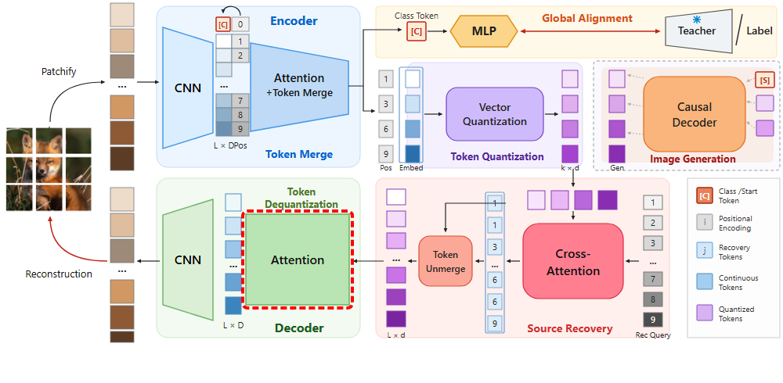
Notes:
Attention layers perform token dequantization and feature refinement.
[Hopping Bbox · CVPR_2025_arch01761 · frame_28.png · 28.50s]

Slide 30

Notes:
Producing dense continuous feature representations.
[Hopping Bbox · CVPR_2025_arch01761 · frame_29.png · 29.50s]

Slide 31

Notes:
A convolutional decoder maps features back to image space.
[Hopping Bbox · CVPR_2025_arch01761 · frame_30.png · 30.50s]

Slide 32
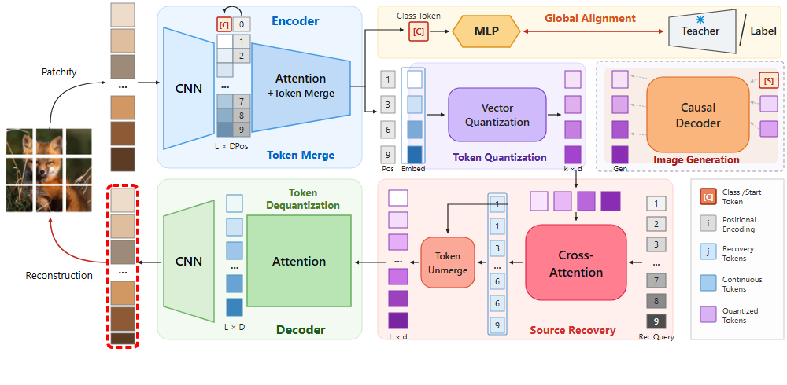
Notes:
Finally, all patches are reconstructed, generating the final high-resolution image.
[Hopping Bbox · CVPR_2025_arch01761 · frame_31.png · 31.50s]

