Slide 1
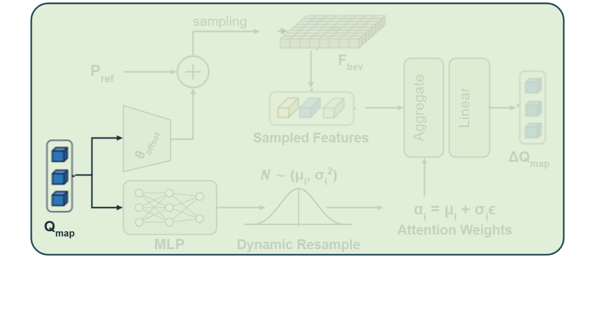
Notes:
The uncertainty-aware attention module takes map queries as input, splitting them into two parallel processing branches.
[Alpha Masking · CVPR_2025_arch03005 · frame_00.png · 1.00s]

Slide 2
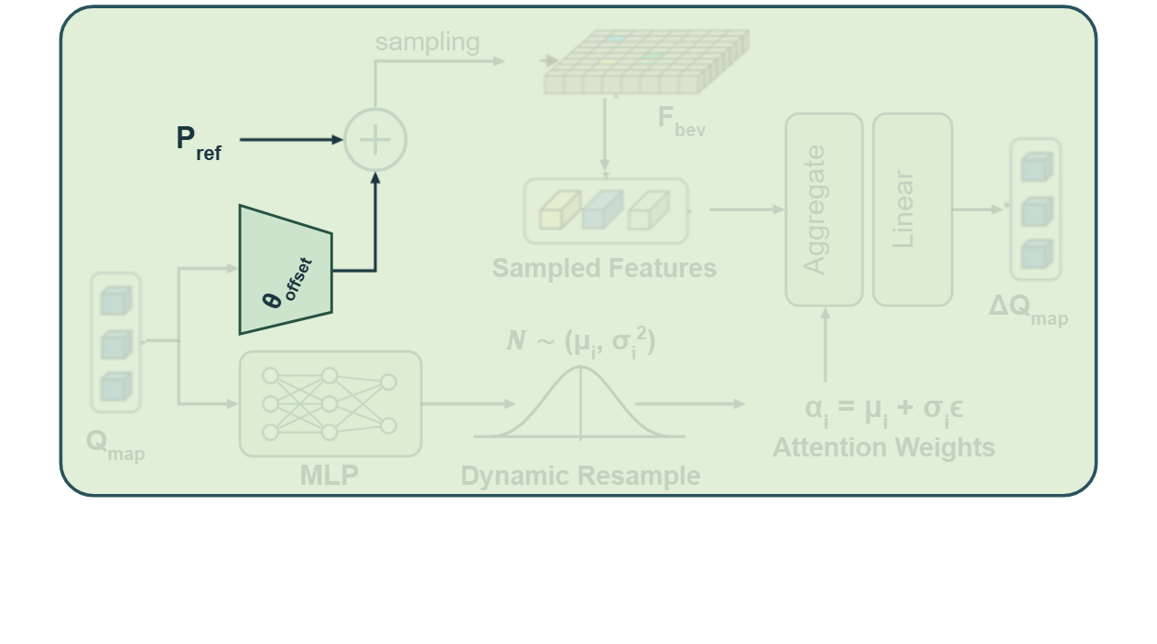
Notes:
In the upper branch, the queries predict spatial coordinate offsets to be added to reference points.
[Alpha Masking · CVPR_2025_arch03005 · frame_01.png · 3.00s]

Slide 3
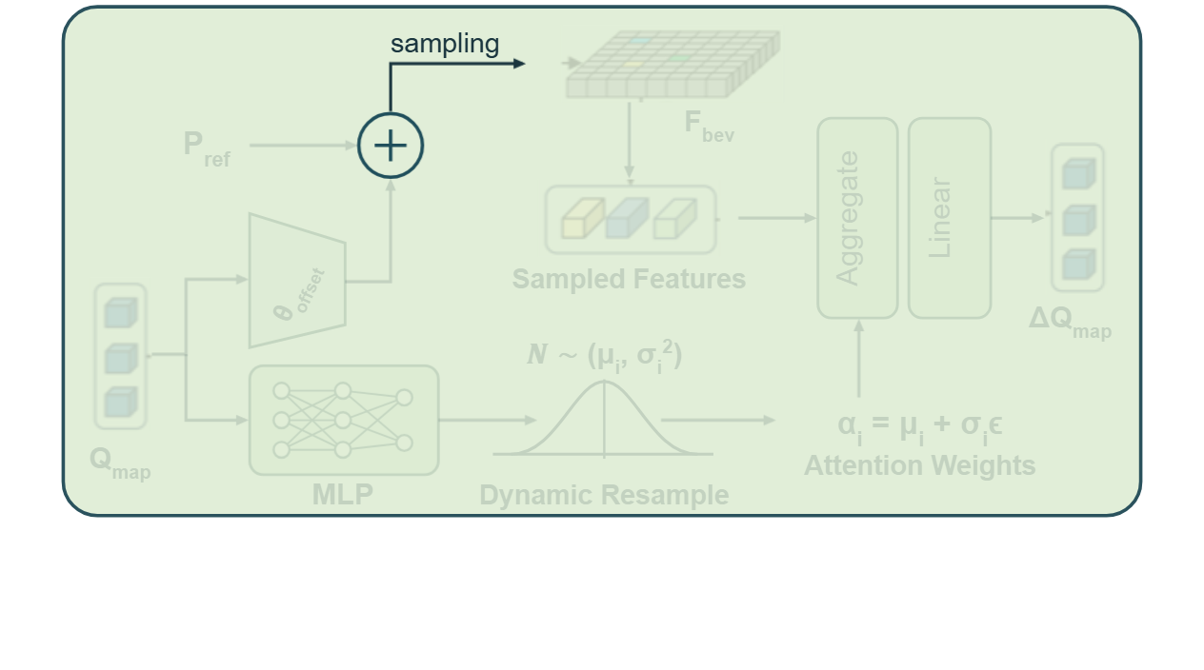
Notes:
The summed positions define sampling locations across the bird's-eye-view grid.
[Alpha Masking · CVPR_2025_arch03005 · frame_02.png · 5.00s]

Slide 4
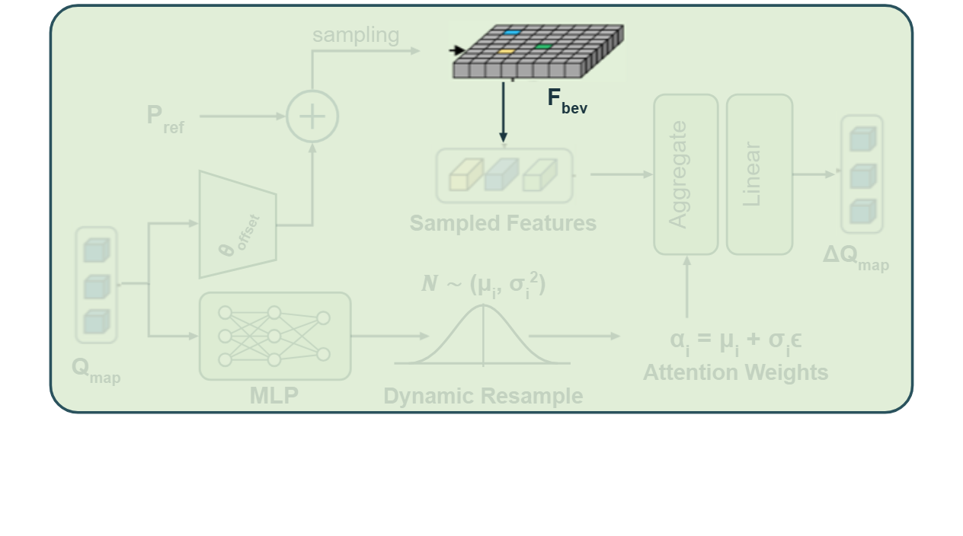
Notes:
Features are sampled directly from the bird's-eye-view feature map at these locations.
[Alpha Masking · CVPR_2025_arch03005 · frame_03.png · 7.00s]

Slide 5
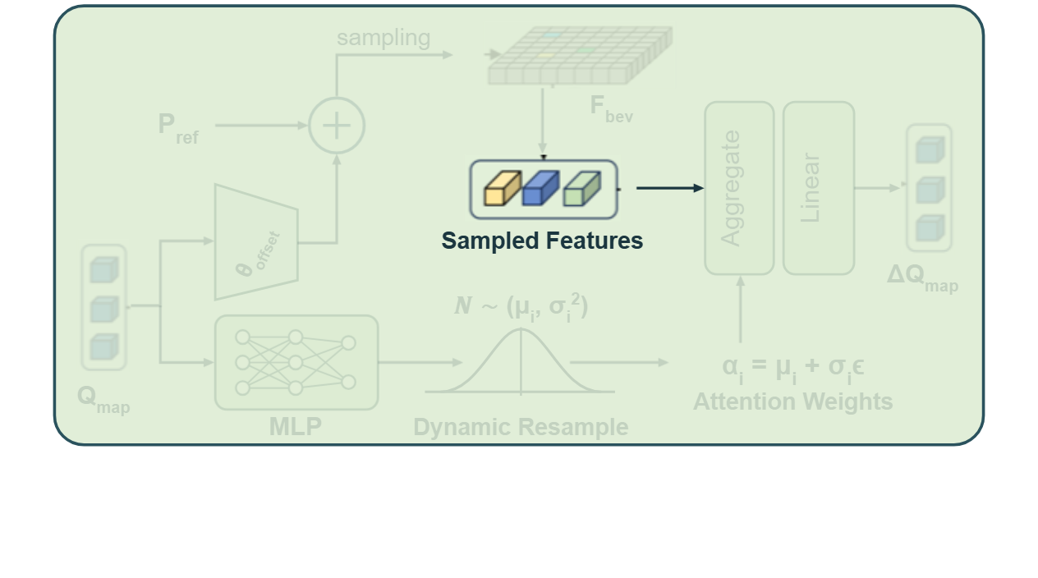
Notes:
This extracts a focused set of sampled spatial features.
[Alpha Masking · CVPR_2025_arch03005 · frame_04.png · 9.00s]

Slide 6
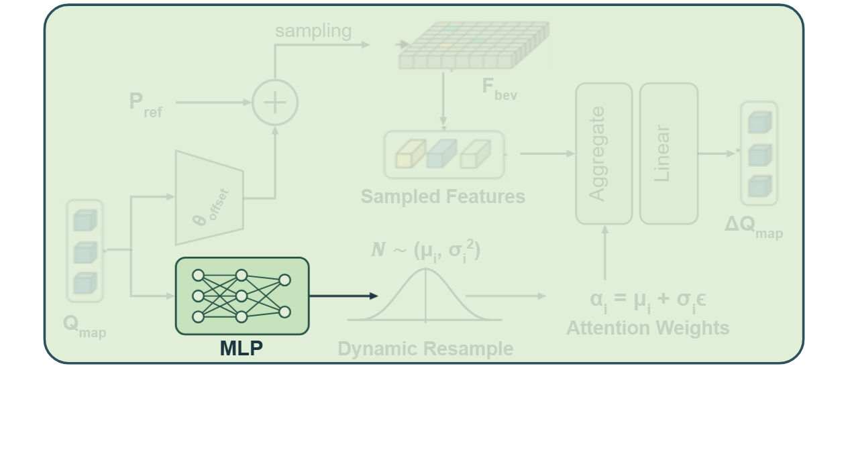
Notes:
Simultaneously, the lower branch feeds the map queries into a multilayer perceptron.
[Alpha Masking · CVPR_2025_arch03005 · frame_05.png · 11.00s]

Slide 7
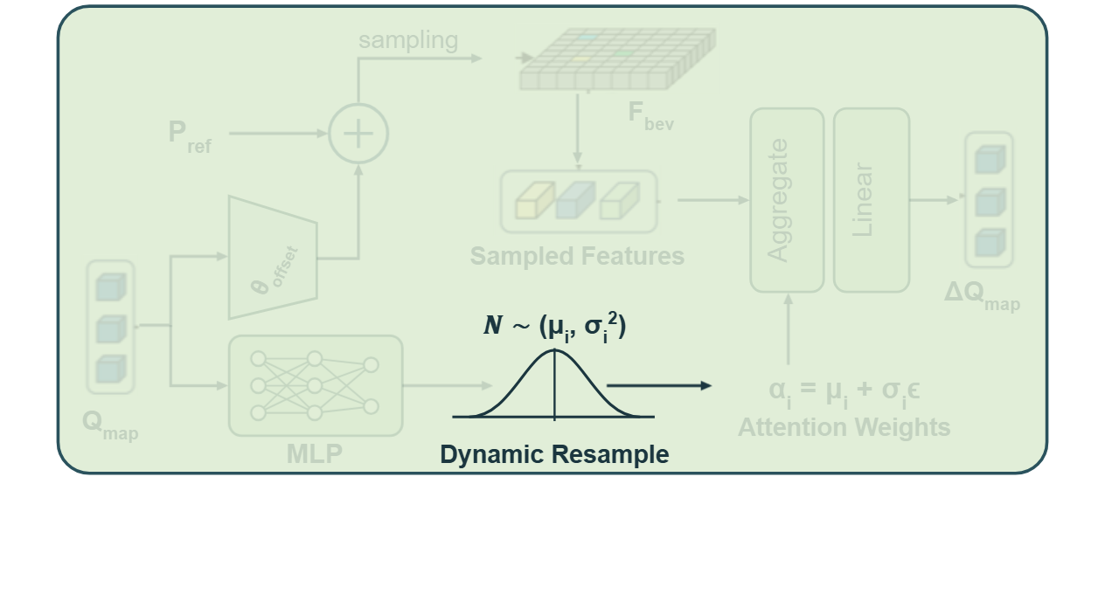
Notes:
The network outputs mean and variance parameters for dynamic resampling from a Gaussian distribution.
[Alpha Masking · CVPR_2025_arch03005 · frame_06.png · 13.00s]

Slide 8
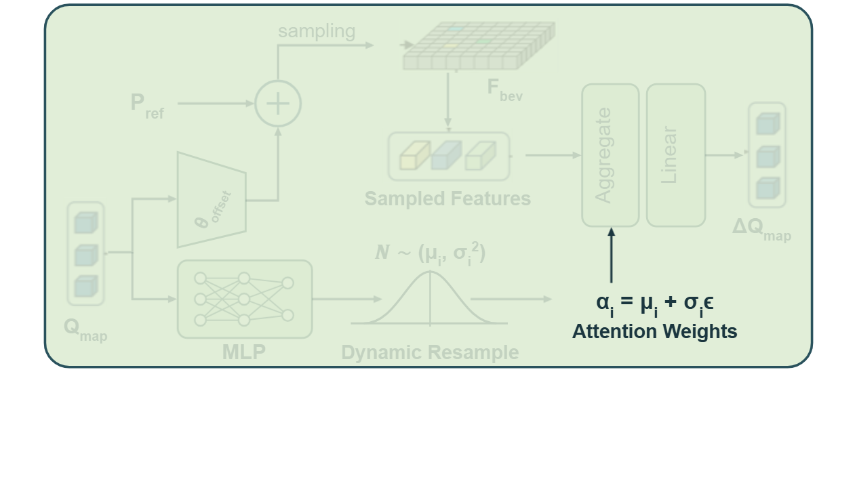
Notes:
Learned attention weights are formed by incorporating stochastic disturbance into the distribution parameters.
[Alpha Masking · CVPR_2025_arch03005 · frame_07.png · 15.00s]

Slide 9
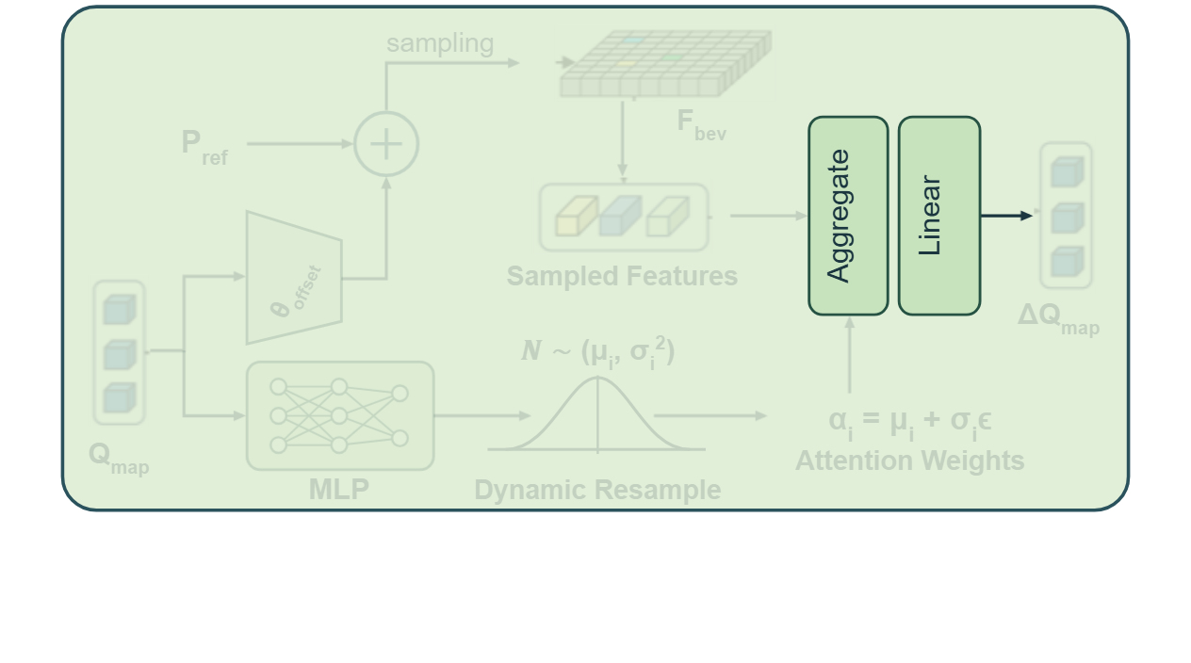
Notes:
The sampled features and dynamic attention weights are aggregated and projected through a linear layer.
[Alpha Masking · CVPR_2025_arch03005 · frame_08.png · 17.00s]

Slide 10
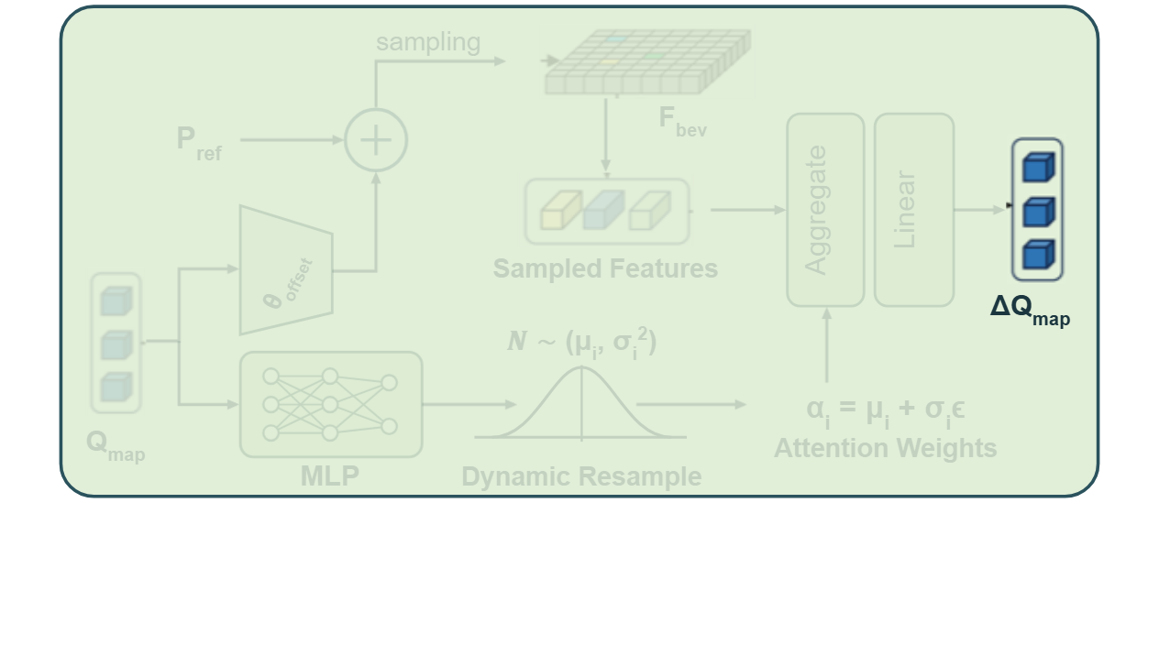
Notes:
The resulting update terms refine the map queries for generalizable vectorization.
[Alpha Masking · CVPR_2025_arch03005 · frame_09.png · 19.00s]

