Slide 1
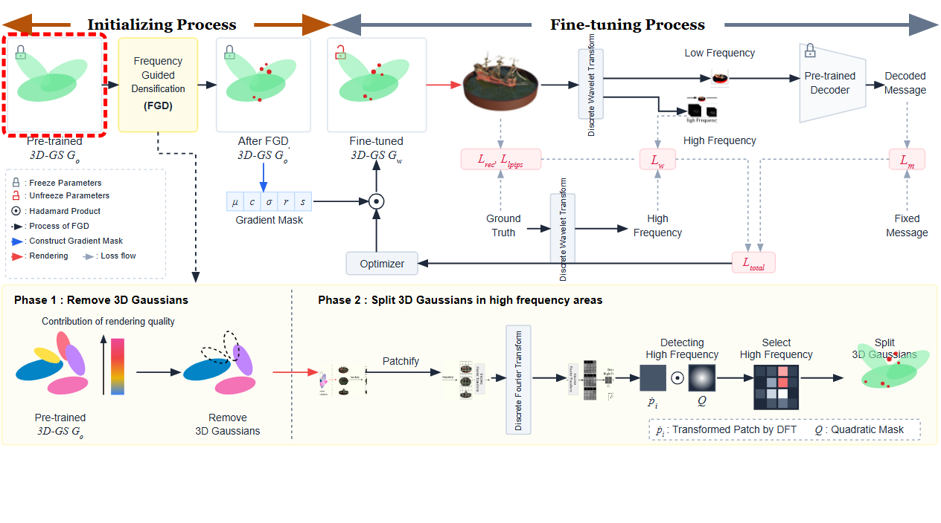
Notes:
The initializing process begins with a pre-trained 3D Gaussian Splatting model with frozen parameters.
[Hopping Bbox · CVPR_2025_pipe00011 · frame_00.png · 1.00s]

Slide 2
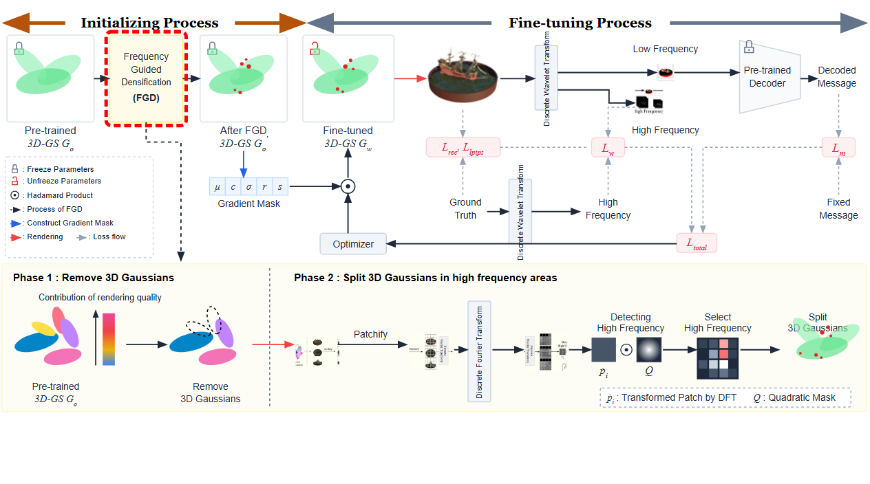
Notes:
The model is passed into the Frequency Guided Densification module.
[Hopping Bbox · CVPR_2025_pipe00011 · frame_01.png · 3.00s]

Slide 3
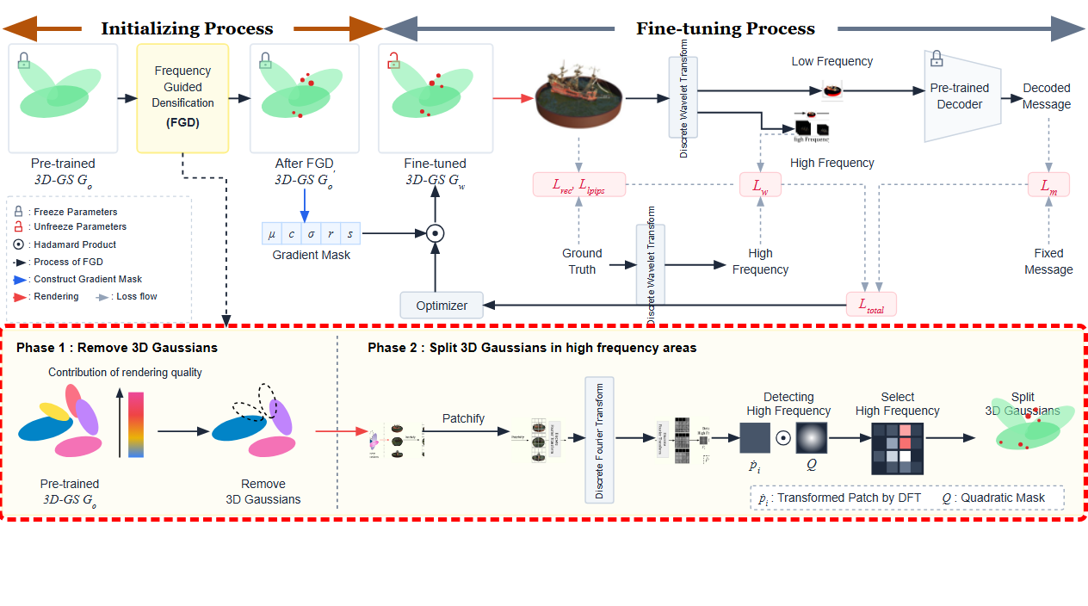
Notes:
Frequency Guided Densification is structured into two main phases shown below.
[Hopping Bbox · CVPR_2025_pipe00011 · frame_02.png · 5.00s]

Slide 4
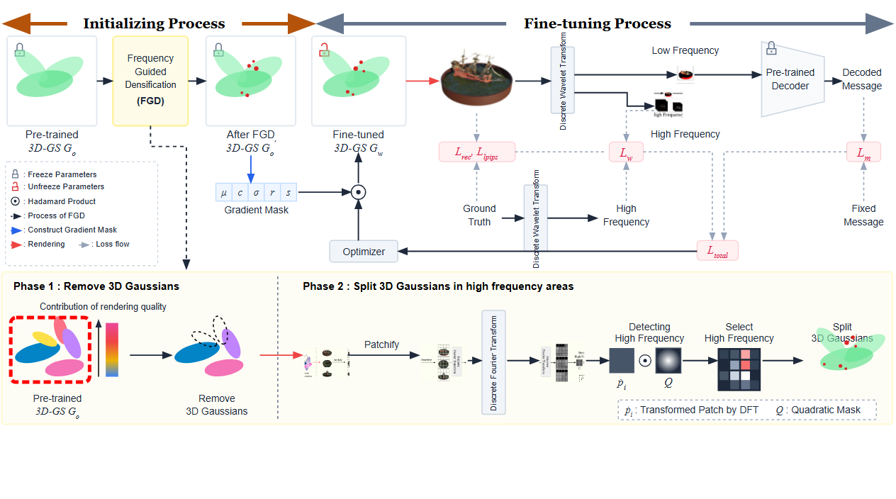
Notes:
In Phase 1, the contribution of each 3D Gaussian to rendering quality is evaluated.
[Hopping Bbox · CVPR_2025_pipe00011 · frame_03.png · 7.00s]

Slide 5
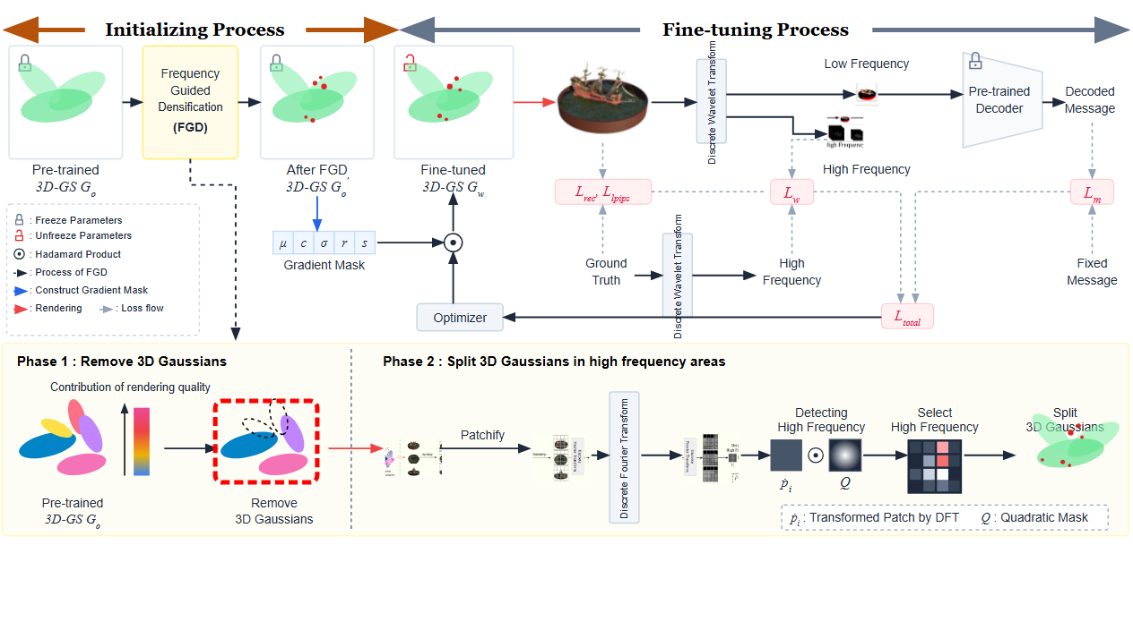
Notes:
Low-contribution 3D Gaussians are removed.
[Hopping Bbox · CVPR_2025_pipe00011 · frame_04.png · 9.00s]

Slide 6
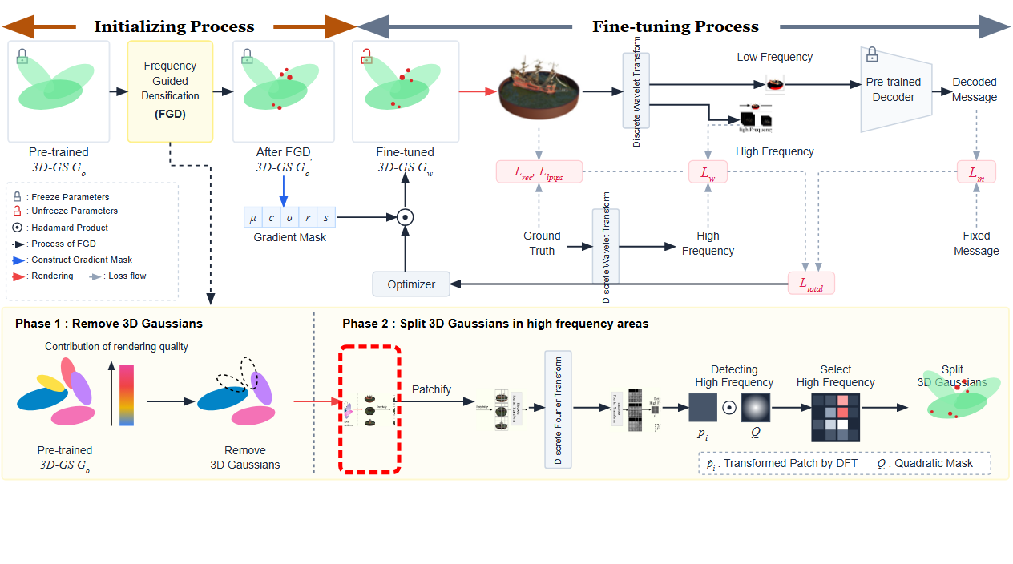
Notes:
In Phase 2, views are rendered from multiple perspectives.
[Hopping Bbox · CVPR_2025_pipe00011 · frame_05.png · 11.00s]

Slide 7
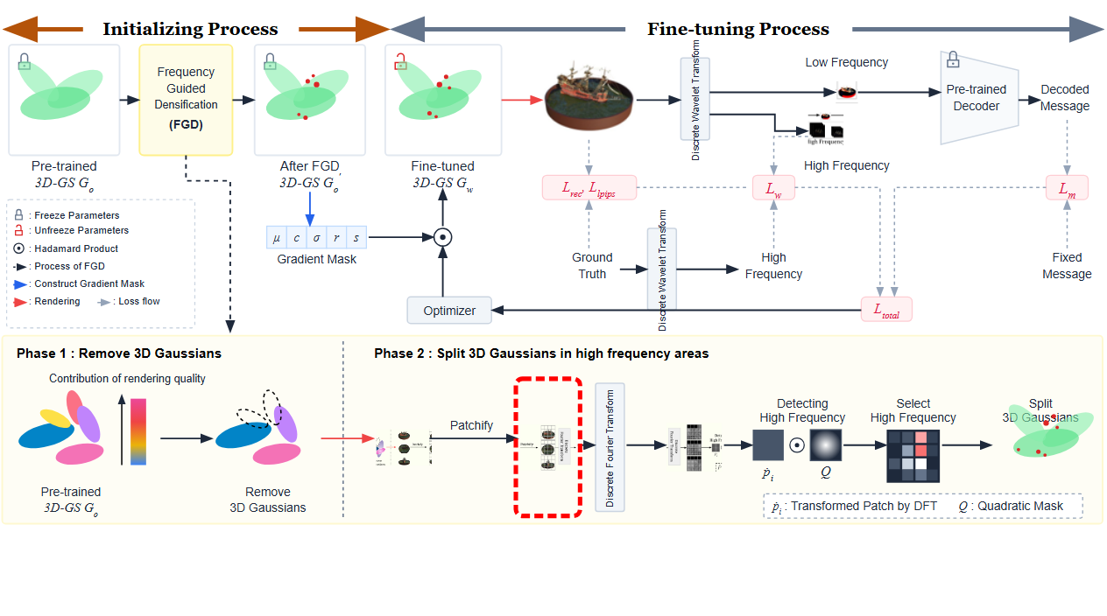
Notes:
Each rendered image is split into a grid of patches.
[Hopping Bbox · CVPR_2025_pipe00011 · frame_06.png · 13.00s]

Slide 8
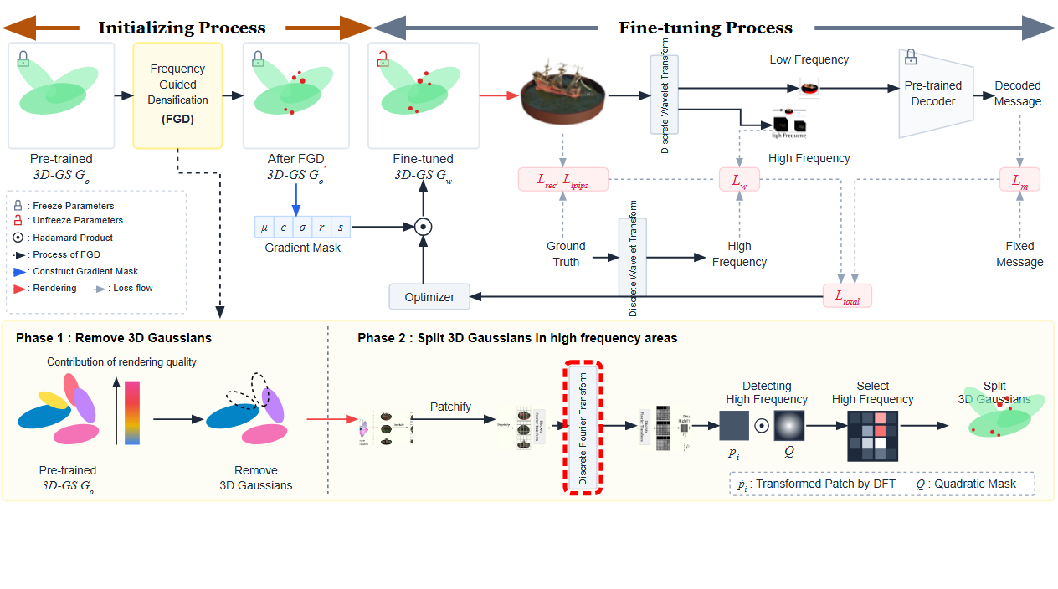
Notes:
A Discrete Fourier Transform is applied to the patches.
[Hopping Bbox · CVPR_2025_pipe00011 · frame_07.png · 15.00s]

Slide 9
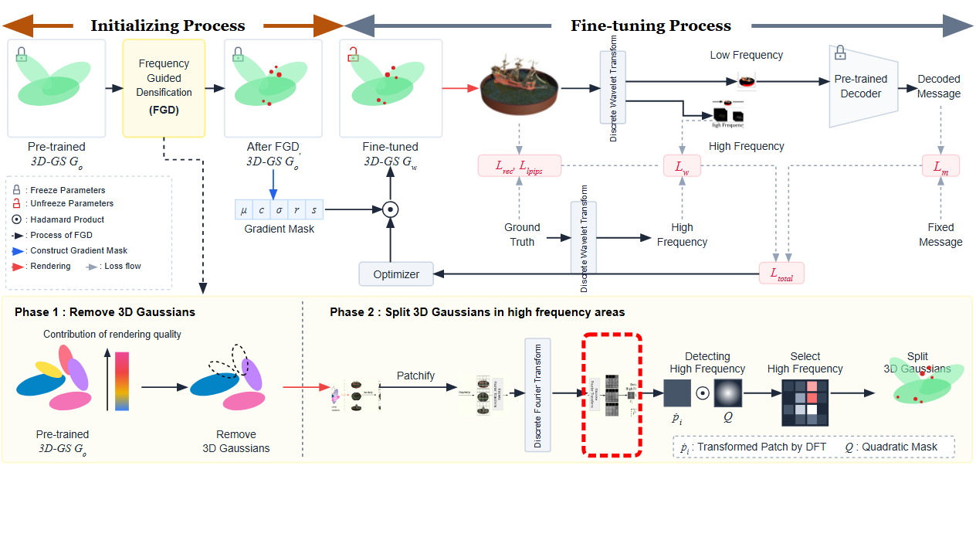
Notes:
This converts the image patches into transformed frequency representations.
[Hopping Bbox · CVPR_2025_pipe00011 · frame_08.png · 17.00s]

Slide 10
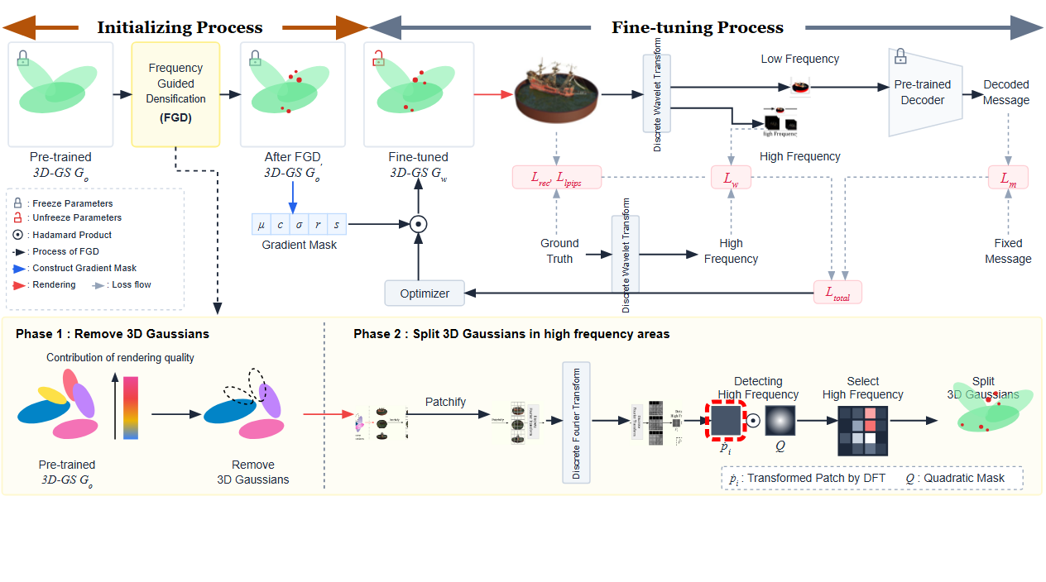
Notes:
Transformed patches enter the high frequency detection stage.
[Hopping Bbox · CVPR_2025_pipe00011 · frame_09.png · 19.00s]

Slide 11
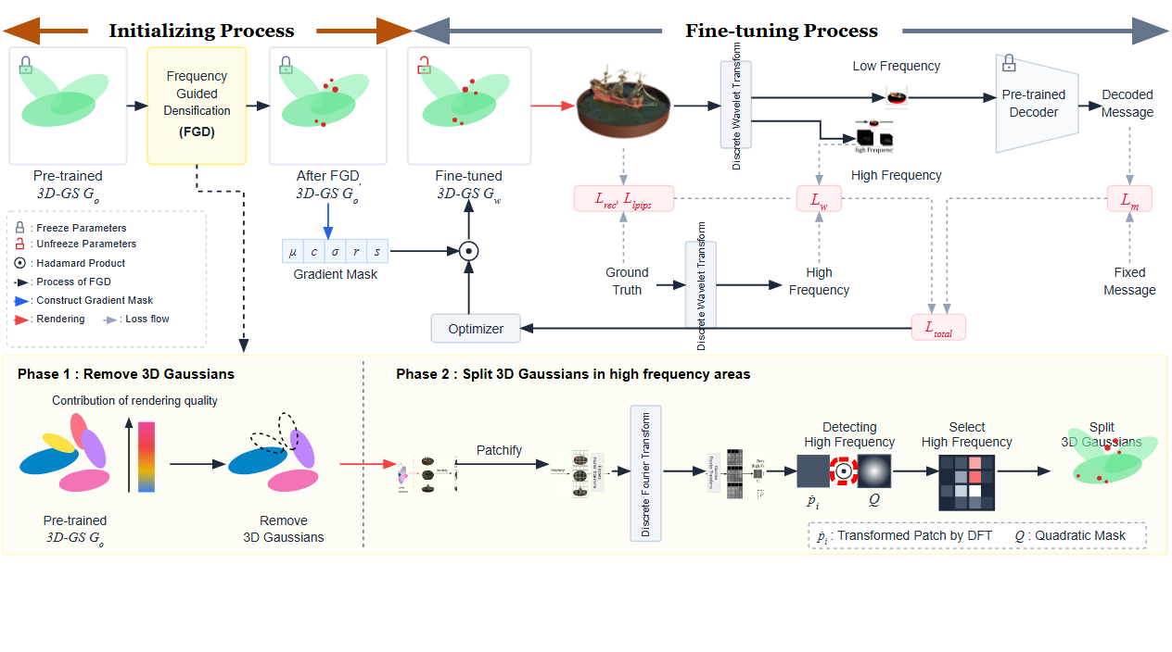
Notes:
Each transformed patch is combined via Hadamard product with a quadratic mask.
[Hopping Bbox · CVPR_2025_pipe00011 · frame_10.png · 21.00s]

Slide 12
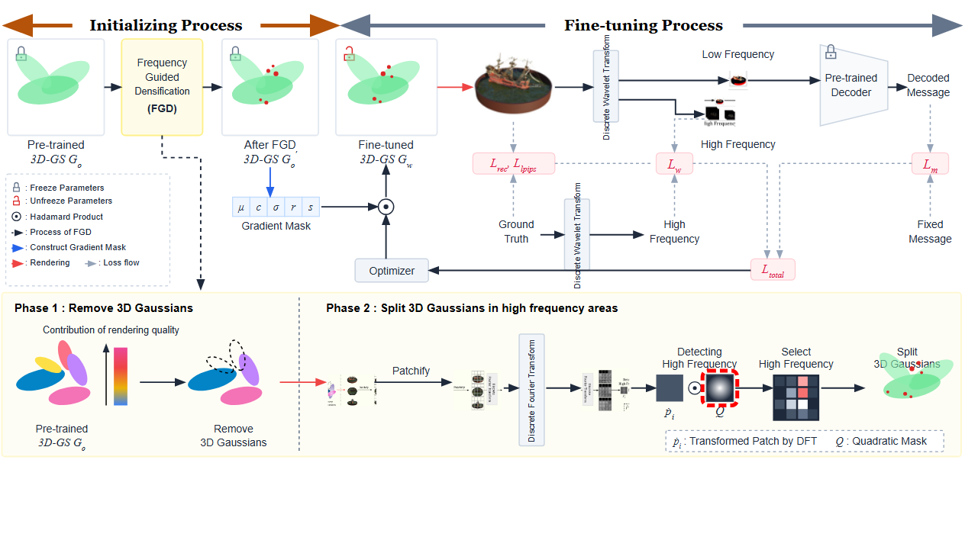
Notes:
The quadratic mask highlights high frequency regions.
[Hopping Bbox · CVPR_2025_pipe00011 · frame_11.png · 23.00s]

Slide 13
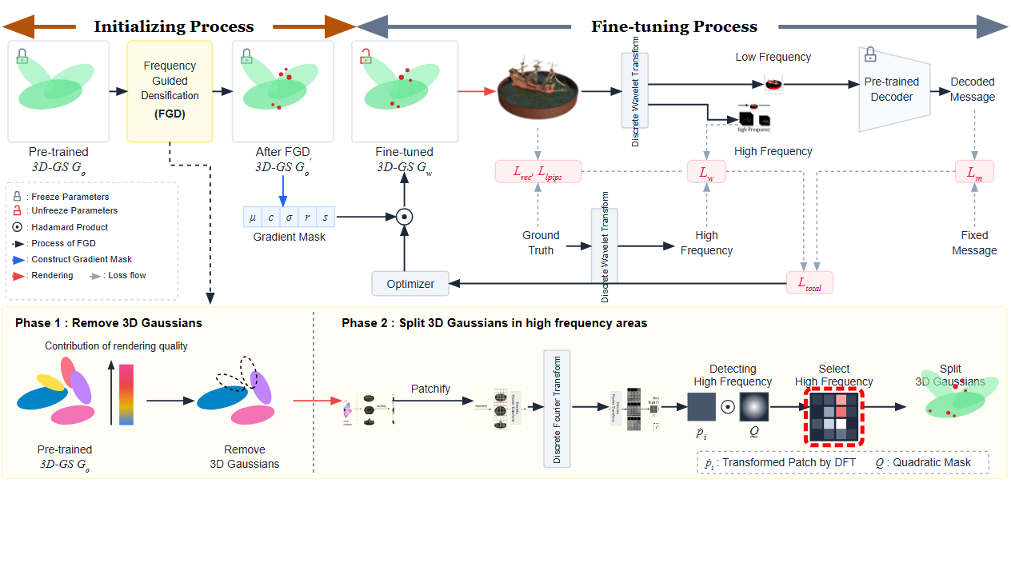
Notes:
Patches exhibiting high frequency components are selected.
[Hopping Bbox · CVPR_2025_pipe00011 · frame_12.png · 25.00s]

Slide 14
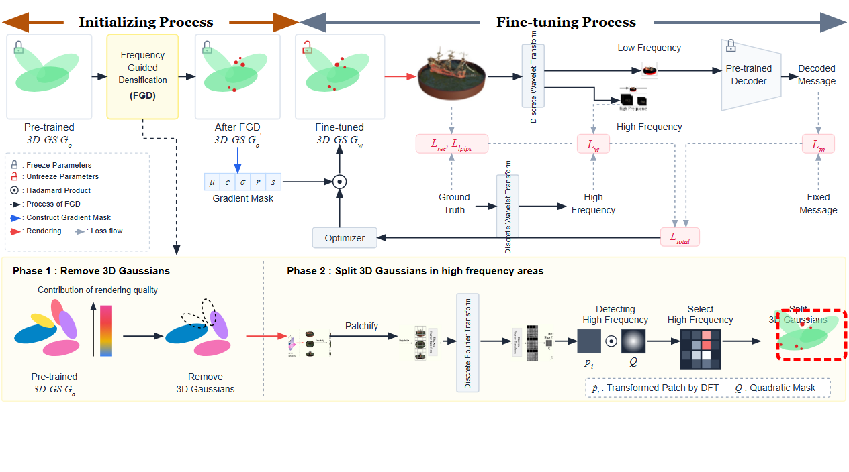
Notes:
The 3D Gaussians within these high frequency areas are split into denser elements.
[Hopping Bbox · CVPR_2025_pipe00011 · frame_13.png · 27.00s]

Slide 15
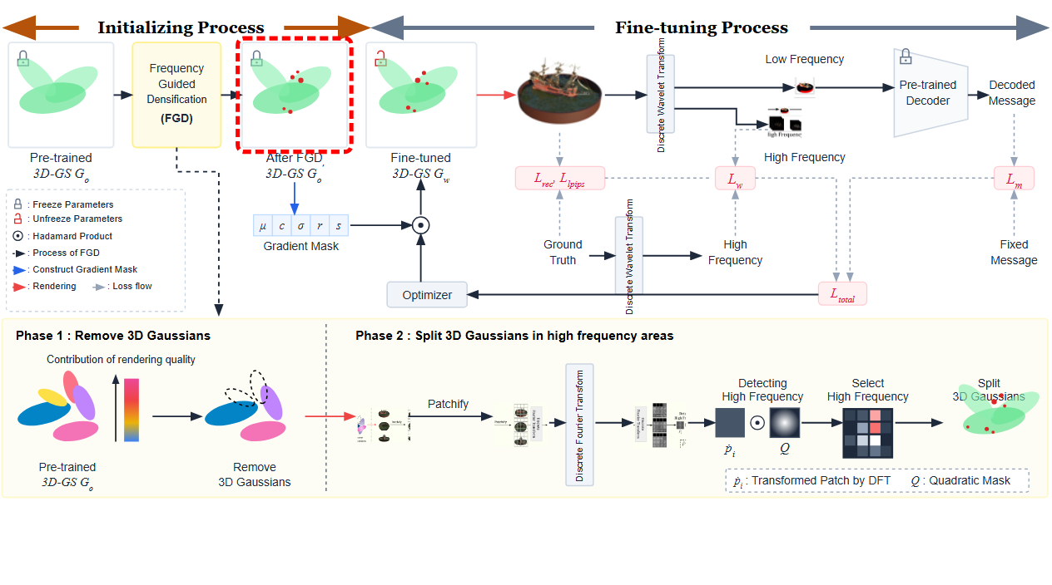
Notes:
This yields the updated 3D Gaussian Splatting representation after densification.
[Hopping Bbox · CVPR_2025_pipe00011 · frame_14.png · 29.00s]

Slide 16
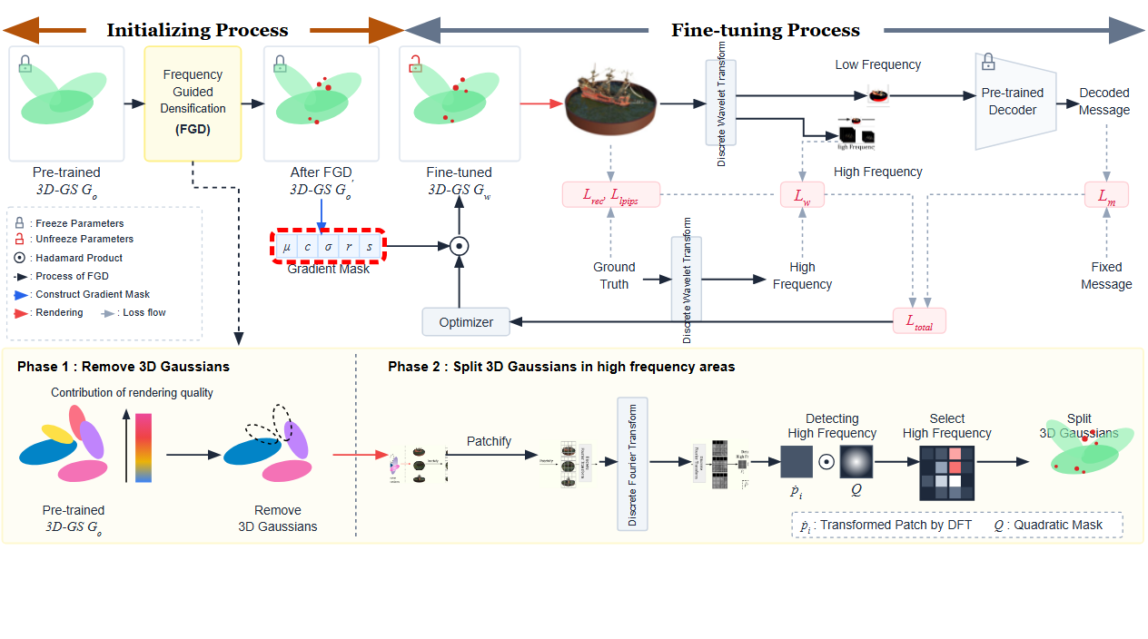
Notes:
A gradient mask is constructed across the Gaussian parameter set.
[Hopping Bbox · CVPR_2025_pipe00011 · frame_15.png · 31.00s]

Slide 17
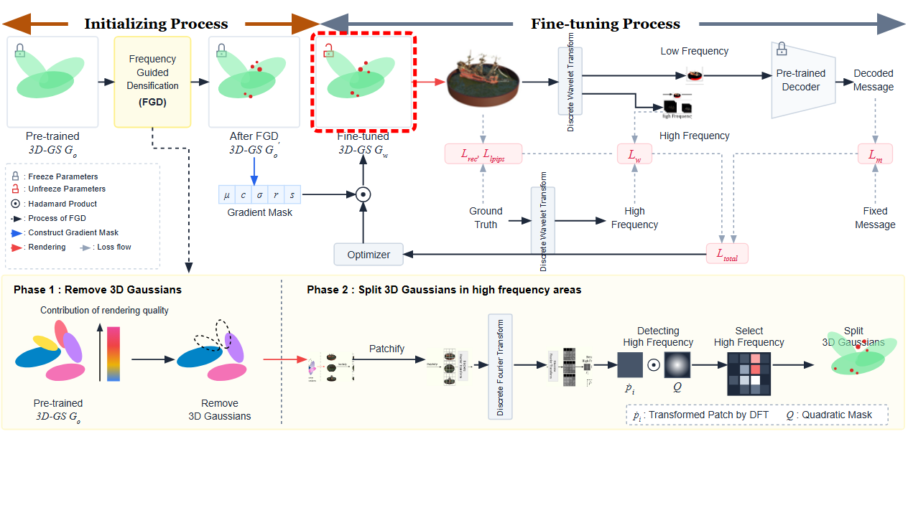
Notes:
In the fine-tuning process, parameters are unfrozen for model optimization.
[Hopping Bbox · CVPR_2025_pipe00011 · frame_16.png · 33.00s]

Slide 18
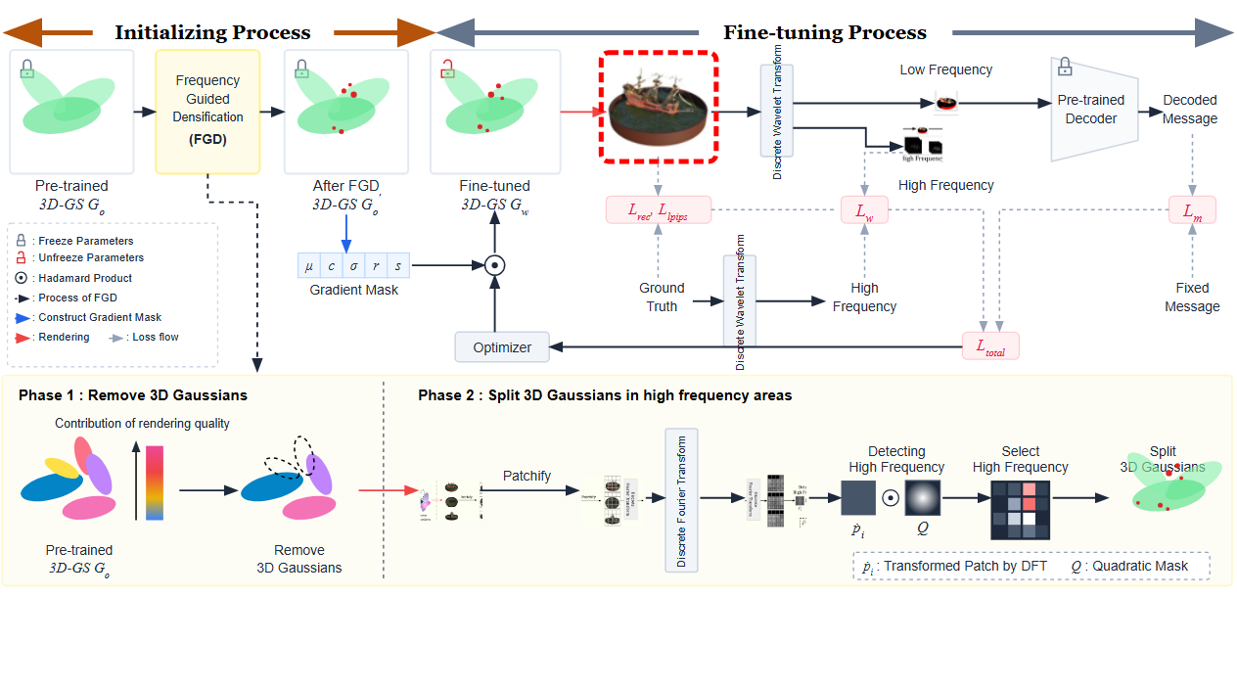
Notes:
Rendering is performed using the fine-tuned 3D Gaussians.
[Hopping Bbox · CVPR_2025_pipe00011 · frame_17.png · 35.00s]

Slide 19
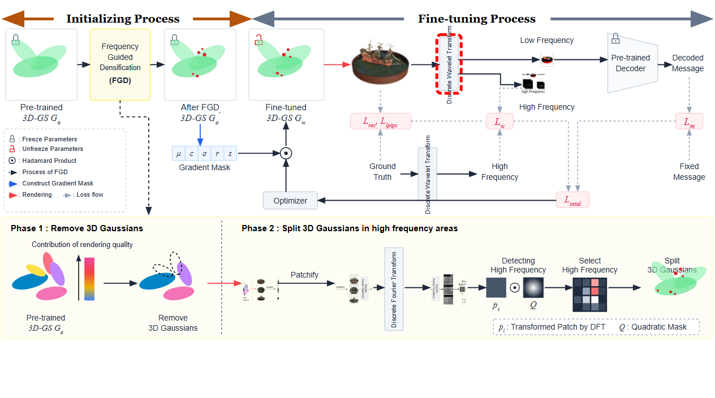
Notes:
A Discrete Wavelet Transform decomposes the rendered image into frequency sub-bands.
[Hopping Bbox · CVPR_2025_pipe00011 · frame_18.png · 37.00s]

Slide 20
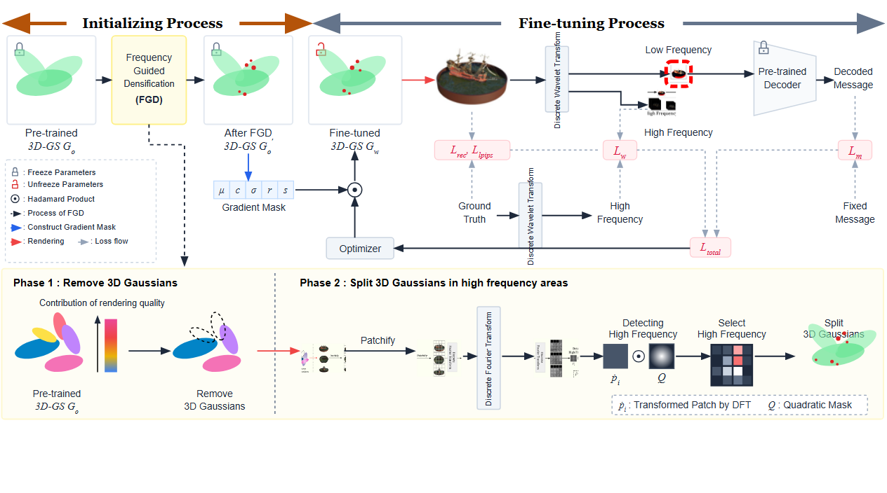
Notes:
The low frequency component is routed forward.
[Hopping Bbox · CVPR_2025_pipe00011 · frame_19.png · 39.00s]

Slide 21
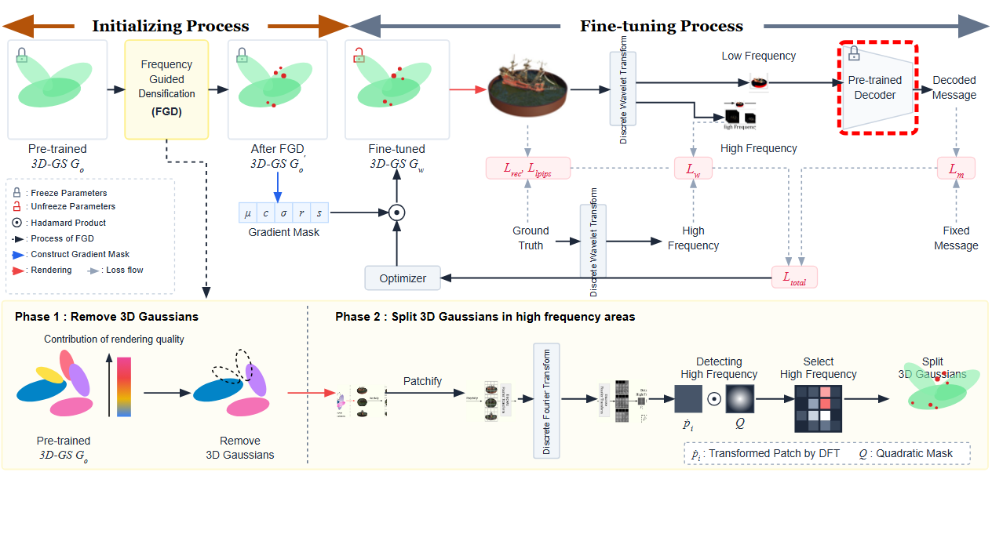
Notes:
A pre-trained decoder with frozen parameters processes the low frequency signal.
[Hopping Bbox · CVPR_2025_pipe00011 · frame_20.png · 41.00s]

Slide 22
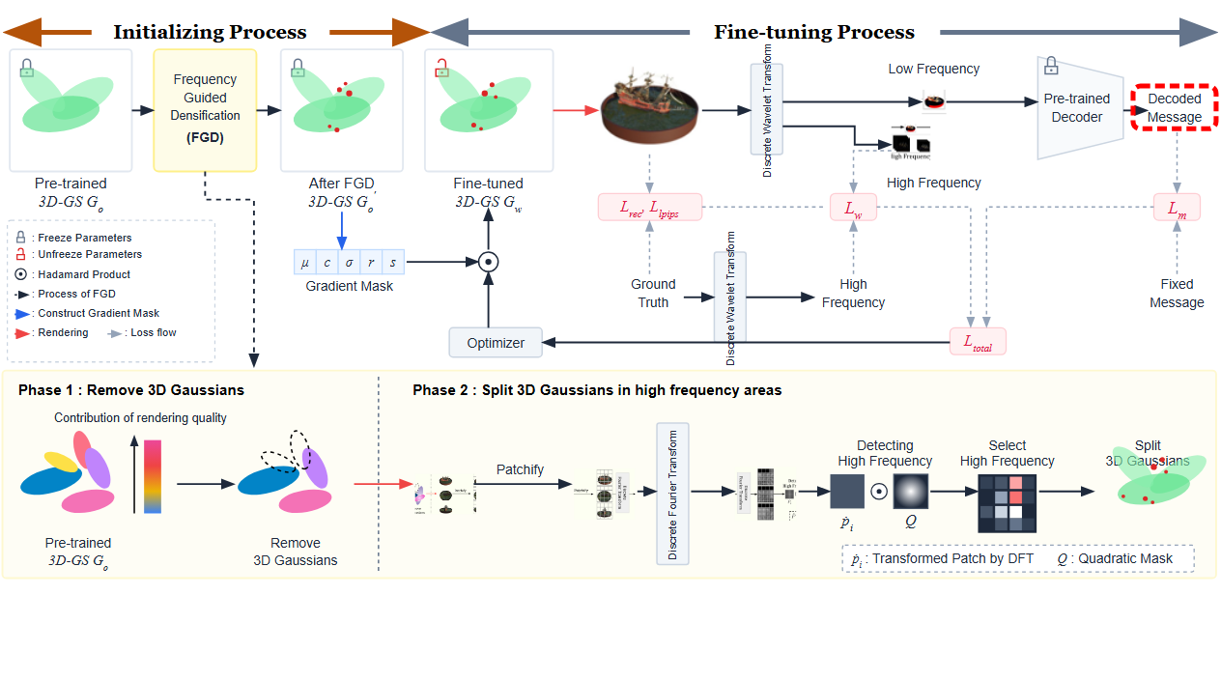
Notes:
The decoder outputs the recovered decoded message.
[Hopping Bbox · CVPR_2025_pipe00011 · frame_21.png · 43.00s]

Slide 23
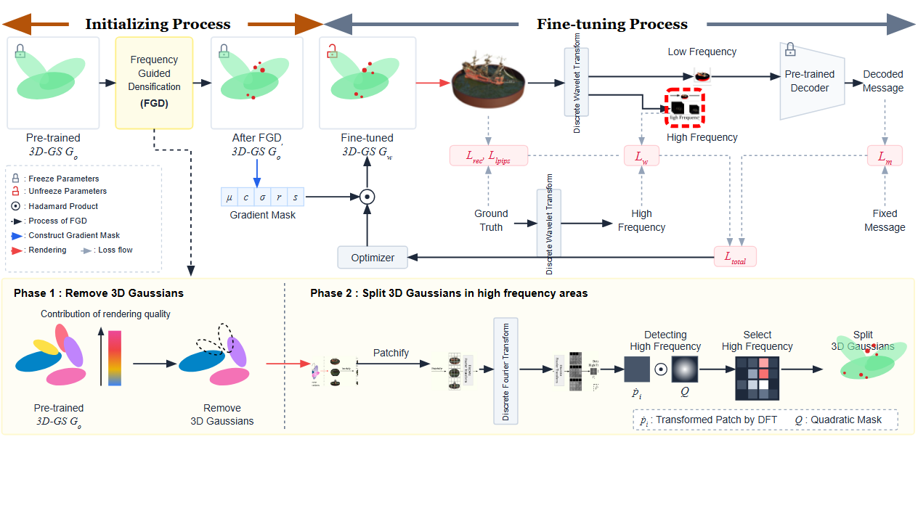
Notes:
Meanwhile, the high frequency components from the rendered image are extracted.
[Hopping Bbox · CVPR_2025_pipe00011 · frame_22.png · 45.00s]

Slide 24
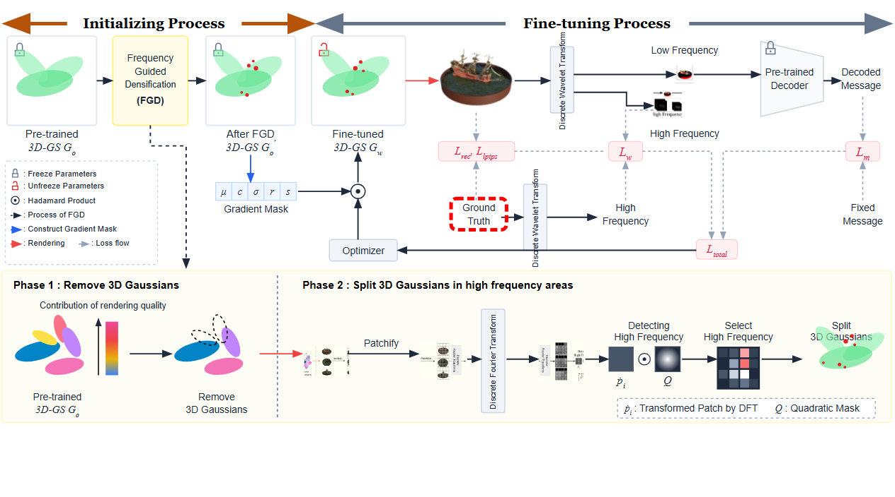
Notes:
The ground truth image is introduced for supervision.
[Hopping Bbox · CVPR_2025_pipe00011 · frame_23.png · 47.00s]

Slide 25
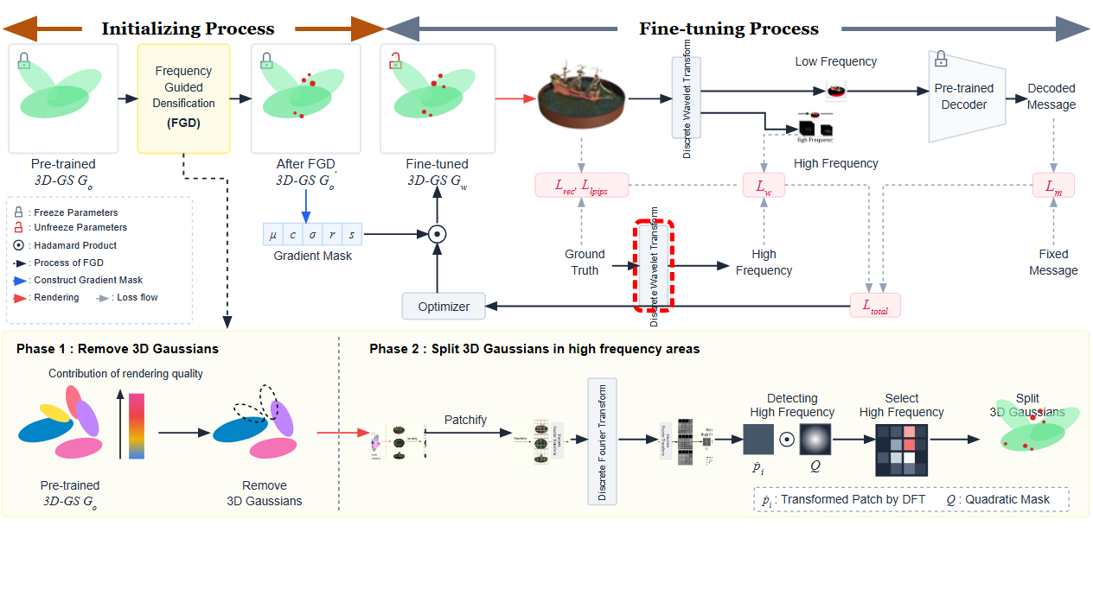
Notes:
A Discrete Wavelet Transform is applied to the ground truth image.
[Hopping Bbox · CVPR_2025_pipe00011 · frame_24.png · 49.00s]

Slide 26
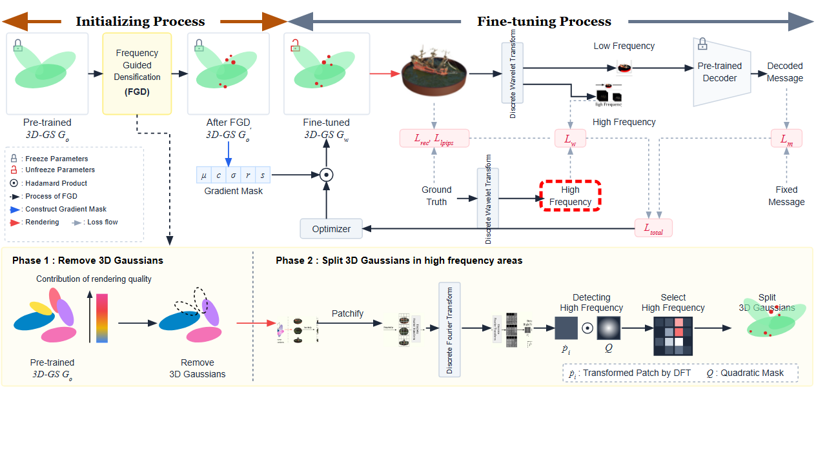
Notes:
This isolates the high frequency components of the ground truth.
[Hopping Bbox · CVPR_2025_pipe00011 · frame_25.png · 51.00s]

Slide 27
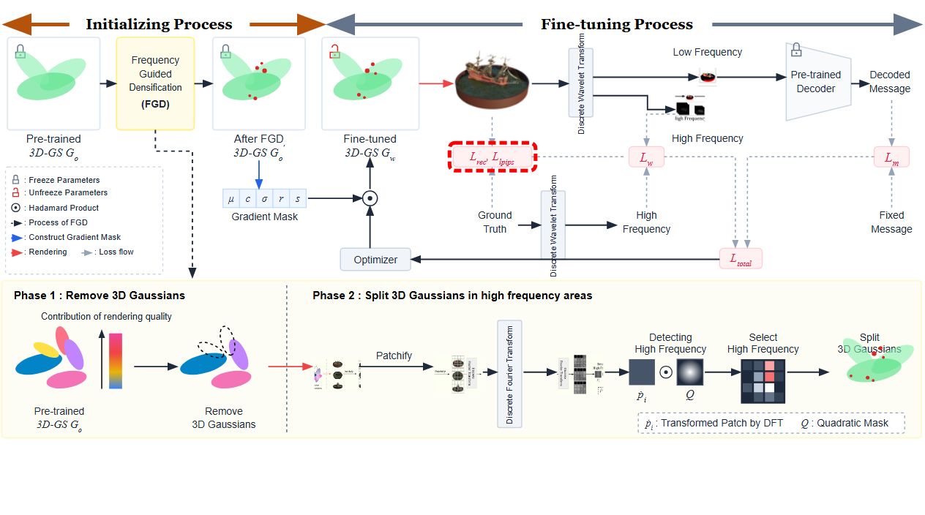
Notes:
Reconstruction and perceptual loss functions compare rendered views with ground truth.
[Hopping Bbox · CVPR_2025_pipe00011 · frame_26.png · 53.00s]

Slide 28
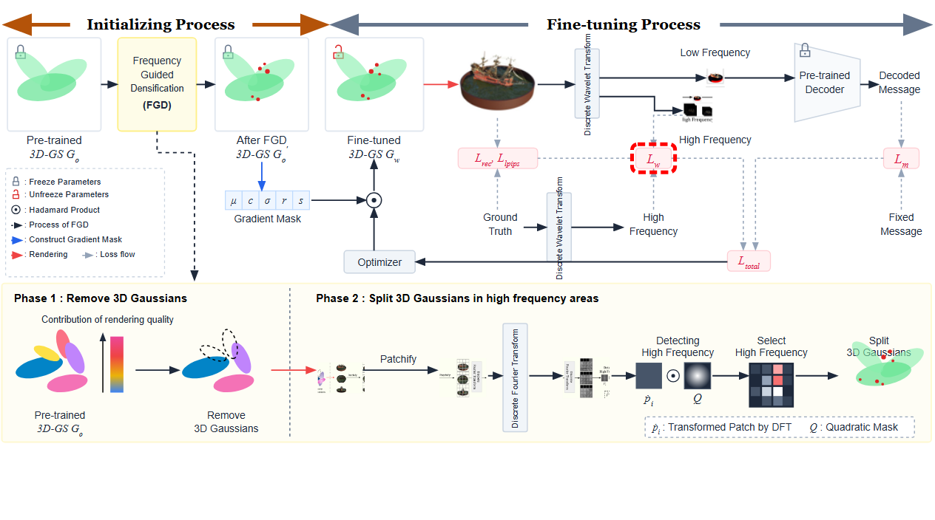
Notes:
A wavelet loss is computed between rendered and ground truth high frequencies.
[Hopping Bbox · CVPR_2025_pipe00011 · frame_27.png · 55.00s]

Slide 29
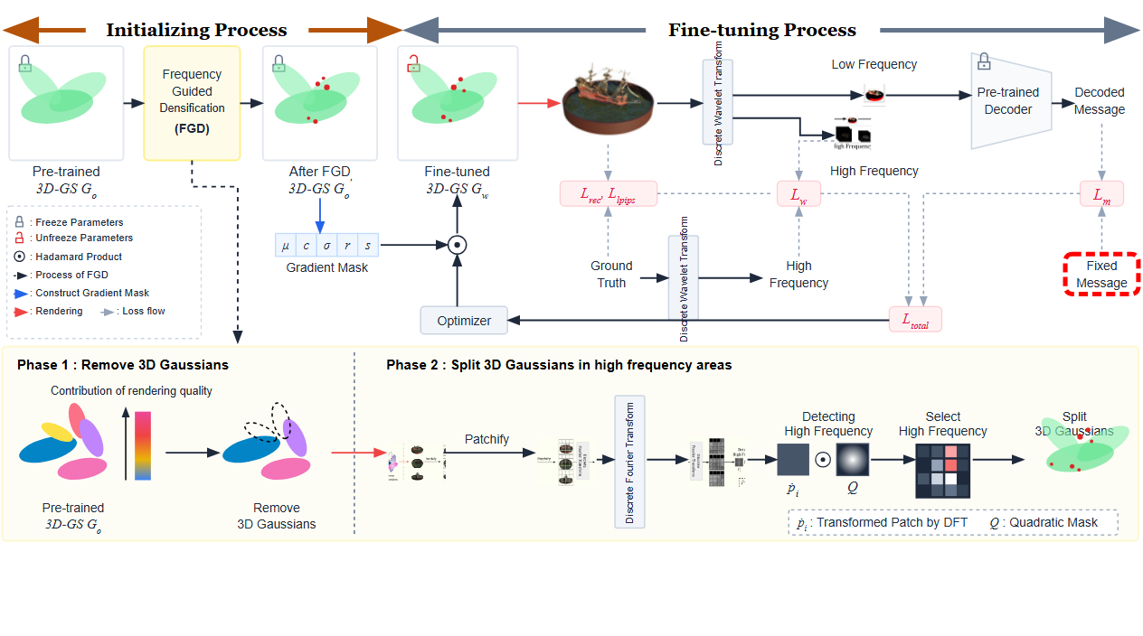
Notes:
A fixed message serves as target supervision.
[Hopping Bbox · CVPR_2025_pipe00011 · frame_28.png · 57.00s]

Slide 30
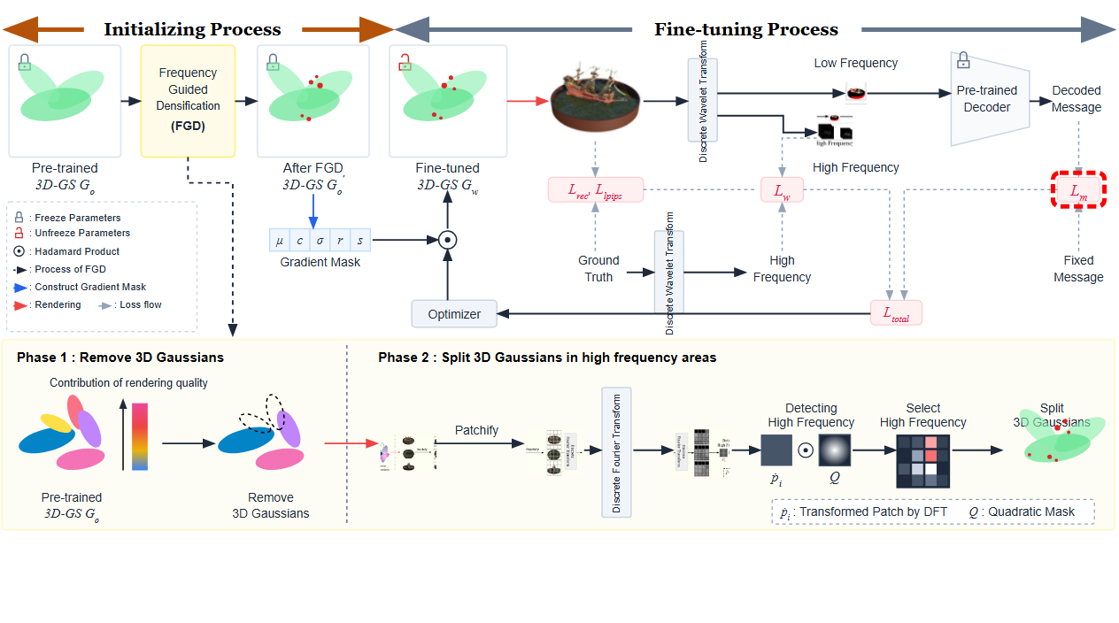
Notes:
Message loss compares the decoded message with the fixed message.
[Hopping Bbox · CVPR_2025_pipe00011 · frame_29.png · 59.00s]

Slide 31
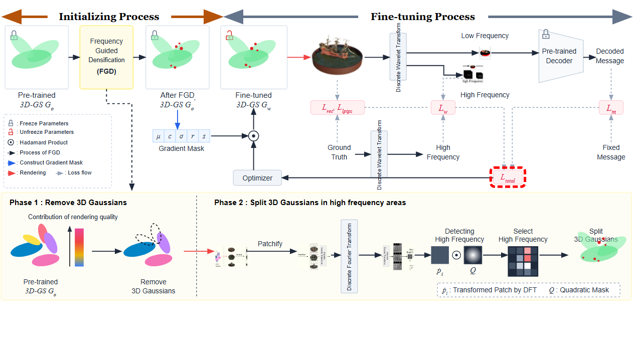
Notes:
All objectives combine into a single total loss function.
[Hopping Bbox · CVPR_2025_pipe00011 · frame_30.png · 61.00s]

Slide 32
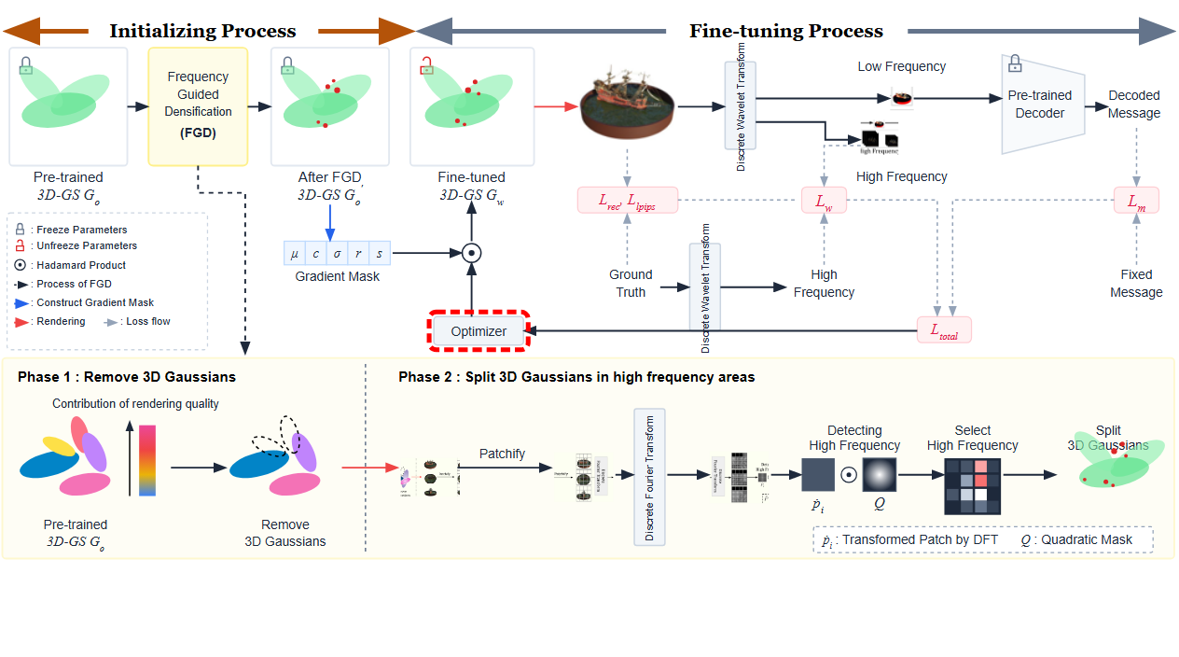
Notes:
The total loss guides the optimizer.
[Hopping Bbox · CVPR_2025_pipe00011 · frame_31.png · 63.00s]

Slide 33
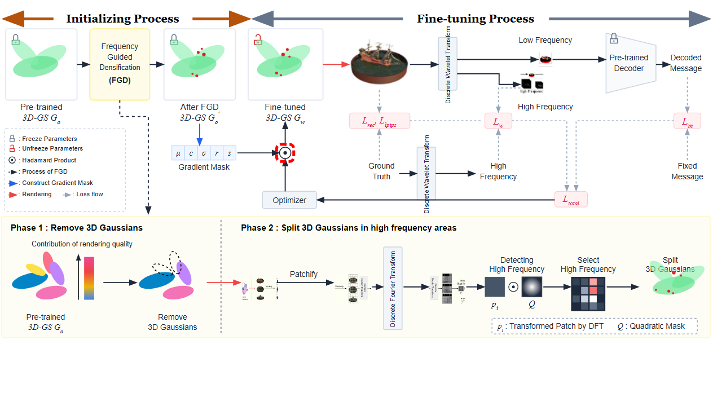
Notes:
Finally, the optimizer applies the gradient mask via Hadamard product to update the fine-tuned 3D Gaussians.
[Hopping Bbox · CVPR_2025_pipe00011 · frame_32.png · 65.00s]

