Slide 1
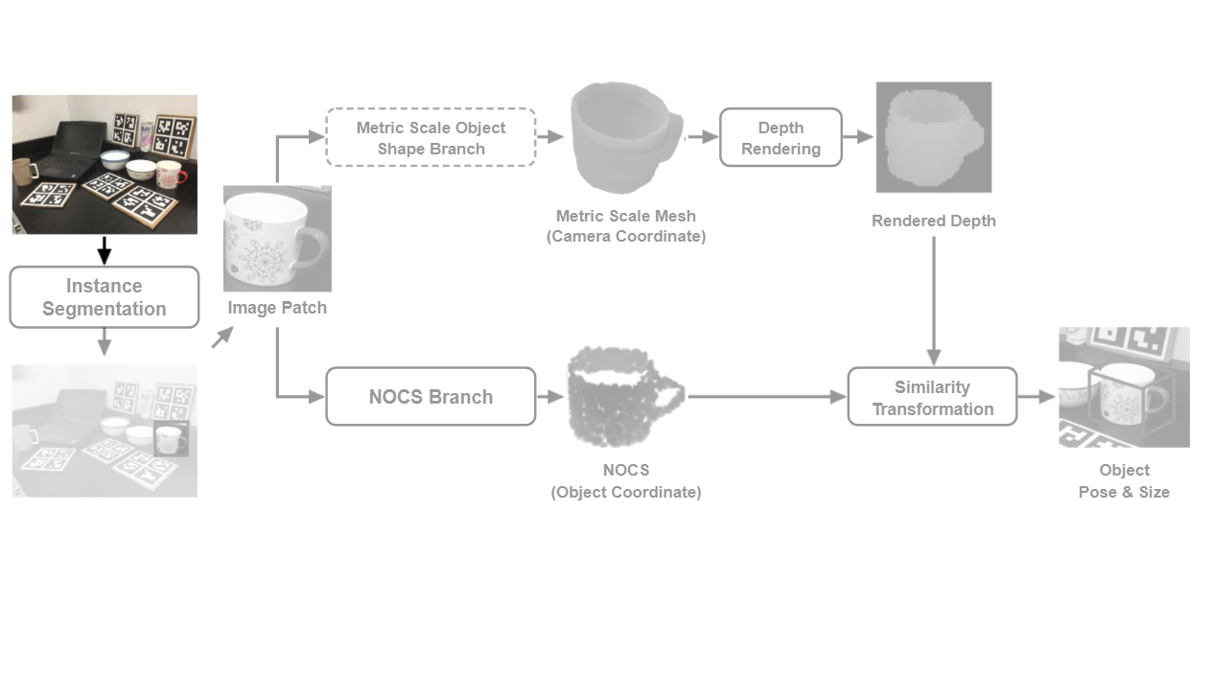
Notes:
The pipeline begins with an input RGB image containing tabletop objects.
[Colour Pop · Paper2Fig_pipe_diff_000000486 · frame_00.png · 0.50s]

Slide 2
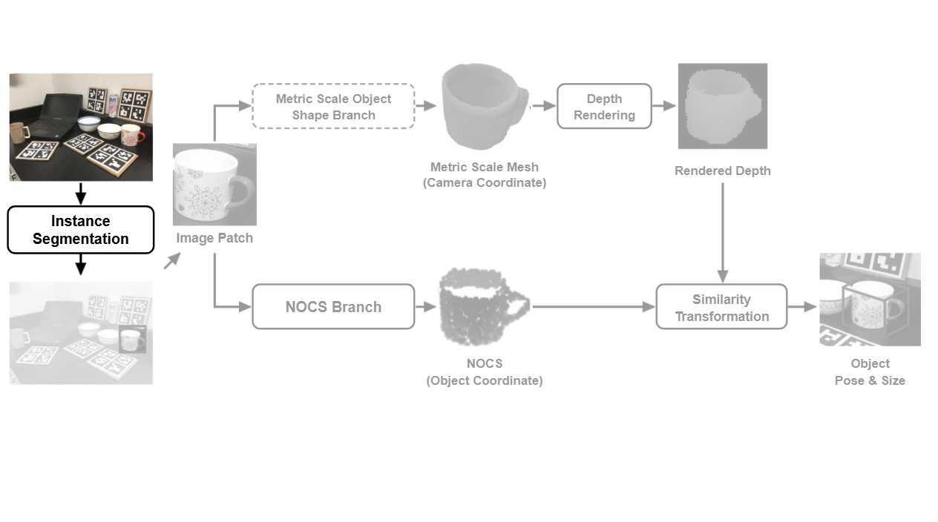
Notes:
An off-the-shelf instance segmentation module detects class labels, bounding boxes, and object masks.
[Colour Pop · Paper2Fig_pipe_diff_000000486 · frame_01.png · 1.00s]

Slide 3
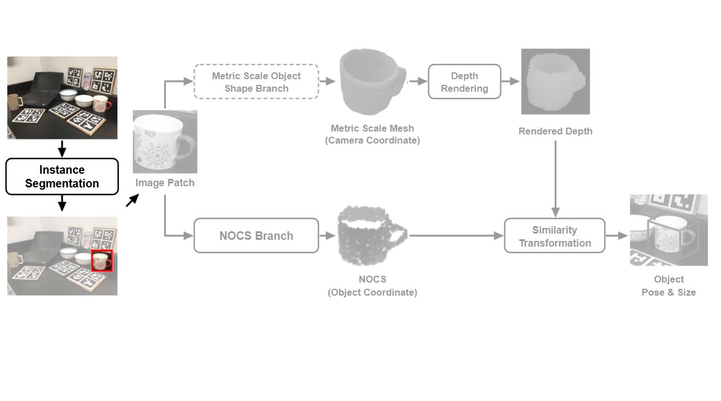
Notes:
The detected bounding box isolates the specific target object in the scene.
[Colour Pop · Paper2Fig_pipe_diff_000000486 · frame_02.png · 1.50s]

Slide 4
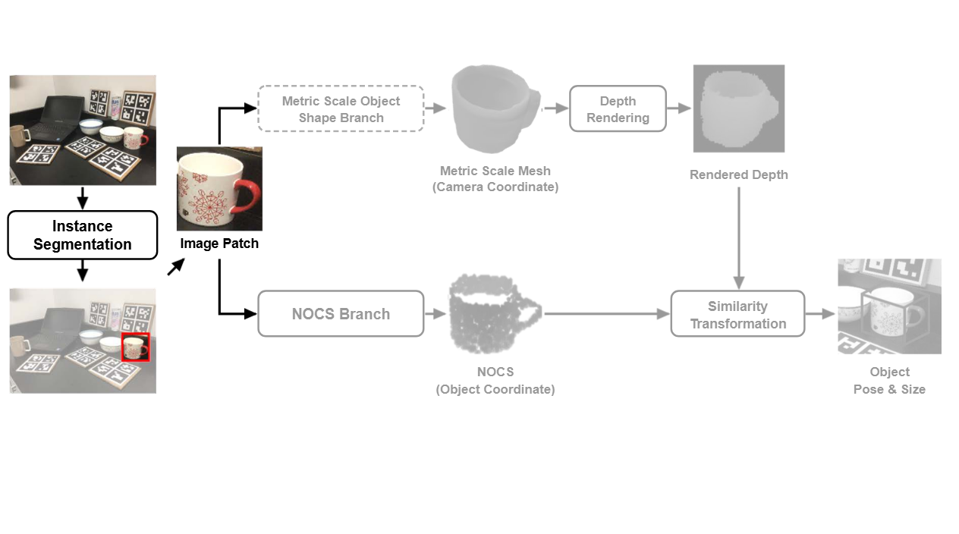
Notes:
The cropped image patch is then fed simultaneously into two parallel estimation branches.
[Colour Pop · Paper2Fig_pipe_diff_000000486 · frame_03.png · 2.00s]

Slide 5
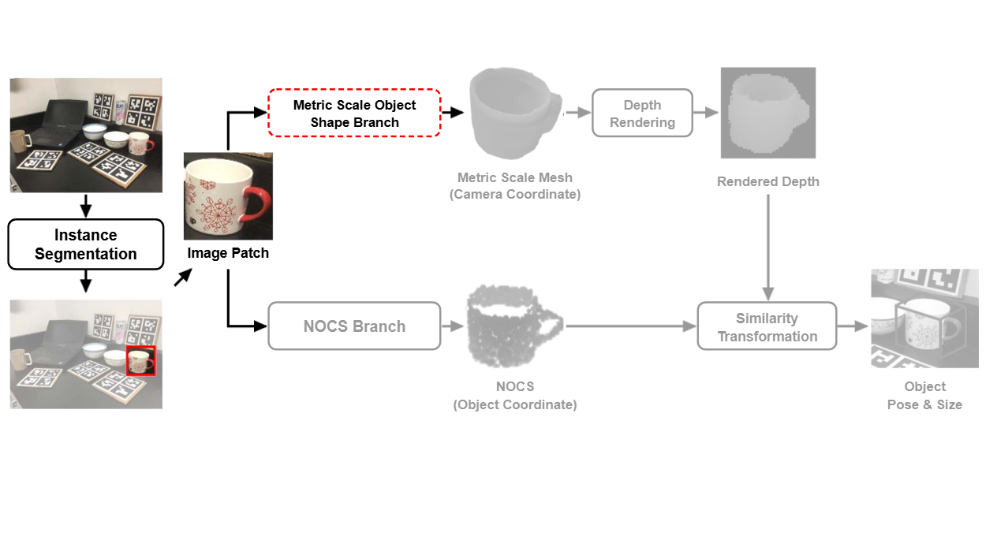
Notes:
The Metric Scale Object Shape branch estimates the 3D metric geometry in camera coordinates.
[Colour Pop · Paper2Fig_pipe_diff_000000486 · frame_04.png · 2.50s]

Slide 6
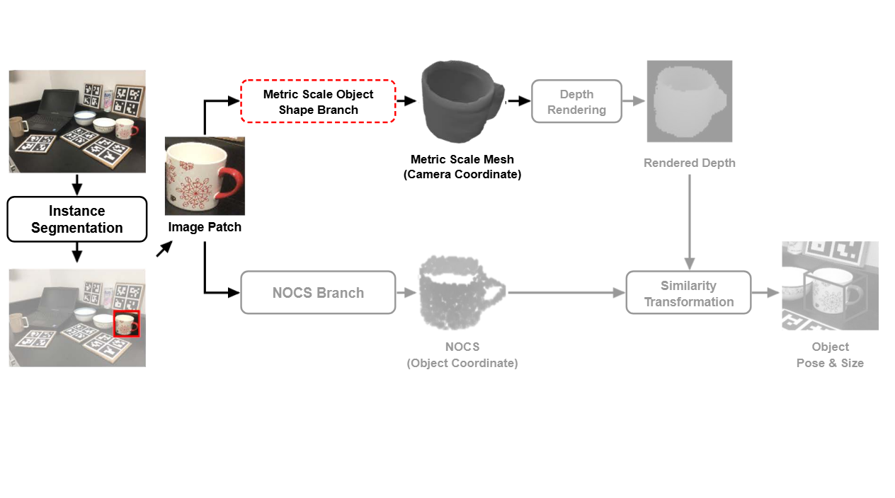
Notes:
This generates a metric scale mesh aligned with the camera coordinate system.
[Colour Pop · Paper2Fig_pipe_diff_000000486 · frame_05.png · 3.00s]

Slide 7
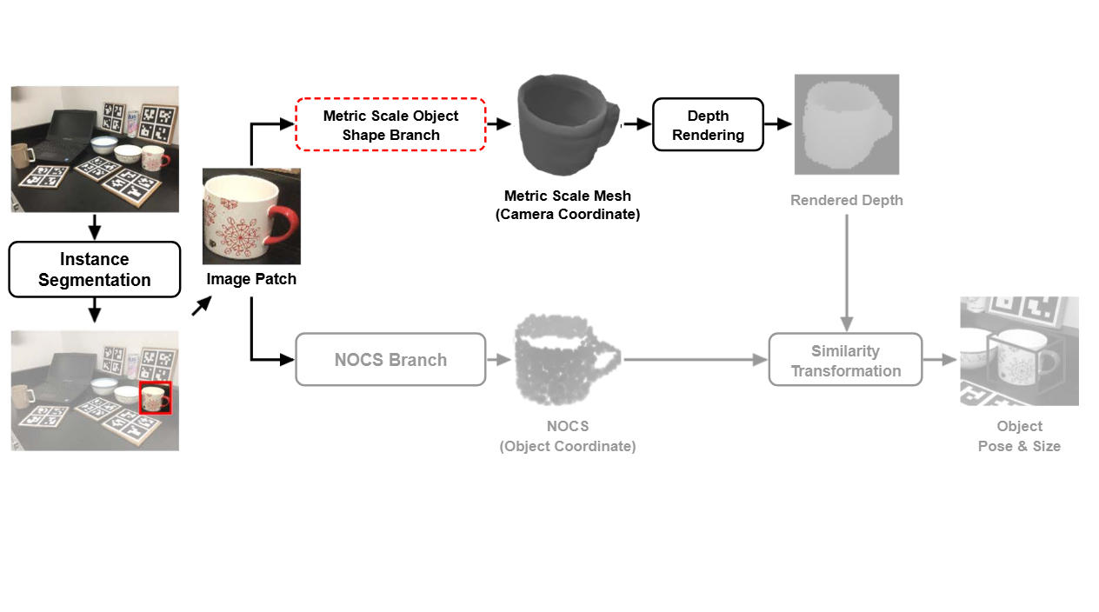
Notes:
The predicted metric mesh is then projected onto the image plane via depth rendering.
[Colour Pop · Paper2Fig_pipe_diff_000000486 · frame_06.png · 3.50s]

Slide 8
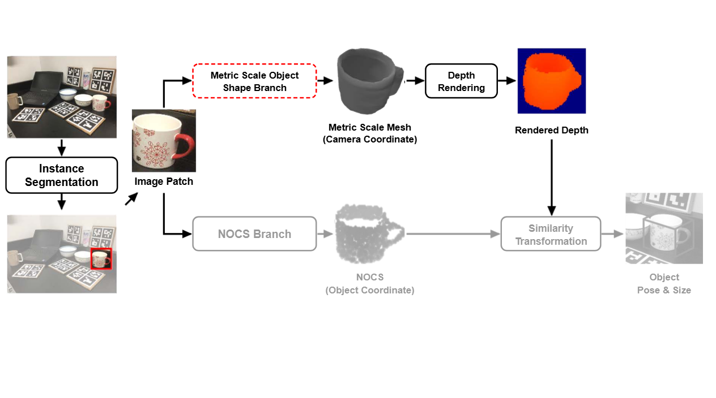
Notes:
This produces a dense rendered depth map of the target object.
[Colour Pop · Paper2Fig_pipe_diff_000000486 · frame_07.png · 4.00s]

Slide 9
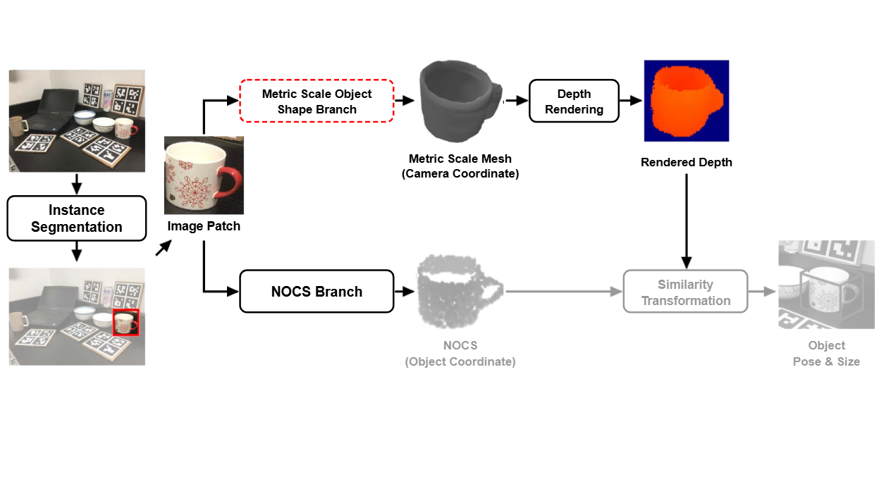
Notes:
In parallel, the Normalized Object Coordinate Space branch processes the image patch.
[Colour Pop · Paper2Fig_pipe_diff_000000486 · frame_08.png · 4.50s]

Slide 10
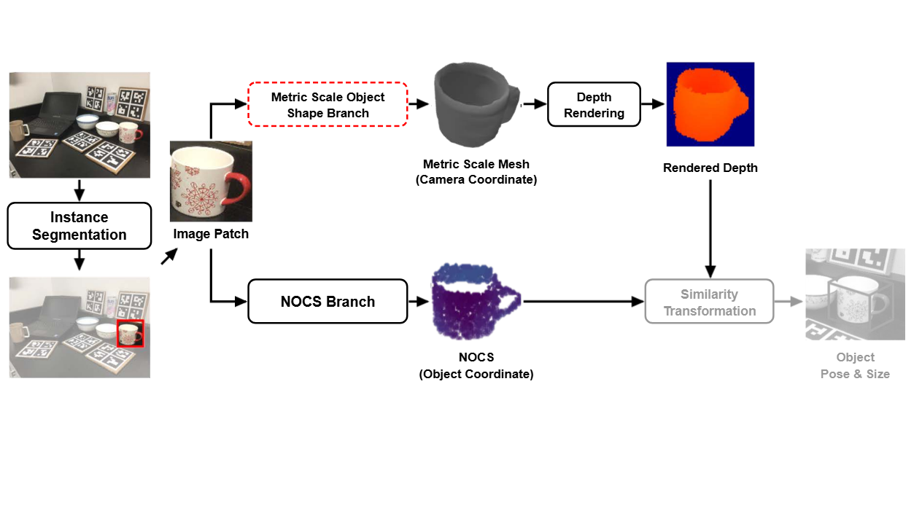
Notes:
It predicts a canonical coordinate map defined directly in the object reference frame.
[Colour Pop · Paper2Fig_pipe_diff_000000486 · frame_09.png · 5.00s]

Slide 11
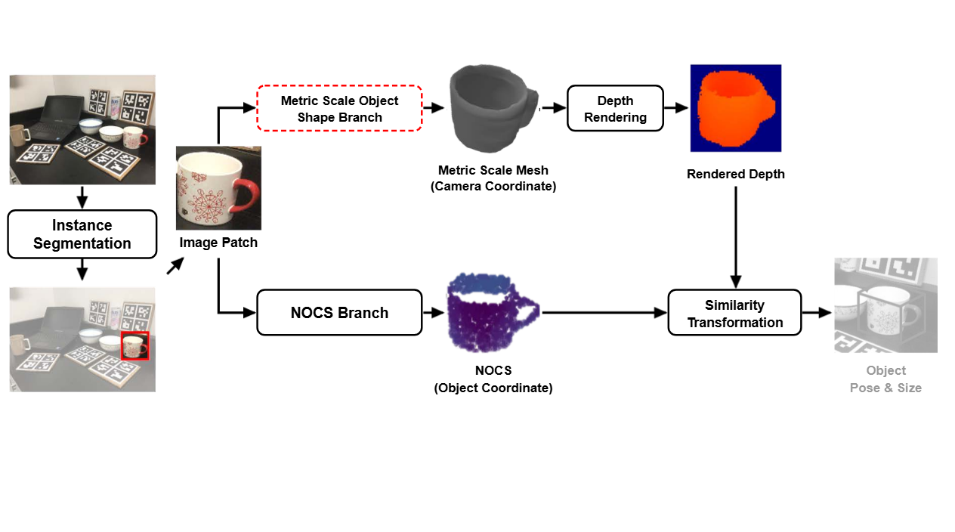
Notes:
A similarity transformation aligns the rendered depth map with the predicted normalized coordinate map.
[Colour Pop · Paper2Fig_pipe_diff_000000486 · frame_10.png · 5.50s]

Slide 12
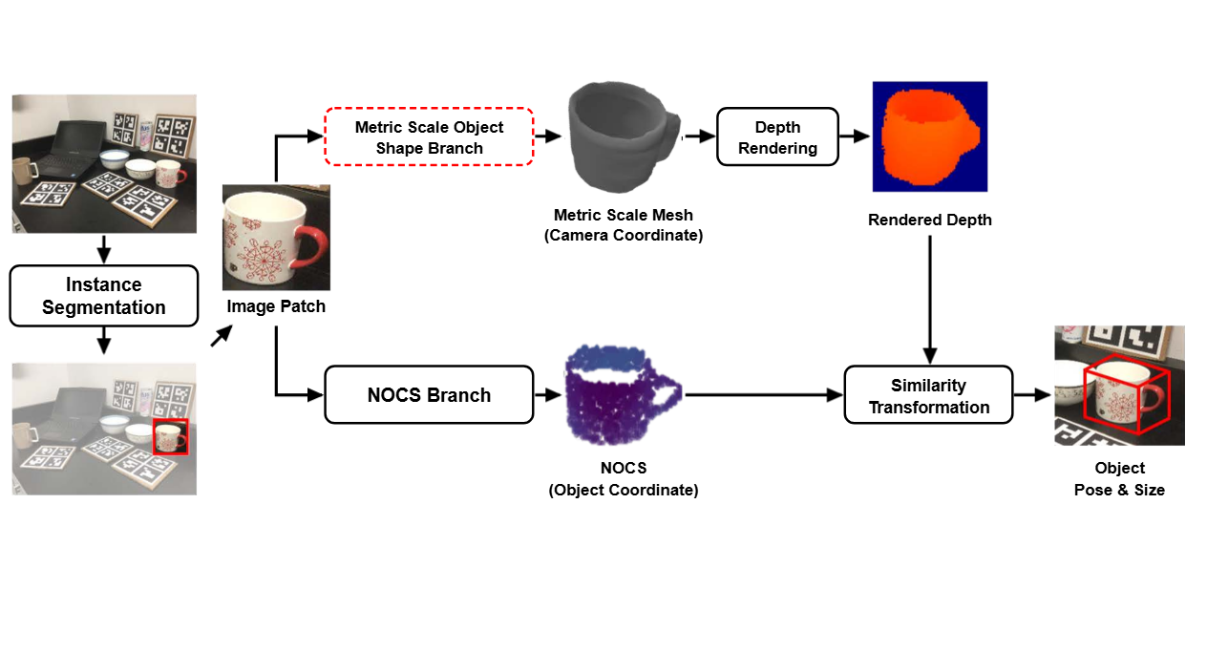
Notes:
The final output accurately determines the six-dimensional object pose and bounding box size.
[Colour Pop · Paper2Fig_pipe_diff_000000486 · frame_11.png · 6.00s]

