Slide 1

Notes:
The training pipeline begins with the Breast Cancer Image Dataset, providing source data for segmentation and classification workflows.
[Progressive Reveal · Paper2Fig_pipe_diff_000000492 · frame_00.png · 0.50s]

Slide 2
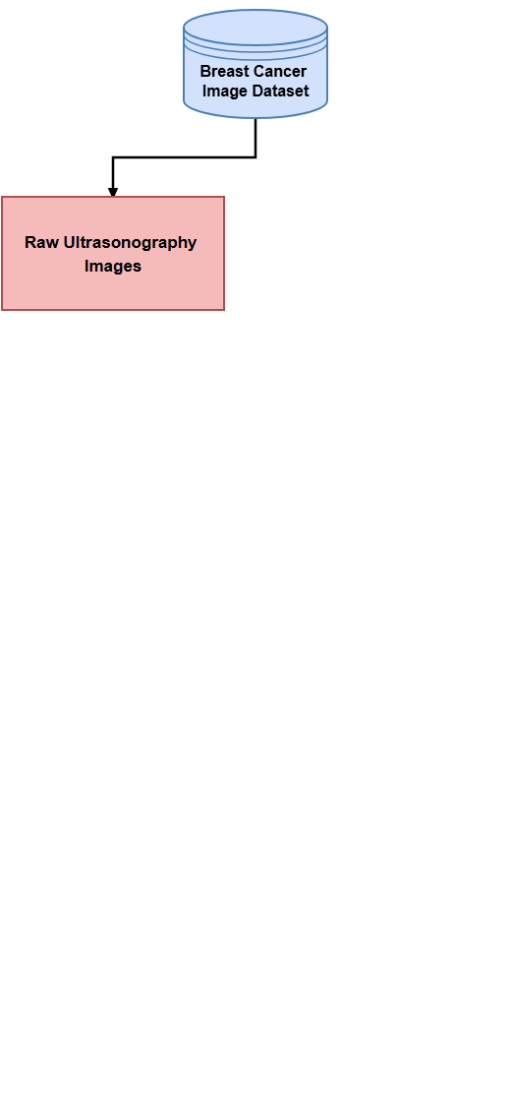
Notes:
In the segmentation branch, raw ultrasonography images are extracted from the dataset.
[Progressive Reveal · Paper2Fig_pipe_diff_000000492 · frame_01.png · 1.00s]

Slide 3
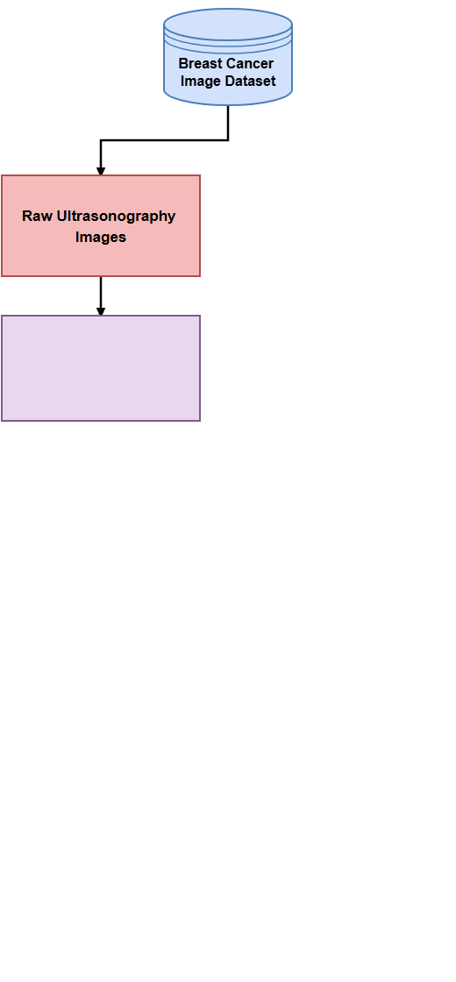
Notes:
These images enter the preprocessing stage,
[Progressive Reveal · Paper2Fig_pipe_diff_000000492 · frame_02.png · 1.50s]

Slide 4
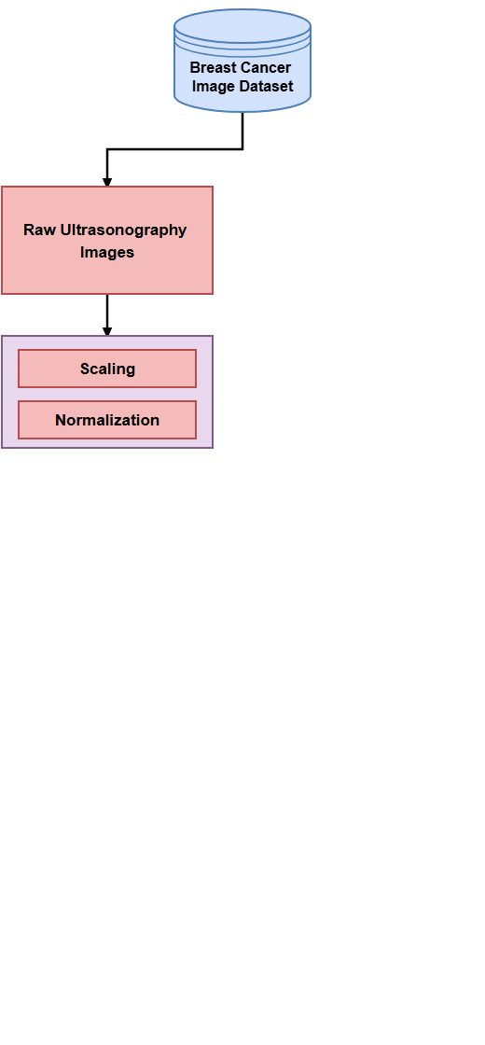
Notes:
where they undergo dimension scaling to 128 by 128 pixels followed by pixel normalization.
[Progressive Reveal · Paper2Fig_pipe_diff_000000492 · frame_03.png · 2.00s]

Slide 5
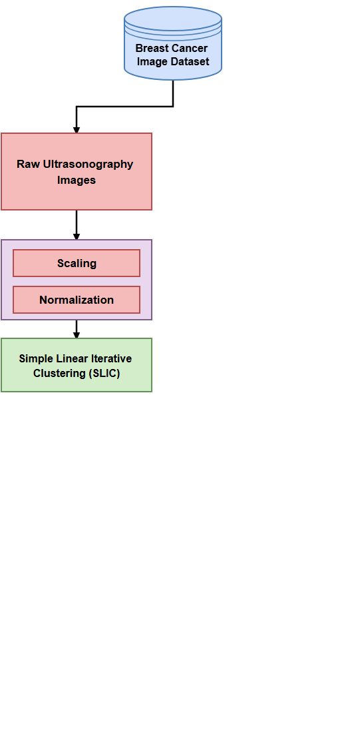
Notes:
Simple Linear Iterative Clustering (SLIC) then clusters pixels into superpixels to mitigate noise.
[Progressive Reveal · Paper2Fig_pipe_diff_000000492 · frame_04.png · 2.50s]

Slide 6
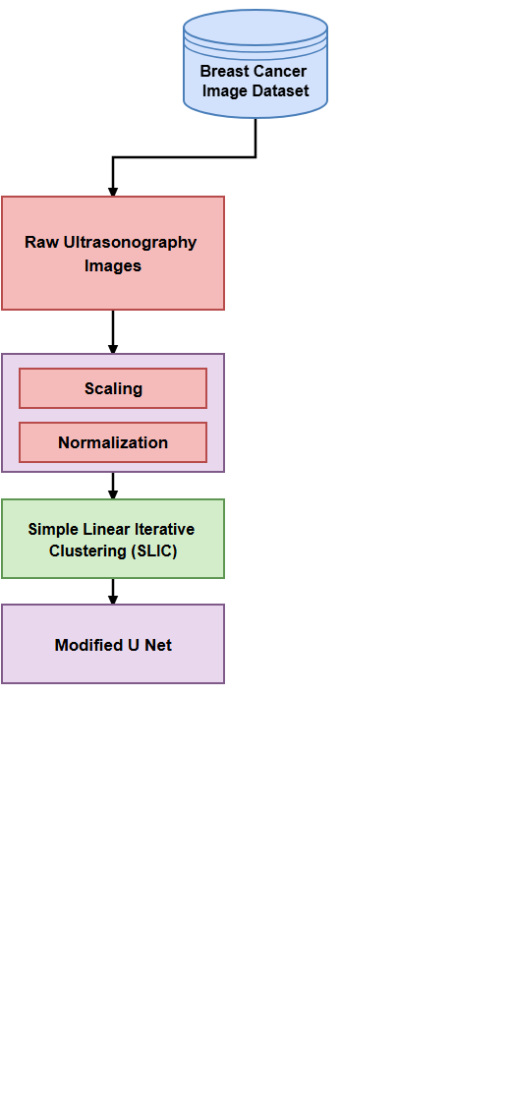
Notes:
The clustered images are fed into a modified U-Net encoder-decoder network alongside ground truth masks.
[Progressive Reveal · Paper2Fig_pipe_diff_000000492 · frame_05.png · 3.00s]

Slide 7
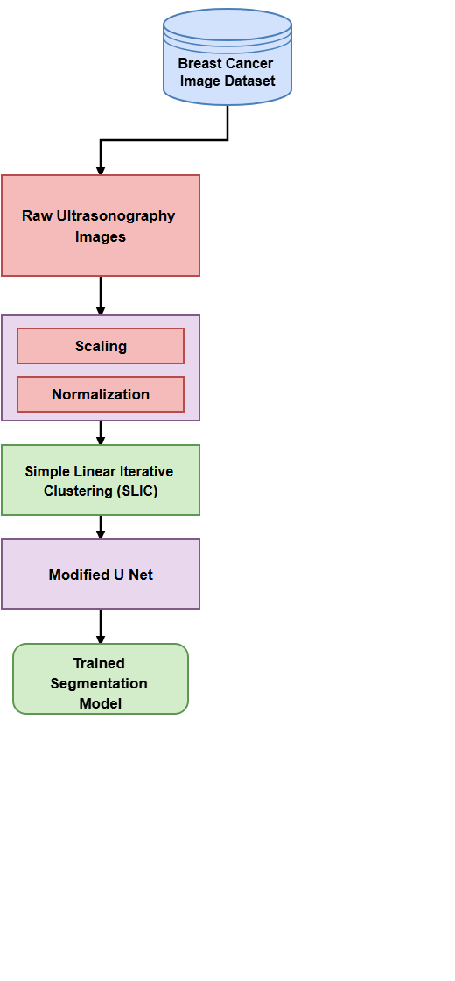
Notes:
Completing this training yields the trained segmentation model.
[Progressive Reveal · Paper2Fig_pipe_diff_000000492 · frame_06.png · 3.50s]

Slide 8
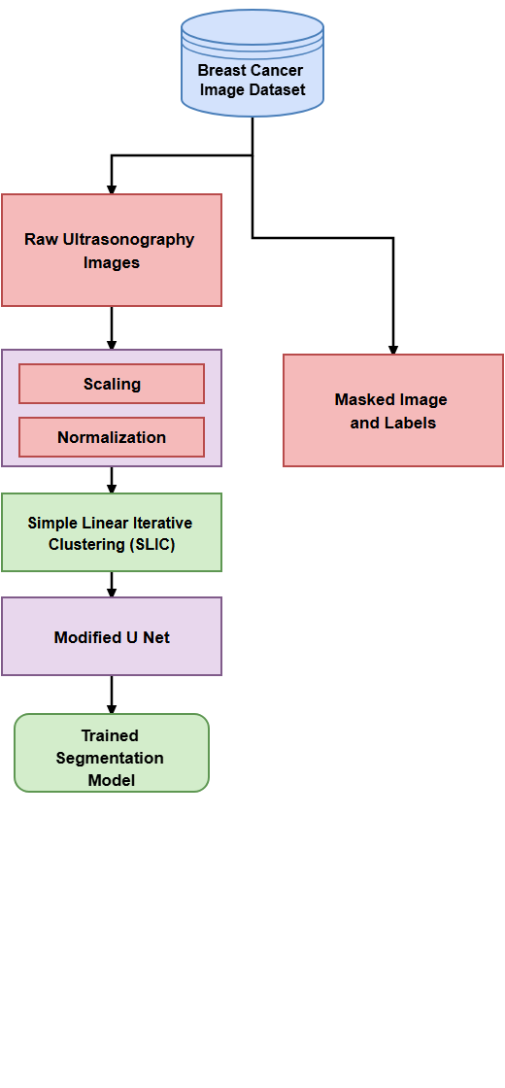
Notes:
In parallel, masked images and corresponding class labels are retrieved for detection training.
[Progressive Reveal · Paper2Fig_pipe_diff_000000492 · frame_07.png · 4.00s]

Slide 9
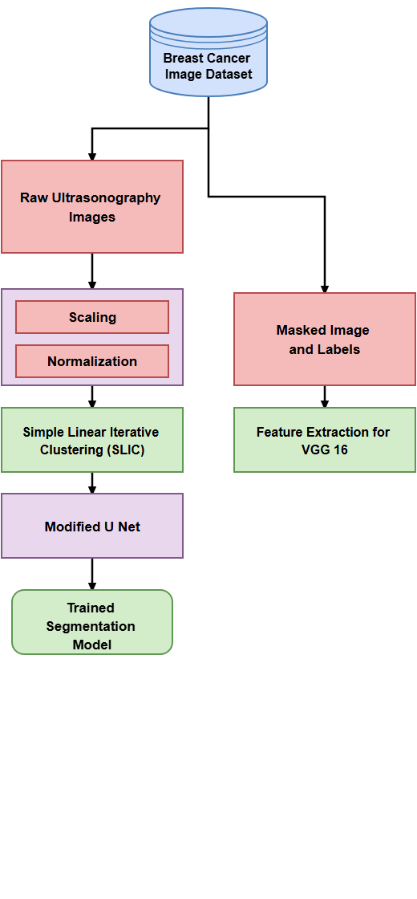
Notes:
A pre-trained VGG 16 model extracts deep spatial features from these masked ultrasound images.
[Progressive Reveal · Paper2Fig_pipe_diff_000000492 · frame_08.png · 4.50s]

Slide 10
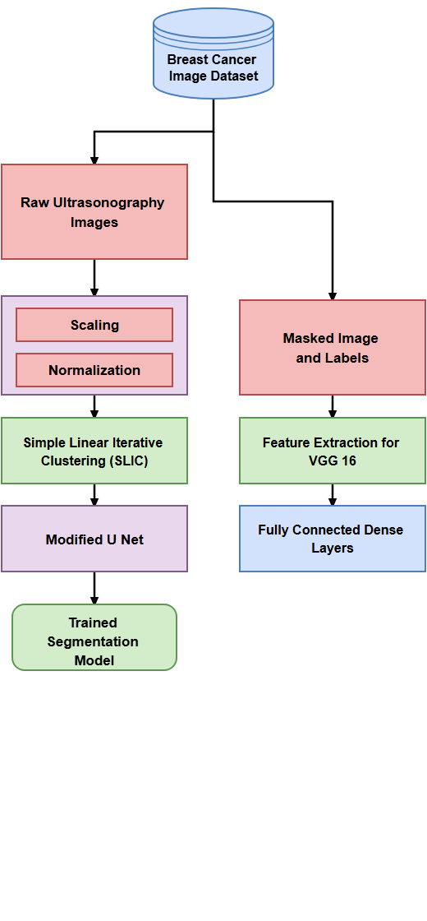
Notes:
Extracted features are processed through five fully connected dense layers with dropout and activations.
[Progressive Reveal · Paper2Fig_pipe_diff_000000492 · frame_09.png · 5.00s]

Slide 11
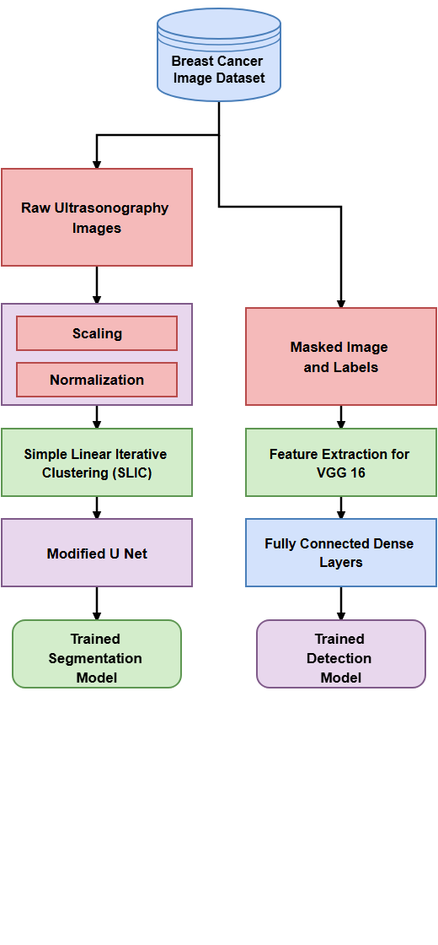
Notes:
This establishes the trained detection model for classifying tumor types.
[Progressive Reveal · Paper2Fig_pipe_diff_000000492 · frame_10.png · 5.50s]

Slide 12
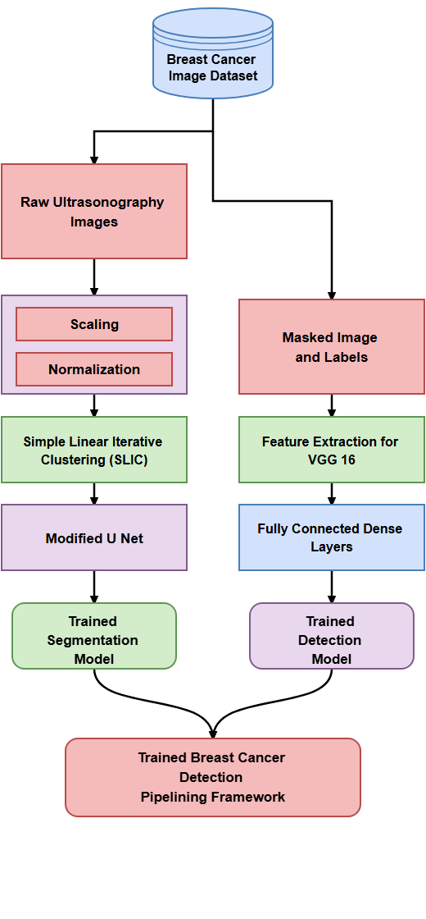
Notes:
Finally, the trained components combine into the unified breast cancer detection pipelining framework.
[Progressive Reveal · Paper2Fig_pipe_diff_000000492 · frame_11.png · 6.00s]

