Slide 1
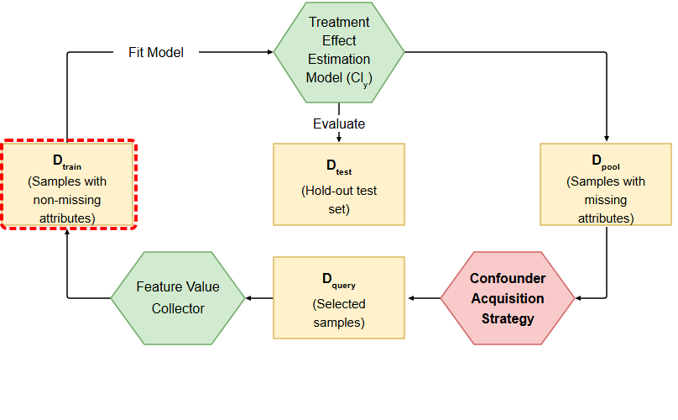
Notes:
The pipeline begins with the training dataset, containing samples with fully observed, non-missing attributes.
[Hopping Bbox · Paper2Fig_pipe_easy_000000503 · frame_00.png · 1.50s]

Slide 2
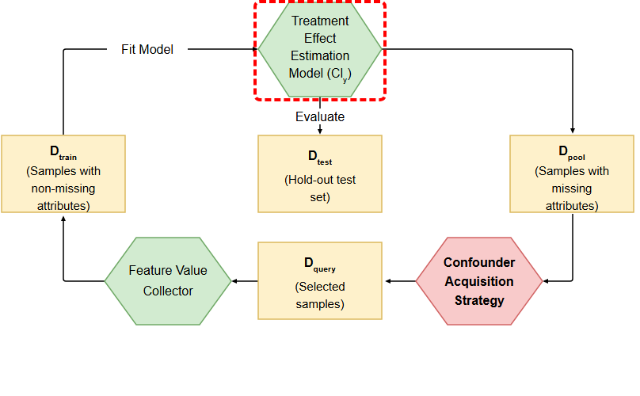
Notes:
These samples are used to train the treatment effect estimation model, fitting the outcome predictors.
[Hopping Bbox · Paper2Fig_pipe_easy_000000503 · frame_01.png · 4.50s]

Slide 3
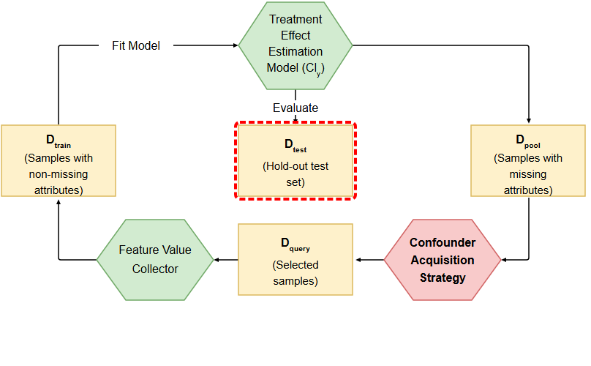
Notes:
The performance of the estimator is periodically evaluated on a hold-out test set.
[Hopping Bbox · Paper2Fig_pipe_easy_000000503 · frame_02.png · 7.50s]

Slide 4
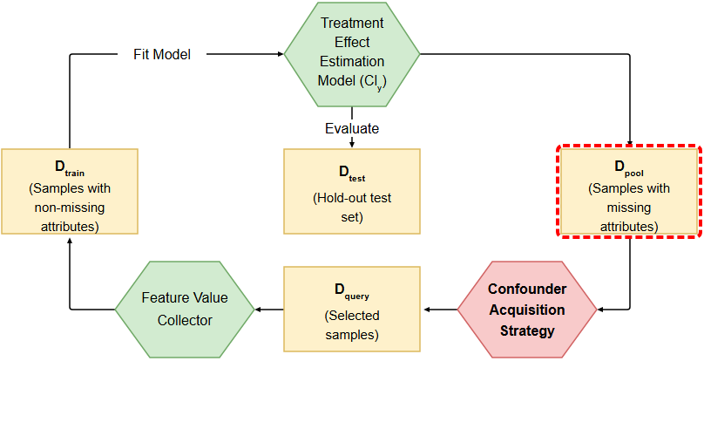
Notes:
Meanwhile, unlabeled candidate samples with missing confounding attributes are maintained in the data pool.
[Hopping Bbox · Paper2Fig_pipe_easy_000000503 · frame_03.png · 10.50s]

Slide 5
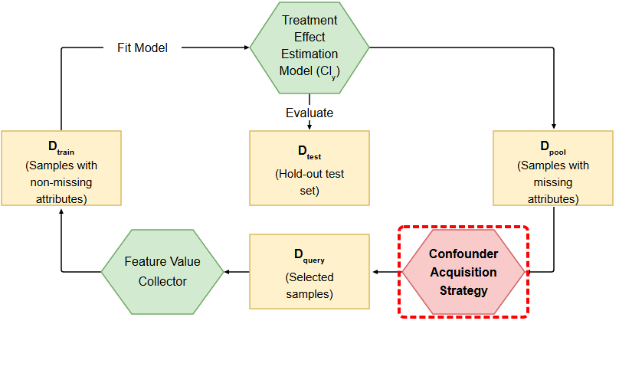
Notes:
A confounder acquisition strategy evaluates the pool, selecting instances based on covariate balancing or outcome estimation error.
[Hopping Bbox · Paper2Fig_pipe_easy_000000503 · frame_04.png · 13.50s]

Slide 6
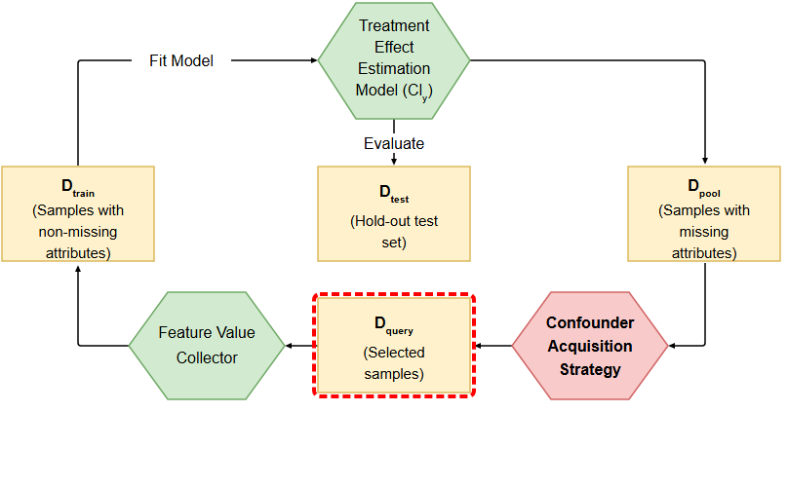
Notes:
The chosen batch forms the query set of prioritized samples.
[Hopping Bbox · Paper2Fig_pipe_easy_000000503 · frame_05.png · 16.50s]

Slide 7
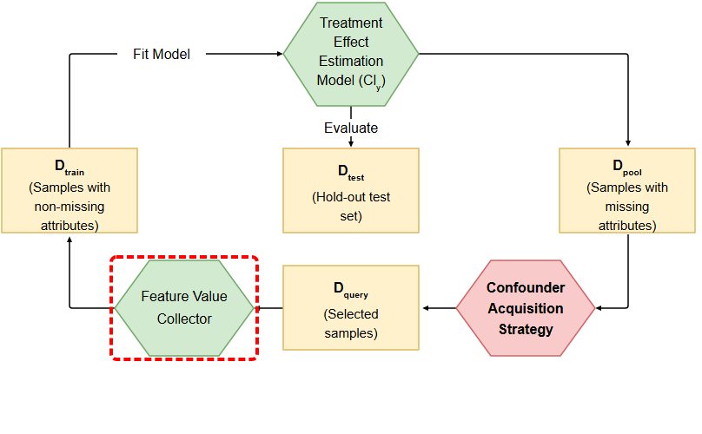
Notes:
The feature value collector retrieves the missing confounding values, adding the newly completed samples back into the training set for the next iteration.
[Hopping Bbox · Paper2Fig_pipe_easy_000000503 · frame_06.png · 19.50s]

