Slide 1
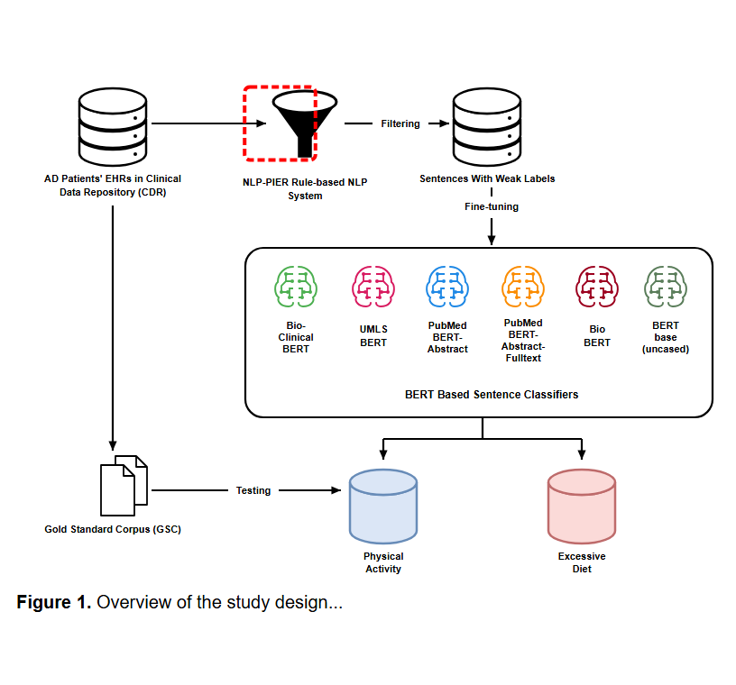
Notes:
The pipeline begins by retrieving clinical notes for Alzheimer's disease patients from the Clinical Data Repository.
[Sliding Bbox · Paper2Fig_pipe_easy_000000521 · frame_0003.png · 1.015s]

Slide 2
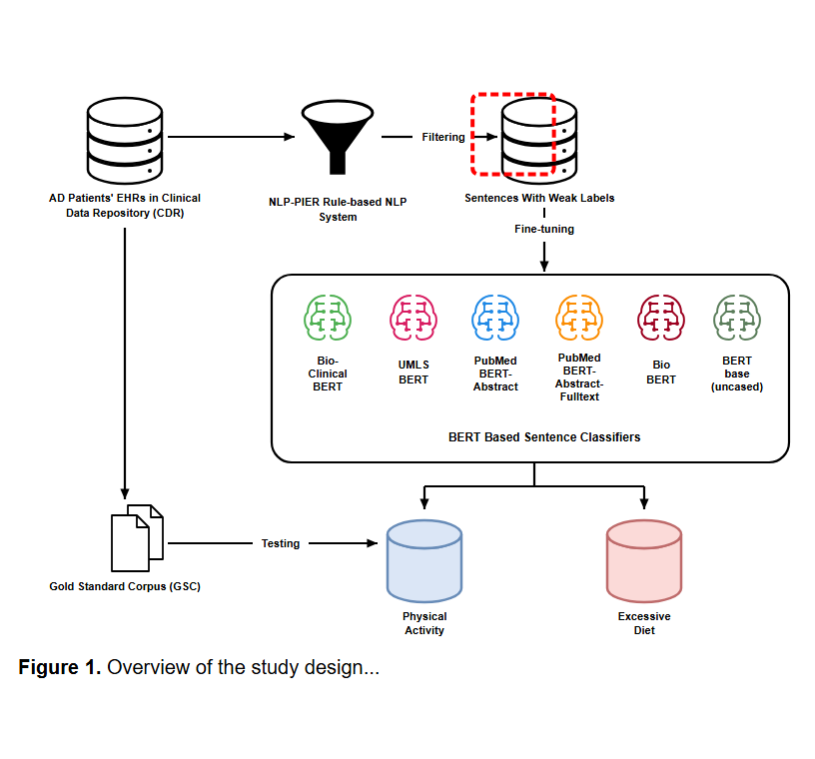
Notes:
The records are filtered using the rule-based NLP-PIER information extraction system.
[Sliding Bbox · Paper2Fig_pipe_easy_000000521 · frame_0007.png · 3.554s]

Slide 3
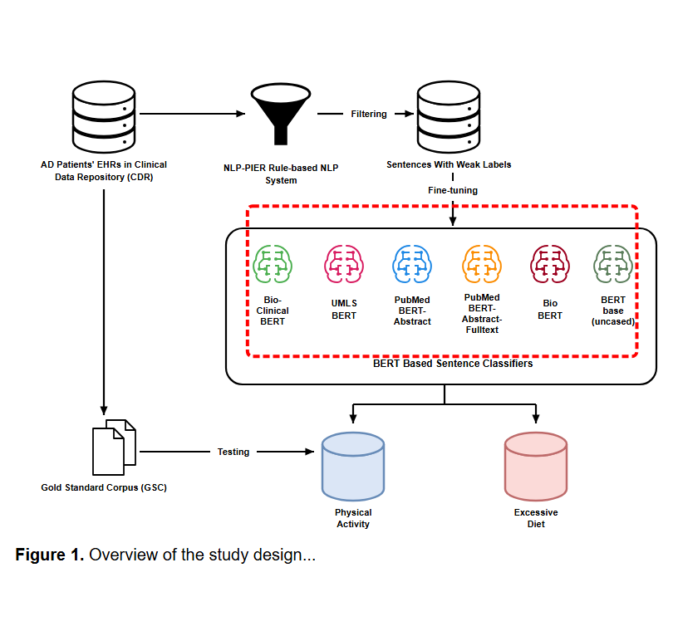
Notes:
This filtering generates a dataset of lifestyle-related sentences with automatically assigned weak labels.
[Sliding Bbox · Paper2Fig_pipe_easy_000000521 · frame_0011.png · 6.092s]

Slide 4
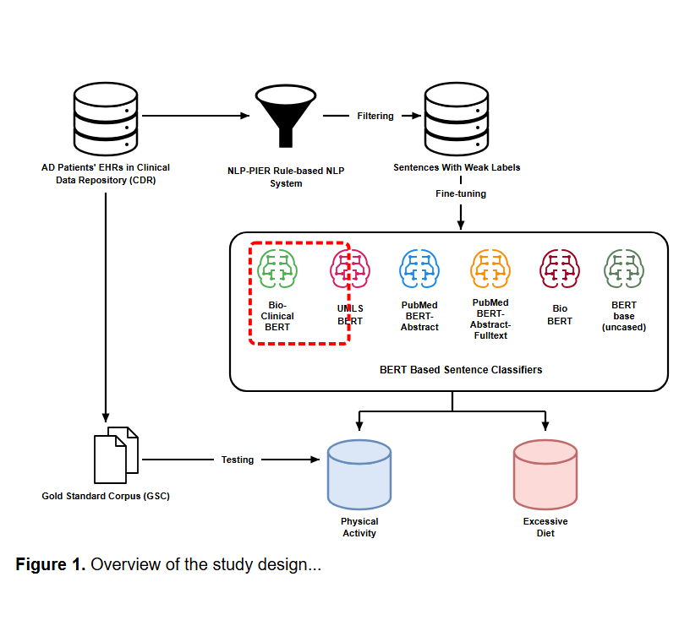
Notes:
The weakly labeled corpus is then used to fine-tune a suite of BERT-based sentence classifiers.
[Sliding Bbox · Paper2Fig_pipe_easy_000000521 · frame_0015.png · 8.631s]

Slide 5
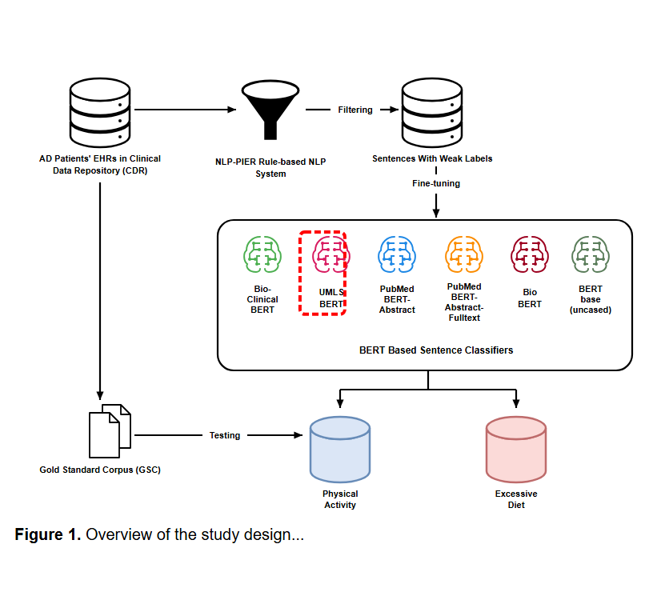
Notes:
The models include Bio-Clinical BERT,
[Sliding Bbox · Paper2Fig_pipe_easy_000000521 · frame_0019.png · 11.169s]

Slide 6
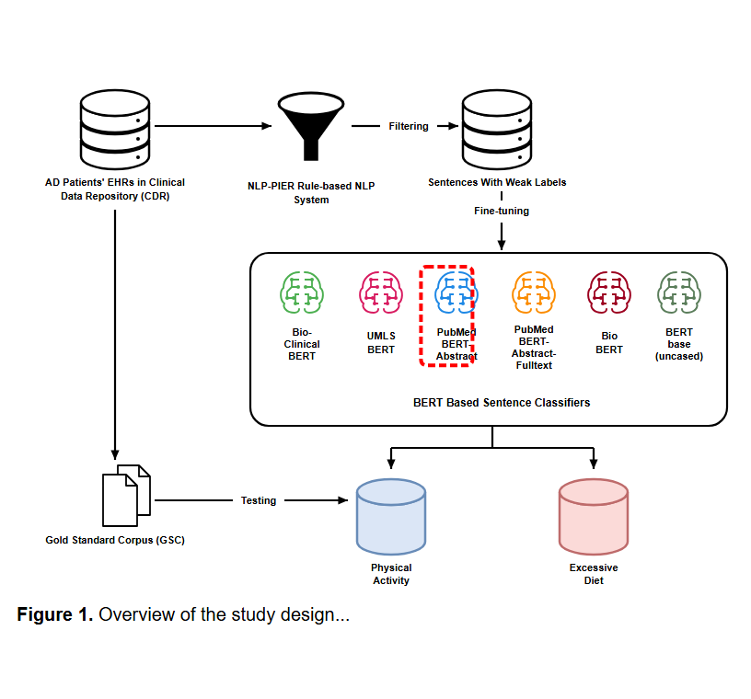
Notes:
UMLS BERT,
[Sliding Bbox · Paper2Fig_pipe_easy_000000521 · frame_0023.png · 13.708s]

Slide 7
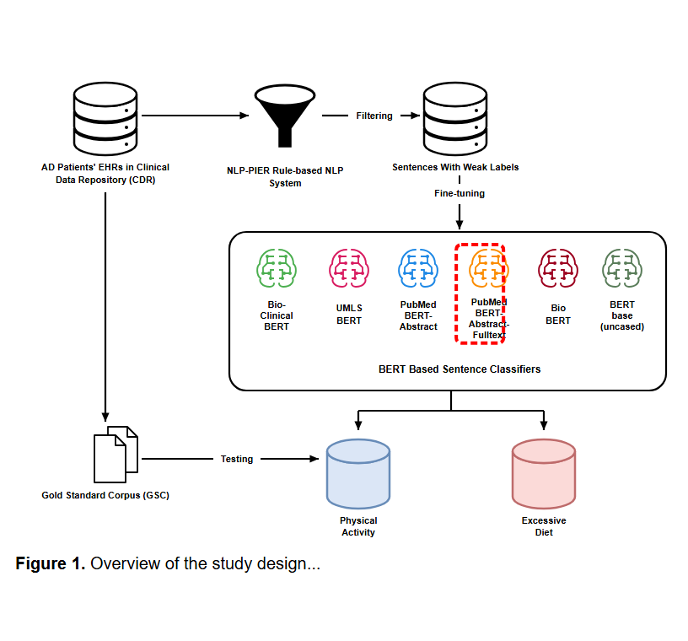
Notes:
PubMedBERT trained solely on abstracts,
[Sliding Bbox · Paper2Fig_pipe_easy_000000521 · frame_0027.png · 16.246s]

Slide 8
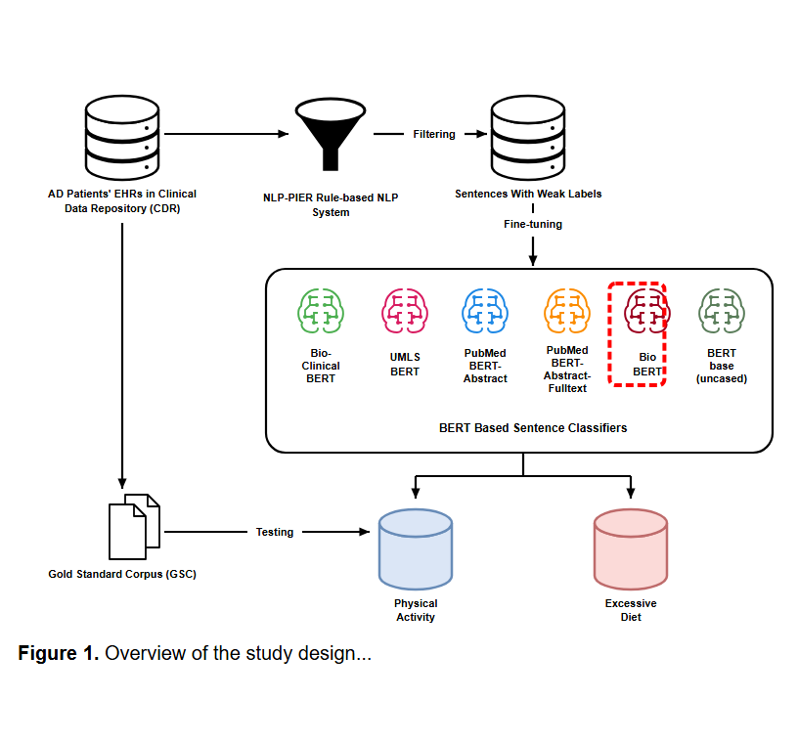
Notes:
PubMedBERT trained on abstracts and full text,
[Sliding Bbox · Paper2Fig_pipe_easy_000000521 · frame_0031.png · 18.785s]

Slide 9
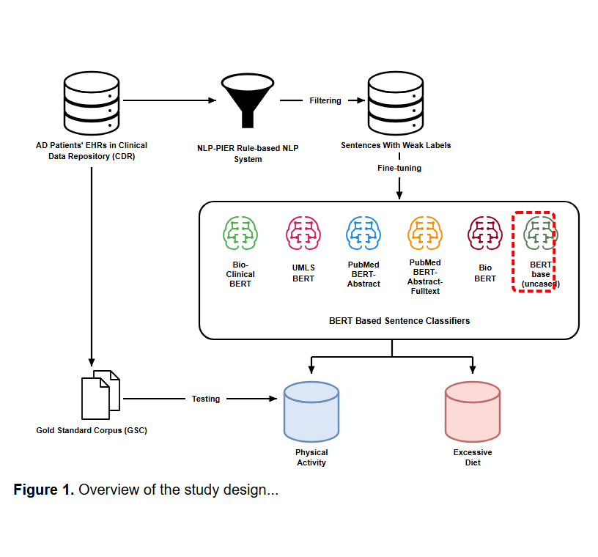
Notes:
BioBERT,
[Sliding Bbox · Paper2Fig_pipe_easy_000000521 · frame_0035.png · 21.323s]

Slide 10
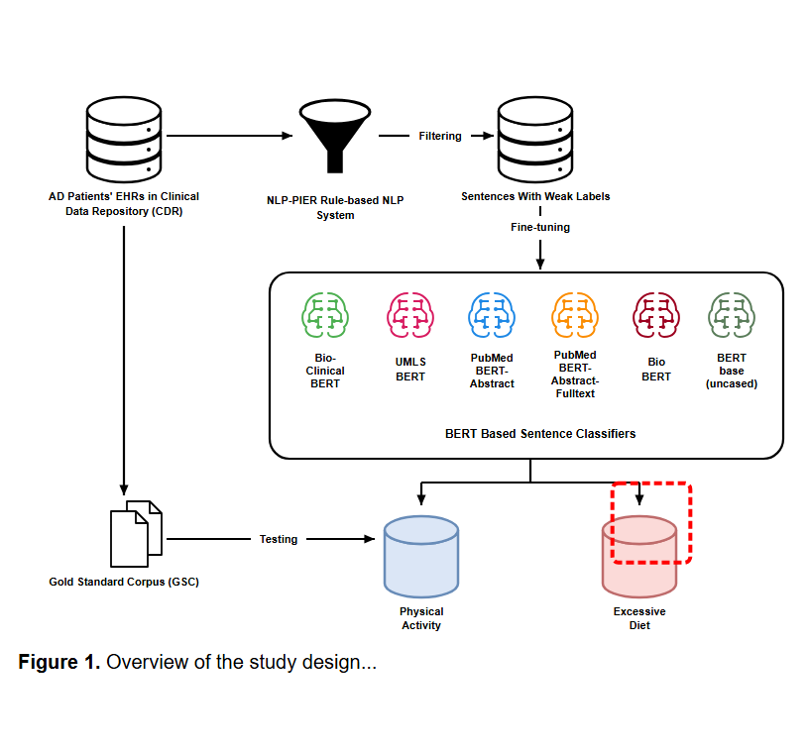
Notes:
and the standard uncased BERT base model.
[Sliding Bbox · Paper2Fig_pipe_easy_000000521 · frame_0039.png · 23.861s]

Slide 11
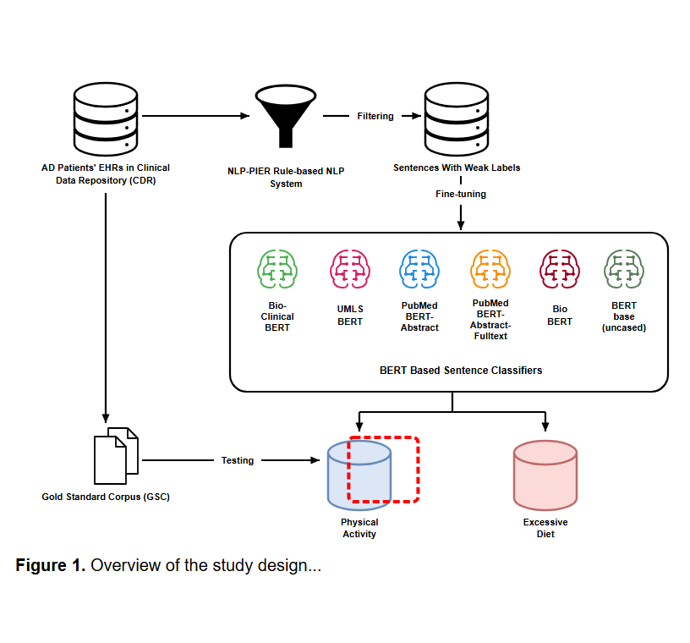
Notes:
The classifiers predict risk factors across two case studies, identifying excessive diet...
[Sliding Bbox · Paper2Fig_pipe_easy_000000521 · frame_0043.png · 26.400s]

Slide 12
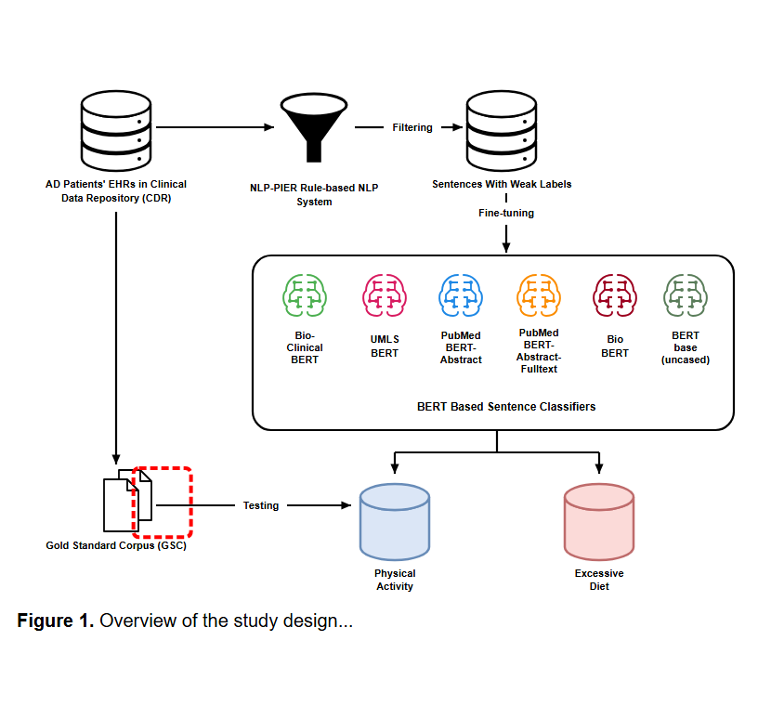
Notes:
...and physical activity levels.
[Sliding Bbox · Paper2Fig_pipe_easy_000000521 · frame_0047.png · 28.939s]

Slide 13
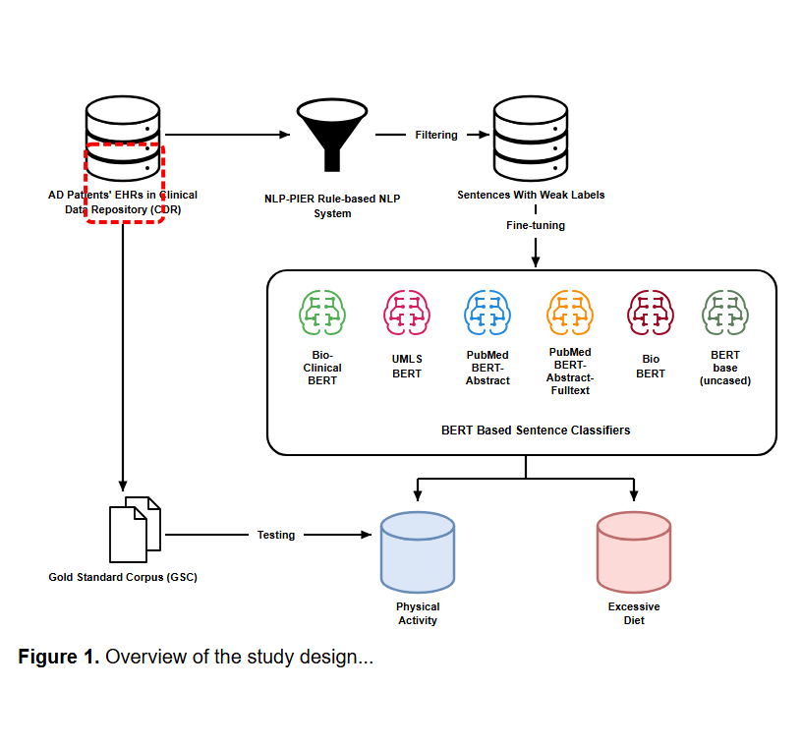
Notes:
Finally, all models are tested and evaluated against a manually annotated Gold Standard Corpus.
[Sliding Bbox · Paper2Fig_pipe_easy_000000521 · frame_0051.png · 31.477s]

