Slide 1
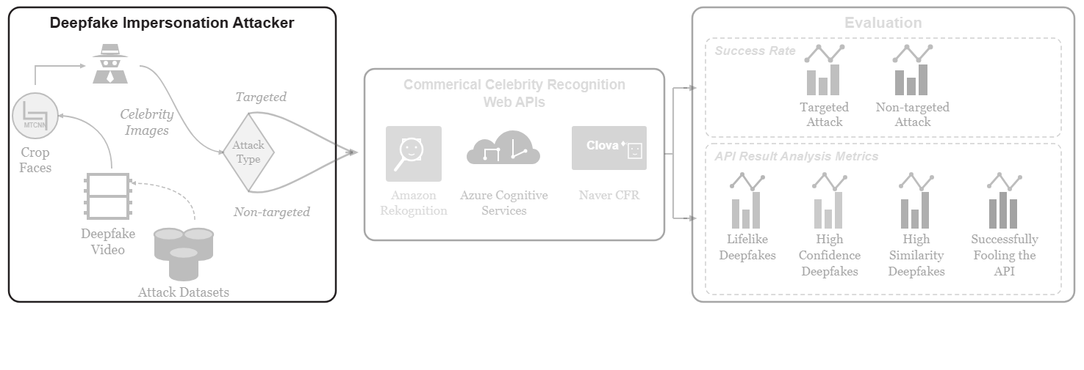
Notes:
The pipeline begins with the deepfake impersonation attack framework.
[Colour Pop · Paper2Fig_pipe_easy_000000552 · frame_00.png · 0.50s]

Slide 2
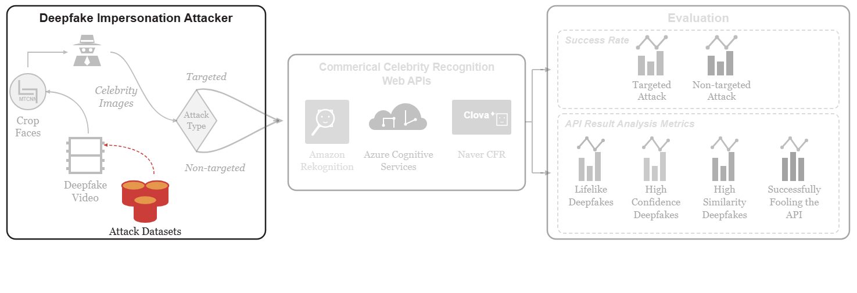
Notes:
The attack leverages diverse datasets encompassing facial replacement, reenactment, and synthesis.
[Colour Pop · Paper2Fig_pipe_easy_000000552 · frame_01.png · 1.00s]

Slide 3
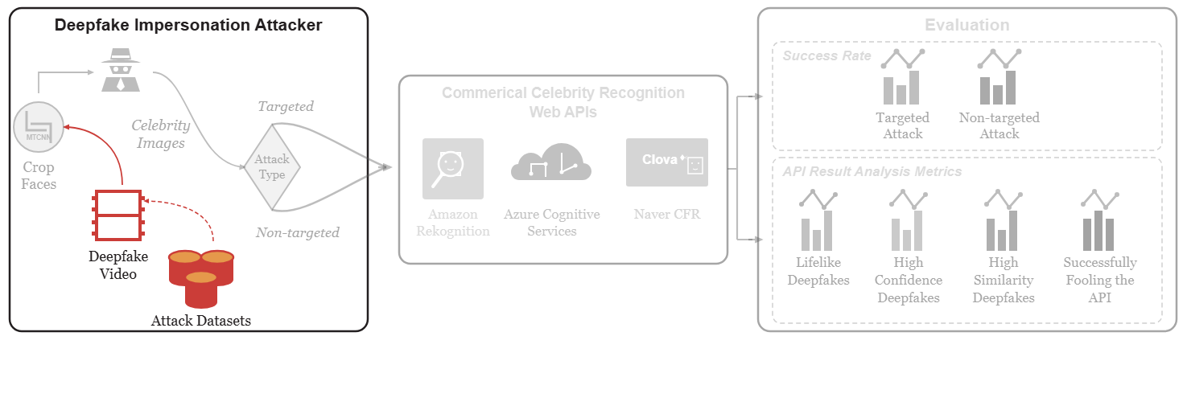
Notes:
Deepfake video sequences are supplied from these datasets.
[Colour Pop · Paper2Fig_pipe_easy_000000552 · frame_02.png · 1.50s]

Slide 4
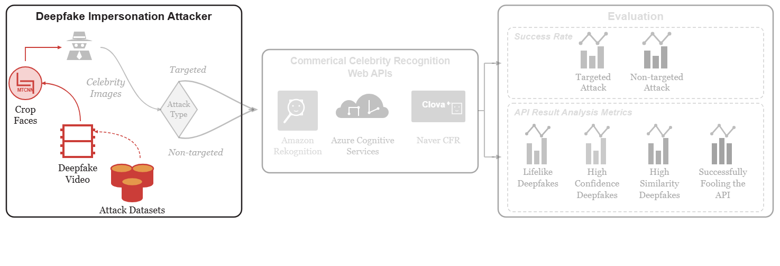
Notes:
An MTCNN model is applied to detect and crop face images from each video frame.
[Colour Pop · Paper2Fig_pipe_easy_000000552 · frame_03.png · 2.00s]

Slide 5
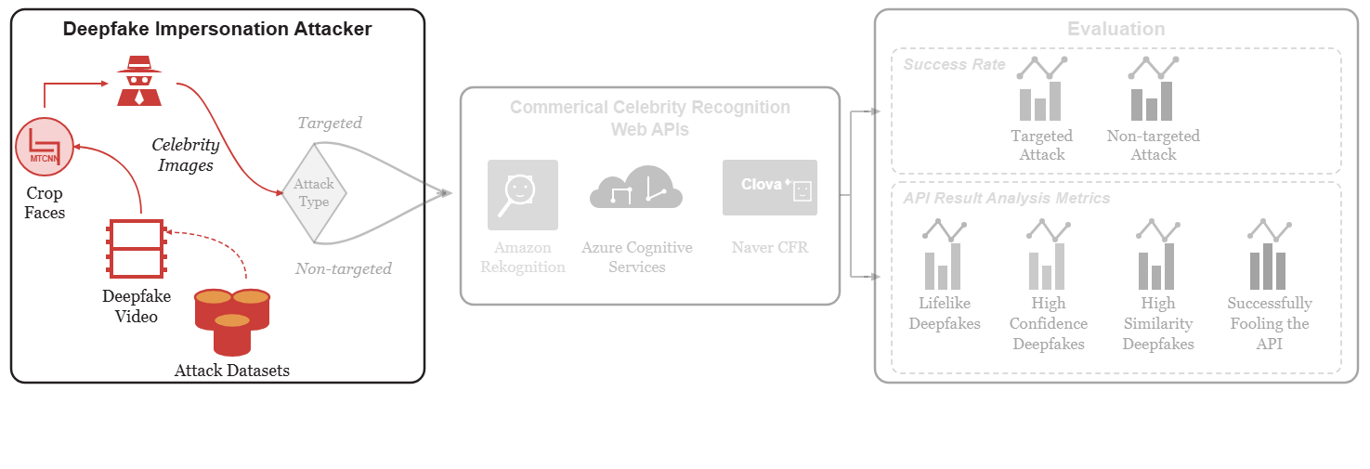
Notes:
The attacker prepares these cropped celebrity face images for transmission.
[Colour Pop · Paper2Fig_pipe_easy_000000552 · frame_04.png · 2.50s]

Slide 6
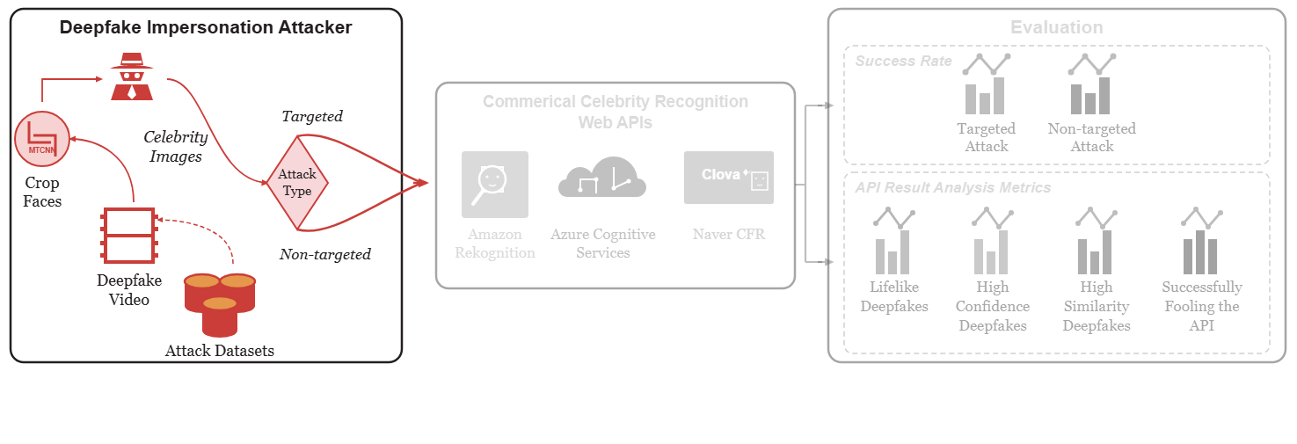
Notes:
Attacks are categorized into targeted impersonation against a specific victim and non-targeted impersonation across any celebrity class.
[Colour Pop · Paper2Fig_pipe_easy_000000552 · frame_05.png · 3.00s]

Slide 7
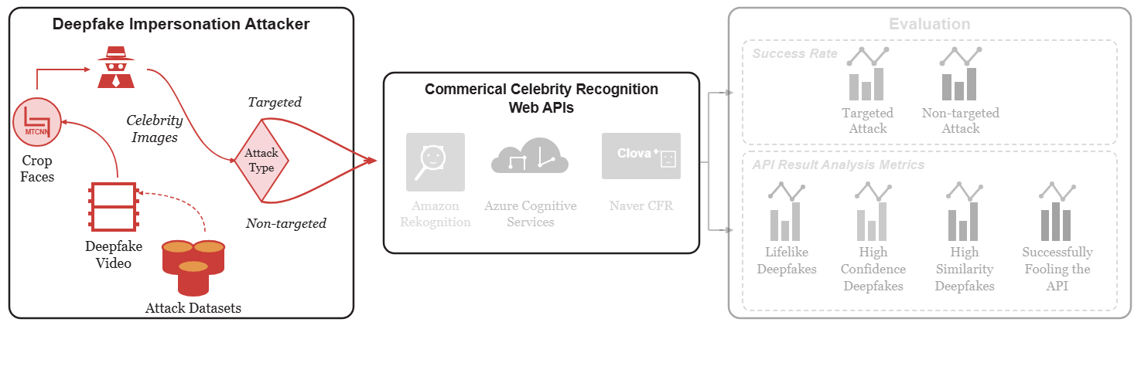
Notes:
The attack queries are dispatched to commercial celebrity recognition web APIs.
[Colour Pop · Paper2Fig_pipe_easy_000000552 · frame_06.png · 3.50s]

Slide 8
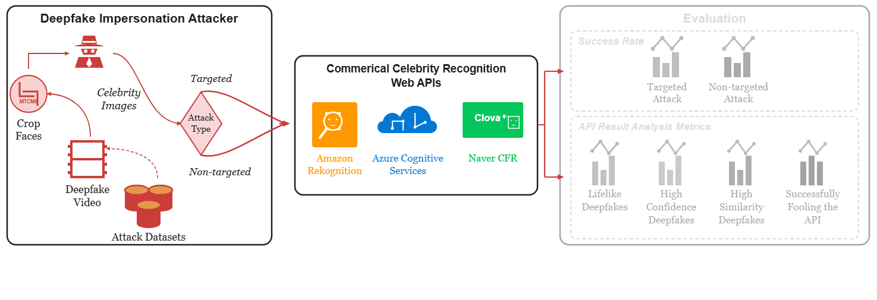
Notes:
Evaluation targets black-box platforms including Amazon Rekognition, Azure Cognitive Services, and Naver CFR.
[Colour Pop · Paper2Fig_pipe_easy_000000552 · frame_07.png · 4.00s]

Slide 9
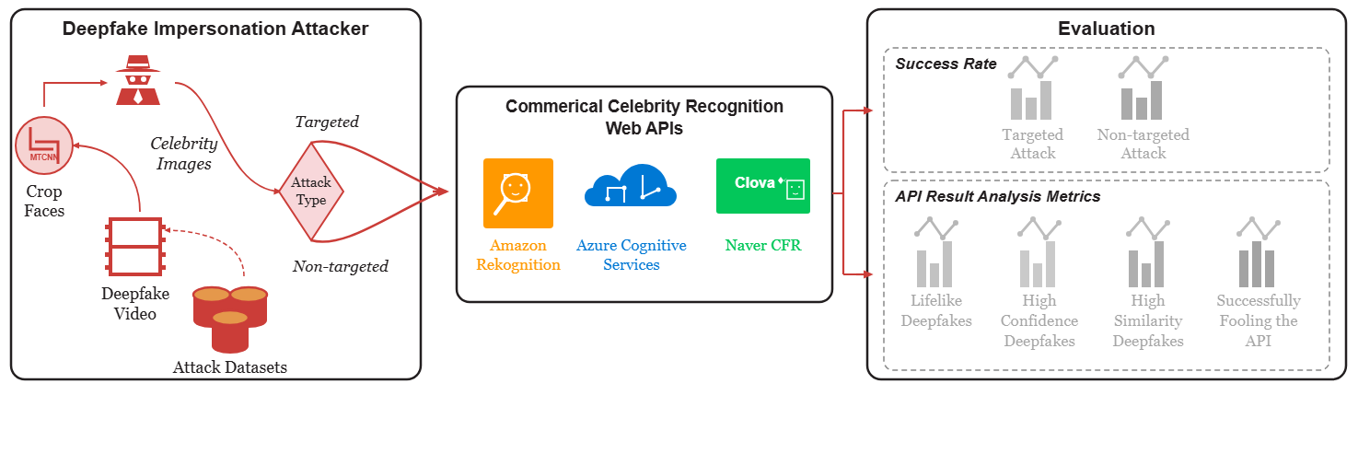
Notes:
The evaluation module systematically analyzes the resulting responses.
[Colour Pop · Paper2Fig_pipe_easy_000000552 · frame_08.png · 4.50s]

Slide 10
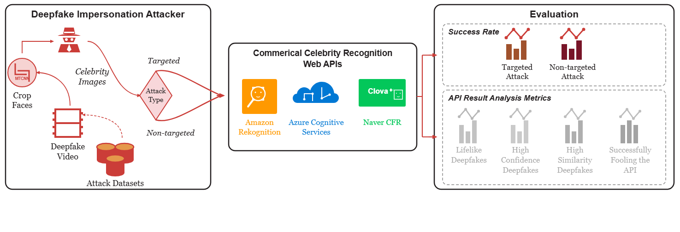
Notes:
Success rates are measured for both targeted and non-targeted attack configurations.
[Colour Pop · Paper2Fig_pipe_easy_000000552 · frame_09.png · 5.00s]

Slide 11
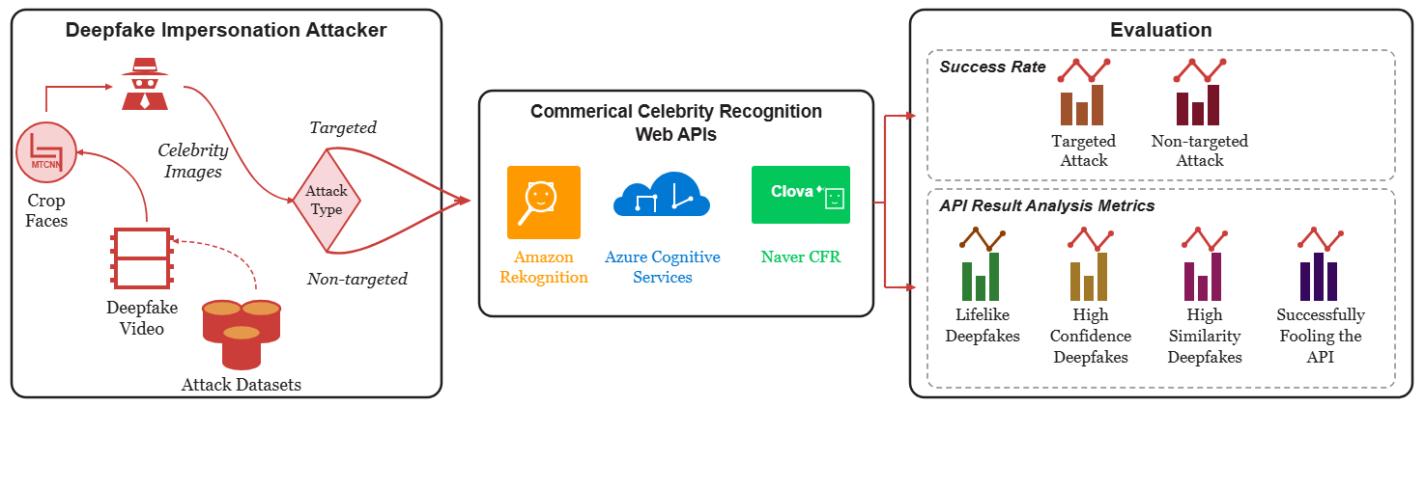
Notes:
Detailed metrics further analyze API behavior, including lifelike quality, prediction confidence, face similarity, and overall successful impersonation.
[Colour Pop · Paper2Fig_pipe_easy_000000552 · frame_10.png · 5.50s]

