Slide 1
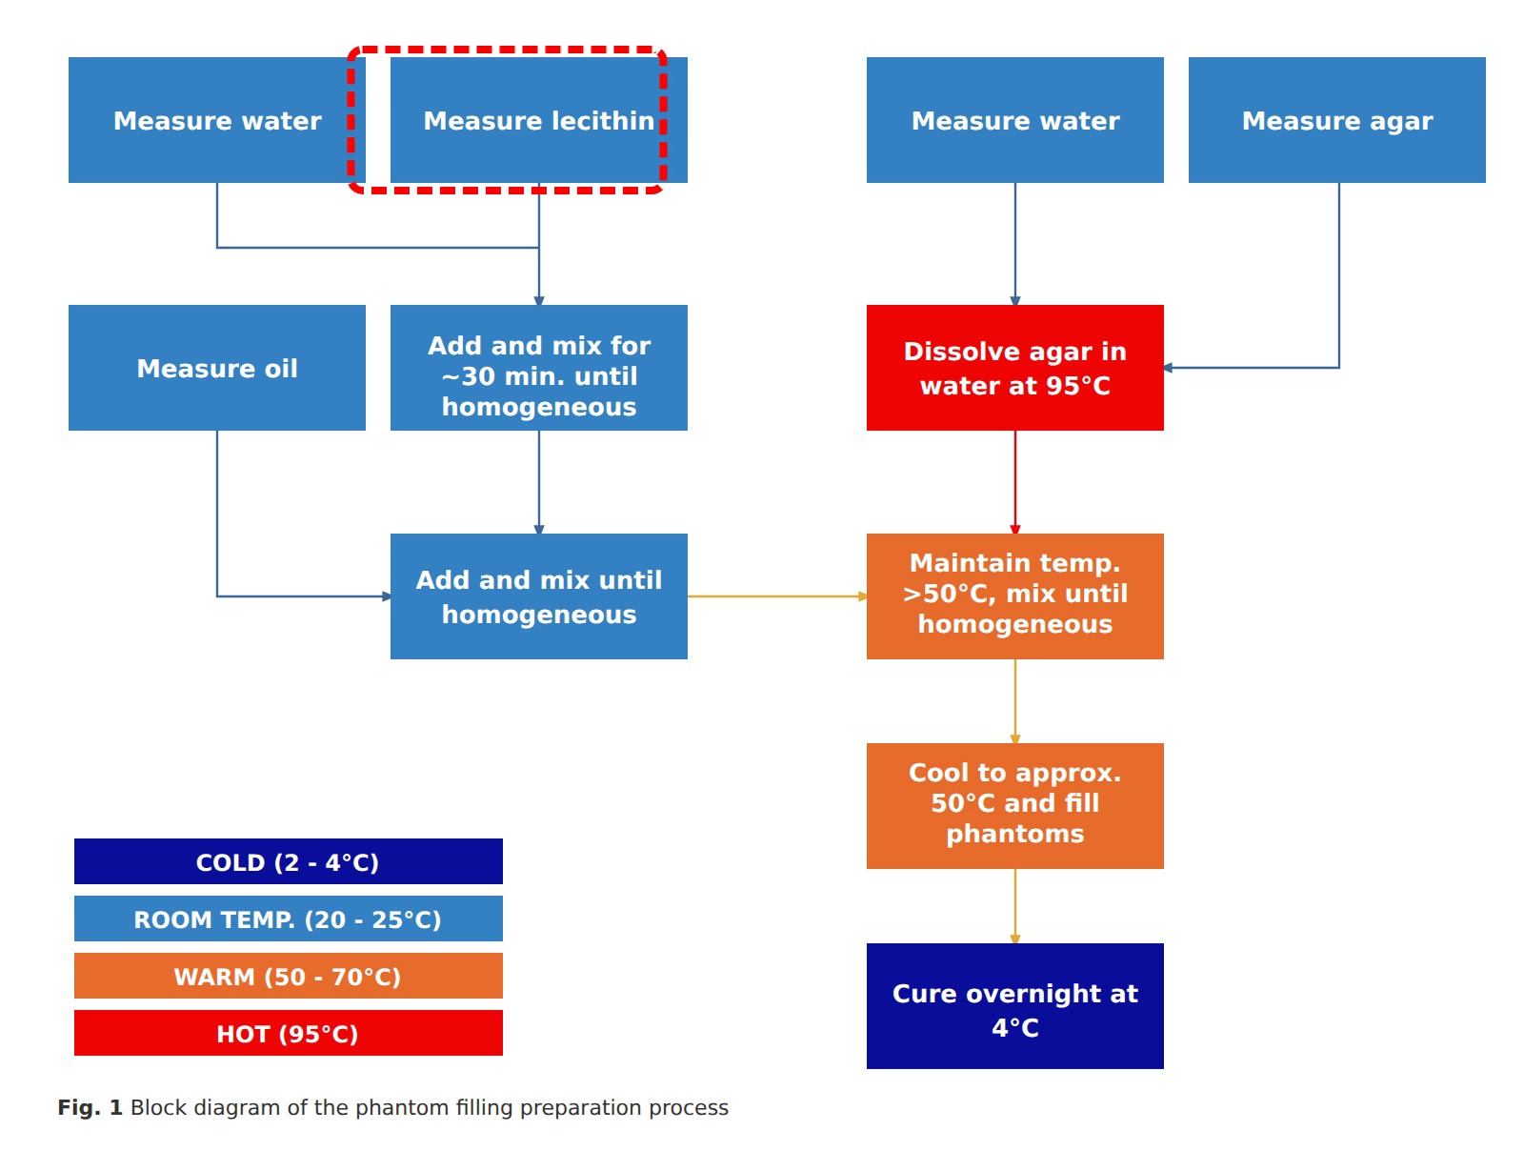
Notes:
The phantom preparation begins at room temperature by measuring the water required for the lipid emulsion.
[Sliding Bbox · Pubmed_bio_00007 · frame_04.png · 0.000s]

Slide 2
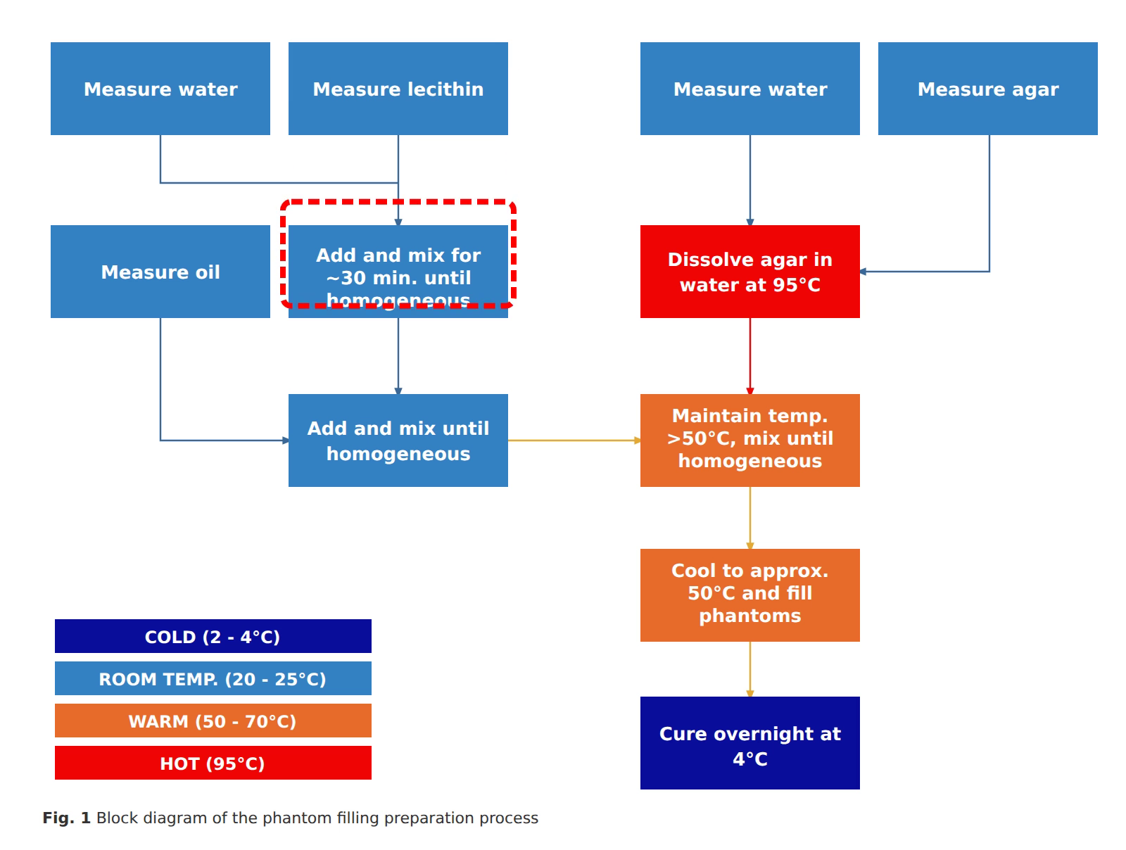
Notes:
Next, the required quantity of soy lecithin is measured.
[Sliding Bbox · Pubmed_bio_00007 · frame_11.png · 2.500s]

Slide 3
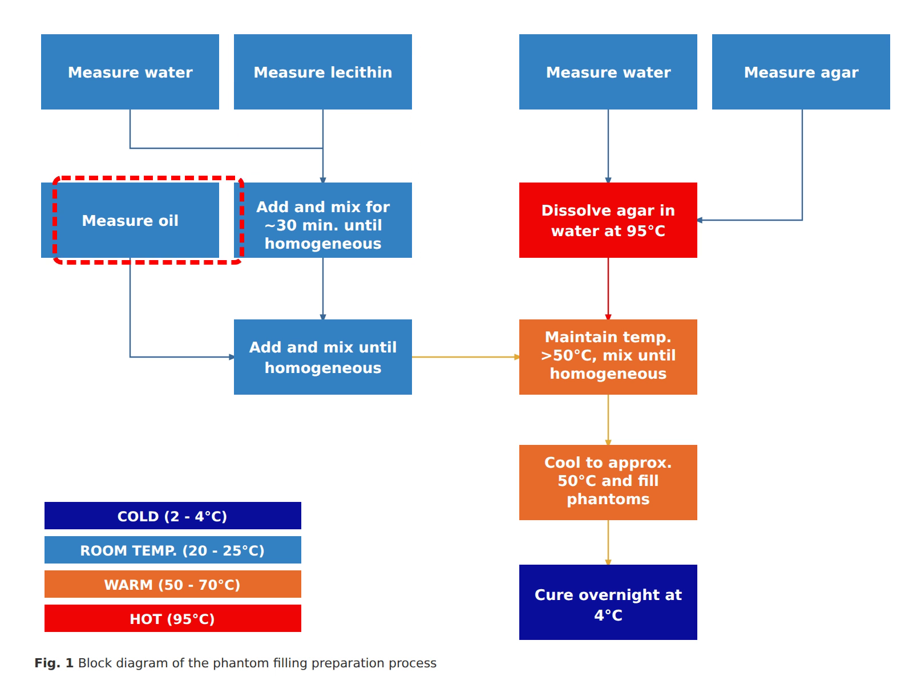
Notes:
The lecithin is added to the water and stirred for approximately thirty minutes until the solution becomes homogeneous.
[Sliding Bbox · Pubmed_bio_00007 · frame_18.png · 6.000s]

Slide 4

Notes:
Separately, rapeseed oil representing the fatty tissue component is measured.
[Sliding Bbox · Pubmed_bio_00007 · frame_25.png · 9.500s]

Slide 5
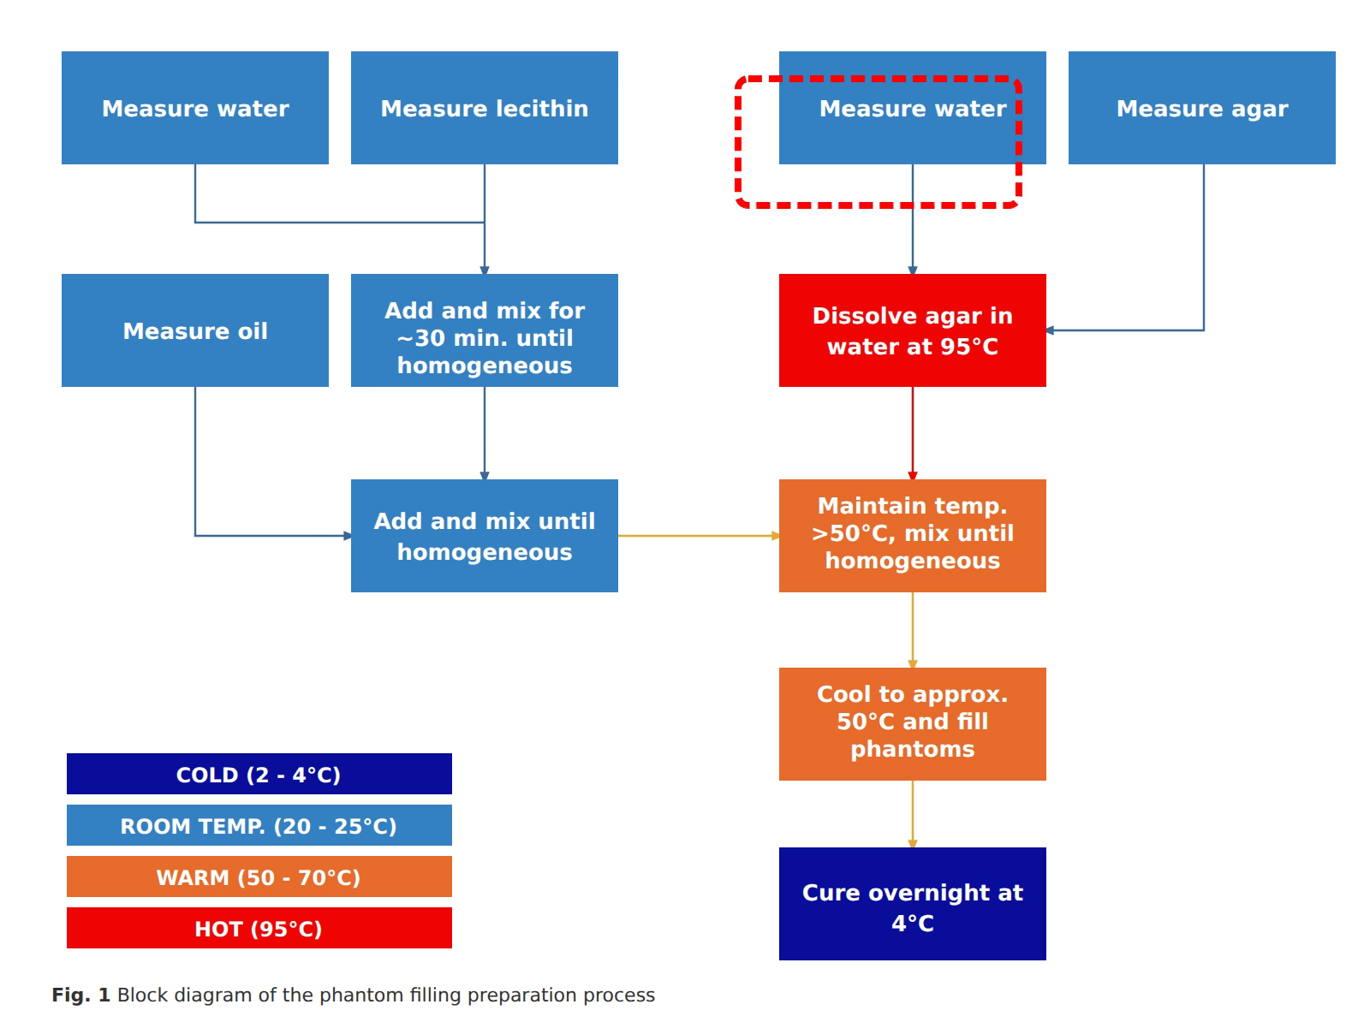
Notes:
The oil is combined with the lecithin solution and mixed thoroughly until fully homogeneous.
[Sliding Bbox · Pubmed_bio_00007 · frame_32.png · 13.000s]

Slide 6

Notes:
In parallel, a separate volume of water is measured to prepare the agar solution.
[Sliding Bbox · Pubmed_bio_00007 · frame_39.png · 16.500s]

Slide 7

Notes:
Agar powder representing the fibroglandular tissue component is then measured.
[Sliding Bbox · Pubmed_bio_00007 · frame_46.png · 20.000s]

Slide 8
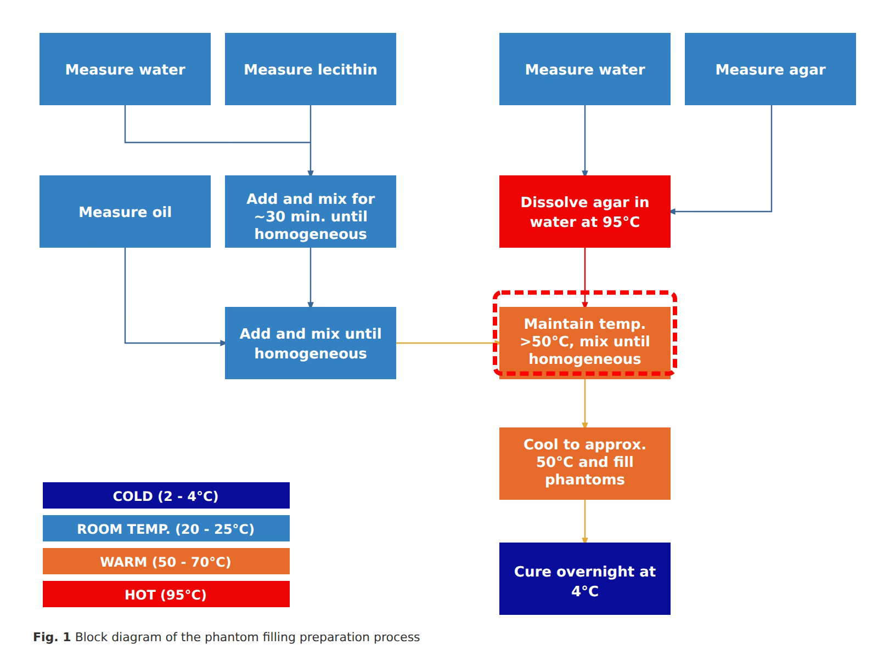
Notes:
The agar is dissolved into the water heated to ninety-five degrees Celsius to create a uniform solution.
[Sliding Bbox · Pubmed_bio_00007 · frame_53.png · 23.500s]

Slide 9

Notes:
The oil and lecithin mixture is slowly added to warm agar while maintaining temperature >50°C with continuous mixing.
[Sliding Bbox · Pubmed_bio_00007 · frame_60.png · 27.000s]

Slide 10

Notes:
The final mixture is cooled to approximately fifty degrees Celsius and poured directly into the 3D printed phantom molds.
[Sliding Bbox · Pubmed_bio_00007 · frame_67.png · 30.500s]

Slide 11

Notes:
Finally, the filled phantoms are cured overnight at four degrees Celsius to solidify before imaging experiments.
[Sliding Bbox · Pubmed_bio_00007 · frame_76.png · 34.000s]

