Slide 1
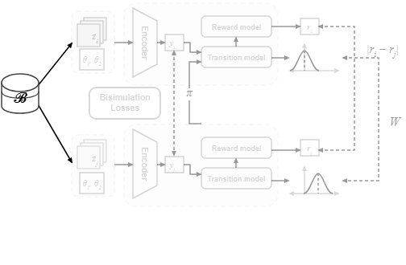
Notes:
Pairs of experience observations are sampled from the replay buffer.
[Colour Pop · SciMMIR_arch_diff_000000124 · frame_00.png · 0.50s]

Slide 2
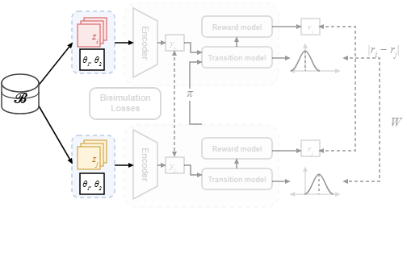
Notes:
Each sampled instance pairs raw observation frames with corresponding context parameters across different environment shifts.
[Colour Pop · SciMMIR_arch_diff_000000124 · frame_01.png · 1.00s]

Slide 3
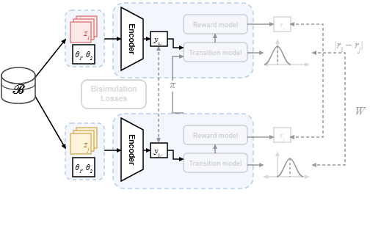
Notes:
The encoders map these contextual observations into a shared latent representation space.
[Colour Pop · SciMMIR_arch_diff_000000124 · frame_02.png · 1.50s]

Slide 4
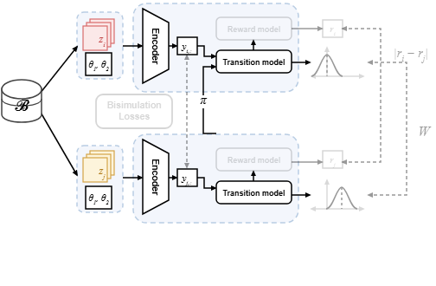
Notes:
Conditioned on the policy's actions, probabilistic transition models predict the next-state distributions.
[Colour Pop · SciMMIR_arch_diff_000000124 · frame_03.png · 2.00s]

Slide 5
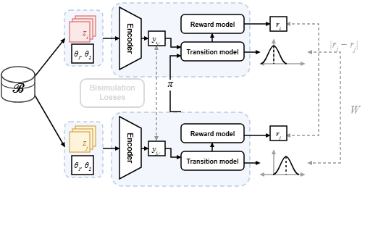
Notes:
Concurrently, reward models estimate expected scalar rewards for each latent state.
[Colour Pop · SciMMIR_arch_diff_000000124 · frame_04.png · 2.50s]

Slide 6
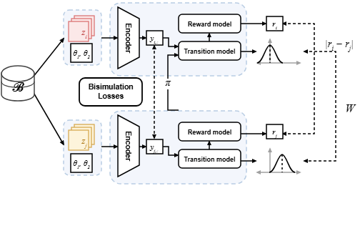
Notes:
Finally, bisimulation losses align latent representation distances with the combined reward differences and Wasserstein transition distances.
[Colour Pop · SciMMIR_arch_diff_000000124 · frame_05.png · 3.00s]

