Slide 1
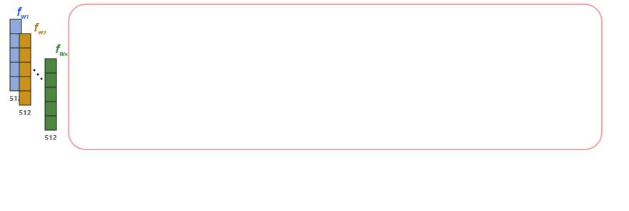
Notes:
The pipeline begins with a sequence of five hundred twelve dimensional input feature vectors.
[Progressive Reveal · WACV_2022_set5_000001 · frame_00.png · 0.50s]

Slide 2
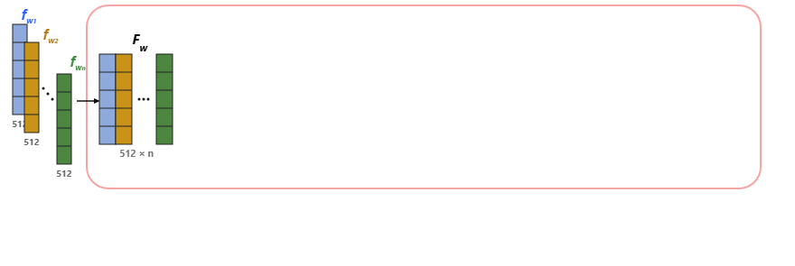
Notes:
These vectors are organized into an input feature matrix labeled F sub w, with dimensions five hundred twelve by n.
[Progressive Reveal · WACV_2022_set5_000001 · frame_01.png · 1.00s]

Slide 3
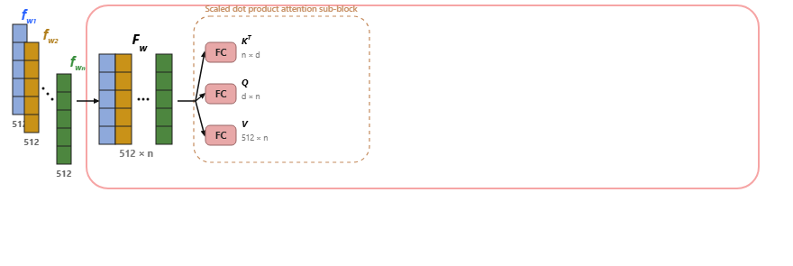
Notes:
Inside the scaled dot product attention sub-block, the matrix branches through fully connected layers into key transpose, query, and value matrices.
[Progressive Reveal · WACV_2022_set5_000001 · frame_02.png · 1.50s]

Slide 4
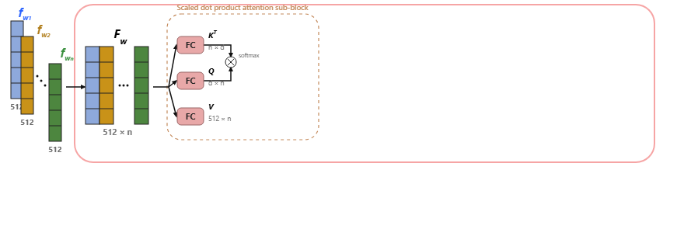
Notes:
The key transpose and query representations are multiplied together and processed by a softmax function.
[Progressive Reveal · WACV_2022_set5_000001 · frame_03.png · 2.00s]

Slide 5
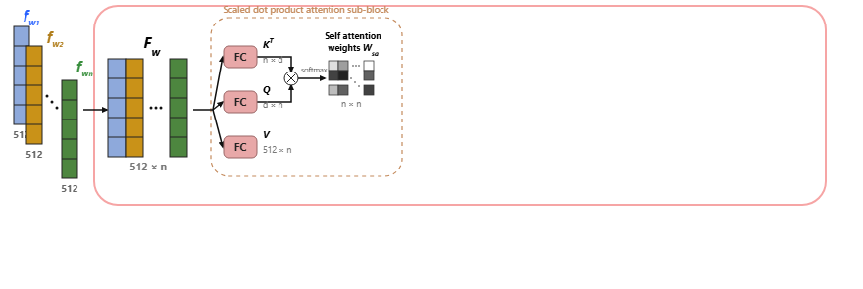
Notes:
This yields an n-by-n matrix of self-attention weights labeled W sub s a.
[Progressive Reveal · WACV_2022_set5_000001 · frame_04.png · 2.50s]

Slide 6
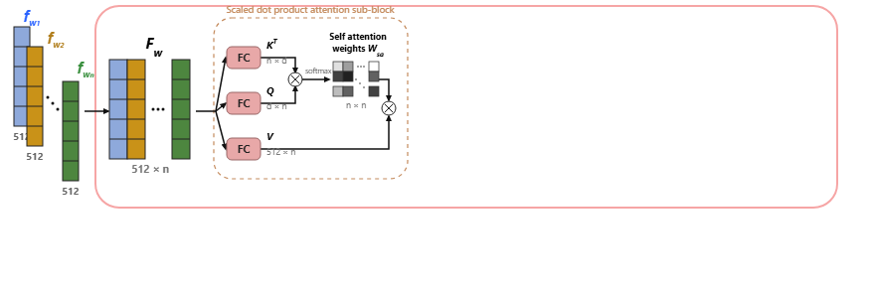
Notes:
The self-attention weights are then multiplied with the value matrix.
[Progressive Reveal · WACV_2022_set5_000001 · frame_05.png · 3.00s]

Slide 7
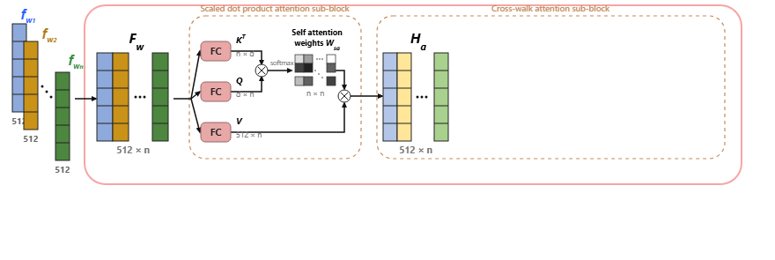
Notes:
The result feeds into the cross-walk attention sub-block as an intermediate matrix labeled H sub a.
[Progressive Reveal · WACV_2022_set5_000001 · frame_06.png · 3.50s]

Slide 8
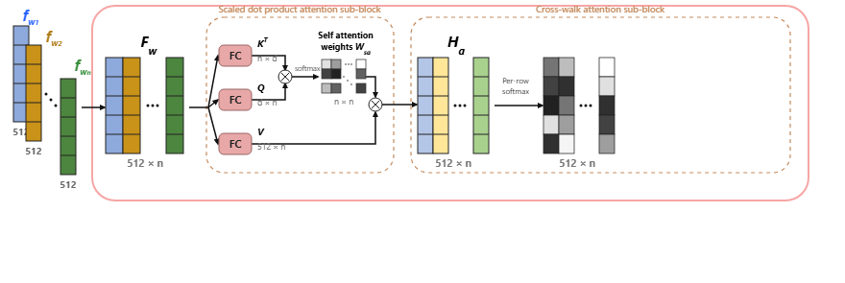
Notes:
A per-row softmax operation is then applied across the matrix columns.
[Progressive Reveal · WACV_2022_set5_000001 · frame_07.png · 4.00s]

Slide 9
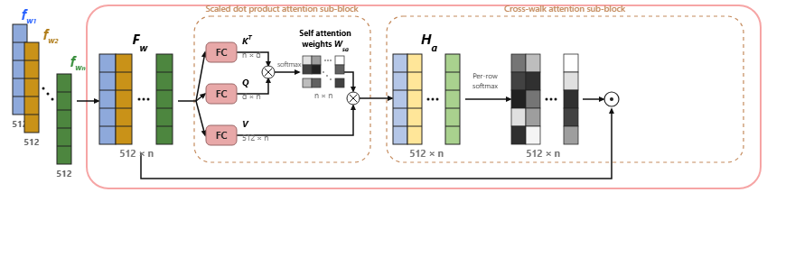
Notes:
Next, the softmax output is combined element-wise with a bypass connection from the original matrix F sub w.
[Progressive Reveal · WACV_2022_set5_000001 · frame_08.png · 4.50s]

Slide 10
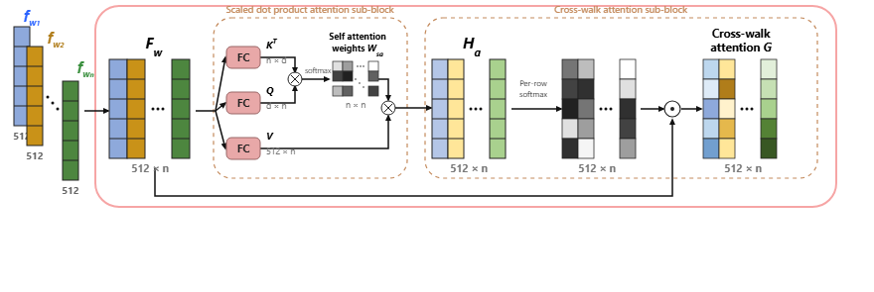
Notes:
This creates the cross-walk attention matrix labeled G, with dimensions five hundred twelve by n.
[Progressive Reveal · WACV_2022_set5_000001 · frame_09.png · 5.00s]

Slide 11
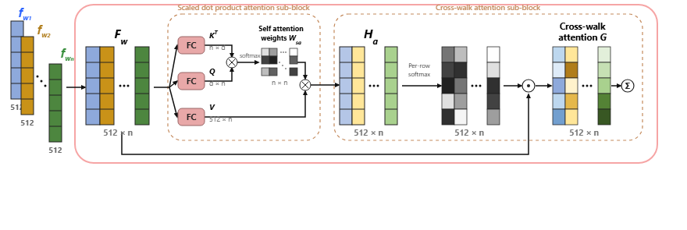
Notes:
The column vectors are then aggregated through a summation operation.
[Progressive Reveal · WACV_2022_set5_000001 · frame_10.png · 5.50s]

Slide 12
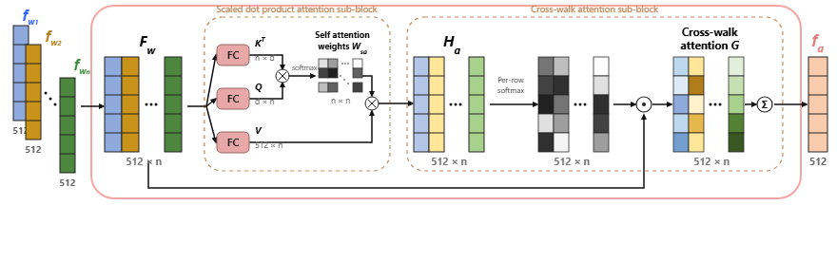
Notes:
Finally, the system outputs the five hundred twelve dimensional feature vector labeled f sub a.
[Progressive Reveal · WACV_2022_set5_000001 · frame_11.png · 6.00s]

