Slide 1
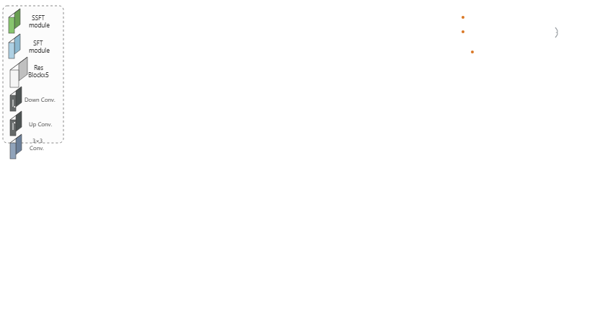
Notes:
The legend outlines the core modules, including SSFT, SFT, residual blocks, and convolutional layers.
[Progressive Reveal · WACV_2022_set5_000002 · frame_00.png · 0.50s]

Slide 2
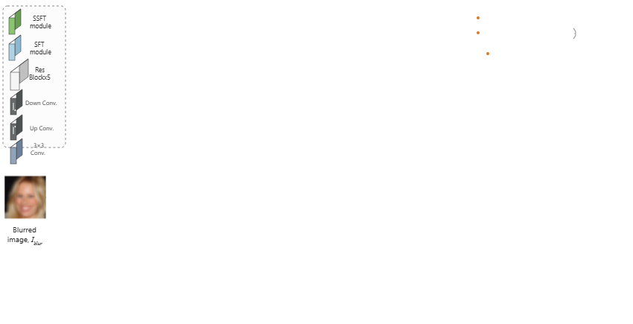
Notes:
The pipeline begins with a blurred face image as input.
[Progressive Reveal · WACV_2022_set5_000002 · frame_01.png · 1.00s]

Slide 3
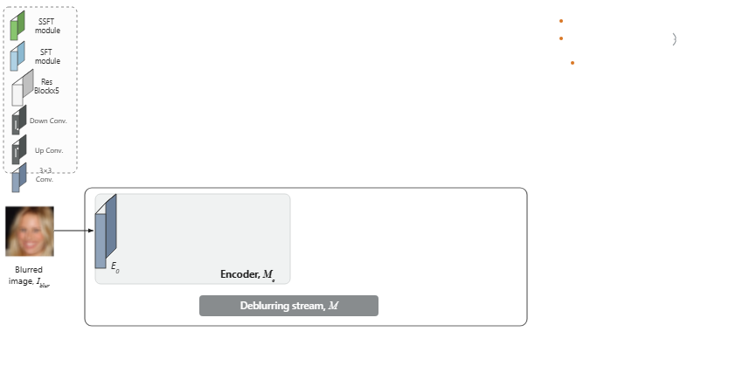
Notes:
Within the deblurring stream, the input image enters the encoder through an initial convolution layer labeled E zero.
[Progressive Reveal · WACV_2022_set5_000002 · frame_02.png · 1.50s]

Slide 4
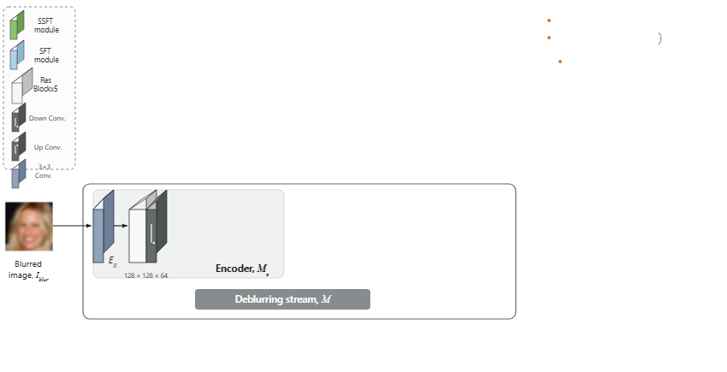
Notes:
The first encoder stage processes feature maps through residual blocks followed by a downsampling convolution.
[Progressive Reveal · WACV_2022_set5_000002 · frame_03.png · 2.00s]

Slide 5
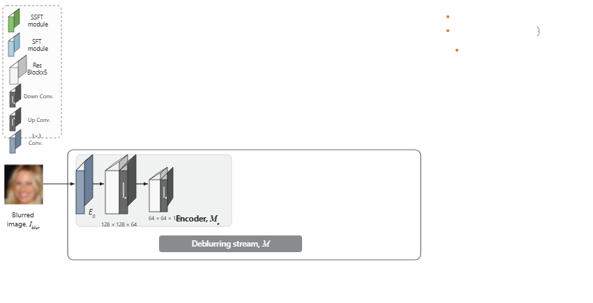
Notes:
A second stage further extracts features and downsamples the spatial resolution.
[Progressive Reveal · WACV_2022_set5_000002 · frame_04.png · 2.50s]

Slide 6
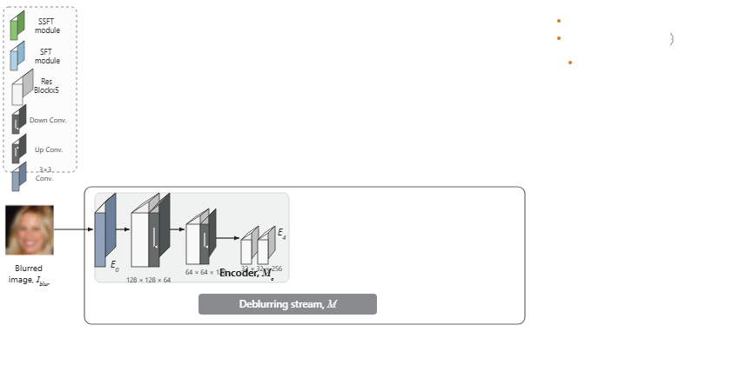
Notes:
The encoder concludes at bottleneck stage E four to form compact feature representations.
[Progressive Reveal · WACV_2022_set5_000002 · frame_05.png · 3.00s]

Slide 7
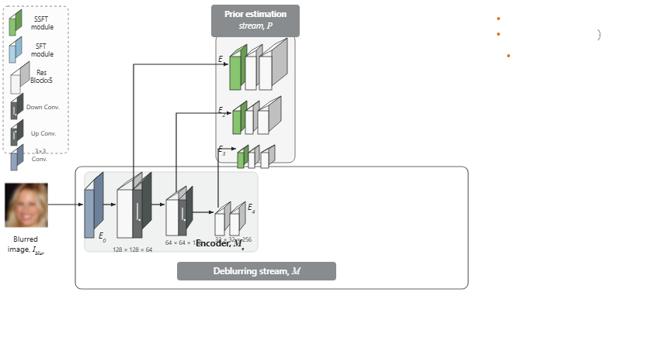
Notes:
Features from each intermediate encoder stage branch into the prior estimation stream via SSFT modules and residual blocks.
[Progressive Reveal · WACV_2022_set5_000002 · frame_06.png · 3.50s]

Slide 8
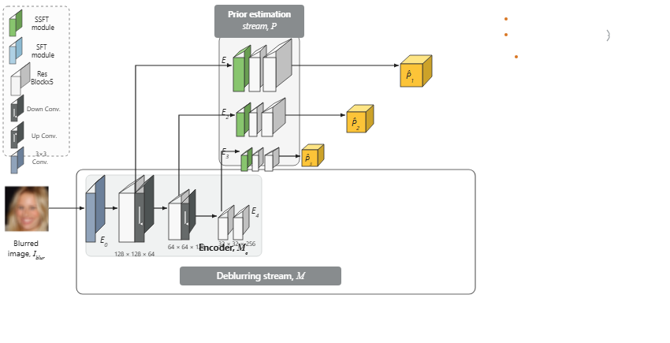
Notes:
This stream outputs multi-scale estimated priors labeled P-hat one, P-hat two, and P-hat three.
[Progressive Reveal · WACV_2022_set5_000002 · frame_07.png · 4.00s]

Slide 9
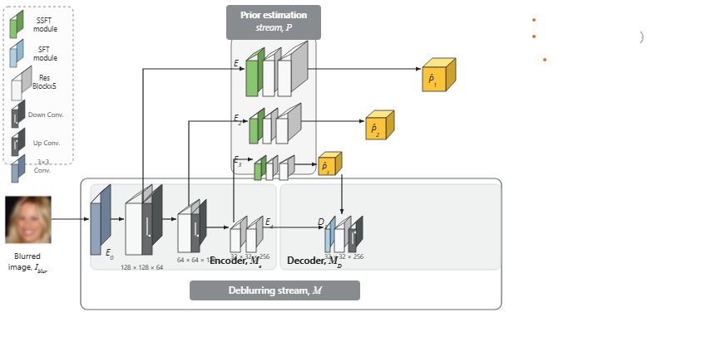
Notes:
In the decoder, stage D three modulates bottleneck features with estimated prior P-hat three using an SFT module.
[Progressive Reveal · WACV_2022_set5_000002 · frame_08.png · 4.50s]

Slide 10
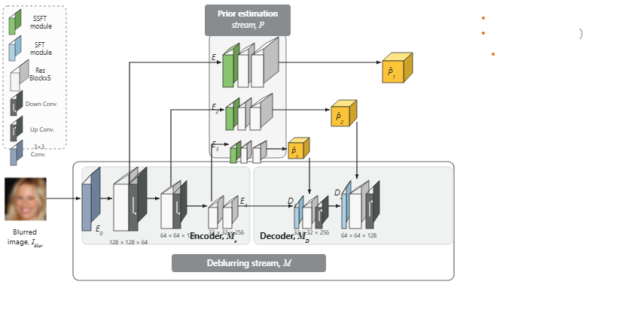
Notes:
Decoder stage D two incorporates estimated prior P-hat two and continues upsampling.
[Progressive Reveal · WACV_2022_set5_000002 · frame_09.png · 5.00s]

Slide 11
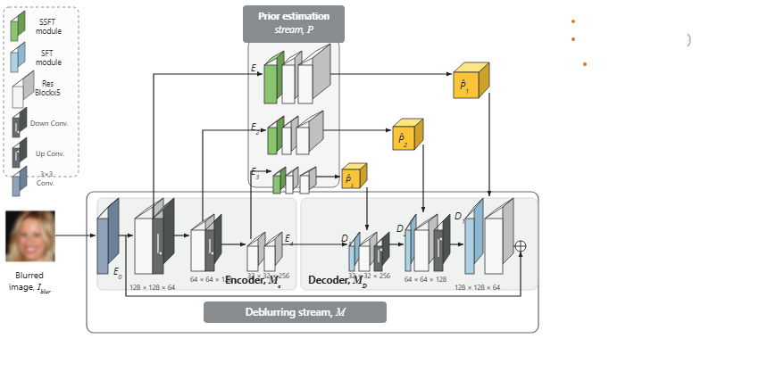
Notes:
Stage D one modulates with prior P-hat one, combining the decoded features with a skip connection from E zero.
[Progressive Reveal · WACV_2022_set5_000002 · frame_10.png · 5.50s]

Slide 12
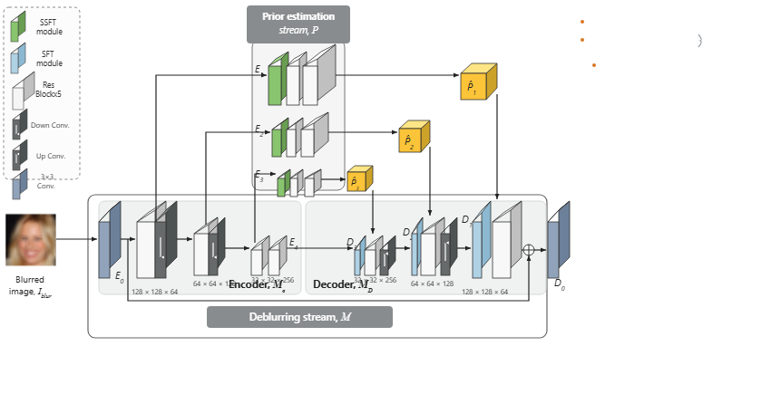
Notes:
A final convolution block labeled D zero maps the merged representations.
[Progressive Reveal · WACV_2022_set5_000002 · frame_11.png · 6.00s]

Slide 13
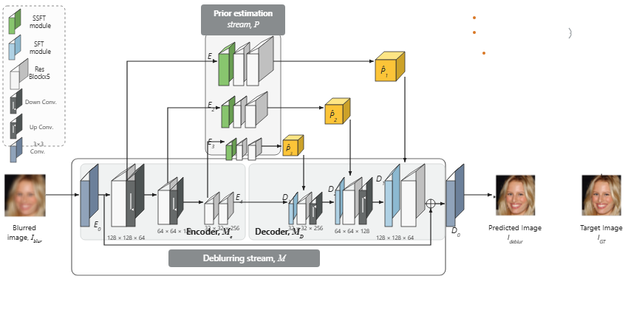
Notes:
This generates the predicted deblurred image, presented alongside the target ground truth image.
[Progressive Reveal · WACV_2022_set5_000002 · frame_12.png · 6.50s]

Slide 14
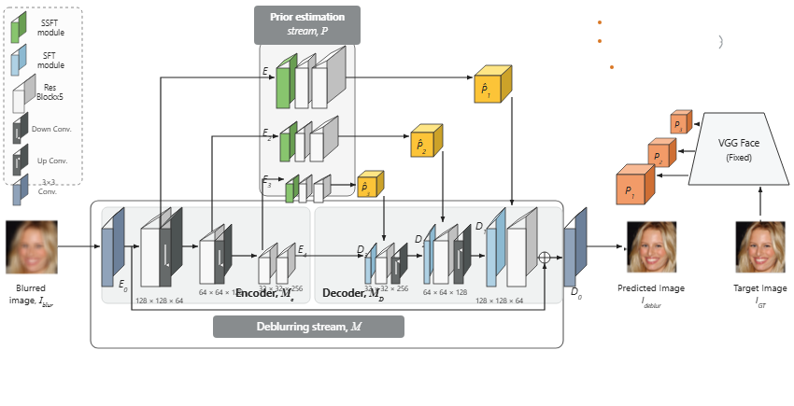
Notes:
A fixed VGG Face model extracts multi-scale feature priors labeled P one, P two, and P three from the target image.
[Progressive Reveal · WACV_2022_set5_000002 · frame_13.png · 7.00s]

Slide 15

Notes:
Prior loss supervises the estimated priors against target features, while pixel loss compares the predicted image to the ground truth.
[Progressive Reveal · WACV_2022_set5_000002 · frame_14.png · 7.50s]

Slide 16
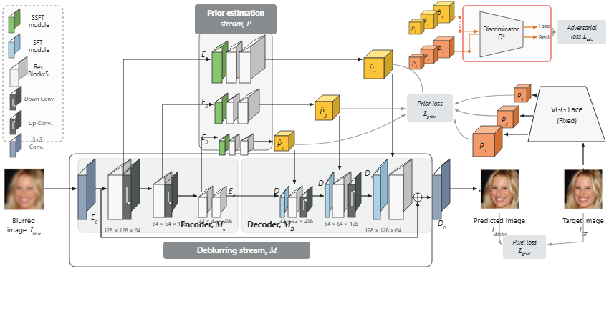
Notes:
Finally, a discriminator evaluates sets of estimated and real feature priors to compute the adversarial loss.
[Progressive Reveal · WACV_2022_set5_000002 · frame_15.png · 8.00s]

