Slide 1
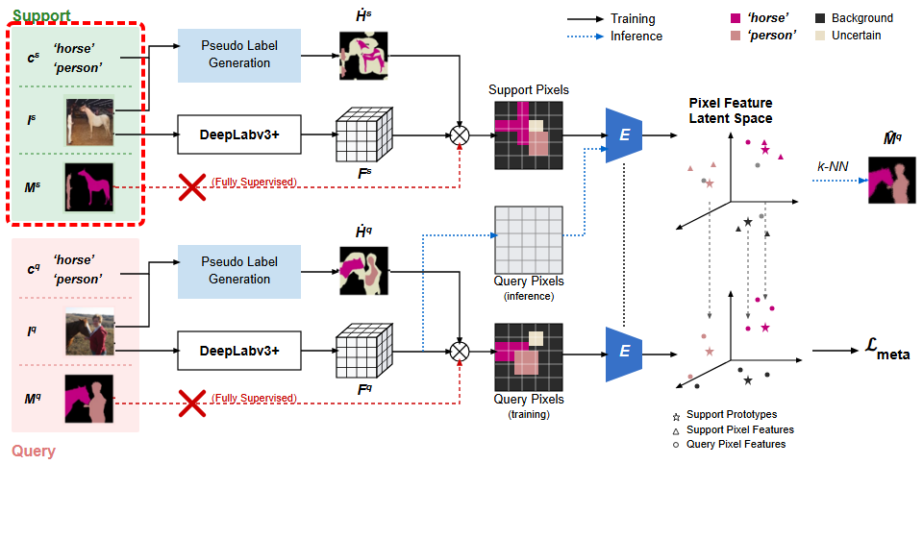
Notes:
We begin with the support branch, containing class labels, an input image, and a ground truth mask.
[Hopping Bbox · WACV_2022_set5_000006 · frame_00.png · 1.00s]

Slide 2
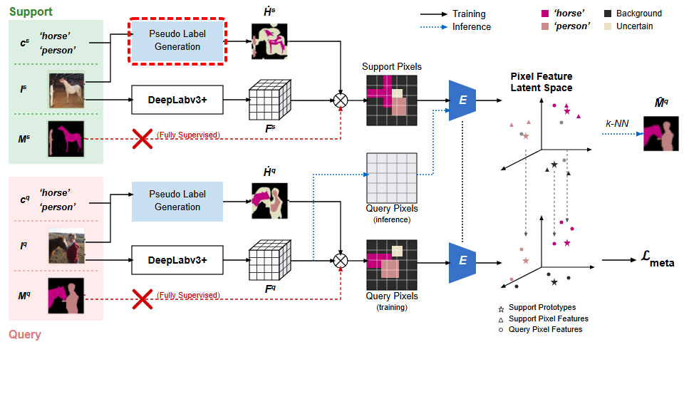
Notes:
The class labels and support image feed into Pseudo Label Generation.
[Hopping Bbox · WACV_2022_set5_000006 · frame_01.png · 3.00s]

Slide 3
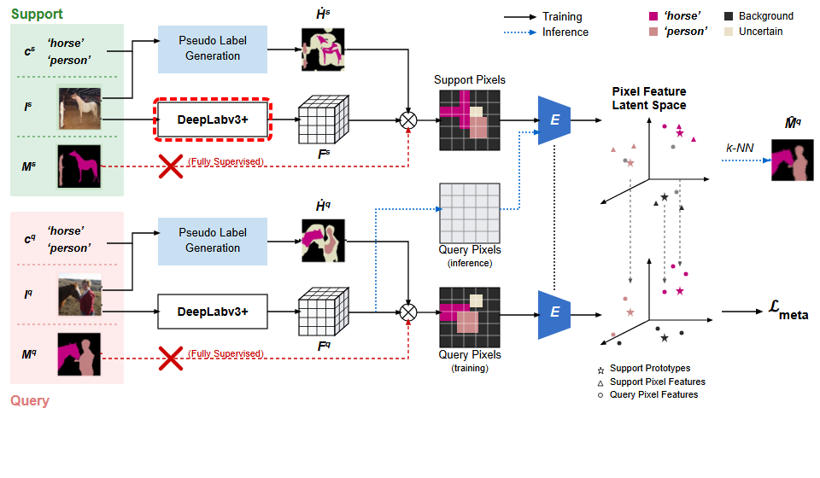
Notes:
In parallel, the support image is processed through DeepLabv3+.
[Hopping Bbox · WACV_2022_set5_000006 · frame_02.png · 5.00s]

Slide 4
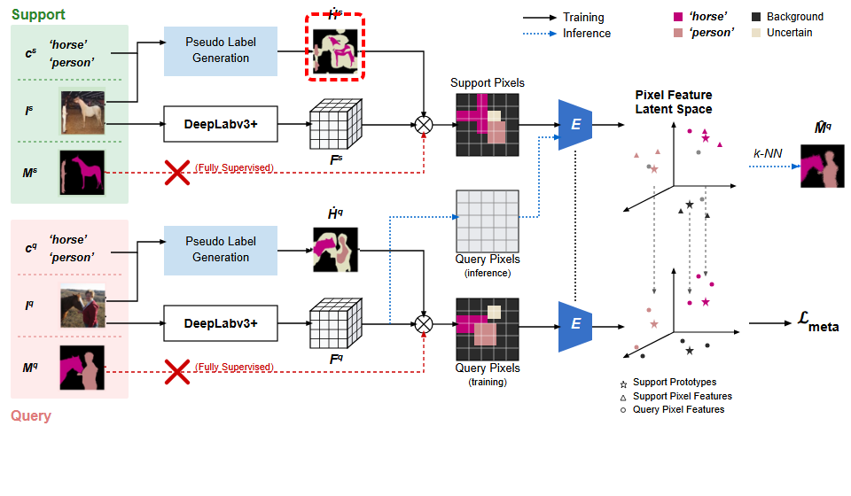
Notes:
This produces a pseudo label mask covering horse, person, background, and uncertain regions.
[Hopping Bbox · WACV_2022_set5_000006 · frame_03.png · 7.00s]

Slide 5
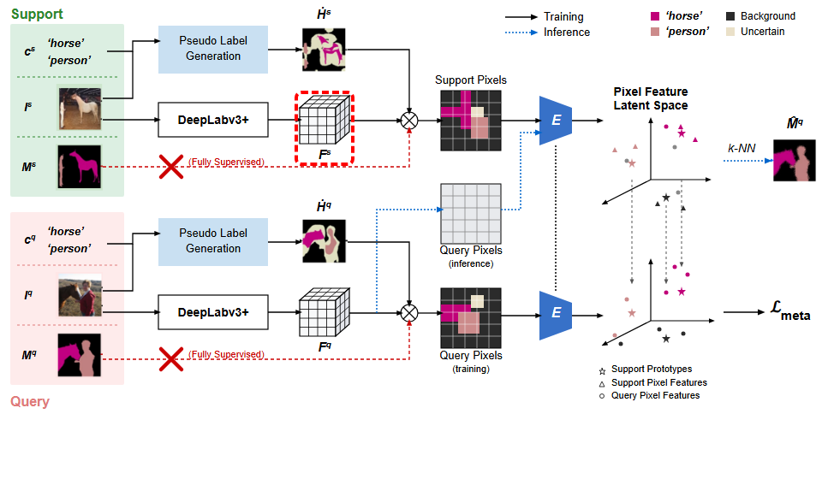
Notes:
Meanwhile, DeepLabv3+ outputs a support feature map.
[Hopping Bbox · WACV_2022_set5_000006 · frame_04.png · 9.00s]

Slide 6
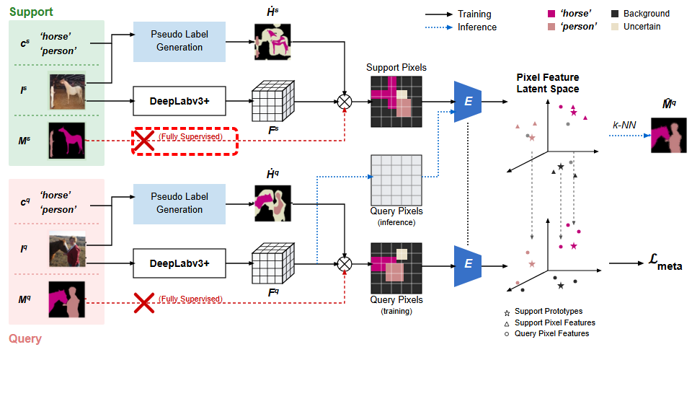
Notes:
The fully supervised support mask pathway is crossed out and bypassed.
[Hopping Bbox · WACV_2022_set5_000006 · frame_05.png · 11.00s]

Slide 7

Notes:
The pseudo mask is combined with the support feature map via pixel-wise multiplication.
[Hopping Bbox · WACV_2022_set5_000006 · frame_06.png · 13.00s]

Slide 8

Notes:
This generates a set of categorized support pixels.
[Hopping Bbox · WACV_2022_set5_000006 · frame_07.png · 15.00s]

Slide 9
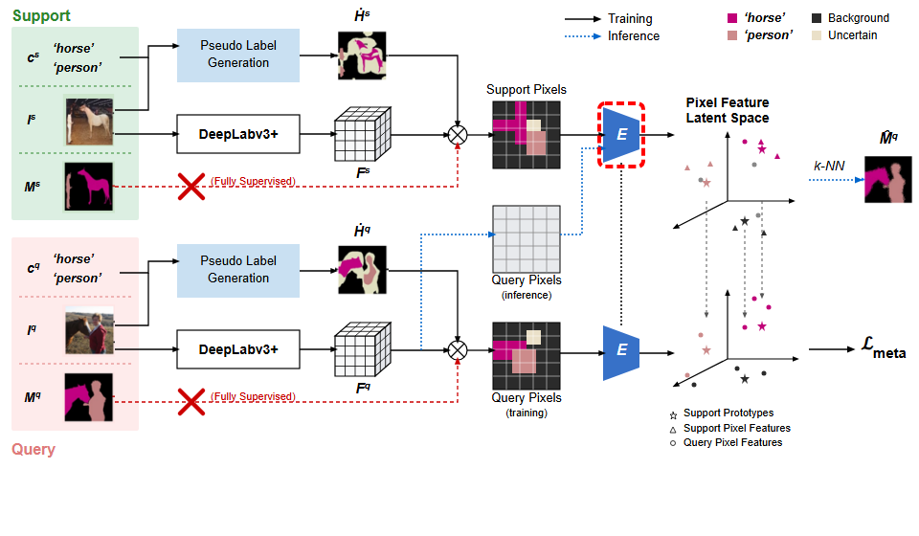
Notes:
The support pixels are passed into an encoder module, labeled E.
[Hopping Bbox · WACV_2022_set5_000006 · frame_08.png · 17.00s]

Slide 10
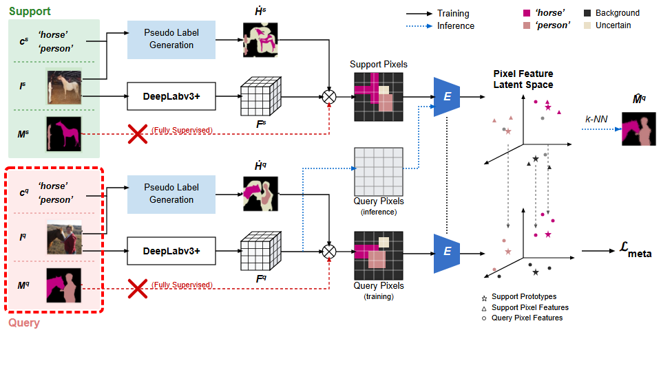
Notes:
Following a similar setup, the query branch receives query class labels, an input image, and a ground truth mask.
[Hopping Bbox · WACV_2022_set5_000006 · frame_09.png · 19.00s]

Slide 11
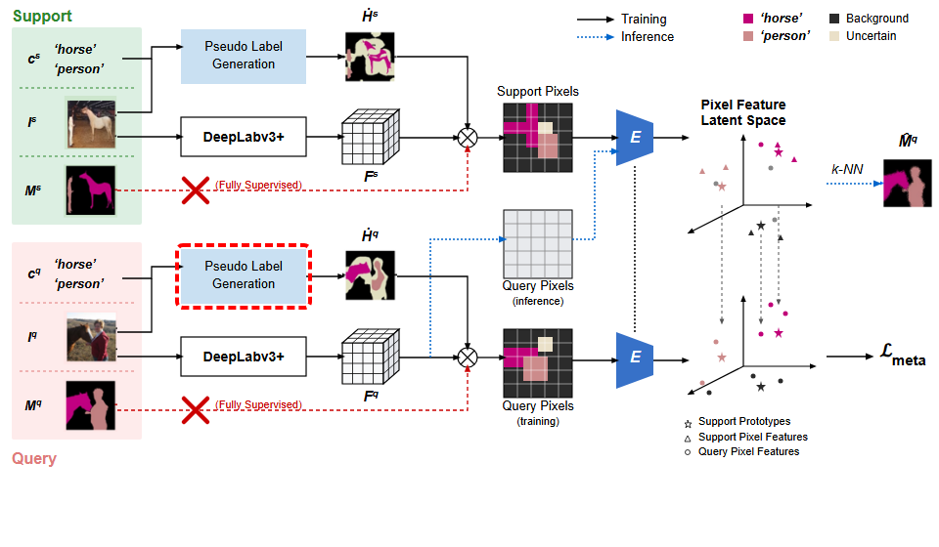
Notes:
The query inputs enter the Pseudo Label Generation module.
[Hopping Bbox · WACV_2022_set5_000006 · frame_10.png · 21.00s]

Slide 12
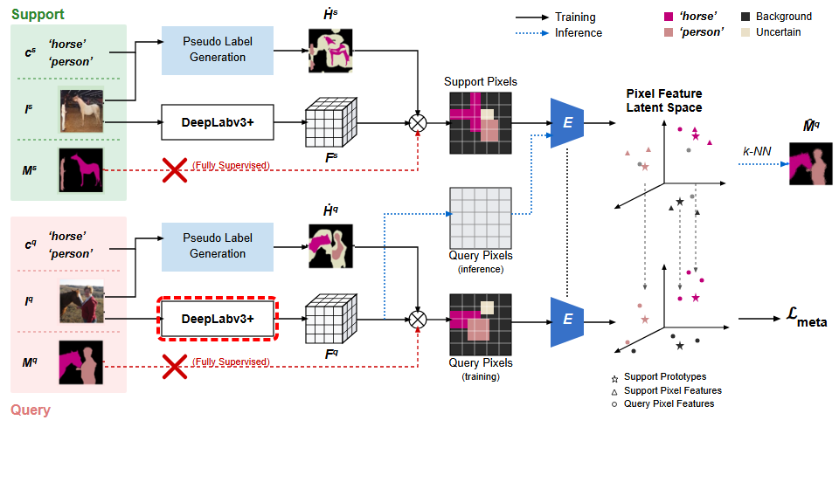
Notes:
The query image is simultaneously processed by DeepLabv3+.
[Hopping Bbox · WACV_2022_set5_000006 · frame_11.png · 23.00s]

Slide 13
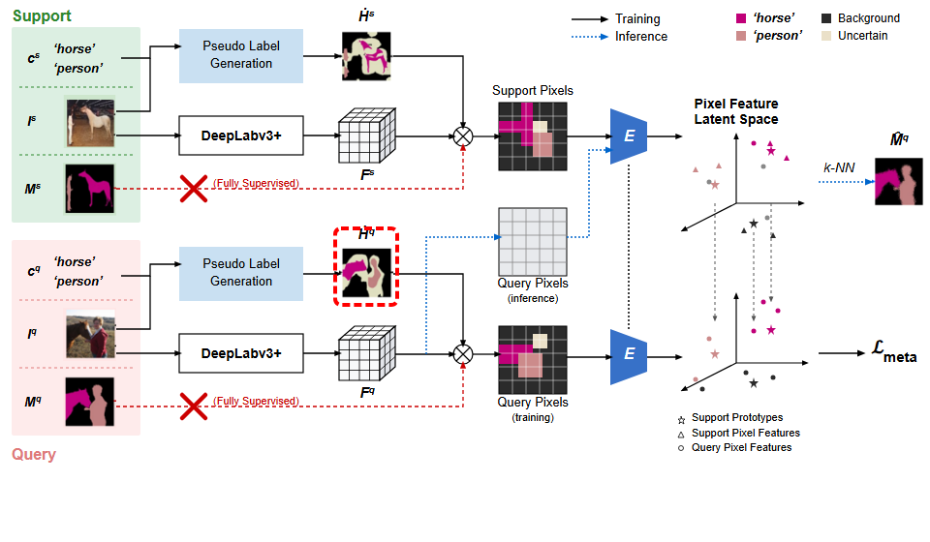
Notes:
This creates the query pseudo label mask.
[Hopping Bbox · WACV_2022_set5_000006 · frame_12.png · 25.00s]

Slide 14
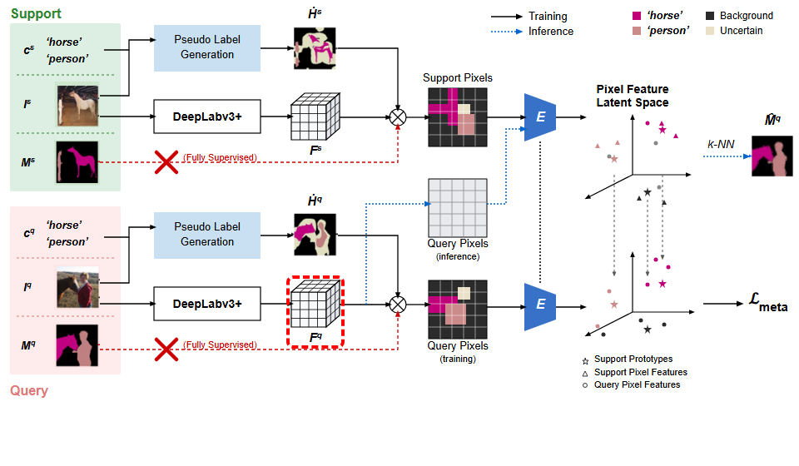
Notes:
Along with a dense query feature representation.
[Hopping Bbox · WACV_2022_set5_000006 · frame_13.png · 27.00s]

Slide 15
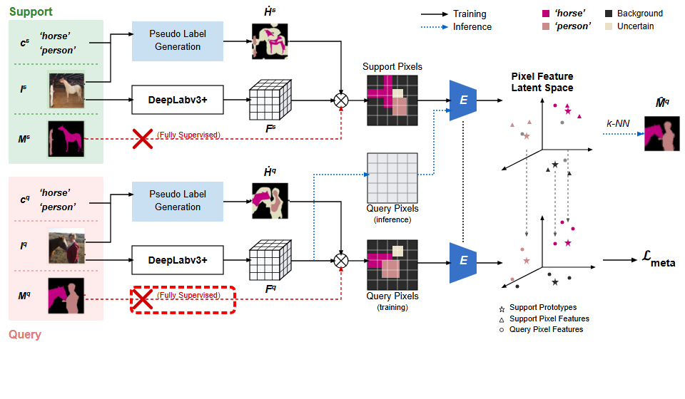
Notes:
As before, fully supervised ground truth masks are crossed out.
[Hopping Bbox · WACV_2022_set5_000006 · frame_14.png · 29.00s]

Slide 16

Notes:
The query feature map is multiplied by the query pseudo mask during training.
[Hopping Bbox · WACV_2022_set5_000006 · frame_15.png · 31.00s]

Slide 17
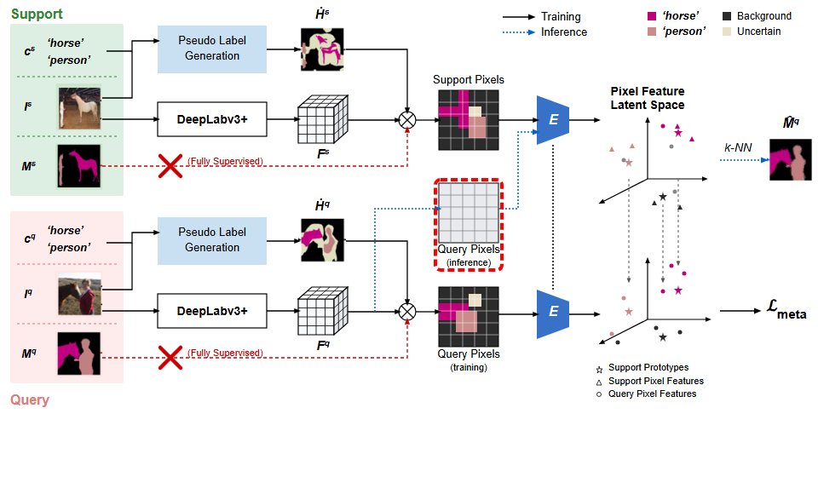
Notes:
During inference, query pixels flow directly from the feature map.
[Hopping Bbox · WACV_2022_set5_000006 · frame_16.png · 33.00s]

Slide 18
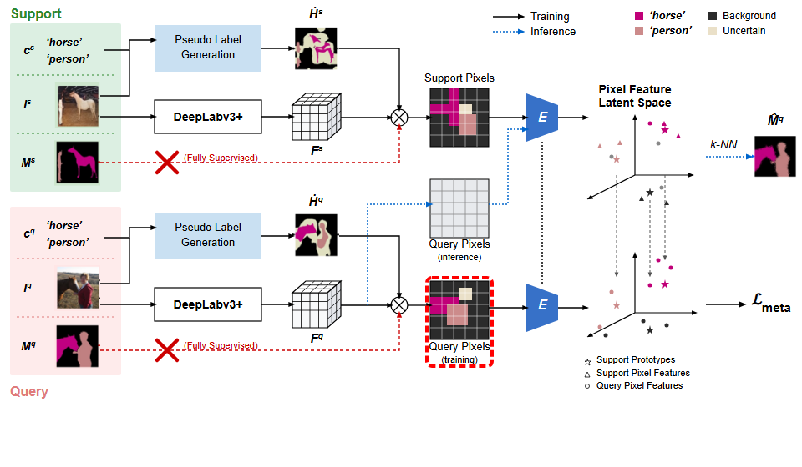
Notes:
During training, the masked query pixels are generated instead.
[Hopping Bbox · WACV_2022_set5_000006 · frame_17.png · 35.00s]

Slide 19
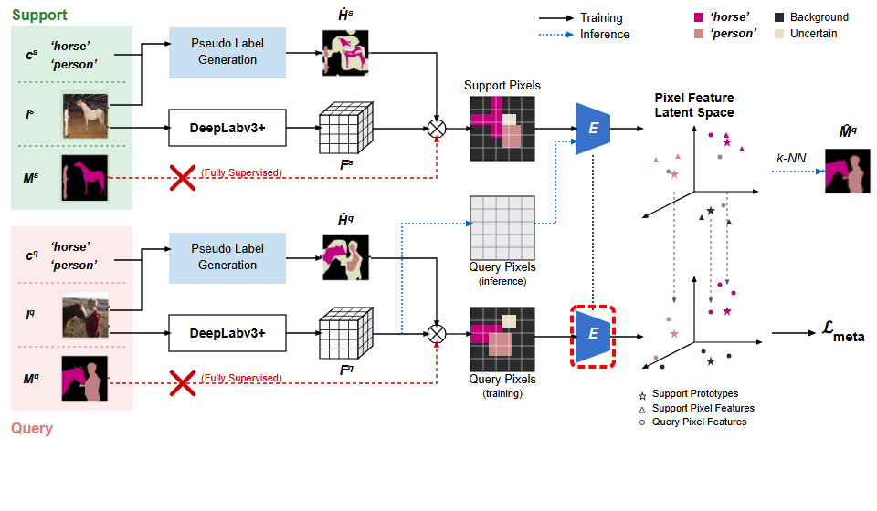
Notes:
These query pixels pass through the shared encoder E.
[Hopping Bbox · WACV_2022_set5_000006 · frame_18.png · 37.00s]

Slide 20
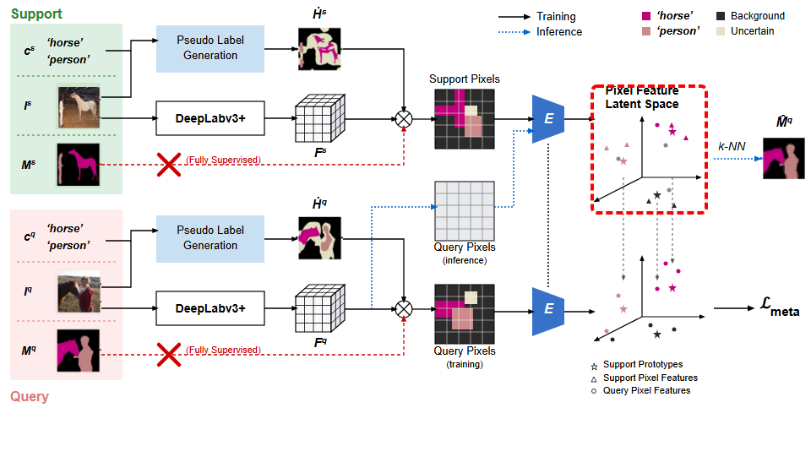
Notes:
In the upper pixel feature latent space, support pixel features form support prototypes.
[Hopping Bbox · WACV_2022_set5_000006 · frame_19.png · 39.00s]

Slide 21

Notes:
Query pixel features are embedded into the corresponding latent space relative to the prototypes.
[Hopping Bbox · WACV_2022_set5_000006 · frame_20.png · 41.00s]

Slide 22
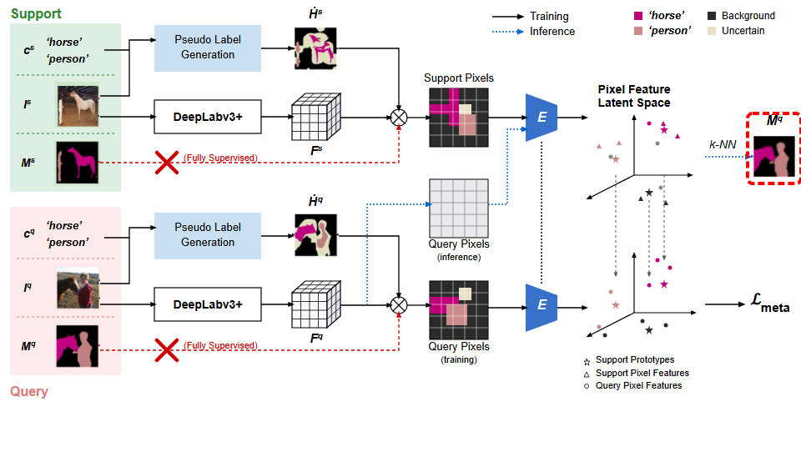
Notes:
For inference, k-nearest neighbors classification is applied to produce the predicted query mask.
[Hopping Bbox · WACV_2022_set5_000006 · frame_21.png · 43.00s]

Slide 23
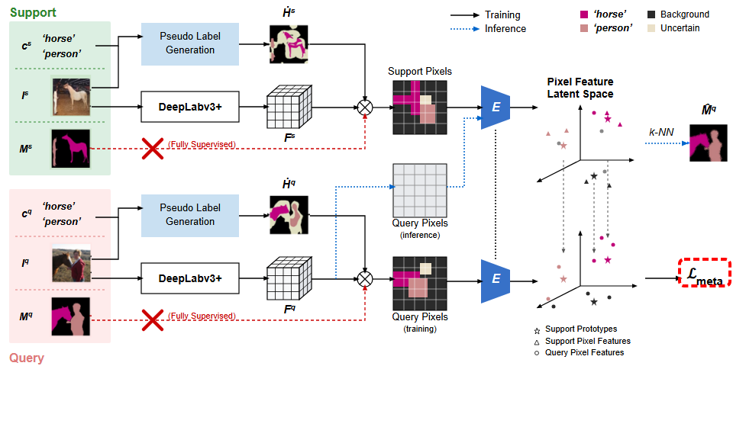
Notes:
For training, the latent embeddings are optimized using the meta loss function.
[Hopping Bbox · WACV_2022_set5_000006 · frame_22.png · 45.00s]

