Slide 1
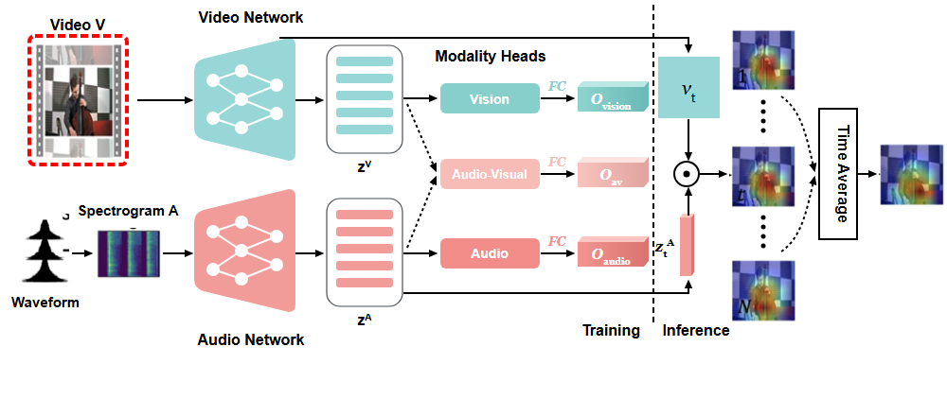
Notes:
The input video sequence is fed into the system.
[Hopping Bbox · WACV_2022_set5_000009 · frame_00.png · 1.00s]

Slide 2
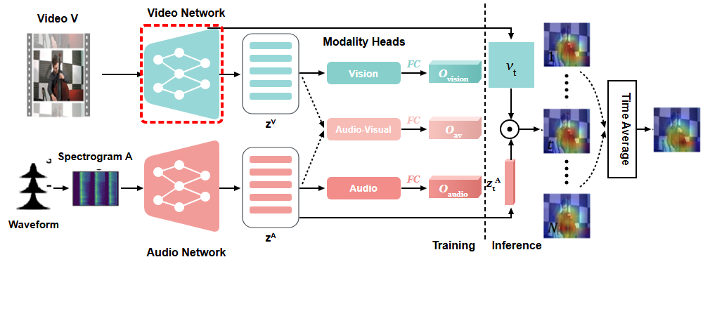
Notes:
It passes into the Video Network.
[Hopping Bbox · WACV_2022_set5_000009 · frame_01.png · 3.00s]

Slide 3
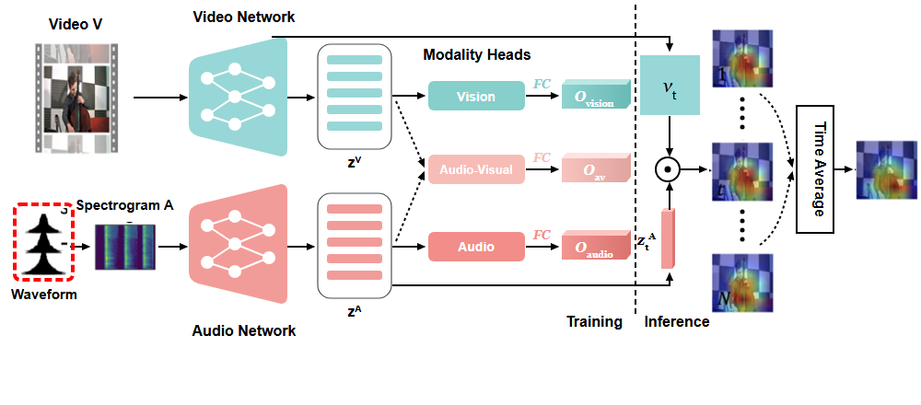
Notes:
Simultaneously, the audio waveform is captured.
[Hopping Bbox · WACV_2022_set5_000009 · frame_02.png · 5.00s]

Slide 4
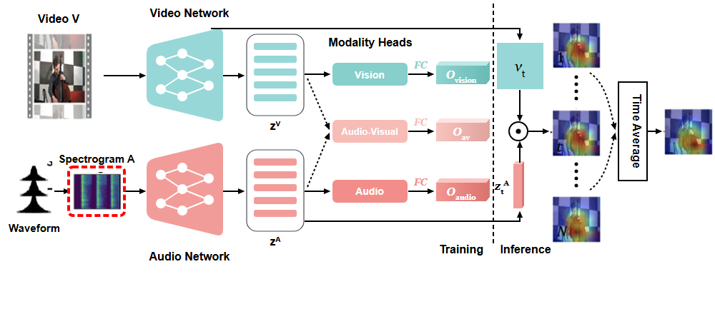
Notes:
The waveform converts into spectrogram A.
[Hopping Bbox · WACV_2022_set5_000009 · frame_03.png · 7.00s]

Slide 5
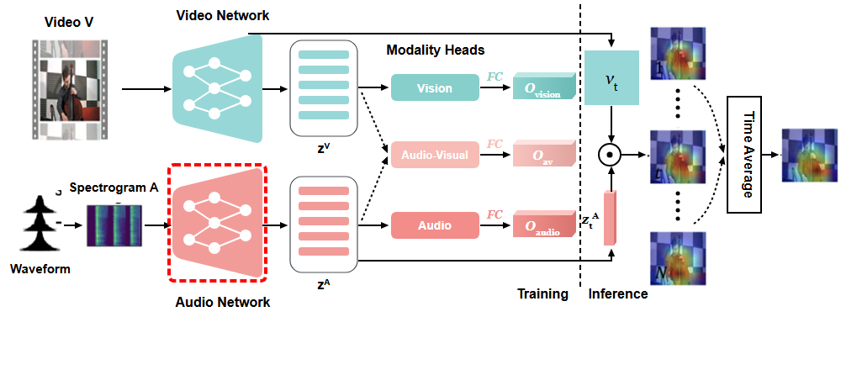
Notes:
Spectrogram A enters the Audio Network.
[Hopping Bbox · WACV_2022_set5_000009 · frame_04.png · 9.00s]

Slide 6
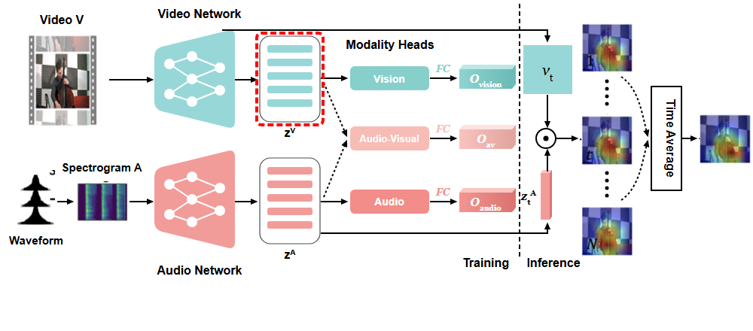
Notes:
The Video Network yields visual feature embeddings.
[Hopping Bbox · WACV_2022_set5_000009 · frame_05.png · 11.00s]

Slide 7
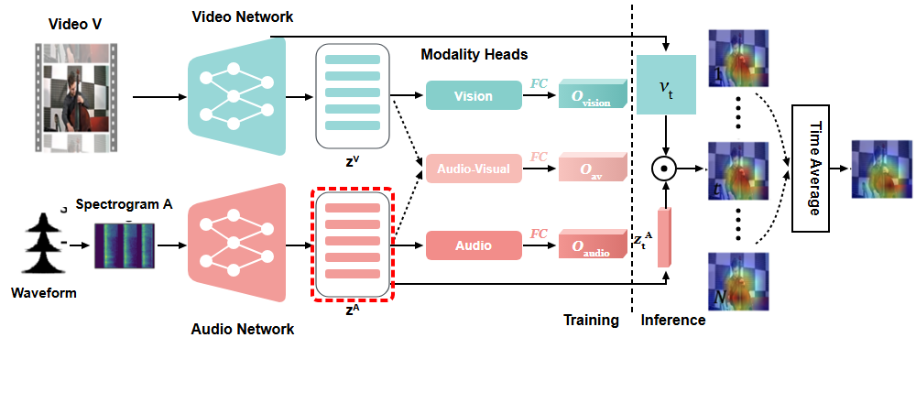
Notes:
The Audio Network yields audio feature embeddings.
[Hopping Bbox · WACV_2022_set5_000009 · frame_06.png · 13.00s]

Slide 8
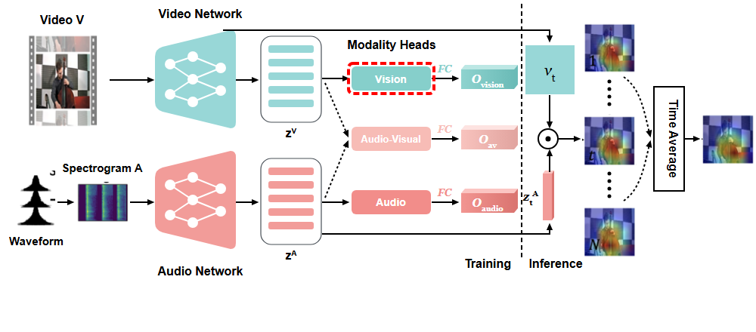
Notes:
In training, visual features route to the Vision modality head.
[Hopping Bbox · WACV_2022_set5_000009 · frame_07.png · 15.00s]

Slide 9
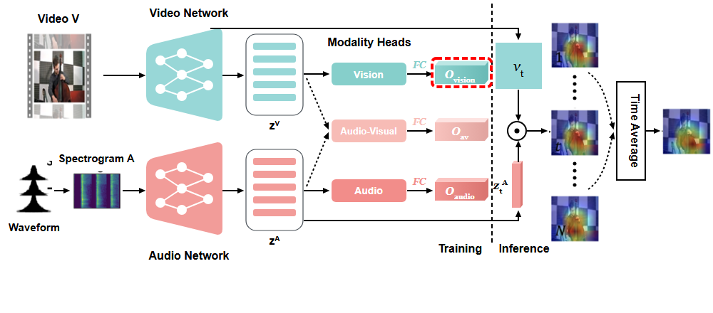
Notes:
A fully connected layer generates the vision output.
[Hopping Bbox · WACV_2022_set5_000009 · frame_08.png · 17.00s]

Slide 10

Notes:
Both feature streams merge into the Audio-Visual modality head.
[Hopping Bbox · WACV_2022_set5_000009 · frame_09.png · 19.00s]

Slide 11
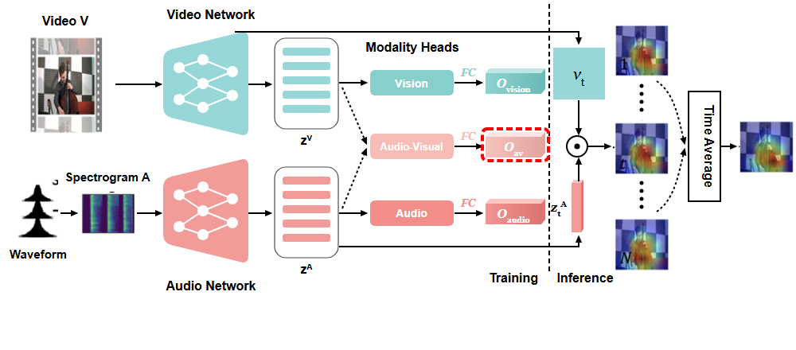
Notes:
Producing the audio-visual output.
[Hopping Bbox · WACV_2022_set5_000009 · frame_10.png · 21.00s]

Slide 12

Notes:
Audio features also enter the Audio modality head.
[Hopping Bbox · WACV_2022_set5_000009 · frame_11.png · 23.00s]

Slide 13
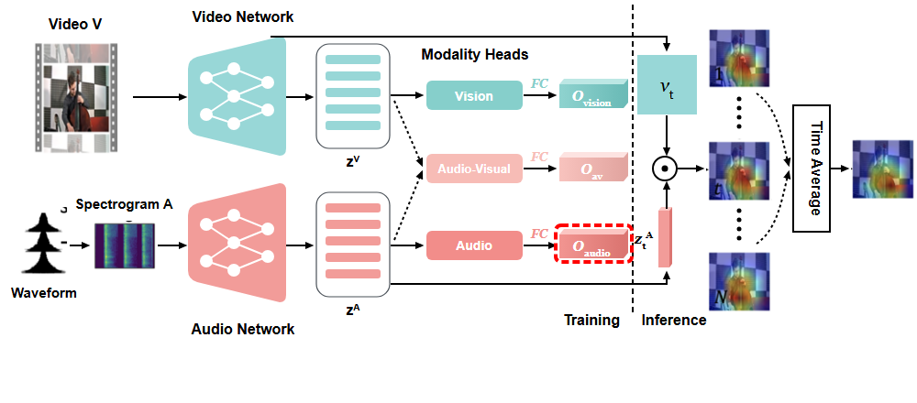
Notes:
Yielding the audio output.
[Hopping Bbox · WACV_2022_set5_000009 · frame_12.png · 25.00s]

Slide 14

Notes:
During inference, visual feature maps are extracted.
[Hopping Bbox · WACV_2022_set5_000009 · frame_13.png · 27.00s]

Slide 15

Notes:
Along with the corresponding audio embeddings.
[Hopping Bbox · WACV_2022_set5_000009 · frame_14.png · 29.00s]

Slide 16
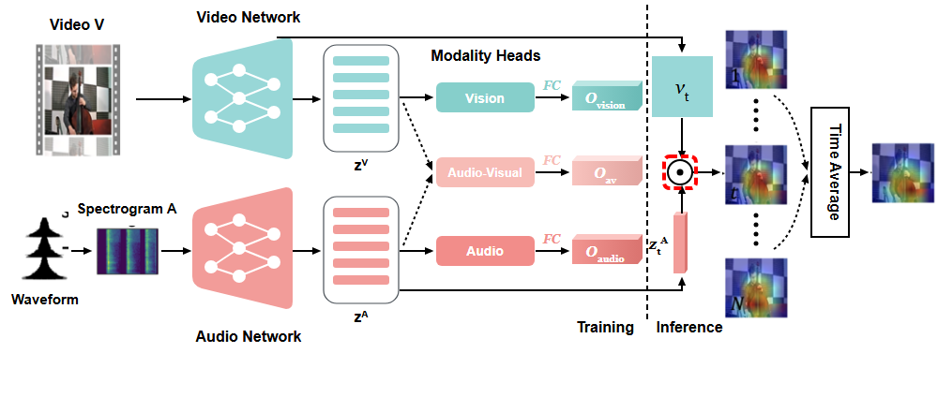
Notes:
Both streams combine via a dot product operation.
[Hopping Bbox · WACV_2022_set5_000009 · frame_15.png · 31.00s]

Slide 17
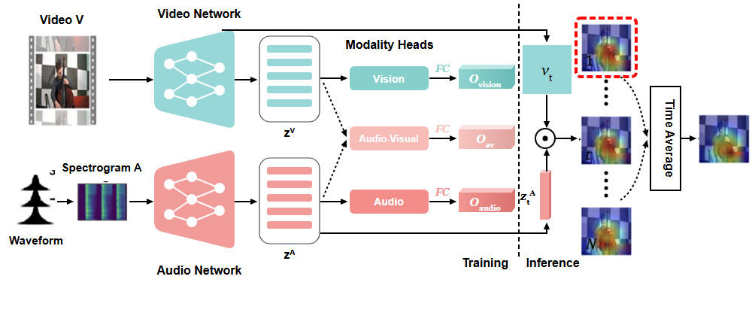
Notes:
This generates a localization heatmap for frame one.
[Hopping Bbox · WACV_2022_set5_000009 · frame_16.png · 33.00s]

Slide 18
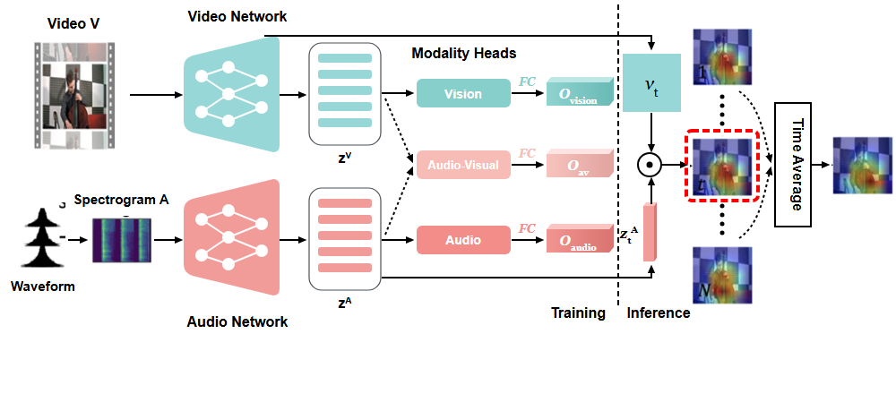
Notes:
As well as for frame t.
[Hopping Bbox · WACV_2022_set5_000009 · frame_17.png · 35.00s]

Slide 19
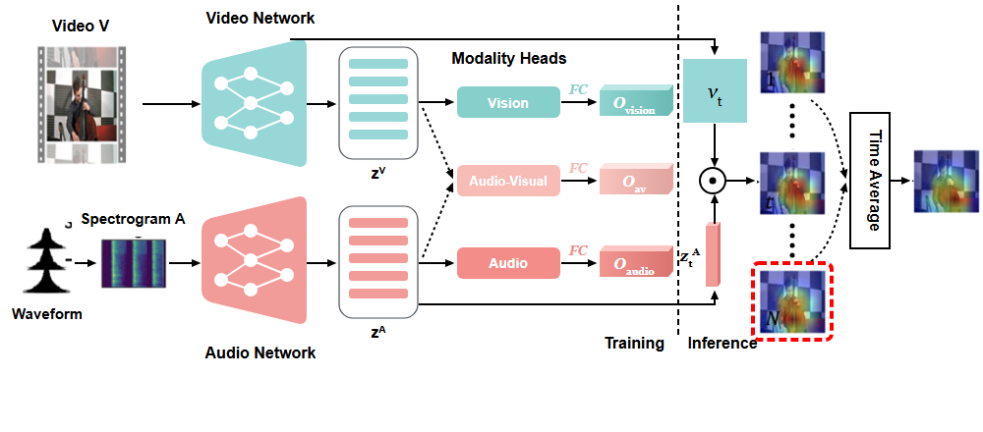
Notes:
Through to frame N.
[Hopping Bbox · WACV_2022_set5_000009 · frame_18.png · 37.00s]

Slide 20
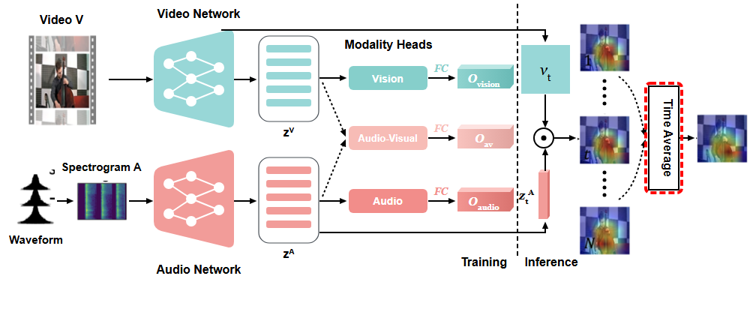
Notes:
All frame heatmaps enter Time Average.
[Hopping Bbox · WACV_2022_set5_000009 · frame_19.png · 39.00s]

Slide 21
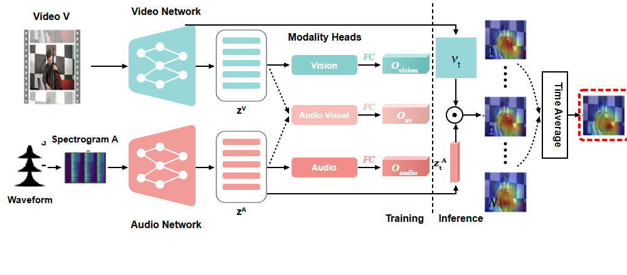
Notes:
Producing the final averaged output heatmap.
[Hopping Bbox · WACV_2022_set5_000009 · frame_20.png · 41.00s]

