Slide 1
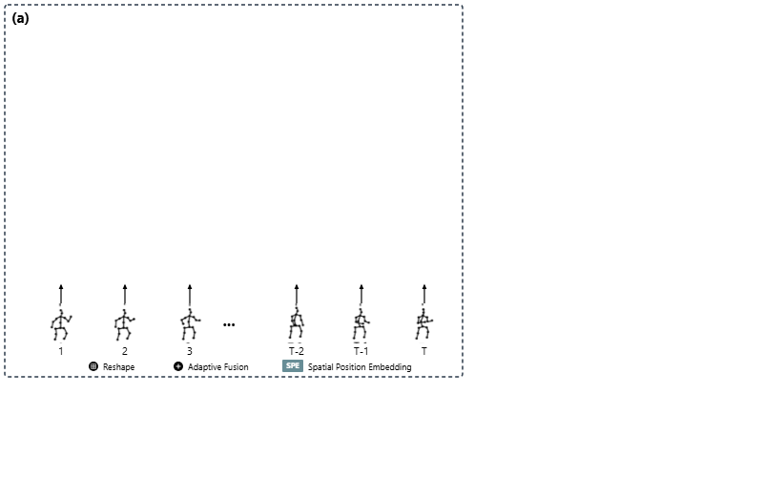
Notes:
The architecture begins by taking a sequence of two-dimensional human poses spanning frames one through T as input.
[Progressive Reveal · WACV_2024_set5_000035 · frame_00.png · 0.50s]

Slide 2
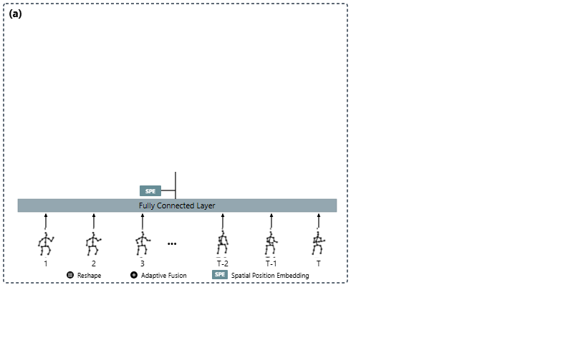
Notes:
A fully connected layer linearly projects the joints into feature tokens, which are then enriched with spatial position embeddings.
[Progressive Reveal · WACV_2024_set5_000035 · frame_01.png · 1.00s]

Slide 3
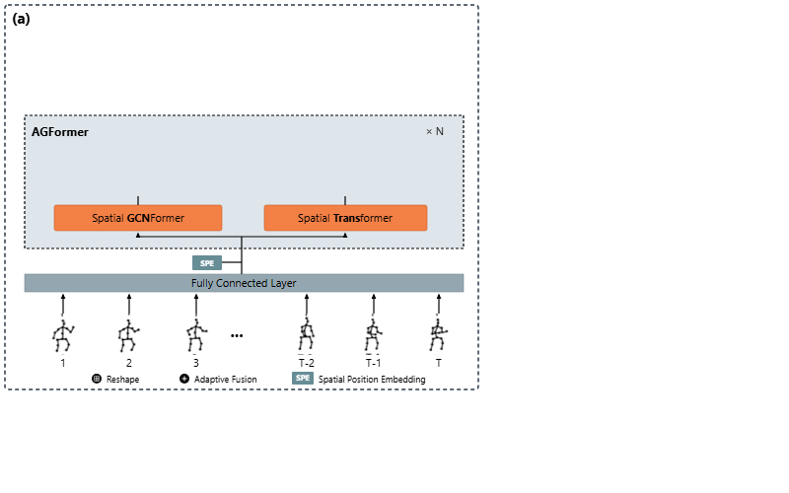
Notes:
Inside the AGFormer block, features branch into parallel Spatial GCNFormer and Spatial Transformer streams to capture local and global joint relations.
[Progressive Reveal · WACV_2024_set5_000035 · frame_02.png · 1.50s]

Slide 4
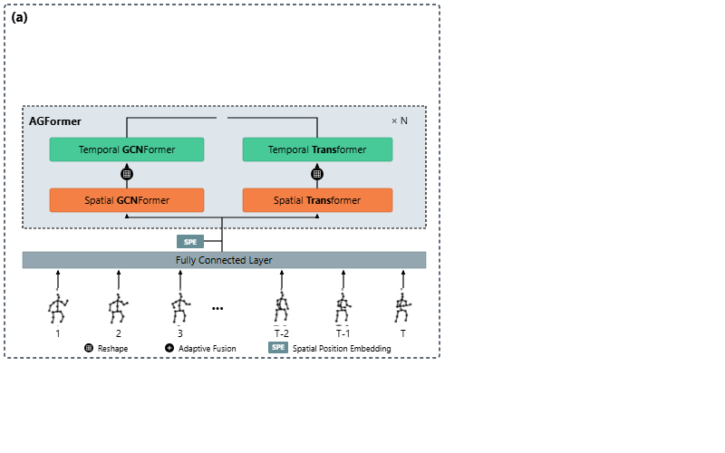
Notes:
After feature reshaping, representations pass into Temporal GCNFormer and Temporal Transformer modules to model cross-frame temporal dynamics.
[Progressive Reveal · WACV_2024_set5_000035 · frame_03.png · 2.00s]

Slide 5
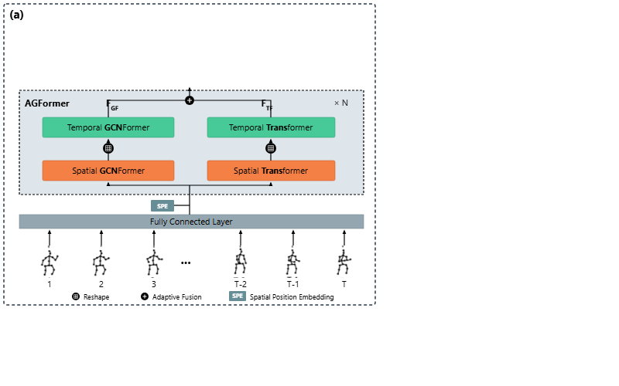
Notes:
The GCNFormer and Transformer feature streams are merged via adaptive fusion across N stacked AGFormer blocks.
[Progressive Reveal · WACV_2024_set5_000035 · frame_04.png · 2.50s]

Slide 6
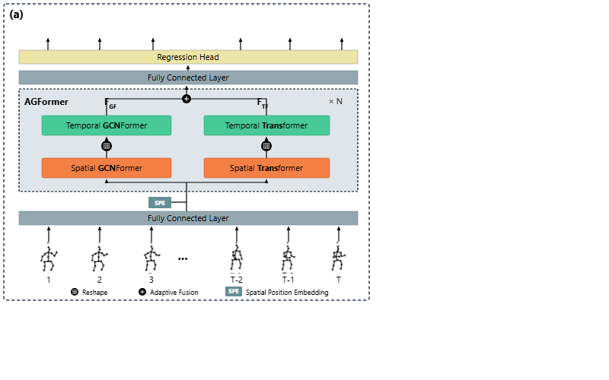
Notes:
The fused representations proceed through an upper fully connected layer to the regression head.
[Progressive Reveal · WACV_2024_set5_000035 · frame_05.png · 3.00s]

Slide 7
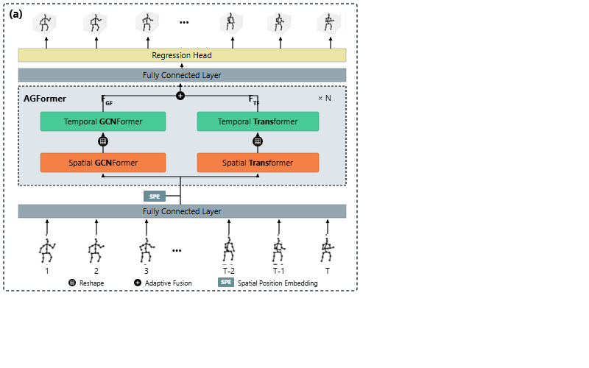
Notes:
The regression head outputs the final estimated three-dimensional skeletal poses across all time frames.
[Progressive Reveal · WACV_2024_set5_000035 · frame_06.png · 3.50s]

Slide 8
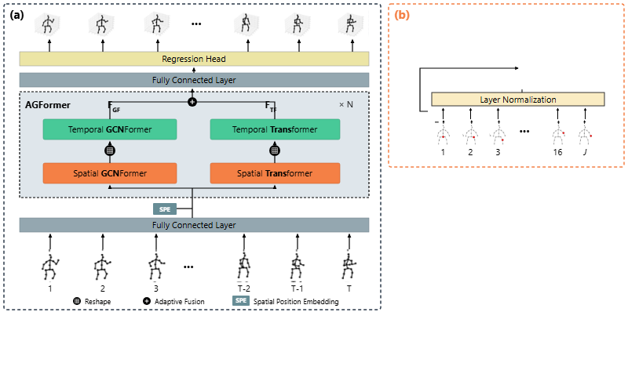
Notes:
Panel B details the Spatial MetaFormer, treating individual body joints from one to J as distinct input tokens.
[Progressive Reveal · WACV_2024_set5_000035 · frame_07.png · 4.00s]

Slide 9
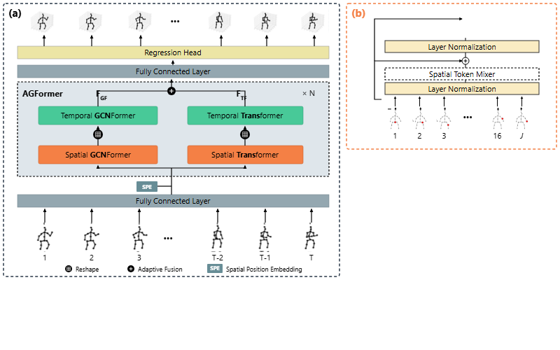
Notes:
The joint tokens pass through layer normalization and a spatial token mixer, combined with a residual skip connection.
[Progressive Reveal · WACV_2024_set5_000035 · frame_08.png · 4.50s]

Slide 10
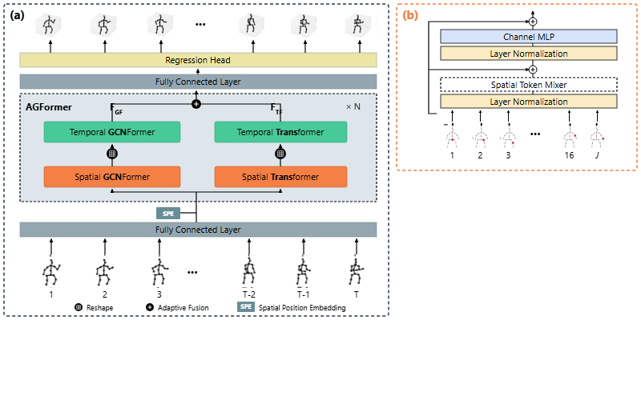
Notes:
Features then undergo a second layer normalization, channel multilayer perceptron processing, and residual addition.
[Progressive Reveal · WACV_2024_set5_000035 · frame_09.png · 5.00s]

Slide 11
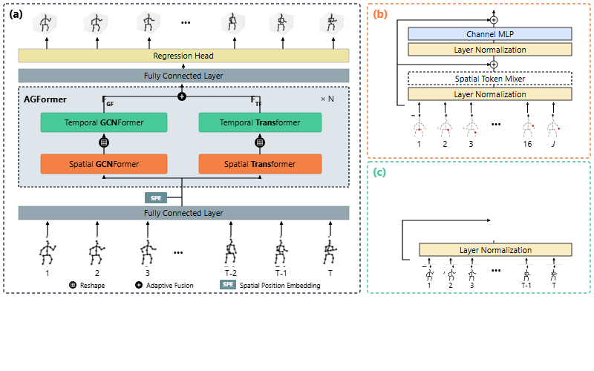
Notes:
Panel C outlines the Temporal MetaFormer, where entire pose frames across time steps one through T serve as tokens.
[Progressive Reveal · WACV_2024_set5_000035 · frame_10.png · 5.50s]

Slide 12
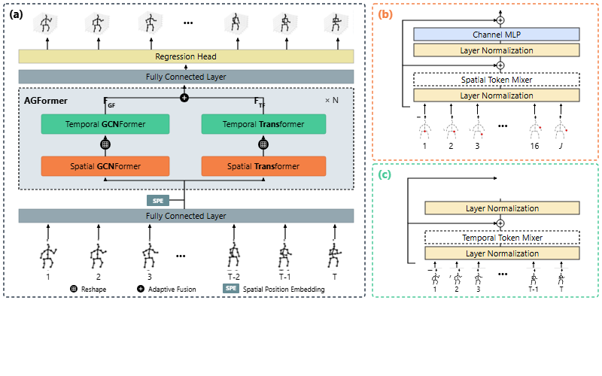
Notes:
Frame tokens undergo layer normalization, temporal token mixing, and residual addition to model temporal context.
[Progressive Reveal · WACV_2024_set5_000035 · frame_11.png · 6.00s]

Slide 13
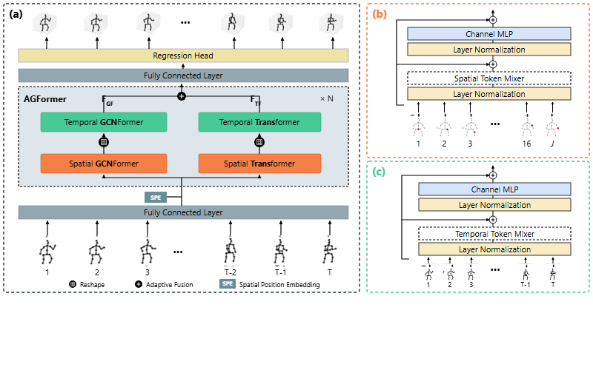
Notes:
Finally, the temporal representations pass through layer normalization and a channel multilayer perceptron with a residual connection.
[Progressive Reveal · WACV_2024_set5_000035 · frame_12.png · 6.50s]

