Slide 1

Notes:
The architecture builds upon a pre-trained, frozen CLIP model containing text and image encoders.
[Progressive Reveal · WACV_2024_set5_000054 · frame_00.png · 0.50s]

Slide 2
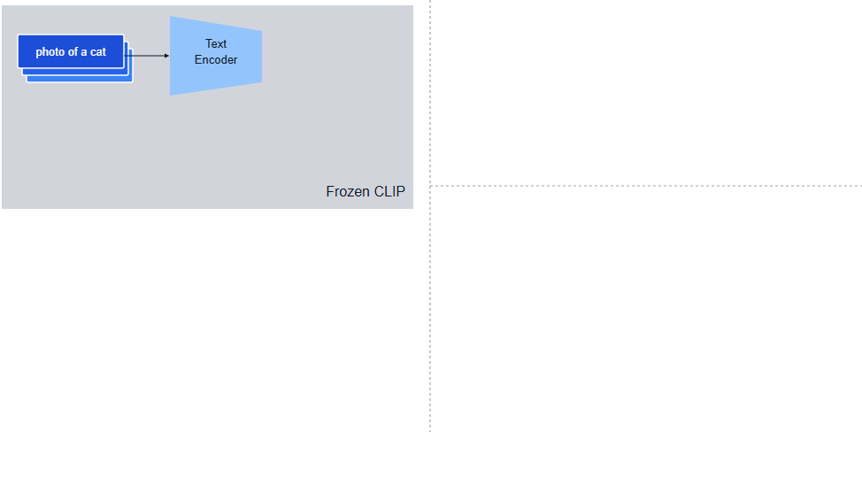
Notes:
In standard CLIP, the text encoder processes natural language prompts such as 'photo of a cat'.
[Progressive Reveal · WACV_2024_set5_000054 · frame_01.png · 1.00s]

Slide 3
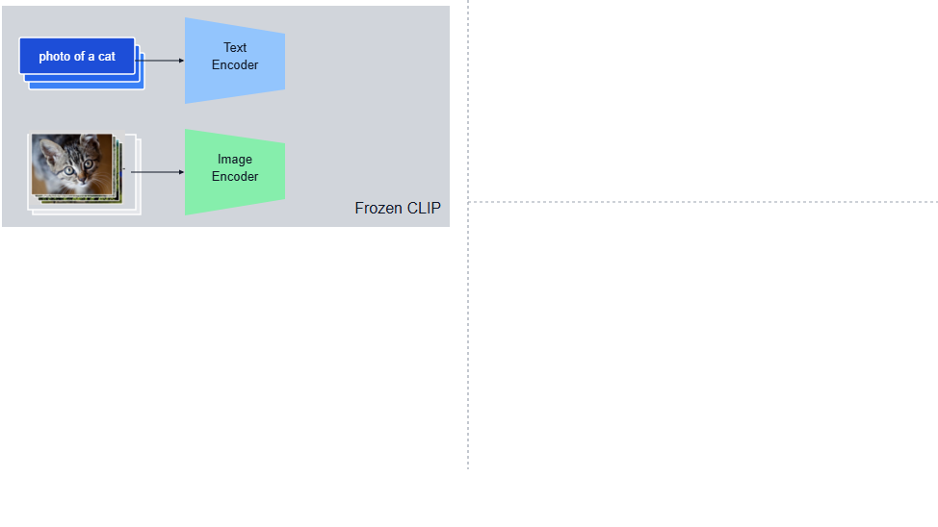
Notes:
In parallel, the image encoder extracts visual features from corresponding images.
[Progressive Reveal · WACV_2024_set5_000054 · frame_02.png · 1.50s]

Slide 4
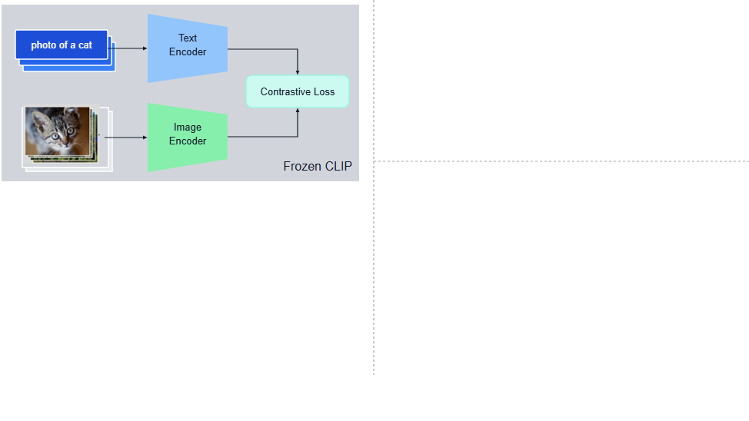
Notes:
A contrastive loss trains both encoders to align text and image representations within a shared embedding space.
[Progressive Reveal · WACV_2024_set5_000054 · frame_03.png · 2.00s]

Slide 5
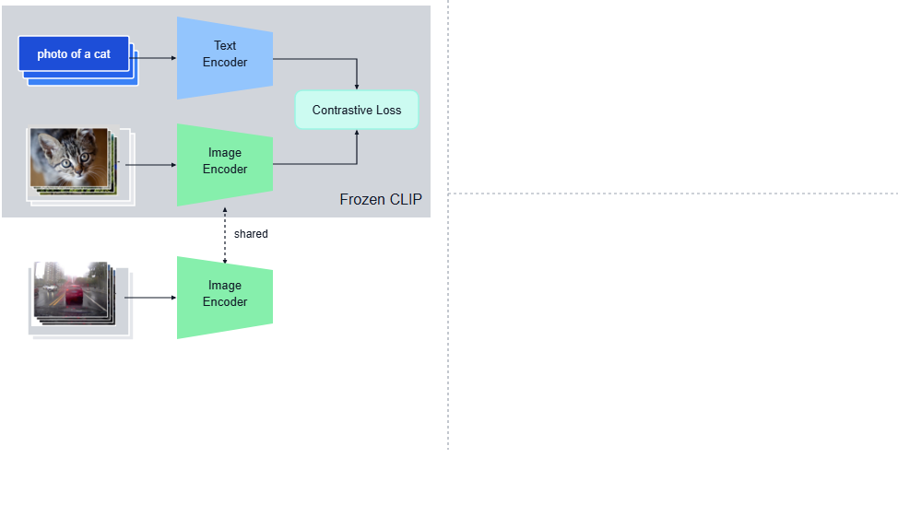
Notes:
To train LidarCLIP, automotive camera frames are passed through the frozen CLIP image encoder without gradient updates.
[Progressive Reveal · WACV_2024_set5_000054 · frame_04.png · 2.50s]

Slide 6
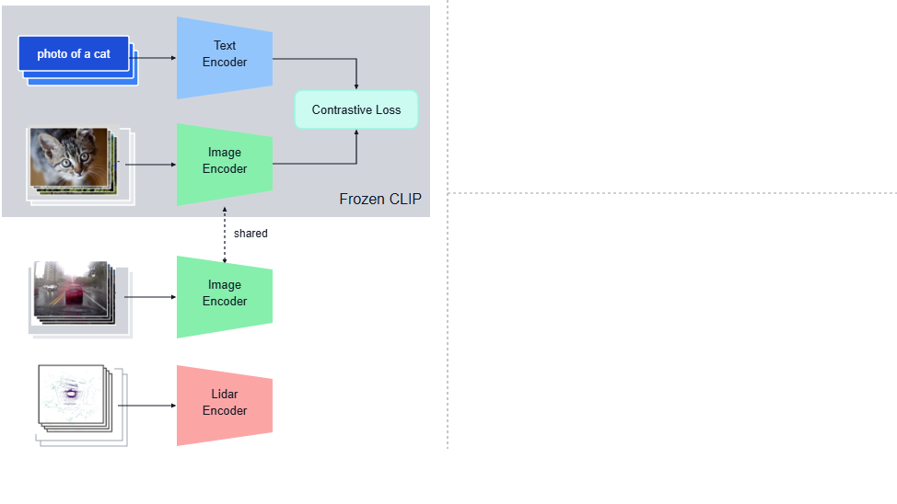
Notes:
Synchronized point clouds from image-lidar pairs are concurrently processed by a trainable lidar encoder.
[Progressive Reveal · WACV_2024_set5_000054 · frame_05.png · 3.00s]

Slide 7
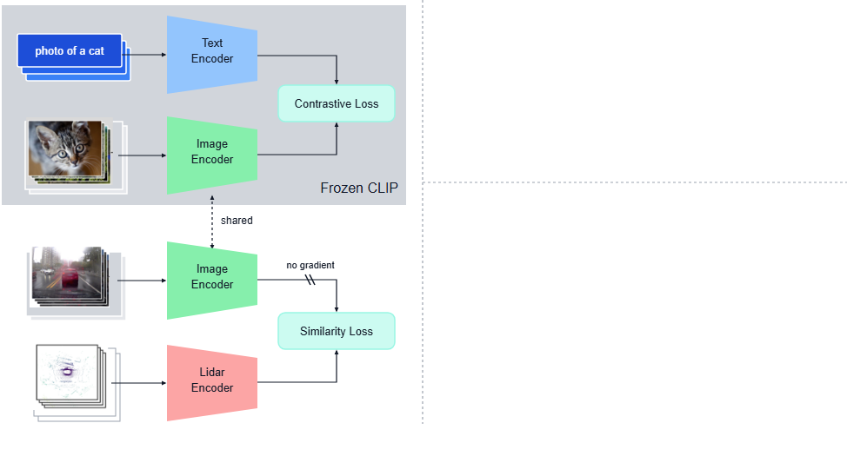
Notes:
A similarity loss maximizes the alignment between lidar and image embeddings, effectively connecting point clouds to text via the image domain.
[Progressive Reveal · WACV_2024_set5_000054 · frame_06.png · 3.50s]

Slide 8
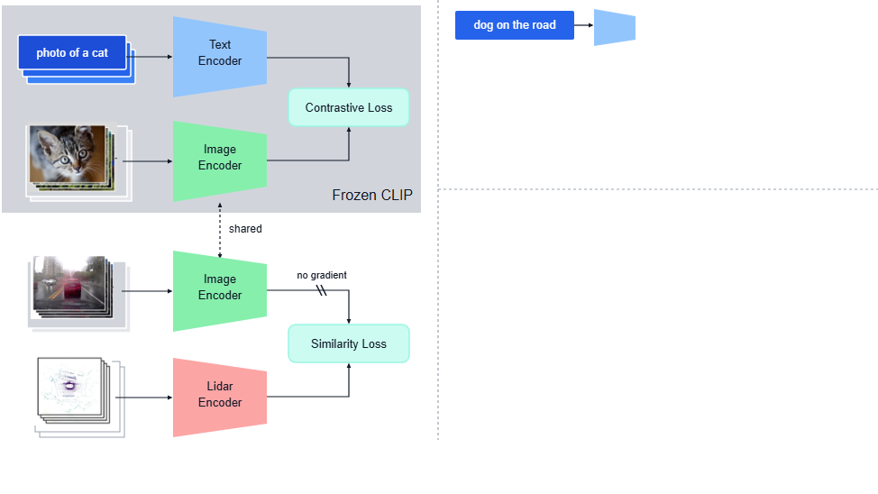
Notes:
For text-to-lidar retrieval, a natural language query is mapped into feature space using the frozen text encoder.
[Progressive Reveal · WACV_2024_set5_000054 · frame_07.png · 4.00s]

Slide 9
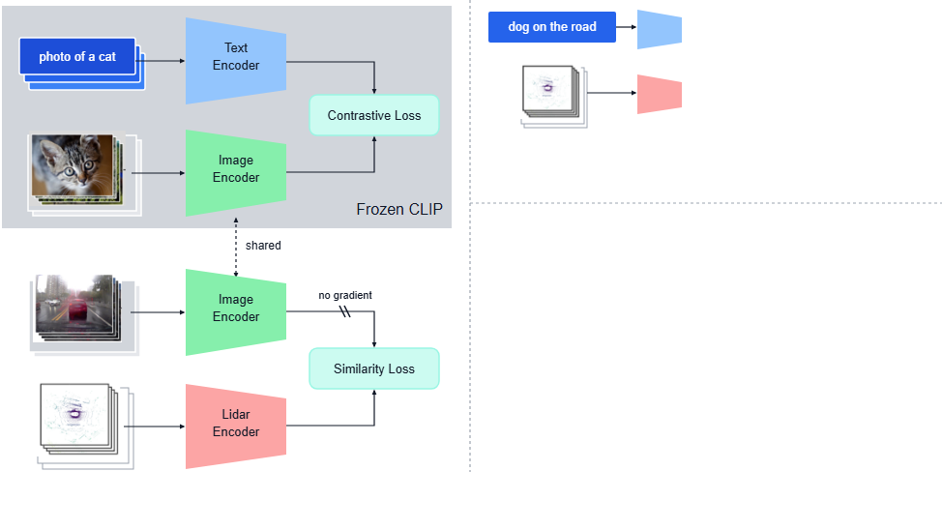
Notes:
Candidate point cloud scans are embedded through the trained lidar encoder.
[Progressive Reveal · WACV_2024_set5_000054 · frame_08.png · 4.50s]

Slide 10
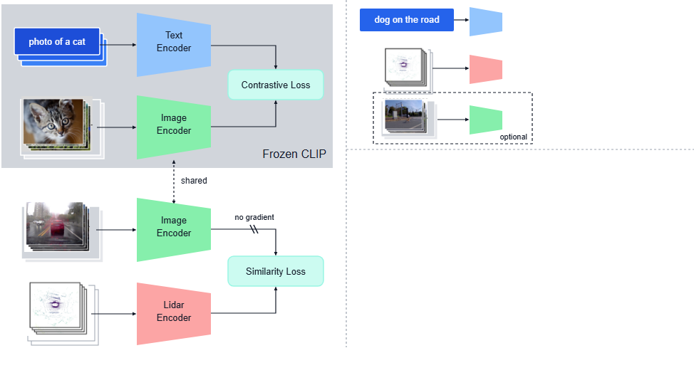
Notes:
Optionally, camera images can also be encoded to support multi-modal retrieval under challenging scenarios.
[Progressive Reveal · WACV_2024_set5_000054 · frame_09.png · 5.00s]

Slide 11
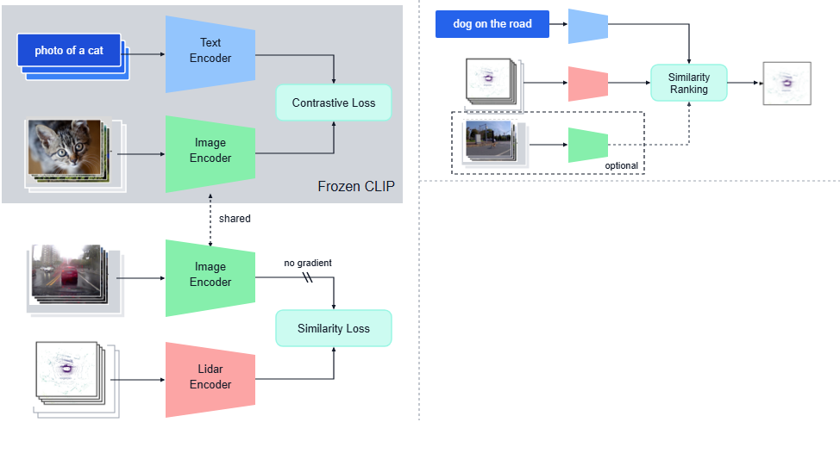
Notes:
A similarity ranking module then identifies and retrieves the point cloud matching the query.
[Progressive Reveal · WACV_2024_set5_000054 · frame_10.png · 5.50s]

Slide 12
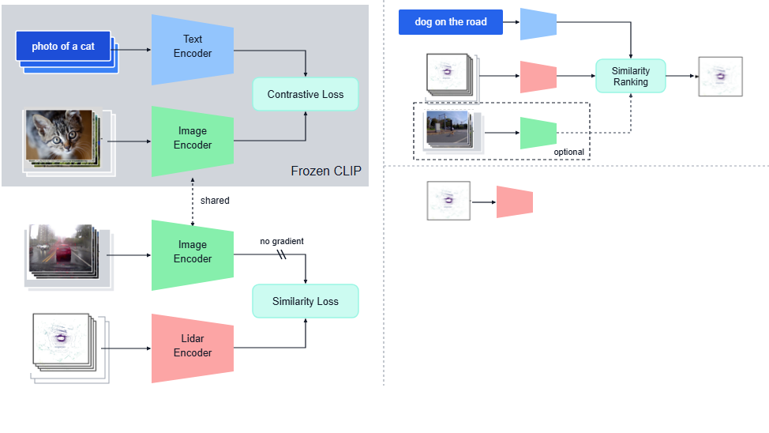
Notes:
At inference, the trained lidar encoder embeds point cloud inputs into the unified feature space for downstream tasks.
[Progressive Reveal · WACV_2024_set5_000054 · frame_11.png · 6.00s]

Slide 13
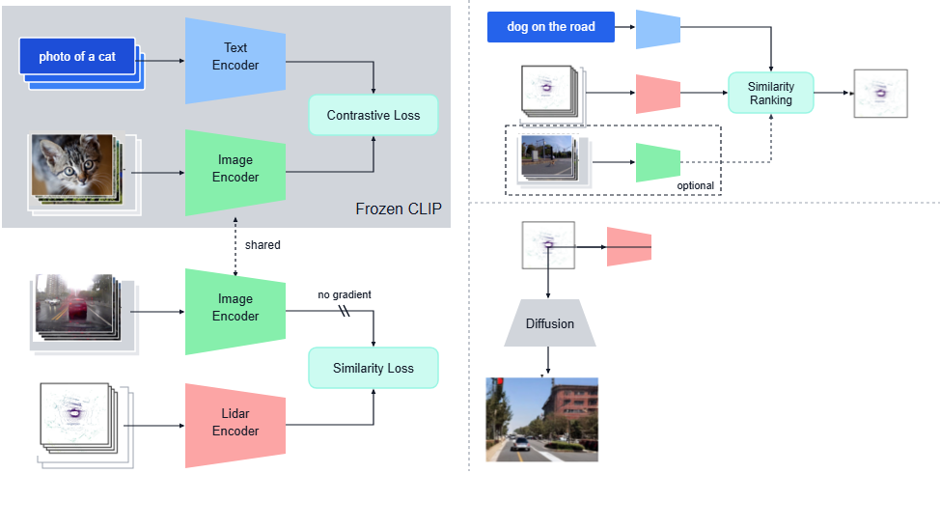
Notes:
For lidar-to-image generation, the lidar embedding directly conditions a diffusion model to synthesize realistic visual scenes.
[Progressive Reveal · WACV_2024_set5_000054 · frame_12.png · 6.50s]

Slide 14
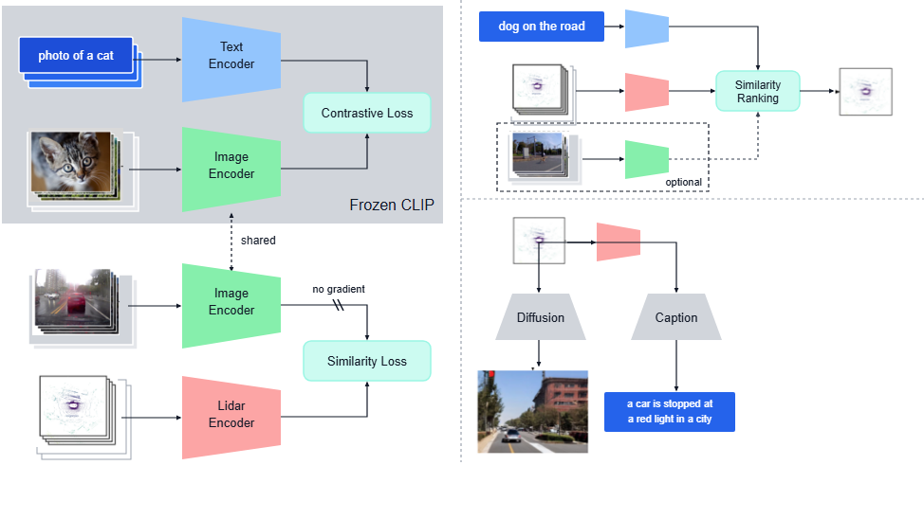
Notes:
For lidar-to-text generation, the embedding feeds into a captioning model to produce descriptive text of the driving scene.
[Progressive Reveal · WACV_2024_set5_000054 · frame_13.png · 7.00s]

Slide 15
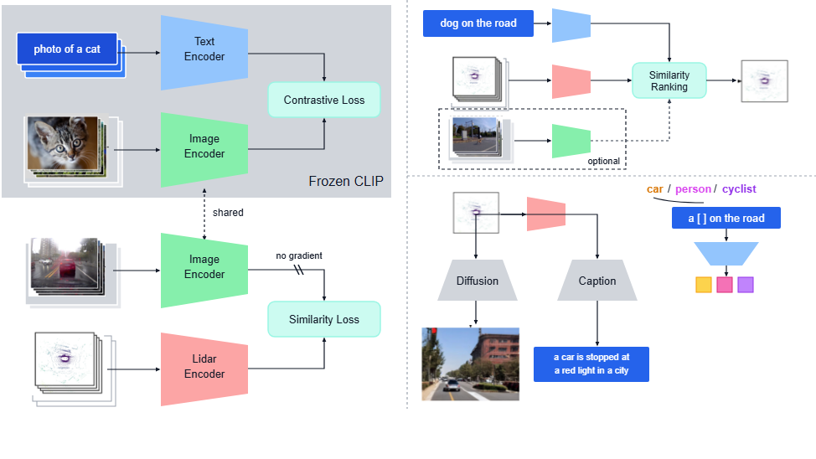
Notes:
For zero-shot classification, candidate category labels inserted into text prompt templates are encoded into text embeddings.
[Progressive Reveal · WACV_2024_set5_000054 · frame_14.png · 7.50s]

Slide 16
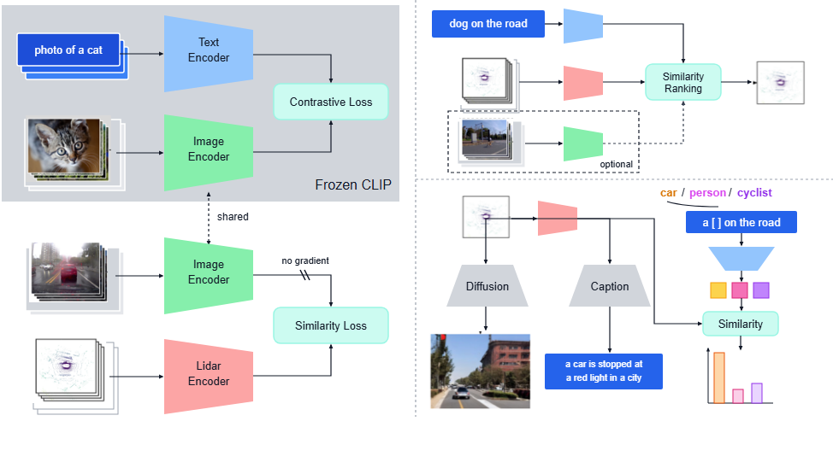
Notes:
Measuring the similarity between the lidar embedding and text embeddings yields zero-shot classification scores across target categories.
[Progressive Reveal · WACV_2024_set5_000054 · frame_15.png · 8.00s]

