Slide 1
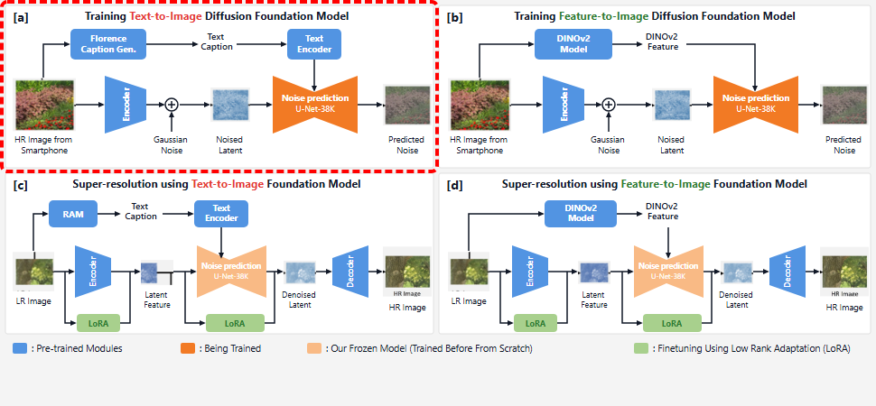
Notes:
Panel A illustrates the training pipeline for the text-to-image diffusion foundation model.
[Hopping Bbox · arch_arxiv_ai_2025_000000151 · frame_00.png · 0.50s]

Slide 2
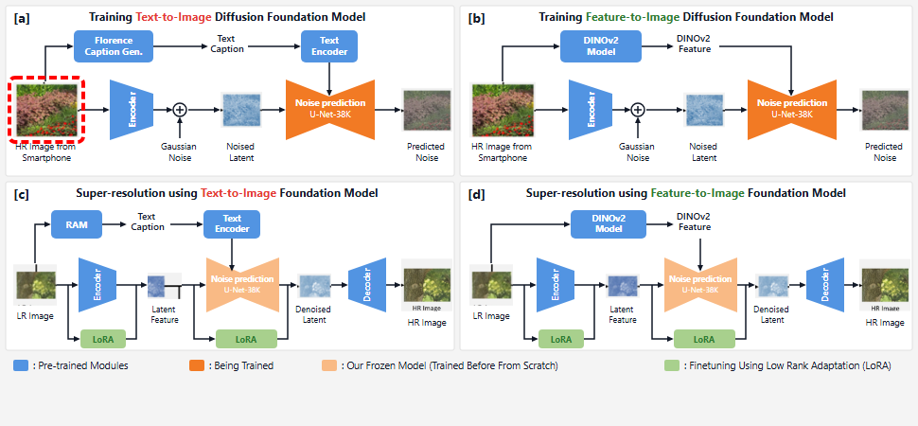
Notes:
High-resolution smartphone image patches serve as the training input.
[Hopping Bbox · arch_arxiv_ai_2025_000000151 · frame_01.png · 1.50s]

Slide 3
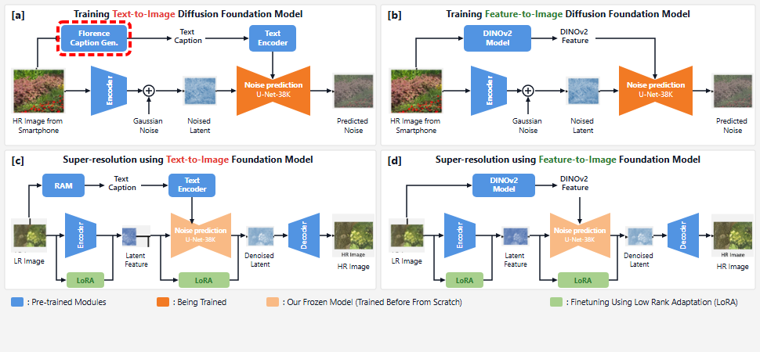
Notes:
The Florence caption generator extracts descriptive text from each patch.
[Hopping Bbox · arch_arxiv_ai_2025_000000151 · frame_02.png · 2.50s]

Slide 4
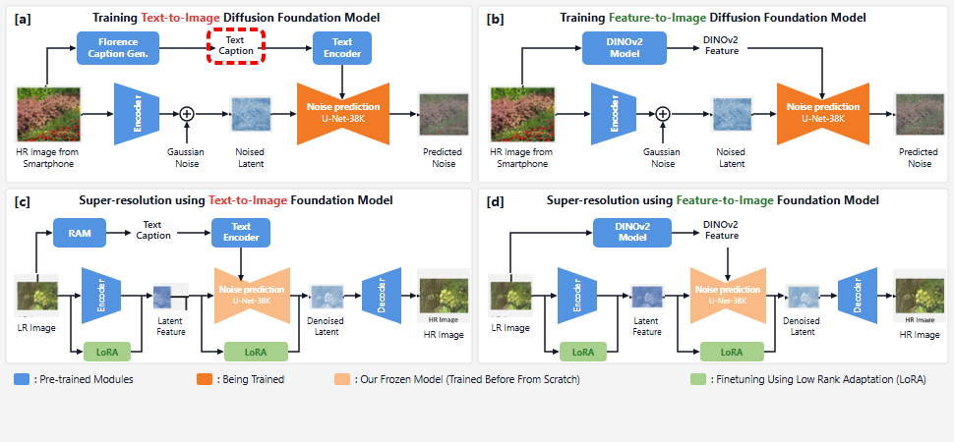
Notes:
This produces a text caption describing the patch content.
[Hopping Bbox · arch_arxiv_ai_2025_000000151 · frame_03.png · 3.50s]

Slide 5
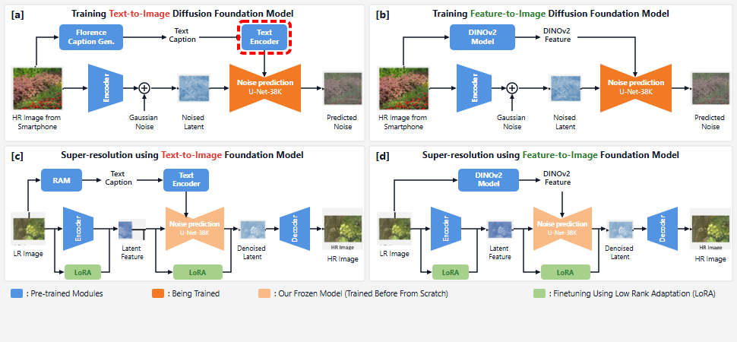
Notes:
A pretrained text encoder embeds the caption to provide semantic conditioning.
[Hopping Bbox · arch_arxiv_ai_2025_000000151 · frame_04.png · 4.50s]

Slide 6
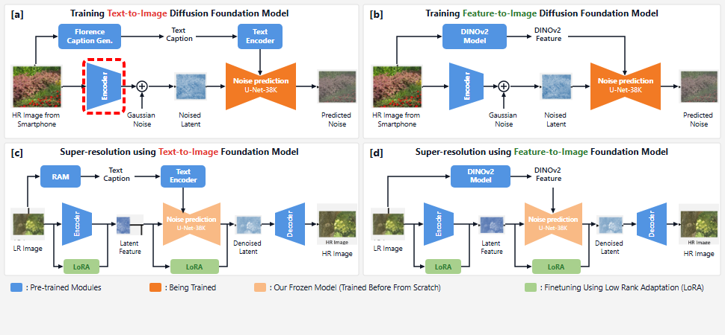
Notes:
In parallel, a pretrained image encoder maps the high-resolution patch into latent space.
[Hopping Bbox · arch_arxiv_ai_2025_000000151 · frame_05.png · 5.50s]

Slide 7
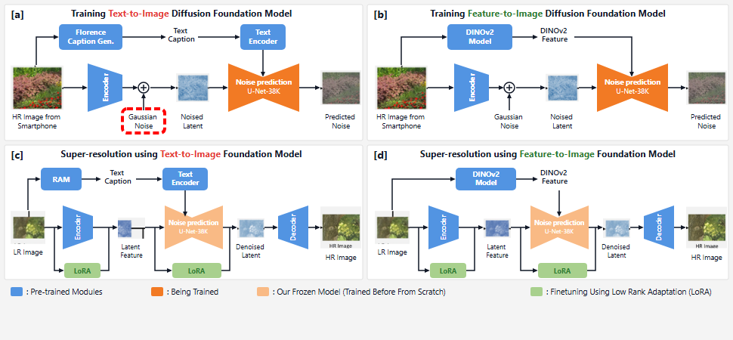
Notes:
Gaussian noise is introduced during the forward diffusion process.
[Hopping Bbox · arch_arxiv_ai_2025_000000151 · frame_06.png · 6.50s]

Slide 8
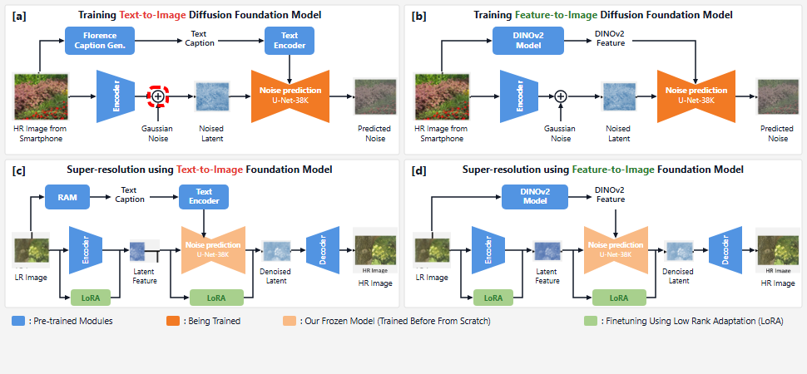
Notes:
These are added and carried forward.
[Hopping Bbox · arch_arxiv_ai_2025_000000151 · frame_07.png · 7.50s]

Slide 9
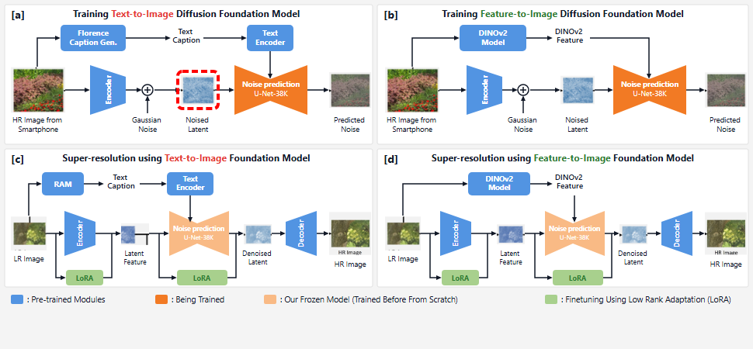
Notes:
This creates the noised latent representation.
[Hopping Bbox · arch_arxiv_ai_2025_000000151 · frame_08.png · 8.50s]

Slide 10
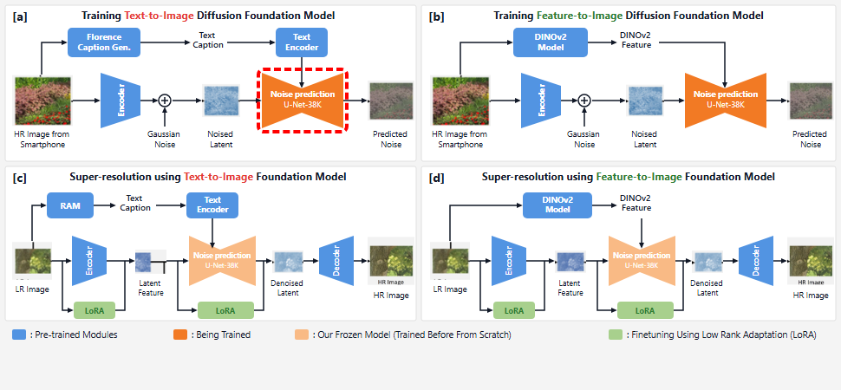
Notes:
A diffusion U-Net is trained from scratch on 38,000 images conditioned on the text embeddings.
[Hopping Bbox · arch_arxiv_ai_2025_000000151 · frame_09.png · 9.50s]

Slide 11
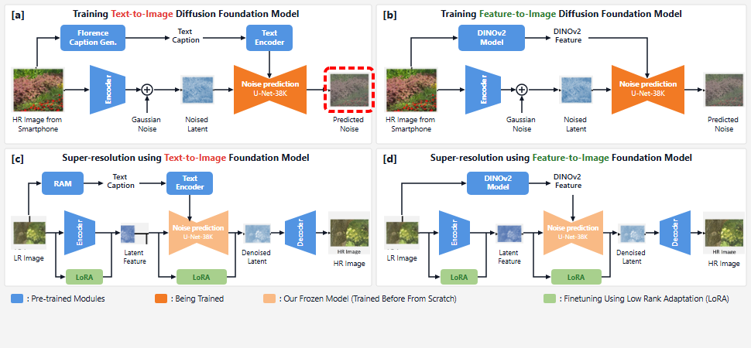
Notes:
The network outputs the predicted noise to optimize diffusion training.
[Hopping Bbox · arch_arxiv_ai_2025_000000151 · frame_10.png · 10.50s]

Slide 12
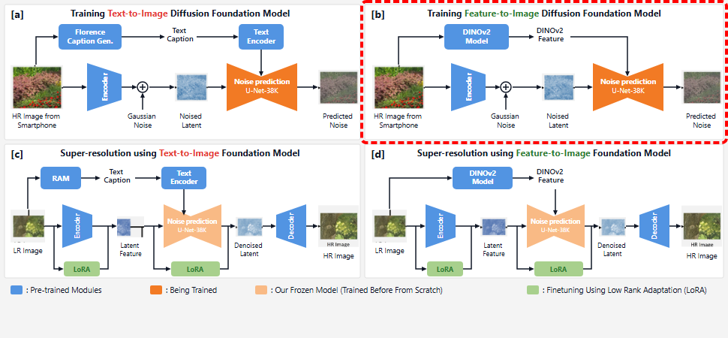
Notes:
Panel B presents the proposed feature-to-image foundation model training framework.
[Hopping Bbox · arch_arxiv_ai_2025_000000151 · frame_11.png · 11.50s]

Slide 13
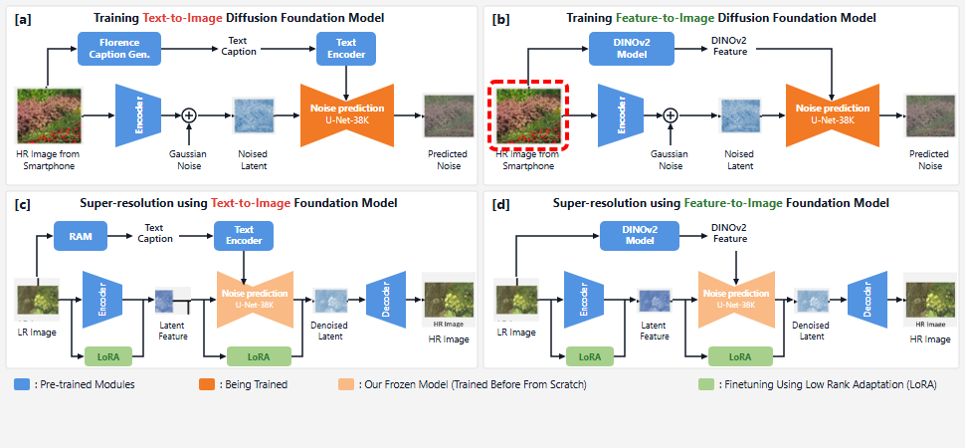
Notes:
The same high-resolution smartphone dataset provides the input patches.
[Hopping Bbox · arch_arxiv_ai_2025_000000151 · frame_12.png · 12.50s]

Slide 14
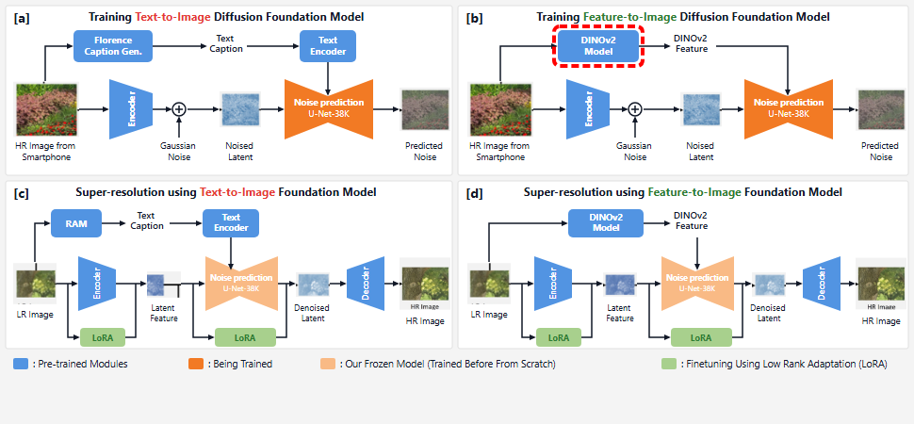
Notes:
A pretrained DINOv2 vision transformer extracts dense visual representations on the fly.
[Hopping Bbox · arch_arxiv_ai_2025_000000151 · frame_13.png · 13.50s]

Slide 15
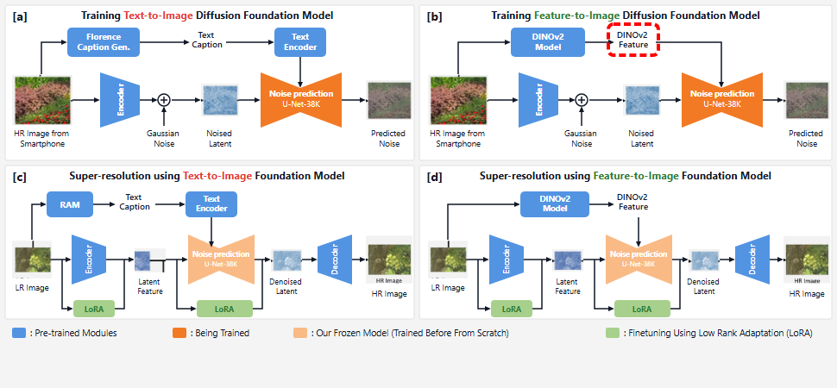
Notes:
These low-level DINOv2 features provide rich, hallucination-resistant spatial conditioning.
[Hopping Bbox · arch_arxiv_ai_2025_000000151 · frame_14.png · 14.50s]

Slide 16
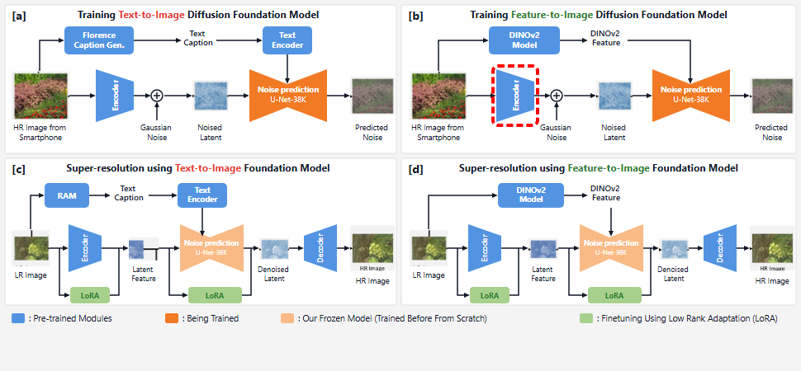
Notes:
The image is encoded into latent space by the pretrained encoder.
[Hopping Bbox · arch_arxiv_ai_2025_000000151 · frame_15.png · 15.50s]

Slide 17
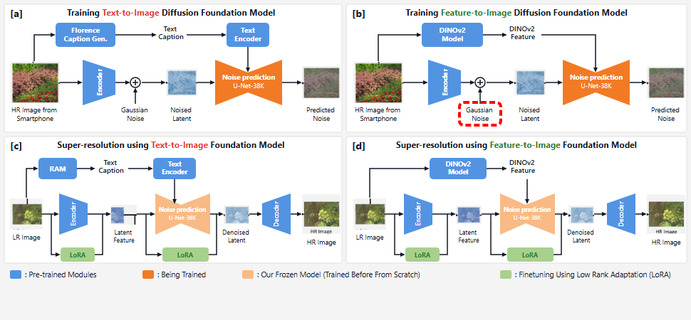
Notes:
Gaussian noise is added to the latent representation.
[Hopping Bbox · arch_arxiv_ai_2025_000000151 · frame_16.png · 16.50s]

Slide 18
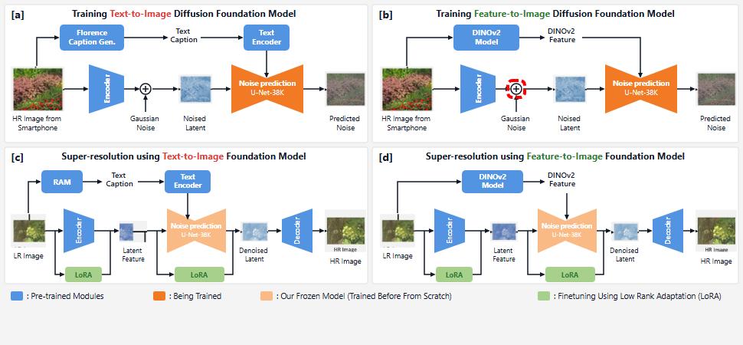
Notes:
These are added and carried forward.
[Hopping Bbox · arch_arxiv_ai_2025_000000151 · frame_17.png · 17.50s]

Slide 19
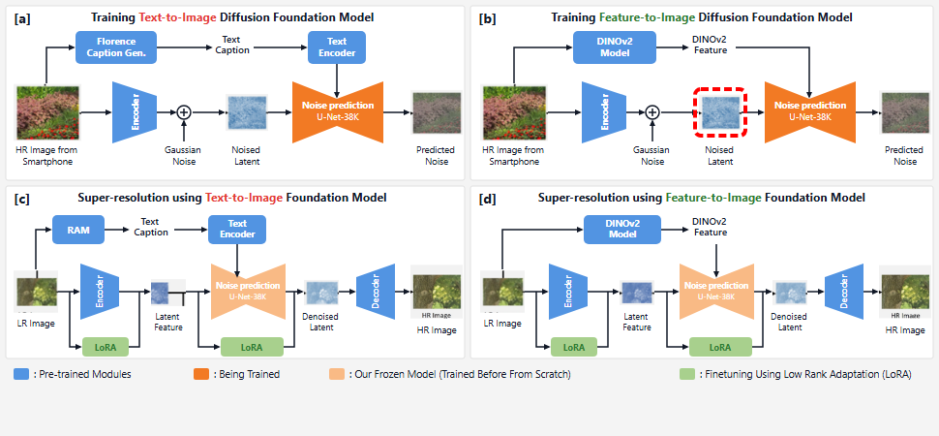
Notes:
This yields the noised latent vector.
[Hopping Bbox · arch_arxiv_ai_2025_000000151 · frame_18.png · 18.50s]

Slide 20
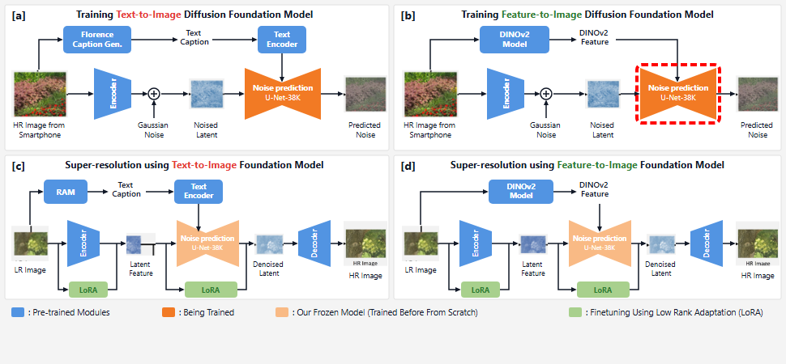
Notes:
The diffusion U-Net is trained from scratch with DINOv2 feature conditioning.
[Hopping Bbox · arch_arxiv_ai_2025_000000151 · frame_19.png · 19.50s]

Slide 21
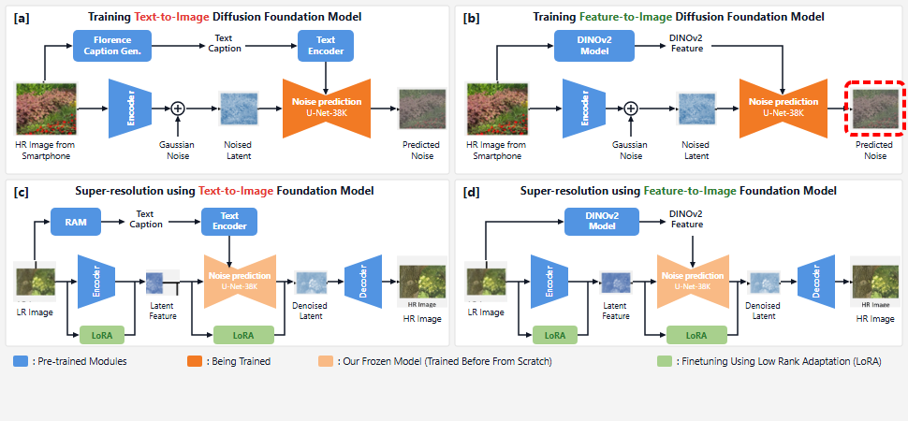
Notes:
It predicts the added noise, learning fine structural priors.
[Hopping Bbox · arch_arxiv_ai_2025_000000151 · frame_20.png · 20.50s]

Slide 22
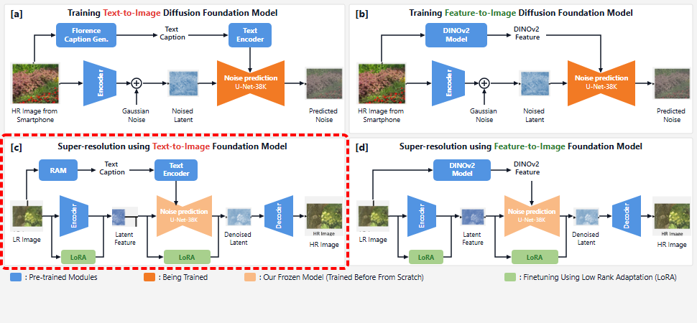
Notes:
Panel C shows single-image super-resolution adaptation using the text-to-image foundation model.
[Hopping Bbox · arch_arxiv_ai_2025_000000151 · frame_21.png · 21.50s]

Slide 23
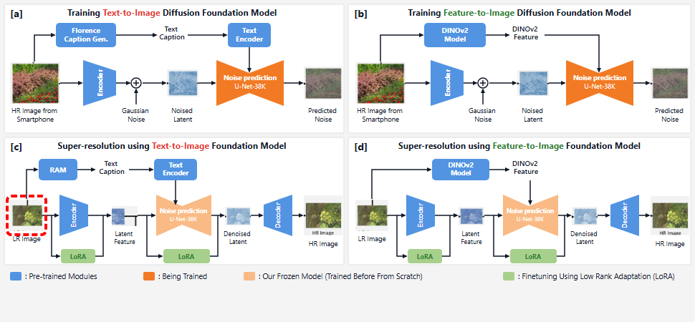
Notes:
A low-resolution input image is fed into the system.
[Hopping Bbox · arch_arxiv_ai_2025_000000151 · frame_22.png · 22.50s]

Slide 24
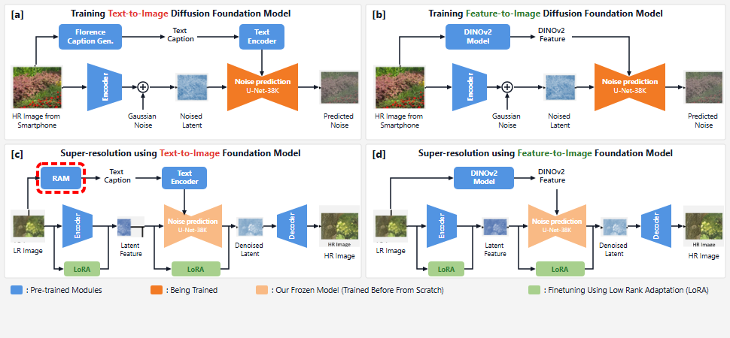
Notes:
The RAM captioning module generates descriptive text tags for the image.
[Hopping Bbox · arch_arxiv_ai_2025_000000151 · frame_23.png · 23.50s]

Slide 25
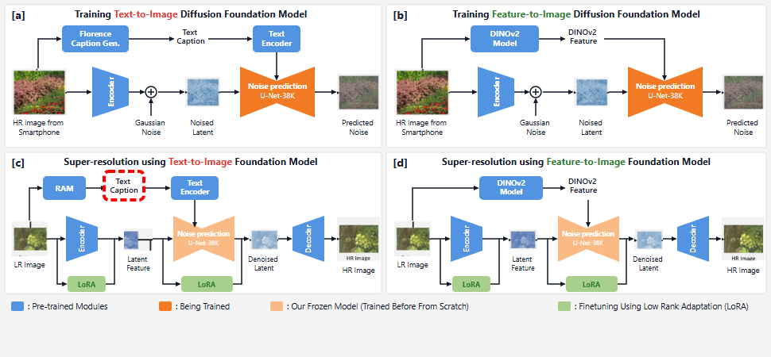
Notes:
The descriptive caption is fed to the text encoder.
[Hopping Bbox · arch_arxiv_ai_2025_000000151 · frame_24.png · 24.50s]

Slide 26
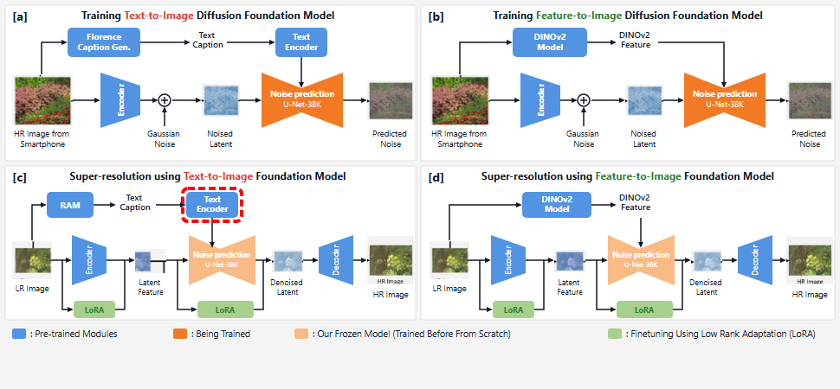
Notes:
The text encoder converts the caption into conditioning vectors.
[Hopping Bbox · arch_arxiv_ai_2025_000000151 · frame_25.png · 25.50s]

Slide 27
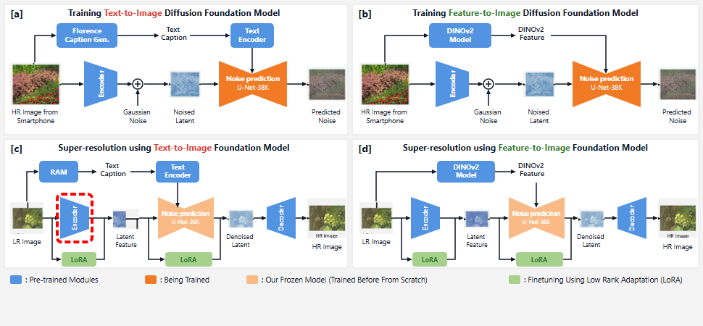
Notes:
The image encoder maps the low-resolution input into latent space.
[Hopping Bbox · arch_arxiv_ai_2025_000000151 · frame_26.png · 26.50s]

Slide 28
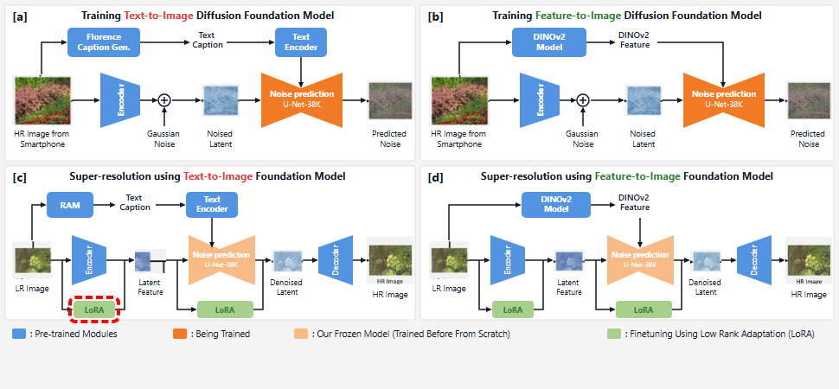
Notes:
Low-rank adaptation fine-tunes the encoder for super-resolution.
[Hopping Bbox · arch_arxiv_ai_2025_000000151 · frame_27.png · 27.50s]

Slide 29
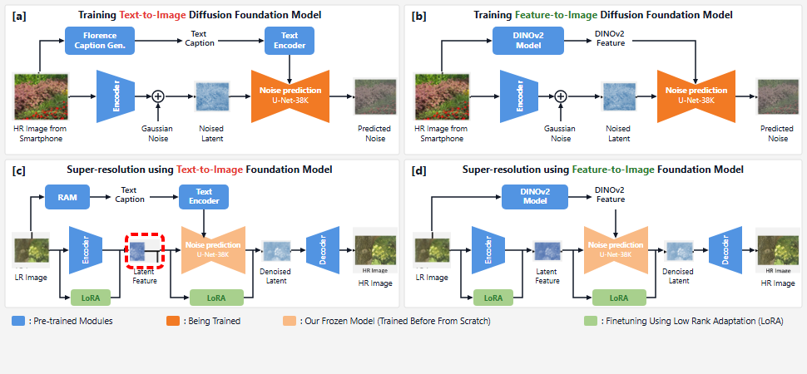
Notes:
The resulting latent feature is passed to the diffusion backbone.
[Hopping Bbox · arch_arxiv_ai_2025_000000151 · frame_28.png · 28.50s]

Slide 30
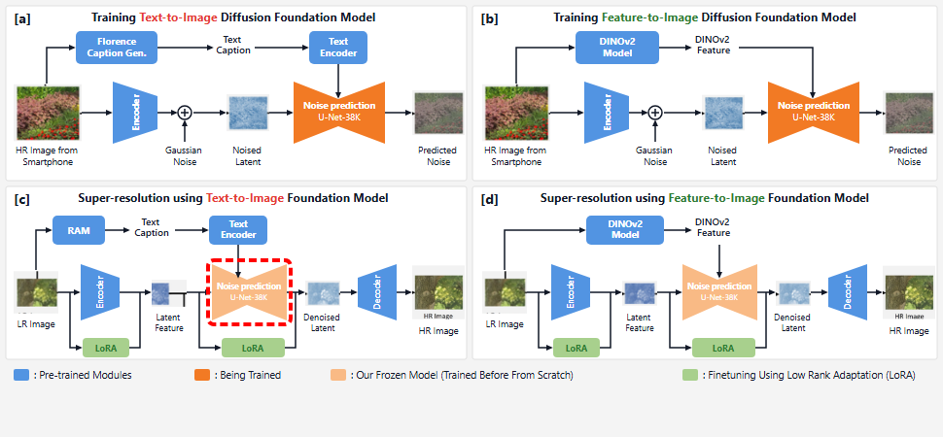
Notes:
The previously trained diffusion U-Net is frozen.
[Hopping Bbox · arch_arxiv_ai_2025_000000151 · frame_29.png · 29.50s]

Slide 31
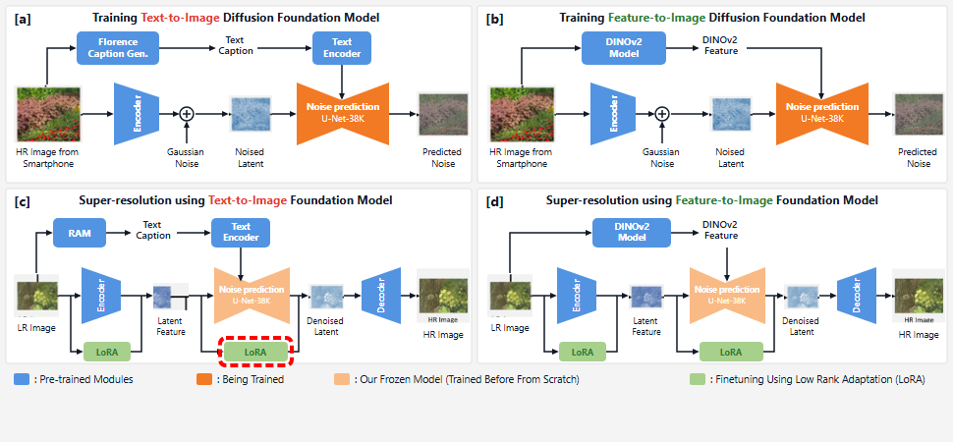
Notes:
LoRA layers adapt the U-Net for single-step restoration.
[Hopping Bbox · arch_arxiv_ai_2025_000000151 · frame_30.png · 30.50s]

Slide 32
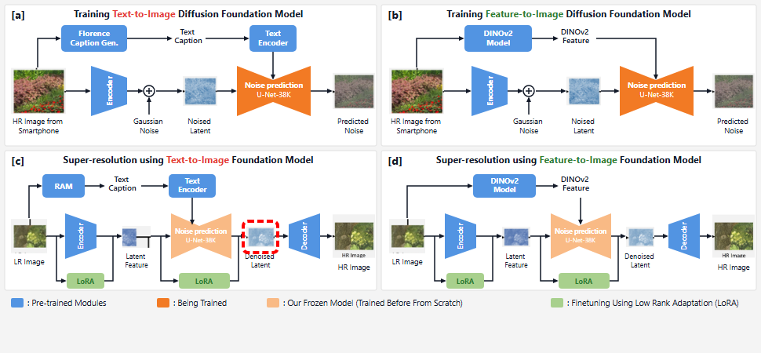
Notes:
A denoised latent feature is reconstructed.
[Hopping Bbox · arch_arxiv_ai_2025_000000151 · frame_31.png · 31.50s]

Slide 33

Notes:
The pretrained decoder maps the latent feature back to pixel space.
[Hopping Bbox · arch_arxiv_ai_2025_000000151 · frame_32.png · 32.50s]

Slide 34
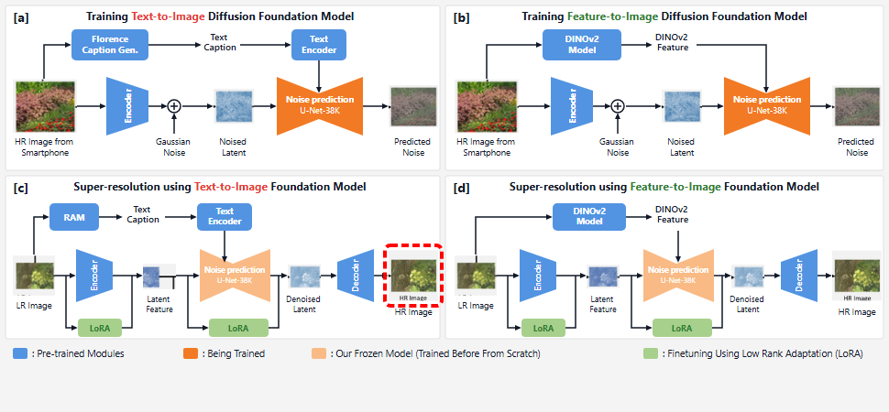
Notes:
This generates the super-resolved high-resolution output image.
[Hopping Bbox · arch_arxiv_ai_2025_000000151 · frame_33.png · 33.50s]

Slide 35
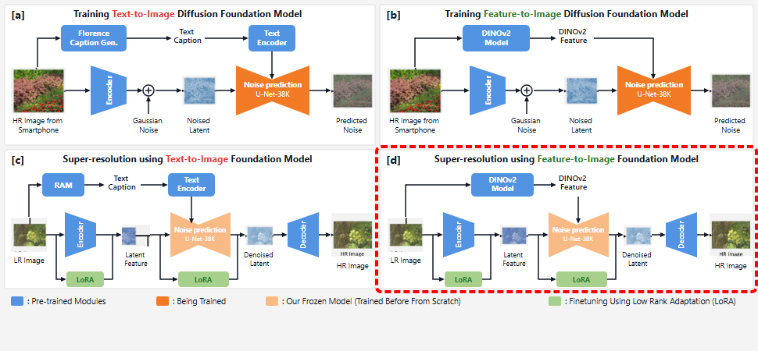
Notes:
Panel D demonstrates super-resolution leveraging the feature-to-image foundation model.
[Hopping Bbox · arch_arxiv_ai_2025_000000151 · frame_34.png · 34.50s]

Slide 36
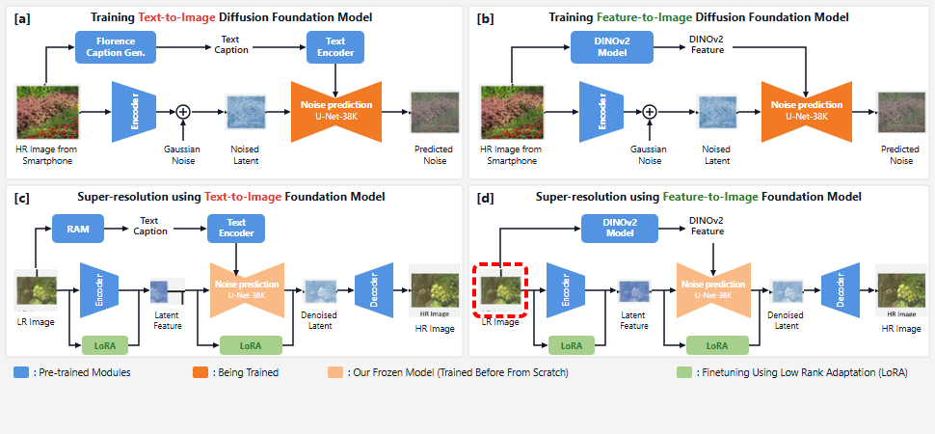
Notes:
The low-resolution input image is provided to the pipeline.
[Hopping Bbox · arch_arxiv_ai_2025_000000151 · frame_35.png · 35.50s]

Slide 37
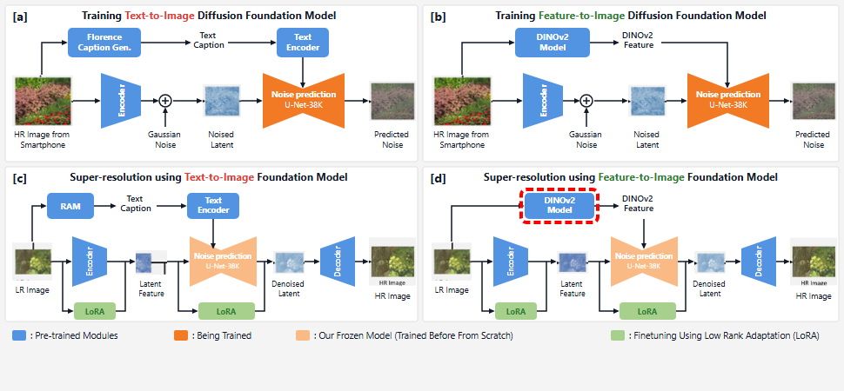
Notes:
The frozen DINOv2 model processes the low-resolution image directly.
[Hopping Bbox · arch_arxiv_ai_2025_000000151 · frame_36.png · 36.50s]

Slide 38
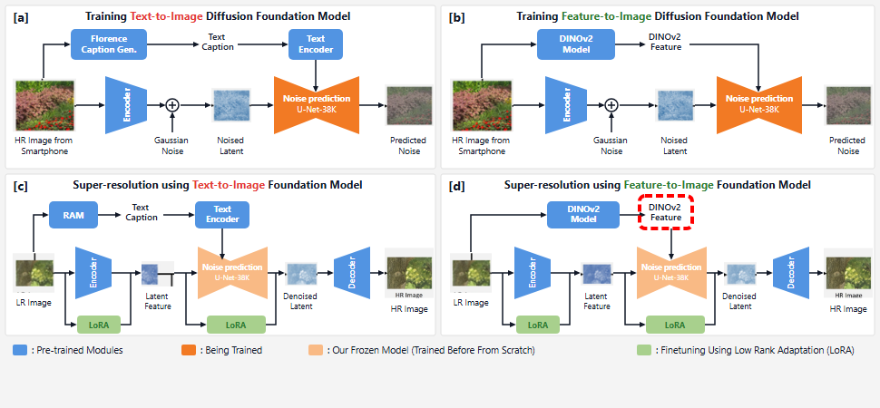
Notes:
It produces detailed visual features that closely match high-resolution references.
[Hopping Bbox · arch_arxiv_ai_2025_000000151 · frame_37.png · 37.50s]

Slide 39
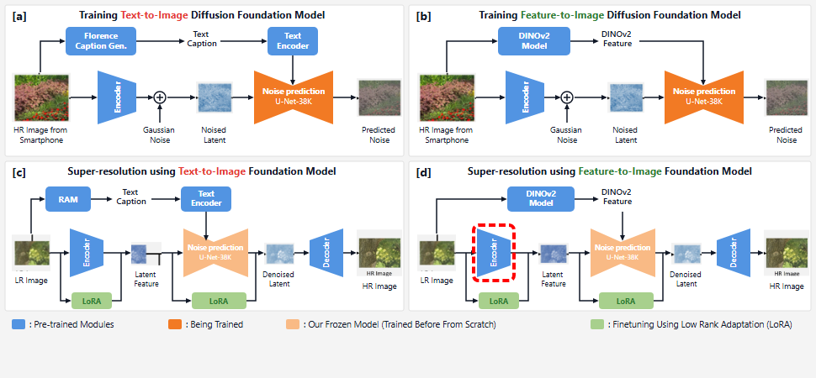
Notes:
The low-resolution image is concurrently passed to the latent encoder.
[Hopping Bbox · arch_arxiv_ai_2025_000000151 · frame_38.png · 38.50s]

Slide 40
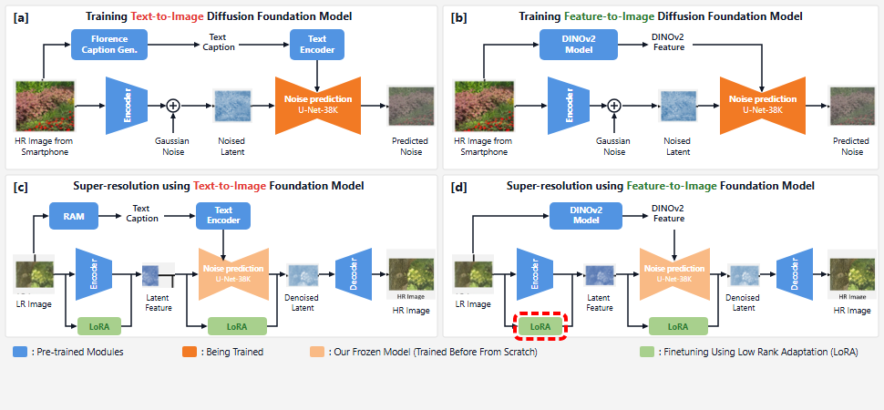
Notes:
Encoder LoRA parameters are optimized during fine-tuning.
[Hopping Bbox · arch_arxiv_ai_2025_000000151 · frame_39.png · 39.50s]

Slide 41
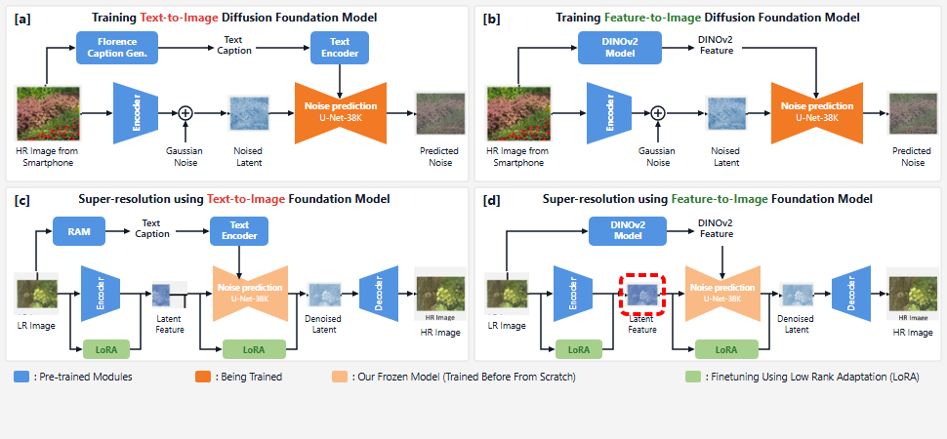
Notes:
The latent representation is fed to the diffusion backbone.
[Hopping Bbox · arch_arxiv_ai_2025_000000151 · frame_40.png · 40.50s]

Slide 42
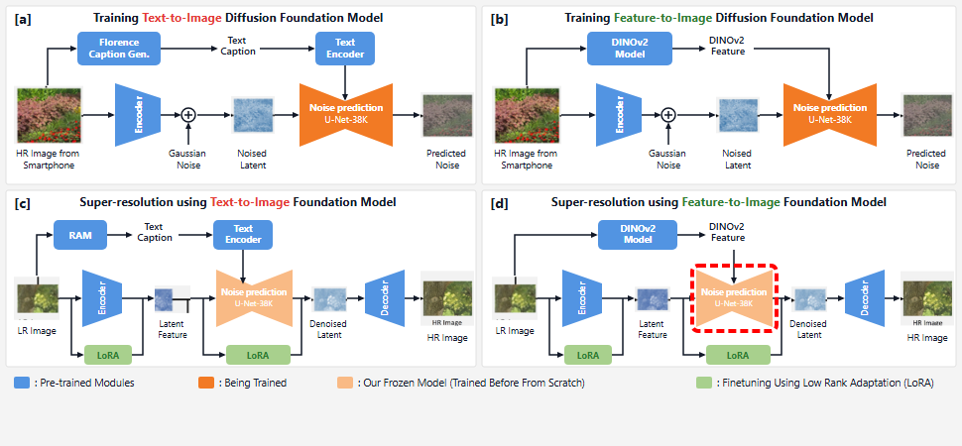
Notes:
The frozen U-Net guides generative synthesis based on DINOv2 conditioning.
[Hopping Bbox · arch_arxiv_ai_2025_000000151 · frame_41.png · 41.50s]

Slide 43
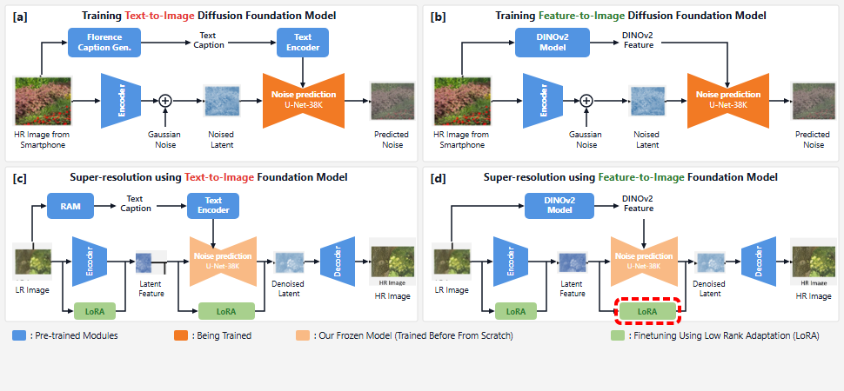
Notes:
LoRA weights adapt the U-Net for single-step restoration.
[Hopping Bbox · arch_arxiv_ai_2025_000000151 · frame_42.png · 42.50s]

Slide 44
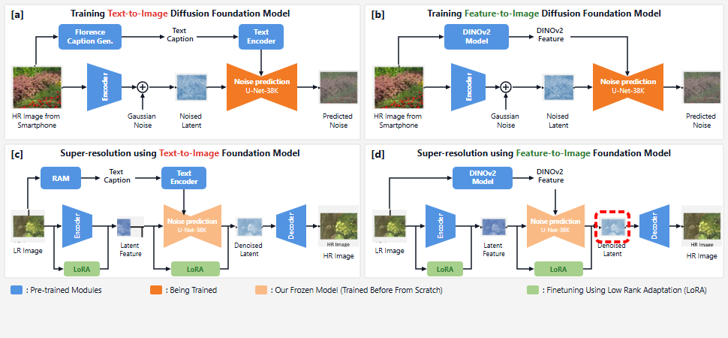
Notes:
A high-fidelity denoised latent is predicted.
[Hopping Bbox · arch_arxiv_ai_2025_000000151 · frame_43.png · 43.50s]

Slide 45

Notes:
The pretrained decoder converts the latent back into image space.
[Hopping Bbox · arch_arxiv_ai_2025_000000151 · frame_44.png · 44.50s]

Slide 46
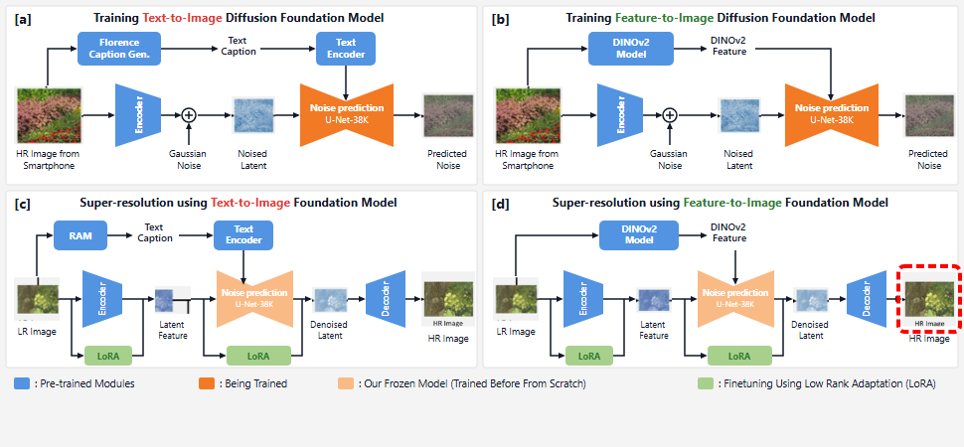
Notes:
Producing a super-resolved image with natural textures and minimal artifacts.
[Hopping Bbox · arch_arxiv_ai_2025_000000151 · frame_45.png · 45.50s]

