Slide 1
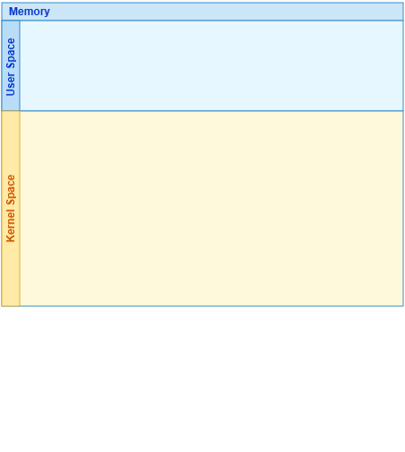
Notes:
The memory architecture is divided into User Space and Kernel Space.
[Progressive Reveal · arch_arxiv_db_ir_2026_000000718 · frame_00.png · 0.50s]

Slide 2
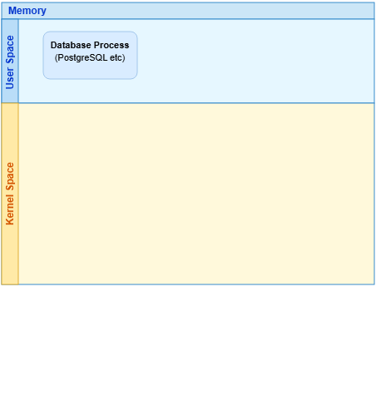
Notes:
In User Space, execution begins at the Database Process.
[Progressive Reveal · arch_arxiv_db_ir_2026_000000718 · frame_01.png · 1.00s]

Slide 3
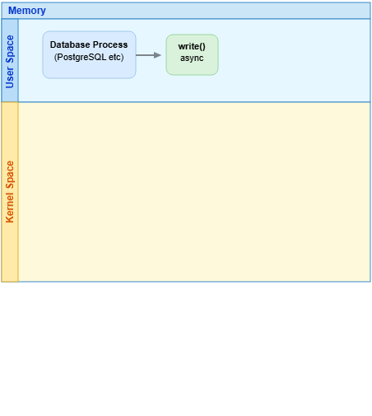
Notes:
The process initiates an asynchronous write call.
[Progressive Reveal · arch_arxiv_db_ir_2026_000000718 · frame_02.png · 1.50s]

Slide 4
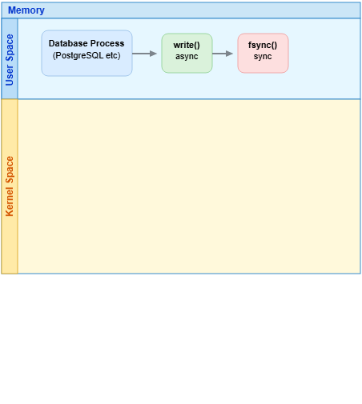
Notes:
This is followed by a synchronous fsync operation.
[Progressive Reveal · arch_arxiv_db_ir_2026_000000718 · frame_03.png · 2.00s]

Slide 5
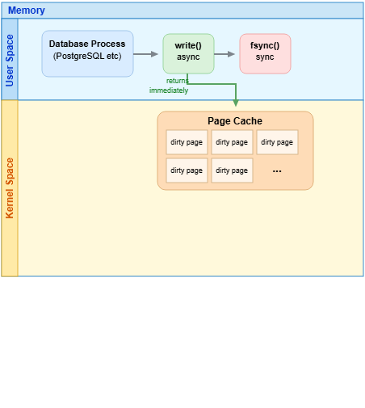
Notes:
The write call routes into the Page Cache within Kernel Space and returns immediately, creating dirty pages.
[Progressive Reveal · arch_arxiv_db_ir_2026_000000718 · frame_04.png · 2.50s]

Slide 6
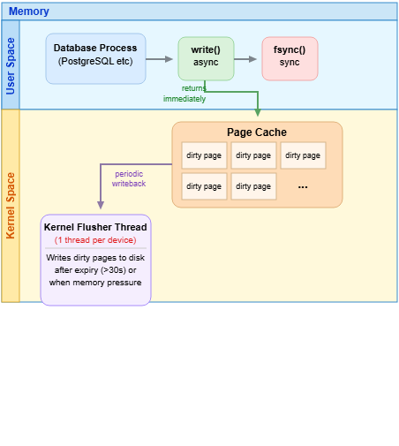
Notes:
The Kernel Flusher Thread periodically handles writebacks from the Page Cache.
[Progressive Reveal · arch_arxiv_db_ir_2026_000000718 · frame_05.png · 3.00s]

Slide 7
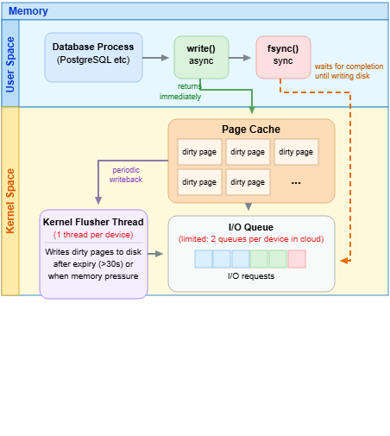
Notes:
Requests pass into the I/O Queue, while fsync waits for disk completion.
[Progressive Reveal · arch_arxiv_db_ir_2026_000000718 · frame_06.png · 3.50s]

Slide 8
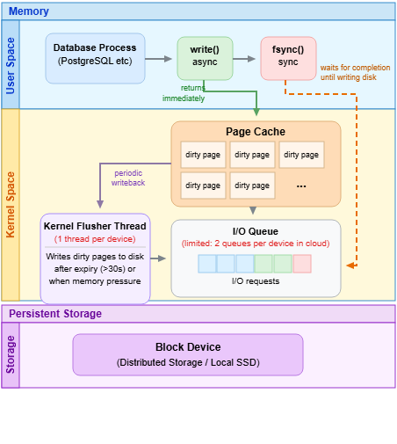
Notes:
At the bottom is Persistent Storage, containing the Block Device.
[Progressive Reveal · arch_arxiv_db_ir_2026_000000718 · frame_07.png · 4.00s]

Slide 9
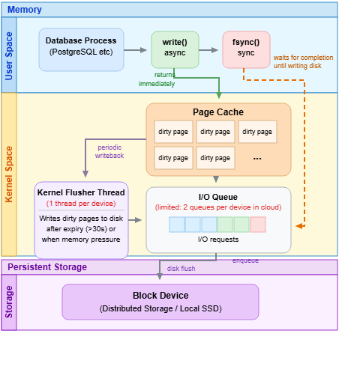
Notes:
Finally, enqueued operations are flushed from the I/O Queue down to the Block Device.
[Progressive Reveal · arch_arxiv_db_ir_2026_000000718 · frame_08.png · 4.50s]

