Slide 1
Problem Statement:-
Track a bed:
We can create a customised android, web application using maps to track the nearby hospitals around us which will be connected to the hospital’s database which will give information about the availability of the beds and facilities in that particular hospital.

Slide 2
Introduction and Approach to the problem:-
According to the problem it is asked to make an application either web or app. The application should be able to detect nearby hospitals and display number of beds available in those hospitals and facilities that are being provided by the hospital.
To achieve this objective we are going to develop an android app. So the basic idea for the challenge is that we are using Google cloud Places API to look for nearest hospitals around the user. These hospitals appear as markers on the maps Android application. It is necessary for a hospital to first be affiliated with the app, i.e. , they need to register to the service using their unique login details. Hospital management can also signup by providing name of the hospital, their unique email Id and password and a pin that will be provided to them. This is done to make sure that the search results include hospitals that actually have COVID care available instead of just putting all the hospitals out there. This will also ensure easy database entry, i.e. , we can easily enter the available bed information as well as other facilities. To differentiate between markers we are using three colours: red, blue and green. A marker is red when a hospital isn't registered but is still in the vicinity, a marker is yellow when the hospital doesn't have beds and facilities available and a marker is green if it has beds and facilities.

Slide 3
Implementation and Results:-
To implement this problem and make an android app we have used flutter. First we have defined three bottom navigation bar which is fixed that is Home, Maps and Profile. Initially when app runs then Home will be opened automatically. When Home is opened then all the nearby hospitals will be displayed with number of beds and facilities available in that hospital. Hospitals shown in yellow colour are the hospitals which doesn’t have beds and green colour shows that beds are available in that hospital.

Slide 4
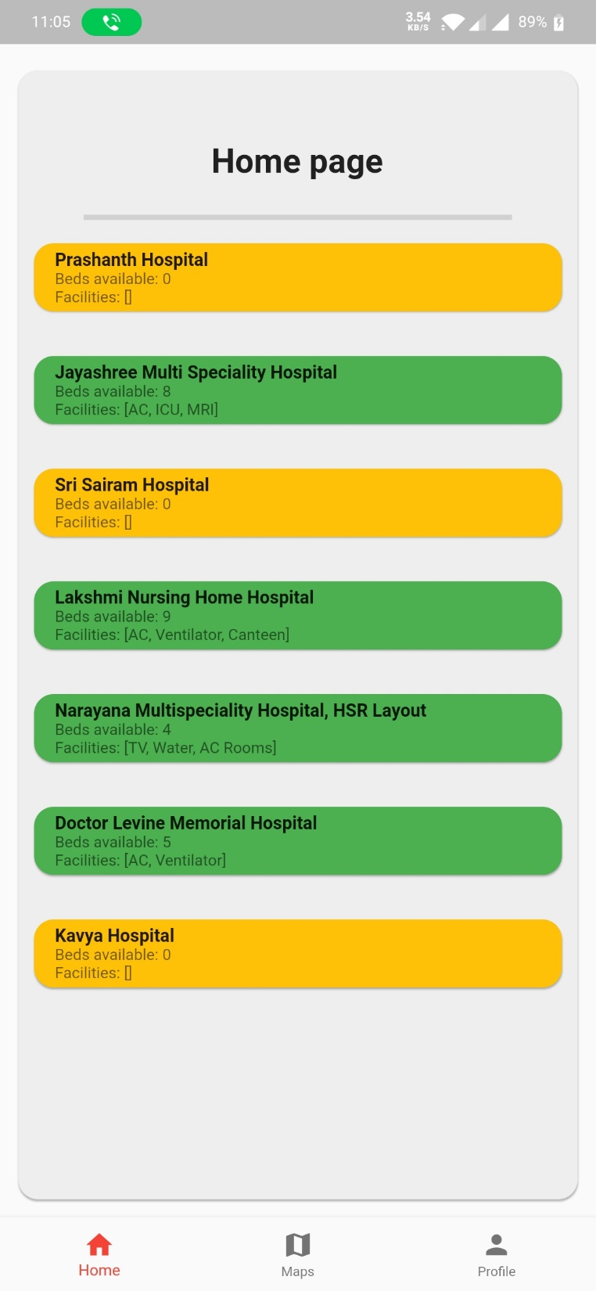

Slide 5
When Maps is opened then a google map will be displayed with current location and hospitals nearby. Nearby hospitals which are not registered in our app but are there in nearby location will be displayed in red colour marker and registered will be displayed in green or yellow colour marker based on the number of beds in the hospital. When registered hospitals marker is clicked then number of beds and facilities will be displayed and if non registered hospital is selected then its latitude and longitude will be displayed. After selecting the marker you can also direct to google maps for direction to that selected marker.

Slide 6
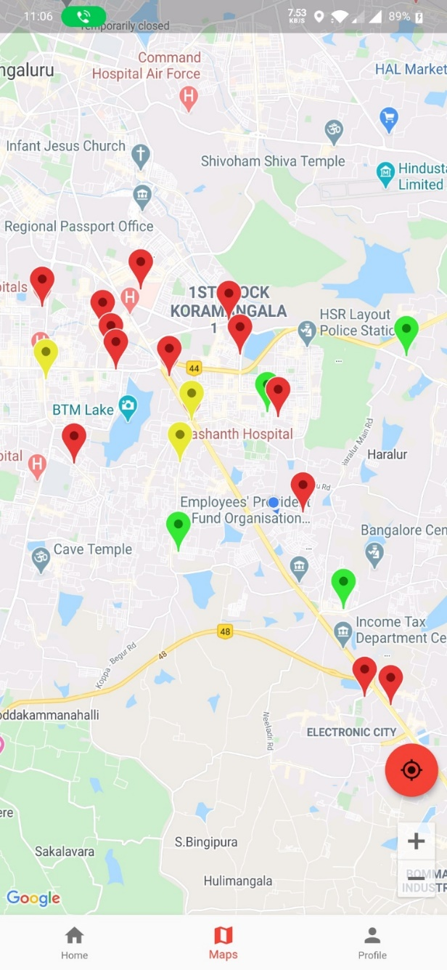
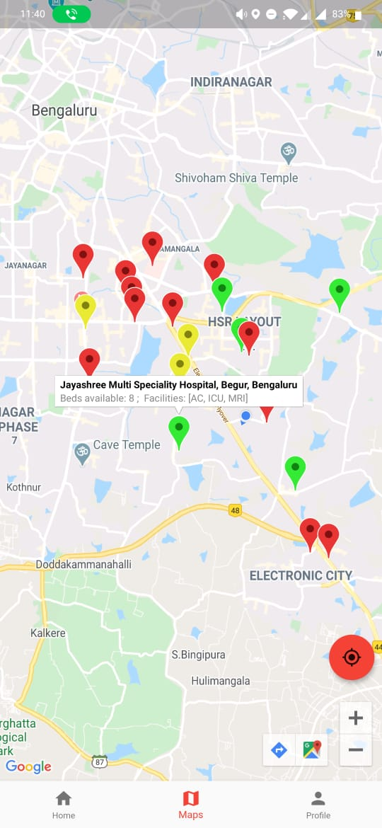
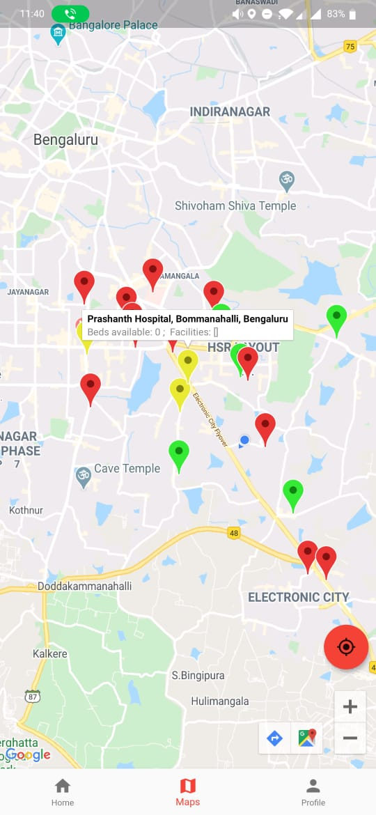
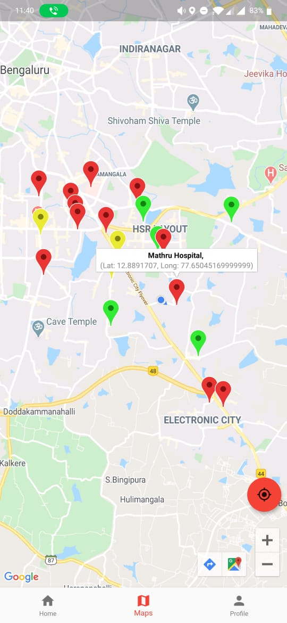

Slide 7
When Profile is opened then login page will be displayed where it will ask the user to enter email id and password. If they want to sign up then they can select create an account option and then enter a valid hospital name, email id and password followed by a pin that will be used to validate the hospital in our app. Profile section is only for hospital management where they can login or register and give information about number of beds and facilities. After login they can edit there hospital information in the edit screen by clicking on the edit button. Using the human symbol on the top right corner we can sign out.

Slide 8
