Slide 1
Hardware- Heat Sinks and Graphic Cards
Peter Gomes
Seth Charron
Cameron Lewis

Slide 2

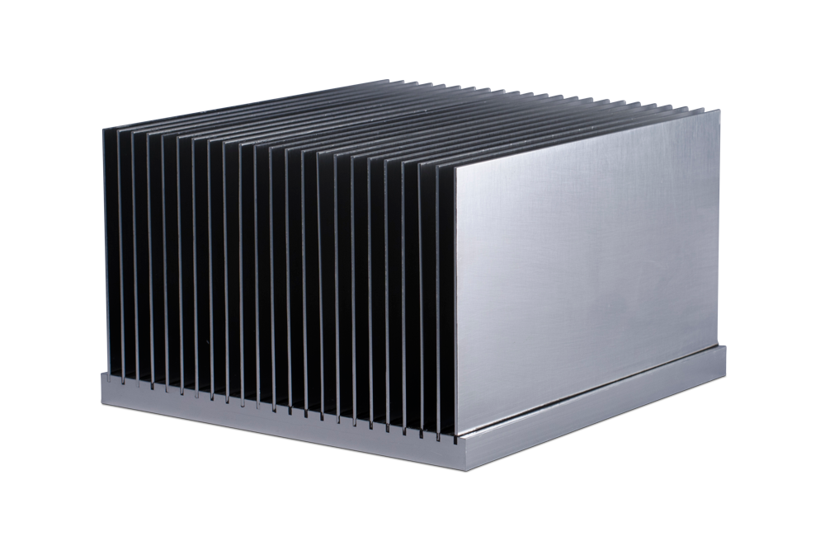
Heat Sinks: What Are They?
Hardware that regulates heat in a computer.
Use “fins”.
Spread heat over a larger area.
Generally in a HSF combination.
Passive and active heat sinks.

Slide 3
Heat Sinks: The Cost
Range from $1 to $402,000.
Price varies by quality and/or surface area.

Slide 4
Buying the Perfect heat sink
Higher the temperature is, more surface area.
Make sure material is highly thermal conductive.
If possible, check heat sink spec sheets.

Slide 5




Where Should I get A Heat Sink?
Best Buy
Amazon
Mouser Electronics

Slide 6
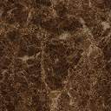
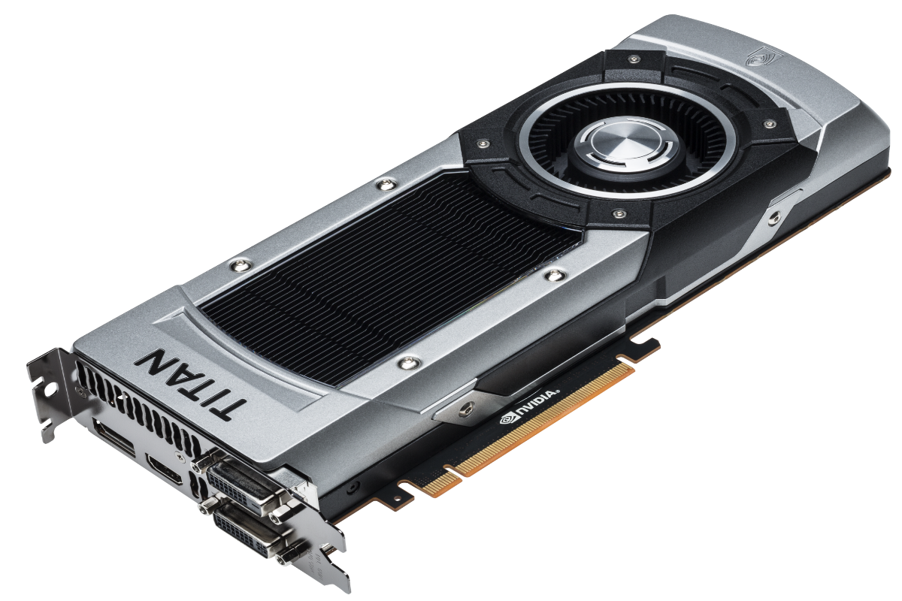
Graphic Cards

Slide 7
Graphics Cards
PCBs that sends pixels using GPU.
Perform Hardware Transform and Lighting.
Common attachments for motherboards.
Processor, video memory, RAMDAC, and the driver software.
Display video game graphics and essential for textures and realism.

Slide 8
Graphics Card Cost
Less than $100 to more than $500
Reasons For Cost:
Triangles per second.
Texture fill rate.
Shader core.
GPU clock speed.

Slide 9




Places To Get Graphic Cards
Amazon
New Egg
Staples
Tiger Direct

Slide 10

This has been our presentation.
Thank you for your time.

