Slide 1
Minimizing Business impact during server/network outage.
The Great Gatsby

Slide 2
CONTENTS :
Why? Why did we choose this problem?
How? How could we solve it?
What? What did we do?

Slide 3
Why?
High impact on business due to network constraints.
Loss of business during downtimes.
Every delivery delayed is a potential loss.
Tier II & Tier III cities still are uncharted.

Slide 4
Problem?
( Downtime = No Orders = Business Loss = REALLY BAD )

Slide 5
How?
Decentralized contingency plan for network outage.
Shadow network dependency on service instance.
SMS communication in case mobile network fails.
State is maintained and transferred when server comes back online.

Slide 6
What?

Slide 7



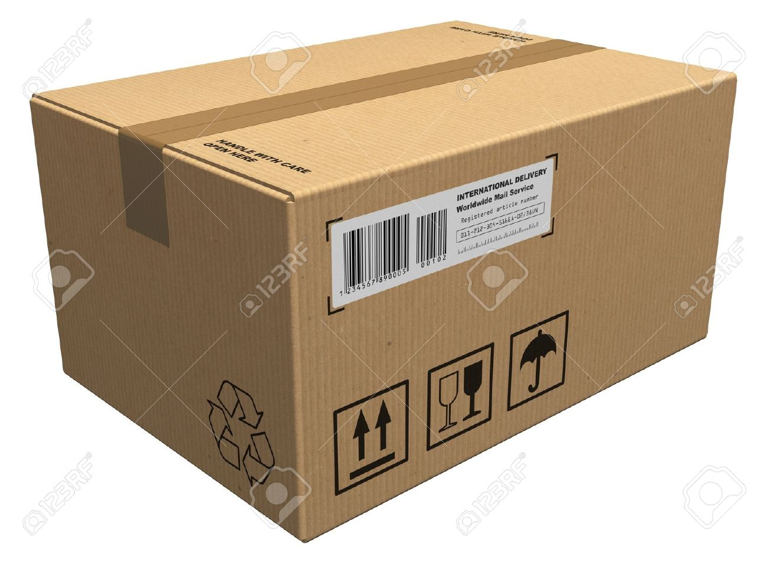
IDEAL PHASE
Oblivion
Instance
Minion
MegaMind
Minion
Merchants
Minion

Slide 8

N/W OUTAGE
Oblivion
Instance
Minion
MegaMind
Minion
Minion
Merchants

Slide 9
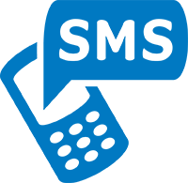
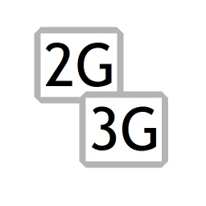

MegaMind activates
Oblivion
Instance
Minion
MegaMind
Minion
Merchants
Minion

Slide 10
Back to Normal State
Oblivion
Instance
Minion
MegaMind
Minion
Minion
Merchants

Slide 11
DEMO

