Slide 1
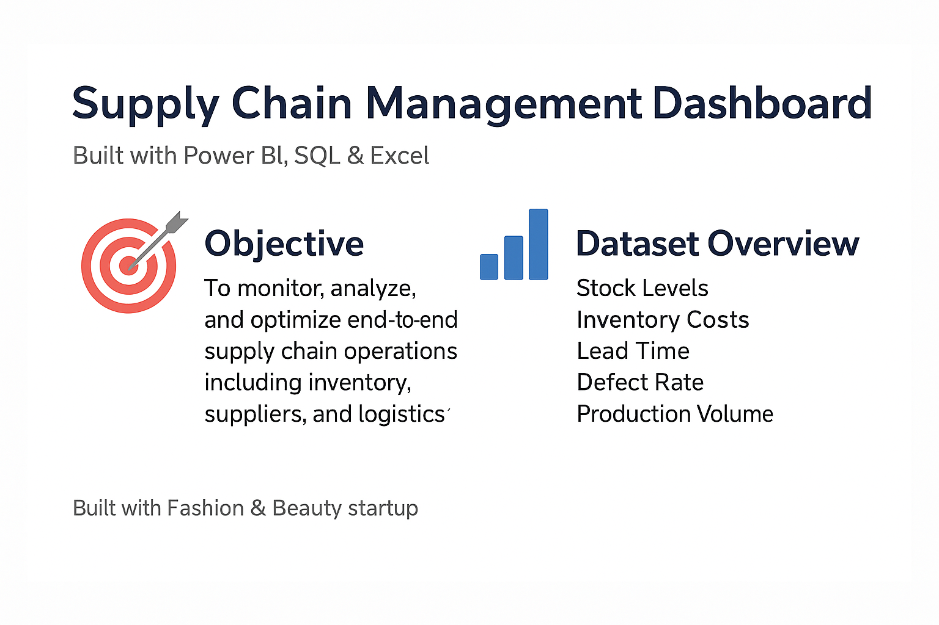

Slide 2
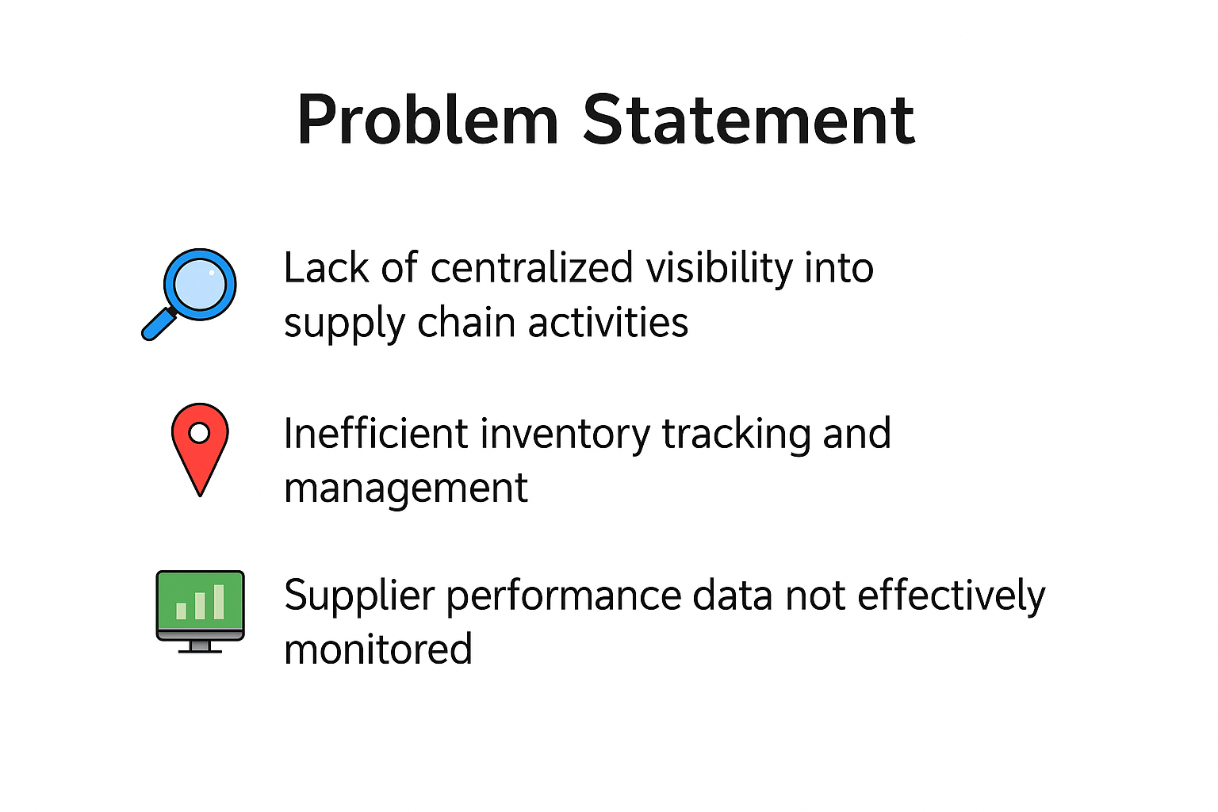

Slide 3
Project Goals
✅ Centralized Supply Chain Monitoring
✅ Optimize Operational Efficiency
✅ Data-Driven Supplier & Logistics Management
✅ Improve Decision-Making

Slide 4
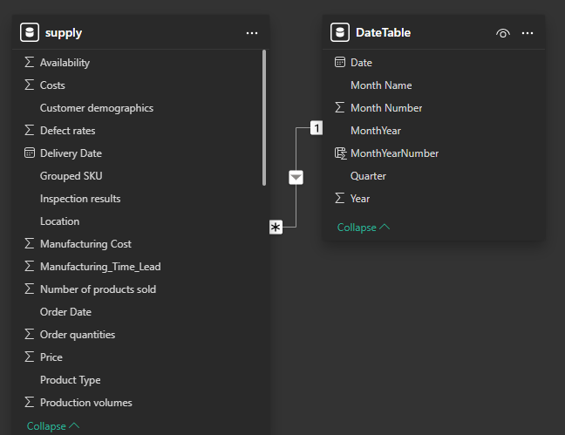
Data Integration & Modeling
Date Integration
This image shows a data model from a Power BI environment, with two tables: Financials and DateTable (Created Using DAX), connected via a relationship.
Data Model
A one-to-many relationship (1:*) from DateTable to Financials, connected on the Date column.
This means each date in the DateTable can map to many rows in the Financials table.
This model allows for accurate time-based analysis, such as grouping financial data by month or year, using the richer DateTable.

Slide 5
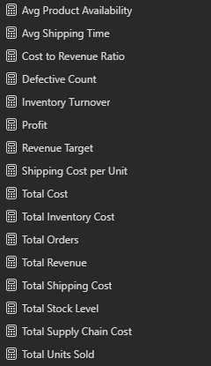
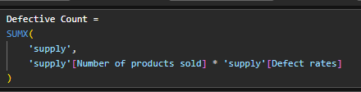
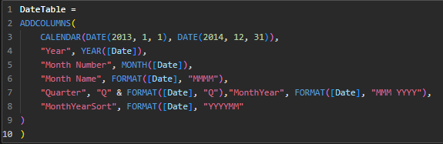
DAX Measures & Calculations
Defective Count
Measures Created
Avg Defect rate
Unit Sold
Inventory Turnover
Date Table using DAX

Slide 6
Interactive Dashboards
&
Visualizations

Slide 7
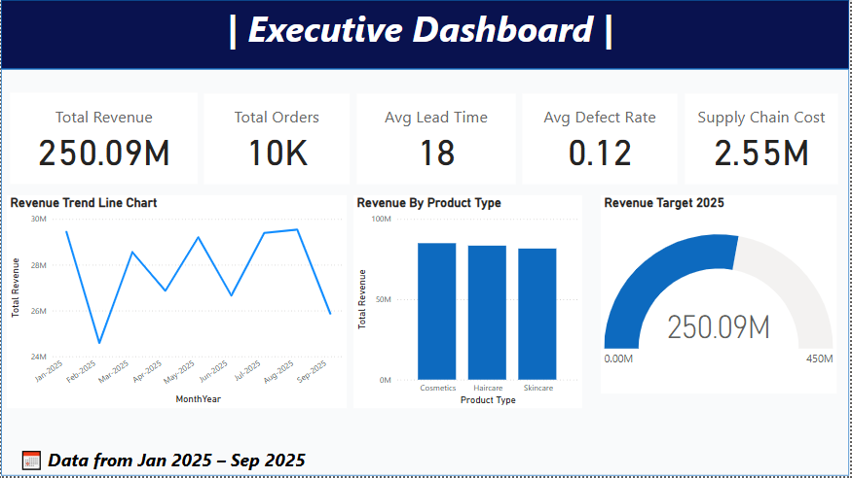

Slide 8
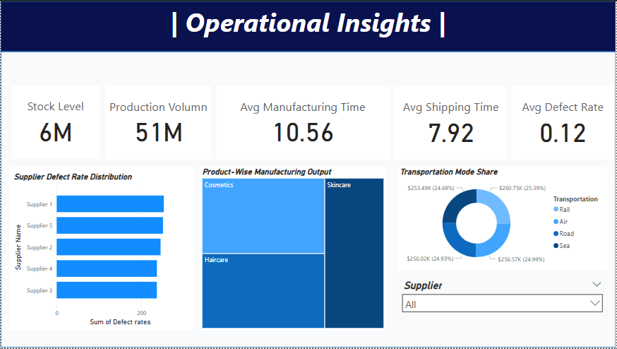

Slide 9
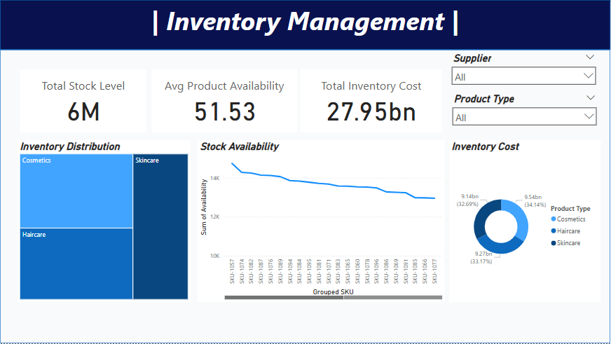

Slide 10
