Slide 1

Problem Statement
Business Contract Validation- To classify content within the Contract Clauses & to determine deviations from Template & highlight them
Submitted by:
Animesh Singh
Sahil Sahani
Satyakam Nayak
Intel Unnati Industrial Training Program- Summer 2024

Slide 2
Unique Idea Brief (Solution)
Our project, Business Contract Validation, offers an innovative solution for automatically classifying and highlighting deviations within contract clauses from a predefined template. Leveraging Natural Language Processing (NLP) and machine learning, our tool streamlines the review process for legal documents, ensuring compliance and mitigating risks associated with inappropriate or unfair contract terms. This solution is particularly beneficial for businesses and legal teams seeking to enhance efficiency and accuracy in contract management.

Slide 3
Features Offered
Automated PDF Text Extraction: Seamlessly extracts text from uploaded PDF contracts.
Named Entity Recognition (NER): Identifies and categorizes entities within the contract using SpaCy's NLP capabilities.
Clause Highlighting: Automatically detects and highlights inappropriate or non-compliant clauses within the contract text.
Base64 PDF Encoding: Provides an option to download the processed and highlighted contract in PDF format.
User-Friendly Interface: Simple and intuitive web interface for uploading contracts and viewing results.
Detailed Reporting: Generates detailed reports of identified entities and highlighted clauses for further review.

Slide 4
Process flow
User Uploads PDF: The user uploads a PDF contract through the web interface.
Text Extraction: The uploaded PDF is processed, and its text content is extracted using pdfplumber.
NER Processing: The extracted text is analyzed using SpaCy's NLP model to identify named entities.
Clause Detection: The text is scanned for predefined inappropriate clauses.
Highlighting: Inappropriate clauses are highlighted in the PDF, and named entities are listed.
Output Generation: The highlighted PDF and a detailed report are generated and provided to the user for download.

Slide 5
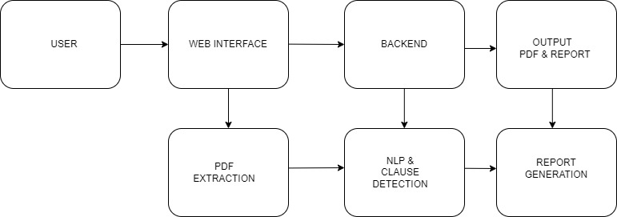
Architecture Diagram

Slide 6
Technologies used
Flask: For building the web application.
pdfplumber: For extracting text from PDF documents.
SpaCy: For performing Named Entity Recognition (NER).
ReportLab: For generating and highlighting PDFs.
HTML/CSS/JavaScript: For creating a user-friendly web interface.
Python: The primary programming language for implementing backend logic.

Slide 7
Team members and contribution:
Animesh Singh:
Implemented the Flask backend and integrated pdfplumber for text extraction.
Developed the logic for clause detection and highlighting using ReportLab.
Worked on the architecture design and overall project integration.
Sahil Sahani:
Integrated SpaCy for Named Entity Recognition (NER) and performed initial text processing.
Developed the user interface using HTML, CSS, and JavaScript.
Handled the front-end to back-end communication and data processing.
Satyakam Nayak:
Conducted extensive testing and debugging to ensure accuracy and reliability.
Assisted with the design and creation of the architecture diagram and process flow.
Contributed to the documentation and prepared presentation materials.

Slide 8
Conclusion
The Business Contract Validation tool revolutionizes contract management by automating the review process. Using advanced NLP and machine learning, it extracts text from PDFs, identifies key entities, and highlights non-compliant clauses, ensuring accuracy and compliance. This reduces human error and saves time, allowing legal teams to focus on strategic tasks. The tool’s features include automated text extraction, Named Entity Recognition, and clause highlighting, all accessible through a user-friendly web interface. Developed with Flask, pdfplumber, SpaCy, and ReportLab, it offers a robust and scalable solution. Our team's combined expertise ensured thorough development and testing, making this tool an indispensable asset for businesses and legal professionals.

