Slide 1
DATA ANALYTICS & MACHINE LEARNING PROJECT
Student Performance Analysis
& Academic Success Prediction
Student Name:
[TO BE FILLED]
Course:
[TO BE FILLED]
College / University:
[TO BE FILLED]
Academic Year:
[TO BE FILLED]
Instructor:
[TO BE FILLED]

Slide 2
Introduction
Student performance can be influenced by academic, demographic, social and behavioral factors.
Data analytics can reveal patterns within student performance data.
Machine learning can be used to develop predictive models.
This project analyzes student performance and predicts final mathematics grades.
G3
Final Mathematics Grade
(Prediction Target)
395 students • 33 variables
Student Performance Analysis & Academic Success Prediction
2

Slide 3
Problem Statement
Raw student data contains multiple academic, demographic, family, social and behavioral variables. These variables need to be analyzed to identify meaningful patterns associated with final academic performance.
"Can student characteristics be used to predict a student's final mathematics grade?"
Student Data
→
Analysis
→
Prediction
Student Performance Analysis & Academic Success Prediction
3

Slide 4
Project Objectives
Understand the student performance dataset
Clean and prepare the data
1
2
Analyze patterns associated with final grades
Examine study time, absences and previous failures
3
4
Build machine-learning prediction models
Compare Linear Regression and Random Forest
5
6
Evaluate model performance using MAE, RMSE and R²
Create a Power BI dashboard
7
8
Student Performance Analysis & Academic Success Prediction
4

Slide 5
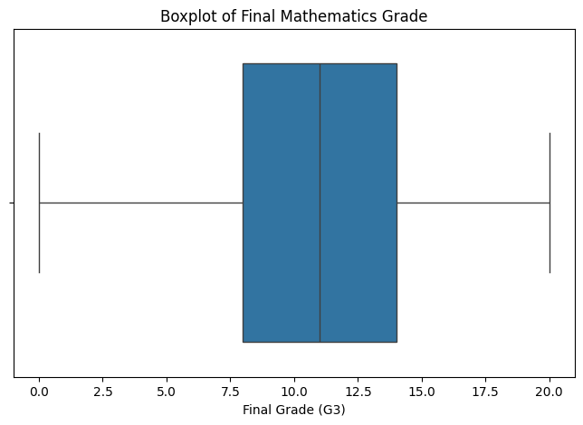
Dataset Overview
Dataset
Student Performance (Math)
File
student-mat.csv
Students
395
Variables
33
Target
G3 — Final Mathematics Grade
Key Variables Used
school · sex · age · studytime · failures · schoolsup · absences · G1 · G2 · G3
Distribution of final grades (G3) across all 395 students
Student Performance Analysis & Academic Success Prediction
5

Slide 6
Data Preparation
Raw Dataset
→
Data Quality Check
→
Missing / Duplicate Check
→
Feature Selection
→
Categorical Encoding
→
Numerical Scaling
→
80/20 Train-Test Split
Numerical variables were processed using preprocessing / scaling (median imputation + standard scaling).
Categorical variables were one-hot encoded.
The primary ML model excluded G1 and G2 (previous-period grades), to test prediction from student characteristics alone.
Student Performance Analysis & Academic Success Prediction
6

Slide 7
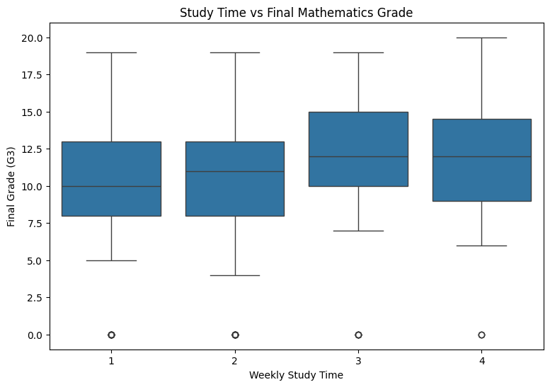
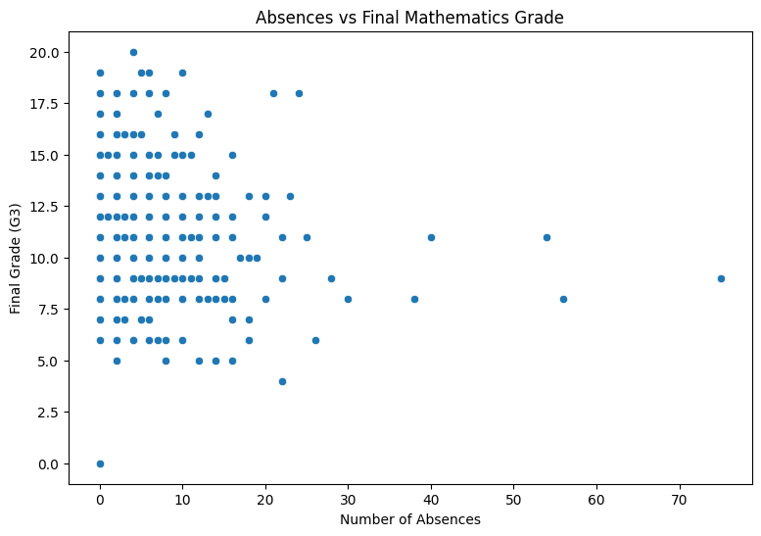
Exploratory Data Analysis
Final Grade Distribution (Boxplot)
Study Time vs Final Grade
Absences vs Final Grade
Student Performance Analysis & Academic Success Prediction
7

Slide 8
Key EDA Observations
Final grade distribution
Most students score in the middle range; the boxplot shows the spread and outliers of G3.
Study time
Average G3 rises with weekly study time (approx. 10.1 at the lowest band to 11.3 at the highest, per group means).
Absences
Correlation between absences and G3 is very weak (r ≈ 0.03) in this dataset — no strong linear relationship.
Previous failures
Average G3 drops sharply as prior failures increase (from ≈11.3 with 0 failures to ≈5.7 with 3 failures).
Correlation heatmap
G1 and G2 show the strongest correlation with G3; most other numerical variables correlate weakly.
Student Performance Analysis & Academic Success Prediction
8

Slide 9
Machine Learning Methodology
Student Dataset
→
Feature Selection
(excl. G1, G2)
→
80% Train /
20% Test Split
→
Preprocessing
→
Linear Regression
+ Random Forest
→
Prediction
→
Evaluation
Target Variable
Evaluation Metrics
G3 — Final Mathematics Grade
MAE • RMSE • R²
Models Compared
Linear Regression • Random Forest Regression (n_estimators = 300)
Student Performance Analysis & Academic Success Prediction
9

Slide 10
Model Performance
Model | MAE | RMSE | R²
Linear Regression | 3.395 | 4.196 | 0.141
Random Forest | 3.010 | 3.765 | 0.309
On the test split used in this project, Random Forest produced lower MAE and RMSE and a higher R² than Linear Regression.
Student Performance Analysis & Academic Success Prediction
10

Slide 11
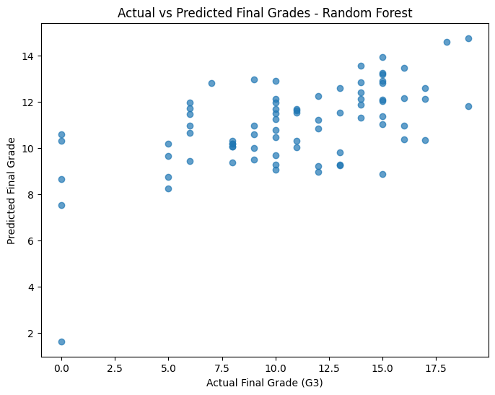
Actual vs Predicted Final Grades
Comparison of observed final grades and Random Forest predictions on the test set.
The spread of observations indicates that the model does not perfectly predict every student's final grade.
Student Performance Analysis & Academic Success Prediction
11

Slide 12
Interactive Power BI Dashboard
[DASHBOARD SCREENSHOT TO BE FILLED]
Dashboard File: Student_Performance_Dashboard.pbix
Average Final Grade (G3) by Sex and School Support
Breakdown by Absences, Study Time and Failures
Average Final Grade (G3) overview chart
[ADDITIONAL DASHBOARD VISUALS TO BE FILLED]
Note: only the visuals actually present in the submitted .pbix file are listed above.
Student Performance Analysis & Academic Success Prediction
12

Slide 13
Key Results & Insights
Random Forest
(Best-performing model on this test split)
Study time shows a positive relationship with average final grade.
Previous failures show a strong negative relationship with average final grade.
Absences show a very weak correlation with final grade in this dataset.
G1 and G2 correlate most strongly with G3 among all numerical variables.
3.010
MAE
3.765
RMSE
0.309
R²
Student Performance Analysis & Academic Success Prediction
13

Slide 14
Limitations & Future Scope
Limitations
Future Scope
Dataset represents a specific student population.
Available variables do not capture every factor affecting academic performance.
Model performance depends on available features and test split.
Predictive relationships do not establish causation.
Test additional machine-learning algorithms.
Perform hyperparameter tuning.
Add additional educational / contextual variables.
Use larger or more diverse datasets.
Develop an interactive prediction application.
Student Performance Analysis & Academic Success Prediction
14

Slide 15
Conclusion & References
Conclusion
References
Student performance was analyzed using data analytics and machine learning.
EDA was used to investigate patterns associated with final mathematics grades.
Linear Regression and Random Forest Regression were evaluated.
Random Forest produced MAE 3.010, RMSE 3.765 and R² 0.309 on the test split.
The Power BI dashboard provides a visual summary of the analysis.
Student Performance Dataset (student-mat.csv) — UCI Machine Learning Repository.
Python: pandas, numpy, matplotlib, seaborn, scikit-learn.
Microsoft Power BI Desktop.
[ADDITIONAL REFERENCES TO BE FILLED]
Thank You

