Slide 1
PhD CREDIT SEMINAR
Remote Sensing for Quantifying Aerosol Impact on Terrestrial Ecosystem Productivity
Presented by: Animesh Panda
Roll No. 13098 · Ph.D. 2nd Year
Chairman: Rabi N. Sahoo
Seminar Leader: Subash Nataraja Pillai
Notes:
Good morning. My seminar is on remote sensing for quantifying aerosol impact on terrestrial ecosystem productivity. I am Animesh Panda, Roll No. 13098, Ph.D. second year. The chairman is Dr Rabi N. Sahoo and the seminar leader is Dr Subash Nataraja Pillai.
The background picture summarises the whole topic in one image. Sunlight passes through a layer of haze; part of the direct beam is scattered and becomes diffuse light that arrives from the whole sky; a satellite observes both the haze and the land surface; and below are the forest and cropland whose photosynthesis, and therefore productivity, is affected. The seminar follows exactly this chain: what aerosols are, how we measure them and the light they change, how we measure productivity from space, how we link the two, what the mechanisms are, what the evidence shows across the world and in India, and finally the challenges and the way forward.

Slide 2
Seminar outline
Outline
1
Introduction
Why aerosol–productivity interactions matter; conceptual framework
Slides 3–4
6
Mechanisms of aerosol impact
Light route, climate route, ozone and aerosol type, optimum load, modulating conditions
Slides 23–27
2
Atmospheric aerosols
Types, distribution, trends, optical and radiative effects
Slides 5–10
7
Evidence
Natural ecosystems, crops, India and South Asia
Slides 28–31
3
Remote sensing of aerosols and radiation
Ground networks, satellite retrieval, lidar, reanalysis, direct and diffuse PAR
Slides 11–15
8
Case studies
Wang et al., 2021 · Shu et al., 2022
Slides 32
4
Remote sensing of productivity
Productivity concepts, flux towers, vegetation indices, SIF and GPP products
Slides 16–19
9
Challenges and way forward
Uncertainties, research gaps, new missions
Slides 33–34
5
Linking aerosols to productivity
Statistical designs, natural experiments, process models
Slides 20–22
10
Conclusions
Take-home messages
Slides 35
Notes:
This is the plan of the seminar in ten parts. Part 1 explains why the interaction between aerosols and ecosystem productivity matters and sets out the conceptual framework. Part 2 introduces atmospheric aerosols: their types and sources, where and when they occur over South Asia, how their amount is changing globally and in South Asia, their optical properties and their radiative effects. Part 3 explains how aerosols and the light they modify are measured, from ground networks to satellite retrieval, lidar, reanalysis and models that split sunlight into direct and diffuse parts. Part 4 does the same for the other side of the problem, productivity: the basic carbon-flux terms, flux towers, vegetation indices, solar-induced fluorescence and gridded GPP products. Part 5 explains how the two are linked: statistical designs, natural experiments and process models. Part 6 describes the mechanisms: the light route, the climate route, ozone and aerosol type, the optimum aerosol load, and the conditions that change the outcome. Part 7 brings the evidence from natural ecosystems, crops, and India and South Asia. Part 8 is the two case studies, Wang et al., 2021 and Shu et al., 2022. Part 9 covers uncertainties, research gaps and new missions, and Part 10 gives the take-home messages. The slide numbers for each part are shown on the cards.

Slide 3
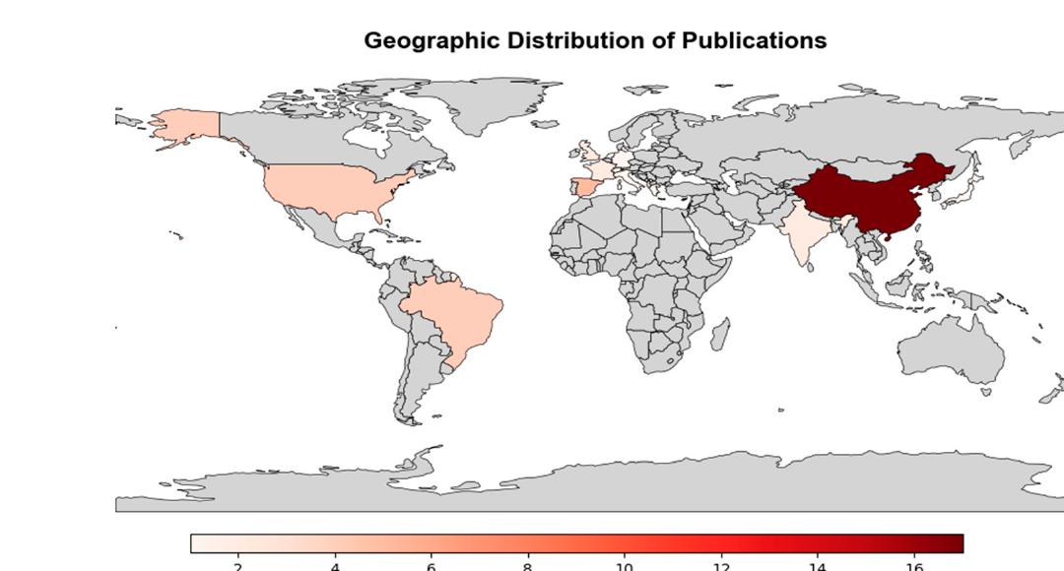
Why aerosol–productivity interactions matter
1 · Introduction
Why it matters | Key fact | Reference
Land carbon sink | Land ecosystems absorb about 30% of human CO₂ emissions | Friedlingstein et al., 2023
Climate forcing | Aerosol forcing ≈ −1.3 W m⁻²: the largest uncertainty in human climate forcing | Forster et al., 2021
Diffuse-light effect | Global dimming raised the land carbon sink by about one quarter (1960–1999) | Mercado et al., 2009
Food security | North-west India, the breadbasket under the IGP haze, grows two-thirds of India's food grains | Jethva et al., 2019
Why remote sensing | Ground sites are sparse; satellites map aerosol, light and vegetation consistently | Wei et al., 2020
Where aerosol–PAR studies were done (2021–2025)
China 17 of 22 studies; India only 2: a clear research gap
Source: de Oliveira et al., 2025
Core idea: aerosols change both the amount and the quality (direct vs diffuse) of light reaching vegetation, and so change how much carbon ecosystems fix.
Notes:
Why should we care about aerosols and productivity. First, land ecosystems absorb about 30 percent of the carbon dioxide that humans emit, according to the Global Carbon Budget of Friedlingstein and colleagues, so even a few percent change in photosynthesis is significant for the global carbon cycle. Second, aerosols are the largest uncertainty in human climate forcing: the IPCC Sixth Assessment Report, Forster and colleagues, puts aerosol effective radiative forcing at about minus 1.3 watts per square metre, offsetting part of greenhouse warming. Third, aerosols do not only reduce light; they make it more diffuse, and diffuse light is used more efficiently by plant canopies. Mercado and colleagues estimated that the 'global dimming' period, with more scattering aerosol, increased the land carbon sink by about one quarter between 1960 and 1999. Fourth, the topic matters for food security in India: north-west India is the breadbasket of the country and produces about two-thirds of India's food grains, and this is exactly where the Indo-Gangetic Plain aerosol plume sits, as Jethva and colleagues point out. Fifth, the problem needs remote sensing, because ground stations for aerosol, radiation and carbon flux are sparse, while satellites observe aerosol, light and vegetation consistently over large areas, as reviewed by Wei and colleagues.
The map, from a 2025 systematic review by de Oliveira and colleagues, shows where aerosol–photosynthetically active radiation studies were carried out between 2021 and 2025. Of the 22 studies that met their criteria, 17 were from China, and India had only two. So the most aerosol-loaded agricultural region of the world is one of the least studied, which is the research gap that motivates this seminar.
The core idea to remember is in the bottom strip: aerosols change both the amount of light and its quality, that is, the split between direct and diffuse light, and this changes how much carbon ecosystems fix.

Slide 4
Conceptual framework and objectives
1 · Introduction
Aerosol
Radiation & climate
Canopy
Productivity
What changes
AOD, single-scattering albedo, size, type
Remote-sensing tools
AERONET, MODIS/MAIAC, VIIRS, CALIOP, MERRA-2
What changes
PAR ↓, diffuse fraction ↑, cooling, cloud and rain changes
Remote-sensing tools
Radiometers, SBDART, BESS, CERES
What changes
Sunlit vs shaded leaves, light-use efficiency, stomata
Remote-sensing tools
LAI, FAPAR, SIF, leaf chambers
What changes
GPP, NPP, NEE, crop yield
Remote-sensing tools
Flux towers, MOD17, FLUXCOM, yield statistics
Objectives of the seminar
Explain how aerosols change light and climate at the canopy
Review the remote-sensing tools that measure each link of the chain
Synthesise the evidence of aerosol impact on productivity, with focus on India
1
2
3
Logic of the seminar: measure aerosol from space → convert it to direct and diffuse light → feed canopy and productivity models or compare with satellite productivity proxies → separate the aerosol effect from climate, ozone and technology.
Notes:
This slide gives the framework that organises the whole seminar. The impact of aerosols on productivity is a chain of four links. The first link is the aerosol itself: what changes is the aerosol optical depth, the single-scattering albedo that tells us whether particles scatter or absorb, their size and their type; these are measured by AERONET sun photometers, MODIS and its MAIAC algorithm, VIIRS, the CALIOP lidar and the MERRA-2 reanalysis. The second link is radiation and climate: aerosols reduce photosynthetically active radiation, increase the diffuse fraction, cool the surface and change clouds and rain; these are measured with radiometers, computed with radiative-transfer models such as SBDART, or taken from satellite radiation products such as BESS and CERES. The third link is the canopy: the balance between sunlit and shaded leaves, light-use efficiency and stomatal behaviour change; we observe the canopy with leaf area index, FAPAR, solar-induced fluorescence and, at small scale, leaf chambers. The fourth link is productivity itself, expressed as gross primary productivity, net primary productivity, net ecosystem exchange or crop yield, measured with flux towers, the MODIS MOD17 product, FLUXCOM and yield statistics.
From this chain come the three objectives of the seminar: first, to explain how aerosols change light and climate at the canopy; second, to review the remote-sensing tools that measure each link; and third, to synthesise the evidence of aerosol impact on productivity, with particular focus on India.
The logic, in the bottom strip, is the workflow used by most studies: aerosol is measured from space, converted into direct and diffuse light, and this is either fed into canopy and productivity models or compared with satellite productivity proxies; finally the aerosol effect has to be separated from other drivers such as climate, ozone and changes in technology.

Slide 5
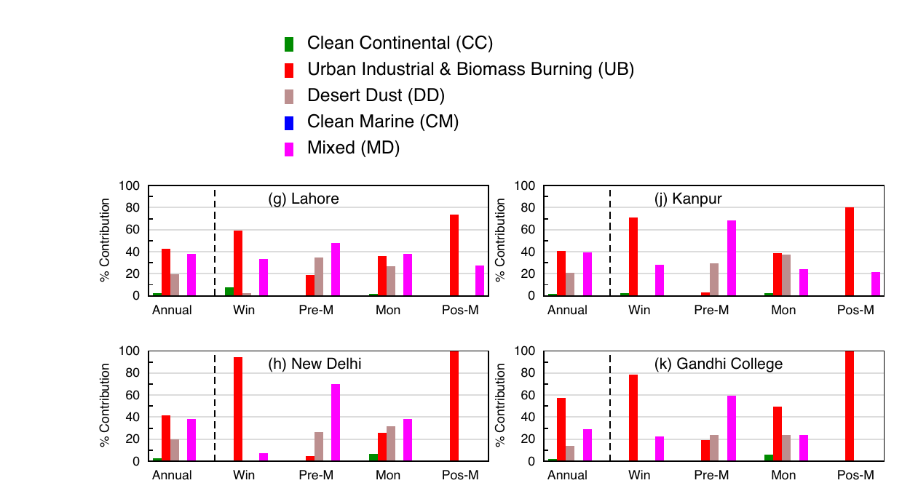
Aerosol types and sources
2 · Atmospheric aerosols
Aerosol type | Main sources (India examples) | Size · light interaction | Reference
Sulfate & nitrate | SO₂, NO_{x}, NH₃ from coal power, vehicles, fertilizer | Fine · strong scattering; swell in humid air | Seinfeld & Pandis, 2016
Black carbon | Diesel, brick kilns, biomass and residue burning | Fine · strongly absorbing | Bond et al., 2013
Organic carbon & SOA | Biomass burning; oxidised plant VOCs | Fine · mostly scattering; brown carbon absorbs UV–blue | Andreae & Gelencsér, 2006
Mineral dust | Thar and Arabian deserts, dry soils | Coarse · scatters, weakly absorbs blue | Ginoux et al., 2012
Sea salt | Ocean spray along the coasts | Coarse · scattering, hygroscopic | Hess et al., 1998
Aerosol types over the western and central IGP (AOD–α classification)
Urban-industrial and biomass-burning aerosol dominates; dust peaks before the monsoon
Source: Ramachandran & Rupakheti, 2026
Primary particles are emitted directly; secondary particles form from gases. Fine mode: radius ≤ 1 µm (modal radius 0.1–0.3 µm); coarse mode: ≥ 1 µm (modal radius 2–5 µm) (Ramachandran & Rupakheti, 2026).
Notes:
Aerosols are solid or liquid particles suspended in the air, and their composition decides how they interact with sunlight. Sulfate and nitrate form from sulfur dioxide, nitrogen oxides and ammonia emitted by coal power plants, vehicles and fertilizer use; they are fine particles that scatter light very efficiently and grow when the air is humid. Black carbon, from diesel engines, brick kilns and biomass and crop-residue burning, is fine and strongly absorbing: it removes light and heats the air. Organic carbon and secondary organic aerosol come from biomass burning and from the oxidation of volatile organic compounds released by plants; they mostly scatter, although the 'brown carbon' part absorbs ultraviolet and blue light. Mineral dust from the Thar and Arabian deserts and from dry soils is coarse, scatters light and absorbs weakly in the blue. Sea salt from ocean spray is coarse, scattering and hygroscopic.
The figure, from Ramachandran and Rupakheti, 2026, classifies aerosol types at AERONET sites over the western and central Indo-Gangetic Plain using aerosol optical depth and the Ångström exponent. Urban-industrial and biomass-burning aerosol, shown in red, dominates in most seasons, while dust, shown in grey, peaks in the pre-monsoon season.
Two definitions are useful. Primary particles are emitted directly, such as dust, sea salt and black carbon; secondary particles form in the atmosphere from gases, such as sulfate, nitrate and secondary organics. By size, the same study defines fine-mode particles as those with radius up to 1 micrometre, with a modal radius of 0.1 to 0.3 micrometre, and coarse-mode particles as those above 1 micrometre, with a modal radius of 2 to 5 micrometres. Size matters because fine particles scatter far more light per unit mass, and this will come back when we discuss optical properties.

Slide 6
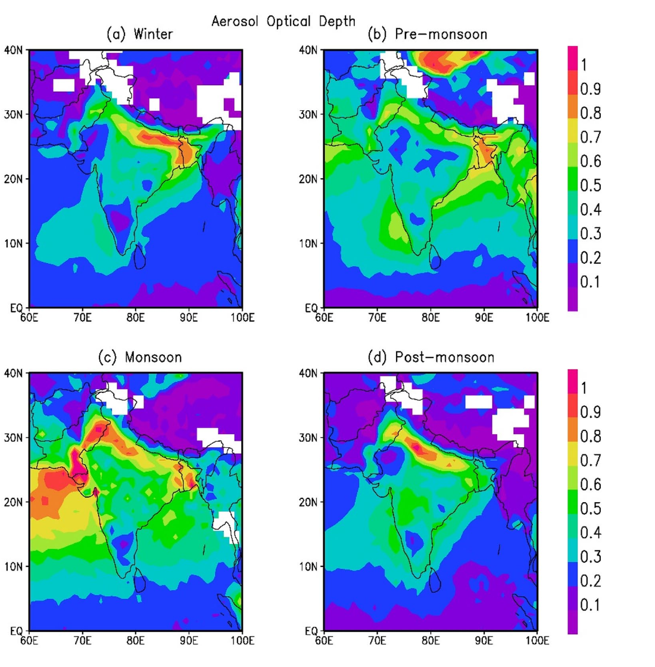
Spatial and seasonal distribution of aerosols over South Asia
2 · Atmospheric aerosols
MODIS AOD (550 nm): winter, pre-monsoon, monsoon, post-monsoon
Season | Dominant aerosol and cause
Winter (Dec–Feb) | Combustion aerosol trapped under a shallow boundary layer; fog
Pre-monsoon (Mar–May) | Dust transported from the Thar and Arabian deserts
Monsoon (Jun–Sep) | Rain washes out aerosol; lowest AOD of the year
Post-monsoon (Oct–Nov) | Crop-residue burning in Punjab–Haryana; smoke over the IGP
Key facts
The Indo-Gangetic Plain (IGP) is the persistent AOD hotspot of South Asia
Fine-mode aerosol gives > 80% of AOD in post-monsoon and winter (Ramachandran & Rupakheti, 2026)
AOD trends are strongest in the dry months, December–March (Babu et al., 2013)
Source: Ramachandran & Rupakheti, 2026
Notes:
This slide shows where and when aerosols occur over South Asia. The four MODIS maps of aerosol optical depth at 550 nanometres, for winter, pre-monsoon, monsoon and post-monsoon, all show the same feature: the Indo-Gangetic Plain, the belt from Punjab to West Bengal along the foot of the Himalaya, is the persistent aerosol hotspot. It is enclosed by the Himalaya to the north, so emissions and transported particles accumulate there.
The seasonal calendar in the table explains the pattern. In winter, December to February, combustion aerosol from vehicles, industry and domestic burning is trapped under a shallow, stable boundary layer, often with fog. In the pre-monsoon, March to May, hot dry winds bring dust from the Thar and Arabian deserts. During the monsoon, June to September, rain washes aerosol out of the air, giving the lowest AOD of the year in most places. In the post-monsoon, October and November, burning of rice residue in Punjab and Haryana sends smoke over the whole plain.
The key facts summarise three points. The IGP is the persistent hotspot. In the post-monsoon and winter seasons fine-mode aerosol contributes more than 80 percent of AOD at almost all sites, according to Ramachandran and Rupakheti, 2026, which means combustion and smoke dominate. And the long-term increase in AOD is strongest in the dry months from December to March, as Babu and colleagues reported in 2013. This dry season coincides with the rabi wheat season, so the crop that is growing when aerosol is highest is wheat.

Slide 7
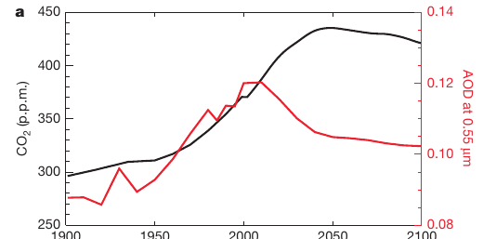
AOD trends: global
2 · Atmospheric aerosols
Region | AOD trend | Reference
USA, Europe | Decreasing (satellite record, 1997–2010) | Hsu et al., 2012
China, India | Increasing (satellite record, 1997–2010) | Hsu et al., 2012
Fire regions | Global burned area −24% (1998–2015) → less smoke | Andela et al., 2017
Global mean | Total AOD reached a maximum of ~0.12 around 2000; projected to fall steeply under mitigation | Mercado et al., 2009
Global CO₂ (black) and AOD (red), 1900–2100
AOD peaks around 2000 and declines as sulfate emissions fall
Source: Mercado et al., 2009, Fig. 4a
Aerosol has shifted, not disappeared: clean-air policies lowered aerosol over North America and Europe, while emissions grew over South and East Asia, so the aerosol–productivity question is now mainly an Asian one.
Notes:
Before focusing on South Asia, it helps to see how aerosol is changing worldwide. Satellite records analysed by Hsu and colleagues in 2012, and summarised in the review by Wei and colleagues, show that between 1997 and 2010 aerosol optical depth decreased over the United States and Europe, while it increased over China and India. The decrease in the West reflects clean-air legislation that cut sulfur emissions. In fire-dominated regions, mainly the African savannas and tropical grasslands, Andela and colleagues found that global burned area declined by about 24 percent between 1998 and 2015, largely because of agricultural expansion, which means less smoke from those regions.
The figure, from Mercado and colleagues in 2009, shows the long-term global picture. The black line is atmospheric carbon dioxide and the red line is total aerosol optical depth. AOD rose through the twentieth century with industrialisation and reached a maximum of about 0.12 around the year 2000. Under a mitigation scenario with rapid cuts in sulfate and black carbon emissions, it is projected to fall steeply, while carbon dioxide stays high. One consequence, which Mercado discussed, is that the diffuse-light fertilization that helped the carbon sink in the late twentieth century will shrink in the future.
The message in the strip is that aerosol has shifted rather than disappeared: it fell in North America and Europe but grew in South and East Asia. The question of how aerosol affects productivity is therefore now mainly an Asian question, and South Asia, which we look at next, is the region where aerosol is still clearly rising.

Slide 8
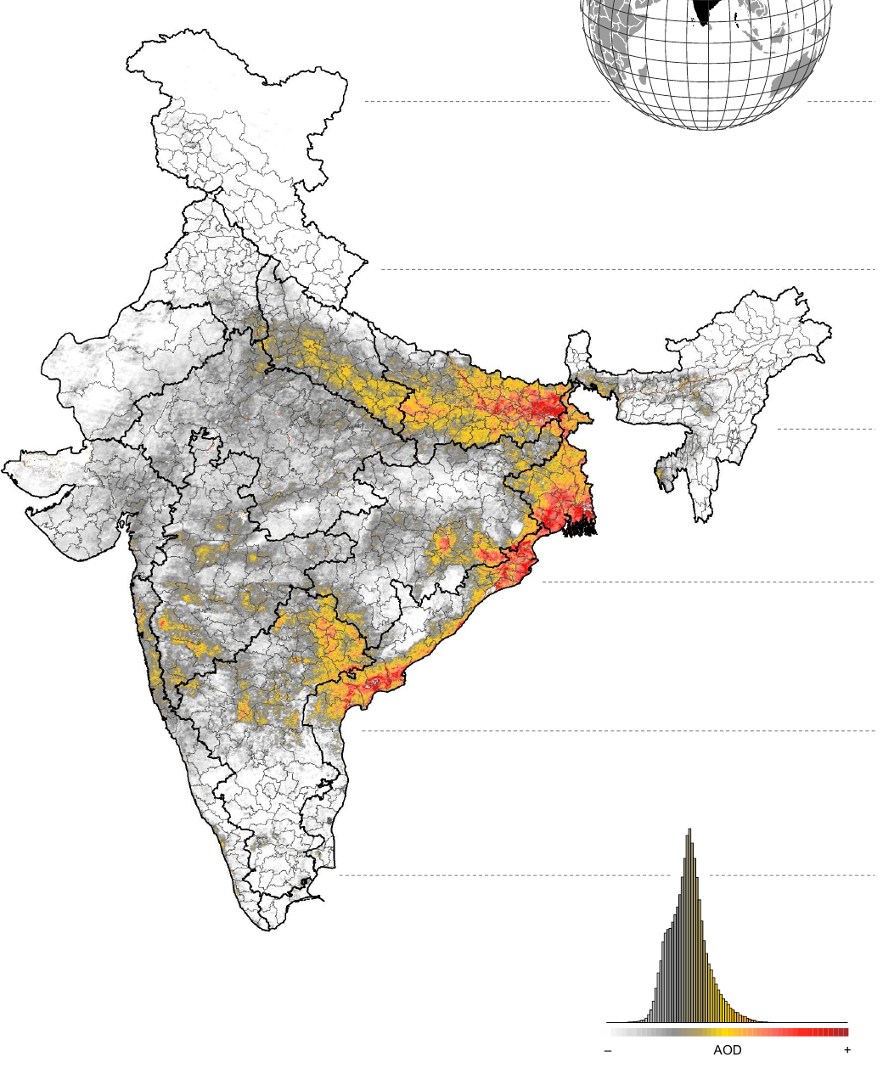
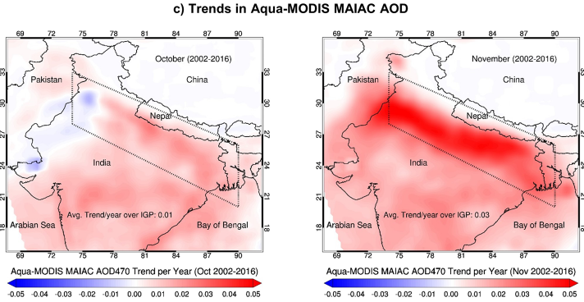
AOD trends: South Asia
2 · Atmospheric aerosols
India AOD trend, 2001–2020
MAIAC AOD trend over the IGP, October (left) and November (right), 2002–2016
Reported AOD rise
India: +0.006 yr⁻¹ (1998–2019) Gupta et al., 2024
India: +0.29 (2001–2020) Hari & Tyagi, 2022
IGP: +43% (2002–2016); +45% post-monsoon Jethva et al., 2019
IGP, November: +0.03 yr⁻¹ (extinction), +0.003 yr⁻¹ (absorption) Jethva et al., 2019
Kanpur AERONET: +34% (2002–2016) Jethva et al., 2019
Steepest rise in November, the residue-burning month
Source: Jethva et al., 2019, Fig. 6c
Drivers: industry, power plants, vehicles, residue burning (Oct–Nov) and winter stagnation as surface winds weaken (Ramachandran & Rupakheti, 2026). TGP monsoon AOD reaches 0.91 (Hari & Tyagi, 2022).
Strongest rise: IGP, east coast, Odisha
Source: Hari & Tyagi, 2022, Fig. S2
Notes:
South Asia is the clearest example of rising aerosol. The map on the left, from Hari and Tyagi, 2022, shows the MODIS AOD trend over India from 2001 to 2020: the strongest increase is along the Indo-Gangetic Plain, the east coast and Odisha. Over India as a whole they report an increase of about 0.29 in AOD over these twenty years. Gupta and colleagues, 2024, found the annual mean AOD over India rising at 0.006 per year between 1998 and 2019.
The middle figure is from Jethva and colleagues, 2019, using the 1-kilometre MAIAC product. It compares the AOD trend in October, on the left, with November, on the right, between 2002 and 2016. In October the trend is weak, but in November, the main month of rice-residue burning in Punjab and Haryana, the trend is strongly positive over the entire plain. Their numbers, listed in the table, are an overall increase of about 43 percent in aerosol loading over the IGP and 45 percent in the post-monsoon season; in November the trend is 0.03 per year in extinction AOD and 0.003 per year in absorption AOD, meaning that both scattering and absorbing smoke are increasing. The AERONET station at Kanpur, in the centre of the plain, confirms a 34 percent increase over the same period, so the satellite trend is not an artefact.
The drivers are industry, thermal power plants, vehicles, crop-residue burning in October and November, and in winter, stagnant air: Ramachandran and Rupakheti note that weakening surface winds over the IGP intensify winter pollution. Seasonal AOD in the Trans-Gangetic Plain reaches about 0.91 during the monsoon, according to Hari and Tyagi. These are among the highest aerosol loads anywhere over cropland, which is why the region is central to this seminar.

Slide 9
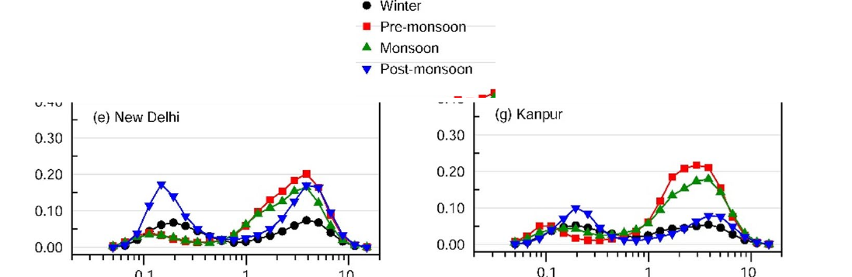
Aerosol optical properties that control light at the canopy
2 · Atmospheric aerosols
Property | Typical values | Relevance to productivity | Reference
Aerosol optical depth (τ) | Clean < 0.1; IGP often 0.5–1.0 | Sets how much PAR is lost and how much becomes diffuse | Holben et al., 1998
Ångström exponent & fine-mode fraction | α > 1: smoke, pollution; α < 0.5: dust | Fine particles scatter more light per unit mass | Eck et al., 1999
Single-scattering albedo (ω₀) | Sulfate ≈ 0.98; dust ≈ 0.92–0.95; smoke ≈ 0.84–0.94 | High ω₀ → diffuse gain; low ω₀ → light lost as heat | Dubovik et al., 2002
Asymmetry (g) & humidity growth | g ≈ 0.6–0.75; sulfate radius doubles near 95% RH | Forward scattering keeps light reaching canopies | Hess et al., 1998
Seasonal aerosol size distribution: New Delhi and Kanpur
Fine mode peaks after the monsoon (smoke); coarse mode before it (dust)
Source: Ramachandran & Rupakheti, 2026
20% → 80%
diffuse share of sunlight as AOD rises from 0.2 to 1.0
Kanniah et al., 2012
Key relations
Beer–Lambert: I = I₀ e^{−τ/cosθ}
Ångström: τ(λ) = β λ^{−α}
Absorption AOD: τ_{abs} = (1 − ω₀) τ
For plants, AOD alone is not enough: two hazes with the same AOD can have opposite effects; scattering haze can raise canopy photosynthesis, absorbing haze mostly removes light.
Notes:
Four optical properties determine what aerosol does to the light that reaches a canopy. Aerosol optical depth, tau, is the total extinction of light by the column of particles; in clean air it is below 0.1, while over the Indo-Gangetic Plain it is often 0.5 to 1.0. AOD sets how much photosynthetically active radiation is lost and how much is turned into diffuse light. The Ångström exponent and the fine-mode fraction describe particle size: values of alpha above 1 indicate fine smoke and pollution particles, and values below 0.5 indicate coarse dust. Fine particles scatter much more light per unit mass. The single-scattering albedo, omega-zero, is the fraction of extinction that is scattering rather than absorption. For sulfate it is about 0.98, for dust 0.92 to 0.95, and for smoke 0.84 to 0.94, values compiled by Dubovik and colleagues from AERONET. This is the key property for plants: high values mean the light is redirected as diffuse light that can still be used, low values mean the light is absorbed and lost as heat. Finally the asymmetry parameter, about 0.6 to 0.75, means scattering is mostly forward, so scattered light still reaches the ground, and hygroscopic growth means particles such as sulfate roughly double in radius near 95 percent relative humidity, which raises AOD in humid air.
The relations box gives the three equations used in retrievals: Beer–Lambert attenuation of the direct beam, the Ångström power law linking AOD to wavelength, and absorption optical depth as one minus omega-zero times tau. The size-distribution figure from Ramachandran and Rupakheti for New Delhi and Kanpur shows two modes: a fine mode that peaks after the monsoon, from smoke, and a coarse mode that peaks before the monsoon, from dust. The callout, from the review by Kanniah and colleagues, shows how strongly AOD controls light quality: the diffuse share of sunlight is about 20 percent at an AOD of 0.2 and rises to about 80 percent at an AOD of 1. The main lesson is that AOD alone is not enough: two hazes with the same AOD can have opposite effects on plants depending on whether they scatter or absorb.

Slide 10
Aerosol radiative effects
2 · Atmospheric aerosols
Direct effect
Scatters and absorbs sunlight → surface dimming, more diffuse light
Aerosol radiative forcing
ARF = F_{with aerosol} − F_{clean}
Surface ARF ≪ 0 and TOA ARF small → atmosphere heated by absorption
MERRA reanalysis forcing efficiency ≈ 35 W m⁻² per unit AOD, about half the ground value (NE India)
Latha et al., 2018
Aerosol layer
Scattering and absorbing particles
At the surface
Less total PAR, more diffuse PAR, cooler days, changed rain
Semi-direct effect
Black carbon heats the layer → stabilises air, burns off clouds
Indirect effect
Particles seed clouds → brighter, longer-lived clouds; rain suppressed or invigorated
Seasonal–decadal impact: absorbing aerosol and reduced evaporation weaken the South Asian monsoon (Bollasina et al., 2011); rain is invigorated up to AOD ≈ 0.25 and suppressed by heavier pollution (Rosenfeld et al., 2008).
Notes:
Aerosols affect radiation through three effects, shown in the diagram. The direct effect is the scattering and absorption of sunlight by the particles themselves; it dims the surface and increases the diffuse fraction of light. The semi-direct effect comes from absorbing aerosol such as black carbon: by heating the aerosol layer it stabilises the lower atmosphere and can evaporate, or 'burn off', clouds. The indirect effect acts through clouds: aerosol particles serve as cloud condensation nuclei, so polluted clouds have more, smaller droplets; they are brighter and live longer, and rain can be either suppressed or, in deep convective clouds, invigorated. The combined result at the surface is less total photosynthetically active radiation, more diffuse radiation, cooler days and changed rainfall, which are exactly the variables that affect productivity.
The size of the effect is expressed as aerosol radiative forcing: the difference between the radiative flux with aerosol and the flux in clean conditions. At the surface the forcing is strongly negative, whereas at the top of the atmosphere it is small, which means the difference has been absorbed in the atmosphere, mainly by black carbon. Over a northeast Indian station, Latha and colleagues found that forcing estimated from the MERRA reanalysis gave a forcing efficiency of about 35 watts per square metre per unit AOD, only about half of the value from ground observations, so reanalysis underestimates the surface dimming.
The strip adds the longer time scales. Bollasina and colleagues, 2011, showed that anthropogenic aerosol has weakened the South Asian summer monsoon, because absorbing aerosol and reduced evaporation stabilise the atmosphere. Rosenfeld and colleagues, 2008, showed that rain is invigorated as aerosol increases only up to a modest AOD of about 0.25; beyond that, further aerosol suppresses convection and rain. For rainfed agriculture this rain pathway can be as important as the light pathway.

Slide 11
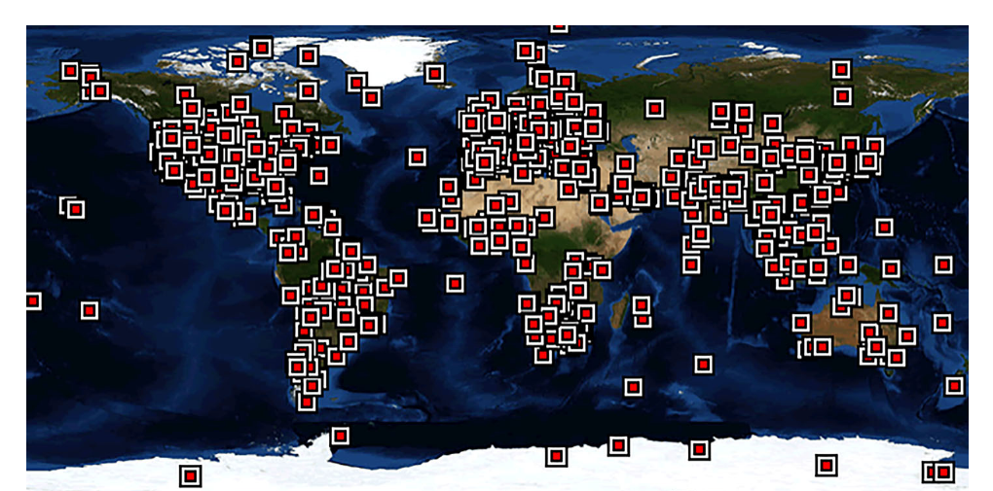
Ground-based aerosol measurement
3 · Remote sensing of aerosols and radiation
Direct-sun radiance
Langley calibration (V₀)
Beer–Lambert → total τ
Remove Rayleigh and gases → AOD
Quality levels 1.0 → 1.5 → 2.0
Method | Instruments / networks | Key outputs
Sun/sky photometer Holben et al., 1998 | AERONET (CIMEL), SKYNET, ISRO ARFINET | AOD at 340–1020 nm, α, SSA, size distribution
In-situ sampling Drinovec et al., 2015 | Nephelometer, aethalometer, BAM | Scattering, black carbon, PM_{2.5}
Ground lidar Pappalardo et al., 2014 | MPLNET, EARLINET, Raman lidar | Vertical profile, boundary-layer height
Radiometers Ohmura et al., 1998 | Pyranometer, shadow-band, PAR sensors (BSRN) | Total and diffuse radiation, diffuse fraction
AERONET sun-photometer network
Indian sites include Kanpur, Delhi, Jaipur, Gandhi College and Pune
Source: Wei et al., 2020, Fig. 1
Role: AERONET Level 2.0 is the ground truth used to validate every satellite AOD product; its limitation is sparse point coverage, especially over Indian croplands.
Notes:
Remote sensing of aerosol starts on the ground, because ground instruments provide the reference for everything else. The most important instrument is the sun photometer. The flow at the top shows how it works. It points at the sun and measures the direct-sun radiance at several wavelengths. The instrument is calibrated by the Langley method, which extrapolates measurements made at different air masses to obtain the signal at the top of the atmosphere, V-zero. With this calibration the Beer–Lambert law gives the total optical depth of the atmosphere; subtracting the known contribution of Rayleigh scattering by air molecules and absorption by gases such as ozone and water vapour leaves the aerosol optical depth. In AERONET, data pass through three quality levels, 1.0 raw, 1.5 cloud-screened and 2.0 quality-assured, and Level 2.0 is what we use for validation. Almucantar sky scans additionally give the single-scattering albedo and the size distribution.
The table lists four families of ground methods. Sun and sky photometers in AERONET, the Japanese SKYNET and ISRO's ARFINET network give AOD from 340 to 1020 nanometres, the Ångström exponent, single-scattering albedo and size. In-situ instruments such as nephelometers, aethalometers and beta-attenuation monitors measure scattering, black carbon and PM2.5 at the surface. Ground lidars, in networks such as MPLNET and EARLINET, give the vertical profile and boundary-layer height. Radiometers such as pyranometers, shadow-band instruments and PAR sensors, standardised by the Baseline Surface Radiation Network, measure total and diffuse radiation, which is essential for productivity studies.
The map, from the review by Wei and colleagues, shows the global AERONET network. In India there are only a few sites, such as Kanpur, Delhi, Jaipur, Gandhi College and Pune. So the role of AERONET is to be the ground truth for satellite AOD, but its limitation is sparse, point-scale coverage, particularly over croplands.

Slide 12
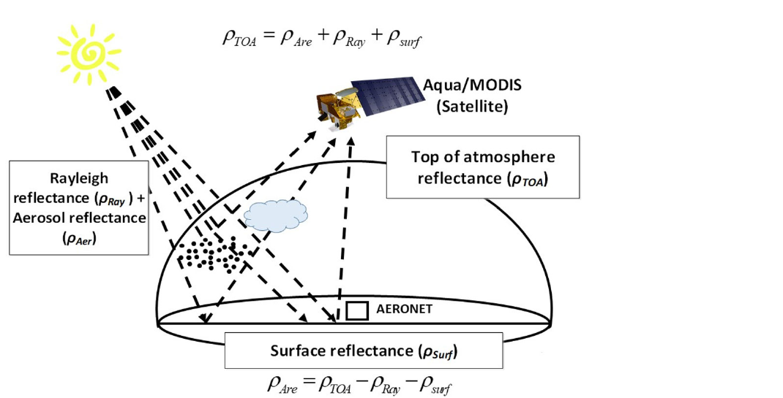
Satellite aerosol retrieval principle
3 · Remote sensing of aerosols and radiation
What the satellite sees: aerosol, air and surface signals
1. Observe
Top-of-atmosphere reflectance at several wavelengths
2. Screen
Remove cloud, snow, water and sun glint
3. Remove Rayleigh
Subtract scattering by air molecules
4. Estimate surface
Dark pixels, blue band, time series or multi-angle
5. Invert
Match look-up tables of aerosol models → AOD
Source: Wei et al., 2020, Fig. 6
6. Validate
Compare with AERONET; assign quality flag
ρ_{TOA} = ρ_{aer} + ρ_{Ray} + ρ_{surf}. Rayleigh scattering is easy to compute; the surface term is the hard part, so every algorithm is a different way of estimating it.
Notes:
Every satellite aerosol algorithm solves the same basic problem, which the figure from Wei and colleagues illustrates. The sensor, here MODIS on Aqua, measures reflectance at the top of the atmosphere. That signal is the sum of three parts: light scattered back by aerosol, light scattered by air molecules, called Rayleigh scattering, and light reflected by the surface and transmitted back through the atmosphere. The aerosol part is what we want.
The six steps on the right are common to all algorithms. First, observe the top-of-atmosphere reflectance at several wavelengths. Second, screen out pixels that cannot be used: clouds, snow, water and sun glint. Third, remove the Rayleigh contribution, which can be calculated accurately from pressure and geometry. Fourth, estimate the surface reflectance, which is the difficult step: algorithms use dark vegetated pixels, the blue band where bright surfaces look dark, time series of the same pixel, or several viewing angles. Fifth, invert: compare the remaining signal with pre-computed look-up tables for different aerosol models and AOD values and choose the AOD that matches. Sixth, validate against AERONET and assign a quality flag.
The equation in the strip summarises it: top-of-atmosphere reflectance equals the aerosol term plus the Rayleigh term plus the surface term. Because the Rayleigh term is easy, the whole difference between algorithms is how they estimate the surface. Over bright, heterogeneous land such as Indian croplands in the dry season, this is the main source of error.

Slide 13
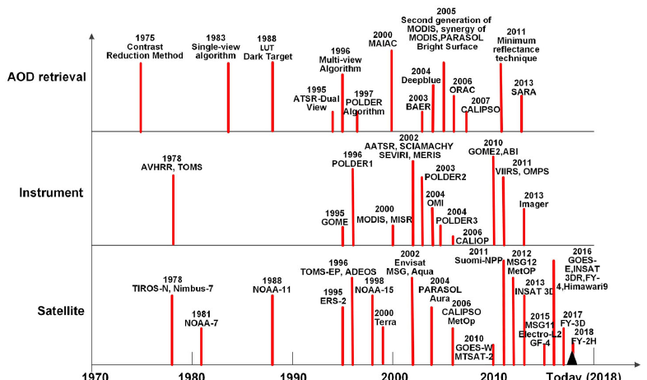
Main satellite aerosol algorithms and sensors
3 · Remote sensing of aerosols and radiation
Algorithm | Key idea | Resolution · reference
Dark Target | Dark vegetation; surface from the 2.1 µm band | 10 and 3 km · Levy et al., 2013
Deep Blue | Bright land is dark at 412–470 nm | 6–10 km · Hsu et al., 2013
MAIAC | Time series: slow surface, fast aerosol | 1 km · Lyapustin et al., 2018
MISR | Nine view angles separate surface and aerosol | 17.6 km · Kahn et al., 2010
Polarimetry | Polarization gives size and SSA (POLDER, PACE) | 6 × 7 km · Dubovik et al., 2011
UV sensors | OMI, TROPOMI aerosol index flags absorbing aerosol | 13 × 24 km · Torres et al., 2007
Geostationary | INSAT-3D/3DR, Himawari: AOD every 10–30 min | 0.5–4 km · Yoshida et al., 2018
Development of satellites, instruments and AOD algorithms
Source: Wei et al., 2020, Fig. 5
± (0.05 + 0.15τ)
expected error of MODIS Dark Target AOD over land
Levy et al., 2013
Choice for productivity studies: MAIAC for field and district scale, UV sensors for absorbing smoke, geostationary sensors for the diurnal cycle.
Notes:
The algorithms differ mainly in how they handle the surface. Dark Target, the classic MODIS algorithm described by Levy and colleagues, works over dark vegetation and estimates visible surface reflectance from the 2.1 micrometre band; it gives AOD at 10 and 3 kilometres. Its expected error over land, shown in the callout, is plus or minus 0.05 plus 15 percent of AOD. Deep Blue, by Hsu and colleagues, uses the blue bands at 412 to 470 nanometres where deserts and cities are dark, so it works over bright surfaces at 6 to 10 kilometres. MAIAC, by Lyapustin and colleagues, uses a time series of observations on the assumption that the surface changes slowly while aerosol changes quickly; it gives AOD at 1 kilometre, the right scale for fields and districts. MISR uses nine viewing angles to separate surface and aerosol and gives particle shape and size, at 17.6 kilometres in the standard product. Polarimeters such as POLDER and the new PACE mission use polarisation, which is sensitive to particle size and single-scattering albedo. Ultraviolet sensors such as OMI and TROPOMI give an aerosol index that detects absorbing smoke and dust even above clouds. Geostationary sensors such as INSAT-3D and 3DR over India and Himawari over East Asia give AOD every 10 to 30 minutes, which captures the diurnal cycle.
The figure from Wei and colleagues shows the history: from AVHRR and TOMS in the late 1970s, through Dark Target in 1988, MODIS and MISR in 2000, MAIAC, Deep Blue and CALIPSO in the 2000s, to geostationary sensors such as Himawari and INSAT-3DR after 2013. For productivity studies, MAIAC suits field and district analysis, ultraviolet sensors help separate absorbing smoke, and geostationary sensors capture the daily cycle that a single polar overpass misses.

Slide 14
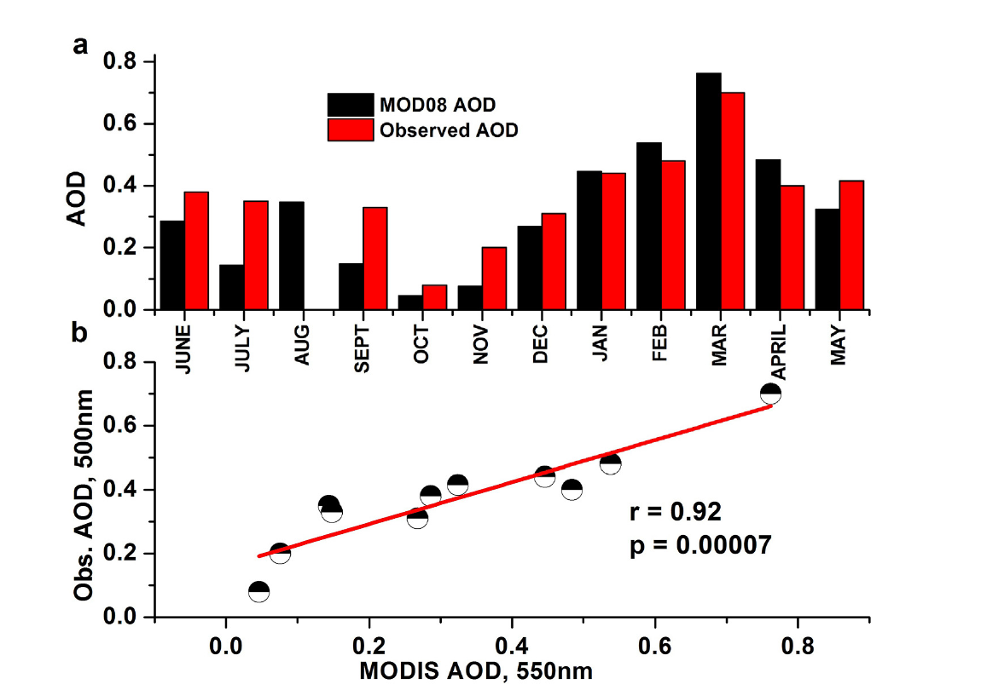
Lidar, reanalysis and validation of aerosol products
3 · Remote sensing of aerosols and radiation
Approach | Principle | Output · reference
Spaceborne lidar | Laser backscatter and depolarization (CALIOP 2006–23; EarthCARE ATLID 2024–) | Vertical profile, aerosol type · Winker et al., 2009
Reanalysis | Satellite AOD assimilated into transport models (MERRA-2, CAMS) | Gap-free AOD by species · Randles et al., 2017; Inness et al., 2019
Surface PM_{2.5} | AOD scaled to surface mass with boundary-layer height and humidity | PM_{2.5} maps · van Donkelaar et al., 2010
Validation | Match satellite and AERONET within ±30 min and ~25 km | R, RMSE, % within error · Ichoku et al., 2002
MODIS vs ground-measured AOD, Dibrugarh, Assam (r = 0.92)
MODIS underestimates AOD in monsoon and post-monsoon, overestimates in winter and pre-monsoon
Source: Latha et al., 2018, Fig. 4
Best data for productivity studies: MAIAC (field scale) · OMI and AERONET SSA (absorption) · CALIOP (layers) · MERRA-2 and CAMS (species, gap-free).
Notes:
Passive sensors give only a column total. Spaceborne lidar adds the vertical dimension: CALIOP on CALIPSO, from 2006 to 2023, and now the ATLID lidar on EarthCARE, launched in 2024, measure laser backscatter and depolarisation, which give the height of aerosol layers and distinguish dust from smoke and pollution, as described by Winker and colleagues. Reanalyses such as MERRA-2 and the Copernicus CAMS system assimilate satellite AOD into chemical transport models; they provide gap-free AOD, even under clouds, split into species such as dust, sulfate, black carbon and organic carbon, although at coarse resolution of about half a degree. AOD can also be converted into surface PM2.5 by scaling with boundary-layer height and humidity, which van Donkelaar and colleagues used to map PM2.5 globally.
Every product has to be validated. The standard method, from Ichoku and colleagues, matches satellite pixels within about 25 kilometres of an AERONET station with sun-photometer measurements within plus or minus 30 minutes of the overpass, and reports the correlation, the root-mean-square error and the percentage of points within the expected error.
The figure, from Latha and colleagues, 2018, shows this validation for Dibrugarh in Assam. Monthly MODIS AOD follows the ground observations closely, with a correlation of about 0.92, but MODIS underestimates AOD in the monsoon and post-monsoon months and overestimates it in winter and pre-monsoon, so seasonal biases must be checked before using satellite AOD for crop studies. The strip summarises the best data sources for productivity work: MAIAC for field scale, OMI and AERONET single-scattering albedo for absorption, CALIOP for layer height, and MERRA-2 and CAMS for species and gap-free coverage.

Slide 15
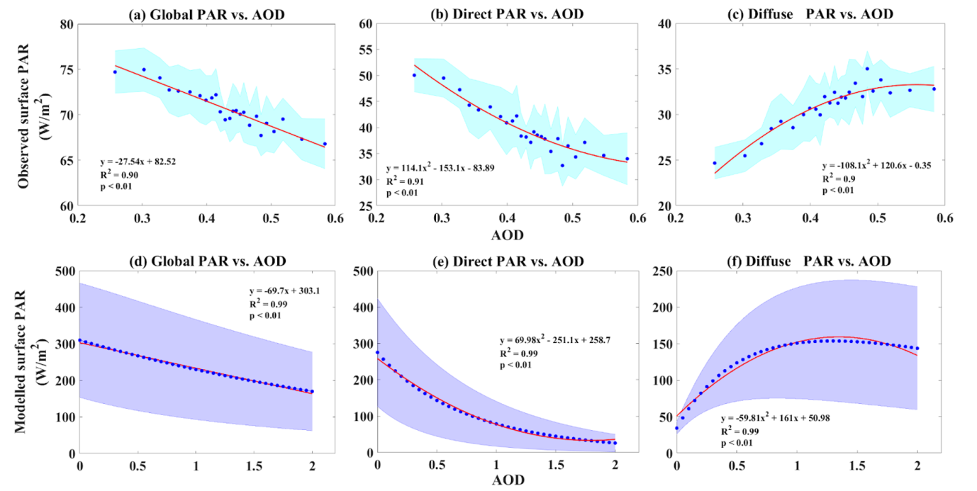
Estimating direct and diffuse PAR from aerosol data
3 · Remote sensing of aerosols and radiation
Approach | How direct and diffuse PAR are obtained | Example
Radiative transfer models | AOD, ω₀, sun angle → direct and diffuse PAR (SBDART, TUV, 6S) | Tie et al., 2016; Sankhla et al., preprint
Empirical partitioning | Diffuse fraction from clearness index, sunshine and AOD | Spitters et al., 1986; Feng et al., 2020
Satellite products | BESS (5 km), CERES SYN1deg, MODIS MCD18 PAR | Ryu et al., 2018; Rutan et al., 2015
Reanalysis | MERRA-2, ERA5 surface radiation and forcing | Gelaro et al., 2017
Punjab: global, direct and diffuse PAR vs AOD (observed, top; SBDART, bottom)
Direct PAR falls and diffuse PAR rises as AOD increases
Source: Sankhla et al., preprint, Fig. 3
Why it matters: the diffuse fraction is the variable that links aerosol to canopy light use; models give the mechanism, satellite products give maps, and measured diffuse PAR is needed for validation.
Notes:
For productivity studies, aerosol optical depth is not enough: we need to know how much photosynthetically active radiation arrives as direct beam and how much as diffuse light. There are four ways to obtain these. Radiative-transfer models such as SBDART, TUV and 6S take AOD, single-scattering albedo, sun angle and atmospheric profiles and compute direct and diffuse PAR; Tie and colleagues used TUV for China and Sankhla and colleagues used SBDART for Punjab. Empirical partitioning models, such as the scheme of Spitters and colleagues, estimate the diffuse fraction from the clearness index, sunshine duration or AOD; Feng and colleagues used this approach to drive a two-leaf model. Satellite products such as BESS at 5 kilometres, CERES SYN1deg and the MODIS MCD18 PAR product provide gridded direct and diffuse radiation. Reanalyses such as MERRA-2 and ERA5 provide surface radiation with and without aerosol.
The figure, from the study of Sankhla and colleagues over Punjab during the wheat season, shows global, direct and diffuse PAR plotted against AOD, with observations at the top and SBDART simulations at the bottom. Both show the same pattern: as AOD increases, direct PAR falls steeply, diffuse PAR rises, and global PAR falls only moderately. The agreement between observation and model gives confidence in the radiative-transfer approach.
The strip gives the take-home point. The diffuse fraction is the variable that links aerosol to how efficiently the canopy uses light. Models are best for understanding the mechanism, satellite products for mapping, and measured diffuse PAR is needed to validate both, which is a gap in India that we return to in the challenges section.

Slide 16
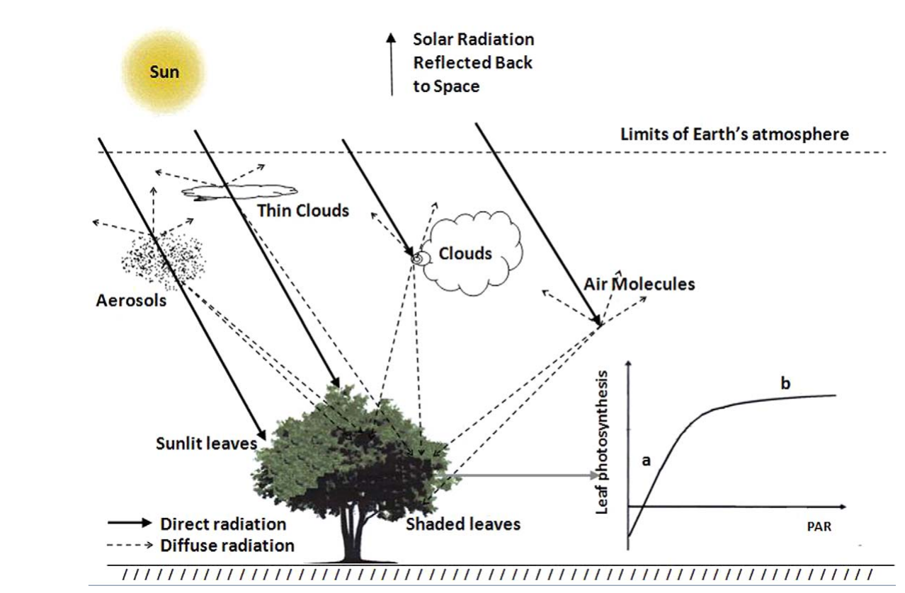
Ecosystem productivity: key concepts
4 · Remote sensing of productivity
PAR
Sunlight 400–700 nm
APAR
PAR × FAPAR
GPP
APAR × LUE
NPP
GPP − plant respiration
NEP
NPP − soil respiration
Yield
Biomass × harvest index
Term | Measured or estimated by
GPP | Flux towers, SIF, light-use-efficiency models
NPP | MOD17, CASA
NEE / NEP | Eddy-covariance towers
APAR | MODIS FAPAR and PAR
Light-use efficiency (ε) | LUE and two-leaf models
Sunlit vs shaded leaves | Two-leaf canopy models
Direct and diffuse radiation in a canopy: sunlit and shaded leaves
Source: Kanniah et al., 2012, Fig. 1
Notes:
Now we move to the other side of the problem: productivity. The chain at the top defines the terms. Photosynthetically active radiation, PAR, is sunlight between 400 and 700 nanometres. The fraction absorbed by the canopy, FAPAR, gives absorbed PAR, or APAR. Gross primary productivity, GPP, is the total carbon fixed by photosynthesis, which light-use-efficiency models write as APAR times the light-use efficiency epsilon. Net primary productivity, NPP, is GPP minus plant, or autotrophic, respiration, and represents biomass growth. Net ecosystem productivity, NEP, is NPP minus soil, or heterotrophic, respiration, and is the net carbon gained by the ecosystem; with the opposite sign it is net ecosystem exchange, NEE, measured by flux towers. For crops, the end point is yield, which is biomass multiplied by the harvest index.
The table shows how each term is obtained. GPP comes from flux towers, from solar-induced fluorescence and from light-use-efficiency models. NPP comes from products such as MODIS MOD17 and models such as CASA. NEE and NEP come from eddy-covariance towers. APAR comes from MODIS FAPAR combined with PAR. Light-use efficiency is the parameter of LUE and two-leaf models, and the split between sunlit and shaded leaves needs two-leaf canopy models.
The figure, from the review by Kanniah and colleagues, shows how radiation enters a canopy. The direct beam, the solid lines, reaches only the sunlit leaves at the top and on the sun-facing side, while diffuse radiation, the dashed lines, comes from the whole sky and reaches shaded leaves inside the canopy as well. This distinction between sunlit and shaded leaves is the basis of the light mechanism that we discuss in section 6.

Slide 17
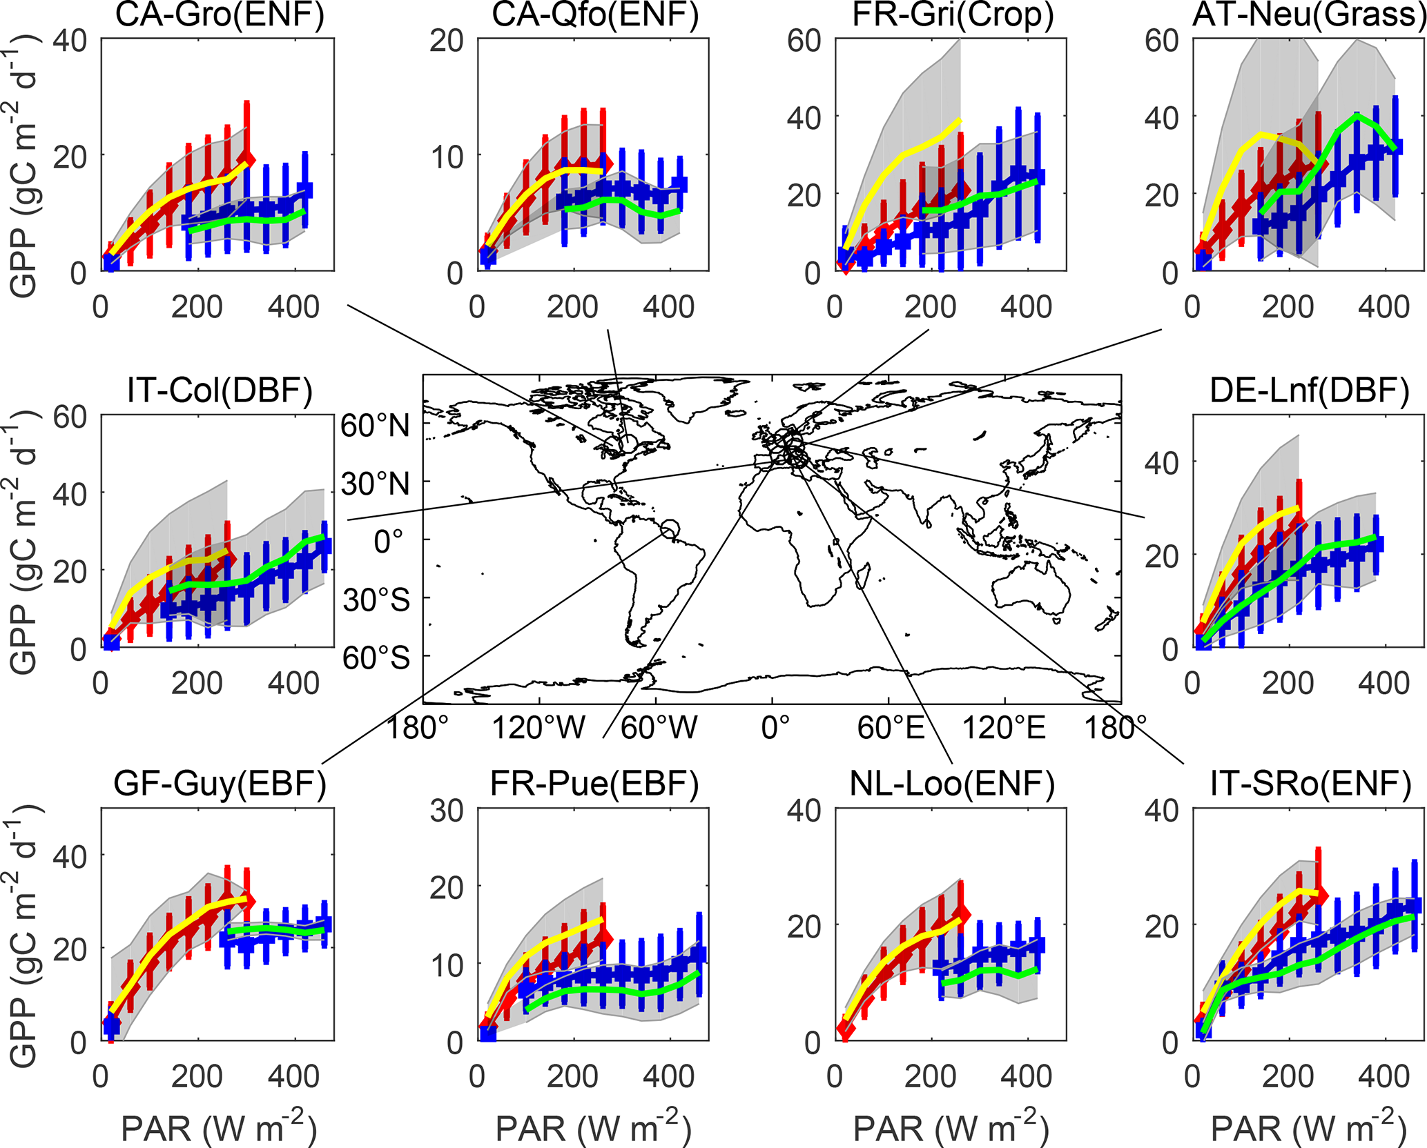
Measuring productivity on the ground
4 · Remote sensing of productivity
Flux tower: NEE = ρ_{a} · cov(w′, c′); GPP = R_{eco} − NEE
GPP vs PAR under diffuse (red) and direct (blue) light at 10 FLUXNET sites
Approach | What is measured | Link to aerosol
Eddy covariance Baldocchi, 2003 | Half-hourly CO₂ flux → GPP by partitioning | GPP on clear vs hazy days at the same PAR
Leaf gas exchange Farquhar et al., 1980 | Leaf CO₂ uptake and stomatal conductance | Calibrates sun- and shade-leaf photosynthesis
Harvest & crop statistics | Biomass and grain yield | Yield regressed on AOD across years
Radiation sensors Ohmura et al., 1998 | Direct and diffuse PAR | Shows the diffuse-fraction pathway
The same PAR gives more GPP when light is diffuse
+0.3–0.7%
GPP per extra W m⁻² of diffuse PAR (24 FLUXNET sites)
Yue & Unger, 2018
Strength: direct, half-hourly carbon flux. Limit: ~1 km² footprint; very few towers over Indian croplands.
Source: Zhou et al., 2022, Fig. 1
Notes:
On the ground we come closest to measuring productivity directly. An eddy-covariance flux tower measures the vertical wind speed and the CO2 concentration ten or twenty times a second; the covariance of their fluctuations, multiplied by air density, gives the net ecosystem exchange, NEE, every half hour, as Baldocchi described. GPP is obtained by partitioning: ecosystem respiration is estimated from night-time fluxes and temperature, and GPP equals respiration minus NEE. Leaf gas-exchange chambers, interpreted with the Farquhar photosynthesis model, measure leaf CO2 uptake and stomatal conductance and are used to calibrate the photosynthesis of sunlit and shaded leaves. Harvest and crop statistics give biomass and yield, which can be regressed on AOD across years. Radiation sensors measure direct and diffuse PAR, which is needed to show the diffuse-fraction pathway.
The figure, from Zhou and colleagues, 2022, shows what towers reveal. At ten FLUXNET sites covering forests, crops and grassland, hourly GPP is plotted against PAR separately for diffuse conditions, in red, and direct conditions, in blue. At the same amount of PAR, GPP is clearly higher when the light is diffuse. Yue and Unger, 2018, quantified this across 24 FLUXNET sites: GPP increases by 0.3 to 0.7 percent for every additional watt per square metre of diffuse PAR.
The strength of towers is that they measure carbon flux directly and continuously. The limitation is that each tower represents only about a square kilometre, and there are very few towers over Indian croplands, which is why satellite proxies are needed to scale up.

Slide 18
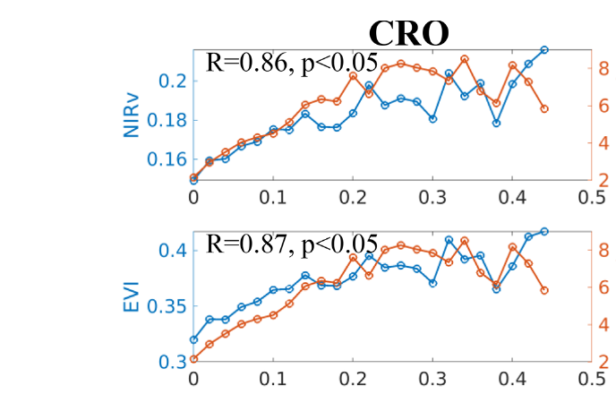
Satellite productivity proxies I: vegetation indices and canopy structure
4 · Remote sensing of productivity
Index | Formula · product | Strength / limit
NDVI Tucker, 1979 | (NIR − Red)/(NIR + Red); MOD13, 250 m | Simple; saturates in dense canopies
EVI Huete et al., 2002 | Adds blue band and soil term; MOD13 | Less saturation; good for cropland
NIRv Badgley et al., 2017 | NDVI × NIR reflectance | Tracks the photosynthesising canopy
kNDVI Camps-Valls et al., 2021 | tanh(NDVI²), kernel NDVI | Robust for shrubs and forests
LAI & FAPAR Myneni et al., 2002 | MOD15, 500 m, 8-day | Leaf area and light absorbed (APAR)
Cropland: NIRv and EVI (blue) and tower GPP (orange) across AOD bins
VIs follow GPP (cropland: EVI R = 0.87, NIRv R = 0.86)
Source: Zhang et al., 2023, Fig. 6
Caution: greenness is not photosynthesis; a green but stressed canopy can still look productive.
Notes:
Satellites cannot measure photosynthesis directly, so we use proxies. The first family is vegetation indices, which measure canopy greenness and structure. NDVI, introduced by Tucker, is the normalised difference of near-infrared and red reflectance; it is simple and available from MODIS at 250 metres, but it saturates in dense canopies. EVI, by Huete and colleagues, adds the blue band and a soil adjustment term, so it saturates less and works well over cropland. NIRv, by Badgley and colleagues, multiplies NDVI by near-infrared reflectance and tracks the photosynthesising part of the canopy closely. kNDVI, by Camps-Valls and colleagues, is a kernel version of NDVI, the hyperbolic tangent of NDVI squared, which is more robust for shrubs and forests. Leaf area index and FAPAR from the MODIS MOD15 product, at 500 metres every 8 days, give the leaf area and the fraction of light absorbed, the APAR term of light-use-efficiency models.
The figure, from Zhang and colleagues, 2023, tests whether vegetation indices capture the aerosol effect. For cropland flux sites, they averaged NIRv, EVI and tower GPP in AOD bins of 0.02. The indices, in blue, rise and fall together with GPP, in orange, across the AOD range. For cropland, the correlation between the indices and GPP was 0.87 for EVI and 0.86 for NIRv, so these two indices are the best candidates for monitoring aerosol effects on crop productivity from space.
The caution in the strip is important: greenness is not photosynthesis. A canopy can remain green while its photosynthesis is reduced by stress, so vegetation indices respond slowly. For faster, physiological signals we need fluorescence, which is the next slide.

Slide 19
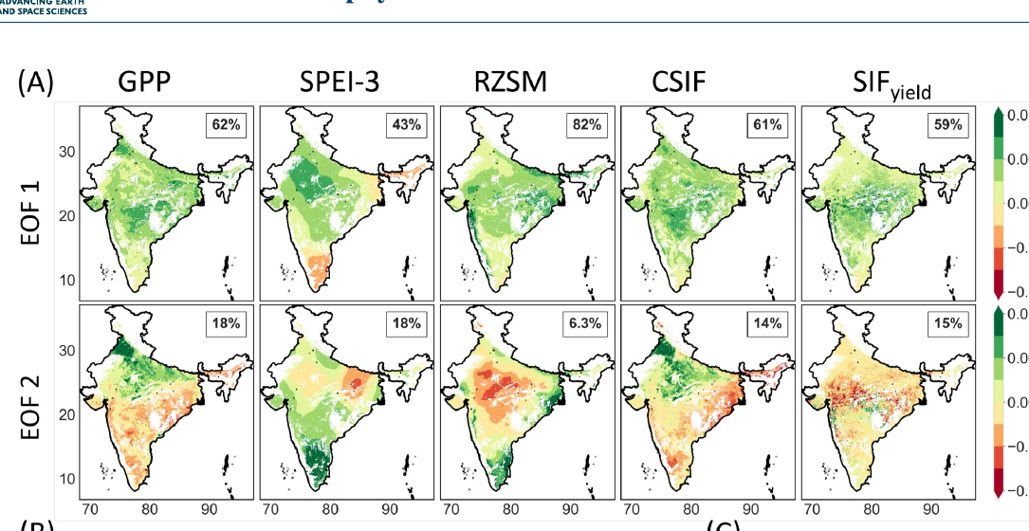
Satellite productivity proxies II: SIF and productivity products
4 · Remote sensing of productivity
Product | What it is | Use / limit
SIF: GOME-2, OCO-2, TROPOMI Joiner et al., 2013; Köhler et al., 2018 | Chlorophyll fluorescence near 740 nm | Tracks photosynthesis within hours; noisy
GOSIF Li & Xiao, 2019 | 0.05°, 8-day SIF from OCO-2 + MODIS | Long, continuous record
SIF yield Behera et al., 2025 | SIF / APAR: physiological signal | Detects stress 1–2 months earlier
MOD17 GPP / NPP Running et al., 2004 | LUE model, 500 m, 8-day | No diffuse-light term
FLUXCOM GPP Jung et al., 2020 | Machine-learning upscaling of FLUXNET | Gridded but coarse
Yield statistics & crop models Jones et al., 2003 | District yield; DSSAT, WOFOST | Agricultural end point
India: leading spatial patterns (EOF) of GPP, drought indices, CSIF and SIF yield
SIF yield follows GPP and leads other indicators
Source: Behera et al., 2025, Fig. 1a
Notes:
The second family of proxies is solar-induced chlorophyll fluorescence, SIF. During photosynthesis a small part of the light absorbed by chlorophyll is re-emitted as fluorescence near 740 nanometres. Because it comes from the photosynthetic machinery itself, SIF responds within hours to changes in light and stress, unlike vegetation indices. It is retrieved from GOME-2, OCO-2 and TROPOMI, as described by Joiner and colleagues and Köhler and colleagues, but individual retrievals are noisy and sparse. GOSIF, by Li and Xiao, combines OCO-2 SIF with MODIS data to give a continuous record at 0.05 degree and 8 days. SIF yield, which is SIF divided by APAR, removes the effect of the amount of light and isolates the physiological signal.
The figure, from Behera and colleagues, 2025, is an Indian example. They decomposed GPP, the SPEI-3 drought index, root-zone soil moisture, continuous SIF and SIF yield over India into their leading spatial patterns. SIF yield shows the strongest positive relationship with GPP and, compared with other indicators, detects emerging stress one to two months earlier. This makes it useful for detecting the physiological effect of stresses, including reduced light under heavy haze.
The remaining rows are productivity products. MOD17, by Running and colleagues, gives GPP and NPP at 500 metres every 8 days from a light-use-efficiency model, but it has no diffuse-light term, so it cannot represent the aerosol effect. FLUXCOM, by Jung and colleagues, upscales FLUXNET towers with machine learning to give gridded GPP at coarse resolution. For crops, district yield statistics and crop models such as DSSAT and WOFOST give the agricultural end point.

Slide 20
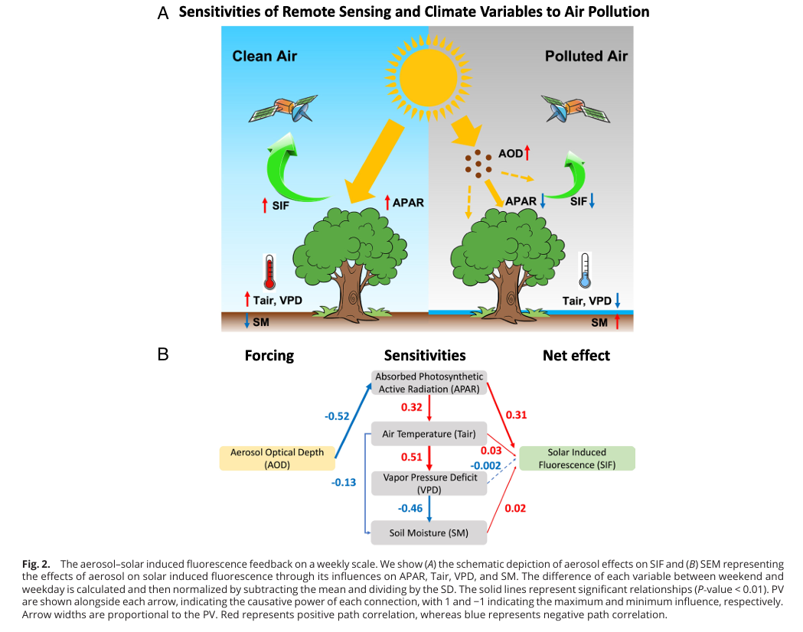
Statistical designs for linking aerosols to productivity
5 · Linking aerosols to productivity
Design | How it works | Example
AOD binning | Compare productivity across AOD classes at similar PAR and season | Niyogi et al., 2004; Zhang et al., 2023
Regression | Productivity ~ AOD + temperature + rain + soil moisture + FAPAR | Liu & Desai, 2021; Gupta et al., 2024
Relative sensitivity | Slope of NPP on AOD within 0.1 AOD bins, scaled by its error | Hari & Tyagi, 2022
Causal path models (SEM) | Separate light, temperature, VPD and soil-moisture routes | He et al., 2023
Europe: causal paths from AOD to SIF
AOD → APAR (−0.52) → SIF: dimming dominates
Source: He et al., 2023, Fig. 2
Correlation is not attribution: each design must remove the effects of weather, season, ozone and technology that change together with aerosol.
Notes:
Section 5 asks how we link aerosol to productivity. The first group of approaches is statistical. AOD binning compares productivity across classes of AOD while holding PAR and season similar; Niyogi and colleagues used it with flux towers in the United States, and Zhang and colleagues used it with vegetation indices. Regression models express productivity or yield as a function of AOD together with temperature, rainfall, soil moisture and FAPAR, so the aerosol coefficient is estimated while the other factors are controlled; Liu and Desai used county statistics for the United States and Gupta and colleagues used Earth-observation data for India. Relative sensitivity analysis, used by Hari and Tyagi, regresses NPP on AOD within AOD bins of 0.1 and scales the slope by its error, which shows at which AOD the response changes sign. Structural equation models trace causal paths through several intermediate variables.
The figure is the structural equation model of He and colleagues, 2023, for Europe. Aerosol affects SIF through four routes: absorbed PAR, air temperature, vapour pressure deficit and soil moisture. The strongest path is AOD to APAR, with a coefficient of minus 0.52, and APAR to SIF, which is positive, while the temperature, VPD and soil-moisture routes are weak. So in Europe, dimming dominates and aerosol reduces photosynthesis.
The strip gives the key caution: correlation is not attribution. Aerosol changes together with weather, season, ozone and farming technology, and a design is only useful if it removes these confounding factors. Natural experiments, on the next slide, are one of the best ways to do this.

Slide 21
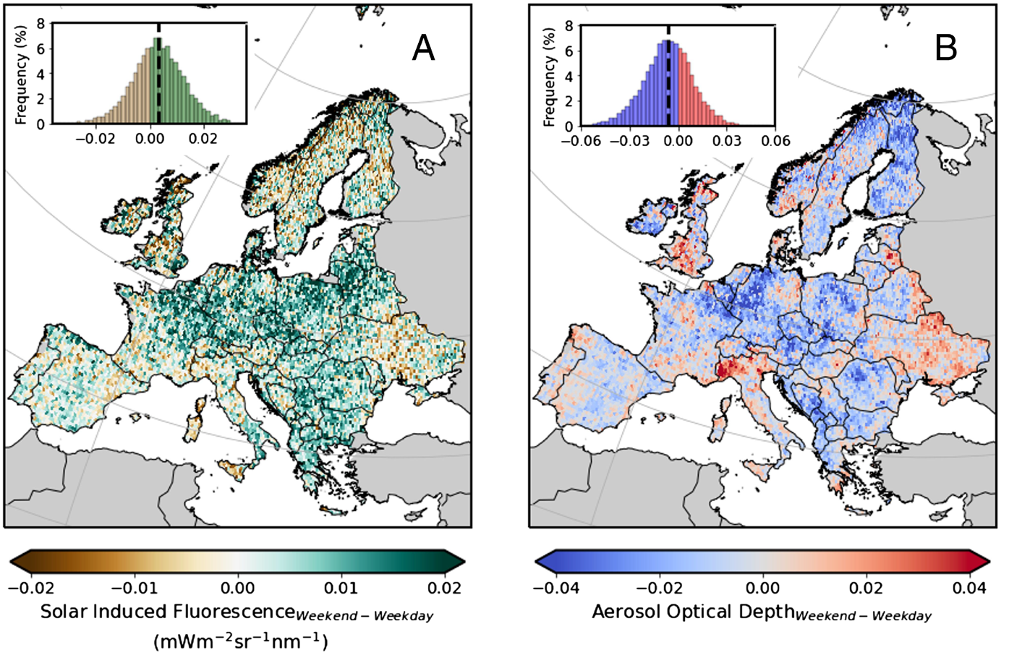
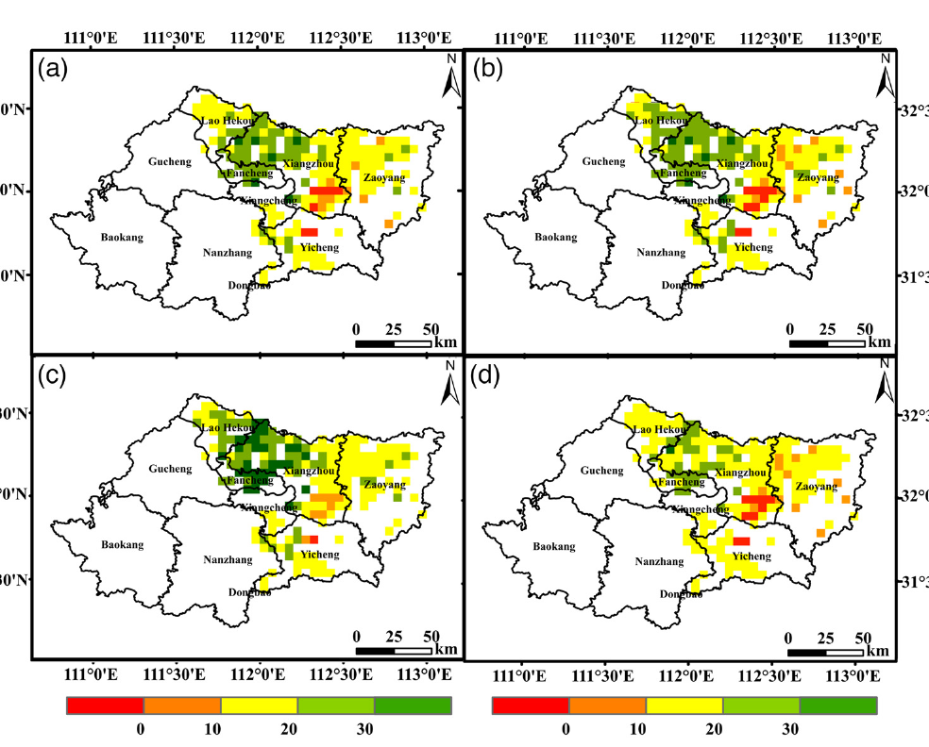
Natural experiments: when aerosol switches on or off
5 · Linking aerosols to productivity
Event | Aerosol change | Productivity response | Reference
COVID-19 lockdown, Hubei, 2020 | AOD −23.8% | Winter-wheat GPP +16.5%, water-use efficiency up | Bai et al., 2022
COVID-19 lockdown, NE China | AOD about −30% | Rice GPP and NPP +5% | de Oliveira et al., 2025
Weekday vs weekend, Europe | Lower AOD on weekends | SIF higher in 64% of regions | He et al., 2023
Volcanic eruptions as instrument | Stratospheric sulfate, less sunlight | Global maize yield ~−9%; soy, rice, wheat ~−5% | Proctor et al., 2018
Hubei lockdown: % change in AOD (a), WUE (b), GOSIF GPP (c), FLUXSAT GPP (d)
Weekend minus weekday: SIF (A), AOD (B), APAR (C)
Source: Bai et al., 2022, Fig. 4
Source: He et al., 2023, Fig. 1
Notes:
Natural experiments are events in which aerosol changes suddenly while technology, land use and, ideally, weather stay similar, so the response can be attributed to aerosol more confidently than in ordinary correlations.
The best-known example is the COVID-19 lockdown of 2020. In Hubei province in China, Bai and colleagues found that AOD fell by 23.8 percent compared with the previous three years, and winter-wheat GPP rose by 16.5 percent, with water-use efficiency also increasing. The left figure shows these percentage changes: AOD in panel a, water-use efficiency in b, and GPP from two independent satellite products, GOSIF in c and FLUXSAT in d. A similar result was found for rice in north-east China, reported in the review by de Oliveira and colleagues: a reduction of about 30 percent in AOD increased rice GPP and NPP by about 5 percent. In these polluted regions, removing aerosol increased productivity, which means the crops were above the optimum aerosol load.
A second, clever design uses the weekly cycle of emissions. Traffic and industry are lower at weekends, so aerosol is lower. He and colleagues compared weekend and weekday satellite data across Europe; the right figure shows the weekend-minus-weekday difference in SIF, AOD and APAR. They found SIF higher at weekends in 64 percent of European regions, consistent with more light reaching plants.
A third design uses volcanic eruptions as a statistical instrument. Proctor and colleagues used the sunlight reduction after major eruptions to estimate the effect of scattering aerosol on crops globally: maize yields fell by about 9 percent and soy, rice and wheat by about 5 percent, because the loss of total light outweighed any diffuse benefit for crops.
The caveat is that other things also change: lockdowns also cut ozone, and eruptions cool the climate, so even natural experiments need care.

Slide 22
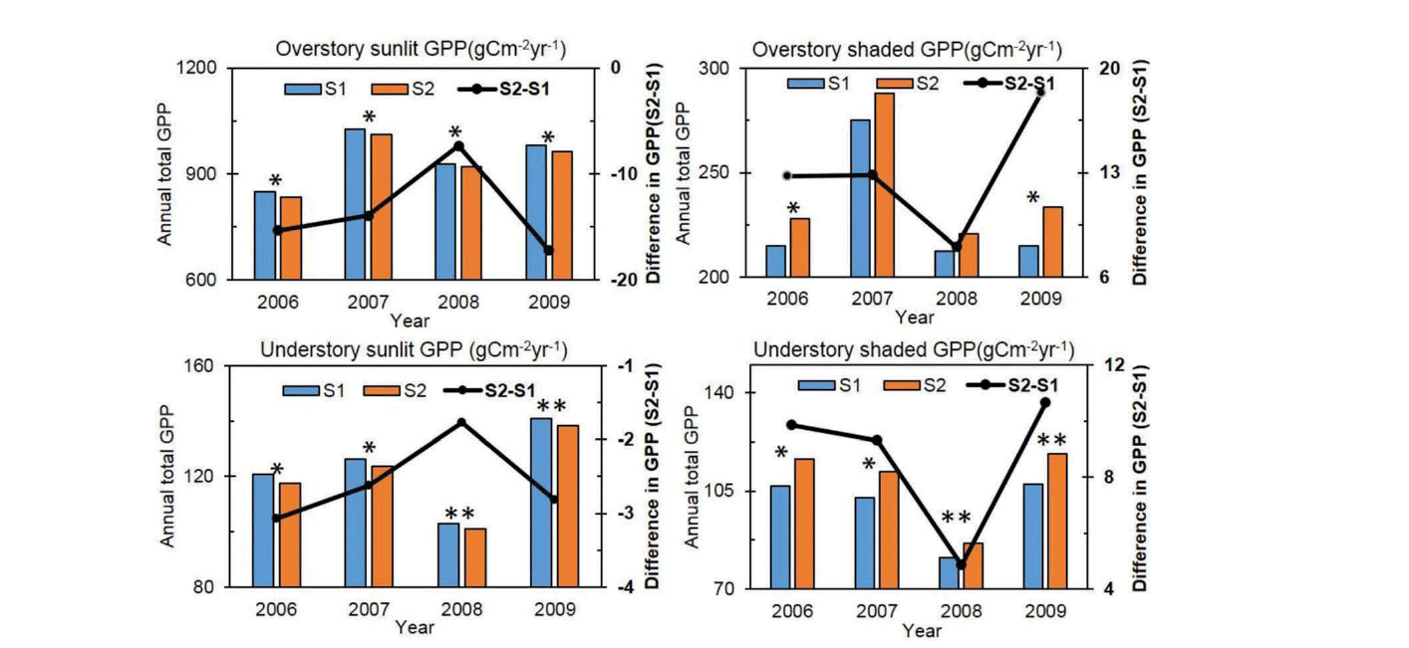
Process models that link aerosols to productivity
5 · Linking aerosols to productivity
GPP = ε × FAPAR × PAR; ε = ε_{dir}(1 − f_{dif}) + ε_{dif} f_{dif}, with ε_{dif} > ε_{dir}
BEPS cropland GPP without (S1) and with (S2) aerosol
Model family | Examples | What it adds
Light-use efficiency Yuan et al., 2007 | MOD17, CASA, VPM, EC-LUE | Separate efficiency for diffuse light
Two-leaf process Chen et al., 1999 | BEPS, Biome-BGC | Sunlit-leaf GPP falls, shaded-leaf GPP rises
Crop simulation Greenwald et al., 2006 | CERES/DSSAT, WOFOST, APSIM | Yield under hazy vs clean-sky light
Global land models Mercado et al., 2009 | JULES, ORCHIDEE, YIBs | Global GPP/NPP change in Pg C yr⁻¹
Sunlit leaves lose, shaded leaves gain
Source: Feng et al., 2020, Fig. 7
Common workflow: AOD → split PAR into direct and diffuse → productivity model → run with and without aerosol → difference = aerosol effect.
Notes:
The third way to link aerosol and productivity is with process models, which compute productivity from light and climate and can be run with and without aerosol. The equation at the top shows the simplest idea. In a light-use-efficiency model, GPP equals efficiency times FAPAR times PAR. To include the aerosol effect, the efficiency is made a weighted average of a direct-light efficiency and a diffuse-light efficiency, weighted by the diffuse fraction, with the diffuse efficiency higher than the direct one. Models such as MOD17, CASA, VPM and EC-LUE, described for example by Yuan and colleagues, belong to this family; the standard MOD17 has no diffuse term, but modified versions do.
Two-leaf models, such as BEPS developed by Chen and colleagues, compute photosynthesis separately for sunlit and shaded leaves, so the effect of diffuse light emerges from the physics. The figure is from Feng and colleagues, 2020, who used an improved BEPS model with satellite aerosol data for seven cropland sites in North China. Comparing a scenario without aerosol, S1, with a scenario with aerosol, S2, the GPP of sunlit leaves falls while the GPP of shaded leaves rises; the total depends on which effect is larger.
Crop simulation models such as CERES in DSSAT, WOFOST and APSIM, used for example by Greenwald and colleagues, give yield under hazy and clean-sky light. Global land models such as JULES, ORCHIDEE and YIBs, used by Mercado and colleagues, give the global change in GPP or NPP in petagrams of carbon per year.
The common workflow is in the strip: convert AOD into direct and diffuse PAR, run the productivity model, run it again without aerosol, and the difference is the aerosol effect. The weakness is that the result depends on how well the model represents the diffuse-light response.

Slide 23
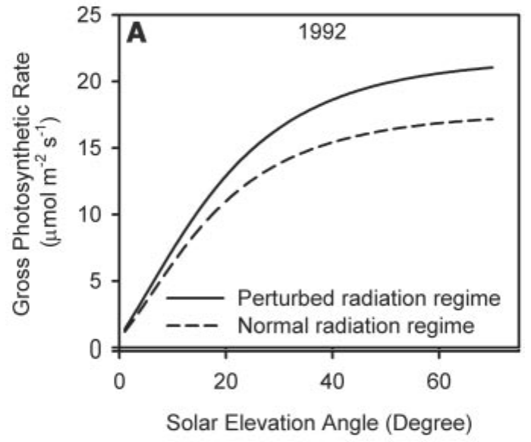
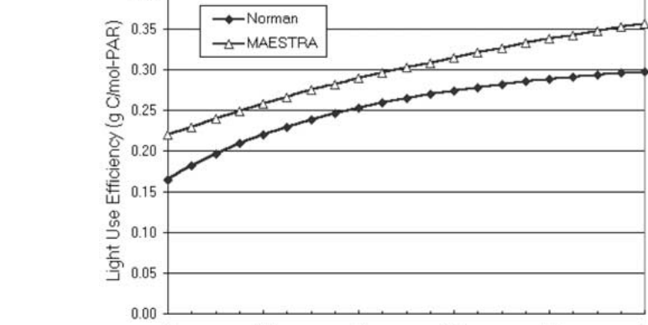
Light route: dimming vs diffuse fertilization
6 · Mechanisms of aerosol impact
Pathway | Mechanism and evidence | Reference
1. Dimming | Scattering and absorption cut PAR; clear-sky PAR −30% as AOD rises from 0.05 to 1.0 | Greenwald et al., 2006
2. Diffuse fertilization | Diffuse light reaches shaded, light-limited leaves; LUE 1.12–1.80 times higher under diffuse light | Kanniah et al., 2012
Proof: Pinatubo | Volcanic sulfate raised diffuse light; noon forest photosynthesis +23% (1992), +8% (1993) | Gu et al., 2003
Net balance | Outcome = loss of total PAR vs gain in diffuse fraction | Mercado et al., 2009
Harvard Forest after Pinatubo, 1992: volcanic (solid) vs normal (dashed)
Source: Gu et al., 2003, Fig. 2a
Canopy LUE rises with AOD (clear sky)
Why: sunlit leaves are often light-saturated, so the lost direct light costs little; diffuse light reaches shaded leaves that are light-limited, so canopy light-use efficiency rises.
Source: Cohan et al., 2002, Fig. 6
Notes:
Section 6 explains the mechanisms, starting with the light route, which has two opposing parts. The first is dimming: scattering and absorption reduce the total PAR reaching the canopy. Greenwald and colleagues computed that under clear skies PAR falls by about 30 percent as AOD rises from a background value of 0.05 to 1.0, while the diffuse fraction more than triples. The second part is diffuse fertilization. Light scattered by aerosol arrives from the whole sky, so it reaches shaded leaves deep in the canopy. The review by Kanniah and colleagues reports that canopy light-use efficiency is 1.12 to 1.80 times higher under diffuse light than under direct light.
The classic proof comes from the 1991 Mount Pinatubo eruption, which filled the stratosphere with scattering sulfate and increased diffuse radiation worldwide for two years. Gu and colleagues, 2003, estimated that at Harvard Forest this enhanced noon-time canopy photosynthesis by 23 percent in 1992 and 8 percent in 1993 under cloudless skies. The top-right figure shows canopy photosynthesis against solar elevation in 1992: the solid line, with volcanic aerosol, lies above the dashed line for normal conditions. The lower figure, from Cohan and colleagues, 2002, shows modelled canopy light-use efficiency rising steadily as AOD increases under clear skies in two canopy models.
The net outcome, as Mercado and colleagues put it, is a balance between the reduction in total PAR, which lowers photosynthesis, and the increase in the diffuse fraction, which raises it. The strip explains why the balance can be positive. Sunlit leaves at the top of the canopy are often light-saturated, so losing part of the direct beam costs little; shaded leaves are light-limited, so the extra diffuse light is used efficiently, and the canopy as a whole becomes more efficient.

Slide 24
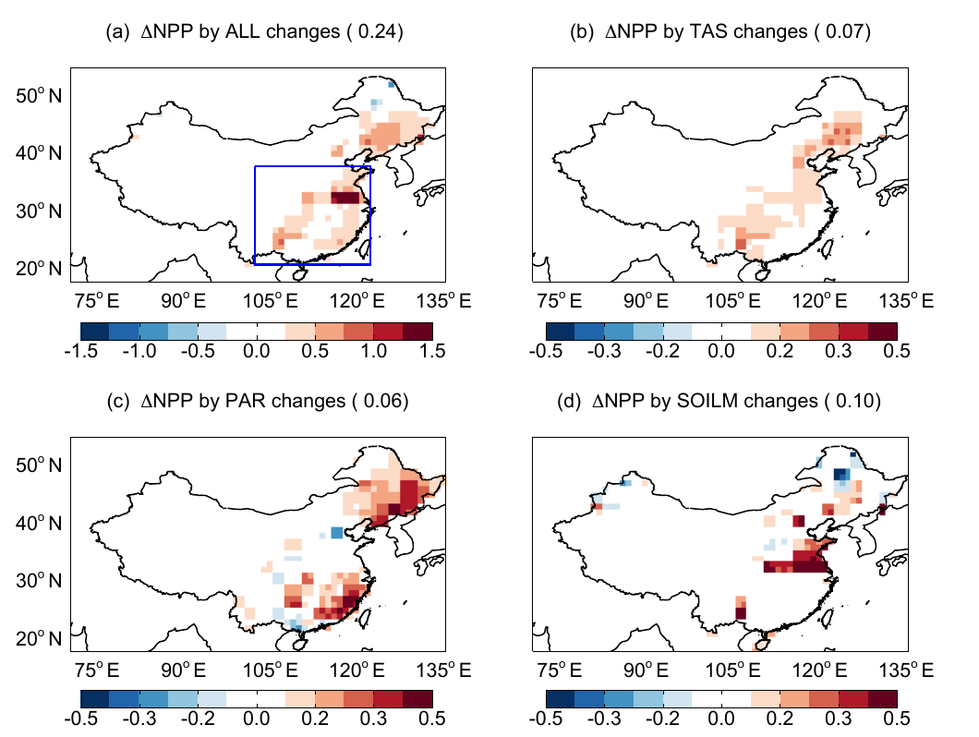
Climate route: temperature, water and rain
6 · Mechanisms of aerosol impact
Aerosol route (China, 2010) | ΔNPP (Pg C yr⁻¹) | What it shows
Diffuse radiation | +0.09 | More light reaches shaded leaves
Soil moisture | +0.07 | Less evaporation, less water stress
Leaf cooling | +0.03 | Summer leaves nearer the 25 °C optimum
Light + climate, total | +0.20 (+5%) | Net gain without cloud effects
Adding cloud and rain effects | −0.20 (−4%) | Summer rain −13% → drought
China: summer NPP change from each aerosol pathway
Source: Yue et al., 2017, Table 3
Humidity, VPD
Night warming
Monsoon rain
(a) all (b) temperature (c) PAR (d) soil moisture
Source: Yue et al., 2017, Fig. 8
VI differences across AOD bins also track temperature and VPD changes
Zhang et al., 2023
Rice yield links more closely to minimum than to maximum temperature
Jannat et al., 2026
Indian rice harvest follows monsoon rainfall (r = +0.61)
Auffhammer et al., 2006
Notes:
Aerosol also affects productivity through climate. Yue and colleagues, 2017, separated these routes for China in 2010 by switching on one aerosol-driven change at a time in a coupled climate–vegetation model. Through diffuse radiation alone, aerosol raised NPP by 0.09 petagrams of carbon per year; through wetter soil, because less sunlight means less evaporation, by 0.07; and through leaf cooling by 0.03. Cooling helps mainly in summer, when leaf temperatures are above the photosynthetic optimum of about 25 degrees Celsius. Together, light and climate gave a gain of 0.20 petagrams, or 5 percent of China's NPP. But when aerosol effects on clouds were added, summer rainfall decreased by 13 percent, soil moisture fell, and the total became a loss of 0.20 petagrams, or minus 4 percent. The figure shows where each route acts over China: the total change in panel a and the temperature, PAR and soil-moisture contributions in panels b to d.
The three cards add other climate routes. Lower vapour pressure deficit under haze keeps stomata open; Zhang and colleagues found that differences in vegetation indices between AOD bins were influenced not only by diffuse radiation but also by the accompanying changes in temperature and VPD. Aerosol can warm nights: in Bangladesh, Jannat and colleagues found rice-yield responses linked more closely to minimum than to maximum temperature, pointing to night-time warming, which increases respiration. Finally, aerosol weakens the monsoon, and in India rice harvests follow monsoon rainfall closely: Auffhammer and colleagues found a correlation of plus 0.61 between rainfall and harvest anomalies. So for rainfed Indian agriculture, the rain route can outweigh the light route.

Slide 25
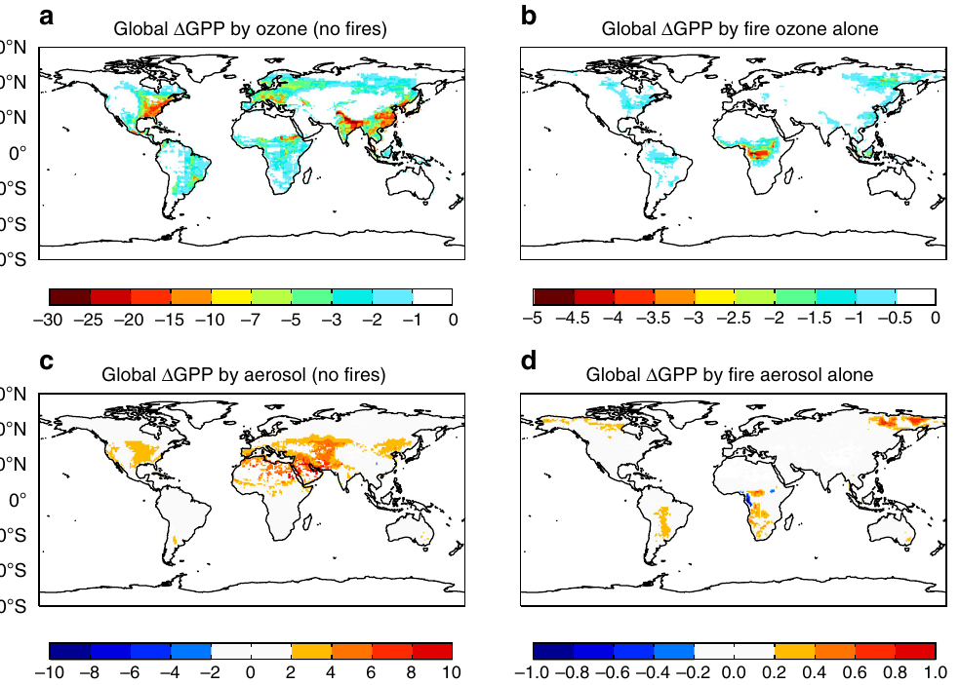
Co-pollutant ozone and aerosol type
6 · Mechanisms of aerosol impact
% change in global GPP: ozone (a, b) and aerosol (c, d); left: all sources except fire; right: fire alone
Effect on GPP or NPP | Pg C yr⁻¹
Ozone, global (non-fire sources) | −4.0 ± 1.9
Aerosol, global (non-fire sources) | +1.0 ± 0.2
Fire pollution: ozone / aerosol / net | −0.91 / +0.05 / −0.86
Black carbon, global (all-sky) | −0.28
Ozone, China NPP (2010) | −0.59 (−14%)
Yue & Unger, 2018; Zhou et al., 2022; Yue et al., 2017
Lesson: a pollution effect is not an aerosol effect. Ozone damage usually exceeds the aerosol benefit; absorbing black carbon lowers GPP, while scattering sulfate and organics give the benefit.
Source: Yue & Unger, 2018
Notes:
Two further factors decide whether pollution helps or harms plants: the co-pollutant ozone, and the type of aerosol. Ozone forms from the same emissions as aerosol, nitrogen oxides and volatile organic compounds, and it enters leaves through the stomata and damages photosynthesis. Yue and Unger, 2018, combined models and measurements for 2002 to 2011. With all emission sources except fires, ozone reduces global GPP by about 4.0 petagrams of carbon per year, while aerosol increases it by only about 1.0 petagram. For fire pollution alone, ozone reduces GPP by 0.91 and aerosol adds only 0.05, giving a net loss of 0.86 petagrams per year. The maps show the percentage change in GPP from ozone in the top row and from aerosol in the bottom row, for non-fire sources on the left and fire on the right. Ozone losses are widespread over eastern China, India, Europe and the eastern United States.
Aerosol type matters as well. Zhou and colleagues, 2022, found that black carbon, which absorbs light and adds little diffuse light, reduces global GPP by 0.28 petagrams per year under all-sky conditions, whereas scattering sulfate and organic aerosols provide the positive diffuse effect. And in China, Yue and colleagues found that ozone reduced NPP by 0.59 petagrams, or 14 percent, larger than any aerosol term.
The lesson is that a 'pollution effect' is not an 'aerosol effect'. A study that relates productivity to pollution without separating ozone and aerosol type cannot attribute the result to the diffuse-light mechanism.

Slide 26
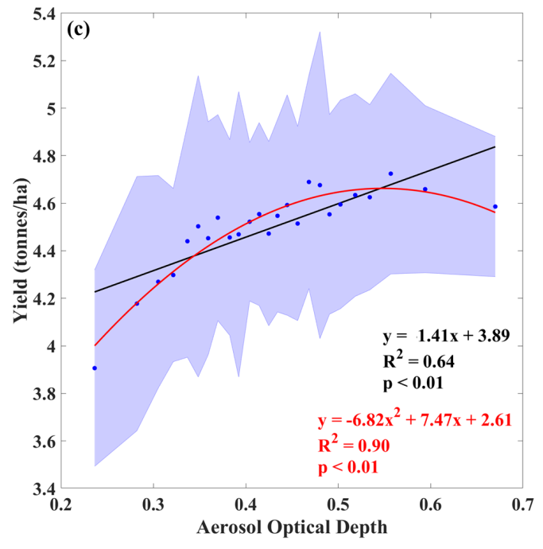
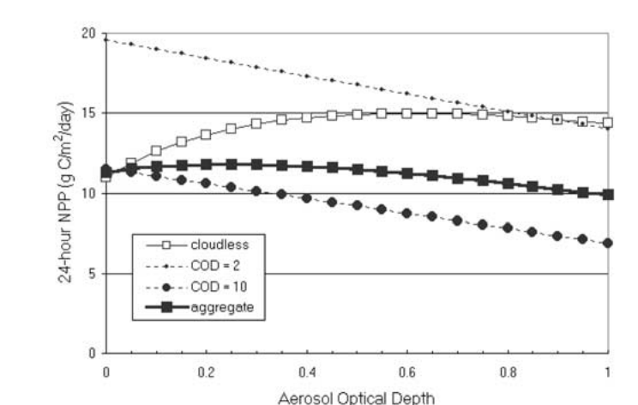
The optimum aerosol load: an inverted-U response
6 · Mechanisms of aerosol impact
Study · system | Optimum
Cohan et al., 2002 · model canopies | AOD ≈ 0.6 (NPP +30%, clear sky)
Feng et al., 2020 · NE China cropland | AOD 0.3–0.6; diffuse fraction 30–40%
Yue & Unger, 2018 · flux sites | Diffuse fraction 0.4–0.6
Sankhla et al. · Punjab wheat | AOD ≈ 0.55 (R² = 0.90)
Hari & Tyagi, 2022 · Indian forests | AOD 0.38, gain persists to 0.51
Hari & Tyagi, 2022 · Indian agro zones | AOD 0.49, restricted above 0.59
Canopy NPP vs AOD: clear sky peaks at moderate AOD; cloud only lowers
Punjab wheat yield vs AOD: quadratic fit peaks near 0.55
Source: Cohan et al., 2002, Fig. 4
Source: Sankhla et al., Fig. 2c
Why an optimum: diffuse gain grows with AOD until shaded leaves saturate; beyond it, the loss of total light dominates. Over the IGP, where AOD is often 0.5–1.0, crops are likely near or above the optimum.
Notes:
Because dimming and diffuse fertilization pull in opposite directions, productivity follows an inverted-U response to aerosol: it rises at first, reaches a maximum and then falls. The left figure, from Cohan and colleagues, 2002, shows modelled 24-hour canopy NPP against aerosol optical depth for clear skies and for increasing cloud optical depth. Under clear skies NPP increases with AOD, with a maximum enhancement of about 30 percent near an AOD of 0.6, and declines beyond that; under cloudy skies, where light is already diffuse, aerosol only reduces NPP.
Observational studies find similar optima. For cropland in north-east China, Feng and colleagues found that an AOD of 0.3 to 0.6, with a diffuse fraction of 30 to 40 percent, increases total GPP. Across flux sites, Yue and Unger note that photosynthesis reaches its maximum when the diffuse fraction is between 0.4 and 0.6. In Punjab, Sankhla and colleagues found a significant non-linear relationship between AOD and wheat yield, with R squared of 0.90: yield increases with AOD up to about 0.55, as shown in the right figure. For India's ecological zones, Hari and Tyagi found that forest NPP is highest at an AOD of 0.38 and keeps increasing up to 0.51, while agricultural NPP is highest at 0.49 and is restricted above 0.59.
The reason for the optimum is in the strip. The diffuse gain grows with AOD only until the shaded leaves themselves become light-saturated; beyond that point, the loss of total light dominates. Since AOD over the Indo-Gangetic Plain is often 0.5 to 1.0, crops there are likely already near or above the optimum, so further increases in aerosol are expected to reduce productivity.

Slide 27
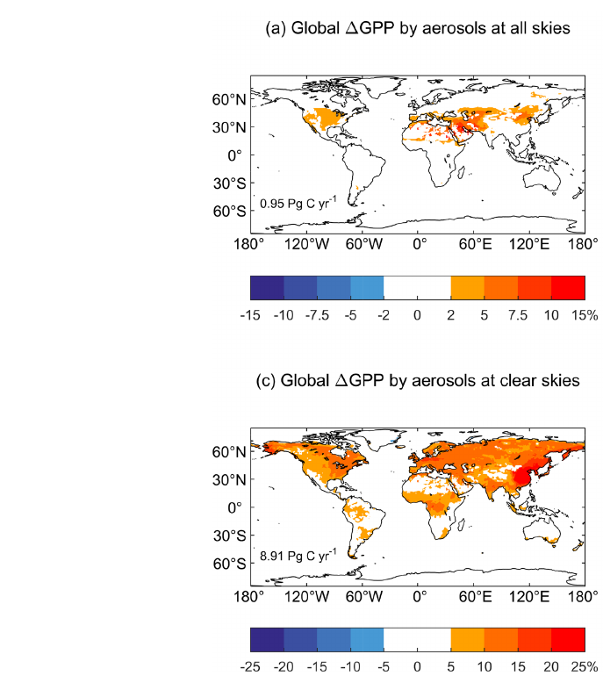
Conditions that modulate the aerosol impact: sky, canopy and plant type
6 · Mechanisms of aerosol impact
Condition | How it changes the impact | Reference
Cloud cover | Global aerosol gain: +8.9 Pg C yr⁻¹ under clear sky, only +0.95 under all skies | Zhou et al., 2022
Emission source | Anthropogenic aerosol gives 41% of the global GPP gain | Zhou et al., 2022
Canopy structure | Uptake rose with aerosol in forest and cropland but fell in grassland (US flux towers) | Niyogi et al., 2004
C3 vs C4 plants | C4 plants rarely light-saturate; soybean (C3) LUE gain ~50% higher than maize (C4) | Kanniah et al., 2012
Aerosol effect on GPP (%): all skies (top) vs clear skies (bottom)
Rule of thumb: the largest gain comes from a dense C3 canopy under moderate, scattering aerosol and clear sky; sparse C4 crops under cloud gain little.
Source: Zhou et al., 2022, Fig. 3a, c
Notes:
The last mechanism slide covers the conditions that decide how large the effect is. The most important is cloud cover. Zhou and colleagues, 2022, found that aerosols increase global GPP by 8.9 petagrams of carbon per year under clear skies, but only 0.95 under real, all-sky conditions, because cloudy light is already diffuse and aerosol then only dims. The two maps show this: the top map, for all skies, has small changes, while the bottom map, for clear skies, shows increases of more than 4 percent over most land areas. Zhou and colleagues also found that anthropogenic aerosols account for 41 percent of the global GPP gain, so human emissions contribute a large share of the diffuse effect.
Canopy structure is the second condition. At flux towers in the United States, Niyogi and colleagues, 2004, found that CO2 uptake increased with aerosol loading over forest and cropland but decreased over grassland, because only taller, multi-layer canopies have many shaded leaves that can use the extra diffuse light. The third condition is the photosynthetic pathway. C4 plants such as maize and sugarcane do not become light-saturated under high irradiance, so redistributing light helps them less. The review by Kanniah and colleagues cites a theoretical result that the increase in light-use efficiency under more diffuse light was about 50 percent higher for soybean, a C3 crop, than for maize, a C4 crop.
The rule of thumb summarises the mechanisms: the largest gain comes from a dense C3 canopy under moderate, scattering aerosol and clear skies, while sparse C4 crops under cloud gain little.

Slide 28
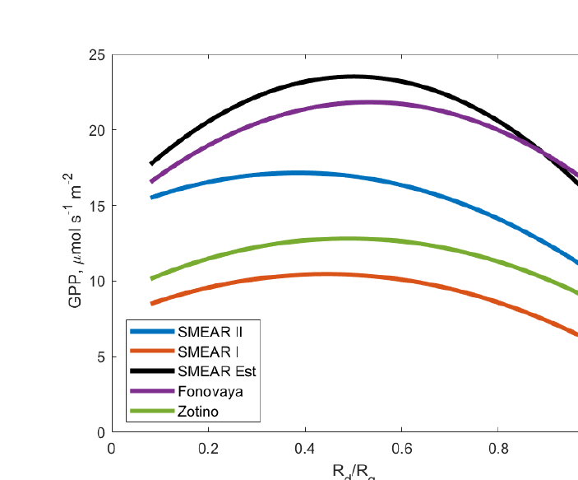
Evidence from natural ecosystems across the globe
7 · Evidence
Ecosystem | Aerosol impact | Reference
Boreal & hemiboreal forest | Diffuse fraction 0.11 → 0.2–0.27; GPP +6 to 14% | Ezhova et al., 2018
Amazon rainforest | Fire smoke raises NPP by 1.4–2.8%; diffuse fraction 0.5–0.7 in the burning season | Rap et al., 2015; Cirino et al., 2014
Savanna (N. Australia) | Diffuse fraction 11 → 21%: no significant change in carbon flux | Kanniah et al., 2012
All biomes (global) | Biogenic aerosol raises NPP by 1.23 Pg C yr⁻¹ | Rap et al., 2018
GPP vs diffuse fraction (R_{d}/R_{g}), five boreal and hemiboreal forest sites
GPP peaks at an intermediate diffuse fraction
Source: Ezhova et al., 2018, Fig. 8
Range: from no significant change (savanna) to +14% GPP (boreal forest); globally, the net effect on natural vegetation is a gain.
Notes:
Section 7 brings the evidence, starting with natural ecosystems. In boreal and hemiboreal forests of Finland, Estonia and Siberia, Ezhova and colleagues, 2018, found that aerosol raised the diffuse fraction from about 0.11 on clean days to 0.2 to 0.27 on more polluted days, increasing GPP by 6 to 14 percent. The figure shows their estimated GPP against diffuse fraction at five sites: GPP rises, peaks at an intermediate diffuse fraction and then declines, the inverted-U response at ecosystem scale.
In the Amazon, Rap and colleagues, 2015, estimated that smoke from fires increases forest NPP by 1.4 to 2.8 percent through diffuse radiation, and Cirino and colleagues, 2014, measured diffuse fractions of 0.5 to 0.7 during the burning season, with carbon uptake falling again under very heavy smoke. In a northern Australian savanna, an increase in diffuse fraction from 11 to 21 percent did not significantly change the carbon flux, as reported in the review by Kanniah and colleagues. Globally, Rap and colleagues, 2018, estimated that secondary organic aerosol formed from plant emissions raises global NPP by 1.23 petagrams of carbon per year, a natural feedback in which vegetation helps itself through the aerosol it produces.
So the effect ranges from no significant change in savanna to a gain of up to 14 percent in boreal forest, and globally the net effect on natural vegetation is a gain, in contrast to the crops that we look at next.

Slide 29
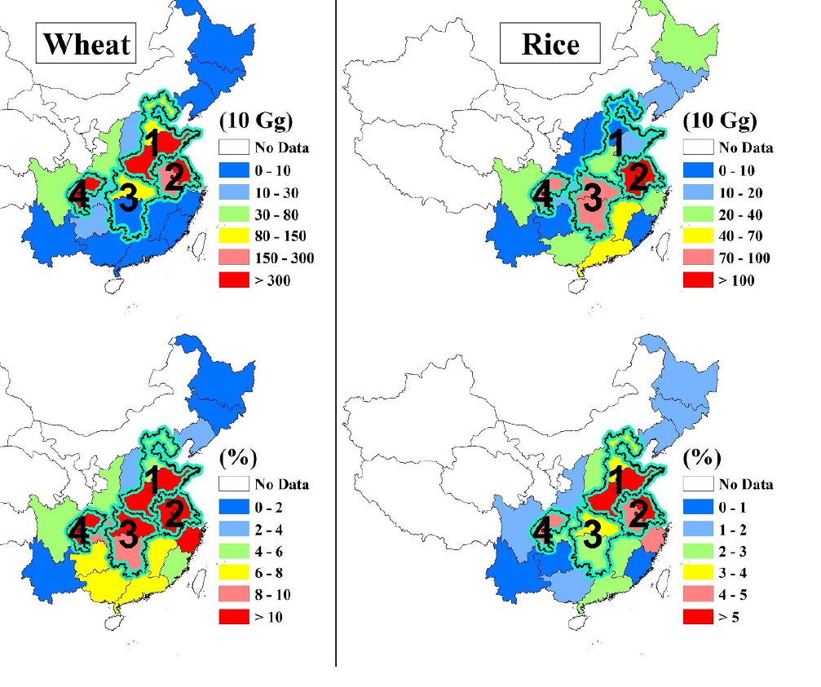
Evidence from crops outside South Asia
7 · Evidence
Region · crop | Method | Aerosol effect | Reference
China · rice, wheat | Radiation + crop model | Haze cuts sunlight 5–30%; optimal yields fall by a similar amount | Chameides et al., 1999
China · rice, wheat | MODIS AOD + radiation model | Sunlight −28 to 49% in hazy regions; national rice −2%, wheat −8% | Tie et al., 2016
Global sites · maize, wheat, rice | CERES crop model | Maize −10 to 0%, wheat ±5%, rice ±10%; up to +30% at very sunny sites | Greenwald et al., 2006
Global · maize, wheat, rice | Chemistry model + crop RUE | PM +9 to +16% (max diffuse response); net with O₃: +5.6, −3.7, +4.5% | Schiferl & Heald, 2018
USA · maize, soybean | County statistics, 1980–2019 | Aerosol yield loss: maize 11.3%, soybean 23.2%; shrinking as air cleans | Liu & Desai, 2021
Europe · cropland | Weekly cycle of SIF | SIF −2.4% per 0.1 rise in AOD | He et al., 2023
Haze-related loss of wheat (left) and rice (right) production in China
Top: loss (10 Gg); bottom: loss (%)
Source: Tie et al., 2016, Fig. 3
Pattern: models assuming a strong diffuse response find gains; observations in polluted regions mostly find losses.
Notes:
For crops outside South Asia, the result depends on the method and the region. Chameides and colleagues, 1999, using a radiation and crop model, estimated that regional haze in eastern China cuts sunlight by 5 to 30 percent and reduces optimal yields of rice and wheat by a similar amount. Tie and colleagues, 2016, used MODIS AOD with a radiation model and found that solar irradiance is reduced by 28 to 49 percent in China's heavily polluted regions, reducing national production by about 2 percent for rice and 8 percent for wheat. The maps show where these losses occur: the upper maps give the loss in units of 10 gigagrams, the lower maps the percentage loss, both concentrated in the North China Plain, the Yangtze River Delta and the Sichuan Basin.
Greenwald and colleagues, 2006, used the CERES crop model at sites worldwide and found changes of minus 10 to 0 percent for maize, plus or minus 5 percent for wheat and plus or minus 10 percent for rice, with gains of up to 30 percent only under exceptionally sunny conditions such as California's Central Valley. Schiferl and Heald, 2018, with a global chemistry model, found that particulate matter could raise production by 9 to 16 percent, but only if crops respond strongly to diffuse light; including ozone damage, the net effect was plus 5.6 percent for maize, minus 3.7 for wheat and plus 4.5 for rice.
Observational studies mostly find losses. Liu and Desai, 2021, using county statistics for 1980 to 2019, found historical aerosol yield losses of 11.3 percent for maize and 23.2 percent for soybean in the United States, which have shrunk as air quality improved. In Europe, He and colleagues found that cropland SIF decreases by 2.4 percent for every 0.1 increase in AOD. The pattern is that models assuming a strong diffuse benefit find gains, while observations in polluted regions find losses.

Slide 30
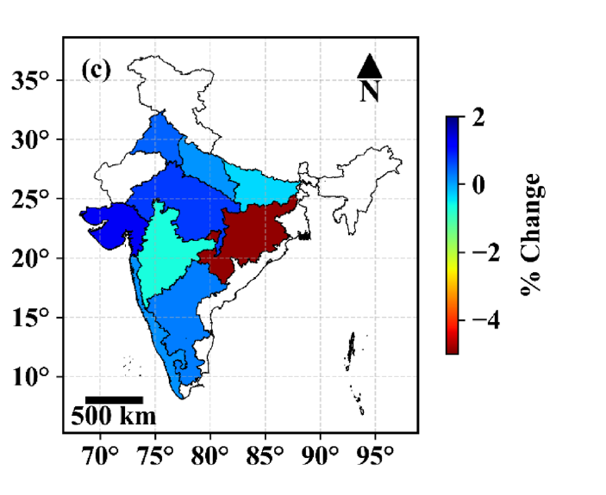
Evidence from India and South Asia
7 · Evidence
Region · system | Aerosol impact | Reference
India · rice | Brown clouds alone cut rice harvest 10.6%; with GHGs 14.4% (1985–1998) | Auffhammer et al., 2006
India · wheat | Climate and pollution trends (black carbon, O₃): wheat yield up to 36% lower | Burney & Ramanathan, 2014
India · rice, maize | Aerosol lowered yield: rice −7.9%, maize −8.8% (1998–2019) | Gupta et al., 2024
India (agroclimatic zones) · rice | AOD lowered rice yield by 0.73% per year (1998–2019) | Gupta et al., 2025
Assam (Dibrugarh) · vegetation | Evapotranspiration falls as AOD rises (r = 0.83) | Latha et al., 2018
Bangladesh · Boro rice | Positive effect in 5 districts, negative in 3 | Jannat et al., 2026
Median change in rice yield (% per year) due to AOD, 1998–2019
Largest losses in the east (Odisha)
Source: Gupta et al., 2025, Fig. 11c
India: high, rising and partly absorbing aerosol mostly lowers yield, but the sign varies by crop, season and region.
Notes:
In India and South Asia, most evidence shows losses. Auffhammer and colleagues, 2006, combined a statistical model of historical rice harvests with regional climate scenarios. They estimated that atmospheric brown clouds alone reduced India's rice harvest by 10.6 percent during 1985 to 1998, and that reducing brown clouds and greenhouse gases together would have increased the harvest by 14.4 percent, mainly through rainfall and night temperature. Burney and Ramanathan, 2014, attributed a wheat-yield gap of up to 36 percent to recent climate and pollution trends, mostly short-lived pollutants such as black carbon and ozone; this is a model counterfactual and has been debated. Gupta and colleagues, 2024, using Earth-observation data from 1998 to 2019, estimated that rising aerosol reduced rice yield by 7.9 percent and maize yield by 8.8 percent. In their 2025 study across agroclimatic zones, AOD lowered rice yield by about 0.73 percent per year; the map shows the largest losses in the east, especially Odisha.
Two regional studies show other effects. In Assam, Latha and colleagues found that evapotranspiration over dense vegetation falls as AOD rises, with a correlation of 0.83, because aerosol forcing reduces the energy available for evaporation. In Bangladesh, Jannat and colleagues found that the effect of aerosol on Boro rice was positive in five districts and negative in three, so the sign can differ even within a small country.
The conclusion for India is that high, rising and partly absorbing aerosol mostly lowers yield, but the sign varies by crop, season and region, so regional analysis is essential.

Slide 31
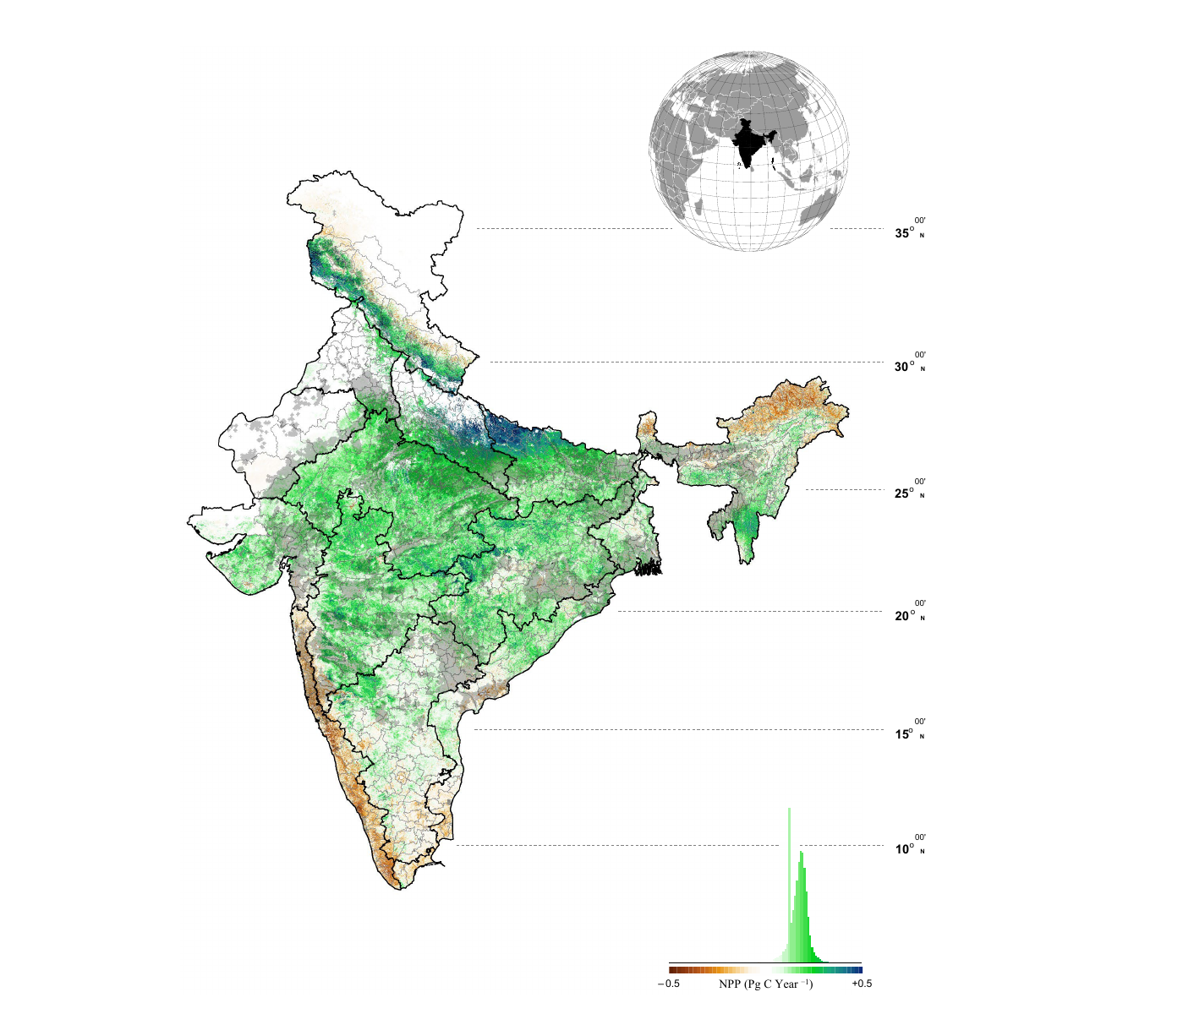
Ecosystem-wise productivity trends in India
7 · Evidence
NPP trend 2001–2020; black = zones sensitive to AOD (p < 0.05)
Zone group | NPP trend (2001–2020)
Negative | LGP, MGP, TGP, ECP, EPlat, EH, WCP
Positive | CPlat, SPlat, GP, UGP, WP
India total | 1.09 → 1.33 Pg C yr⁻¹; decadal trend −2.51%
Key results
Diffuse PAR rises with AOD only up to ≈ 0.54 in agro zones, then falls
Aerosol altered NPP of the Gangetic agro zones by about 11%
Maximum negative effect: Western and Eastern Plateau, post-monsoon
Pattern: India is still greening, but more slowly, and high-AOD cropland zones lose NPP.
Source: Hari & Tyagi, 2022, Fig. 5
Notes:
The last evidence slide looks inside India, using the zone-wise study of Hari and Tyagi, 2022. They modelled NPP with the CASA model for India's agroecological zones from 2001 to 2020 and related it to MODIS AOD. The map shows the NPP trend: green means increasing and brown decreasing, and black stippling marks the areas where NPP is significantly sensitive to AOD.
Using their Innovative Trend Analysis, the NPP trend is negative in the Lower, Middle and Trans-Gangetic Plains, the East Coast Plain, the Eastern Plateau, the Eastern Himalaya and the West Coast Plain, and positive in the Central and Southern Plateaus, the Gujarat Plain, the Upper Gangetic Plain and the Western Plain. India's total NPP rose from about 1.09 to 1.33 petagrams of carbon per year, but the decadal trend weakened by 2.51 percent, which is the 'slowing greening' in the title of their paper.
Three results connect this to the mechanisms. Using the SBDART radiative-transfer model, they found that in the agricultural zones diffuse PAR increases with AOD only up to about 0.54 and then decreases, because heavy aerosol removes light overall. Aerosol altered the NPP of the four Gangetic agricultural zones by about 11 percent. And the maximum negative effect occurred over the Western and Eastern Plateau in the post-monsoon season, when aerosol load is highest.
The pattern is that India is still greening, but more slowly, and the high-AOD cropland zones lose NPP. This brings us to the two case studies.

Slide 32
Case studies: applying remote sensing to the aerosol–productivity link
8 · Case studies
Case study 1
Case study 2
Wang et al., 2021
Intermediate aerosol loading enhances photosynthetic activity of croplands
Field and satellite SIF · cropland · North China Plain
Shu et al., 2022
Effects of aerosols on gross primary production from ecosystems to the globe
AOD-LUE model · ecosystems to globe · 2000–2019
Case study 1 tests the optimum aerosol load for a cropland; case study 2 scales the diffuse-light effect from ecosystems to the globe.
Notes:
Having seen the tools, the mechanisms and the evidence, I now present two case studies that apply remote sensing to the aerosol–productivity link. Case study 1 is Wang and colleagues, 2021, 'Intermediate aerosol loading enhances photosynthetic activity of croplands', which uses field measurements and satellite solar-induced fluorescence to test the optimum aerosol load for a cropland in the North China Plain. Case study 2 is Shu and colleagues, 2022, 'Effects of aerosols on gross primary production from ecosystems to the globe', which uses an AOD-driven light-use-efficiency model to scale the diffuse-light effect from individual ecosystems to the whole globe for 2000 to 2019. Together they cover the two scales of this seminar: the field scale and the global scale.

Slide 33
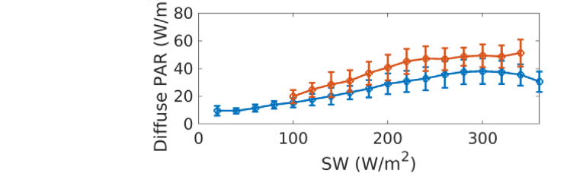
Uncertainties and challenges
9 · Challenges and way forward
Challenge | Problem and evidence | Remedy
Satellite AOD error Ramachandran & Rupakheti, 2026 | < 70% of MODIS AOD within expected error over South Asia vs ≥ 80% over N. America and Europe | MAIAC; AERONET bias correction
Cloud contamination Várnai & Marshak, 2009 | Clear-sky retrievals only; cloud-edge brightening inflates AOD | Strict masks; all-sky analysis
Scale mismatch Chu et al., 2021 | Tower footprint ~1 km² vs 1–50 km satellite pixels | Footprint-weighted matching
Reverse causation Jethva et al., 2019 | Bigger harvest → more residue fires → higher AOD (vegetation index +21%, fires +60%) | Pre-burning AOD; lagged tests
Ozone confounding Liu & Desai, 2021 | Same sources and season; US ozone yield losses 8.7% (maize), 4.8% (soybean) | Add ozone as a covariate
Circular reasoning Zhang et al., 2023; Ryu et al., 2018 | BESS/CERES diffuse PAR is computed from MODIS aerosol | Use measured diffuse PAR
BESS diffuse PAR by AOD bin (cropland)
Rises with AOD partly by construction
Source: Zhang et al., 2023, Fig. 10
Key point: most aerosol–productivity results are associations; robust attribution needs accurate AOD over South Asia, measured diffuse PAR, ozone data and designs that rule out reverse causation.
Notes:
Six problems can distort the link between aerosol and productivity. First, satellite AOD error: Ramachandran and Rupakheti, citing Ansari and Ramachandran, report that fewer than 70 percent of MODIS AOD values fall within the expected error over South Asia, compared with at least 80 percent over North America and Europe; the remedy is MAIAC and correction against AERONET. Second, cloud contamination: AOD can only be retrieved in clear skies, and near cloud edges scattered light brightens pixels and inflates AOD, as Várnai and Marshak showed; strict cloud masks and all-sky analyses are needed. Third, scale mismatch: a flux tower sees about one square kilometre, while satellite pixels are 1 to 50 kilometres, so footprints must be matched carefully, as discussed by Chu and colleagues. Fourth, reverse causation: Jethva and colleagues showed that in north-west India the vegetation index rose by 21 percent and post-harvest fires by about 60 percent, so a bigger harvest produces more residue, more fires and more aerosol; productivity can drive AOD, not only the reverse. Using pre-burning AOD and lagged tests helps. Fifth, ozone confounding: ozone shares sources and season with aerosol; Liu and Desai found US yield losses from ozone of 8.7 percent for maize and 4.8 percent for soybean, so ozone must be included as a covariate. Sixth, circular reasoning: satellite diffuse-PAR products such as BESS and CERES are computed from MODIS aerosol, so showing that their diffuse PAR rises with AOD is partly circular. The figure from Zhang and colleagues shows BESS diffuse PAR increasing across AOD bins for cropland. The key point is that most results are associations; robust attribution needs better AOD over South Asia, measured diffuse PAR, ozone data and designs that exclude reverse causation.

Slide 34
Research gaps and way forward
9 · Challenges and way forward
Research gap | Way forward | Reference
Few Indian flux towers and diffuse-PAR sensors | Flux and diffuse-radiation network over IGP croplands | de Oliveira et al., 2025
Aerosol type and height poorly known | PACE polarimetry and EarthCARE lidar (both launched 2024) | Werdell et al., 2019; Illingworth et al., 2015
One polar-orbit view a day; cloud gaps | Geostationary AOD (INSAT-3DR, GEMS) for the diurnal cycle | Kim et al., 2020; Wei et al., 2020
Processes studied separately | Coupled aerosol–cloud–ozone–crop models | Yue et al., 2017
Attribution weak | Natural experiments and causal models with SIF | He et al., 2023
Observe
Attribute
Act
Measure AOD, aerosol type, direct and diffuse PAR and SIF together over Indian croplands
Separate aerosol from ozone, weather and reverse causation
Cleaner air as a co-benefit for food security and carbon uptake (Hari & Tyagi, 2022)
Notes:
From these challenges follow five research gaps and a way forward. First, India has very few flux towers and diffuse-radiation sensors, which the review by de Oliveira and colleagues identifies as a major gap; a network of flux towers and diffuse-PAR sensors over Indo-Gangetic croplands would provide the ground truth that is now missing. Second, aerosol type and vertical distribution are poorly known; two missions launched in 2024 address this: NASA's PACE carries polarimeters that retrieve particle size and absorption, described by Werdell and colleagues, and ESA–JAXA's EarthCARE carries the ATLID lidar, described by Illingworth and colleagues. Third, a polar-orbiting satellite sees a place only once a day and clouds create gaps; geostationary sensors such as INSAT-3DR over India and GEMS over Asia, described by Kim and colleagues, provide hourly AOD and capture the diurnal cycle. Fourth, the light, climate, cloud and ozone processes are usually studied separately, as Yue and colleagues showed is misleading; coupled aerosol–cloud–ozone–crop models are needed. Fifth, attribution remains weak; natural experiments and causal models using SIF, as in the work of He and colleagues, are the most promising designs.
The bottom row summarises the way forward in three steps. Observe: measure AOD, aerosol type, direct and diffuse PAR and SIF together over Indian croplands. Attribute: separate the aerosol effect from ozone, weather and reverse causation. Act: as Hari and Tyagi conclude, reducing local pollution in an agricultural nation would reduce aerosol loading and support greening and carbon uptake, so clean-air policy is also a food-security and climate policy.

Slide 35
Conclusions and take-home messages
10 · Conclusions
Aerosols change both the amount (dimming) and the quality (diffuse fraction) of light reaching vegetation
The response is non-linear: productivity gains at moderate AOD but falls at high AOD or under cloud
1
2
Dense C3 canopies gain most; grasslands, C4 crops and sparse canopies gain little
Remote sensing (MAIAC AOD, SIF, vegetation indices, LUE and two-leaf models) quantifies the link from field to globe, with ground validation
3
4
Over India, high, rising and partly absorbing aerosol mostly lowers crop yield and slows greening; evidence is still sparse
Priorities: accurate AOD over South Asia, measured diffuse PAR, ozone-aware attribution and new missions
5
6
Take-home: over the Indo-Gangetic Plain, where AOD is above the optimum and still rising, aerosol is likely reducing crop and ecosystem productivity.
Notes:
To conclude, six messages. First, aerosols change both the amount of light reaching vegetation, through dimming, and its quality, through the diffuse fraction. Second, the response of productivity is non-linear: it gains at moderate aerosol loads but falls at high loads or under cloud, giving an optimum aerosol load. Third, the ecosystem matters: dense C3 canopies such as forests gain most, while grasslands, C4 crops and sparse canopies gain little. Fourth, remote sensing makes it possible to quantify this link from the field to the globe, using MAIAC AOD, fluorescence, vegetation indices and light-use-efficiency and two-leaf models, always validated with ground measurements. Fifth, over India, high, rising and partly absorbing aerosol mostly lowers crop yield and is slowing the greening trend, but the evidence is still sparse. Sixth, the priorities are more accurate AOD over South Asia, measured diffuse radiation, attribution that accounts for ozone, and the use of new missions such as PACE, EarthCARE and geostationary sensors.
The single take-home message is that over the Indo-Gangetic Plain, where aerosol loading is already above the optimum and still rising, aerosol is likely reducing crop and ecosystem productivity. Thank you; I welcome your comments.

